Slide 1
Employee Data Analysis using Excel
STUDENT NAME: Archana.p
REGISTER NO: 312216910
DEPARTMENT: B.com (General)
COLLEGE: Shri krishnaswamy College for women

Slide 2
PROJECT TITLE
Salary and compensation analysis through Excel data modelling

Slide 3


AGENDA
Problem Statement
Project Overview
End Users
Our Solution and Proposition
Dataset Description
Modelling Approach
Results and Discussion
Conclusion
3/21/2024 Annual Review

Slide 4

PROBLEM STATEMENT
To analyze and compare salary and compensation data across various departments, job roles, and employee demographics within the organization. The goal is to identify compensation disparities, trends, and areas for potential adjustment to ensure equitable and competitive compensation practices.
you can systematically approach the salary and compensation analysis using Excel, ensuring a thorough and actionable evaluation of compensation practices within your organization.

Slide 5

PROJECT OVERVIEW
.
1.Data Collection and Preparation
2.Data modelling
3.Analysis
4.Reporting
This overview outlines the structured approach to conducting a salary and compensation analysis using Excel, focusing on uncovering insights and improving compensation practices within the organization.

Slide 6

WHO ARE THE END USERS?
The end users of a salary and compensation analysis conducted through Excel data modeling typically include:
Executive Leadership
Department Heads/Managers
Employees (Indirectly)
External Consultants
Finance team
HR professionals

Slide 7

OUR SOLUTION AND ITS VALUE PROPOSITION
Solution approach:
1.Data collection
2.Data analysis
3.Data cleaning
4.Data organisation
5.Modelling
Value proposition:
1.Data driven decisions
2. Increased transparency
3. Competitive edge
4.Enhanced budget management
5.Strategic planning

Slide 8
Dataset Description
1.Employee Information
2.compensation details
3.demographic information
4.job and location details
5.historical data
Data Preparation Tips:
1.Consistency
2.Accuracy
3.Privacy

Slide 9

THE "WOW" IN OUR SOLUTION
1.Comprehensive Analysis Capabilities
2. Advanced DataVisualization
3. Scenario and What-If Analysis
4.Benchmarking and Competitive Analysis
5.Enhanced Data Integrity and Automation
6.Strategic Insights and Recommendations
7. User-Friendly Design
3/21/2024 Annual Review
9

Slide 10
MODELLING
1.Insights and Recommendations 2.Forecasting 3.Review and Reporting 4.Data Analysis 5.Data Modeling
6. Data Collection and Preparation
7. Data Entry and Structuring
10

Slide 11
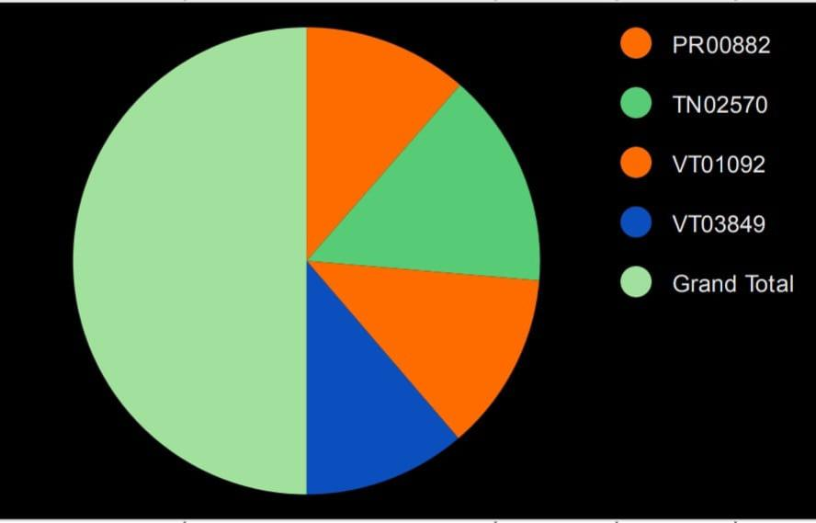
RESULTS
11

Slide 12
conclusion
In conclusion, the analysis provides actionable insights that can guide strategic decisions on compensation management, helping the organization attract and retain talent while ensuring fair and competitive pay practices By summarizing these conclusions, you can effectively communicate insights to stakeholders, support strategic decisions, and ensure that your compensation practices contribute to organizational success and employee satisfaction.

