Slide 1
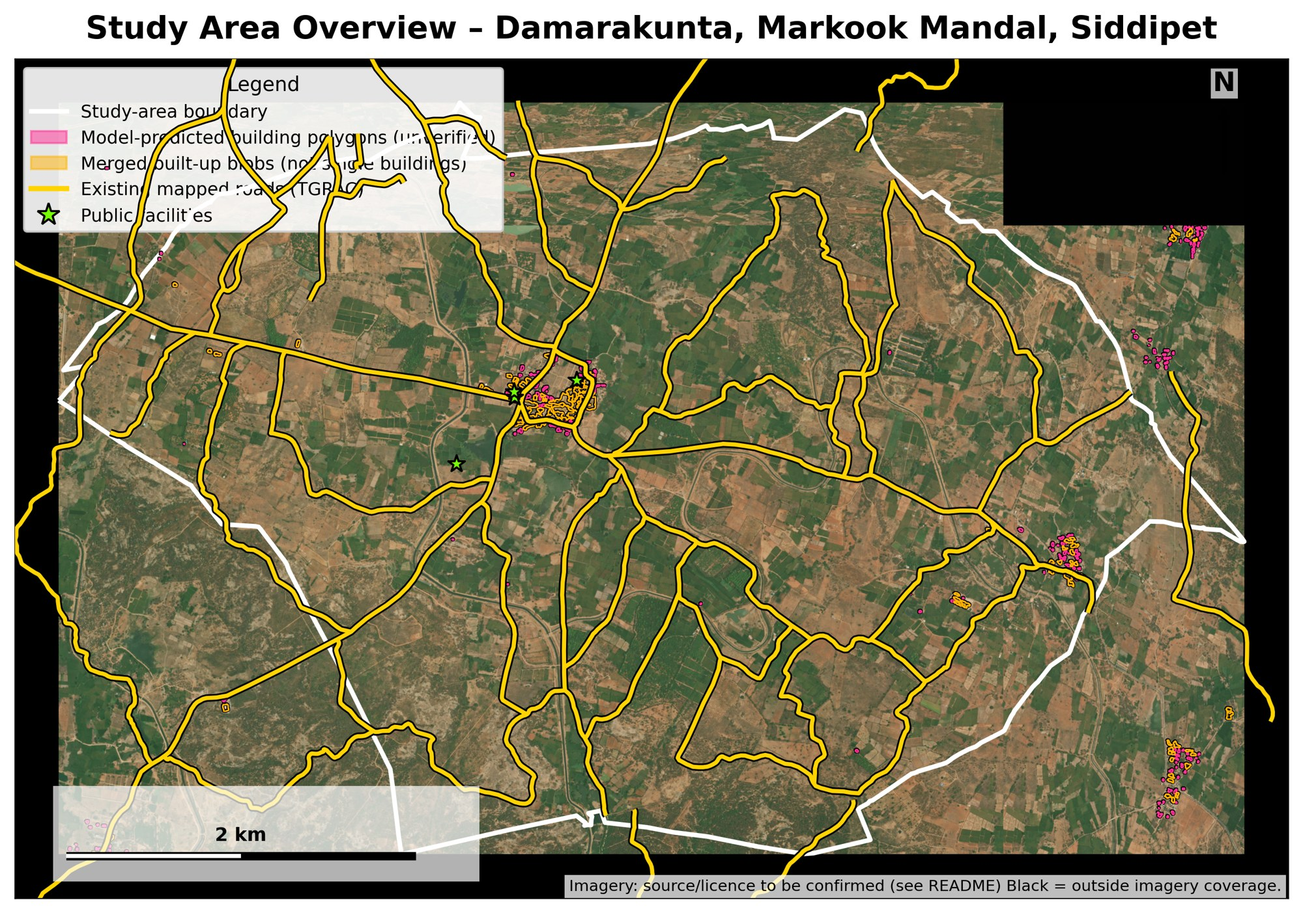
M.Tech Major Project Review
GIS-Based Smart Village Infrastructure Planning and Multi-Criteria Rural Road Network Optimization Using Remote Sensing and AI
Pendyala Archana
M.Tech Information Technology: AI and Robotics
Chaitanya Bharathi Institute of Technology, Hyderabad
Study area: Damarakunta, Markook Mandal, Siddipet, Telangana
Imagery source and licence: to be confirmed
Notes:
What I will say: Good morning. My major project is about planning rural road connections for a village using satellite images and GIS data. I studied one village, Damarakunta in Siddipet district. This is a review of work in progress, so I will clearly separate what is finished and verified from what is still pending.

Slide 2
Abstract
Rural road planning needs many spatial datasets together. This project builds a GIS and least-cost-path planner for Damarakunta village (18.466 km²), using satellite imagery, roads, building candidates, land cover and slope. It generates alternative routes, selects a shared network, and tests how missing building data changes the result.
Completed so far
Ongoing or pending
Data integrated on a 10 m grid
163 house and 4 facility routes generated
C1 omission and C2 ablation runs executed
Connectivity exception (one house)
Imagery licence and data-source checks
Field or expert validation; second village (C3)
2
Notes:
What I will say: Rural villages often lack a clear plan for connecting houses and public facilities to the road network. I took Damarakunta village as the study area. I combined a satellite mosaic, a village boundary, existing roads, building candidates, land cover and terrain into one planning grid. A planner then generates alternative low-cost routes and selects them into one shared network. I also test what happens when some buildings are missing from the input. The planning runs are executed and the numbers are verified for the primary run. Connectivity checks, field validation and a second village are still pending. The outputs are planning support, not construction designs.

Slide 3
Introduction
1
Why roads matter
Access to schools, health care and markets
2
Why satellite and GIS
One view of a whole village; layers can be combined
3
Why many layers
Terrain, land cover, roads, facilities and buildings all change a route
4
Why automate
Compare many alternatives quickly and consistently
5
Why verify
Outputs are model results; experts and field checks are still needed
3
Notes:
What I will say: Roads decide whether a family can reach a school or a health centre. Satellite images and GIS let us look at a whole village at once. But a good route depends on terrain, land cover, existing roads, facilities and where buildings are. An automated planner can compare many alternatives quickly. The results still need engineers and local field checks before anything is built.

Slide 4
Problem statement
How can alternative rural road connections be generated and combined into a shared network from multi-source GIS data, when building information may be incomplete?
Many datasets
Uncertain buildings
Imagery, roads, facilities, land cover and terrain must be combined
Candidate buildings are model output, not a verified census
Many alternatives
Shared segments
Routes must be compared using terrain, land cover and constraints
Routes that share road should not be costed separately
4
Notes:
What I will say: The main problem is how to plan rural road connections when the data come from many sources and are not perfect. Building information may be incomplete. Routes must respect terrain, land cover and existing roads. And if we plan each route alone we can count the same road several times, so we should plan the routes together.

Slide 5
Objectives and current status
O1
Prepare and integrate GIS and remote-sensing data for Damarakunta
Achieved
O2
Generate connections from target buildings and priority facilities to the road network
Achieved (163 houses, 4 facilities)
O3
Select and compare a shared network using route costs and marginal network cost
Executed; primary run verified
O4
Evaluate effect of building omissions and planner choices
Executed; final checks pending
5
Notes:
What I will say: I have four objectives. The first two, data preparation and route generation, are done for Damarakunta. The third, shared network selection, has been executed and the numbers for the primary run are verified. The fourth, the effect of building omissions and method choices, is executed, but final consolidation and some checks are pending.

Slide 6
Mini-project versus major project
Aspect | Mini-project | Major project
Purpose | Explore remote-sensing image segmentation | Rural infrastructure and road-network planning
Study data | LoveDA benchmark (5,987 images) | Damarakunta village GIS layers and imagery
Methods | StrongDINOv2Seg: DINOv2-base, FPN + ASPP decoder, CE + Dice + Boundary loss | GIS cost grid, least-cost routes, shared-network selection
Output | Segmentation maps; best validation mIoU 53.80%, mDice 68.91% (epoch 4) | Candidate routes, selected network, C1 and C2 results
Research focus | Segmentation performance | Effect of building-data uncertainty; shared-network planning
Mini-project numbers are LoveDA validation results only (10 epochs, no test set recorded). They are not Damarakunta results.
6
Notes:
What I will say: My mini-project explored image segmentation on the public LoveDA benchmark with a DINOv2 model. Those results belong only to the mini-project. LoveDA is not Damarakunta data. The major project takes the next step: it uses GIS data for one real village, plans roads, and studies how uncertain building data affect the plan.

Slide 7
Literature survey (1 of 2): perception
No. | Author, year | Topic | Method | Main finding | Limitation or gap | Relevance
1 | Ding et al., 2022 | Adversarial Shape Learning for Building Extraction in VHR Remote Sensing Images | Adversarial shape learning with a shape regularizer | Improves building footprint geometry | Does not test road-planning effects | Quality of building targets
2 | Li et al., 2024 | A Review of Building Extraction From Remote Sensing Imagery | Review (optical and SAR) | Maps geometric and semantic challenges | Does not name a best model for rural India | Frames the building stage
3 | Hu et al., 2023 | LGNet: Location-Guided Network for Road Extraction From Satellite Images | Road-location task plus guided decoder | Improves road continuity | Needs vector graph checks | Road connectivity matters
4 | Xu et al., 2023 | Road Extraction With Satellite Images and Partial Road Maps | Partial-to-Complete network | Completes incomplete road maps | No house connection; no rural India test | Like our incomplete road layer
Full citations on the References slide.
7
Notes:
What I will say: These papers cover building and road extraction from satellite images. They show good progress on footprints and on road continuity. But they mostly score the map, not what happens to a road plan when a building is missed. That is the gap I look at. Findings here are from abstracts and summaries, not a full reading.

Slide 8
Literature survey (2 of 2): planning
No. | Author, year | Topic | Method | Main finding | Limitation or gap | Relevance
5 | Zhu et al., 2025 | A Multi-Objective Path Planning Framework in Off-Road Environments Based on Deep Reinforcement Learning | Actor-critic deep RL on a traversability map | Terrain-aware multi-objective path cost | Single vehicle path, not a network | Terrain-aware cost idea
6 | Wang et al., 2024 | A Practical Urban Distribution Network Planning Method With Geographic Information System | GIS street graph, shortest paths, optimisation | Path distances beat straight-line distances | Urban power network, not rural roads | Supports path-based network planning
7 | Malczewski, 2006 | GIS-based multicriteria decision analysis: a survey of the literature | Literature survey | Reviews multi-criteria methods in GIS | General survey; no rural roads | Basis for multi-criteria cost
8 | Yang et al., 2025 | UGD-DLinkNet: Enhanced Network for Occluded Road Extraction Using Attention and Uncertainty Estimation | Attention, Monte Carlo dropout, distillation | Uses uncertainty for occluded roads | Not propagated into planning | Motivates uncertainty study
8
Notes:
What I will say: These papers are about route planning, multi-criteria analysis and uncertainty. Path planning and multi-criteria GIS are mature tools, so I use them as they are and do not claim them as new. The papers do not connect uncertain building input to the final shared road network, which is the focus of my C1 and C2 experiments.

Slide 9
Research gap and project questions
C1
Building-data uncertainty
Executed
How can missing building targets affect road-planning decisions?
C2
Shared-network planning
Executed
Does generate-and-select with shared-edge credit reduce duplicated network cost compared with independent routing?
C3
Transfer to other villages
Pending
Future evaluation only. Not an established contribution.
Not claimed as new: A*, least-cost path, AHP / multi-criteria analysis, DINOv2, FPN, ASPP, facility prioritisation.
9
Notes:
What I will say: I am not claiming that A star, least-cost path, multi-criteria analysis or facility prioritisation are new. They are established tools. My questions are narrower. C1: how do missing buildings change the plan. C2: does selecting routes together with shared-edge credit reduce duplicated network length compared with independent routing. C3: transfer to other villages, which I have not tested yet.

Slide 10
Study area: Damarakunta village
Location
Telangana, India
Siddipet District
Markook Mandal
Damarakunta village
18.466 km²
current project boundary layer (EPSG:32644)
State and district context map: not in project files yet. Imagery source and licence: to be confirmed.
10
Notes:
What I will say: The study area is Damarakunta, in Markook Mandal, Siddipet District, Telangana. The boundary layer in my project covers about 18.466 square kilometres. The map shows the boundary, the satellite imagery, existing roads and model-detected building areas. A state-level location map is not yet in my project files, so I have not drawn one.

Slide 11
Dataset inventory (1 of 2)
Dataset | Source | Local file | Resolution / count | Purpose | Limitation / status
A. Satellite mosaic | Esri imagery export (provenance to confirm) | aligned/damarakunta_esri_highres_mosaic_0p6m.tif | 11,296 × 7,171 px, RGB, 0.6 m | Visual review, building and road context | Capture date and licence: to be confirmed
B. Village boundary | TGRAC boundary service | study_area/damarakunta_boundary.gpkg | EPSG:32644, 18.466 km² | Study area, clipping | Equals stored TGRAC response; legal status not established
C. Road network | TGRAC | reference/tgrac_road_network.gpkg | 43 features, 93.5 km | Existing-road goals | 44.7% of length outside boundary; completeness unverified
D. Building candidates | Project model output | results/v8_instances/buildings_v8_full.gpkg | 278 candidates; 165 footprints; 163 routed | Target buildings | Not a verified census of houses
E. Land cover | ESA WorldCover | aligned/damarakunta_worldcover_10m.tif | 10 m, 679 × 432 cells | Land-cover route cost | 2021 per project notes; version to confirm
WorldCover: esa-worldcover.org/en/data-access
11
Notes:
What I will say: These are the main input layers. For each one I list the file, the size, and what is still unverified. The satellite mosaic is the most important open point: its provider details and licence still need confirming. The boundary matches the stored TGRAC response, but that does not prove legal authority. The building candidates are model detections, not a census.

Slide 12
Dataset inventory (2 of 2)
Dataset | Source | Local file | Resolution / count | Purpose | Limitation / status
F. DEM | Copernicus DEM per project plan; project notes also list SRTM | raw/dem/damarakunta_dem_clip.tif | ~30 m | Slope for route cost | Exact product: to be confirmed; not true 10 m detail
G. Slope, cost, prohibited mask | Derived by project scripts | aligned/…_slope_10m, …_cost_surface_10m, …_prohibited_mask_10m.tif | 10 m, 679 × 432 | Terrain difficulty, cost, excluded cells | Model units, not rupees
H. Cadastral parcels | Project parcel layer | reference/damarakunta_cadastral_valid.gpkg | 794 parcels | Parcel-crossing counts | No ownership or legal-access claim
I. Facilities | TGRAC facility and school records | reference/damarakunta_priority_facilities.gpkg; school_compounds*.gpkg | 4 priority facilities | Service destinations | Completeness and identity unverified
J. LoveDA (mini-project only) | Wang et al.; doi:10.5281/zenodo.5706578 | Not in the Damarakunta folders | 5,987 images (as reported) | Mini-project segmentation | Not Damarakunta data
DEM: dataspace.copernicus.eu (COP-DEM collection)
12
Notes:
What I will say: The rest are the elevation data, derived layers, parcels, facilities and the LoveDA benchmark. The slope comes from a roughly 30 metre DEM resampled to 10 metres, so it does not carry true 10 metre detail. Cost values are model units, not rupees. LoveDA is used only in the mini-project and is not Damarakunta data. Parcel counts do not show ownership or legal access.

Slide 13
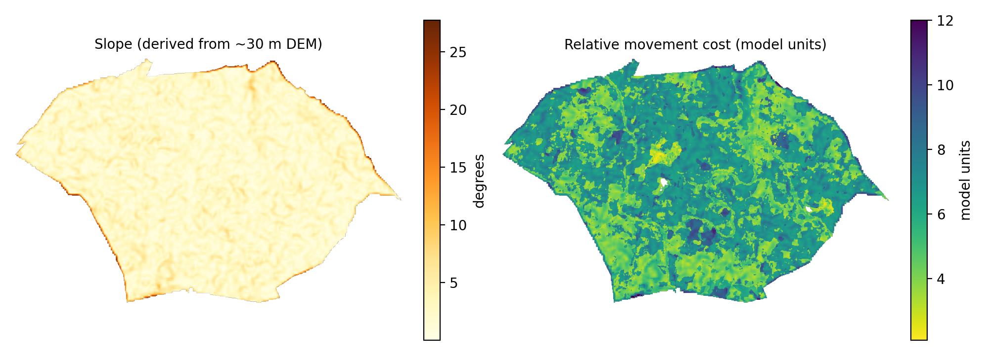
Data preparation and GIS integration
1
2
3
4
5
6
7
Collect input data
Check quality and metadata
Align coordinate systems
Clip to boundary
Prepare targets, roads, facilities, land cover, slope
Build cost grid and prohibited mask
Analysis-ready GIS inputs
›
›
›
›
›
›
Grid: 432 × 679 cells, 10 m, EPSG:32644
Cost = land cover + slope term
Blocked: water, prohibited, slope above 25°
Output quality depends on input quality
13
Notes:
What I will say: Before any routing, the data must be made consistent. I check the data and metadata, put every layer in the same coordinate system, clip to the village boundary, prepare targets, roads, facilities, land cover and slope, and then build a 10 metre cost grid with excluded cells. The result is only as good as the input data.

Slide 14
Proposed system architecture
1 Input data
2 Preprocessing
3 Target preparation
4 Cost surface
Imagery, boundary, roads, buildings, facilities, land cover, DEM, parcels
CRS alignment, clipping, raster and vector preparation, quality checks
Filter buildings; define facilities and road connection points
Land-cover and slope cost, prohibited mask, movement-cost grid
5 Road graph
6 Stage A
7 Stage B
8 Evaluation
Passable grid cells, movement rules, no routing through blocked cells
Generate alternative candidate routes per target
Select routes by marginal cost with shared-edge credit
Connectivity, length, cost; C1 omission, C2 ablation; maps
Planner: graph and least-cost-path heuristic on an 8-connected 10 m grid. Not claimed to be globally optimal.
14
Notes:
What I will say: The system is a GIS and graph-routing pipeline, not a deep-learning model. Inputs are cleaned and aligned, targets are prepared, a cost surface is built, and a routing graph is made from the grid. Stage A generates candidate routes. Stage B selects them into one shared network. At the end we evaluate connectivity, length and cost, and run the C1 and C2 experiments.

Slide 15
Step-by-step execution flow
1
Load project data
2
Check CRS and quality
3
Prepare targets
4
Prepare land cover, slope, mask
Output: files to layers
Output: validated inputs
Output: 163 houses, 4 facilities
Output: 10 m rasters
5
Generate cost surface
6
Build routing graph
7
Generate candidate routes
8
Select shared network
Output: cost grid
Output: grid graph
Output: K = 3 per target
Output: selected routes
9
Evaluate feasibility and cost
10
Run C1 and C2
11
Export maps and tables
12
Final checks and report
Output: length, connectivity
Output: result tables
Output: GIS layers, figures
Output: pending
15
Notes:
What I will say: This is the order in which the work runs, from loading the data to the final report. Each step has an input and an output. Steps one to ten have been run for Damarakunta. Steps eleven and twelve are partly done, because final consolidation and the connectivity checks are still pending.

Slide 16
Implementation and tools
Language
Python 3.10
Raster and vector
rasterio 1.4.4, geopandas 1.1.4, shapely 2.1.2, pyogrio 0.13.0, pyproj 3.7.1, fiona 1.10.1
Numerics and graphs
numpy 2.2.6, scipy 1.15.3, networkx 3.4.2, pandas 2.3.3
Imaging and plots
scikit-image 0.25.2, OpenCV-python 5.0.0.93, matplotlib 3.10.9
Data formats
GeoPackage (.gpkg), GeoTIFF (.tif), CSV, JSON
Planner
plan_network_v2.py (heap-based search; SHA-256 d00ea920…ef70a4)
16
Notes:
What I will say: Everything runs in Python in a project virtual environment. The versions shown come from the installed packages in that environment. Data are stored as GeoPackage and GeoTIFF. The planner is one Python script, and I recorded its file hash in every run so that I know the planner was not changed between runs.

Slide 17
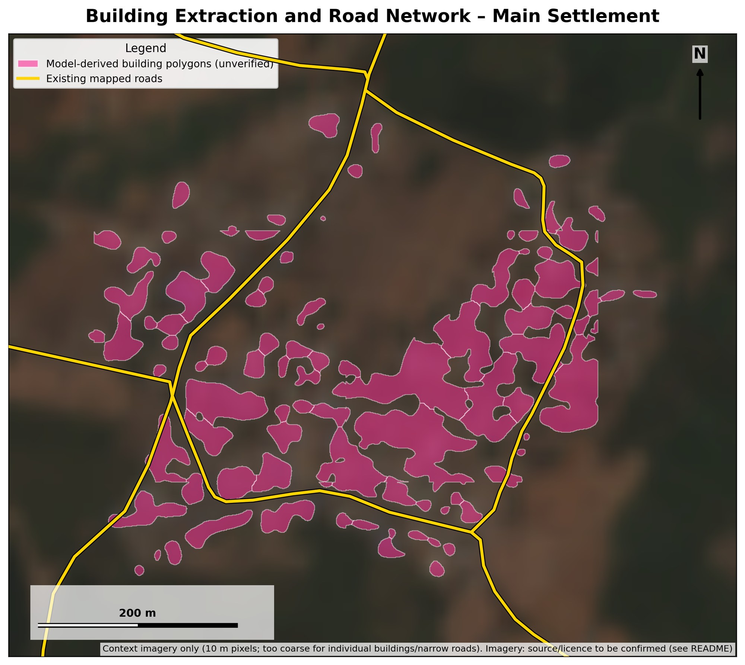
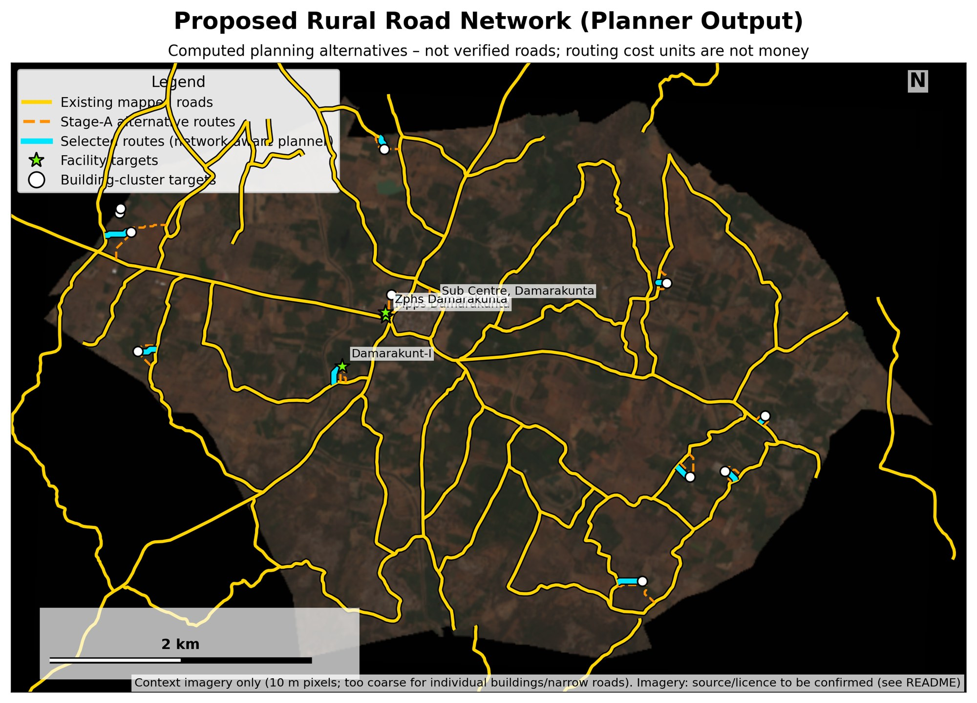
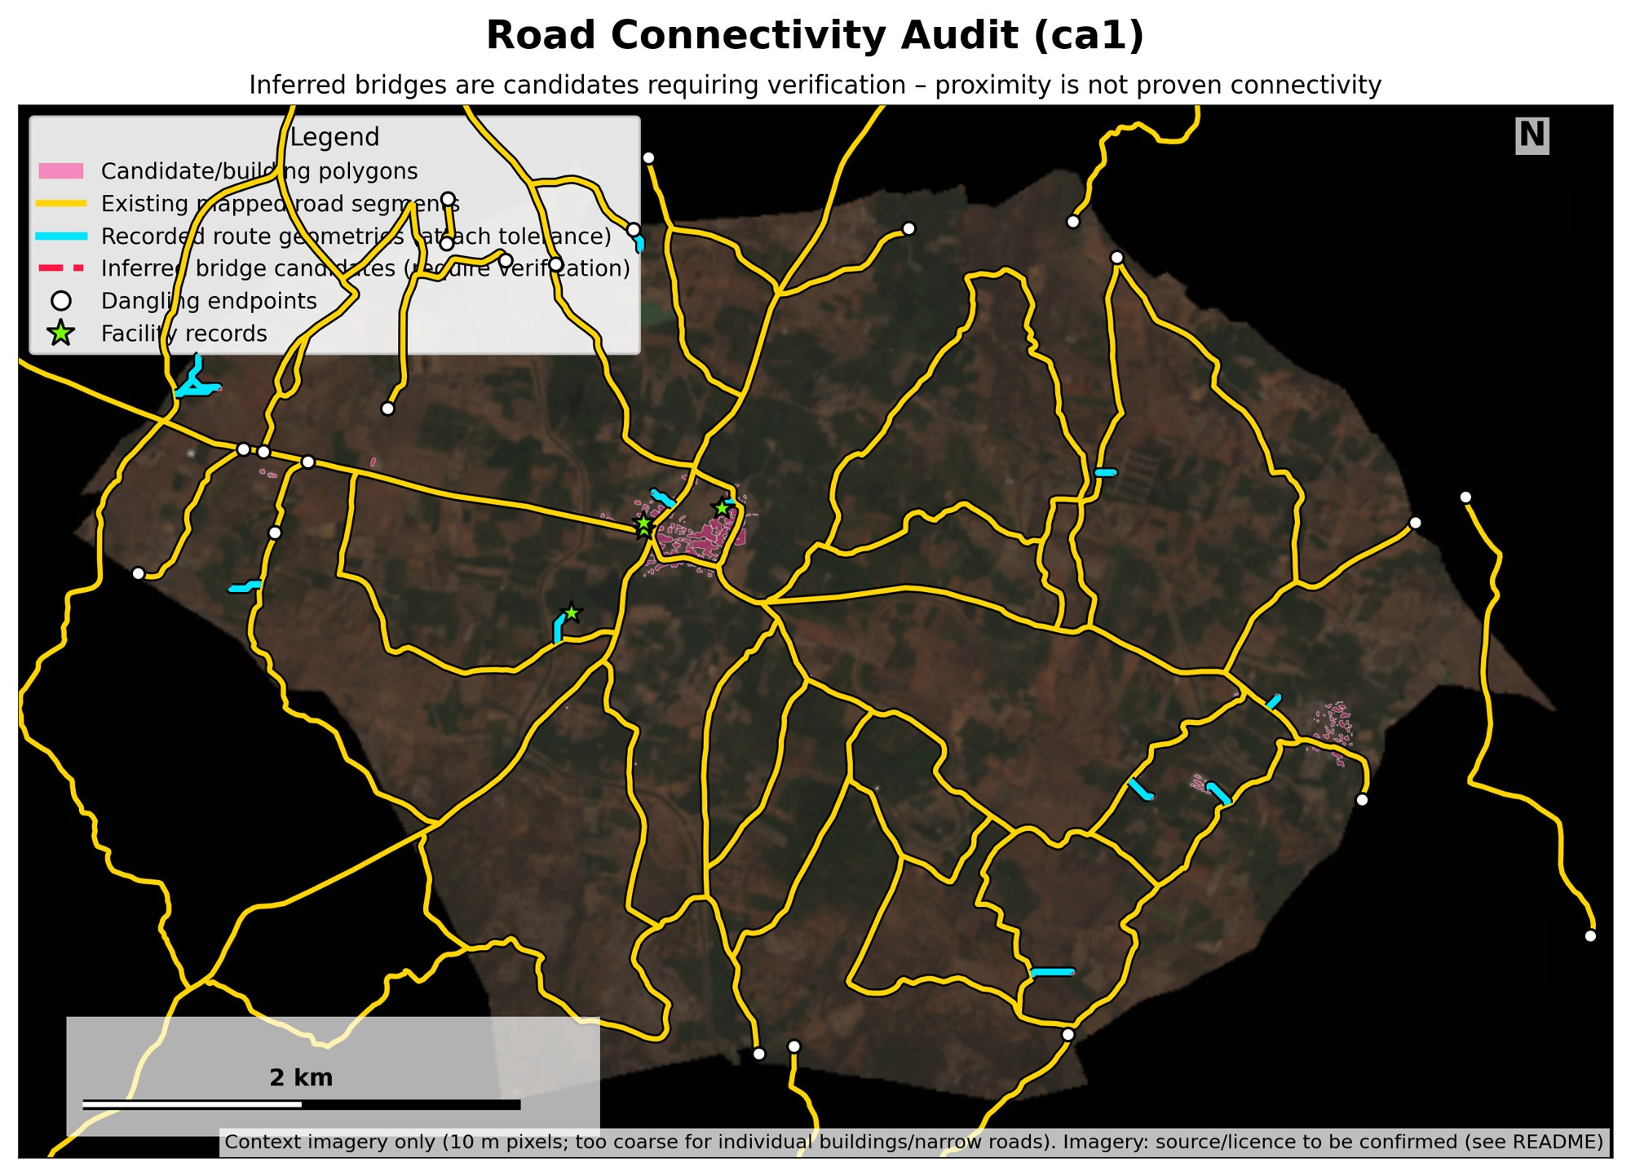
Actual project outputs
Building candidates and existing roads
Planner output (model result, not verified roads)
Connectivity audit: endpoints and bridge candidates
Slope and cost surface (rendered from project rasters)
17
Notes:
What I will say: These are real exports from my project folders. Top left: building areas and existing roads in the main settlement. Top right: proposed network on the village map. Bottom left: connectivity audit, where cyan marks route geometry and white dots are road endpoints. Bottom right: slope and cost surface. Context imagery in some maps is coarse, and the imagery licence is still being confirmed.

Slide 18
C1: Building-data uncertainty
Question: how does omitting targets change the plan?
Fewer targets give a shorter network and no failed routes
Length per served house: 31.5 m baseline; 31.9, 32.3, 35.9 m for the omissions
Synthetic omissions, not measured detection error
Config: S2, K=3, 2 passes, slope limit 25°, building penalty ×4. Source: c1_scenario_comparison.csv
18
Notes:
What I will say: The question is: what happens to the road plan if some buildings are missing from the input? I removed buildings in controlled steps and re-ran the planner. The baseline routes 163 houses with 5,138 metres of unique network. Removing the smallest 25 percent leaves 122 houses and 3,891 metres. The network shrinks because fewer houses are served. So the comparable number is length per served house, which stays near 32 metres and rises to about 36 metres when merged buildings are removed. These omissions are synthetic tests. They do not measure real building-detection error.

Slide 19
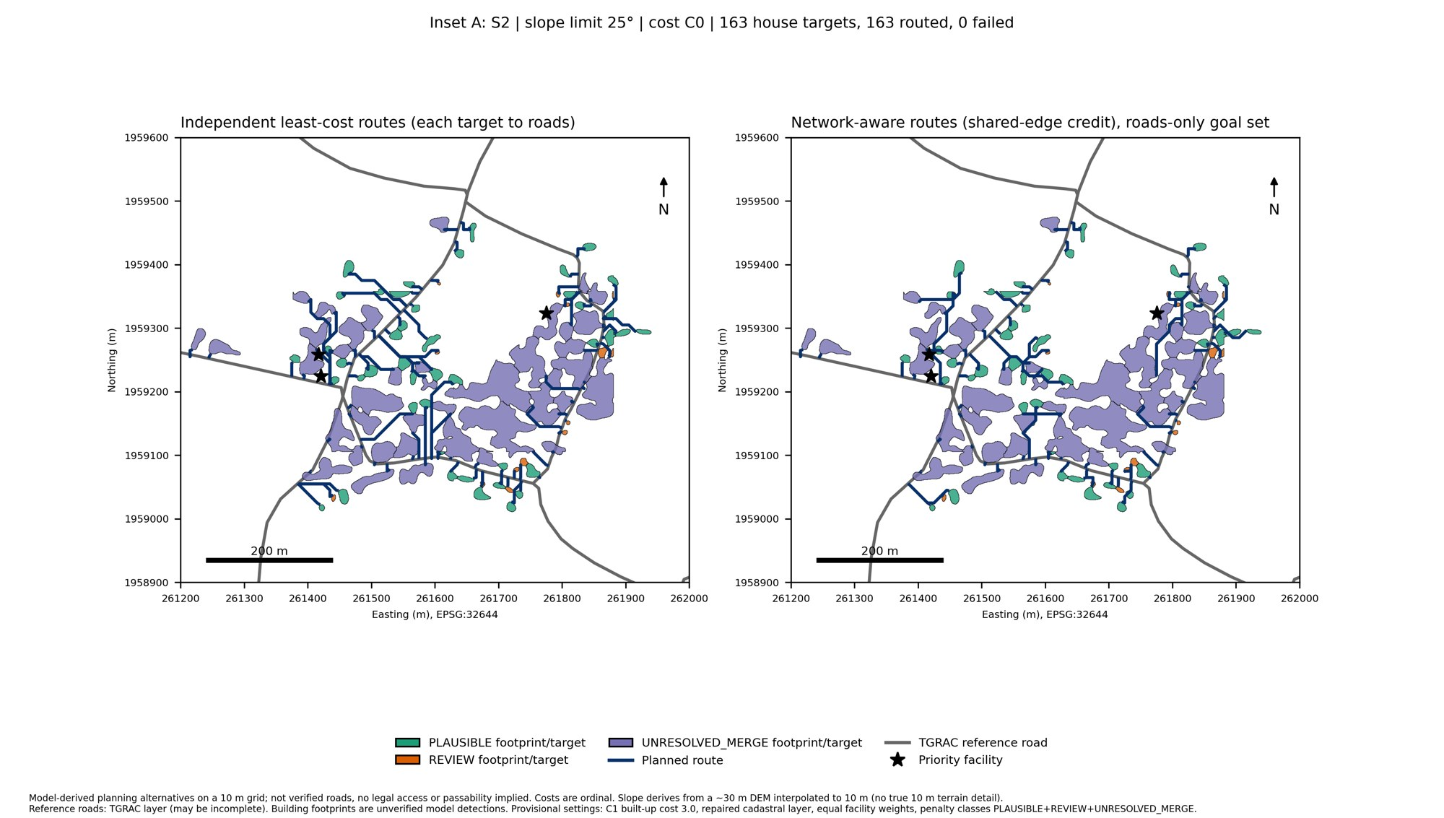
C2: Shared-network planning
Reduction 1,617.7 m (23.9%); heuristic; 0 failed routes
Ablation: K1/P0 5,148.0 m vs K3/P2 5,137.7 m (0.2% gap)
Connectivity: 162 of 163 houses reach the main road component
Config: S2, slope 25°, cost C0. Source: evaluation_summary.json
19
Notes:
What I will say: Independent routing plans each house separately and counts each road each time. Shared-network planning gives credit when a new route can use road that is already selected. The measure is marginal unique network cost, the extra network a new route needs. On the same 163 houses, the independent routes need 6,755 metres of unique network and the shared plan needs 5,138 metres, a reduction of about 24 percent. This is a heuristic and is not claimed to be globally optimal. These lengths are model grid lengths, not construction costs.

Slide 20
Actual numerical results
Experiment | Configuration | Baseline | Method | Change | N | Source file | Status
C2 shared vs independent | S2, K3 P2, slope 25°, C0 | 6,755.4 m | 5,137.7 m | −1,617.7 m (−23.9%) | 163 | evaluation_summary.json | Verified
C2 vs roads-only reference | same run; reference baseline | 6,755.4 m | 5,231.5 m | −1,523.8 m (−22.6%) | 163 | evaluation_summary.json | Verified
C2 ablation K1 P0 vs K3 P2 | 5 runs, same inputs | 5,148.0 m | 5,137.7 m | −10.3 m (−0.2%) | 163 | c2_ablation_summary.csv | Verified
C1 omit 25% smallest | primary, building penalty ×4 | 5,137.7 m | 3,890.6 m | −24.3%; 122 routed | 163 → 122 | c1_scenario_comparison.csv | Verified
C1 omit merged candidates | primary, building penalty ×4 | 5,137.7 m | 3,627.9 m | −29.4%; 101 routed | 163 → 101 | c1_scenario_comparison.csv | Verified
C1 omit merged candidates | P3, no building penalty | 4,761.7 m | 3,425.7 m | −28.1%; 101 routed | 163 → 101 | P3 c1_scenario_comparison.csv | Provisional
Lengths are unique network length in metres on the 10 m grid. Costs are model units, not rupees. Earlier prototype runs (for example 1,506.1 m, 9 clusters) are superseded and not shown as results.
20
Notes:
What I will say: Every number here was read from the saved output files. The status column is honest. Primary-run C1 and C2 numbers are verified from the CSV and JSON files. The no-building-penalty P3 row is provisional because the P3 baseline reproduction run is still pending. The 5,231.5 metre figure is the roads-only reference baseline, not the main planner, and it gives 22.6 percent. The main planner gives 23.9 percent.

Slide 21
Current project status
Component | Status | Evidence | Next action
Core GIS and route planning | Executed | 163/163 houses and 4/4 facilities routed, 0 failed | Final result consolidation
C1 omission experiments | Executed; primary verified | c1_scenario_comparison.csv; 49 report checks pass | P3 baseline reproduction
C2 shared-network ablation | Executed; verified | c2_ablation_summary.csv; control identical | Optional geometry comparison
Boundary comparison | Passed | Saved copy equals stored TGRAC response | Record query date
Connectivity investigation | Ongoing | 12 road components; house C0002 on a 5-cell component | Check boundary exit and re-entry
Connector visual review | Pending | Route connectors need visual review | Complete review
C3 transfer to other villages | Not established | No second village run | Needs approval and data
Report, maps, citation audit | Pending | Maps partly final | Finish audit
21
Notes:
What I will say: This table is the honest status. The core planner experiments are executed. The boundary check passed for the stored boundary. The connectivity investigation is ongoing: one house, C0002, attaches to a small road component that is separate from the main road cells, and I need to check whether the road leaves and re-enters the boundary. Transfer to other villages is not established.

Slide 22
Limitations and future work
1
Confirm satellite mosaic source, date and licence
2
Check road and facility completeness and currency
3
Investigate disconnected road components
4
Finish visual review of route connectors
5
Confirm final C1 and C2 numbers and settings
6
Finish report, literature and citation audit
7
Second-village transfer (C3) only if data and time allow
8
Field or expert validation before any real-world claim
22
Notes:
What I will say: These are the things I know are not finished or are not supported by evidence. The imagery licence, the completeness of roads and facilities, and the disconnected road component need checking. Final numbers need confirmation. Nothing here has been checked in the field, so I do not claim the roads are ready to build.

Slide 23
Conclusion
Data integrated
Imagery, boundary, roads, buildings, land cover, slope on a 10 m grid
System built
GIS cost grid with a generate-and-select route planner
Experiments run
C1 building omissions, C2 shared-network ablation
Confirmed
Primary run: 163 houses, 5,137.7 m shared vs 6,755.4 m independent
Still to do
Connectivity checks, licence checks, validation, transfer (C3)
23
Notes:
What I will say: To conclude. I integrated imagery, boundary, roads, building candidates, land cover and terrain for Damarakunta. I implemented a graph-based planner that generates and selects shared routes. My C1 and C2 experiments investigate building uncertainty and shared networks. The primary-run numbers are verified. Connectivity, licence checks, validation and transfer are still to do. I do not claim the routes are ready to build or optimal.

Slide 24
References
[1] L. Ding et al., "Adversarial Shape Learning for Building Extraction in VHR Remote Sensing Images," IEEE Trans. Image Process., 2022, doi:10.1109/TIP.2021.3134455.
[2] Q. Li et al., "A Review of Building Extraction From Remote Sensing Imagery," IEEE Trans. Geosci. Remote Sens., 2024, doi:10.1109/TGRS.2024.3369723.
[3] J. Hu et al., "LGNet: Location-Guided Network for Road Extraction From Satellite Images," IEEE TGRS, 2023, doi:10.1109/TGRS.2023.3305031.
[4] Q. Xu et al., "Road Extraction With Satellite Images and Partial Road Maps," IEEE TGRS, 2023, doi:10.1109/TGRS.2023.3261332.
[5] L. Zhu et al., "A Multi-Objective Path Planning Framework in Off-Road Environments Based on Deep Reinforcement Learning," IEEE Trans. Intell. Transp. Syst., 2025, doi:10.1109/TITS.2025.3589586.
[6] Z. Wang et al., "A Practical Urban Distribution Network Planning Method With Geographic Information System," IEEE Trans. Power Syst., 2024, doi:10.1109/TPWRS.2024.3384534.
[7] J. Malczewski, "GIS-based multicriteria decision analysis: a survey of the literature," Int. J. Geogr. Inf. Sci., 2006, doi:10.1080/13658810600661508.
[8] P. Yang et al., "UGD-DLinkNet: An Enhanced Network for Occluded Road Extraction Using Attention Mechanisms and Uncertainty Estimation," IEEE JSTARS, 2025, doi:10.1109/JSTARS.2025.3608007.
[9] J. Wang et al., "LoveDA: A Remote Sensing Land-Cover Dataset for Domain Adaptive Semantic Segmentation," NeurIPS Datasets and Benchmarks, 2021, arXiv:2110.08733; data doi:10.5281/zenodo.5706578.
[10] ESA WorldCover: esa-worldcover.org/en/data-access. [11] Copernicus DEM (COP-DEM): dataspace.copernicus.eu.
24
Notes:
What I will say: These are the references used on the slides. The IEEE items were checked against their DOI records in my literature verification file. Full-text reading is still pending for some. The dataset links are the official pages.

Slide 25
Thank you
Questions and suggestions are welcome
Pendyala Archana | M.Tech IT (AI and Robotics) | CBIT Hyderabad
Notes:
What I will say: Thank you. I am happy to take questions. If asked, remember: results are planning support only, the primary-run numbers are verified, and field validation and transfer to other villages are future work.

