Slide 1
Virtusa Project Review
Name- Archana Kumari
Project name- Blogging website RestAPI
Employee Id- 8131303
Training Batch- 18( Java )
Date of joining- 07th June 2022
Qualification- B.Tech, CSE(2022)
From- Dumka, Jharkhand
Past skills – C,CPP,Web Development

Slide 2
Blog - RestAPI
Description
Objectives
Scope
Technical Requirements
Functional Requirements
Diagrams

Slide 3
Description
This is an admin-central blog, in which the admin has the major authorities.
Admin can create new posts, categories and update and delete them also. He also can see and delete his registered readers.
The project is secured with Jwt(json web token) and Spring security, which forbids normal people to access the admin panel. A normal person is only given access like reading to blogs and making some filters.
Also the entities of the project are linked through foreign key-constraints and relationship concepts like one to one and many to one is also applied in the project.
Further, pagination feature is also implemented in the show all blog route, swagger-documentation, junit-5 test for registration route is also there.

Slide 4
Objectives
The objective of the project is to build a platform in which authors can come and open their blogging profiles. On the other hand reader can come and filter on the basis of author and categories and make best use of the available content.

Slide 5
Scope
Let's first discuss the scope of admin. The admin panel consists of three major action buttons, managing post, categories and user.
Manage Posts- Inside manage post admin can create new post, update or delete old posts.
Manage Categories- Inside manage categories, admin can create new category or update/delete old ones.
Manage User- Admin can't update user profile but he can see the list of registered users and also delete them if he wishes to.
A normal user can on the other hand read posts and filter them based on categories and author.
Read posts- Read a specific posts or cal view all the posts.
Filter by Category- Search posts by categories
Filter by Author- Search posts by author.

Slide 6
Technical Requirements
1. Backend- Java Spring Boot
2. Database- MYSQL
3. ORM(Object-Relational Mapping)- Hibernate
4. Language- Java
5. API Testing – Postman Chrome Plugin

Slide 7
Functional Requirements
1.Register new user
New User can only be registered with a normal role.
Passwords are stored in encrypted format.
2.Login
On login a token is generated based using json web token.
The internal routes are restricted on the basis of information from this token by Spring security.
3.Add Posts, Category
This route is preauthorized using spring security, only is admin is logged in will be permitted else forbidden.
4. Add Image
This route updates the image name to the post by id.
The image-path is stored to the database and image is stored in images folder in resources.
5. Get all posts
Posts will come in pagination.
6. Update post and category
Post will be updated by admin only.
7. Delete post, user and category
Post will be deleted by the admin only.

Slide 8
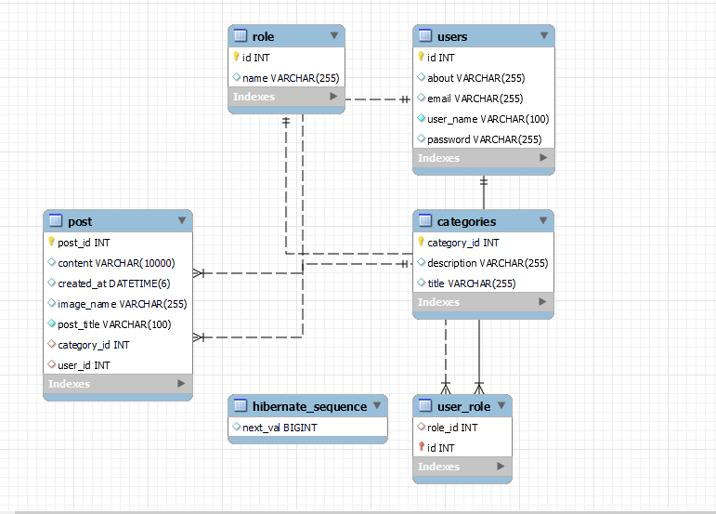
Database

Slide 9
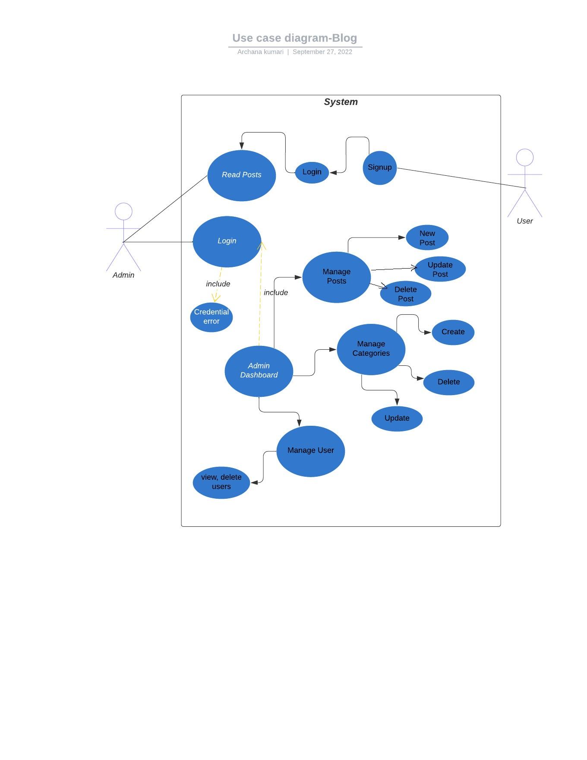

Slide 10
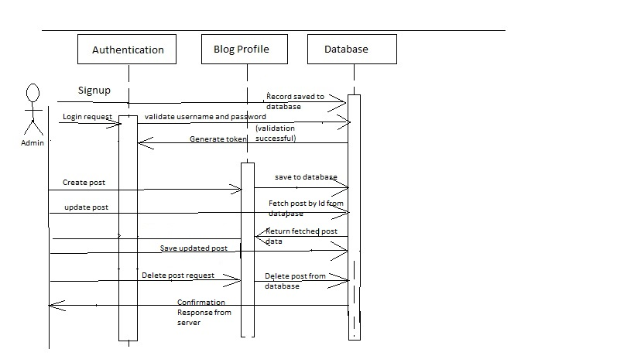
Sequence Diagram

Slide 11
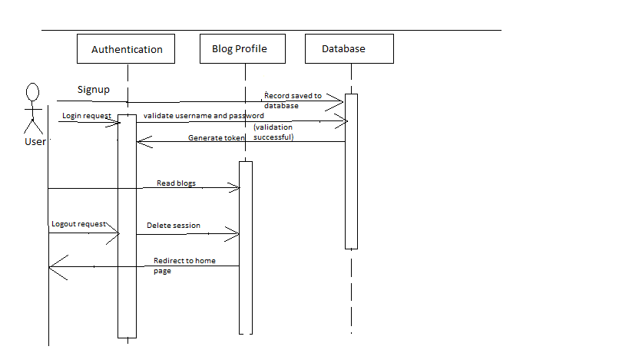
Sequence Diagram

Slide 12
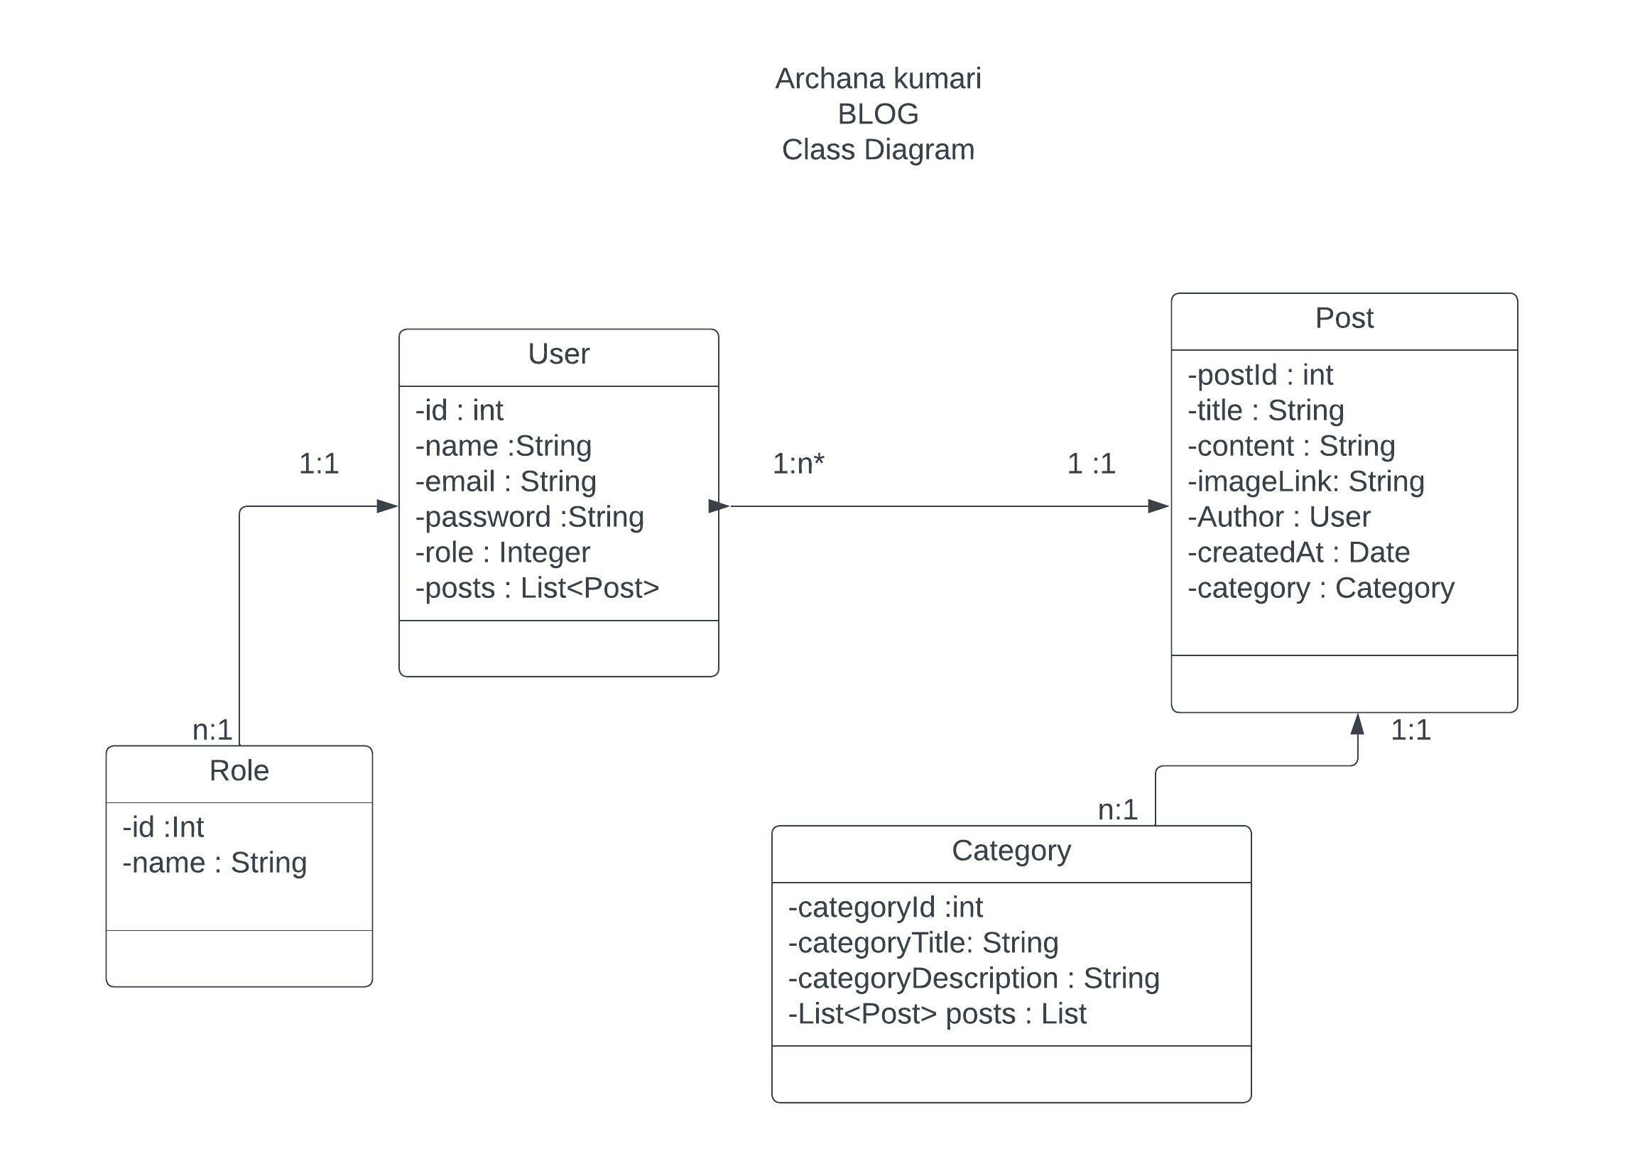

Slide 13
Thank-you

