Slide 1
MET CS 602 – Class Project
Yoga Studio
By Archana Bhogaraju

Slide 2

Yoga Studio - Introduction
Yoga Studio is an application used to schedule yoga courses and to enroll/withdraw from courses. The user roles are -
Admin:
Add, Edit and Delete a Course.
Check Customers along with their enrolled course list.
Customer:
Enroll into Courses.
Withdraw from Courses.
Admin & Customer:
- View All Courses including if the course enrollment capacity is full.
- Search for Courses by name, fee and date ranges.

Slide 3
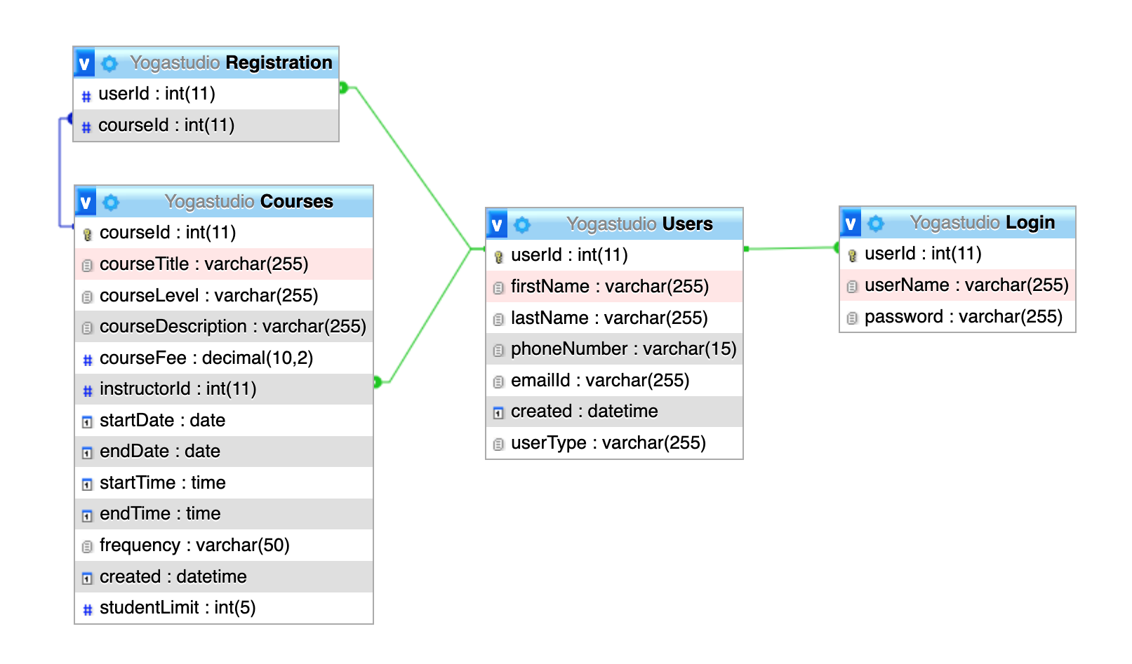
Yoga Studio – MySQL Database
MySQL database tables:
Login
Users
Courses
Registration

Slide 4
Yoga Studio – Technologies Used
Client Application – Angular 13
  UI Framework – Bootstrap 5
Server Environment - MAMP
  Server-side language – PHP 8
  Web Server – Apache
  Database – MySQL
  Database GUI - PhpMyAdmin
IDE - Visual Studio Code
Package Manager – Node, npm
Operating System – Mac OS

Slide 5
Architecture Diagram
Browser
Web Server
http://localhost:4200
http://localhost:8888/yogastudio/
http://localhost:8888/phpMyAdmin5/
RESTAPI
Angular
PHP
PDO
MySQL
yogaclient
yogastudio
YogastudioDB
JSON
Data
User
Local Storage

Slide 6
Demo & Code Review

Slide 7
Project Setup Information
Please check next slides for following steps:
Step 1 - Instructions – Set up MySQL DB
Step 2 - Instructions – Set up PHP
Step 3 - Instructions – Set up Apache
Step 4 - Instructions – Setup and Serve Angular

Slide 8
Step 1 - Instructions – Set up MySQL DB
Make sure the MySQL DB is running on
  Host: localhost
  Port: 8888
  Username: root
  Password: root
Navigate to MySql Database GUI using PHPMyAdmin – http://localhost:8888/phpMyAdmin
Go to “Home” -> “SQL” Tab
Run the following attached SQL Script to create “YogastudioDB” Database with all the necessary tables.
  YogastudioDB.sql

Slide 9
Step 2 - Instructions – Set up PHP
Make sure you have MAMP Installed
Navigate to htdocs folder
Copy yogastudio folder inside htdocs
Make sure PHP is running at the following URL and is able to access the MySQL DB.
  http://localhost:8888/yogastudio/

Slide 10
Step 3 - Instructions – Set up Apache
Since Angular and PHP are running on different ports, we need to configure Apache to allow requests from our Angular application. This will avoid CORS (Cross Origin Resource Sharing) errors in the browser console.
Navigate to /Applications/MAMP/conf/apache folder (This path may be different in Windows)
Open httpd.conf with write access. Make sure headers are set in the Directory tag where htdocs is present. The path to htdocs may vary depending on whether your system is a Mac or Windows PC. But it is essential that “AllowOverride” is set to “All” and all the “Header” Tags below are set.
  <Directory "/Applications/MAMP/htdocs">
  Options All
  AllowOverride All
  Require all granted
  XSendFilePath "/Applications/MAMP/htdocs"
  Header always set Access-Control-Allow-Origin: http://localhost:4200
  Header always set Access-Control-Allow-Credentials: true
  Header always set Access-Control-Allow-Methods "POST, GET, OPTIONS, DELETE, PUT"
  Header always set Access-Control-Max-Age "1000"
  Header always set Access-Control-Allow-Headers "X-Requested-With, Content-Type, Origin, Authorization, Accept, Client-Security-Token, Accept-Encoding"
  </Directory>

Slide 11
Step 4 - Instructions – Setup and Serve Angular
Pre-requisites to be installed. Follow the links for help documentation, if not already installed:
  Node Version: 16.3.1 (Check by Running node --version)
  NPM Version: 8.1.2 (Check by Running npm --version)
  Angular CLI Version: 13.2.0 (Check by Running ng --version)
Navigate to “yogaclient” folder in terminal and run the following commands:
  cd yogaclient (Navigate to yogaclient folder)
  npm install (Install NPM dependencies like Bootstrap etc, listed in package.json)
  ng serve (Serve the Angular application)
  Open http://localhost:4200 in Browser (Run the angular application in browser)
Troubleshooting Angular application:
  Please check the MySQL, PHP and Apache configuration in case the Angular application shows a blank page.
  Inspect the browser console to see if there are any CORS errors. The apache configuration changes are needed to make sure Angular Client works.

Slide 12
Thank You!

