Slide 1

HTML5
Geolocation API
Fundamentals
Week 1 – Full-Stack DPP Course

Slide 2
Welcome
Manuel Cubuca
Technical Trainer
Email: manuelc@justit.co.uk

Slide 3
Part 1 Outline
The HTML5 Geolocation API
What is location?
Getting the location
HTML5 navigator Object
Understanding the code
Google Maps
Inserting maps to our website

Slide 4
Part 1 Learning Objectives
Learners would have a good understanding of:
What is HTML5 Geolocation
Latitude and longitude
What is a location
How to get the location
Methods to determine your location
The core HTLM5 Geolocation code syntax
How to integrate Google maps into a website

Slide 5
Resources
VLE materials
Sample code from the case study
Google Maps
Pluralsight

Slide 6
Download Files
Access my GitHub account and download the HTML5 Geolocation API folder
GitHub Account

Slide 7

HTLM5 Geolocation API
What is a location?
A LOCATION CONSISTS OF TWO PARTS:
A latitude: a distance north or south of equator.
A longitude: a distance east or west of Greenwich, England.
When working with them using Geolocation we use the DECIMAL VERSION, e.g. 27.64, -192.65

Slide 8




HTLM5 Geolocation API
Getting your location?
GPS –Uses satellites
IP Address – Uses the browser
Wi-Fi– Access points
cell phone triangulation – Cell towers
When you use Geolocation API to get a location the browser uses the one of the 4 different methods to determined your location, also depending on the type of connection you have and the technology available on the device you are using.

Slide 9
HTLM5 Geolocation API
Using a Simple Example
function displayLocation(position) {
var latitude = position.coords.latitude;
var longitude = position.coords.longitude;
var pLocation = document.getElementById("location");
pLocation.innerHTML += latitude + ", " + longitude + "<br>";
}
window.onload = function() {
if(navigator.geolocation) {
navigator.geolocation.getCurrentPosition(displayLocation);
} else {
alert("Sorry, this browser doesn't support Geolocation!");
}
}

Slide 10
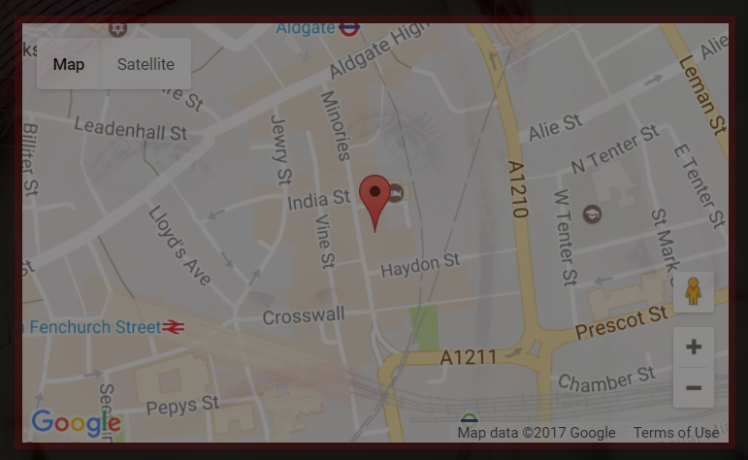
HTLM5 Geolocation API
Adding Google Map into our website

