Slide 1
HTML
Hypertext Markup Language

Slide 2
Why should I use HTML?
HTML is a base for a web-page.
HTML basically contains content of the website/webpage.
It actually holds the words of the page or a site.
HTML is not a technique for styling. It if for the content.
Styling defines colors, backgrounds, images -> Cascased Style Sheets
Page arrangement/design is part of CSS.

Slide 3
HTML
HTML is based on tags. Nested architecture.
General to depth(or specific).

Slide 4
HTML Tags
<HTML> - It contains the entire document.
<Head> - This is for meta data. Thumb rule: No content from the head tag will be displayed.
<body> - Content which is present here will displayed.
https://developer.mozilla.org/en-US/docs/Web/HTML/Element

Slide 5
Primary Tags
<p>: It is used to create a paragraph.
<div> - To make a division. It is used to create a container of the content.
Why should I make a division?
Because to group like tags or behavior or objects in a single frame or together.
<h1>…..

Slide 6
Tags
There are two types of tags.
Inline tags
Void type tags

Slide 7
HTML Inline
<span>
<b>
<i>
<em> Emphasis
<strong>: bold

Slide 8
Inline Tags
You need to have a closing tag. It will have content inside a tag.

Slide 9
void tags: Don’t need a closing tag. They will not have anything.
br
img
input

Slide 10
What is the difference between span and div?
Both are used for in-lines.
Span is used to separate the content from other things.
It will be very useful with CSS.
The basic difference comes with Semantic tags.

Slide 11
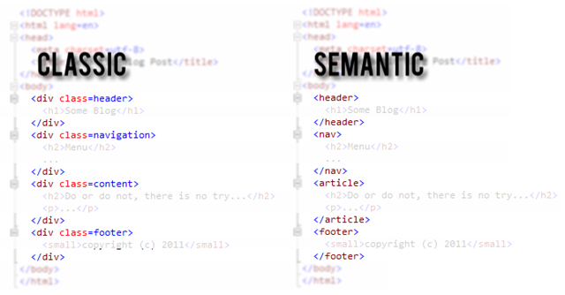
Classic vs Semantic

Slide 12
Semantic HTML
Semantic HTML is the use of HTML markup to reinforce the semantics, or meaning, of the information in webpages and web applications rather than merely to define its presentation or look. Semantic HTML is processed by traditional web browsers as well as by many other user agents.
Using the tag for its exact purpose.

Slide 13
What is the difference between strong and bold?
Both are used for showing bold text.
Strong means standout of the context.
Semantic HTML

Slide 14
What is the difference between em and i tag?
Both are for italics.
Emphasis a particular content of a text.
Semantic HTML.

Slide 15
Attributes
Additional properties for a tag.
This will provide meta data or more information about the tag.
<img src="mdn-logo-sm.png" alt="MDN">

Slide 16
Grouping
It is always recommended to group things.
Similarly in HTML we need to group things.
We have two primary types of groups.
Class based.
ID based.

Slide 17
Class Grouping
<div class="Hyderabad-Pics">
<img src="https://encrypted-tbn0.gstatic.com/images?q=tbn:ANd9GcT1Hl2WVWcWgWmai9zfTCiBzWzlwIjwb4jeeBS_vsjCJV_TZ9j6" alt="Hello"/>
<img src="https://pioneers.io/wp-content/uploads/2015/10/Hyderabad-small.jpg"/>
</div>

Slide 18
ID Grouping
I can have same class for multiple tags on the same page.
But ID is on or unique for the tag on the page.

Slide 19
Conclusion
Give some better names for the class names.
Give some valid names

