Slide 1
Version Control using Git and GitHub

Slide 2
Different Operating Systems
Linux
Macintosh
Windows
We have a concept called “Command Line”.

Slide 3
Command Scripting
In technology world there are some tasks which needs to be automated or repetitive etc.
To run this we need command scripting.
Automate administrative tasks.
Batch processing of commands.
Complex configuration details and pass the parameters by customization.
Get full control of the operating system.
Ability to combine commands allows you to create new commands adding value to your operating system.

Slide 4
Some commands
C:\Users\<username> (Default directory to check the current directory).
ls(To get list of directories in unix).
In windows files are not case sensitive.
chdir to change the directory.
cd.. To go back one directory.

Slide 5
Absolute Paths and Relative Paths
IMAX Address: Address: Necklace Rd, Central Secretariat, Khairatabad, Hyderabad, Telangana 500004, India(Absolute Path).
Panjagutta: Go straight --> Take left → Take a U turn.(Relative Path).
Mehdipatnam : Address can be different (Relative Path).
Relative path starts from the directory where are currently.
Absolute path is the root directory.
Root directory for windows C:\(OS installed directory).

Slide 6
Git vs Github
You need to build a repository system.
Why do we need a version control?
Problem Statement:
2 people...Some software.
index.html ----> Desktop 10 lines + 10(4.00 PM)
Desktop 10 lines + 10(6.00 PM)

Slide 7
Version Control
index.html ----> Desktop 10 lines + 10(4.00 PM)--->01
Desktop 10 lines + 10(6.00 PM)--->02
------------------------------------------------------
3rd person
index.html 10 lines + 5 lines of common code + 5 lines of 1st person code + 5 lines of second code

Slide 8
To learn github
https://git-scm.com/
https://try.github.io/levels/1/challenges/1

Slide 9
What is Git?
Git is an open source.
Git is a version control system.
Git can be used as a repository server remotely.
Git maintains history of all the user changes.

Slide 10
What is Github?
Github is a website.
It is built on top of git.
Github has many free projects.
It is a online free/paid repository with version control.

Slide 11
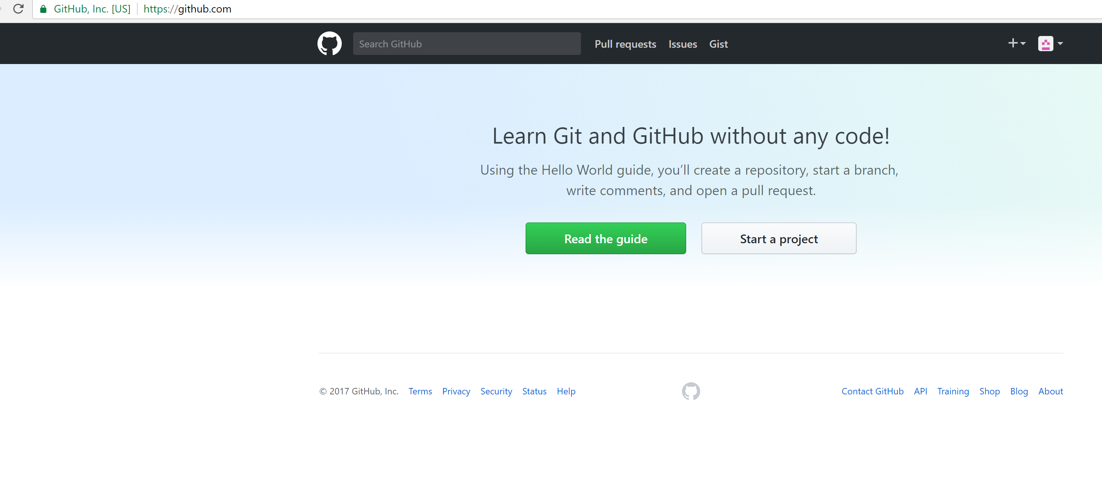
Create a new git hub account

Slide 12
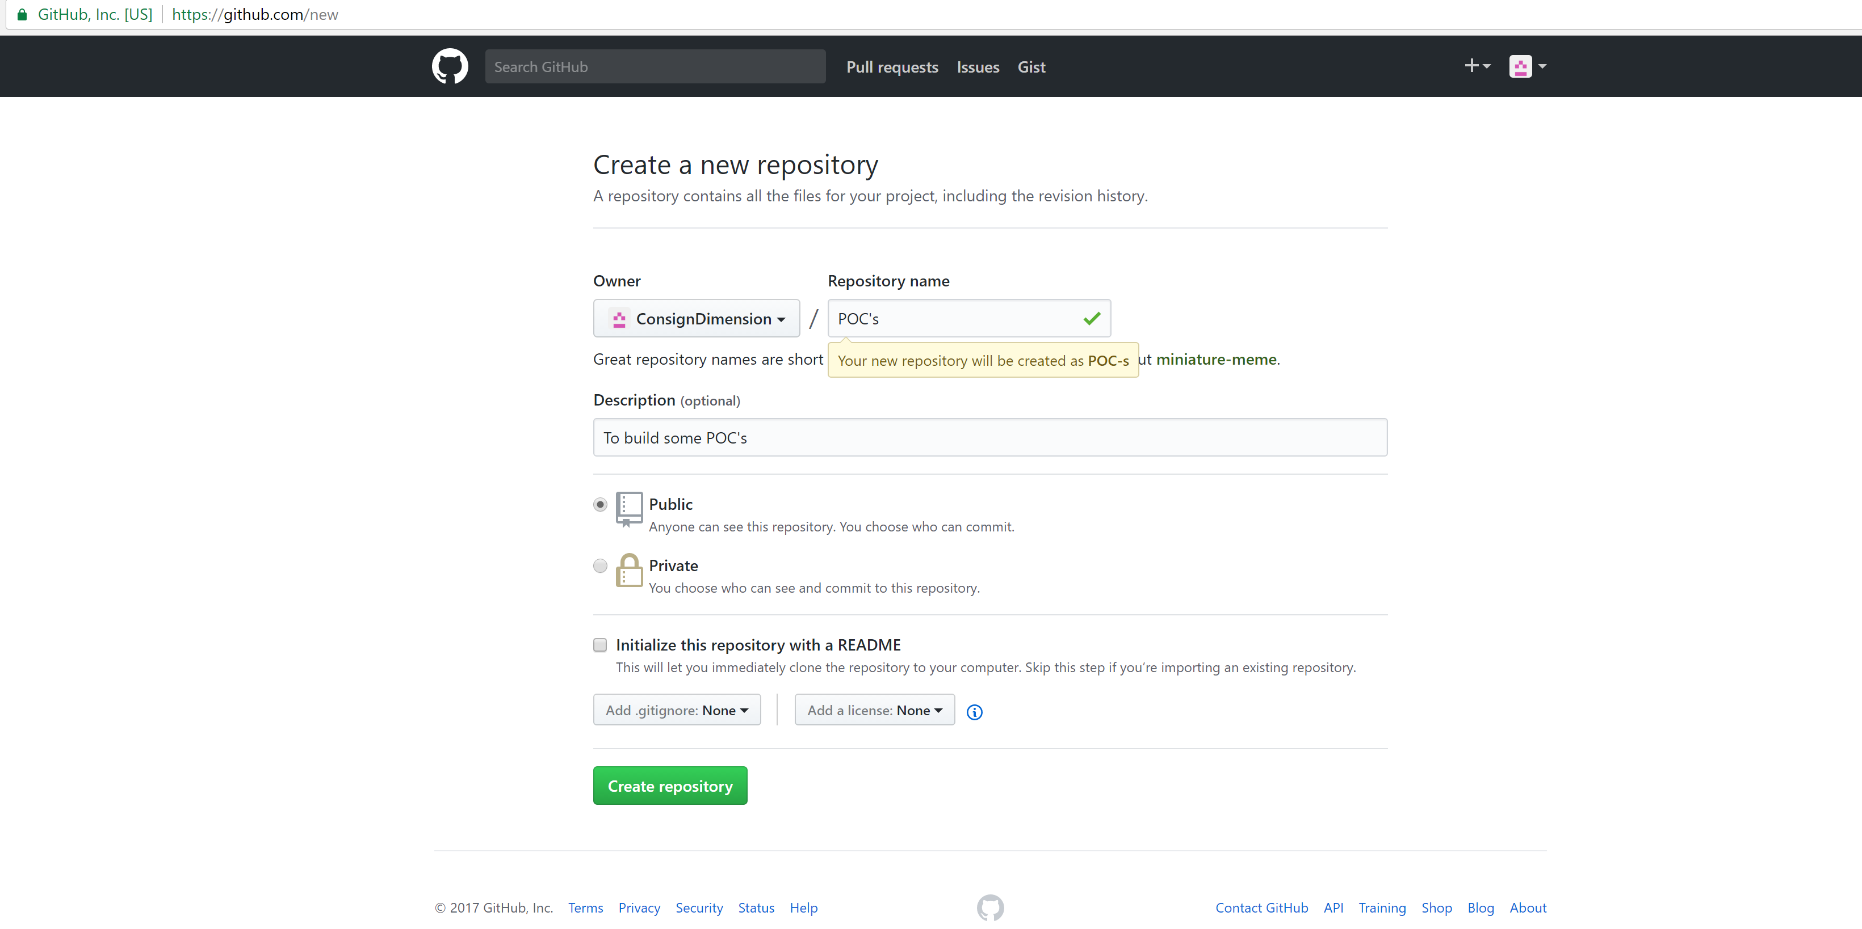
The below will create a remote folder

Slide 13
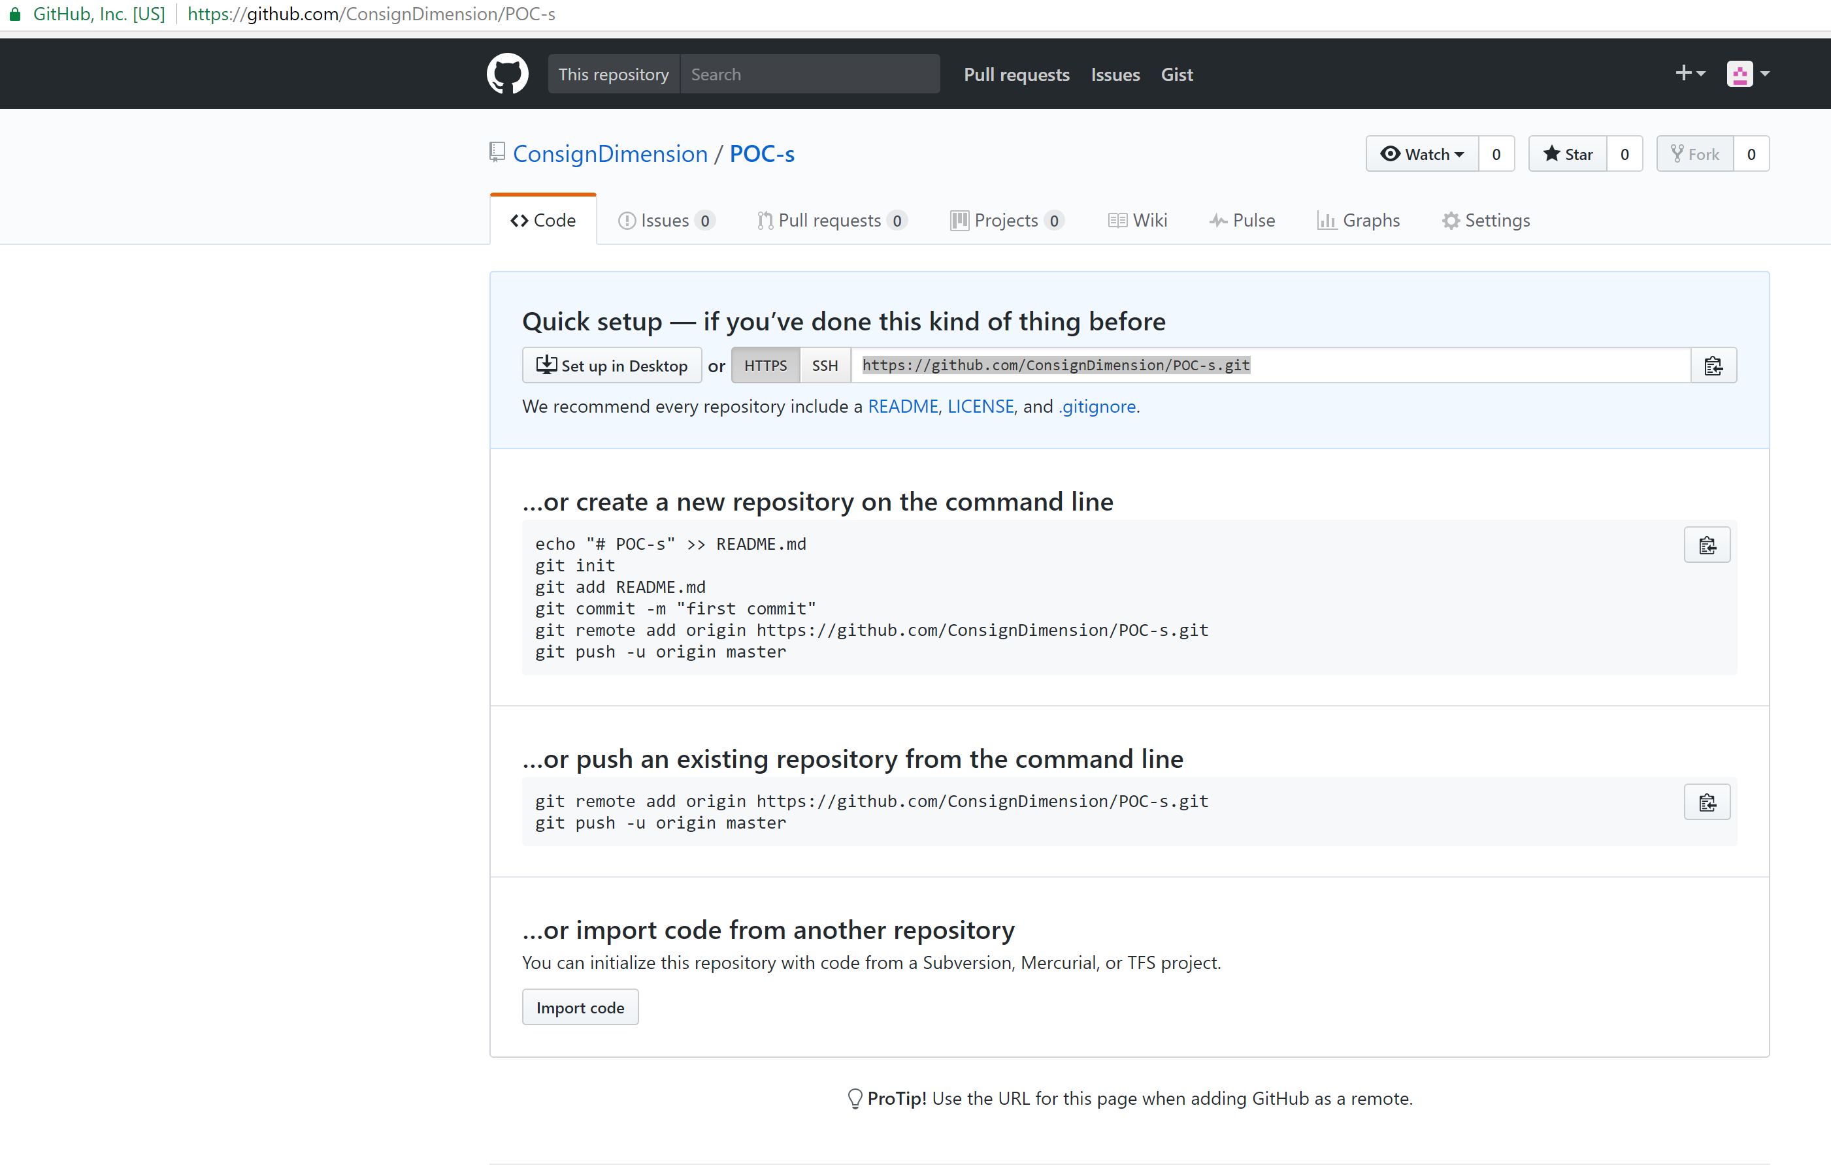
It created a repository(It is a remote folder)

Slide 14
Repository URL
https://github.com/ConsignDimension/POC-s.git

Slide 15
Create a new repository on the command line
…or create a new repository on the command line
echo "# POC-s" >> README.md
git init
git add README.md
git commit -m "first commit"
git remote add origin https://github.com/ConsignDimension/POC-s.git
git push -u origin master

Slide 16
Push an existing repository from the command line
git remote add origin https://github.com/ConsignDimension/POC-s.git
git push -u origin master

Slide 17
Import code from another repository
You can initialize this repository with code from a Subversion, Mercurial, or TFS project.

Slide 18

For every repository there are two images
Star
Fork

Slide 19
One account is for CD.
Other accounts are for us.
Lets say if we have 20 resources, then we will have 21 accounts(1 is CD and other 20 are for employees).

Slide 20
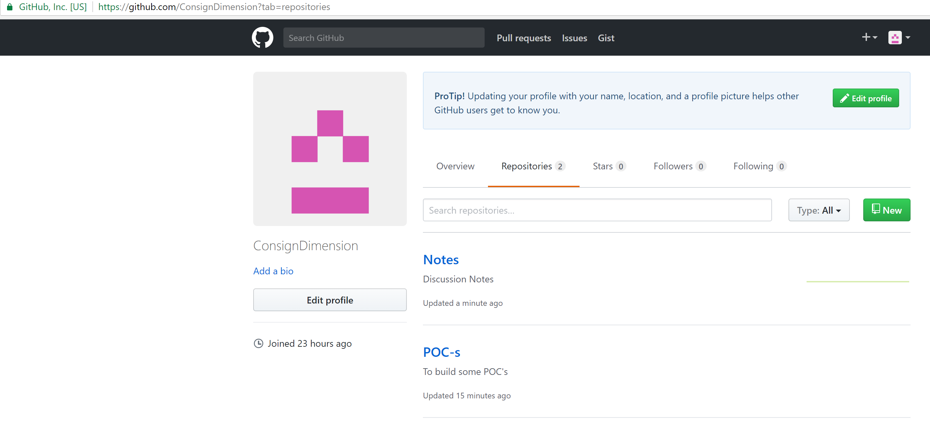
Two Repositories

Slide 21
Concept of Forking
When you fork it, it will move the complete repository into your account(whoever has forked).
ConsignDimension Repository is forked → It will move the repository into the account who has forked it.

Slide 22
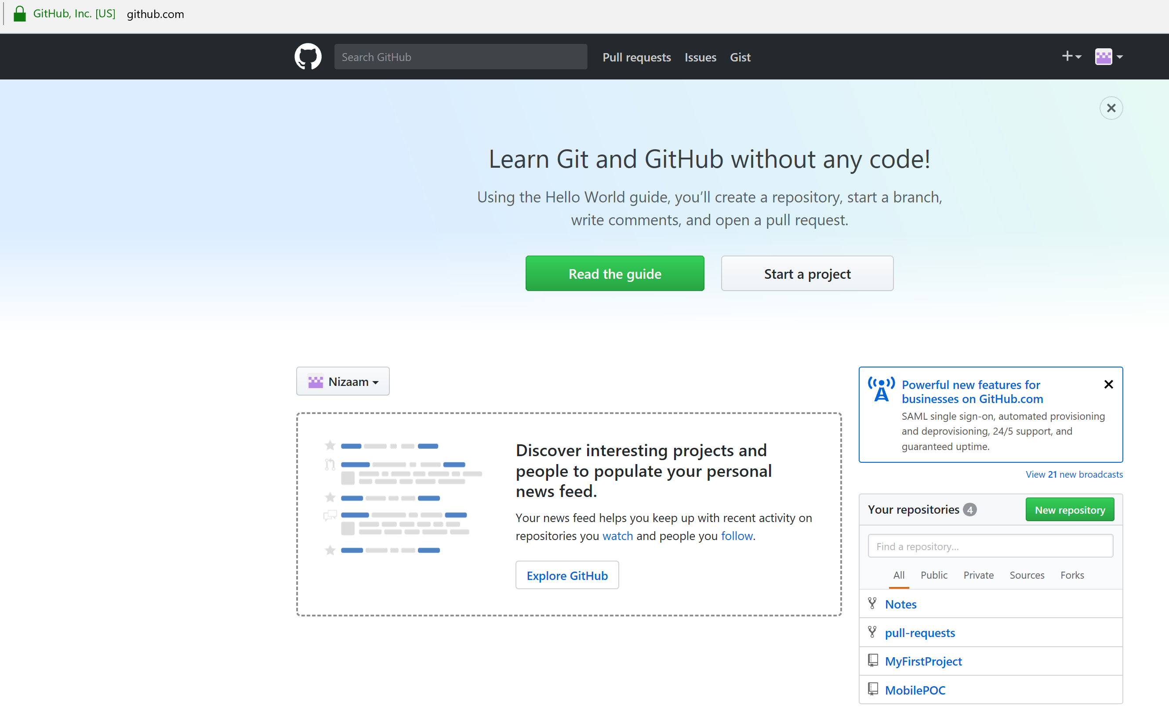
Four repositories are shown

Slide 23
Forking and Cloning
ConsignDimension(Github) --- Fork --- > My Account(GitHub) --- Clone(Only if you install Git) ---- > Desktop(Local Machine).
Forking means moving content from one github account to another github account.
Cloning means moving content from one github account to another git account.

Slide 24
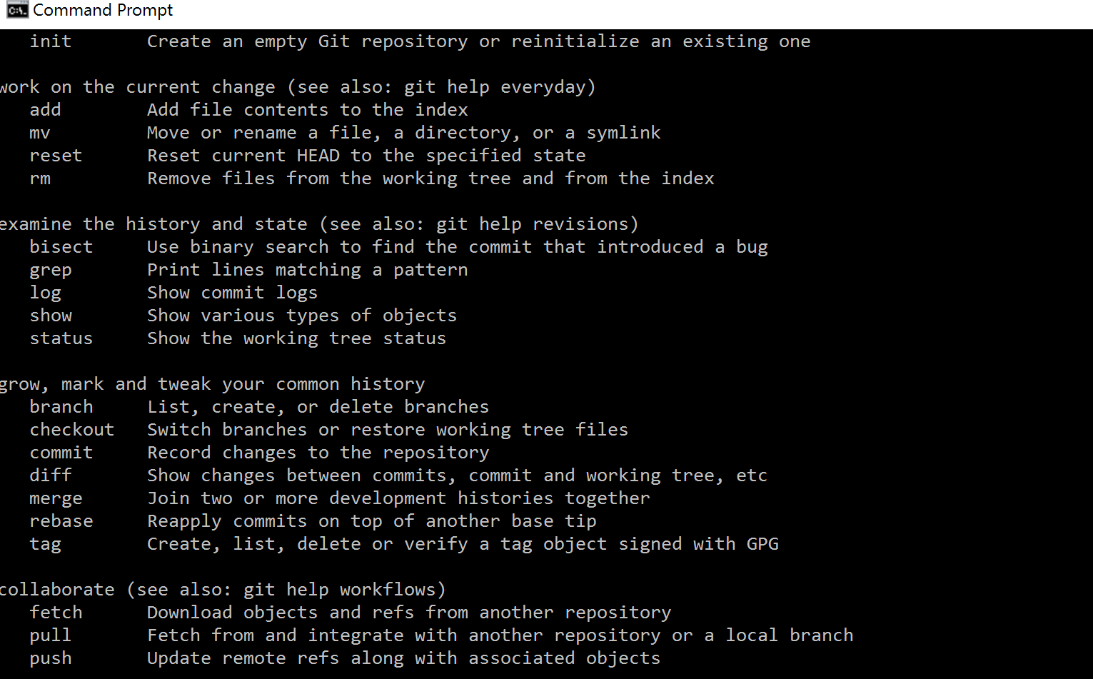
Install git (https://git-scm.com/) and check

Slide 25
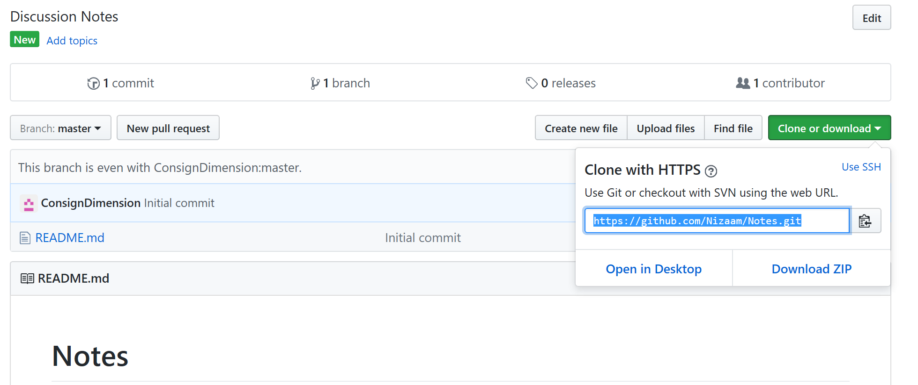
Clone with HTTPS(Select the URL)

Slide 26
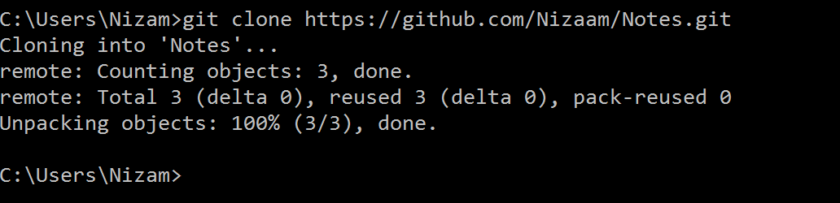
How to clone to your desktop from git hub?
This is copying the files from github to my computer.

Slide 27

When I clone…
It will create a branch of the github repository to the local repository.

Slide 28

What will happen when I click git status
On branch master is up to date or not with origin/master.

Slide 29
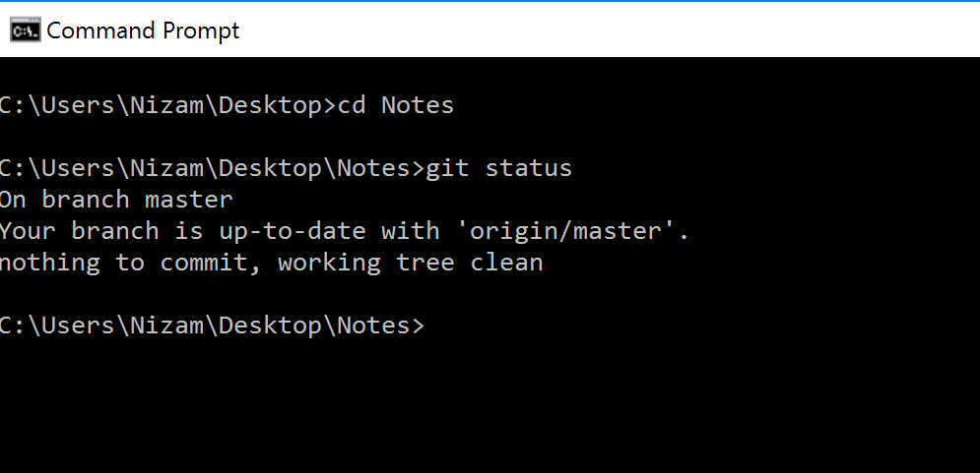

Slide 30
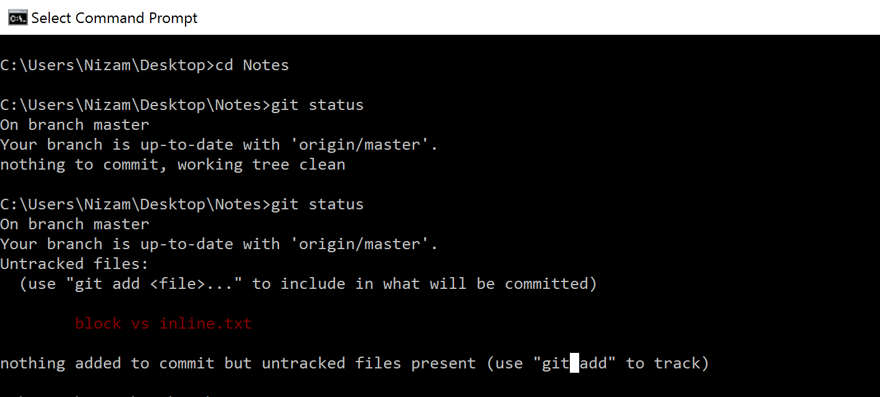

Slide 31
Origin master means -- > Github account
Desktop(Local Version) ----(Virtual Staging Version == Branch-Master)---- Account(GitHub_Origin-Master)

Slide 32
Commands Used
git
git clone “URL”
git status
git add filename
git commit –m “This is my first commit”.( Your branch-master) is ahead of origin-master.
git push origin master

Slide 33
How to make git and git hub balanced?
Currently the changes of our versions are in our local machine only.
In order to move or push the changes to github we need to use git push.

Slide 34
To move from origin master to branch master
git push

Slide 35
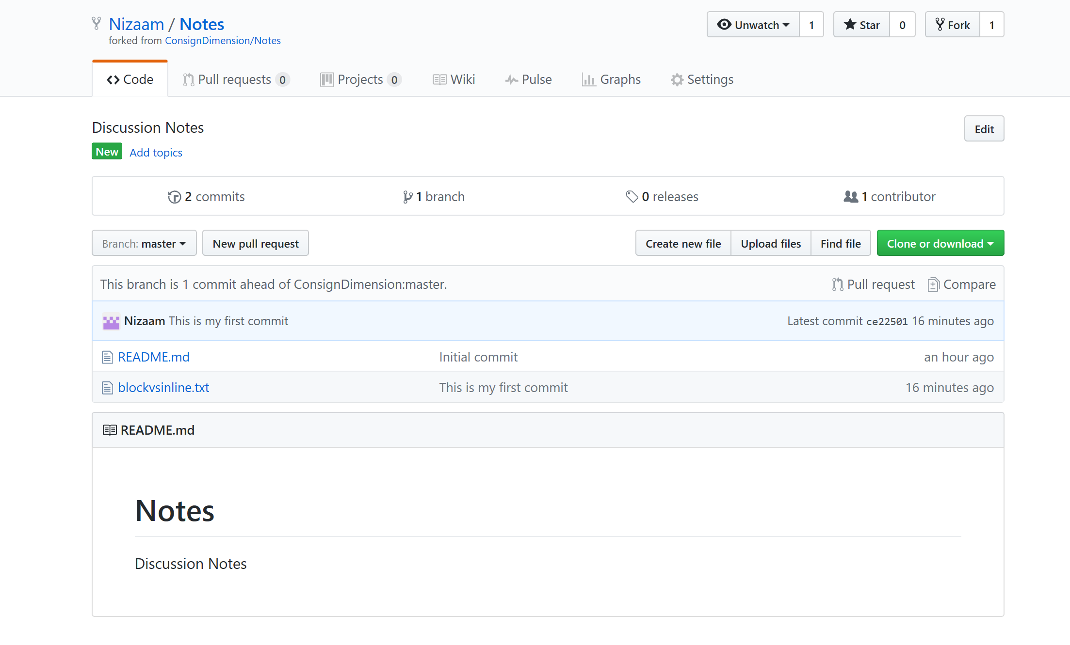
What is opposite to fork?
Pull-request

Slide 36
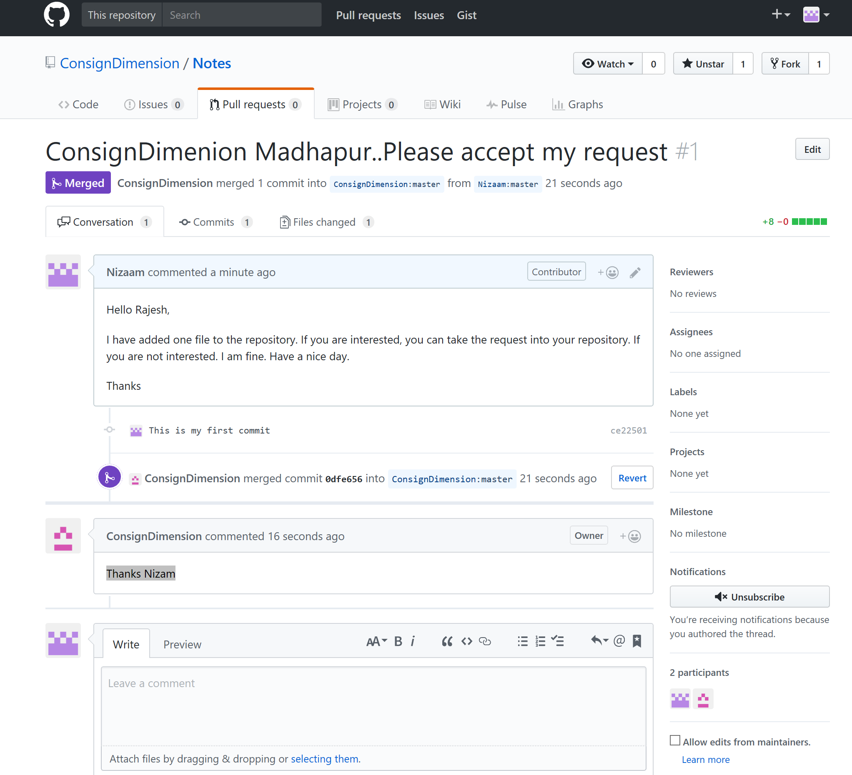
Pull Request Screen

Slide 37
Second Part of GitHub

