Slide 1










ABSTRACTIVE NEWS SUMMARIZATION USING BART AND MISTRAL
TEAM 1
Archana Lakshminarasimman - 2409599
Sai Tanmai Burela - 2360570
1

Slide 2






PROBLEM STATEMENT
With the overwhelming volume of daily news articles, readers face difficulty consuming long content quickly.
Our project addresses this challenge by building abstractive summarization models using BART and Mistral to generate concise, meaningful summaries that preserve the core message.
2

Slide 3

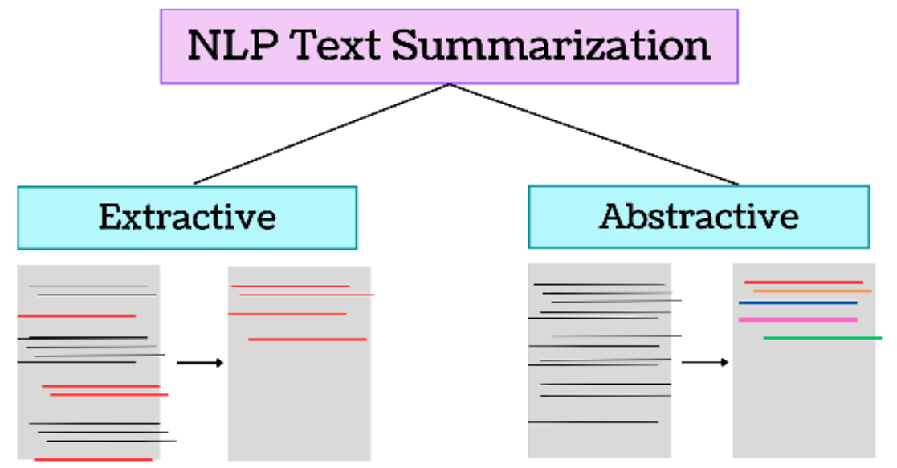

WHY ABSTRACTIVE
3

Slide 4

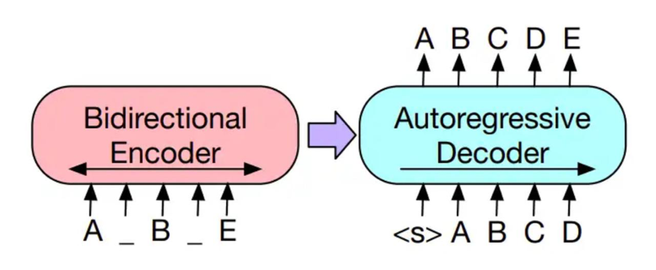
BART VS MISTRAL
BART | Mistral
Encoder-Decoder model (Seq2Seq) | Decoder-only (GPT-style)
Full Self-attention across Encoder & Decoder | Sliding window, local attention
Bidirectional in encoder | Unidirectional in Decoder
400 million parameters | 7 billion parameters
4

Slide 5

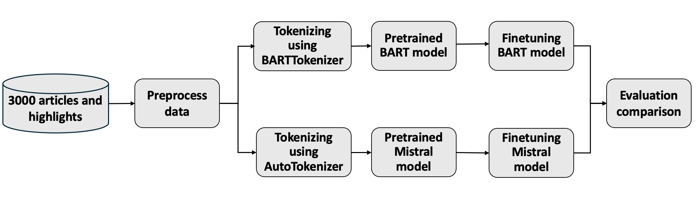
PROJECT ARCHITECTURE
5

Slide 6

DATASET OVERVIEW
Source: News articles and corresponding summaries from CNN and Daily Mail
Total Records Present | 300K
Total Records Used | 3000
Data Splits | Training: 80%, Testing: 20%
Fields Present | Article, Highlights, ID
Article | Full News Story
Highlights | Human-written Abstractive Story
6

Slide 7

DATA PREPROCESSING
Feature selection
Normalization using unicodedata.normalize
Removed HTML tags using regex.
Trimmed unnecessary whitespaces and punctuation.
Converted cleaned pandas DataFrame to Hugging Face Dataset.
7

Slide 8

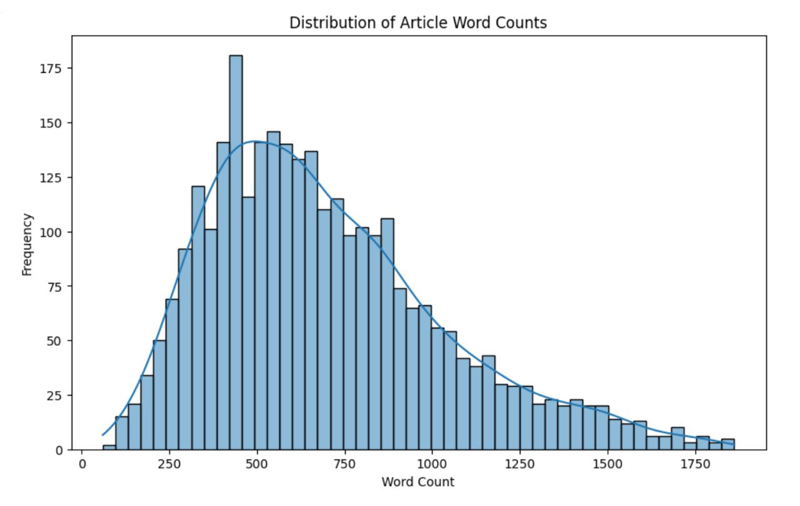
EDA
8

Slide 9
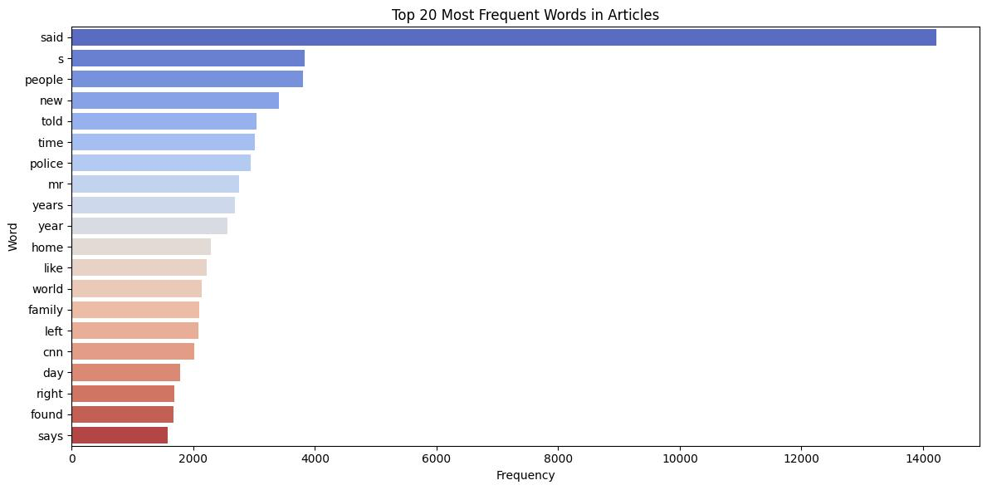
9

Slide 10



WORD CLOUD
10

Slide 11

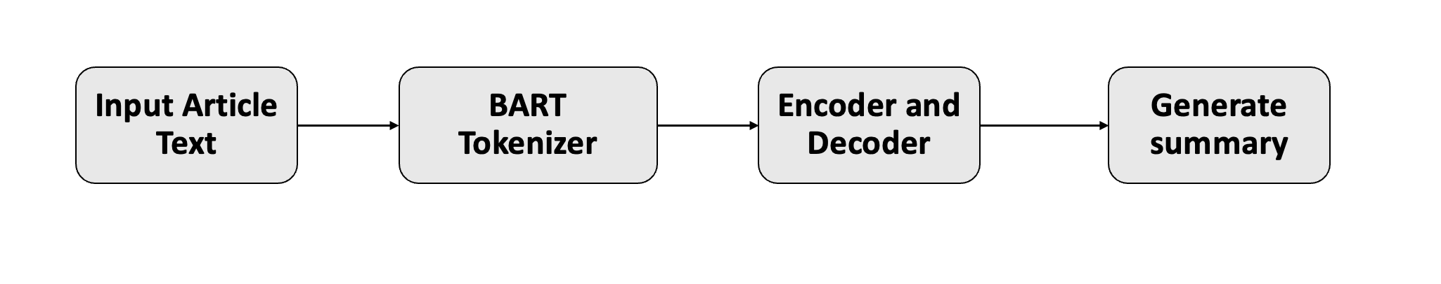
BART ARCHITECTURE
Model facebook/bart-large-cnn
Context window 1024
Max Length 150
Early Stopping True
Num of Beams 4
11

Slide 12

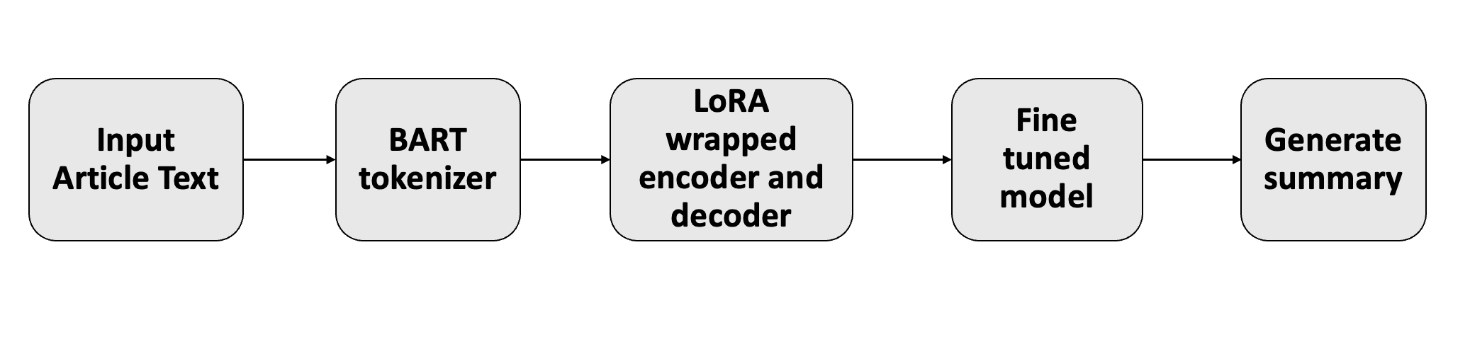
FINE-TUNING BART
12

Slide 13

PARAMETERS
Task Type | Seq2Seq
Rank | 8
Alpha | 16
Dropout | 0.1
Eval Strategy | Epoch
Epochs | 3
Learning Rate | 1E-4
Optimizer | Adam
Total Params: 407,470,080
Trainable Params: 1,179,648
Percentage: 0.28%
13

Slide 14

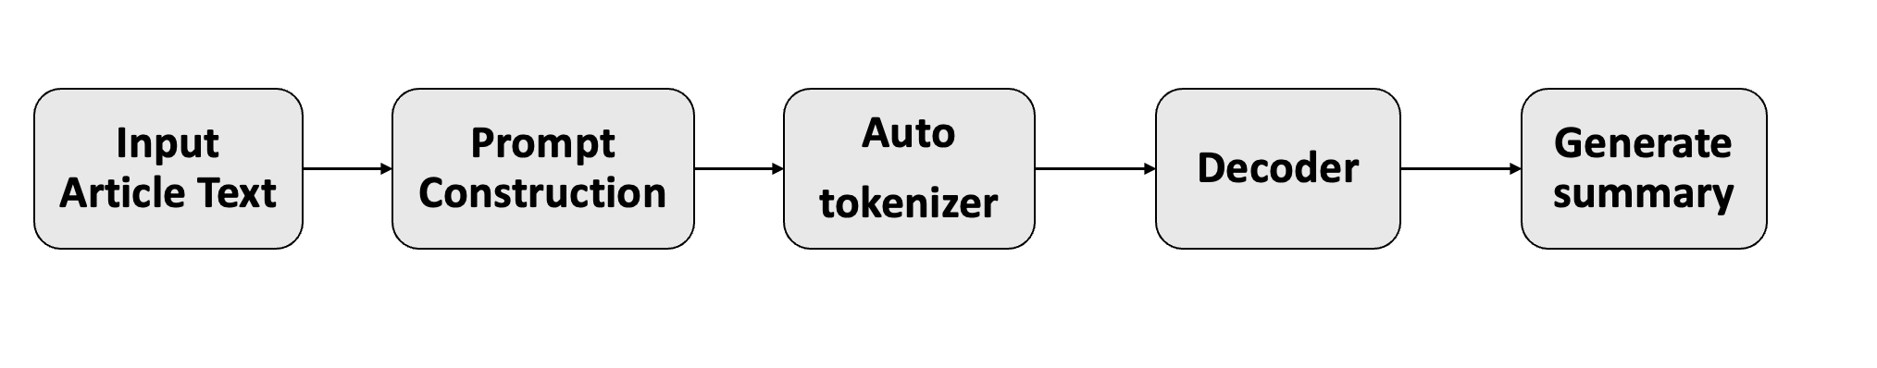
MISTRAL ARCHITECTURE
Model Mistral-7B-Instruct-v0.2
4 bit quantization True
Context 1024
Max Length 150
Early Stopping True
14

Slide 15

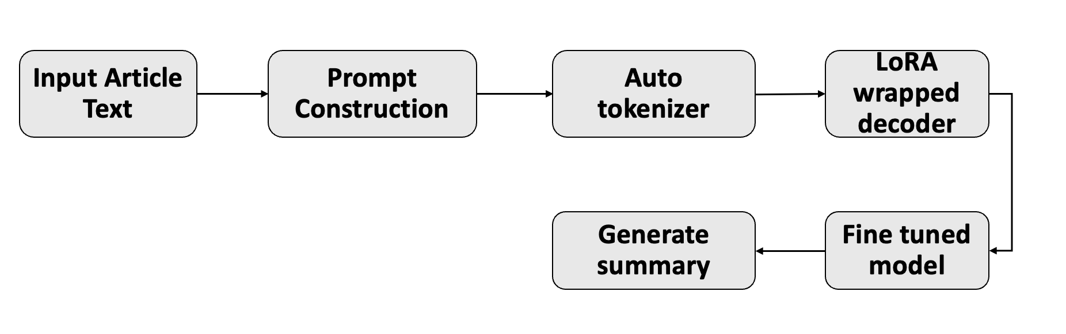
FINE-TUNING MISTRAL
15

Slide 16

PARAMETERS
Task Type | Causal_LM
Target Modules | q_proj, v_proj
Rank | 8
Alpha | 32
Dropout | 0.1
Eval Strategy | Epoch
Epochs | 1
Learning Rate, Optimizer | 5E-5, Adam
Total Params: 3,755,479,040
Trainable Params: 3,407,872
Percentage : 0.09%
16

Slide 17

EVALUATION METRICS
Metrics | Pretrained BART | Fine tuned BART | Pretrained Mistral | Fine tuned Mistral
ROUGE1 | 0.39 | 0.40 | 0.12 | 0.17
ROUGE2 | 0.18 | 0.19 | 0.07 | 0.08
ROUGE-L | 0.27 | 0.29 | 0.09 | 0.12
ROUGE - LSUM | 0.27 | 0.29 | 0.09 | 0.15
BERT Score | 0.85 | 0.87 | 0.82 | 0.83
17

Slide 18

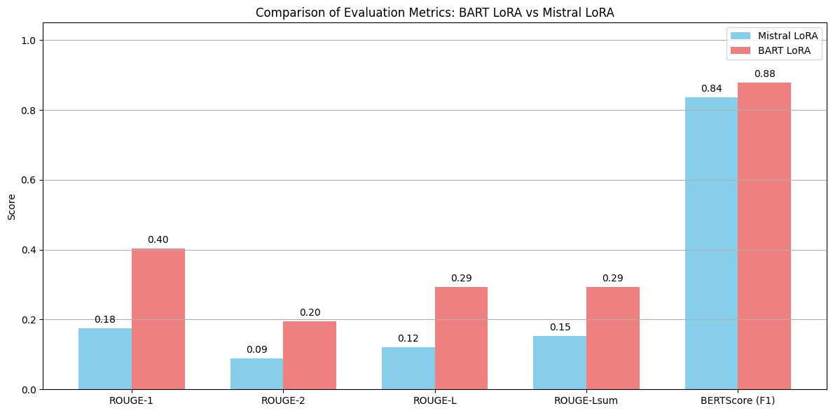
18

Slide 19



CHALLENGES
INCONSISTENT DATA
MEMORY CONSTRAINTS
HARDWARE REQUIREMENTS
HYPERPARAMETER OPTIMIZATION
19

Slide 20



FUTURE WORK
Extend Mistral fine-tuning to more than one epoch for improved summary quality and performance
Develop an interactive demo interface to generate summaries for Mistral fine tuned model.
20

Slide 21
DEMO
LINK FOR INTERFACE
BART MODEL INTERFACE
21

Slide 22
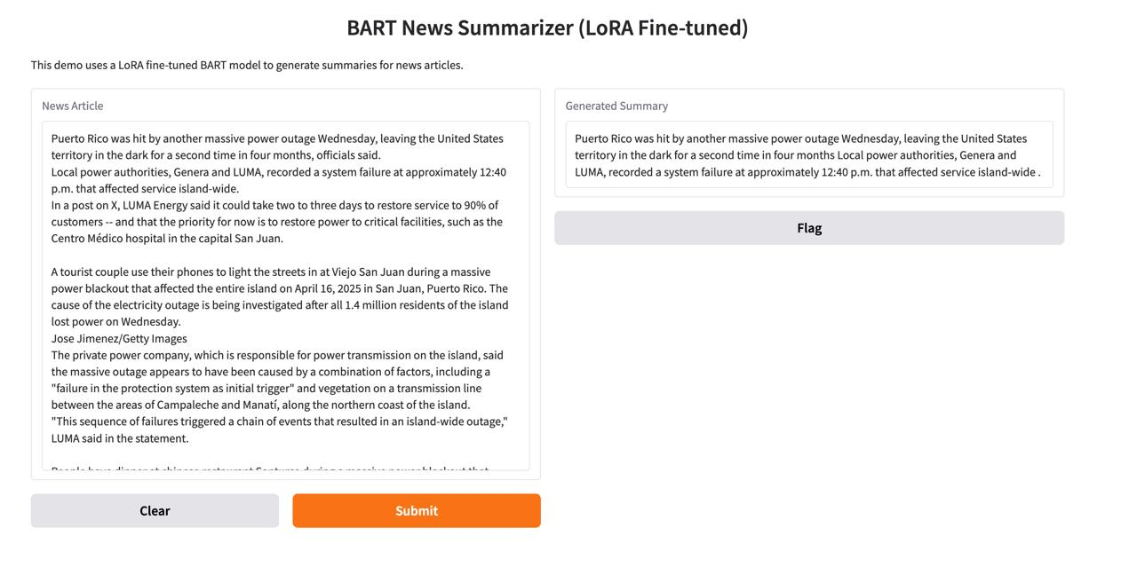
22

Slide 23







Q & A

Slide 24

Thank you

