Slide 1
Web Crawling and Natural Language Processing(NLP) on online support forums
Contoso Service Hub System
Archana Nayak
The University of Auckland

Slide 2
Purpose
To build a web application which performs web crawling on the online support forums and analyse the structured forum data by employing natural language processing algorithms such as keyword extraction algorithm by clustering the data depending on the highest number of occurrences of the keywords
Web crawling the online support forums such as Xero Community Forum
Storing the structured data to the database
Keyword analysing on the collected data

Slide 3
Components of Contoso Service Hub System
Web Crawler
Browses the Internet forum in a systematic manner and creates copy of all the visited web pages, processes them, lists the downloaded pages and extracts only relevant data to produce structured data essential for data analysis.
Keyword Analyser
Filters, transforms and reviews, immense data with a goal to identify relevant information propose solutions and assist in decision-making.
Backend
Stores the structured data

Slide 4
System Architecture
Web
Database (MSSQL))
GetHttpWebRequest
GetHttpWebRequest
Connect to website
Keyword extraction algorithm
Forum
Store
Retrieves data
Collects data
Retrieve
Text Processor
Question
Topic Analyser
Reply
Keyword
Parser
Keyword Analyser
Keyword Analyser
Output
Store data
<<<< Topics
Web Crawler

Slide 5
Web Crawler
Surfs the content of the online forum, creates copy of the visited pages, processes the data and extracts only the relevant information from the web pages
Metadata Extraction
Forum Content
Question
Question Title
Question Content
Author’s Name
Time and Date when the question posted’
Reply
Reply Content
Author’s Name
Time and Date when the reply was posted
IsBest Reply

Slide 6
Web Crawler
Connect to website
Number of Forums to Parse
Parser
Collects
Forum
Parser
Number of Question to Parse
Question
No
Reply
Number of Replies to Parse
Database
Web Crawler

Slide 7
Keyword Analyser
Analyses the collected data by employing keyword extraction algorithm written by Mitsuru Ishizuka of the University of Tokyo in 2003
For more information regarding the algorithm please refer http://ymatsuo.com/papers/ijait04.pdf
The algorithm groups the data based on the highest number of occurrences of the keyword/topic in the collected data

Slide 8
Keyword Analyser
Database
Parse Forum Content
Keyword Extraction Algorithm
Text Processor
Nf
Keyword Analyser
Parse Question Content
Title Extracting
Forum
Collect
Question
Nq
Retrieve
Word Scrapping
Reply
Parser
Forum Keyword
Parse Reply Content
Word Stemming
Nr
Store
Where,
Nf : Number of Forums
Nq : Number of Questions
Nr : Number of Replies
Web Crawler
<<<< Topics

Slide 9
Backend
Forum
Question
FID
Name
….
QID
FID
…..
Keyword
1 N
KID
Name
….
1
Reply
RID
QID
…
N
Forum Detail

Slide 10
Technologies Stack
Development
ASP. Net MVC
Entity Framework
HTML Agility Pack
Backend
Microsoft SQL Server
Source Control
GitHub
Collaboration Tool
Trello

Slide 11
Setting Up
Download Visual Studio Community Edition 2015
Clone Repository
The repository : https://github.com/ArchanaNayak/UOA_ForumData_Analysis.
Install and upgrade latest version of Entity Framework and HTML Agility Pack
More information about the project can be achieved through the Readme file at https://github.com/ArchanaNayak/UOA_ForumData_Analysis/blob/master/README.md

Slide 12
Database Migrations
Enable Migration
Add Migration Configuration
Update the database
The application is implemented in MVC Framework which employs code first migration feature that assists in enhancing the database scheme incrementally while the model changes.
Creates database scheme based on the code logic
Stores the data in LocalDb (MSSQL) by default
Data can be exported to the other system through .mdf and .ldf files

Slide 13
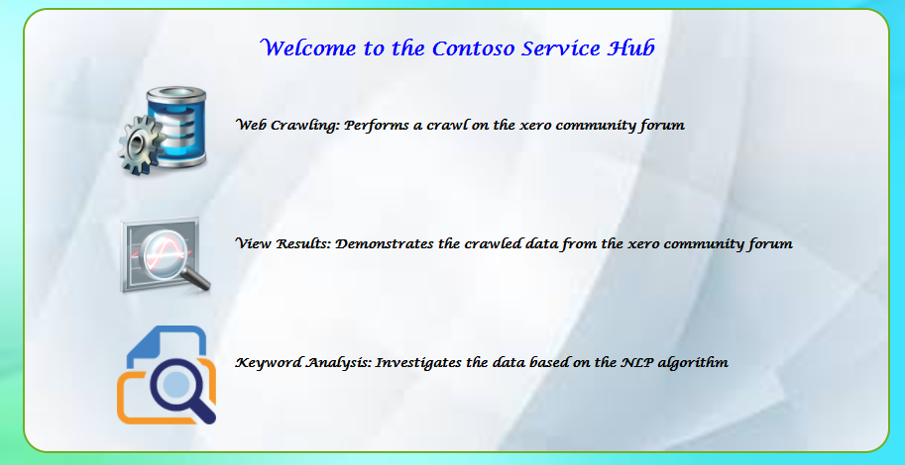
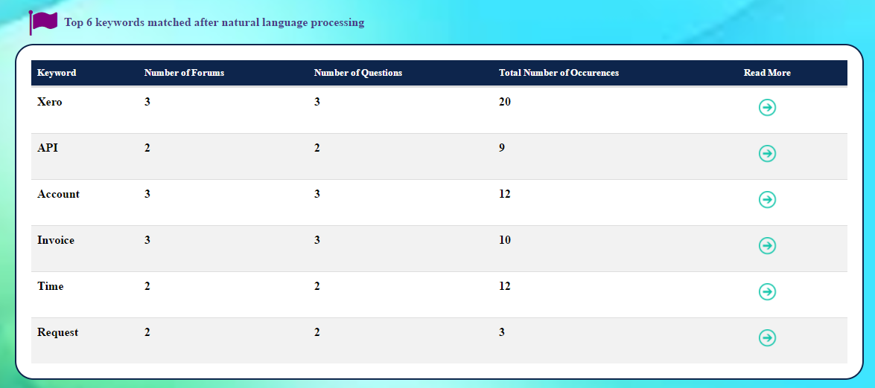
Contoso Service Hub

Slide 14
Future Work
Perform machine learning in Microsoft Azure Cloud termed as ‘Azure Machine Learning’
Azure Machine Learning is a cloud predictive analytics service that makes it possible to quickly create and deploy predictive models as analytics solutions such as :
Topic Detection
Key phrase extraction
Language Detection
Source: https://docs.microsoft.com/en-us/azure/machine-learning

Slide 15


Slide 16


