Slide 1
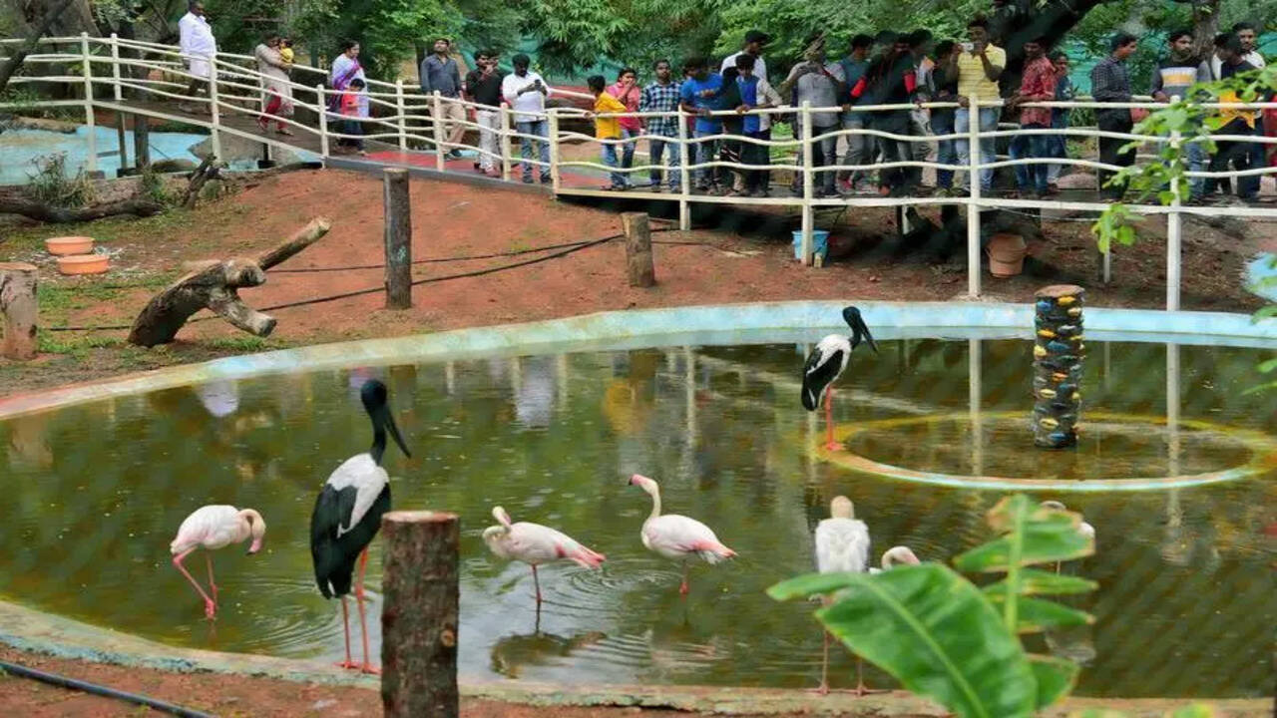
Zoo Animal Classification
Using Machine Learning
Presented By:
P. Archana
R. Vamshi

Slide 2
Problem Statement:
Animal classification is difficult because different animals have different biological characteristics.
Manual classification is time-consuming, requires expert knowledge, and may lead to errors.
Machine Learning can automatically learn from biological features and classify animals accurately.
An accurate classification system improves speed, reliability, and efficiency for biological research and wildlife studies.
Solution:
Develop an intelligent Machine Learning-based animal classification system using the Random Forest algorithm to automatically identify animal classes from biological characteristics, improving accuracy, efficiency, and reducing manual effort.

Slide 3
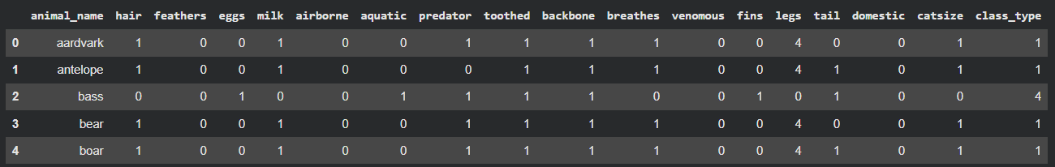
Data Preprocessing
Data Source:
Tabular Zoo Dataset containing 101 animal records with 16 biological characteristics, including hair, feathers, eggs, milk, airborne, aquatic, predator, toothed, backbone, breathes, venomous, fins, legs, tail, domestic, and catsize. The target variable is class_type, representing seven different animal classes.
Steps:
Checked the dataset for missing values and inconsistencies.
Removed the animal_name column as it is not required for classification.
Selected relevant features for analysis.
Split the dataset into training and testing sets.
Prepared the data for the machine learning model.

Slide 4
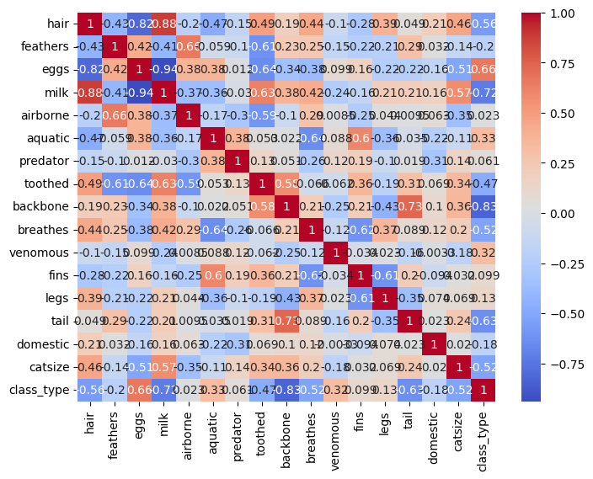
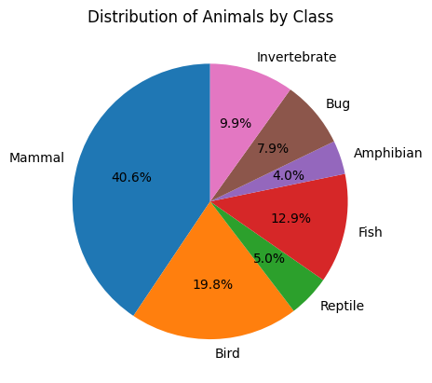
Exploratory Data Analysis
Corelation Heatmap
Target Variable Distribution

Slide 5
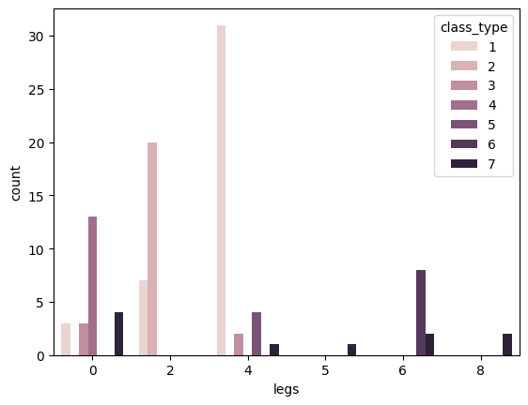
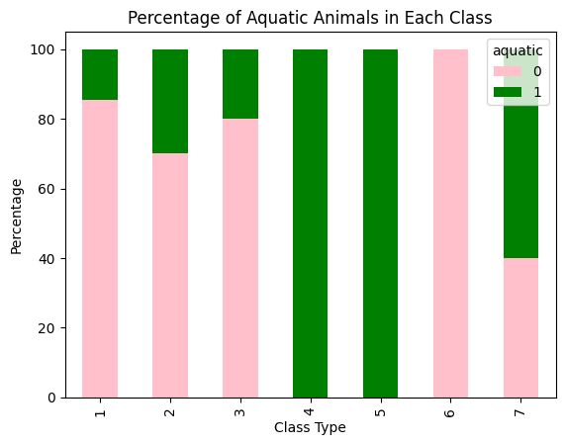
Aquatic Feature Distribution by Animal Class
Analysis of Animal Classes by Number of Legs

Slide 6
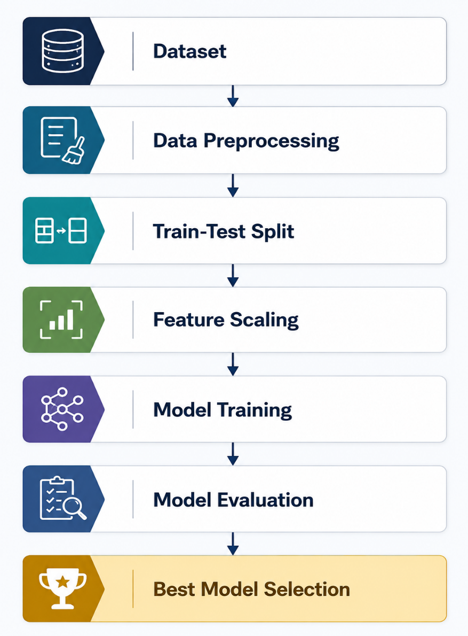
Models Used:
Evaluated Models:
Best Selected Model:
RandomForest Classifier:
Logistic Regression
Decision Tree Classifier
K-Nearest Neighbors (KNN)
Gaussian Naïve Bayes
Support Vector Machine (SVM)
Random Forest Classifier
Handles multiclass classification effectively.
Reduces overfitting through ensemble learning.
Provides stable and consistent predictions.
Handles diverse biological features efficiently. Generalizes well to unseen data.

Slide 7
Model performance And metrices:
Confusion Matirx:
Random Forest Classifier:
Actual \ Predicted | Mammal | Bird | Reptile | Fish | Amphib. | Bug | Invert.
Mammal | 13 | 0 | 0 | 0 | 0 | 0 | 0
Bird | 0 | 6 | 0 | 0 | 0 | 0 | 0
Reptile | 0 | 0 | 1 | 1 | 0 | 0 | 0
Fish | 0 | 0 | 0 | 4 | 0 | 0 | 0
Amphib. | 0 | 0 | 0 | 0 | 1 | 0 | 0
Bug | 0 | 0 | 0 | 0 | 0 | 2 | 0
Invert. | 0 | 0 | 0 | 0 | 0 | 0 | 3
An ensemble learning method that builds many Decision Trees and combines their outputs.
Each tree is trained on a random bootstrap sample of the data, using a random subset of features at each split.
For classification, the final prediction is the class chosen by majority vote across all the trees.
This averaging effect reduces variance and overfitting compared to any single Decision Tree.
Metrices:
Hyperparameters Used:
n_estimators=100, max_depth=4, min_samples_split=5, min_samples_leaf=3, random_state=42
Accuracy: 96.77%
Precision : 97%
Recall :97%
F1-Score : 96%
ROC-AUC Score: 99.75%
Cross-ValidatioAccuracy:95%
Testing Accuracy: 96.77%

Slide 8
Future Scope:
Expand the dataset by including additional animal species and more diverse biological characteristics to improve the model's classification accuracy and robustness.
Integrate image-based animal recognition using computer vision techniques, allowing the system to classify animals directly from photographs.
Develop a web or mobile application that enables users to classify animals anytime and anywhere through an interactive interface.
Deploy the trained model on cloud platforms to provide real-time animal classification services through APIs and online applications.

Slide 9
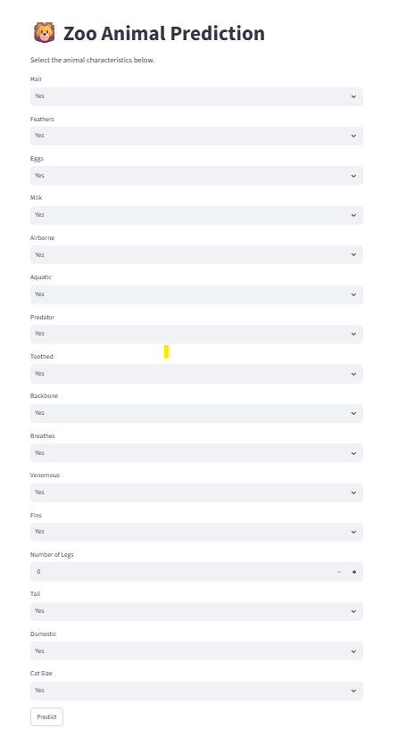
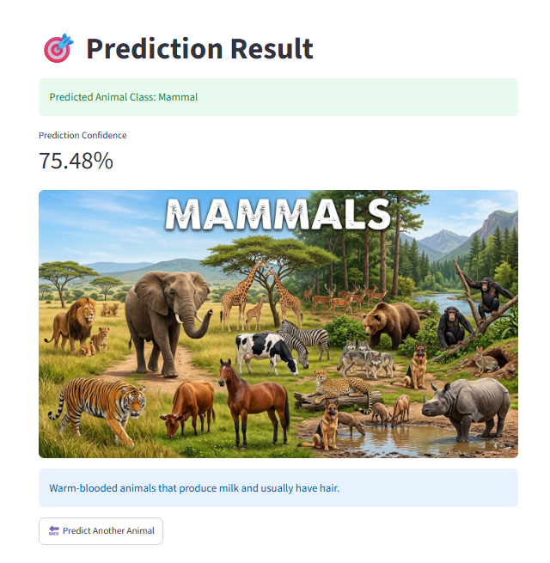
Deployment:
Website:
Animal_Classification

Slide 10
Conclusion:
Successfully developed a machine learning model to classify animals into different classes using their biological characteristics.
Compared multiple algorithms, including Logistic Regression, Decision Tree, KNN, Naive Bayes, SVM, Random Forest, and XGBoost to evaluate their performance.
Among all the models, Random Forest achieved the best overall performance, providing high accuracy, strong classification results, and reliable predictions.
The project demonstrates that machine learning can effectively automate animal classification, making it useful for educational, biological, and wildlife research applications.

