Slide 1

iQuHack2026
Entanglement Distillation Game
Team Members- Achraf Boussahi, Abir Chekroun, Zakaria Lourghi, Archana Singh, Harman Kaur

Slide 2

Problem Statement-
Given a quantum network graph where:
Each edge contains noisy Bell pairs with unknown error characteristics
Each edge has a fidelity threshold that must be exceeded to claim it
We have a limited budget of Bell pairs for distillation attempts
Goal- Build the largest connected subgraph by designing distillation circuits that maximize fidelity while balancing success probability and resource consumption.

Slide 3
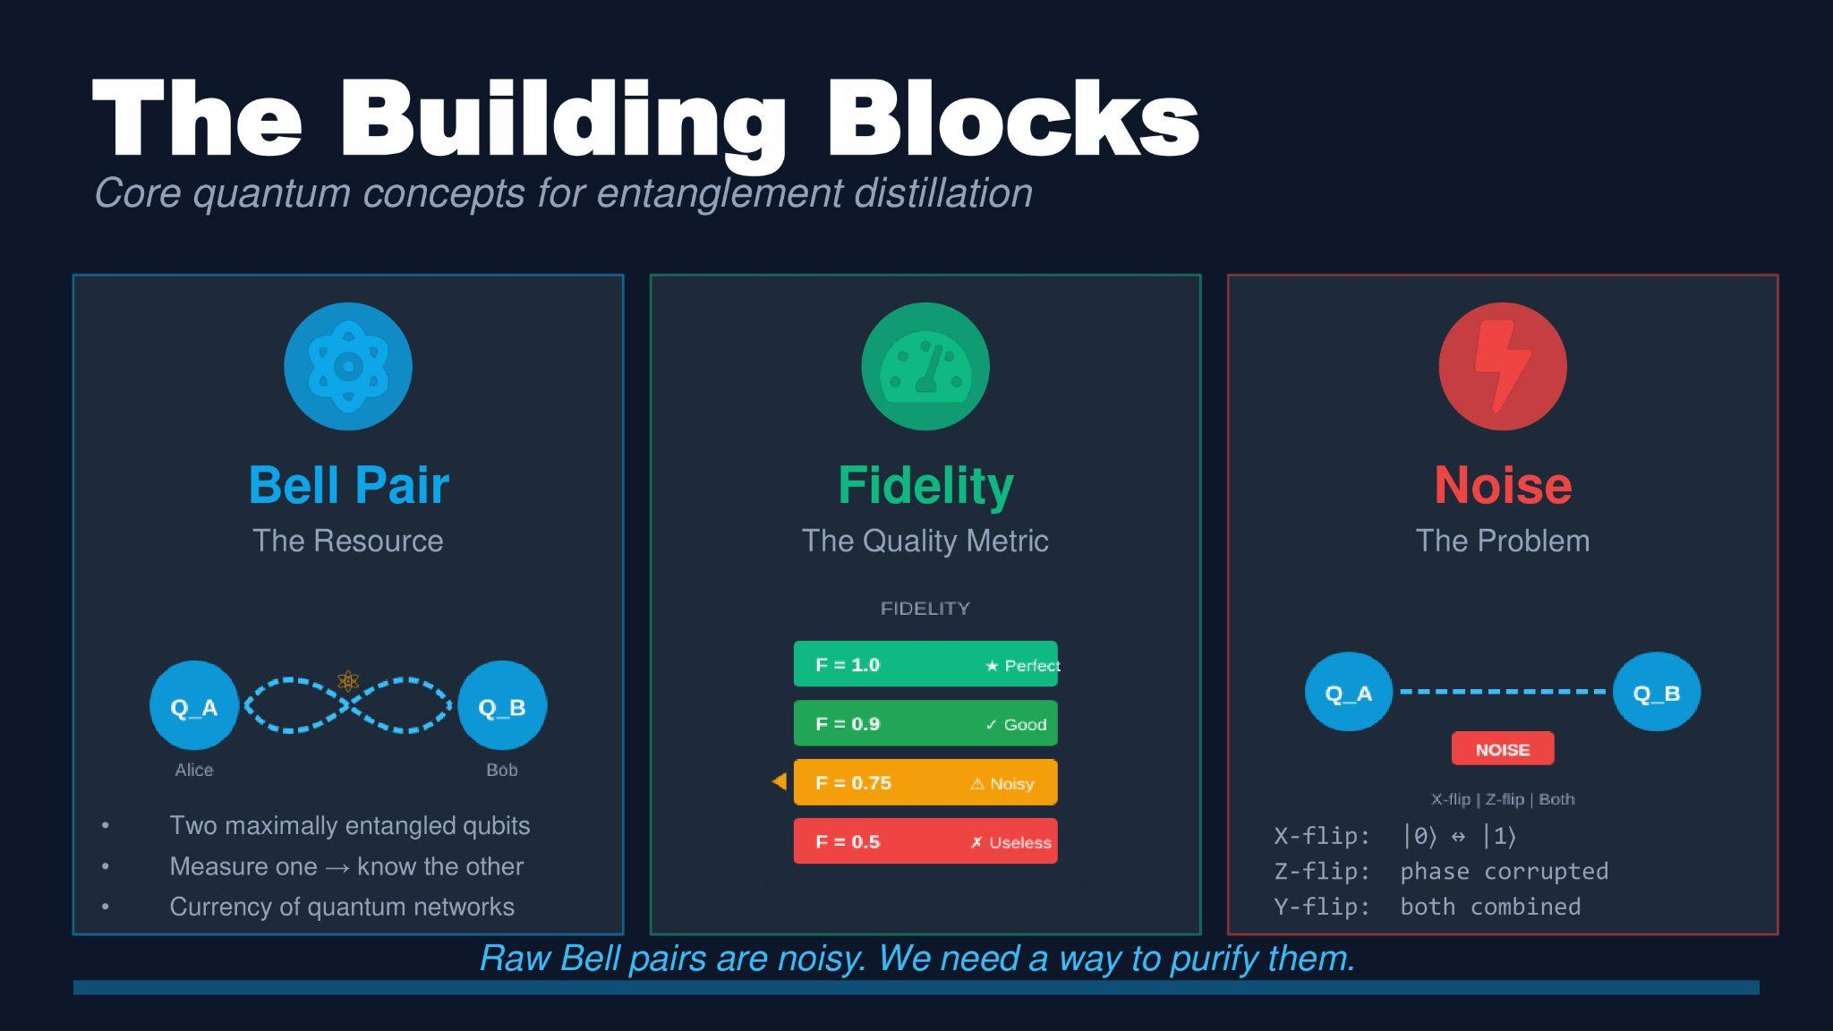
Background / Key Concepts

Slide 4
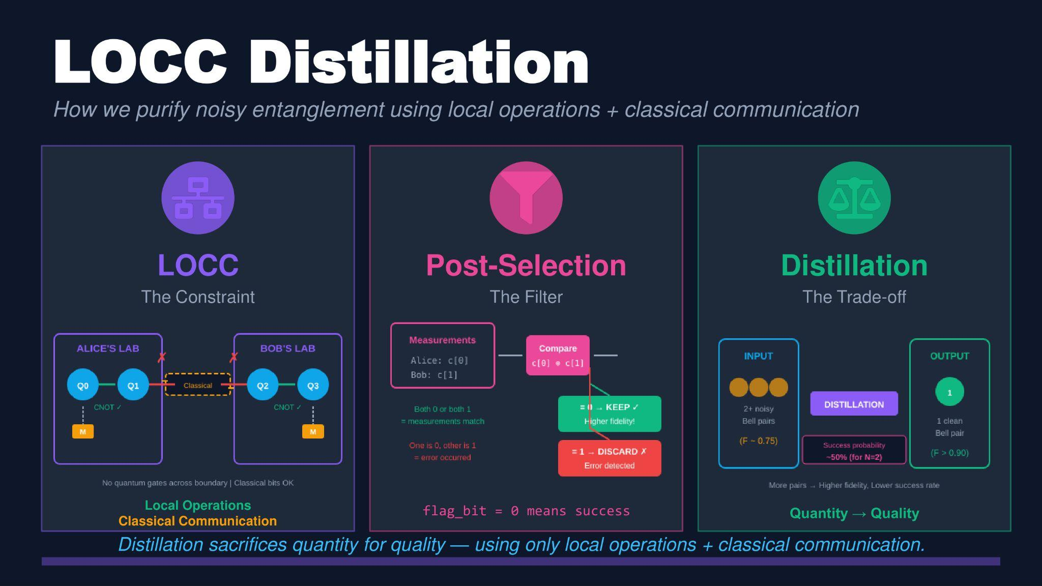

Slide 5
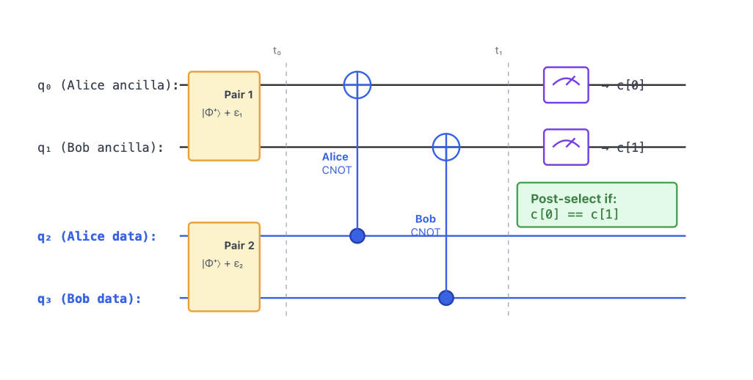
BBPSSW Entanglement Distillation Protocol.

Slide 6
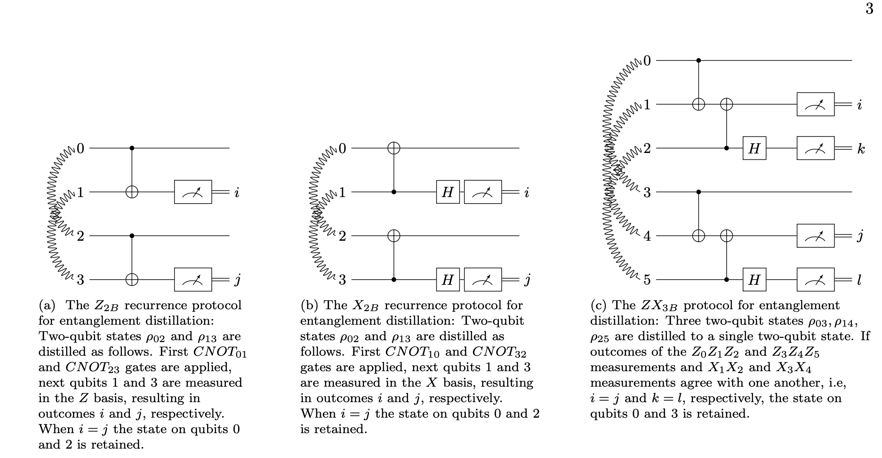
Insert decision flowchart
Local operations for error correction

Slide 7
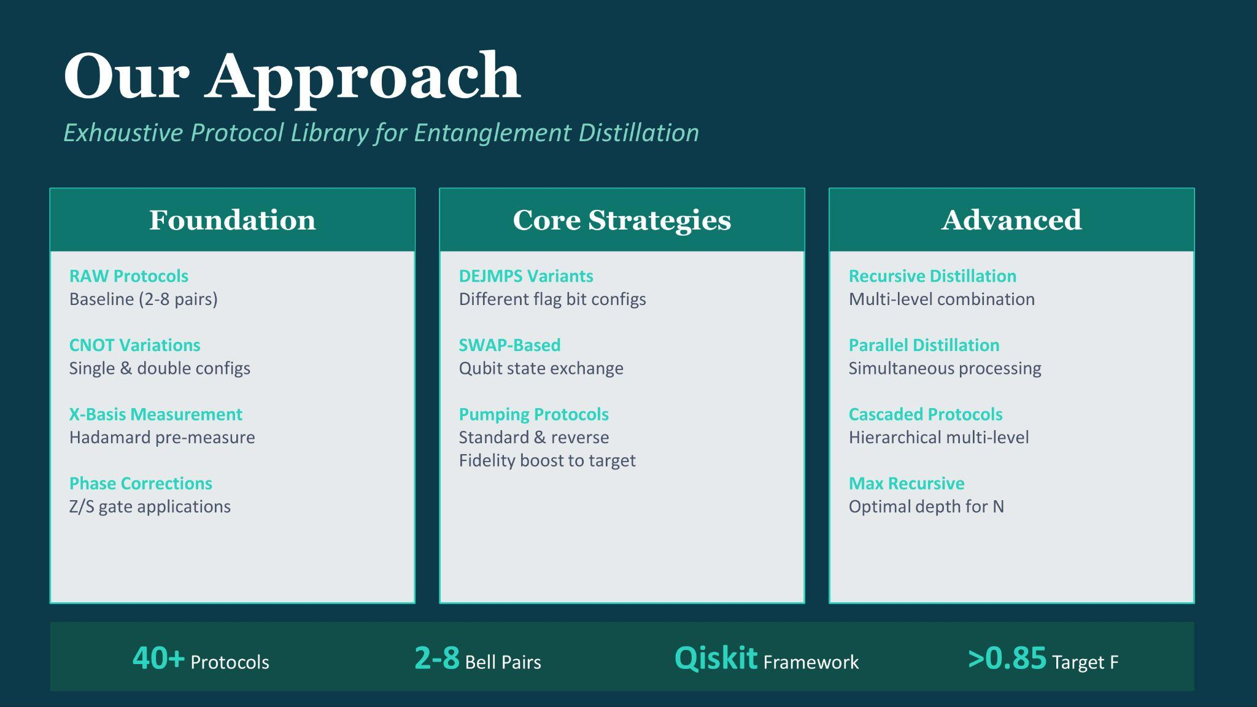
Our approach

Slide 8
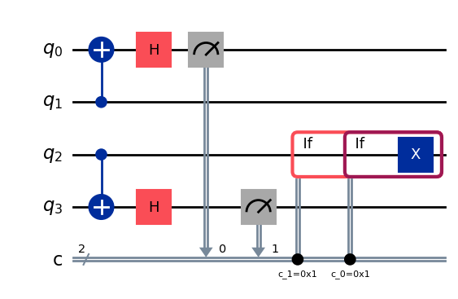
Results
Edges Claimed:0
Average Fidelity:0.85
Budget Efficiency:-
Current Rank:-
Claiming ('Boston, MA', 'Cambridge, MA') (threshold: 0.900)...
Success: False
Fidelity: 0.8500 (threshold: 0.9000)
Success probability: 0.5000

Slide 9
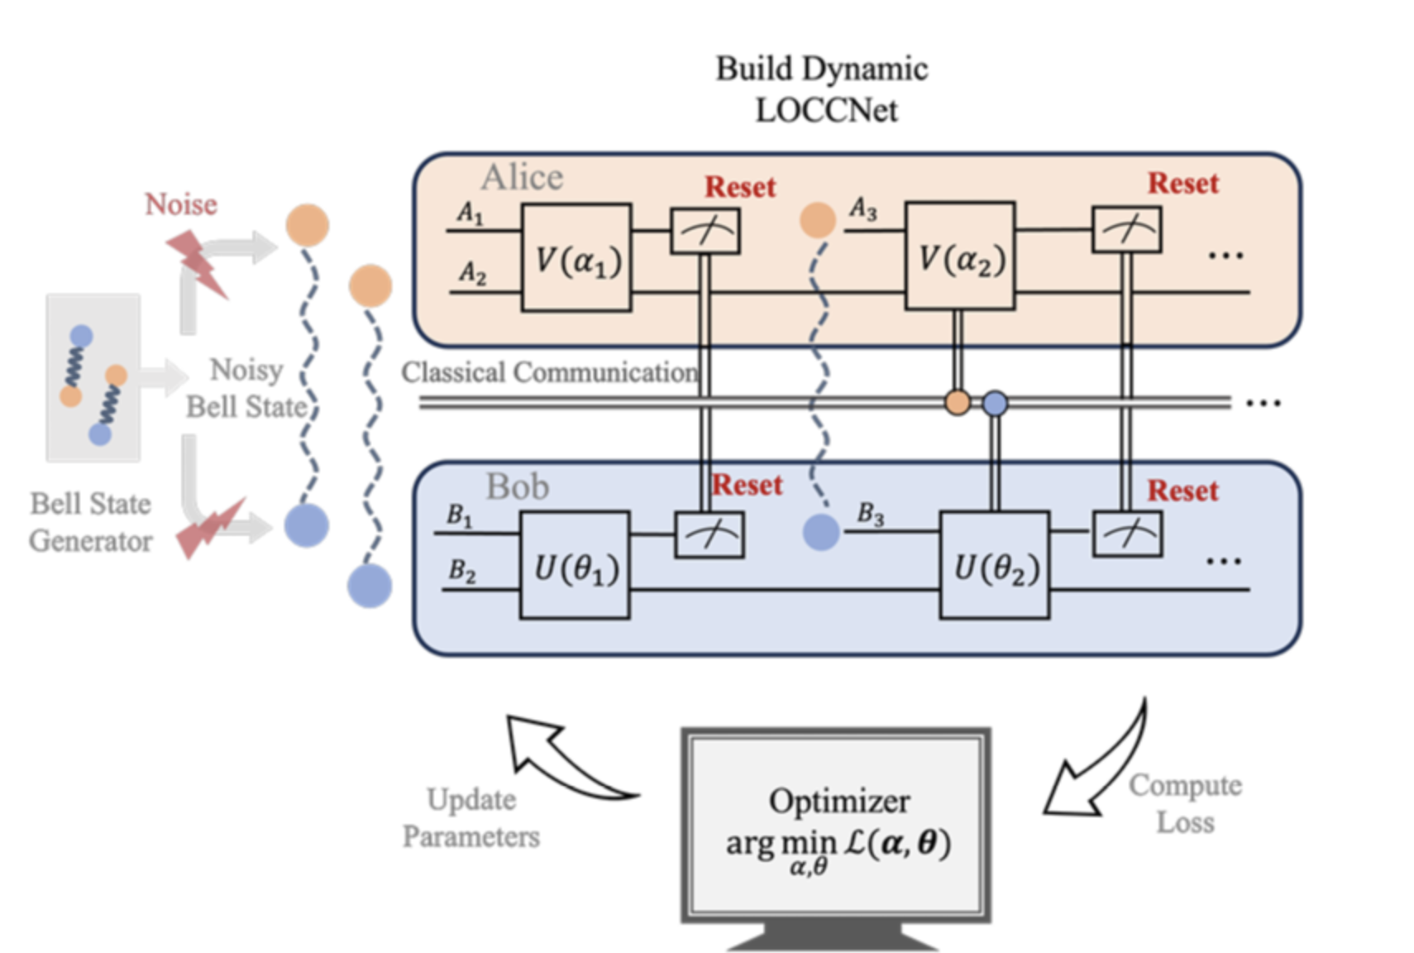
Approach 2
Fidelity rate- 0.85

Slide 10
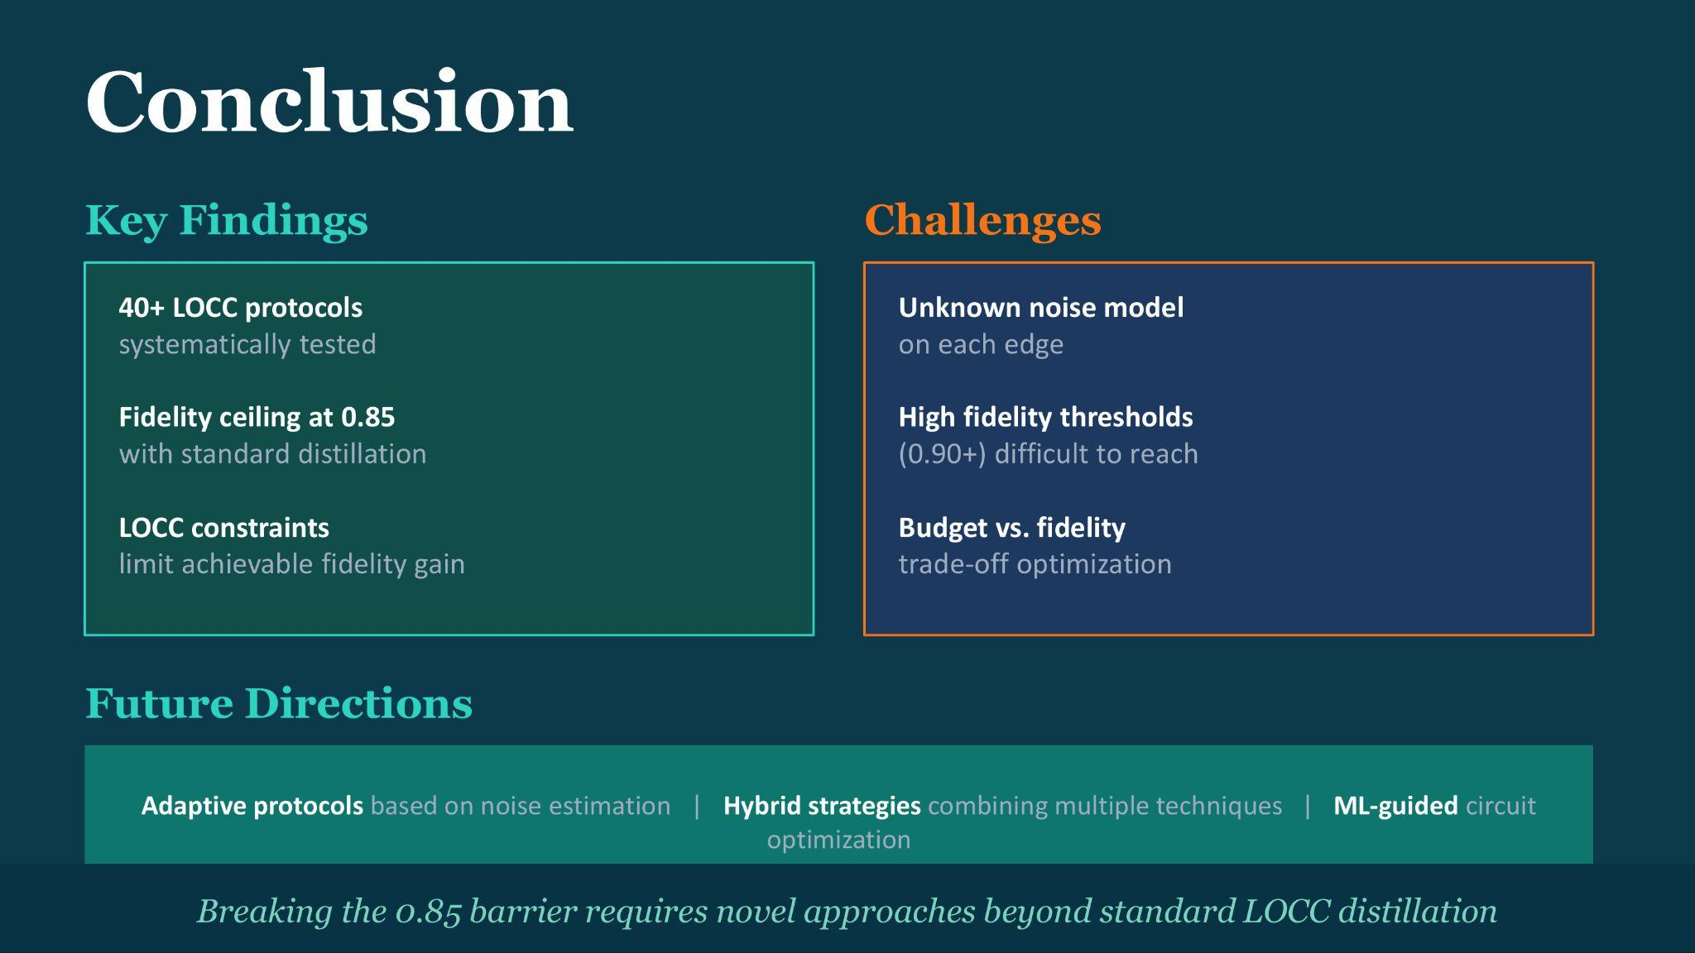

Slide 11
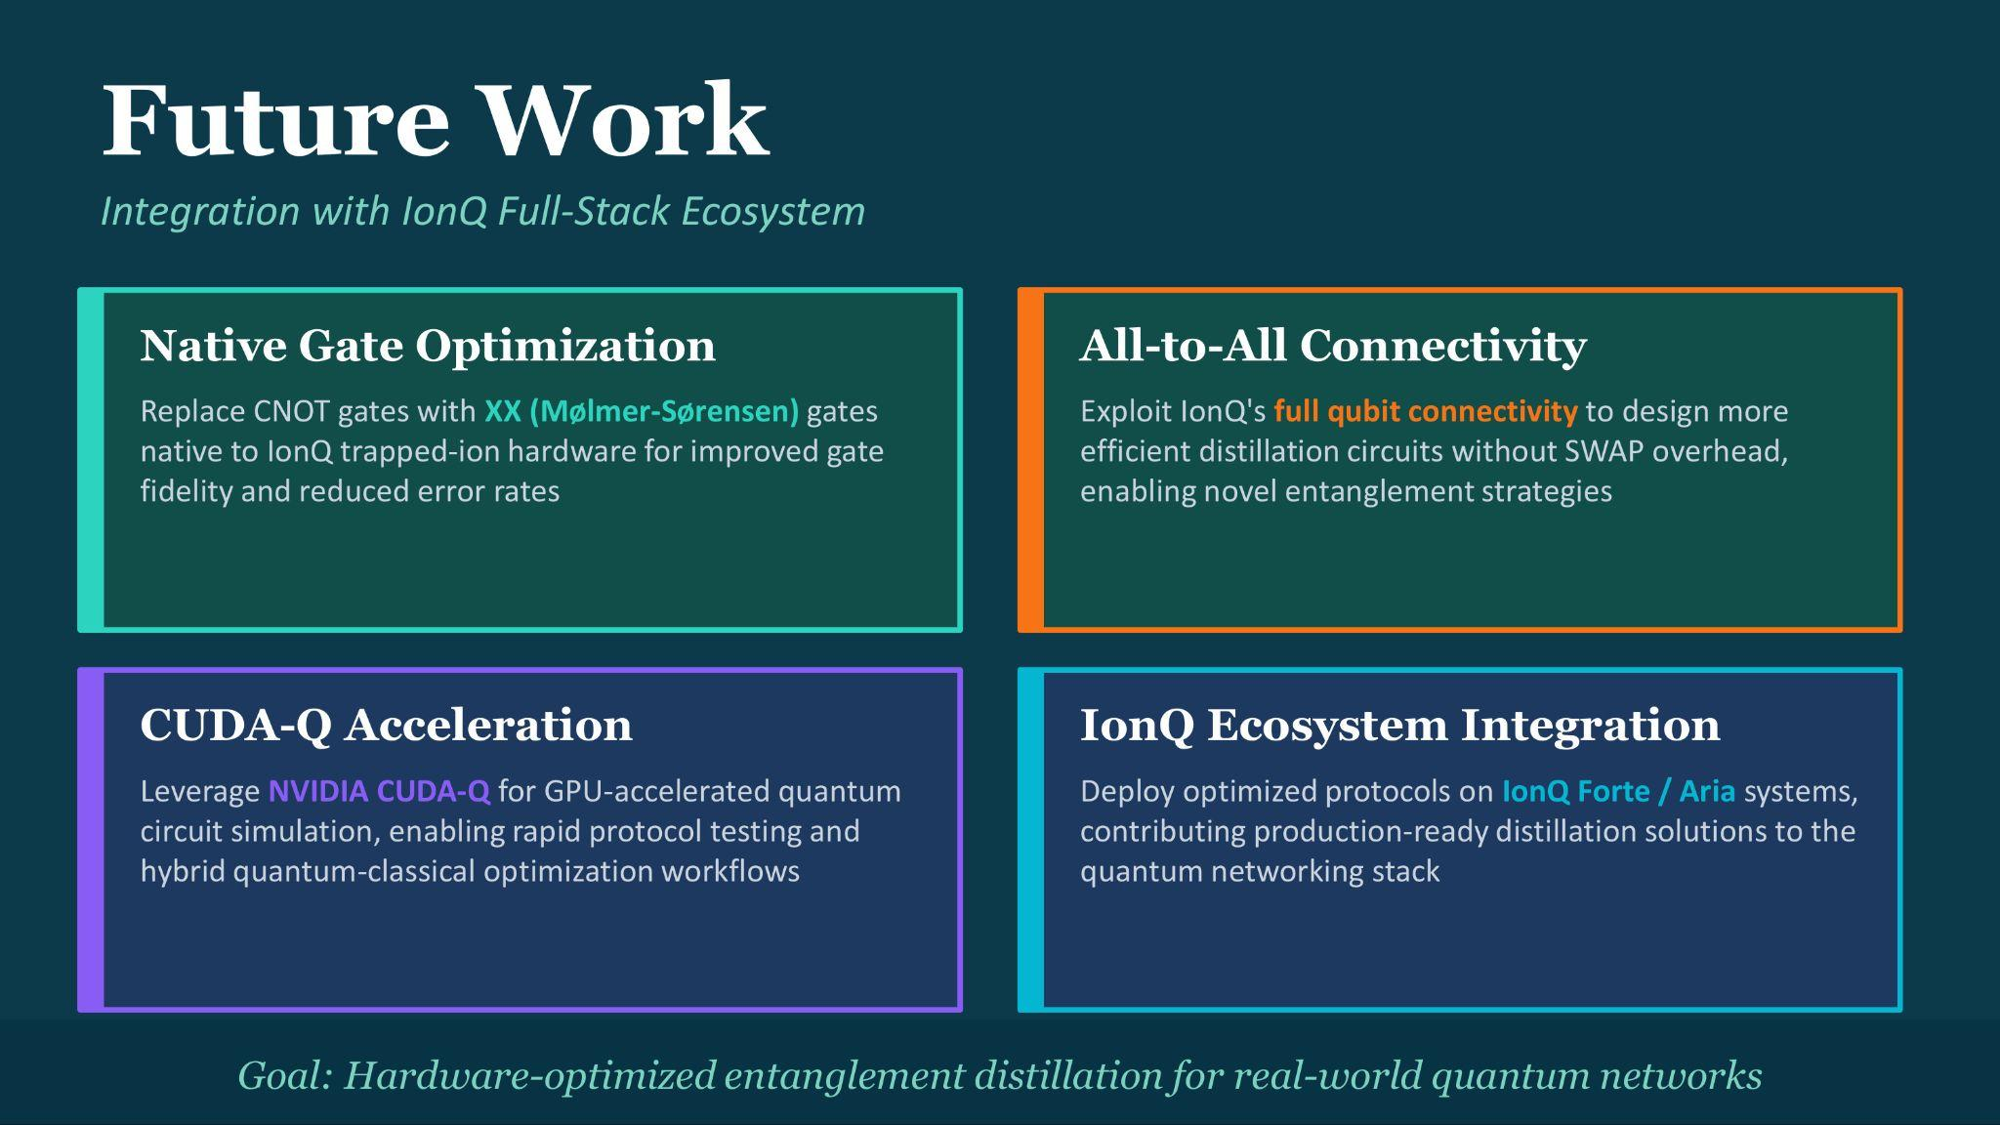

Slide 12
Thank you

