Slide 1

Asian College Of Higher Studies
(Affiliated to Tribhuvan University)
Ekantakuna, Lalitpur

Slide 2
Pitch Shifting System
Archana Adhikari (24221/076)
Rochak Maharjan (24251/076)
Sandesh Adhikari (24254/076)

Slide 3
Overview
Introduction
Problem Statement
Objectives
Literature
Methodology
Activity diagram of pitch shifting system
Class diagram of pitch shifting system
Sequence diagram of pitch shifting system
Applications
Achievements
References

Slide 4
Introduction
Pitch Shifting System is tool designed to change the frequency of a song.
This system takes input audio from user and shift the pitch according to the shift factor (semitone) provided by the user.
It provides visualization of the audio plot of the audio file.

Slide 5
Problem Statement
Pitch shifter tools may harm audio quality during the pitch-shifting process.
After the pitch is shifted, the audio doesn’t remain in same time domain.

Slide 6
Objectives
To plot wave signal of audio file.
To shift the audio to required pitch.
To display spectrum of audio segment.
To have a simple and easy-to-use interface.

Slide 7
Literature Review
Bonada, Gómez, and Herrera studied how preprocessing of the audio signal and harmonic pitch class profile.
Paul Boersma discusses pitch detection algorithms and their application in pitch shifting.
Kim reviews existing techniques for pitch detection and shifting, including time-domain methods like autocorrelation and frequency-domain methods like Fast Fourier Transform (FFT).

Slide 8
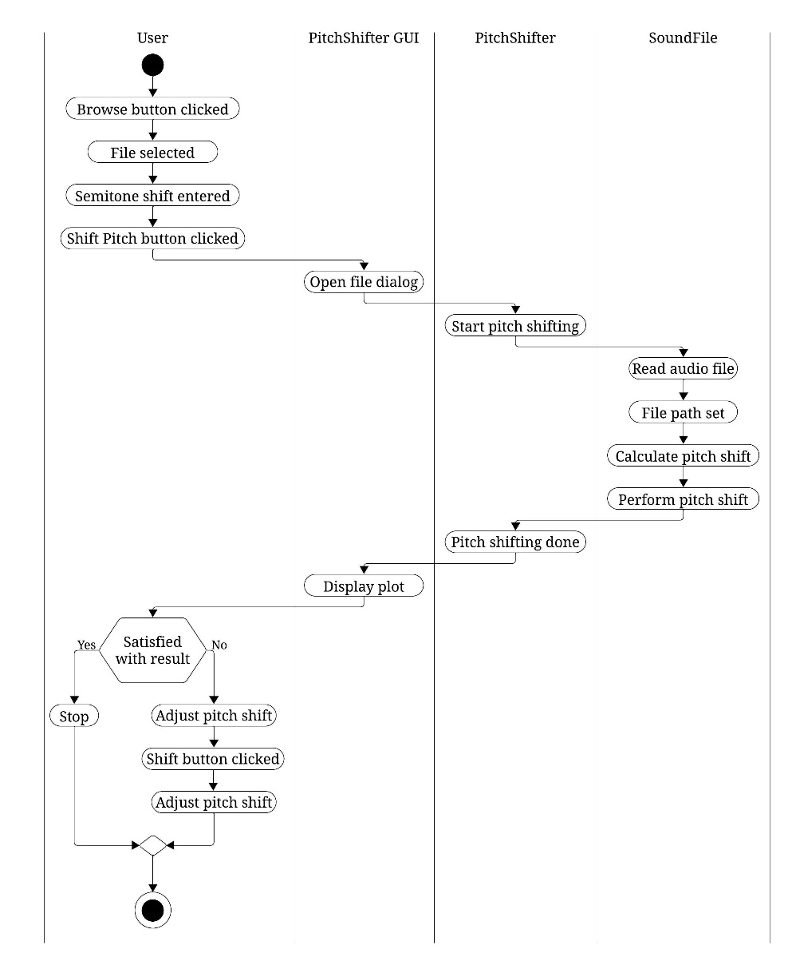
Activity Diagram

Slide 9
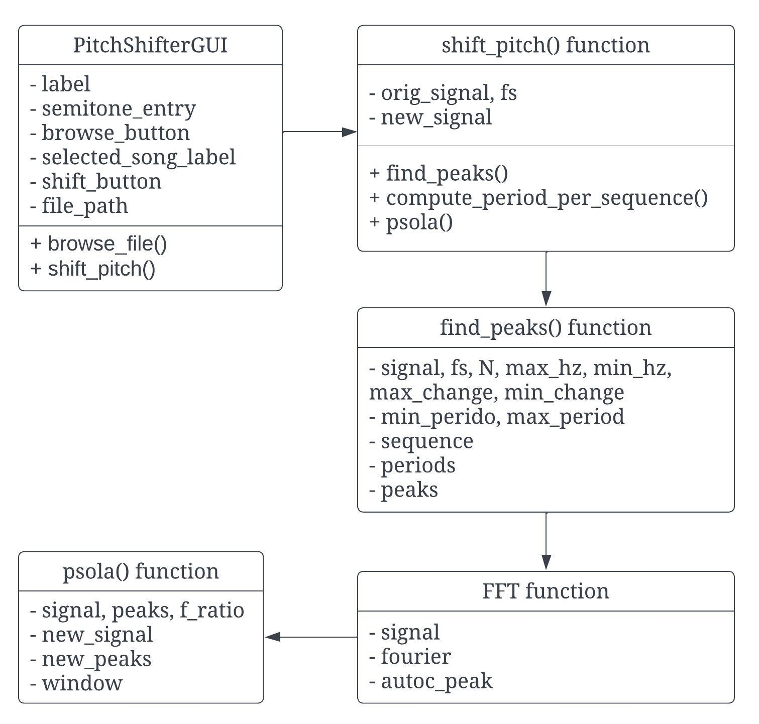
Class Diagram

Slide 10
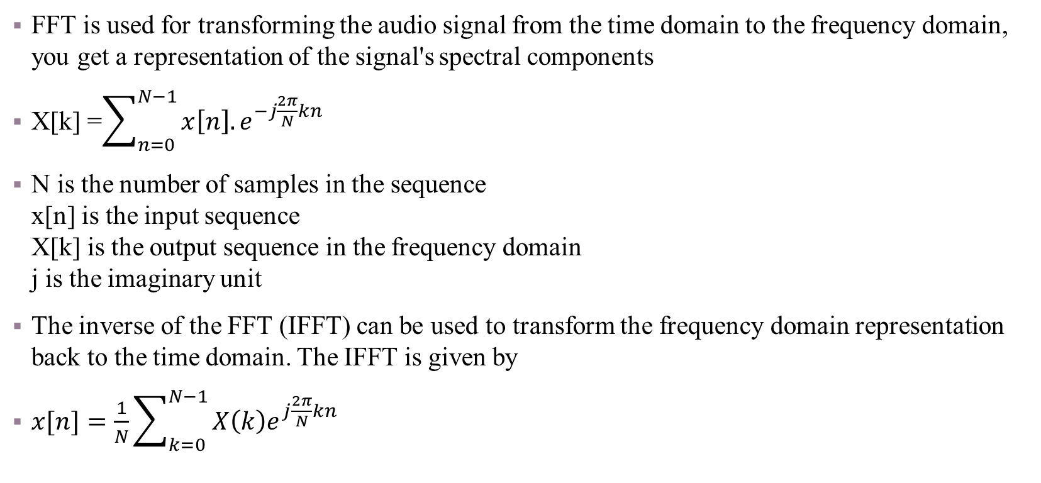
Algorithm Used
FFT is used for transforming the audio signal from the time domain to the frequency domain, you get a representation of the signal's spectral components
X[k] =$\sum_{n=0}^{N−1}{x\left[n\right].e^{−j\frac{2π}{N}kn}}$
N is the number of samples in the sequence x[n] is the input sequence X[k] is the output sequence in the frequency domain j is the imaginary unit
The inverse of the FFT (IFFT) can be used to transform the frequency domain representation back to the time domain. The IFFT is given by
$x[n]=\frac{1}{N}\sum_{k=0}^{N−1}{X\left(k\right)e^{j\frac{2π}{N}kn}}$

Slide 11
PITCH SYNCHRONOUS OVERLAP AND ADD (PSOLA) ALGORITHM
PSOLA is a digital signal processing technique used to modify the pitch and duration of a speech signal. It is a time-domain pitch modification technique commonly used in audio processing. It is often employed in applications such as pitch shifting, time stretching, and voice modification. The algorithm operates on a speech signal by modifying its pitch without changing its duration.

Slide 12
Pitch Analysis: The first step involves analyzing the pitch of the input signal. This can be done using techniques such as autocorrelation or cepstral analysis to determine the fundamental frequency (pitch marks) of the signal.
Pitch Marking: Identify pitch marks in the signal. These represent the points where the pitch period begins and ends.
Time-Scale Modification: Modify the pitch periods to achieve the desired pitch modification. This modification can involve pitch shifting, time stretching, or compressing the pitch periods.
Overlap and Add: The modified pitch periods are then overlapped and added to reconstruct the modified signal. This process ensures smooth transitions between the modified pitch periods.
Output: The final output is the reconstructed signal with the desired pitch modification.

Slide 13
APPLICATION/ FEATURES
Upload any audio file format for pitch shifting.
Preview wave plot of the original and pitch-shifted signal.
Save the pitch-shifted audio file to your computer.
Shift the pitch according to users choice.

Slide 14
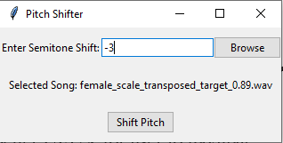
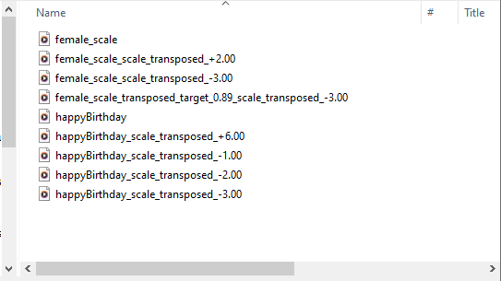
Achievements

Slide 15
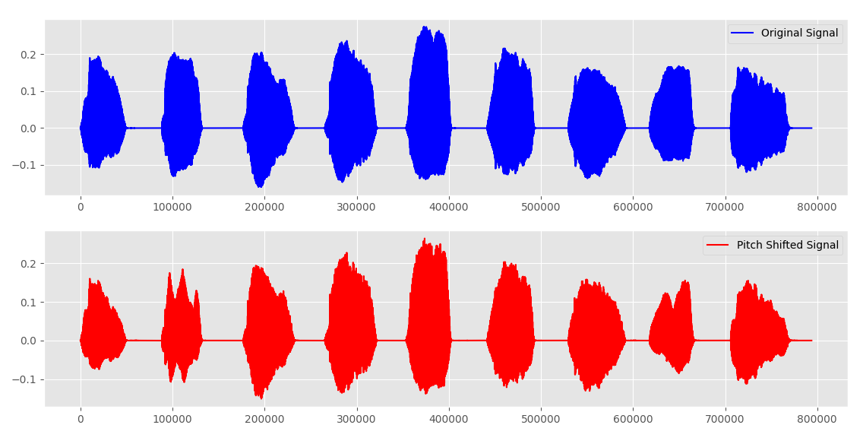
Achievements

Slide 16
REFERENCE
E. Gomez, "Tonal Description of Polyphonic Audio for Music Content Processing," in Tonal Description of Polyphonic Audio for Music Content Processing, Barcelona, Spain, 2006, p. 4.
J. Kim, "Automatic Pitch Detection," Computer Science Department, Boston College, Boston, 2013.
U. o. Oxford. [Online]. Available: https://www.robots.ox.ac.uk/~sjrob/Teaching/SP/l7.pdf.

Slide 17
Future Enhancement
Provide better UI/UX for user to navigate.
Implement pitch detecting more accurately.

Slide 18
Thank You

