Slide 1

Time-Based Trends of Taxi Pickups and Drop-offs: Exploring Trip Duration Variations Across Peak and Off-Peak Hours
By
Kollu Sravan Kumar Reddy - 811295843 - skollu@kent.edu
Keerthi Akhila Pasam – 811304142 - kpasam@kent.edu
Archana Katta – 811298298 – akatta2@kent.edu

Slide 2

Content
Research Question
Introduction
Project design
Data Preprocessing
Algorithms and explanation
Modeling
Future Work
Conclusion

Slide 3

Research Question
How do temporal patterns of taxi pickups and drop-offs correlate with trip duration variations between peak and off-peak hours, considering the fare amount charged for the trips?

Slide 4
Introduction
In urban transportation, the taxi industry plays a pivotal role, offering commuters a flexible and efficient mode of travel. To optimize service quality and meet passenger demand, understanding the dynamics of taxi usage, especially during peak hours, is crucial. In our analysis, we delve into a comprehensive dataset containing detailed information about taxi rides, including pickup and drop-off times, fare amounts, distances traveled, and trip durations and in our dataset we are having 840402 rows and 20 columns.
Our primary objective is to uncover temporal patterns in taxi pickups and drop-offs and explore how these patterns influence variations in trip duration between peak and off-peak hours. Through this analysis, we aim to provide insights that can help taxi companies tailor their services to better meet passenger needs, ultimately enhancing the overall taxi ride experience.

Slide 5
Project design
Load the data
Data preprocessing
Exploratory Data Analysis
Feature selection
Modeling & predictions
Evaluation

Slide 6
Data Preprocessing
Removal of Unnecessary Columns – like tolls_amount and ehail_fee variables.
Handling Missing Values.
Datetime Conversion- 'lpep_pickup_datetime' and 'lpep_dropoff_datetime’ variables were converted to datetime objects
Trip Duration, Peak Hour and Hour Calculation: Calculate trip duration from pickup and drop-off times, identify peak hours, and extract hour.
Statistical Descriptive Analysis.

Slide 7
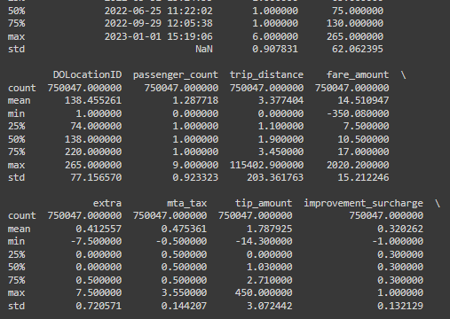
Descriptive Analysis:
such as mean, median, standard deviation, etc., was performed on the cleaned dataset to gain insights into the distribution of numerical features and identify any outliers or anomalies

Slide 8

Correlation Analysis
The correlation analysis provides insights into the relationships between numerical features, helping to understand how they may impact each other.
These findings can guide further analysis and modeling efforts, highlighting potential factors to consider when predicting trip duration or fare amount.

Slide 9
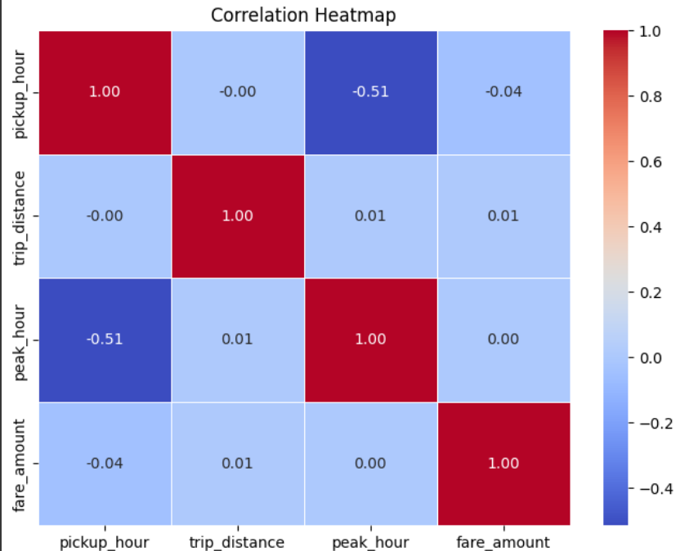
Correlation Heatmap

Slide 10
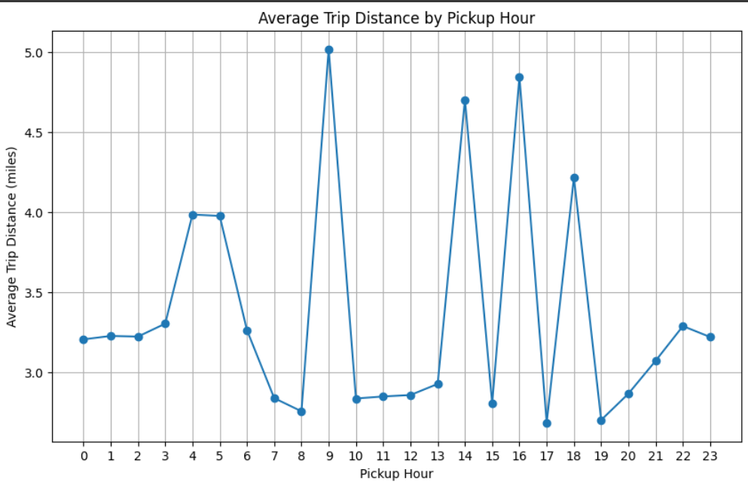
Visualizations
Average Trip Distance Analysis:
Most taxis travel the longest distances between 8 PM and 10 PM.
Taxi companies might want to schedule more drivers during these busy evening hours.
Knowing when taxi rides are longest helps plan city transportation better.

Slide 11
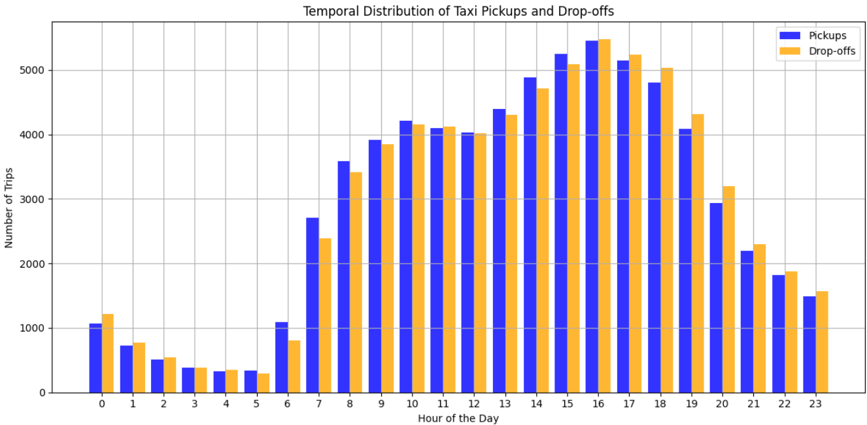
Temporal Distribution Visualization
Taxi Pickups and Drop-offs
Taxi pickups are highest around 6 PM, with a peak at this hour.
Drop-offs are more evenly spread throughout the day.
Morning hours see a rise in drop-offs, possibly due to commuters heading to work.

Slide 12
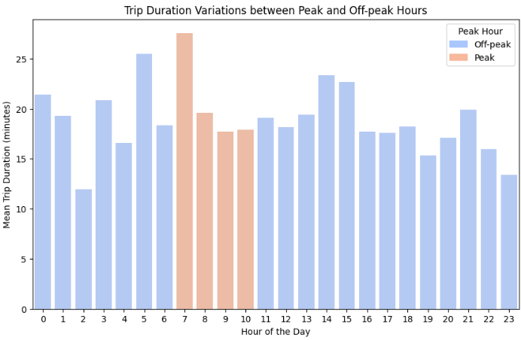
Peak Hour Analysis
Peak and off-peak Hours:
During peak hours, trip durations tend to be slightly longer compared to off-peak hours.
Off-peak hours generally exhibit shorter trip durations across the day.
The difference in trip durations between peak and off-peak hours is most noticeable during rush hours.

Slide 13
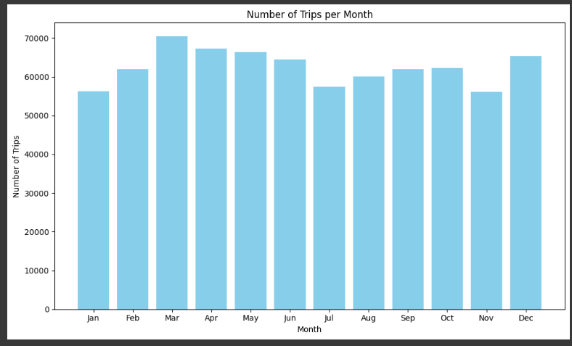
Monthly Trends Exploration
Number of Trips per Month :
The plot shows the number of taxi trips per month throughout the year.
There's a clear variation in taxi usage over the months, with some months experiencing higher demand than others.
The busiest months for taxi trips are typically during the warmer seasons, such as spring and summer.

Slide 14

Feature Selection
Pickup hour
Trip distance
Peak hour
Fare amount

Slide 15
Algorithms and explanation
Random forest:
Random Forest is a versatile supervised machine learning algorithm that grows and combines multiple decision trees to create a “forest.” It can be used for both classification and regression problems.
Gradient boosting:
Gradient Boosting is a machine learning method that builds models sequentially, each one correcting the errors of the previous model, to make more accurate predictions.
Ridge regression:
Ridge regression is a method used in linear regression to handle multicollinearity, where predictors are highly correlated. It adds a penalty term to the traditional regression model, helping to stabilize the estimates and improve model performance.

Slide 16
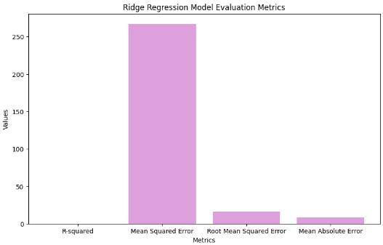
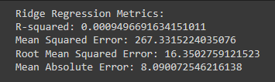
Modeling
Ridge Regression model : Model evaluation metrics:

Slide 17
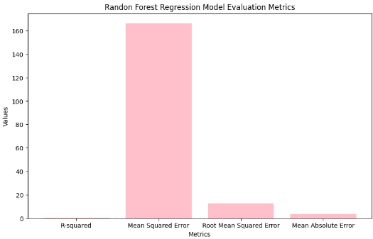
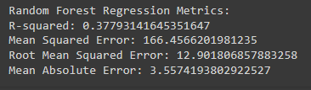
Random Forest Model

Slide 18
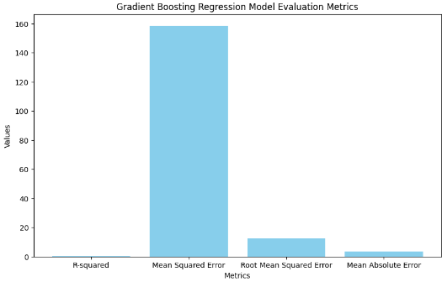
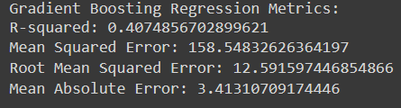
Gradient Boosting Regression

Slide 19
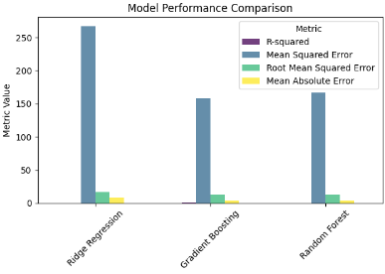
Model Comparison
Ridge Regression model:
R-squared: Shows very weak explanatory power. (0.000949)
Mean Squared Error (MSE): Higher values indicate poorer accuracy. (267.331)
Root Mean Squared Error (RMSE): Higher values suggest larger prediction errors. (16.350)
Mean Absolute Error (MAE): Higher values imply lower precision in predictions. (8.09007)
Random Forest Regression:
R-squared: Indicates moderate explanatory power. (0.3779)
Mean Squared Error (MSE): Lower values indicate better accuracy. (166.456)
Root Mean Squared Error (RMSE): Lower values suggest smaller prediction errors. (12.901)
Mean Absolute Error (MAE): Lower values imply higher precision in predictions. (3.5574)
Gradient Boosting Regression:
R-squared: Shows moderate explanatory power. (0.4074)
Mean Squared Error (MSE): Lower values indicate better accuracy. (158.54)
Root Mean Squared Error (RMSE): Lower values suggest smaller prediction errors. (12.591)
Mean Absolute Error (MAE): Lower values imply higher precision in predictions. (3.4131)

Slide 20
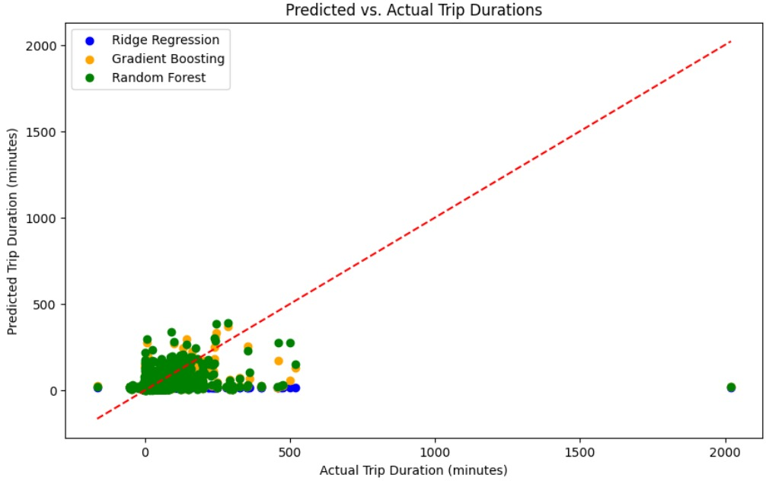
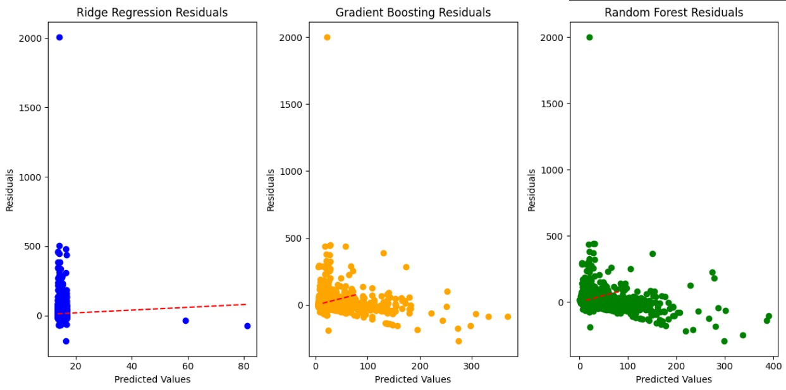
Actual vs predicted and Residual plot

Slide 21
Future Work
More Data Insights: Add weather, traffic, and passenger info for deeper understanding.
Test Prediction Methods: Try different techniques to see what works best.
Spot Popular: Identify where taxis are most needed for better service.
Stay Updated: Keep models fresh with real-time data for accurate predictions.

Slide 22
Conclusion
The analysis studied how taxi pickup times affect trip durations and fares. Three regression models were tested: Ridge, Gradient Boosting, and Random Forest. Gradient Boosting performed the best, showing how pickup times impact trip duration and fares, giving insights into taxi usage and pricing. . This analysis directly addresses the research question by providing insights into the relationship between temporal patterns, trip durations, and fare amounts, thereby enhancing our understanding of factors influencing taxi service utilization and pricing dynamics.

Slide 23

Thank you

