Slide 1
Breast Cancer Diagnosis using Machine Learning
Archana Marol

Slide 2
Table of Content
Overview of the project
Overview of the Dataset and Variables
Machine Learning Model Results
Evaluation Method
Links and references

Slide 3
Overview of the project

Slide 4
Overview of the project
Breast cancer is the most common cancer among the women worldwide. It accounts for about 25% of all cancer (worldwide), affecting 2.1 million women (in 2015). It is said in a research that most experienced physician can diagnose cancer with 79% accuracy. But 91% of correct diagnosis can be achieved by ML.
There are two types of cancer, Malignant and Benign.
Malignant is cancerous so early diagnosis of Malignant can significantly increases the chances of survival.
Where as, Benign is a kind of tumor that do not spread across the body of the patient however, accurate classification of benign in patients can prevent them to undergo unnecessary treatments.
Hence, we are classifying cancer into malignant and benign using the features of several cell images and feeding them into ML models.

Slide 5
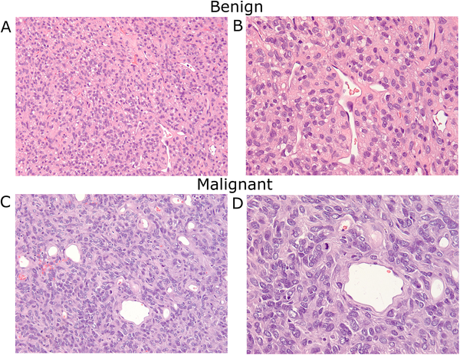
Cancer Diagnosis Procedure :
Cells are extracted out of tumor using Fine needle Aspirate (FNA) process. The images of these cell are classified into Malignant and Benign based on some features of these images.
Features includes radius of the cells, texture, perimeter, area, and smoothness.
We feed these features into the machine learning models. We are going ask ML models to classify without any human intervention. Once the model is good, we can use this to clarify the newer images
FEATURES
FEATURES
MALIGNANT
NEW IMAGES
Area
Texture
Perimeter
Radius
Smoothness
MALIGNANT
Model
Trained
Model
BENIGN
BENIGN

Slide 6
Data : Kaggle data
Libraries used:
Pandas and NumPy for Data Analysis
Matplotlib for visualization
Scikit-Learn for model building
ML techniques used : SVM, Decision tree and Logistic regression
Evaluation methods: Confusion matrix and ROC-AUC curve

Slide 7
Overview of Dataset and Variables

Slide 8
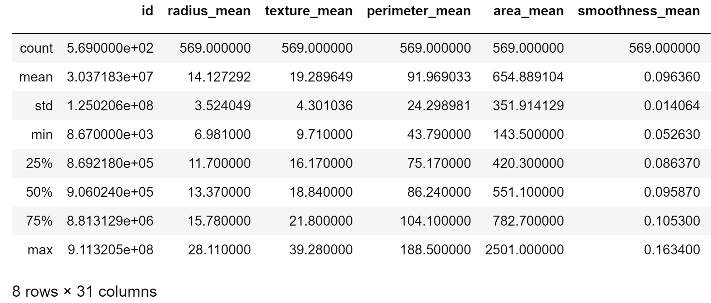
Dataset:
The dataset has 30 features and 569 observations.
(Benign: 357 Malignant: 212)
The dependent variable here is the diagnosis column and independent variables are the feature columns
Correlation was checked in order to make sure that there is independence among the independent variables
Divided the data into test and train data (80% – 20 %)

Slide 9
Machine Learning Models and Evaluation techniques

Slide 10
Support Vector Machine (SVM):
This classifier did not give a good result. Evaluation was done using confusion matrix. Only 0.58 of accuracy was achieved. It predicted that 48 healthy patients have cancer.
On using feature scaling i.e. bringing all values into [0,1] range, gave a very good result. The accuracy was increased to 0.95.
The c and gamma parameter were altered, and optimized values were obtained by using the Scikit-Learn function which gave c=100 and gamma = 0.01. The improved model showed accuracy to 0.97.
0 | 48
0 | 66
43 | 5
0 | 66
45 | 3
0 | 66

Slide 11
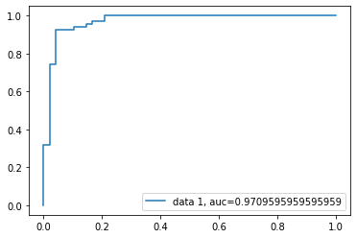
Logistic Regression (LR):
The model gave a very good results. It gave an accuracy of 0.93. The confusion matrix showed that 2 healthy patients have cancer and 5 cancer patients are healthy. The ROC curve: It gave the higher value for AUC
Model improvements :
As this classifier assigns weights to features. The data was scaled to the range [0,1] in order to reduce the influence of high scale features. The accuracy was reduced to 0.57
Gradient descent optimization, weights=0, then applying GD to find the optimum values for the weights with the least loss. Alpha values considered were {0.001, 0.003, 0.01, 0.03, 0.1, 0.3 }. The accuracy still stayed 0.57

Slide 12
Decision tree (DT):
Decision tree gave good prediction with an accuracy of 0.94
The confusion matrix result similar to logistic regression result.
It had a false negative of 2 and false positive of 4.
Altering hyper parameters using Grid Search in Scikit-Learn.
Optimized max depth = 6
Number of component = 8
Result : It had test data accuracy of 0.93 and a cross validation mean of around 0.91

Slide 13
Conclusion

Slide 14
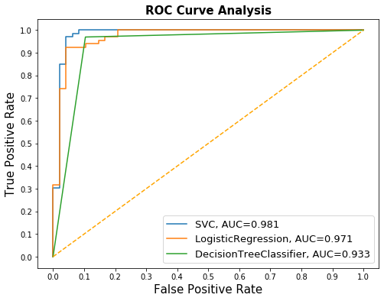
Comparison of 3 models
 | Best SVM | Best LR | Best DT
Accuracy | 0.97 | 0.93 | 0.93
Precision | 0.95 | 0.96 | 0.94
Recall | 1.00 | 0.92 | 0.95

Slide 15
Future Scope
Current Project:
Future Scope:
ML models
Classify the images
Features of the cell
Images
Computer Vision
ML models
Classify the images

Slide 16

References
https://github.com/Archanam5282/Breast_Cancer_using_ML
https://www.kaggle.com/uciml/breast-cancer-wisconsin-data
https://journals.plos.org/plosone/article/figures?id=10.1371/journal.pone.0140362
https://towardsdatascience.com/real-world-implementation-of-logistic-regression-5136cefb8125
https://towardsdatascience.com/building-a-logistic-regression-in-python-step-by-step-becd4d56c9c8
https://towardsdatascience.com/logistic-regression-using-gradient-descent-optimizer-in-python-485148bd3ff2
https://towardsdatascience.com/gradient-descent-algorithm-and-its-variants-10f652806a3
Thank You

