Slide 1
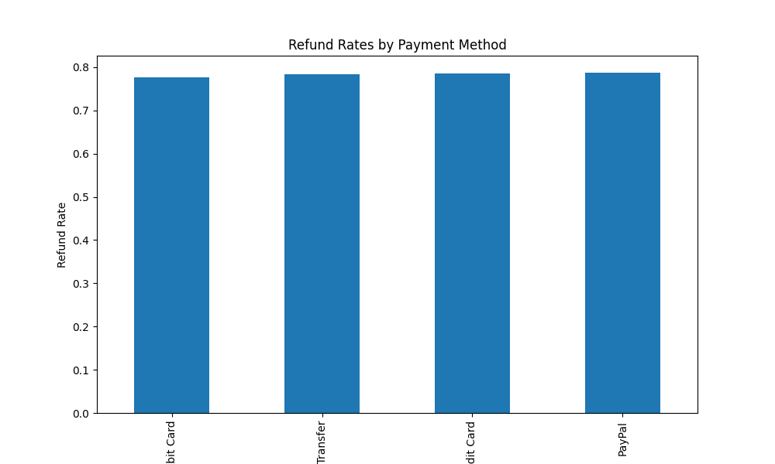
Refund Rates by Payment Method

Slide 2
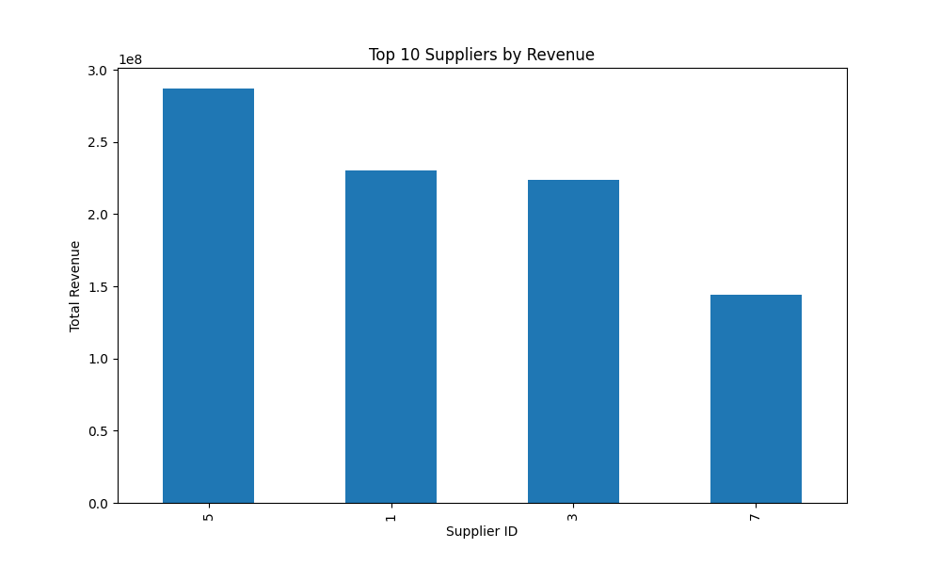
Top 10 Suppliers by Revenue

Slide 3
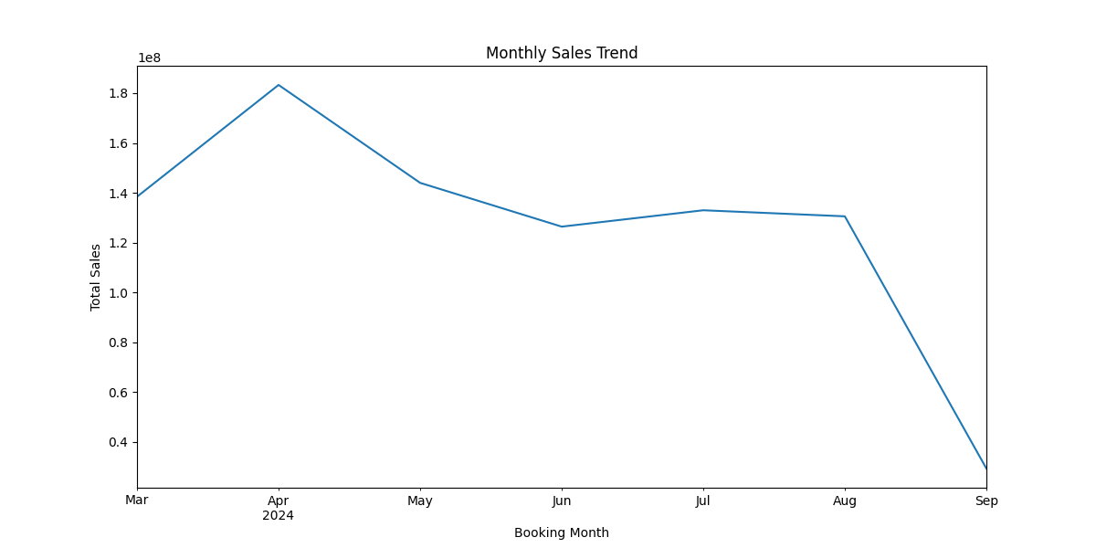
Monthly Sales Trend

