Slide 1
Global Water Quality & Health Impact Analysis
Presented By:
Archand Raj
Batch : PGDDM52
Course : Data Science And Machine Learning

Slide 2
Introduction
We live in an era of rapid environmental change where monitoring water pollution has become critical for public health and ecosystem survival. Safe and clean water is a fundamental necessity, but human activities, industrial runoffs, and changing weather patterns constantly threaten its quality.
Regular monitoring of key parameters is one of the most effective ways to track and mitigate contamination before it reaches critical levels. However, water safety is not uniform. Pollution metrics vary dynamically across different regions, seasons, and water sources based on multiple interacting environmental factors
Understanding these variations through data-driven analysis is essential to identify the root causes of contamination, predict pollution spikes, and develop highly effective, proactive water treatment and resource management strategies.

Slide 3
Objective
The main objective of this project is to analyze the key environmental metrics in the water pollution dataset and understand the factors that drive water contamination and quality degradation.
This includes examining how variables such as water source, region, season, temperature, and rainfall impact critical metrics like turbidity, pH level, dissolved oxygen, chemical concentrations, and overall safety index. The goal is to identify patterns, relationships, and trends that explain variations in water quality.
The project aims to provide data-driven insights that can help environmentalists, municipal authorities, and treatment plants make better decisions regarding water resource management, contamination control, and infrastructure planning.

Slide 4
Business Understanding
Identify high-risk contamination zones and sources
Understand the impact of environmental factors on water quality
Optimize water treatment and mitigation resources

Slide 5
Data Overview
This dataset contains 30,000 records of water quality metrics collected from various geographical regions and water sources.
It includes a comprehensive range of columns covering both environmental conditions and chemical safety indicators, providing a multi-dimensional view of water health.
The dataset consists of information related to regional locations, water body types, and seasonal weather patterns, along with key quality metrics such as turbidity, pH levels, dissolved oxygen, and chemical concentrations.
The data includes both categorical variables (e.g., region, water source) and numerical variables (e.g., rainfall, contamination levels), making it suitable for comparison, correlation, and trend analysis.
This dataset is useful for understanding how environmental factors influence water safety and for identifying patterns in pollution spikes across different regions and seasons.

Slide 6
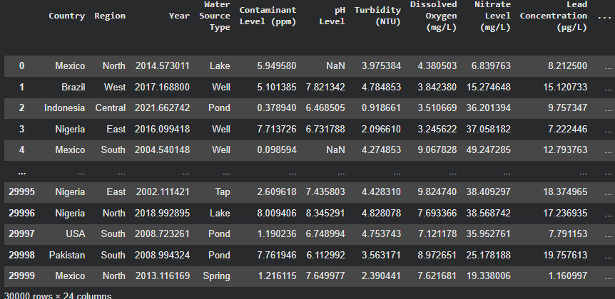
Dataset

Slide 7
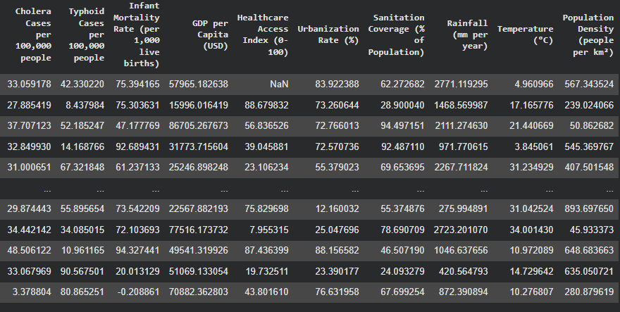

Slide 8
Data Source
The dataset used in this project is a comprehensive collection of environmental records designed to simulate or represent real-world water quality monitoring scenarios.
It represents realistic patterns of environmental behavior, including chemical concentrations, physical water properties, and weather-related impacts.
The data includes information from multiple geographical locations and diverse water body types, such as rivers, lakes, and groundwater reserves.
This dataset is primarily used for educational and analytical purposes, helping to identify trends and risk factors in global water safety management.

Slide 9
EDA Process
Data Loading
Understanding the Data (head(), info(), describe())
Data Cleaning (missing values, duplicates, data types)
Data Categorization (categorical vs numerical)
Univariate Analysis (single variable analysis)
Bivariate Analysis (relationship between two variables)
Multivariate Analysis (multiple variable relationships)
Data Visualization (charts and graphs)

Slide 10
EDA Using Packages
Exploratory Data Analysis (EDA) is an essential step in the data analysis process that helps in understanding the structure, patterns, and key characteristics of a dataset. It involves summarizing data, detecting anomalies, and identifying relationships between variables. There are several Python packages commonly used for performing EDA. Some of the popular ones include:
Pandas: Pandas is a powerful library used for data manipulation and analysis. It provides data structures like DataFrames and Series, which are useful for loading, cleaning, and exploring datasets efficiently.
NumPy: NumPy is used for numerical computations and supports operations on large arrays and matrices. It is often used alongside Pandas for performing mathematical and statistical calculations.
Matplotlib: Matplotlib is a widely used visualization library that helps in creating various types of plots such as line charts, bar charts, histograms, and scatter plots to understand data trends and distributions.
Seaborn: Seaborn is built on top of Matplotlib and provides a higher-level interface for creating visually appealing and informative statistical graphics. It simplifies complex visualizations like heatmaps, box plots, and violin plots.

Slide 11
Data Cleaning
Handling Missing Values: Identified and addressed null entries in critical columns like pH levels or chemical concentrations to maintain dataset integrity.
# Check for missing values in the dataset
print(df.isnull().sum())
# Filling missing numerical values (like pH or Turbidity) with the mean
df['pH_Level'] = df['pH_Level'].fillna(df['pH_Level'].mean())
# Dropping rows where critical data is missing
df.dropna(subset=['Contaminant_Type'], inplace=True)
Removing Duplicates: Scanned the dataset for redundant water sample records to ensure that specific pollution incidents weren't over-counted.
# Check for duplicate rows
print(df.duplicated().sum())
# Remove duplicate entries
df.drop_duplicates(inplace=True)

Slide 12
Standardizing Formats: Ensured consistent naming conventions for regions and water sources.
# Standardizing string formats to lowercase or title case
df['Water_Source'] = df['Water_Source'].str.strip().str.title()
Data Type Conversion: Verified that numerical columns (like Turbidity and Rainfall) were correctly formatted as floats/integers for mathematical analysis.
# Converting columns to numeric, forcing errors to NaN to handle "messy" strings
df['Turbidity_Level'] = pd.to_numeric(df['Turbidity_Level'], errors='coerce')

Slide 13
Outlier Detection: Inspected extreme values in pollution metrics to determine if they were genuine contamination spikes or data entry errors.
# Finding outliers using IQR
Q1 = df['Chemical_Concentration'].quantile(0.25)
Q3 = df['Chemical_Concentration'].quantile(0.75)
IQR = Q3 - Q1
# Defining bounds
lower_bound = Q1 - 1.5 * IQR
upper_bound = Q3 + 1.5 * IQR
# Filtering the data
outliers = df[(df['Chemical_Concentration'] < lower_bound) | (df['Chemical_Concentration'] > upper_bound)]
Column Renaming: Renamed complex or technical column headers to make them more readable.
df.rename(columns={
'region_loc_01': 'Region',
'temp_celsius': 'Temperature',
'turb_ntu': 'Turbidity'
}, inplace=True)

Slide 14
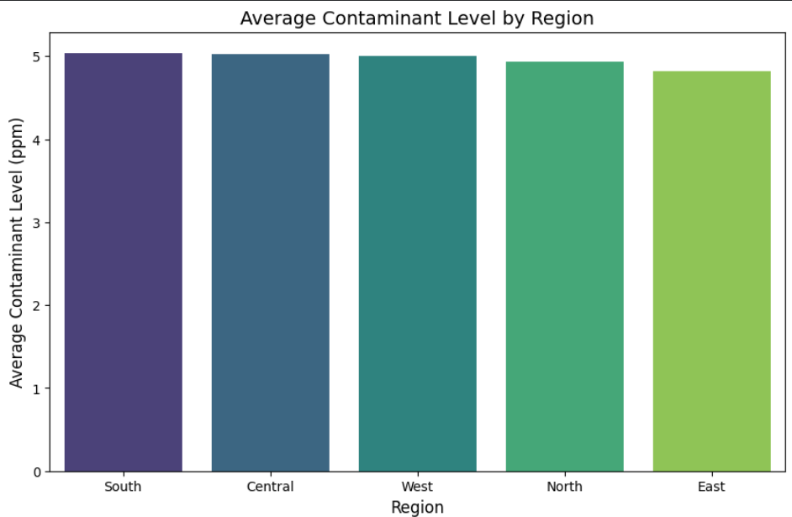
Bar Chart
Compares average contamination levels across regions.
Identifies specific locations with high pollution spikes.
Helps prioritize regional monitoring and intervention.

Slide 15
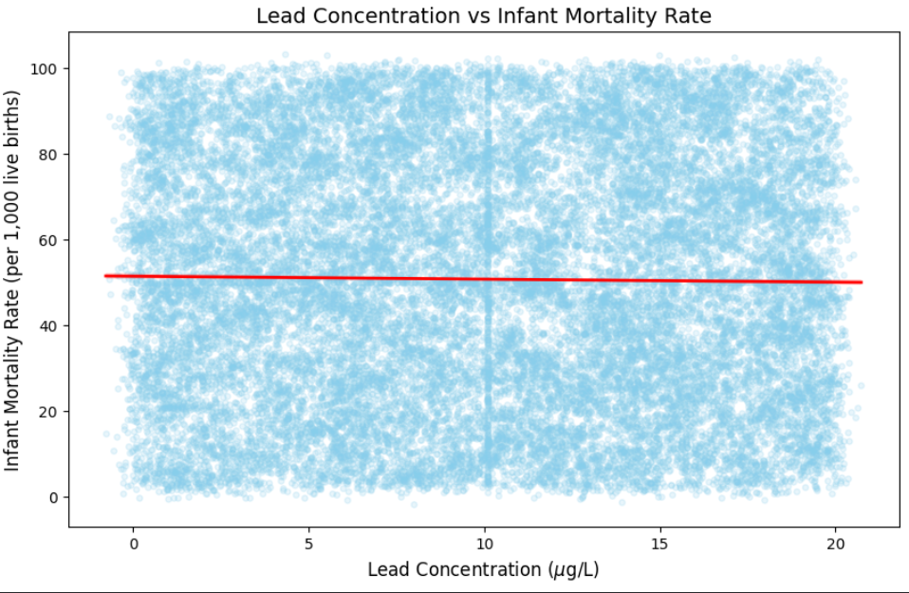
Scatter Plot
Shows link between lead levels and infant mortality.
Identifies health impacts of chemical concentration.
Detects critical trends and outliers in health data.

Slide 16
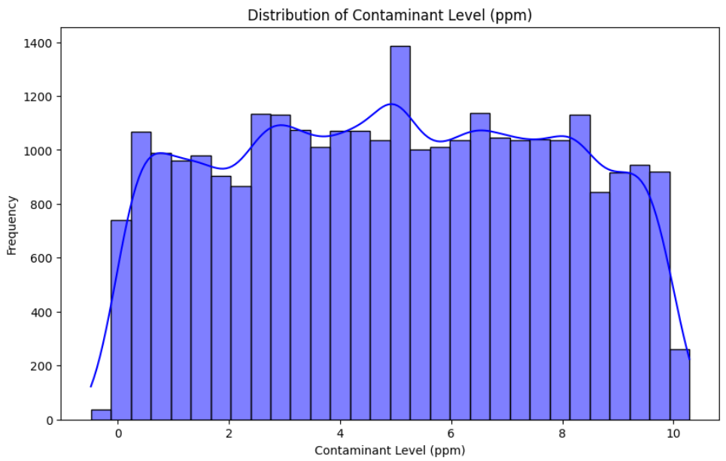
Histogram
Displays frequency of different contaminant levels.
Identifies the most common range of pollution.
Helps detect skewness or outliers in water safety.

Slide 17
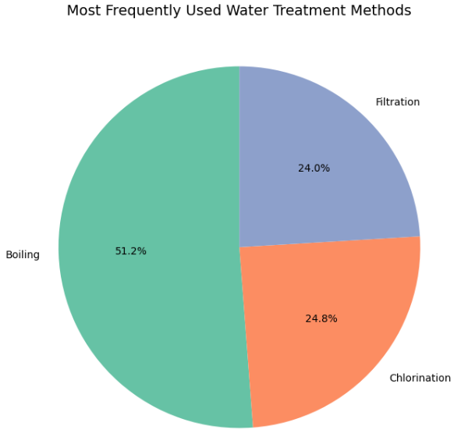
Pie Chart
Illustrates the market share of different water treatment methods.
Highlights Boiling as the most dominant technique at 51.2%.

Slide 18
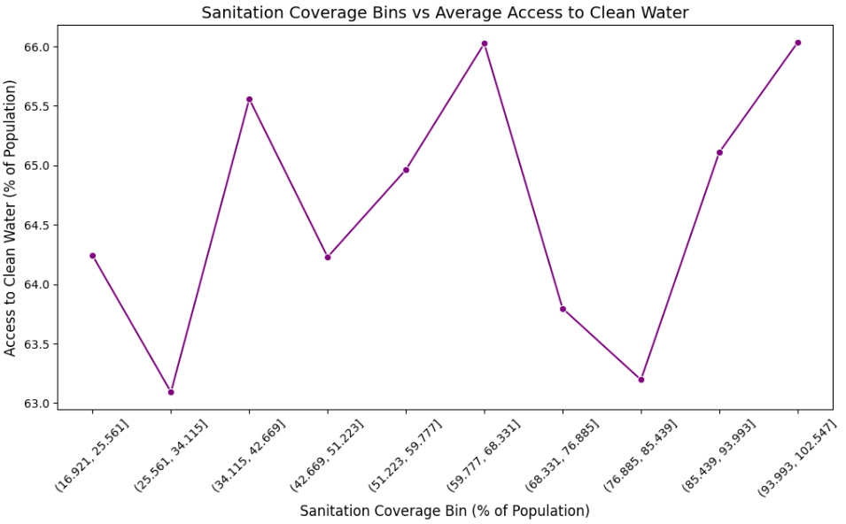
Line Plot
Tracks the relationship between sanitation coverage and clean water access.
Visualizes fluctuations in water availability across different population bins.

Slide 19
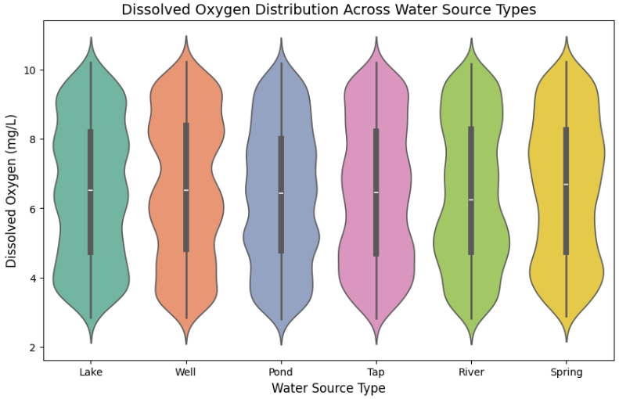
Violin Plot
Combines box plot and density traces to show data distribution.
Displays the range and concentration of dissolved oxygen across sources.
Helps identify variations in water health and oxygen consistency.

Slide 20
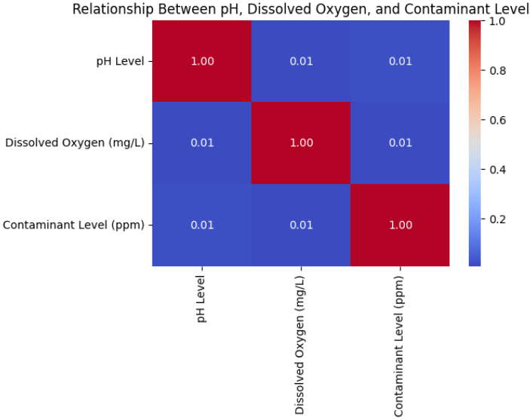
Heatmap
Visualizes the correlation between pH, Oxygen, and Contaminant levels.
Helps identify if certain metrics act as predictors for water pollution.

Slide 21
Key Insights
Policy over Wealth: Higher GDP doesn't guarantee clean water; strong government policy matters more.
Hidden Bacterial Risk: Wells are just as contaminated as rivers; natural sources are not "safer.“
Deceptive Metrics: Water can have perfect pH and Oxygen levels while still being highly toxic.
Infrastructure Mismatch: Sanitation and clean water access grow separately, showing a lack of integrated planning.
No Universal Treatment: No single "best" method exists; safe water requires combining different treatment types.

Slide 22
Recommendations
Prioritize policy and infrastructure over general economic growth.
Mandate water treatment for all sources, including wells.
Implement multi-metric testing beyond basic pH and oxygen.
Integrate sanitation and water supply infrastructure planning.
Deploy multi-barrier treatment frameworks to ensure safety.

Slide 23
Conclusion
Water pollution is a systemic global issue, not a localized one.
Economic wealth alone is insufficient for ensuring water safety.
Natural sources like wells require mandatory active treatment.
Chemical metrics (pH/Oxygen) do not fully guarantee safe water.
Integrated planning of sanitation and supply is critical for health.

Slide 24
Thank You

