Slide 1
Deformable Models
(Formulation)
Deformable Models
(Formulation)
Petia Radeva
(part II)

Slide 2
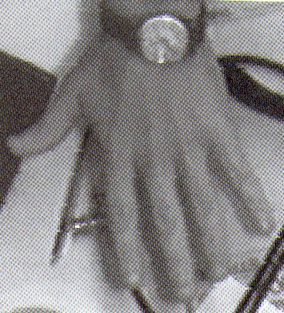
Why snakes
Edge map are ambiguous to be interpreted

Slide 3

Snake representation
A snake is an elastic curve defined by means of:
a discrete representation
- point-based snake - elastic curve as a sequence of snaxels :
a continuous representation
- a tesselation established over the parametrization set
- decomposition of the curve in a basis of functions (usually piecewise polynomials)
- small support of the basis functions

Slide 4


Energy-Minimizing Curve
Snake - an elastic curve with associated energy:
Potential - a surface P ( x, y ) with valleys corresponding to image features
External (image) forces attract the snake to the potential valleys:

Slide 5
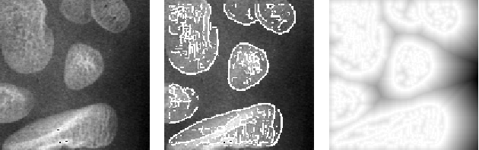
Energy-Minimizing Curve
Original image image features potential field
Other external energies: - volcano and spring energies (User-interaction energy)

Slide 6
Energy-Minimizing Curve
Other external energies: - volcano and spring energies (User-interaction energy)

Slide 7

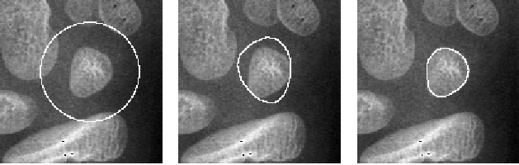
Energy-Minimizing Curve
Internal forces penalize stretching and bending:
Initial snake deforming snake converged snake

Slide 8


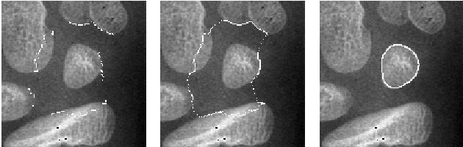
Internal Energy of the Snake
membrane energy given by the first derivative of the curve that avoids the stretching and discontinuity of the curve:
thin-plate energy given by the second derivative of the curve
that avoids the bending of the curve:
Snake deformations with different elastic properties
Segmentation by snakes - an energy-minimization procedure.

Slide 9
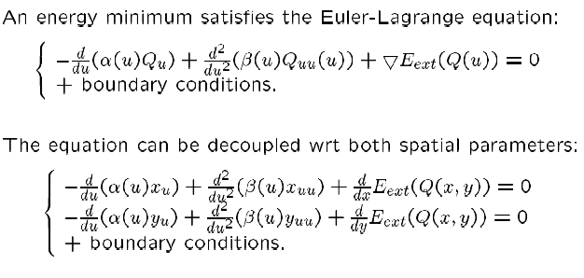
Energy-Minimization Procedure for a Point-Based Snake

Slide 10
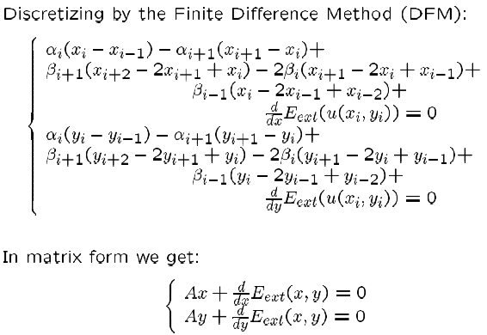
Energy-Minimization Procedure for a Point-Based Snake

Slide 11
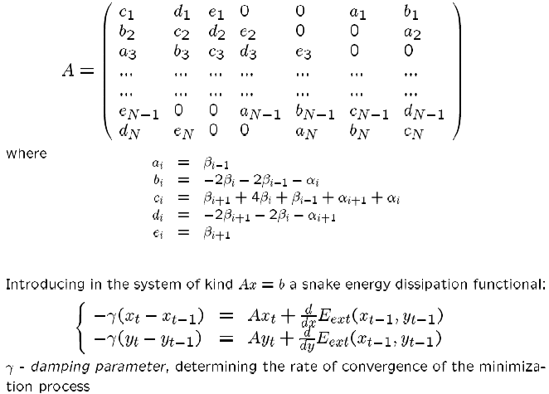
Stiffness matrix A

Slide 12


Energy-Minimization Procedure for a Point-Based Snake
Iterative procedure for snake energy minimization:
The snake deformation is a composition of:
snake attraction by external forces
snake smoothing due to internal forces.

