Slide 1
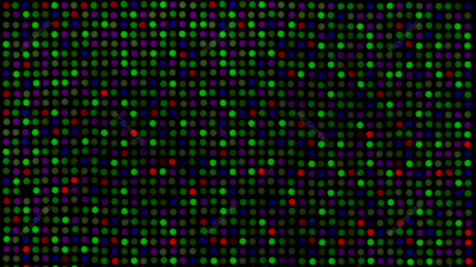
ArcheGEO: Improving Relevance of Gene Expression Omnibus Database Search Results
Chua Huey Eng

Slide 2
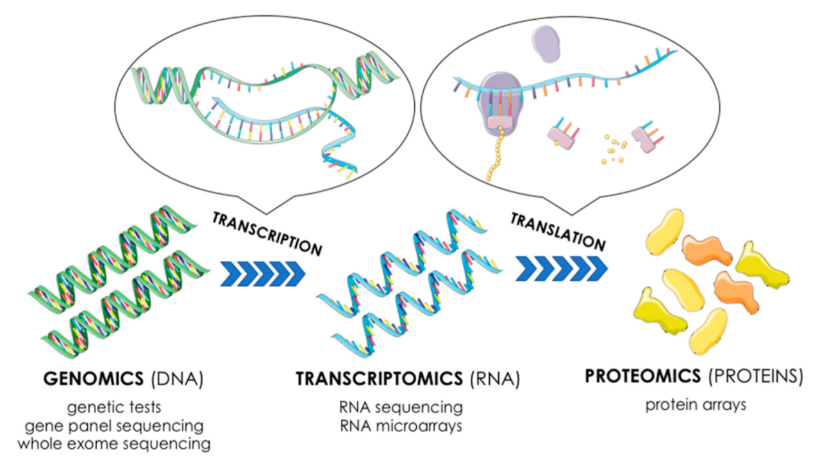



Introduction
Supplitt, S.; Karpinski, P.; Sasiadek, M.; Laczmanska, I. Current Achievements and Applications of Transcriptomics in Personalized Cancer Medicine. Int. J. Mol. Sci. 2021, 22, 1422. https://doi.org/10.3390/ijms22031422
Transcriptome is the set of RNA transcripts present in a cell or sets of cells.
Measuring RNA abundance in different tissue-types, time-points or contexts is a popular method to pursue biological and medical questions.
Gene Expression Omnibus (GEO) is the dominant repository and is rapidly growing.
Gene Expression Archive (GEA)

Slide 3
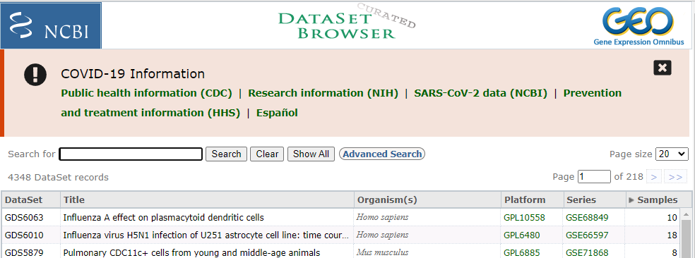
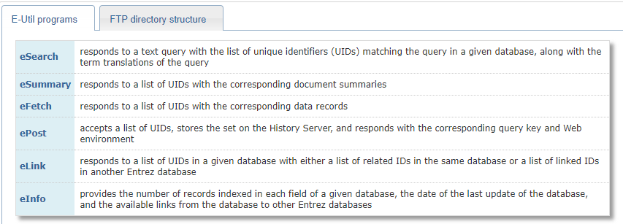
Gene Expression Omnibus (GEO)
Usage of GEO:
Discovering function of uncharacterized genes and genetic networks
Validating interesting gene expression trends
Substantiating experimental discussion and findings
Providing insights to related fields (e.g. gene set analysis, cell-type composition analysis) through re-analysis and re-interpretation of GEO data
2 Interfaces for data retrieval:

Slide 4





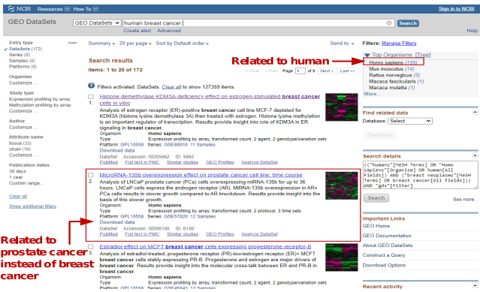
Challenges of GEO entries retrieval
Document
Matching
Query
User
Interface
Ambiguous nature of natural language used to describe query and document can result in irrelevant results during matching.
Results

Slide 5
Technical Challenges Affecting Result Relevance
Generic English parsers perform poorly for named entity recognition on biomedical-related queries and documents
Biomedical terms contain technical terminology and long complex noun phrases
Biomedical terms can be abbreviated, contain common English words and may even be context dependent
Some biomedical terms may need to be inferred from the metadata
Semantic similarity validation
Imperfect match between parsed biomedical entities of query and document
Some existing biological ontologies and vocabularies lack sufficient cross-links and content to support semantic similarity evaluation

Slide 6
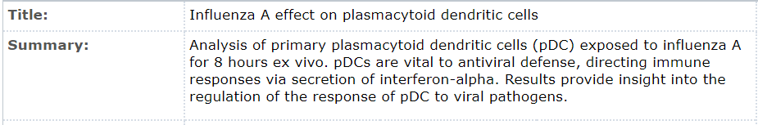
The Result Relevance Problem
Surrogates
(E.g., metadata of returned GEO dataset records)
Documents
Given a query and a set of documents, a search result is considered relevant if its surrogate has topic(s) that is semantically similar to that of the query.
Relevance
Interface
The goal of the search engine is to return documents that are relevant to the query.
User (Perceived information need)
Query (contains topic or subject of interest)

Slide 7


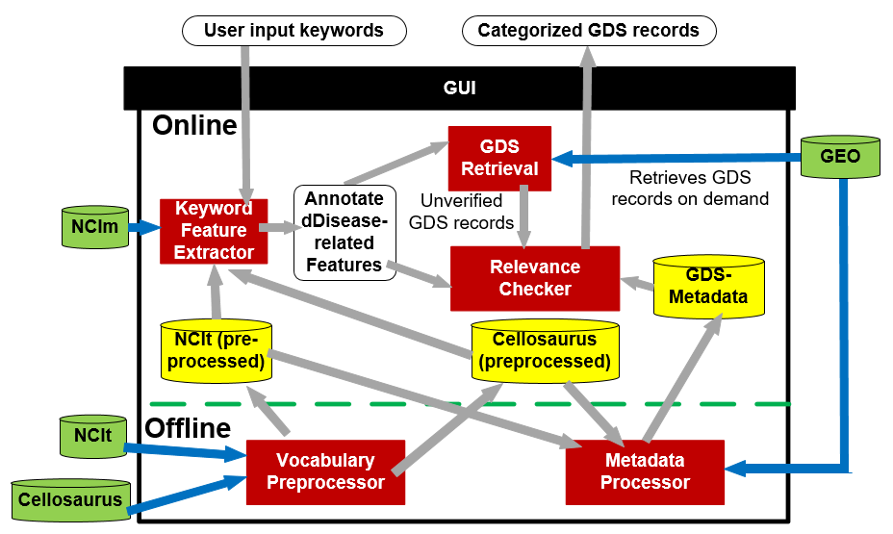


ArcheGEO Architecture
Online: Performs relevance validation
Offline: Pre-processing of controlled vocabularies and GEO dataset (GDS) metadata. PostgreSQL is used to store the data.
Python 3.8

Slide 8
Offline Pipeline: Vocabulary Preprocessor

Slide 9
Offline Pipeline: Metadata Processor
Different information granuality: Title-derived features stored separately from summary-derived feature. Summary deemed less important as additional description that enrich topics adds additional noise.
Utilizes BC5CDR model to extract features of disease synonyms and JNLPBA model to extract features of cell lines
Disease synonym features: UMLS IDs (ScispaCy) links to NCIt.
Organism & anatomy features: link to NCIt by looking for exact matches between features and synonyms of entries.
Cell line feature: link to Cellosaurus entry if at least one token matches at least one cell line synonym
Features annotated with NCIt and Cellosaurus identifiers.

Slide 10

Online Pipeline
Extract features related to the disease concept from the user input keywords.
Annotates keywords with corresponding NCIt ID where appropriate
Send a batch of queries (all possible disease-organism pair-wise) to GEO using eSearch program of the programmatic access utility.
Disease Concept:
Relates to an organism where disease-related RNA comes from cells and cells belong to an organism
Organism
Disease synonyms
Anatomy (body system)
Cell line
O(D), S(D), A(D) and C(D) rep. organism, disease synonym, anatomy and cell line features of disease D, respectively.

Slide 11

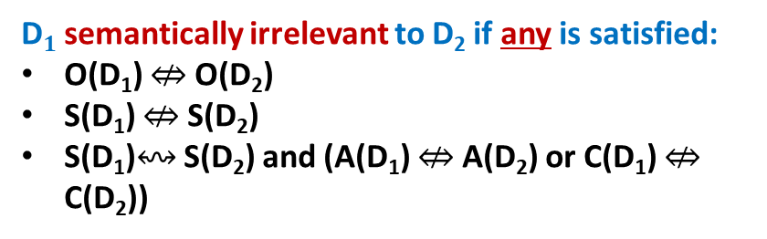
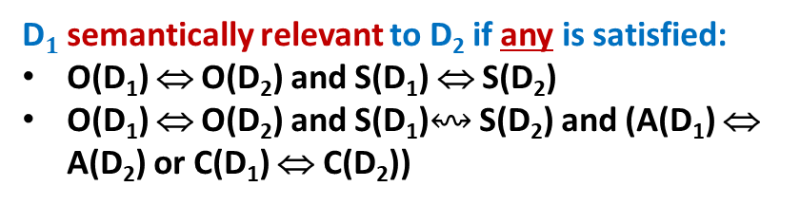
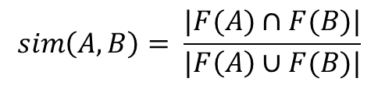
Online Pipeline: Relevance Checker
Concept A is equivalent to Concept B if sim(A,B)=1.
Feature-based semantic similarity is more flexible and often used to determine semantic similarity of concepts from different ontologies.
: equivalent, ↭ : ambiguous, ⇎: not equivalent
D$1$ semantically relevant to D₂ if any is satisfied:
O(D₁) ⇔ O(D₂) and S(D₁) ⇔ S(D₂)
O(D₁) ⇔ O(D₂) and S(D₁)↭ S(D₂) and (A(D₁) ⇔ A(D₂) or C(D₁) ⇔ C(D₂))
Performs semantic relevance checks
D$1$ semantically irrelevant to D₂ if any is satisfied:
O(D₁) ⇎ O(D₂)
S(D₁) ⇎ S(D₂)
S(D₁)↭ S(D₂) and (A(D₁) ⇎ A(D₂) or C(D₁) ⇎ C(D₂))
Semantic Similarity: Concepts share the same meaning
$$sim\left(A,B\right)= \frac{|F(A)∩F(B)|}{|F\left(A\right)∪F(B)|}$$
Features of B
Invalid results

Slide 12
Graphical User Interface
GDS Retrieval retrieves GDS records and Relevance Checker performs semantic similarity checks. Result is summarized and displayed.
Displays summarized features
Takes in input of user keywords to send to Keyword Feature Extractor
Results are categorized according to relevance and displayed as a browsable list.

Slide 13
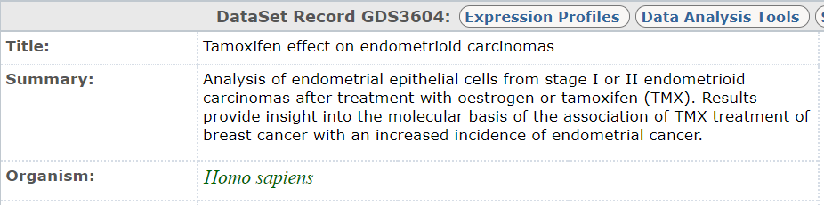
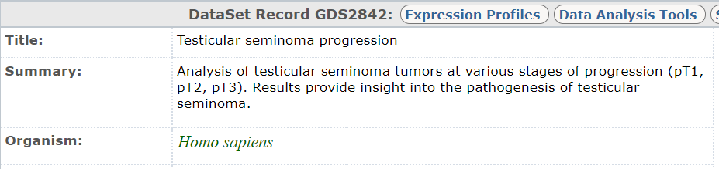
An Example: Human, Prostate and Ovarian Carcinoma
GDS3604 tagged as “endometrioid carcinomas” by ScispaCy
GDS2842 tagged as “testicular seminoma” by ScispaCy
Record B:
GDS3604
Valid organism, mismatched disease (wrt ovarian carcinoma)
Record A:
GDS2842
Valid organism, mismatched disease (wrt prostate carcinoma)

Slide 14





Performance Study
Fixed set of queries
S: set of search results
R: relevant documents (known set indpt of user)
Evaluate S vs R using precision and recall
64-bit Windows desktop with Intel® Core™i7-4790K CPU (4GHz), 32GB main memory
Cranfield paradigm
Assessed based on precision and recall on test collections
GDS record retrieval systems:
GEO Browser (https://www.ncbi.nlm.nih.gov/sites/GDSbrowser)
ScanGEO (http://scangeo.dartmouth.edu/ScanGEO/)
DataMed (https://datamed.org/)
Domain experts (5 postgrad students) provide judgement regarding relevance of topical similarity on test collections
Relevance of record determined by majority voting.
Kappa value of record judgement: [0.68-1]
Pr(a) = actual observed agreement, Pr(e) = chanced agreement

Slide 15
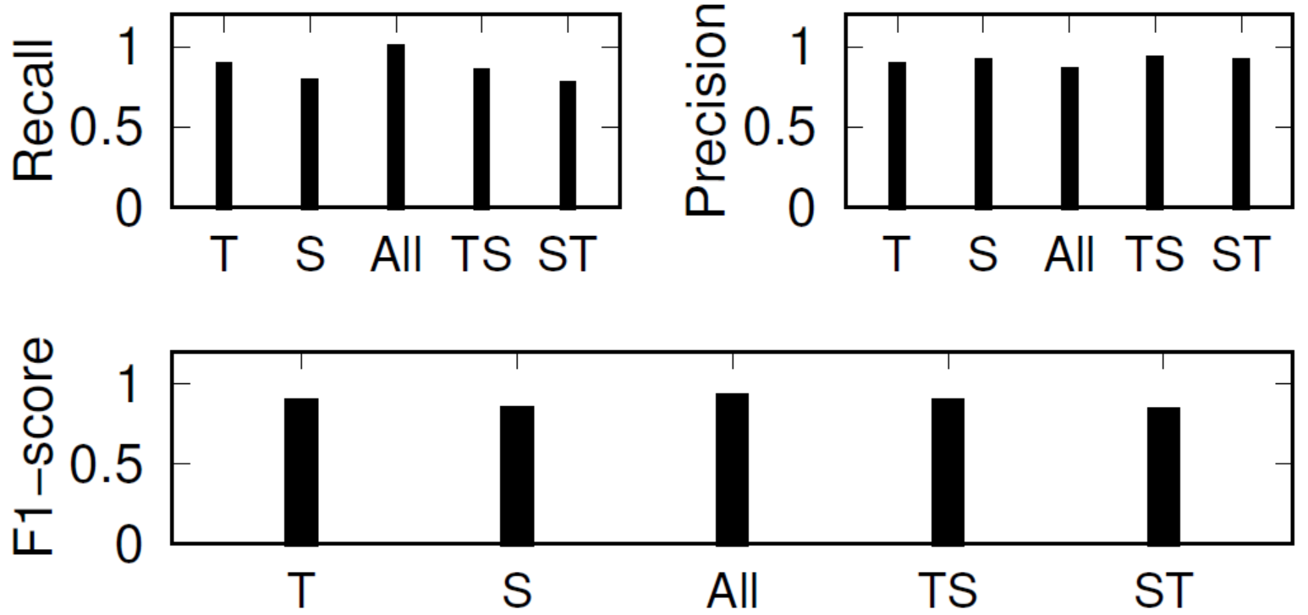

Exp 1: Metadata Structure-based Relevance Validation
Evaluate effect of performing relevance validation based on location (i.e., title vs summary field of GDS) of features in the metadata using TC1.
Poorer recall than T and TS. Agrees with expectation that summary field tend to be more noisy and affect relevance validation.
All has best F1-score (0.92) but poorest precision (0.85)
Similar to TS but order of validation is swapped for Title and Summary fields.
Validation using features from Title field. If record is deemed ambiguous, validate using features from Summary field.
TS has best precision (0.93) and comparable recall and F1-score as T.
Title alone
Summary alone
Title ∪ Summary

Slide 16
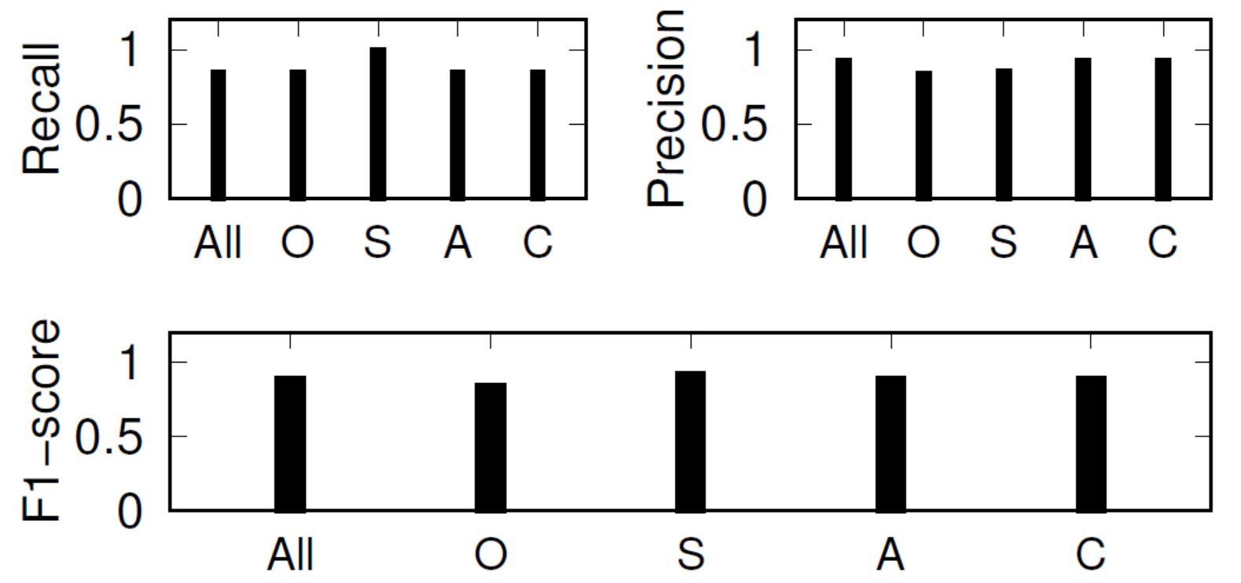
Exp 2: Effect of Disease-related Features
Examine effect of features on relevance validation using TC1.
Exclusion of O (0.84) and S (0.85) resulted in poor precision
Increased in number of ambiguous records in valid record set.
Highlights importance of features O and S compared to A and C as dominant discriminating features between 2 diseases.
Features A and C are still useful for relevance validation, especially in the absence of feature S from the metadata.
77.4% of valid records can still be correctly labelled as “Disease Valid”
ArcheGEO
(all features considered)
Organism
Disease Synonym
Anatomy
Cell line
Excluded feature

Slide 17
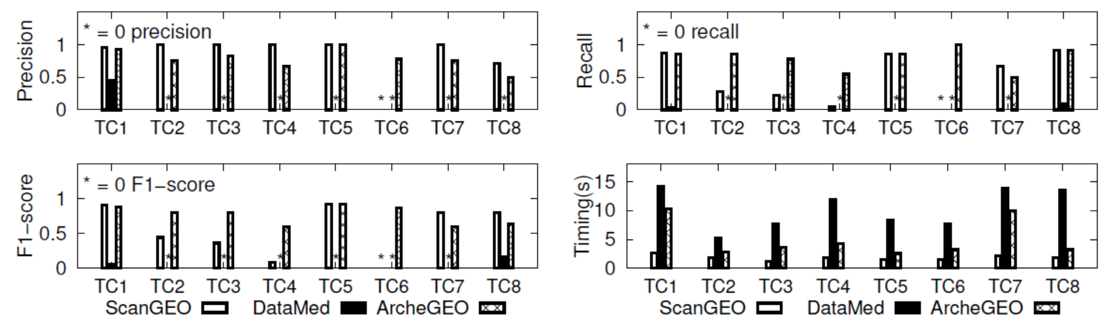
Exp 3: Comparison with Benchmark Systems
Datamed: retrieve no results for TC2 to TC7
ScanGEO: retrieve no results for TC6
F1-score of ArcheGEO is 6.9X better than ScanGEO
Range of recall and precision of ArcheGEO is tighter than ScanGEO (i.e., ArcheGEO has more consistent performance)
DataMed is the slowest in terms of search timing
DataMed is an open source discovery index which references multiple sources. User has to take additional step to configure results to display only GEO-specific results.

Slide 18

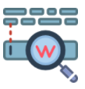
Related Work
ScanGEO performs both differential expression analysis and keyword-based record retrieval
DataMed is an open source discovery index for finding biomedical datasets (including GEO)
ArcheGEO designed to work as companion of GEO query interface to improve quality of search results
Unlike ScanGEO and DataMed, ArcheGEO reports on irrelevant records and why they are irrelevant
GEO-related Software
(Record Retrieval)
Existing research in database community focusses on structured and semi-structured data
The data processed by ArcheGEO includes unstructured data (i.e., GEO metadata)
Keyword Search

Slide 19


Related Work
Process of obtaining feedback from users regarding relevance of documents. Based on feedback, search engine modifies the query to retrieve a new set of results.
ArcheGEO differs from such systems as the main goal is to predict and categorize relevance of the search results for presentation to users. It does not seek user’s feedback on search relevance.
Relevance Feedback
Most common approach is the use of ranked list (i.e., relevance ranking). Effectiveness of such list depend on whether user can input appropriate query for desired document. Less relevant keywords can result in low ranking of relevant results. More amendable regression-type problems.
Alternative approach is document clustering which allows users with no clear search targets to easily interpret search results through cluster labels.
ArcheGEO deals with relevance classification (relevant vs irrelevant) and clustering approach is more appropriate.
Search Result Organization

Slide 20














Open Challenges
Conceptualizing concepts for other GEO data types facilitates expansion of existing framework to support them
Improved NER can improve overall quality of relevance validation
Proper entity linking with knowledge base (KB) critical for supporting systems
Approaches required to address issues related to inconsistent, ambiguous and uncertain information when performing relevance validation
KB1
KB3
Index optimization supports efficient knowledge base search
KB2

