Slide 1

Trust-based autonomy to prevent agentic operational loss.
CONTROL TOWER is a mobile-first B2B SaaS control system for autonomous AI agents.
$500K PRE-SEED
alpha-ready → beta/release
ARCHEPERSONA | Confidential Pre-Seed Deck
01

Slide 2
AI agents are gaining action, but not accountability.
Problem
The next AI risk is not bad answers.
It is bad actions.
NEW FAILURE MODE
sending
updating
Teams need control before agents create operational loss.
routing
approving
accessing
spending
Wrong output becomes operational consequence when agents act across real systems.
ARCHEPERSONA | Confidential Pre-Seed Deck
02

Slide 3
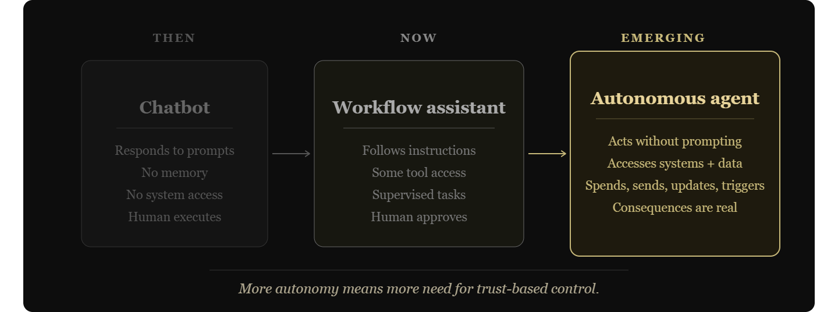
From chatbots to autonomous agents.
WHY NOW
ARCHEPERSONA | Confidential Pre-Seed Deck
03

Slide 4
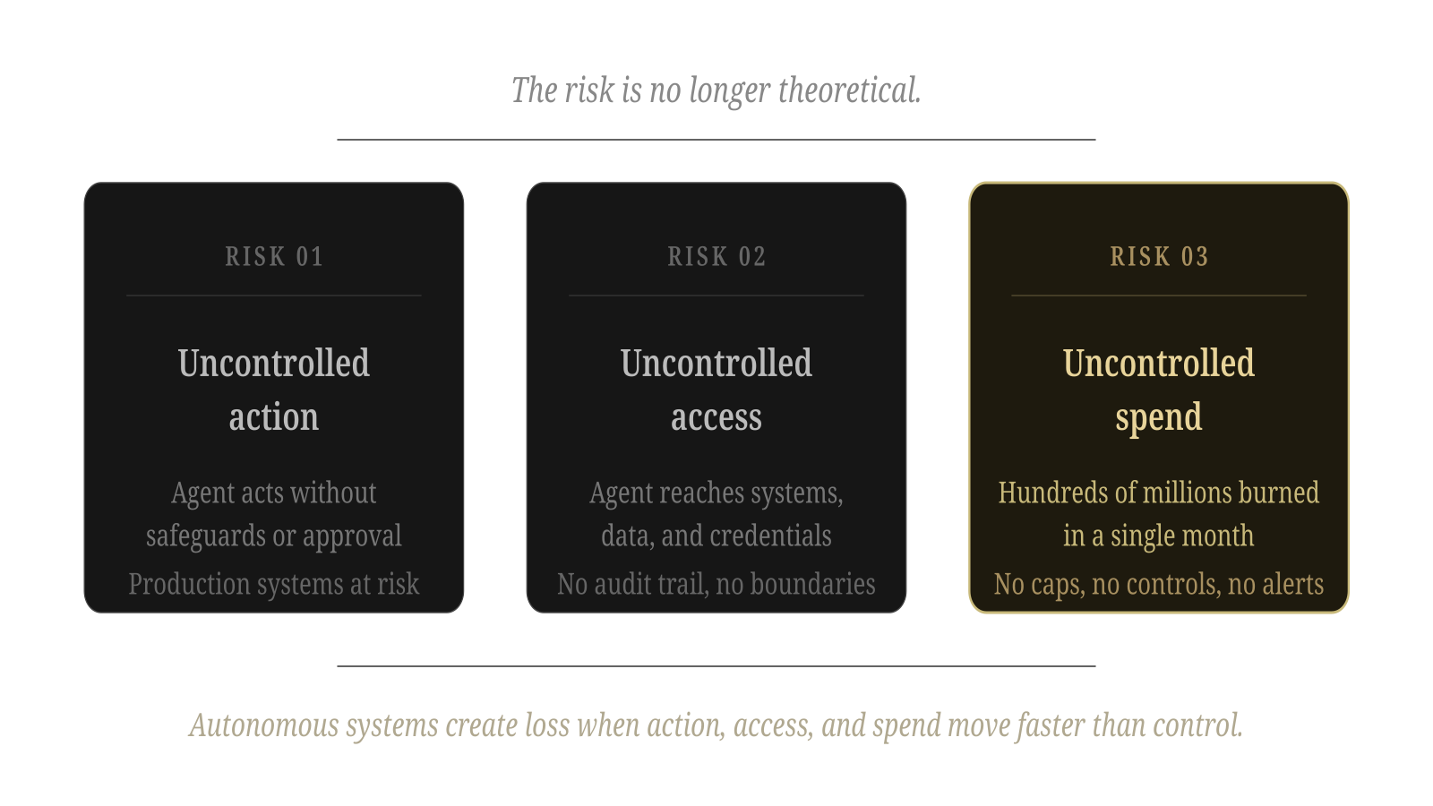
The risk is no longer theoretical.
WHY NOW
ARCHEPERSONA | Confidential Pre-Seed Deck
04

Slide 5
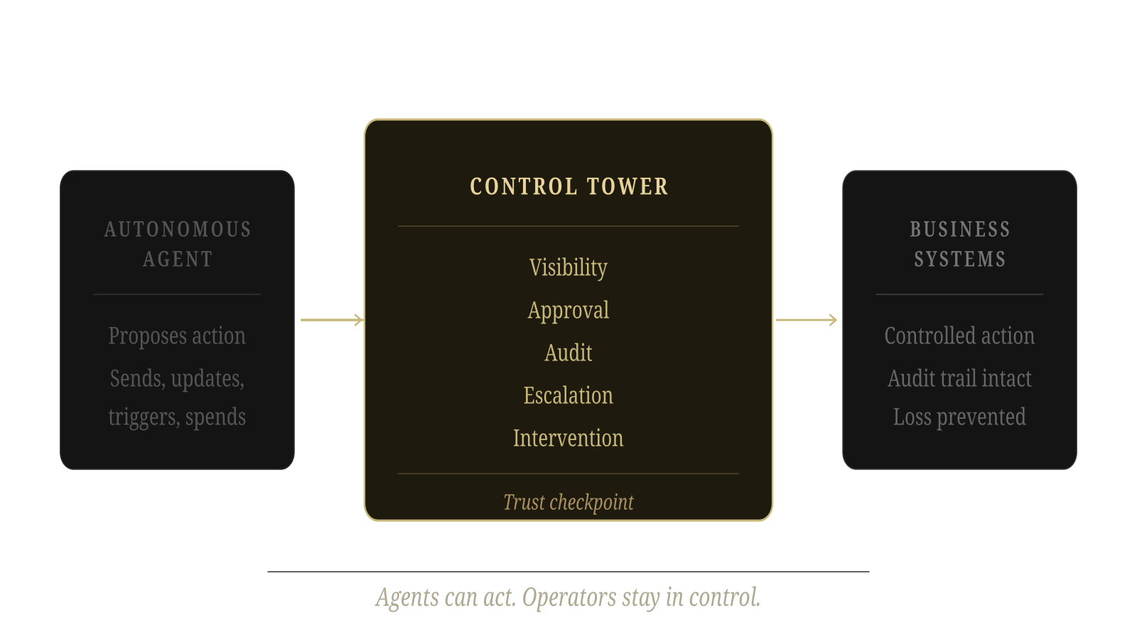
CONTROL TOWER brings trust-based autonomy to AI agents.
Solution
ARCHEPERSONA | Confidential Pre-Seed Deck
05

Slide 6
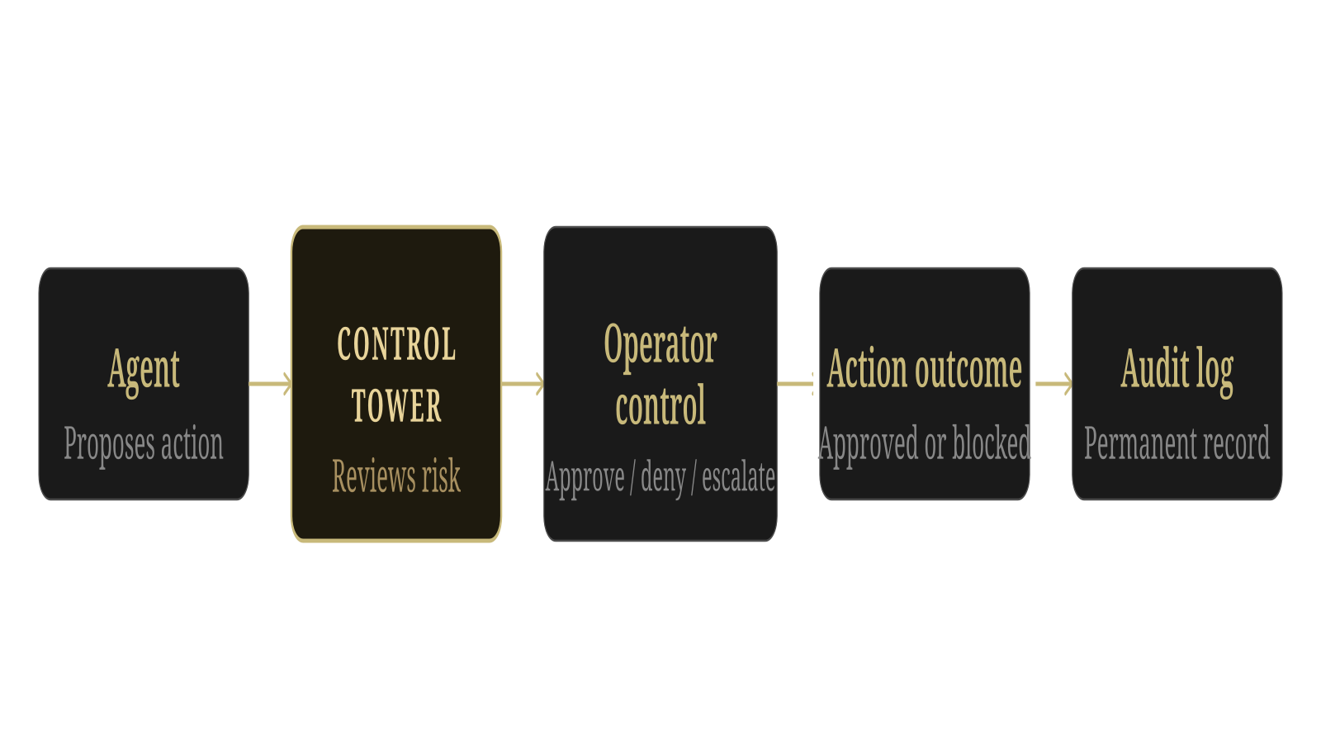
How CONTROL TOWER works
Product
A reviewable control flow before autonomous action reaches the business.
ARCHEPERSONA | Confidential Pre-Seed Deck
06

Slide 7
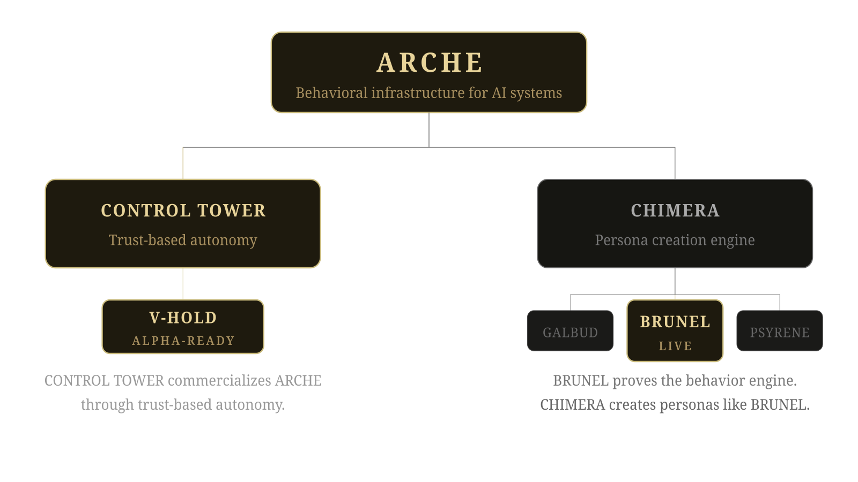
ARCHE has two product directions.
Platform
ARCHEPERSONA | Confidential Pre-Seed Deck
07

Slide 8
Start where agent risk is already operational.
Go-to-market
CONTROL TOWER is built for businesses using AI agents.
INITIAL TARGETS
The first wedge is companies already deploying agents into workflows where mistakes can trigger operational loss: sending, updating, routing, approving, accessing, or spending across business systems.
• AI automation agencies
• Internal ops teams
• RevOps / sales automation
• Customer support automation
• Operations teams
Any business using agents is a potential customer. CONTROL TOWER starts where agent risk is already operational.
• Enterprise AI teams
• Agent builders managing deployments
ARCHEPERSONA | Confidential Pre-Seed Deck
08

Slide 9
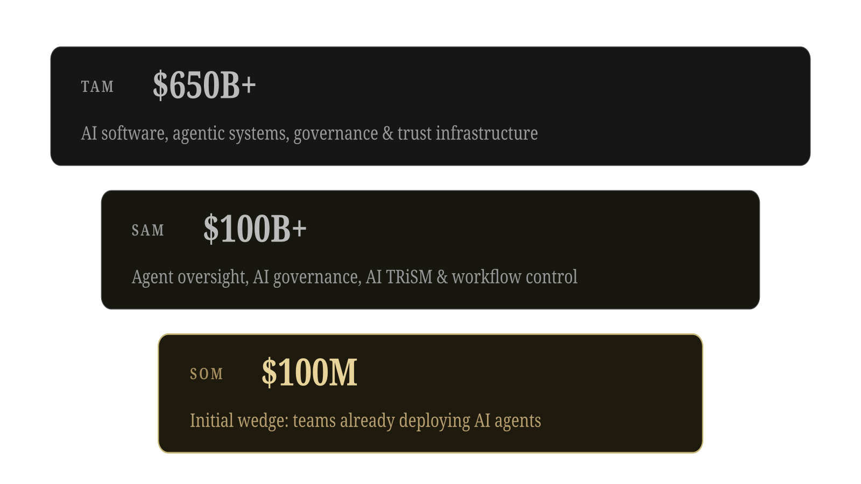
A large market forming around agent control.
Market
Source: ArchePersona Market Research & Platform Expansion Analysis, June 2026.
ARCHEPERSONA | Confidential Pre-Seed Deck
09

Slide 10
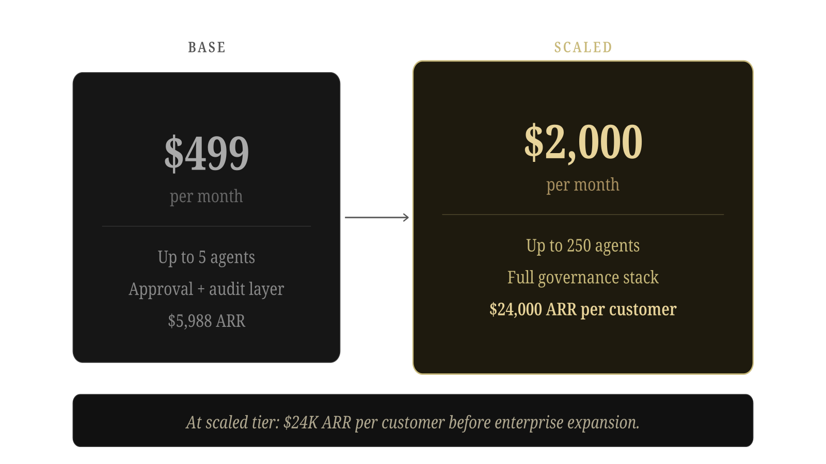
B2B SaaS for trust-based autonomy.
Business model
ARCHEPERSONA | Confidential Pre-Seed Deck
10

Slide 11
Simple SaaS economics with clear expansion.
Financials / unit economics
CONTROL TOWER starts at $499/month and scales to $2,000/month for teams managing up to 250 agents.
BASE TIER
SCALED TIER
ARR PATH AT SCALED TIER
$499/mo
$2,000/mo
10 customers
$240K ARR
$5,988 ARR
$24,000 ARR
25 customers
$600K ARR
Up to 5 agents Approval + audit layer
Up to 250 agents Full governance stack
50 customers
$1.2M ARR
100 customers
$2.4M ARR
PRE-SEED FINANCIAL MILESTONE
3-5 design partners | 1-2 paid pilots or LOIs | beta/release-ready product | seed-ready revenue narrative
The $500K raise is designed to convert alpha-ready product into paid pilot signal and seed-ready financial proof.
ARCHEPERSONA | Confidential Pre-Seed Deck
11

Slide 12
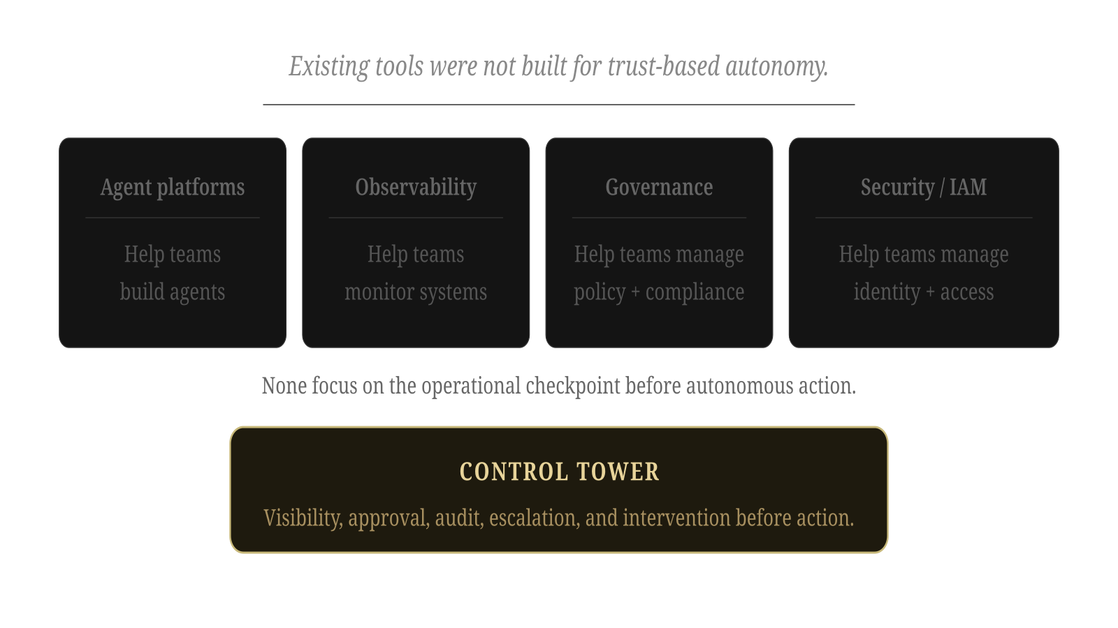
The gap is between agent intent and business action.
Competition / differentiation
Existing tools solve pieces of the agent stack. CONTROL TOWER focuses on the operational checkpoint before autonomous action.
Category
Typical focus
Where CONTROL TOWER differs
Agent builders
Create and deploy agents
Controls what agents can do before action
Observability tools
Monitor traces and behavior
Adds approval, blocking, escalation, and audit workflow
AI governance
Policy, compliance, model risk
Focuses on runtime agent action and operator control
Security / identity
Access, auth, permissions
Adds human-in-the-loop action approval and consequence records
Internal workflows
Manual review processes
Purpose-built for agentic operational risk
CONTROL TOWER does not just monitor agents. It gives teams a trust checkpoint before autonomous actions reach the business.
ARCHEPERSONA | Confidential Pre-Seed Deck
12

Slide 13
ARCHE is not pre-product.
Traction / proof
BRUNEL is live and demonstrates ARCHE’s behavior engine in real interaction.
PROOF STACK
CONTROL TOWER is alpha-ready as the first commercial product for trust-based autonomy.
• BRUNEL live demo available
• Founder-built behavior engine
• CONTROL TOWER alpha-ready
• 20K requests in 48 hours
• Visible behavioral difference
• Early investor interest after demo
Proof is currently product signal, demand signal, and market signal — not revenue claims.
ARCHEPERSONA | Confidential Pre-Seed Deck
13

Slide 14
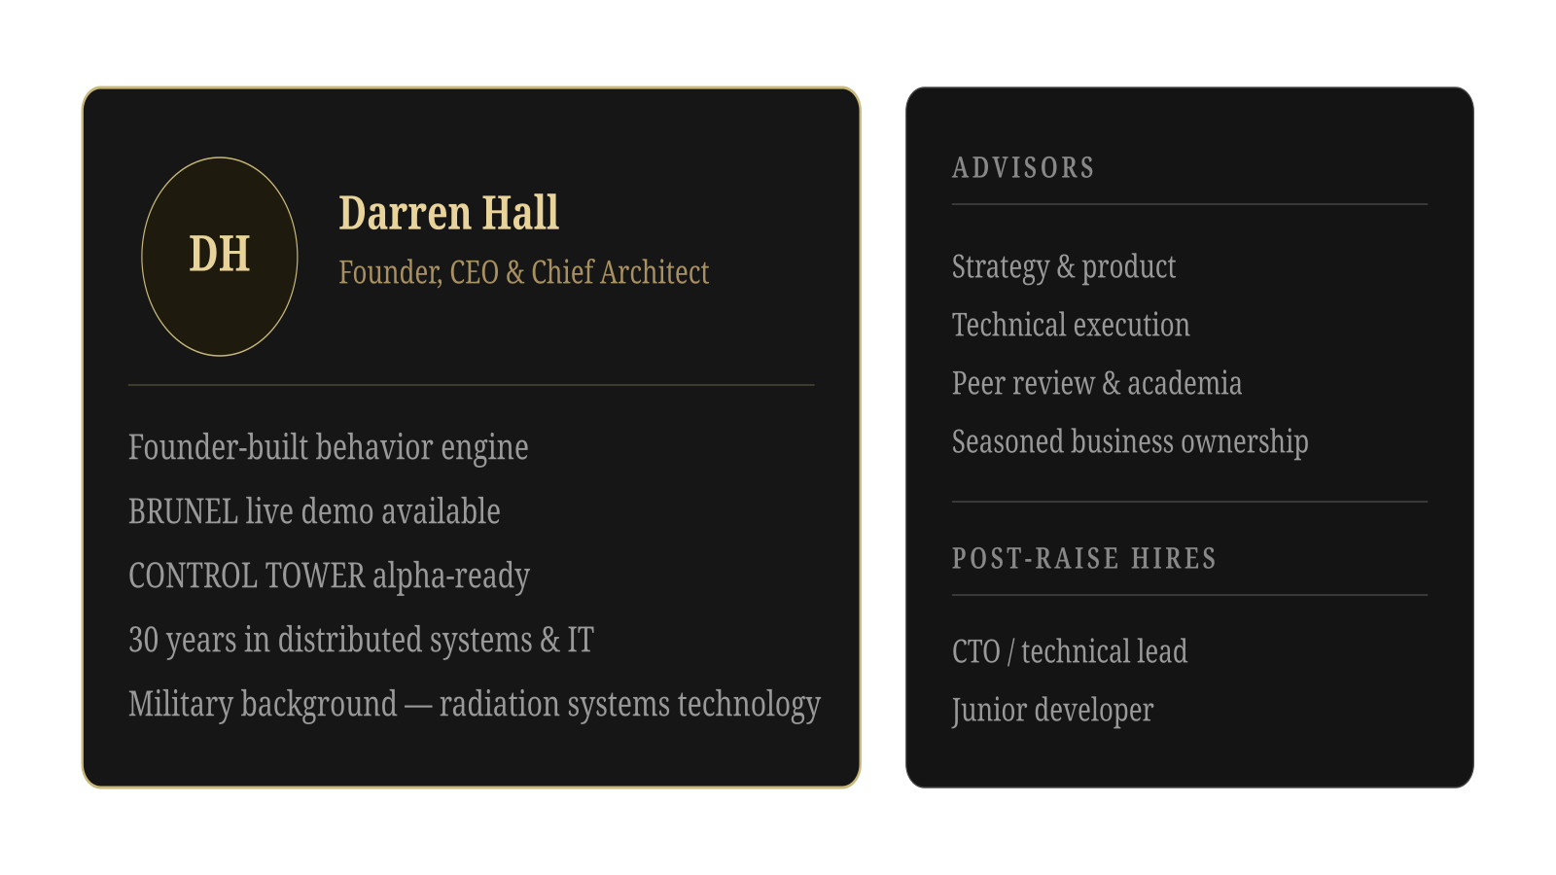
Founder-built behavior engine, now commercializing trust-based autonomy.
Founder / team
ARCHEPERSONA | Confidential Pre-Seed Deck
14

Slide 15
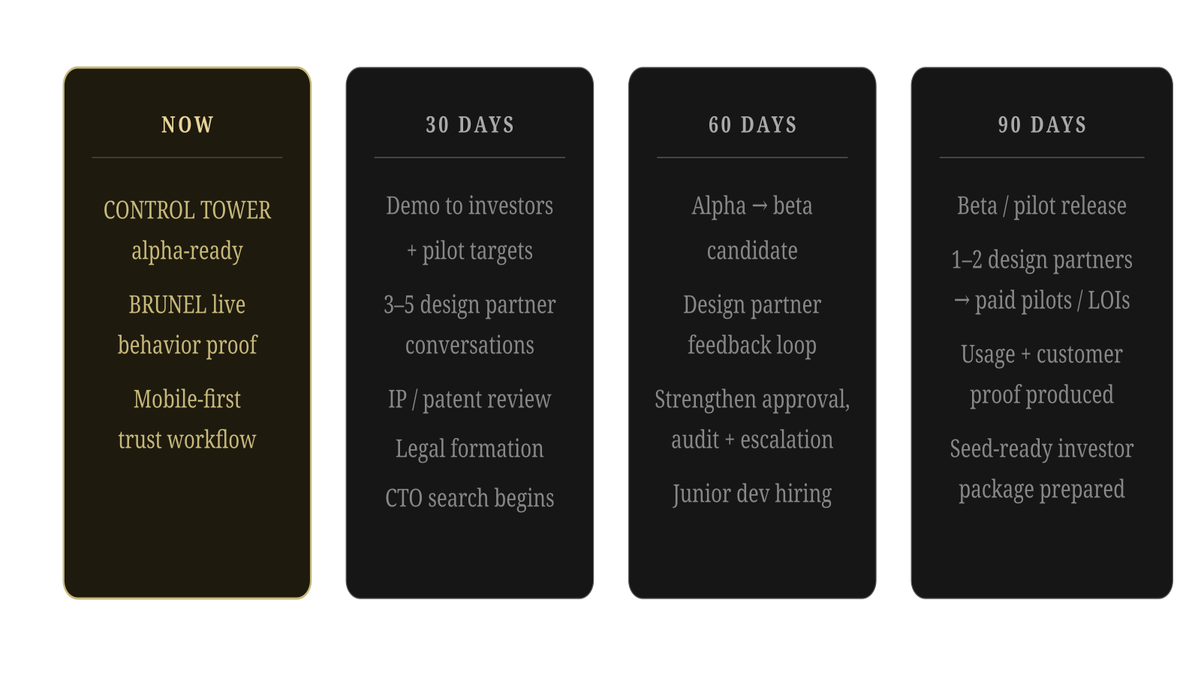
From alpha-ready to beta/release.
Roadmap
ARCHEPERSONA | Confidential Pre-Seed Deck
15

Slide 16
Raising $500K pre-seed.
Use of funds
Raising $500K pre-seed to move CONTROL TOWER from alpha-ready into beta/release, secure design partners, protect core IP, and build the foundation for scale.
USE OF FUNDS
DISCIPLINED RAISE
• CONTROL TOWER beta/release buildout
Enough to convert alpha-ready product into beta/release — not an oversized round before traction is converted.
• Patent/IP protection
• Incorporation and legal formation
• CTO / technical lead hire
• Junior developer hire
Target outcomes: design partners, paid pilots or LOIs, protected IP, first technical hires, and seed-ready proof.
• Design partner and pilot development
• Infrastructure and deployment stability
• Founder runway
ARCHEPERSONA | Confidential Pre-Seed Deck
16

Slide 17
Trust-based autonomy to prevent agentic operational loss.
Raising $500K pre-seed to move CONTROL TOWER from alpha-ready into beta/release, secure design partners, protect core IP, and build the foundation for scale.
$500K PRE-SEED
ARCHEPERSONA | Confidential Pre-Seed Deck
17

Slide 18
Backup: 15-market platform expansion map.
Backup
We enter through CONTROL TOWER. Here is how ARCHE expands.
CONTROL TOWER MARKETS
CHIMERA MARKETS
• AI agents
• AI companions / persistent assistants
• Agentic AI
• Character-based AI agents
• Workflow automation
• AI governance
• Branded AI agents / corporate personas
• AI TRiSM
• Digital identity / persona systems
• Compliance automation
• Cybersecurity / AI safety
• Enterprise operations
• Customer support automation
• RevOps / sales automation
Source: ArchePersona Market Research & Platform Expansion Analysis, June 2026.
ARCHEPERSONA | Confidential Pre-Seed Deck
18

Slide 19
Backup: ARCHEngine modules.
Technical diligence
ARCHEngine
INVESTOR-SAFE TRANSLATION
V-HOLD
V-HOLD
→ action control
TRUST BALANCER
TRUST BALANCER
→ risk and confidence regulation
DELIVERY ROOM
DELIVERY ROOM
→ controlled response/output layer
MDSA
MDSA
→ behavioral signal analysis
ARKHIVE
ARKHIVE
→ memory/archive layer
No deep architecture, system prompts, repo structure, or internal mechanisms in the main deck.
ARCHEPERSONA | Confidential Pre-Seed Deck
19

Slide 20
Backup: Market risk evidence.
Sources
The market research package includes risk statistics around enterprise AI losses, agentic AI cancellations, failed production deployments, and enterprise AI spend producing limited measurable results.
EVIDENCE CATEGORIES
• AI agent project failures
• Governance gaps
• Cost overruns
• Uncontrolled usage / spend
• Production system incidents
• Enterprise AI spend with weak ROI
Source: ArchePersona Market Research & Platform Expansion Analysis, June 2026.
ARCHEPERSONA | Confidential Pre-Seed Deck
20

Slide 21
Backup: competitive landscape examples.
Competitive diligence
Representative categories only. CONTROL TOWER is positioned at the operational checkpoint before agent action.
Category
Examples
Position
Agent builders
LangChain, CrewAI, AutoGen, OpenAI Agents / Assistants
Build and orchestrate agents
Observability
LangSmith, Langfuse, Arize Phoenix, AgentOps-style tools
Monitor traces, events, and behavior
Governance
Credo AI, Holistic AI, IBM watsonx.governance
Policy, compliance, and model risk
Security / authorization
Arcade.dev, identity/security platforms, MCP/A2A controls
Access, permissions, runtime policy
CONTROL TOWER
Mobile-first trust-based autonomy
Approve, block, escalate, intervene, and audit before action
Strategic advantage: timing + control surface. CONTROL TOWER operates where intent becomes consequence.
ARCHEPERSONA | Confidential Pre-Seed Deck
21

