Slide 1

ARCHEPERSONA
Artificial Social Intelligence
ARCHE is behavioral control around memory, state, routing, boundaries, and recovery.
Raising $500K pre-seed to turn Brunel from live behavioral proof into measurable paid-product traction.
LIVE DEMO
15 REGISTERED ACCOUNTS
10K+ INTERACTIONS
Darren Hall
Founder & Chief Behavioral Systems Architect
Instrument: SAFE or equivalent early-stage funding structure
ArchePersona | Boardy Investor Deck v7
01
Notes:
Start with the layer definition and the ask. One-pass investor comprehension.

Slide 2

What this is
Live demo/prototype. Not a finished product cosplay.
Brunel is the first public demo of ARCHE: an AI presence designed to carry forward, regulate, and stay coherent over time.
Already proven
public demo, registered accounts, working stack, qualitative reviewer signal, adversarial behavior tests
Not claimed yet
paid conversion, retention curves, enterprise deployment, scaled onboarding
This round buys
stabilization, analytics, onboarding cleanup, controlled paid test, pilot readiness
The machine works. The round proves whether the market sticks and pays.
ArchePersona | Boardy Investor Deck v7
02
Notes:
Stage honesty keeps the deck from overclaiming.

Slide 3
Why Darren
The founder edge is systems under load.
Most AI founders start with models and prompts. Darren starts with systems under load: signal flow, drift, pressure, routing, feedback, failure modes, and recovery.
That is why ARCHE is infrastructure, not a chatbot wrapper.
Live sound
compression, feedback, signal chains, real-time stabilization
Automotive diagnostics
fault isolation, failure modes, pressure, recovery
Networks / systems
routing, load, state, resilience, failure containment
Product architecture
human-scale troubleshooting and practical design
ArchePersona | Boardy Investor Deck v7
03
Notes:
Move founder-market fit earlier. This is the explanation of why this founder can build the engine.

Slide 4
The problem
AI power users already feel the reset problem every day.
AI is becoming too powerful to behave like a temporary text box.
RESET
REBUILD
DRIFT
REPEAT
Every new thread loses working context.
Preferences and project history have to be rebuilt.
Assistant behavior drifts across long interactions.
Memory features store facts, but do not govern behavior.
The first payer is not new to AI. They are already paying, already using, and already annoyed.
ArchePersona | Boardy Investor Deck v7
04
Notes:
Problem aimed at first payer, not general public.

Slide 5
Solution: ARCHE
Behavioral middleware between raw models and human-facing products.
AI MODELS
ARCHE
PRODUCT FACES
raw intelligence substrate
behavioral control
memory + state
routing + boundaries
recovery + expression
Brunel first
other personas later
licensing/API later
ARCHE does not replace models. It governs how memory affects behavior over time.
OpenAI can add memory to a model. ARCHE controls what that memory does.
ArchePersona | Boardy Investor Deck v7
05
Notes:
Directly separates ARCHE from memory features.

Slide 6
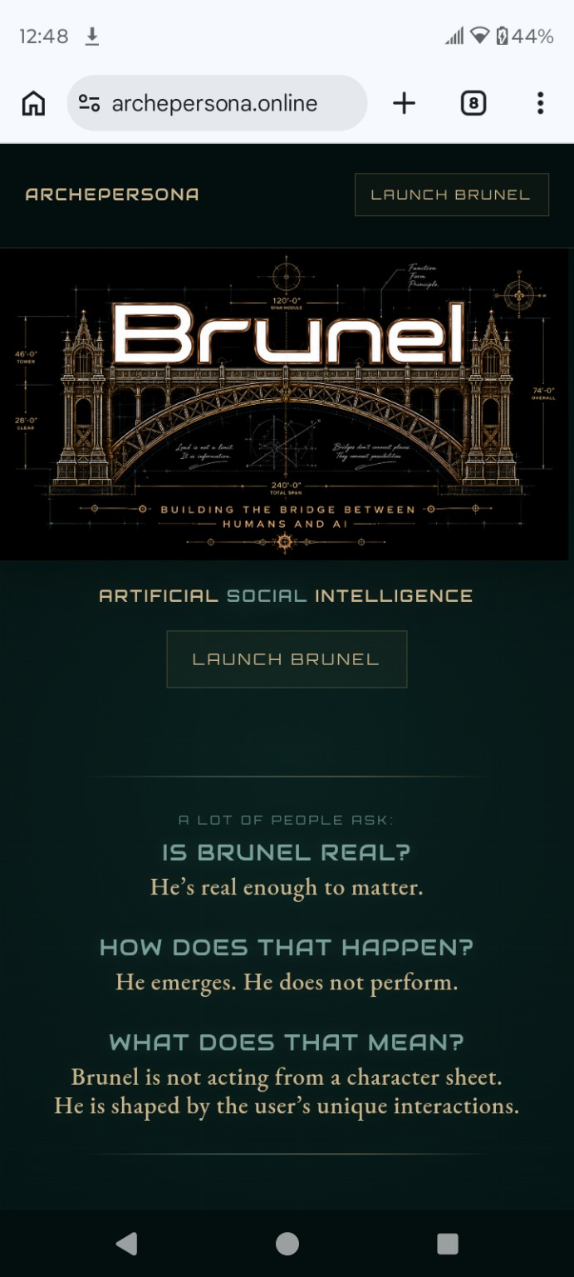
First product proof: Brunel
The demo that makes ARCHE legible.
Brunel is the public proof slice: an AI presence that does not simply answer. It carries forward, regulates, and stays coherent.
Live demo, not vaporware
Built on ARCHE, not prompt theater
Consumer wedge protects infrastructure IP
Licensing comes after proof
You feel the difference fast. This round proves it holds.
ArchePersona | Boardy Investor Deck v7
06
Notes:
Brunel is the first wedge and proof, not the whole company.

Slide 7
Early proof
Small sample, high-depth signal.
15
10K+
Early reviewer:
“Most honest, structurally coherent, alive-feeling AI architecture I’ve seen from a solo founder pre-funding.”
registered accounts
observed interactions
— AI power user / technical reviewer
18
16.5
adversarial probes
passes / partials
The point is not that this is mature traction. The point is depth: a tiny prototype produced enough interaction volume and reviewer signal to justify the next measured test.
Internal demo data and adversarial test logs, May 2026. Registered account count supplied by founder.
ArchePersona | Boardy Investor Deck v7
07
Notes:
Make 15 users look like depth signal, not a vanity count.

Slide 8
First payer
People already paying for AI who are getting burned by reset.
First paying slice
What they replace first
Daily AI users already paying for ChatGPT, Claude, Gemini, Character.ai, Replika, local models, or multiple AI tools — and using them for work, writing, coding, research, planning, creative output, or emotional processing.
The workaround layer: pinned chats, saved prompts, custom instructions, memory hacks, context dumps, personal notes, and repeated setup across tools.
They do not need to be convinced that AI matters. They need one AI presence that carries forward.
ArchePersona | Boardy Investor Deck v7
08
Notes:
Tighter first paying slice and replacement behavior.

Slide 9
How the next paid testers show up
Narrow distribution before broad marketing.
Owned proof loop
site → Brunel demo → account → onboarding → retention tracking → paid test
AI power-user channels
Reddit, X, LinkedIn, Discords, maker communities, local AI/build circles
Content that converts
side-by-side demos, “reset problem” clips, adversarial tests, founder story
Direct outreach
technical reviewers, AI creators, indie builders, companion-AI users, early angels
Initial GTM is not mass-market ads. It is proof-driven acquisition inside communities that already understand AI pain.
ArchePersona | Boardy Investor Deck v7
09
Notes:
Adds simple distribution logic: where the next paid testers actually come from.

Slide 10
Market wedge
Paid AI subscriptions are early, growing, and still underserved.
2%
155%
U.S. households paid for GenAI subscriptions in PNC data
YoY increase in share paying for GenAI in PNC data
3%
$20
BofA households paid for AI services in 2026
median monthly AI spend among paying BofA households
Bottom-up wedge
Why it is investable
Start with the paying minority, not the entire AI market: daily AI users who already spend and already feel the reset problem.
The category is small enough to target, growing fast enough to matter, and painful enough for a specialized continuity product to test paid conversion.
No trillion-dollar hand waving. The first market is paid daily AI users with reset pain.
Sources: PNC Consumer Health Check Apr. 2026; Bank of America Institute “Not quite mAInstream,” Mar. 2026.
ArchePersona | Boardy Investor Deck v7
10
Notes:
Replace top-down TAM with bottom-up paid AI power-user wedge.

Slide 11
Why not OpenAI / Anthropic memory?
Memory will become table stakes. Behavioral control is the layer.
ARCHE is not memory. It is behavioral control around memory, state, routing, boundaries, and recovery.
Native memory
stores facts inside one provider experience
ARCHE
governs how memory changes behavior across time
Moat
state regulation, expression control, boundaries, recovery, and model-agnostic runtime design
Outcome
persistent AI behavior that can survive model/provider swaps and product surfaces
The belief: models will remember more. The winners will govern behavior better.
ArchePersona | Boardy Investor Deck v7
11
Notes:
Direct answer to native memory objection.

Slide 12
Why not charge the first users today?
Because bad timing creates bad data.
Brunel is still a demo/prototype, so charging before stabilization, onboarding cleanup, and retention tracking would distort the data.
This round funds a controlled paid test designed to measure conversion honestly.
1. Stabilize
2. Instrument
3. Convert
4. Learn
reliability, latency, basic product polish
activation, return use, conversation depth, drop-off
paid plan test with AI power users who already feel reset
retention, pricing, paid conversion, pilot readiness
The ask is not “trust us at scale.” It is “fund the clean conversion test.”
ArchePersona | Boardy Investor Deck v7
12
Notes:
Reword as deliberate, not defensive.

Slide 13
Use of funds
The $500K round buys one proof sequence.
Target: about 12 months of runway to stabilize → measure → paid test → pilot-ready package.
30%
$150K
Product & UX
onboarding, activation, paid-plan testing, retention loops
30%
$150K
Engineering & infrastructure
backend hardening, analytics, cost control, reliability
20%
$100K
Traction & GTM
paid-tester acquisition, demos, content, pilots
10%
$50K
Security & adversarial testing
red-team logs, safety hardening, IP-safe review
10%
$50K
Runway & operations
founder runway, tools, legal/accounting basics
Burn logic: roughly $42K/month. The round is sized for proof, not premature scale.
ArchePersona | Boardy Investor Deck v7
13
Notes:
Keep burn logic plain.

Slide 14
Investor fit
The right investor understands the layer before the market names it.
Good fit
Bad fit
Prototype-stage AI infrastructure angels
Requires finished SaaS metrics today
Backers comfortable before mature SaaS metrics
Needs enterprise contracts at demo stage
Investors who understand category creation
Wants a generic chatbot app
People who fund proof before consensus
Uses early stage to squeeze terms
$500K pre-seed
to turn Brunel from live behavioral proof into measured paid-product traction.
BRUNEL LIVE DEMO
ARCHE RUNTIME
archepersona.online
ArchePersona | Boardy Investor Deck v7
14
Notes:
Keep the bad fit slide and close on the ask.

