Slide 1
Bringing compute to the heat
ARCHEGON CAPITAL
A zero-start proof of geothermal-powered AI compute in Australia and/or New Zealand.
Draft for discussion · not an offer · not a priced round
Not a priced round
AU and/or NZ
PoC · zero-start
archegon.com
Archegon · sourced or labelled figures · illustrative, not an offer · October 2026 · v3 · Model FX A$→US$ 0.7122
1 / 27

Slide 2
The right physics, the wrong economics
ARCHEGON
Why a century of proven physics has produced so little capacity.
Geothermal is the only renewable that matches a 24/7 AI load — available around the clock and carbon-free; firm supply to an islanded load still needs N-1 redundancy and backup (slide 17). It has never scaled because the geology had to be found, not built.
Heat, water and permeable rock had to coincide naturally, and that coincidence is a rounding error in global generation. Fervo's claim is that it can be engineered instead of located.
World geothermal at year-end 2025
17,173 MW
VERIFIED · fervo-egs-tech-56 · ThinkGeoEnergy YE2025. The geographic constraint Fervo claims to engineer around.
Archegon · sourced or labelled figures · illustrative, not an offer · October 2026 · v3 · Model FX A$→US$ 0.7122
2 / 27

Slide 3
Fervo made permeability a manufacturing problem
ARCHEGON
Four moves that make permeability a design choice rather than a site accident.
01 Horizontal laterals
02 Multi-stage frac
Sawtooth 7: 7,500 ft / 2,286 m through the hot zone. Rock contacted per well becomes a design choice, not a luck draw.
The lateral is isolated and stimulated in sequence. Permeability is engineered in. It aims to remove the geographic constraint; unproven in Cooper Basin geology, where Habanero's permeability was one sub-horizontal thrust fault.
03 DAS / DTS fibre
04 Doublet
Distributed acoustic and temperature sensing along the whole lateral. Reservoir management becomes measurement, which is what makes a learning curve possible.
Injector and producer as a closed circulation loop into an ORC binary plant. Fluid is recirculated; some is lost to the formation, so make-up water is needed.
Archegon · sourced or labelled figures · illustrative, not an offer · October 2026 · v3 · Model FX A$→US$ 0.7122
3 / 27

Slide 4
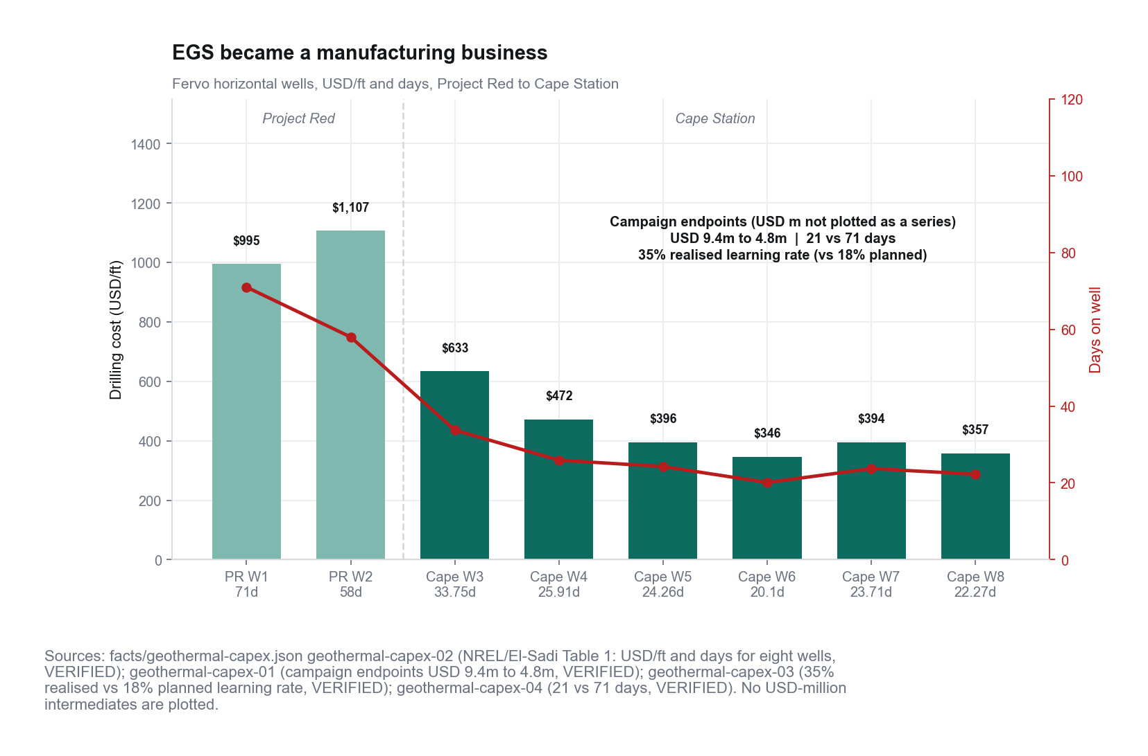
Cape Station cut well cost from US$9.4m to US$4.8m
ARCHEGON
US$/ft and days, eight wells. Source reports a 35% learning rate vs 18% planned; the cost endpoints alone imply ~20% per doubling.
US$9.4m → US$4.8m over eight wells is three doublings, ~20% per doubling of well count (geothermal-capex-01). The 35% vs 18% is the source's own metric (geothermal-capex-03), not well cost. Our model uses none of this; the only Cooper Basin record ran the other way (A$11.40m → A$50.85m, slide 7).
Archegon · sourced or labelled figures · illustrative, not an offer · October 2026 · v3 · Model FX A$→US$ 0.7122
4 / 27

Slide 5
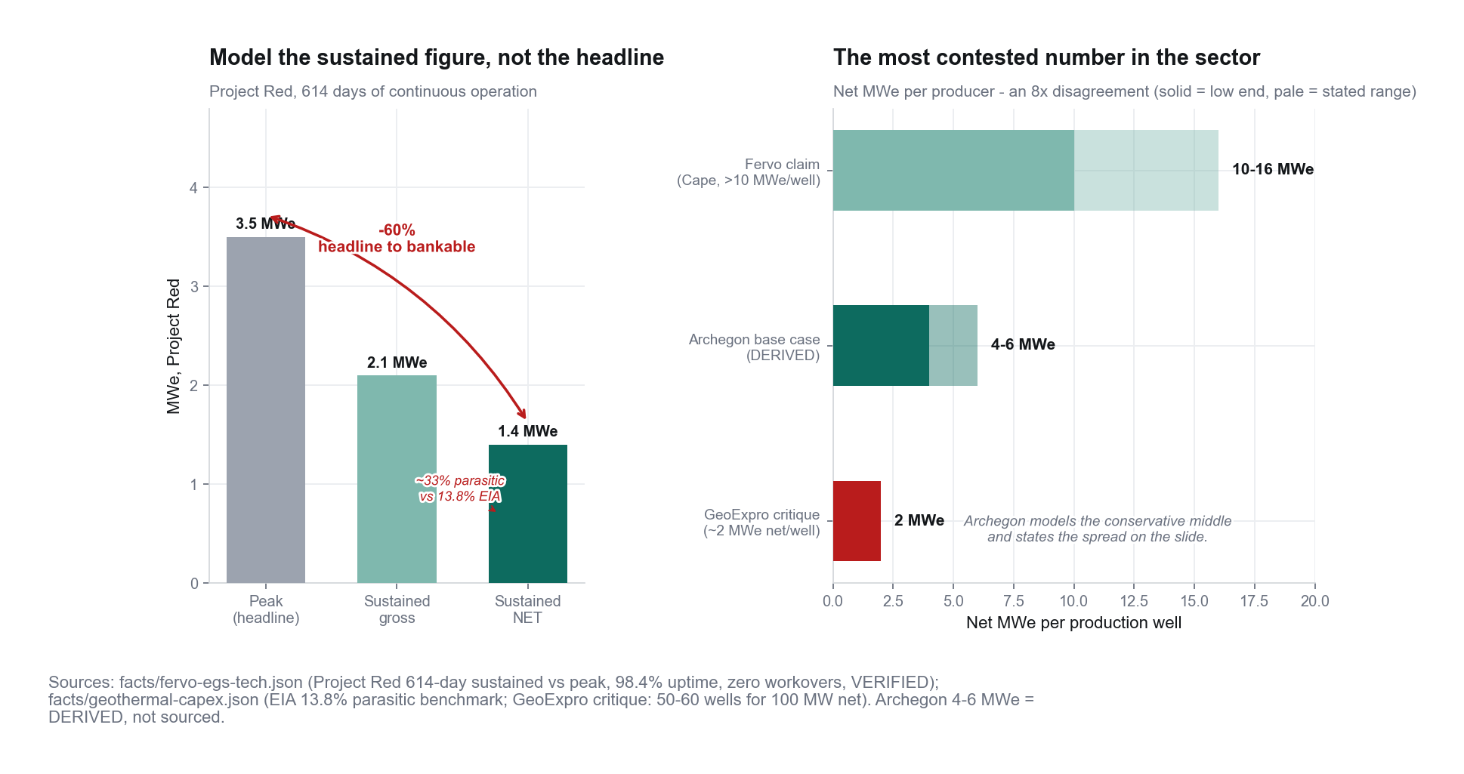
Underwrite 1.4 MWe net sustained, not 3.5 MWe peak
ARCHEGON
Peak is not the number a diligence team will underwrite.
Project Red, step by step
3.5 MWe peak (calculated, not metered)
→ 2.1 MW gross sustained (614+ days)
− 0.7 MW parasitic (pumping) = 1.4 MW net
Our BASE 5 MWe net per producer is an ASSUMPTION 3.6× this. Habanero's best sustained loop (19 kg/s) ≈ 1.0–1.5 MWe net. Flow basis: slide 16. Decline analogue: Soultz (ORC since 2008).
Archegon · sourced or labelled figures · illustrative, not an offer · October 2026 · v3 · Model FX A$→US$ 0.7122
5 / 27

Slide 6
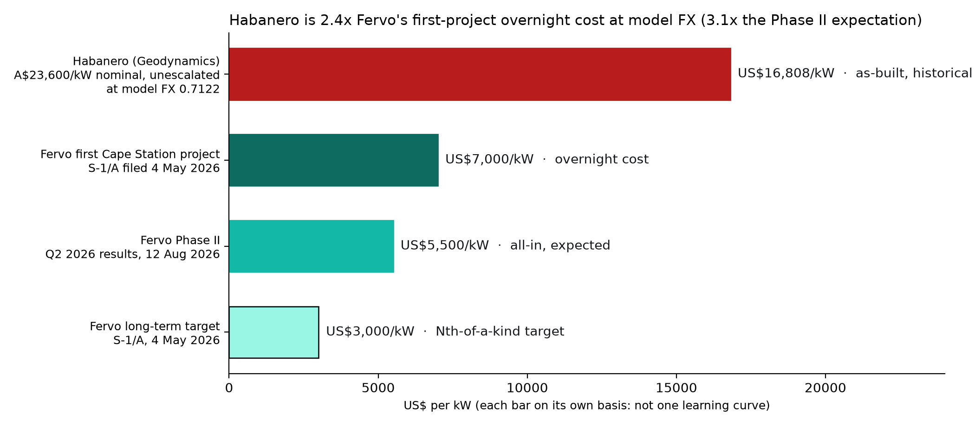
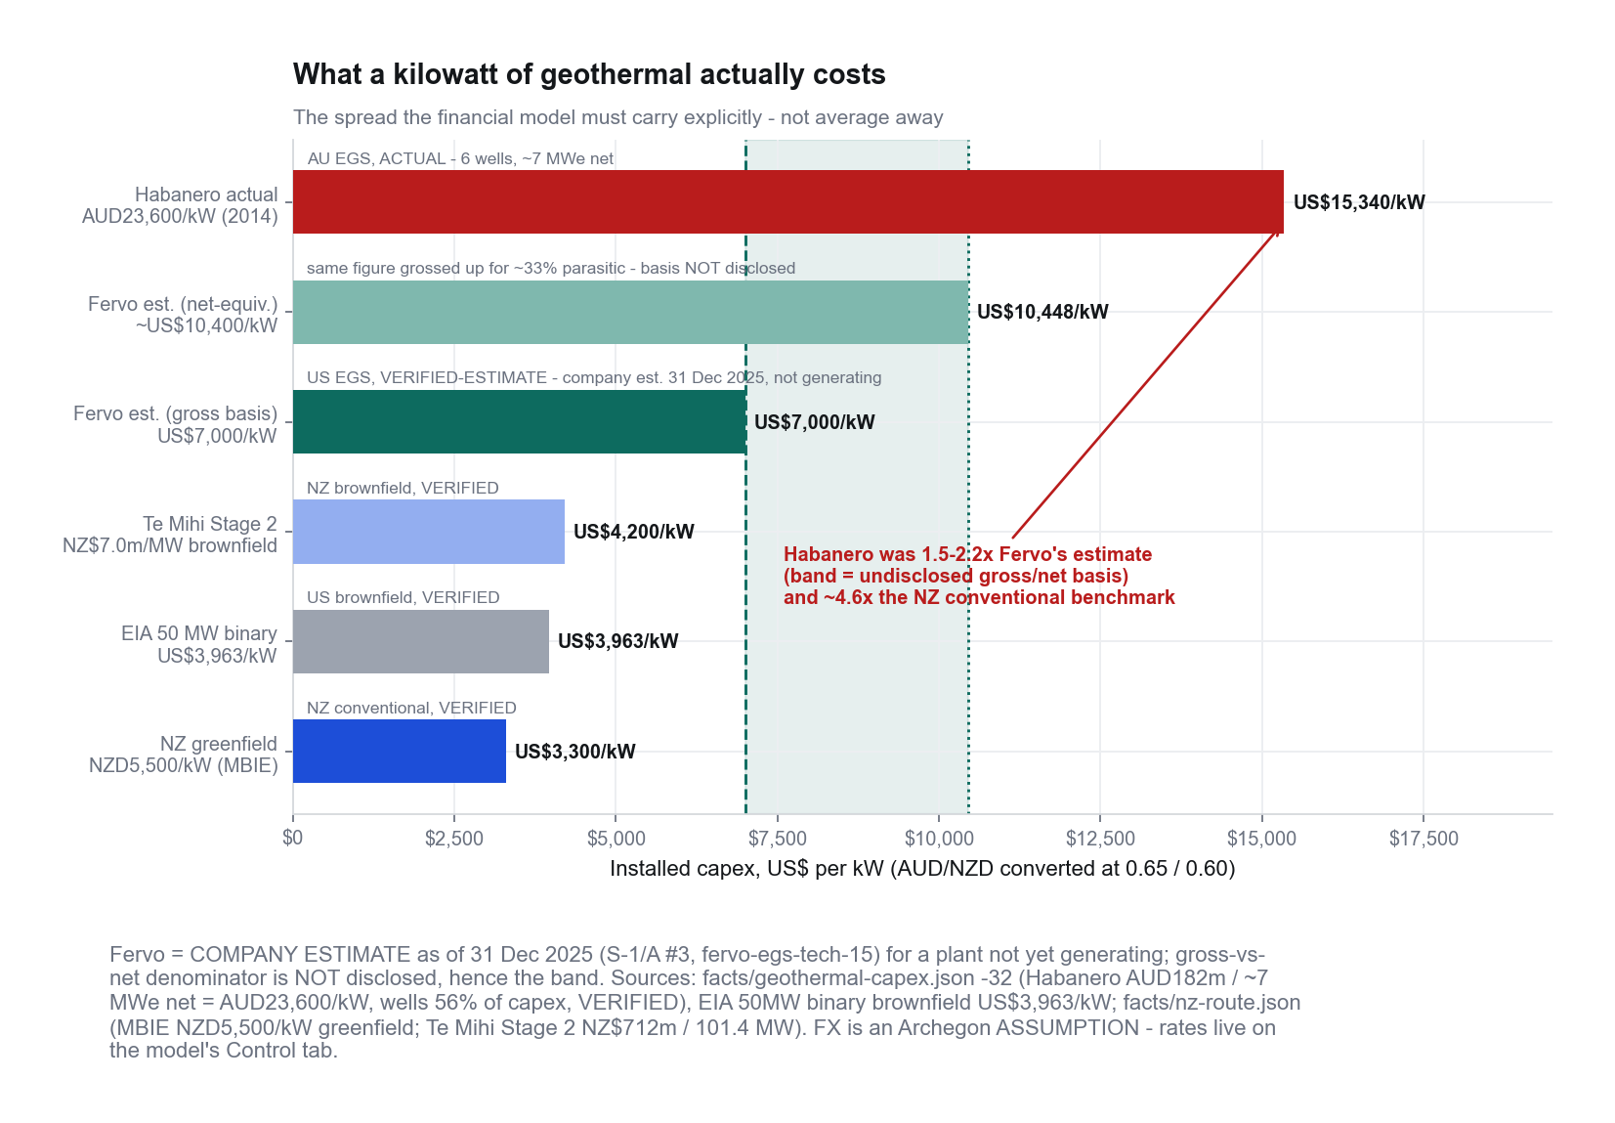
Habanero cost 2.4× Fervo's first-project estimate
ARCHEGON
One currency, model FX 0.7122. Each Fervo figure is on its own basis: overnight, all-in expected, target. Not one curve.
33 MW net, operating
Cape Station GeoBlock 1 reached commercial operation on 30 Sep 2026, selling under its PPA.
7,000 · 5,500 · 3,000
US$/kW: overnight, first project (S-1/A, 4 May 2026) · Phase II all-in expected (12 Aug 2026) · long-term target. Company guidance, not as-built.
2.4× US$
Habanero A$23,600/kW → US$16,808/kW at 0.7122 (nominal, unescalated).
Archegon · sourced or labelled figures · illustrative, not an offer · October 2026 · v3 · Model FX A$→US$ 0.7122
6 / 27

Slide 7
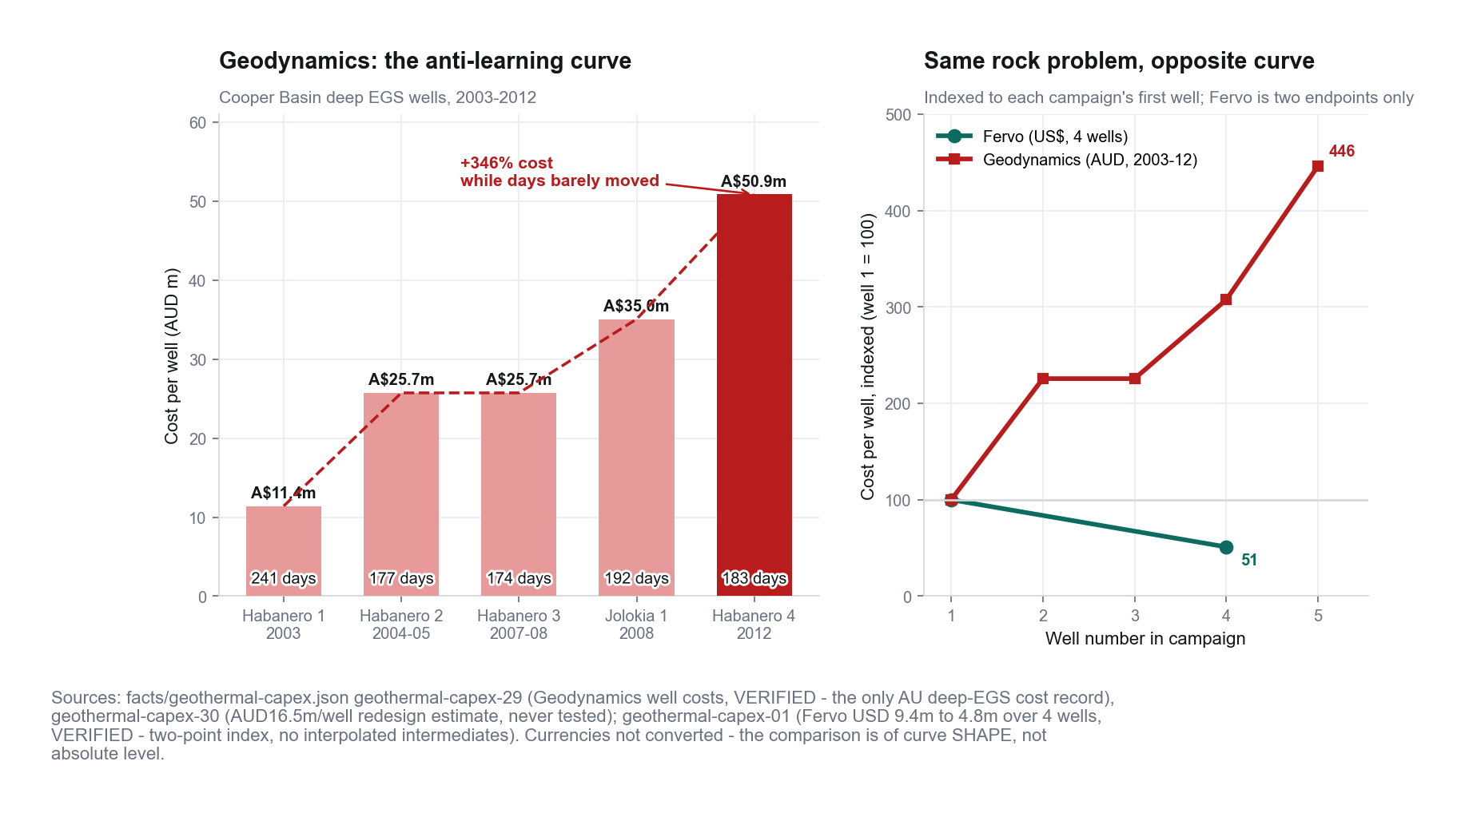
Habanero failed on market access and on flow
ARCHEGON
Geodynamics wells A$11.40m → A$50.85m. Co-location fixes the first failure; Fervo toolkit is the claim on the second.
Market access
Lost the co-located heat customer; transmission uneconomic. Co-location of the AI load is the claim on this half.
Flow / cost
Reservoir and well-cost performance were also disappointing. The Fervo toolkit is the claim on this half — a claim, not a result.
Archegon · sourced or labelled figures · illustrative, not an offer · October 2026 · v3 · Model FX A$→US$ 0.7122
7 / 27

Slide 8
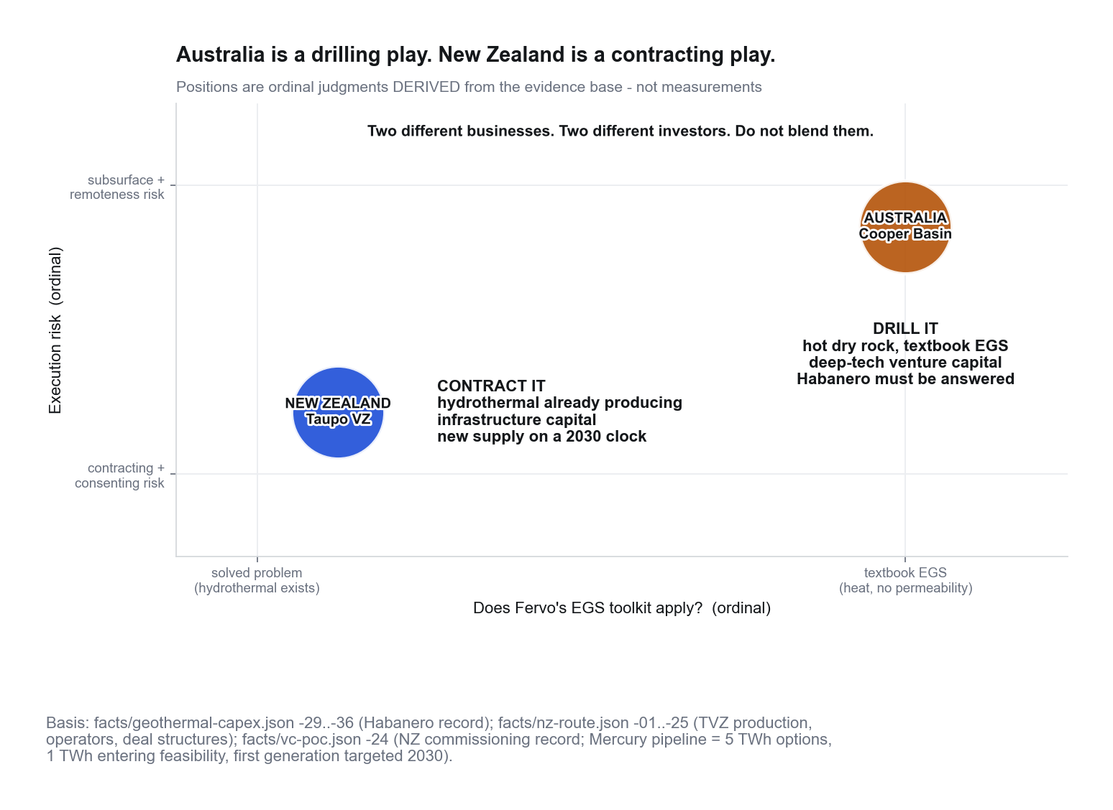
Australia drills. New Zealand contracts.
ARCHEGON
AU = Cooper Basin hot dry rock. NZ = already-producing TVZ. Do not blend.
Archegon · sourced or labelled figures · illustrative, not an offer · October 2026 · v3 · Model FX A$→US$ 0.7122
8 / 27

Slide 9
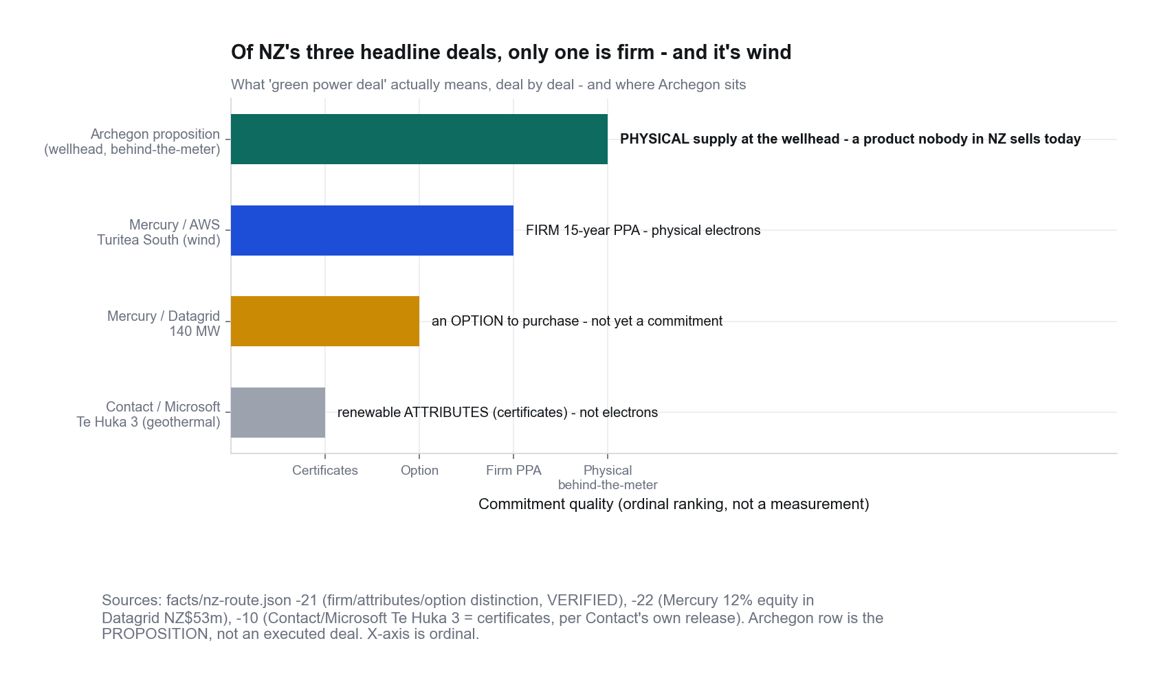
NZ is an option, not a switch
ARCHEGON
Pipeline is real and slow. First generation targeted 2030. Attributes are not electrons.
Mercury (NZX 472609)
Up to 5 TWh options
2.5 TWh active development
1 TWh Ngā Tamariki + Rotokawa entering feasibility
NZ$75m appraisal drilling
First generation 2030
Contact–Microsoft is attributes, not physical supply.
Any NZ plan that needs geothermal electrons before 2030 must source them from existing stations, not this pipeline. Physical, behind-the-meter, wellhead supply is a product nobody in New Zealand is currently selling.
Archegon · sourced or labelled figures · illustrative, not an offer · October 2026 · v3 · Model FX A$→US$ 0.7122
9 / 27

Slide 10
Legals are on the critical path, unpriced
ARCHEGON
Clocks are scenario branches. Zeros in the model are RATE_MISSING — unpriced, not cheap.
Australia
Federal RTN: 6-month s35 floor.
Separate s32 4-month expedited-procedure branch. Do not schedule 4 months as the negotiated minimum.
Unresolved whether a geothermal licence is an NTA “right to mine”. The 6-month clock is not an established geothermal default until counsel answers that.
Conjunctive ILUA is the load-bearing route.
New Zealand
Iwi partnership, not freehold.
Fast-track exists. Archegon is not on Schedule 2 — referral is discretionary, and it adds time.
There is no published cost for concluding the AU native title instrument. NZ grid + fibre are likewise unpriced.
Model land + legals = A$0 · RATE_MISSING
Ships at zero and is labelled unpriced. Resolving land, AU/NZ legals, and NZ grid+fibre can only move the floor up. It is not a free input.
Archegon · sourced or labelled figures · illustrative, not an offer · October 2026 · v3 · Model FX A$→US$ 0.7122
10 / 27

Slide 11
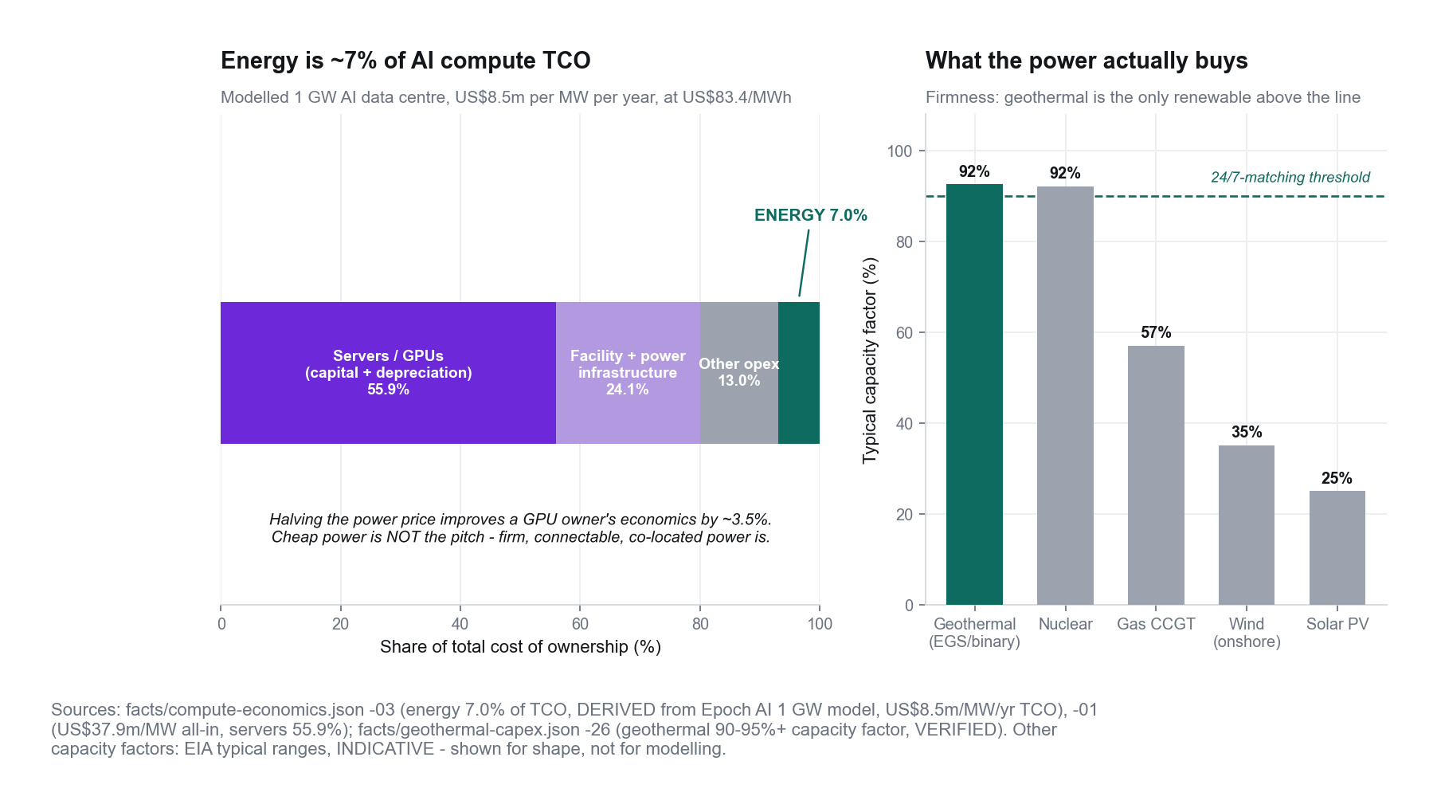
Energy is ~7% of TCO for a GPU owner, not for a landlord
ARCHEGON
Modelled 1 GW stack (compute-economics-03, DERIVED) assumes the operator owns the GPUs. Under COLO the tenant does.
Under COLO our costs are the shell and the power system, and the power system costs ~98% of colo revenue at 8% (slide 18). A premium for firm, carbon-free power is unproven until tenant LOIs price it.
Archegon · sourced or labelled figures · illustrative, not an offer · October 2026 · v3 · Model FX A$→US$ 0.7122
11 / 27

Slide 12
AU: compute is the biggest block; wells carry the risk
ARCHEGON
Model at current settings: Route AU, COLO, BASE/BASE, LIQUID, remote ON, 5.0 MW IT, PUE 1.25, 25% contingency, 90% CF.
AU floor A$301.2m
NZ floor A$127.2m
Zeros = RATE_MISSING
AU · DERIVED / FLOOR
Wells: 2 producers + 2 injectors = 4
Net nameplate: 6.94 MW (5 × 1.25 PUE ÷ 0.90 CF) · 6.25 MW average, not firm
Well ratings are NET (parasitic inside). Compute A$132.3m = 55% of pre-contingency capex; wells + mob 29%.
Infra (wells+mob+plant): A$108.6m
Compute (shell+liquid, remote on): A$132.3m
Land / legals: A$0 RATE_MISSING
NZ · FLOOR
Compute: A$101.8m + A$25.4m contingency = A$127.2m (NZ$157.3m)
Infra / land / legals: A$0 RATE_MISSING
COLO tenant pays IT fit-out.
Archegon · sourced or labelled figures · illustrative, not an offer · October 2026 · v3 · Model FX A$→US$ 0.7122
12 / 27

Slide 13
The derived raise is a floor, and it is not repaid
ARCHEGON
AU capex + A$6.0m 24-month runway. Grants sit beside the raise, never netted.
AU derived raise
A$348.5m
US$248.2m
FLOOR · includes A$6.0m runway
Converted at model FX 0.7122 (geothermal-capex-71) — the rate all workbook money uses.
Offsets, not cash in hand
ARENA Launchpad / NZ RIF named as offsets. No grant dollar is treated as in-hand. Contribution A$10.1m/yr = 2.9% of the raise; 25 years of it (A$251.6m) does not repay A$348.5m.
Archegon · sourced or labelled figures · illustrative, not an offer · October 2026 · v3 · Model FX A$→US$ 0.7122
13 / 27

Slide 14
COLO covers opex; it does not repay the raise
ARCHEGON
No power-only fallback on the islanded AU route (A$0 without a grid tie). ANCHOR comps are ~400 MW hyperscale leases: reference only. BAREMETAL unpriced.
COLO
A$14.5m/yr
ANCHOR
A$16.6m/yr
BAREMETAL
unpriced · A$0
COLO contribution
A$10.1m/yr
before debt service · opex A$4.5m/yr
Archegon · sourced or labelled figures · illustrative, not an offer · October 2026 · v3 · Model FX A$→US$ 0.7122
14 / 27

Slide 15
One meaning per word: net, gross, average, firm
ARCHEGON
v3 fixes the net/gross mix-up. Every MWe-per-producer figure is NET at the plant fence.
Term | Definition | Reference case (5 MW IT)
Gross | Generator-terminal output, before the plant's own load | not modelled directly
Parasitic | Injection pumps, ORC feed pumps, condenser fans, services | EIA 13.8% · EGS stress ~29% (GeoExpro-derived)
Net | Gross − parasitic = delivered to the site board | 6.94 MW nameplate
Average | Net nameplate × 0.90 capacity factor (annual energy) | 6.25 MW = facility load
Firm | Guaranteed every hour with one element out (N-1) | 5.0 MW today (one producer out), no backup
Facility / IT | IT × PUE 1.25 (ASSUMPTION) / power to racks | 6.25 MW / 5.0 MW in four 1.25 MW modules
v2 labelled HIGH (13 MWe) "gross" and LOW/BASE "net", and called the 6.25 MW average "firm". Both are corrected in the model, deck, diagrams and site.
Archegon · sourced or labelled figures · illustrative, not an offer · October 2026 · v3 · Model FX A$→US$ 0.7122
15 / 27

Slide 16
What flow does 5 MWe net per producer need?
ARCHEGON
Screening calc (exergy × 40–50% utilisation × (1 − 13.8–29% parasitic)). Not a reservoir forecast.
Production temp | Flow for 5 MWe net | Reference
169 °C | 104–158 kg/s | Fervo Project Red
200 °C | 74–112 kg/s | Habanero earlier trial (~200 degC)
215 °C | 64–97 kg/s | Habanero 4 wellhead, 2013
220 °C | 61–93 kg/s
240 °C | 52–79 kg/s
Measured flow | Source | Net MWe @215 °C
19 kg/s | Habanero best sustained closed loop | 1.0–1.5
39 kg/s | Habanero 4 open flow | 2.0–3.0
36 kg/s | Fervo Red sustained average | 1.9–2.8
63 kg/s | Fervo Red peak | 3.2–4.9
107 kg/s | Fervo Cape 30-day max, Sep 2024 | 5.5–8.3
Habanero's best sustained loop (19 kg/s) supports ~1.0–1.5 MWe net. BASE needs 3.4–5.4× that. At 1.4 MWe/producer the reference needs 10 wells and A$431.0m; at 2 MWe, 8 wells and A$389.7m; doublet vs triplet adds 50% more wells.
NEEDS SITE DATA: a reservoir engineer's sustainable rate, temperature and injectivity; Habanero tracer/injectivity data; ORC vendor curve.
Archegon · sourced or labelled figures · illustrative, not an offer · October 2026 · v3 · Model FX A$→US$ 0.7122
16 / 27

Slide 17
Average power is not firm power
ARCHEGON
Islanded, the 10% of hours a 0.90 capacity factor leaves uncovered are outages unless something else is on site.
Item | Value
Average net at fence | 6.25 MW
Firm with one producer out (N-1) | 5.0 MW → 4.0 MW IT → 3 whole modules
Hours not covered at 90% CF | 876 h/yr (5,475 MWh)
Diesel to cover them (illustrative) | ~1.42 million litres/yr; price unpriced
N-1 on producers (3rd doublet) | +A$41.25m → raise A$389.7m
BESS, standby gen, black start | Public proxy (GenCost 2025-26): ~A$23.7m incl. contingency; not in the raise
Hot day (40 °C+), air-cooled ORC | Derate RATE_MISSING; at an illustrative 20% loss 3 modules stay lit, 2 with one producer out (Firm-Power D31:D34 corrected 13 Oct)
Wells 20% low | 8 MWe still covers 6.94 MW: no change. Supply falls only below 3.47 MWe/producer (31% low)
Base case has zero margin: four modules draw 6.25 MW against 6.25 MW average. Module 4 is sold as interruptible unless backup is bought.
Archegon · sourced or labelled figures · illustrative, not an offer · October 2026 · v3 · Model FX A$→US$ 0.7122
17 / 27

Slide 18
Two businesses: price the power as power
ARCHEGON
PowerCo (wells + ORC) sells to DCCo (the hall) at a transfer price = its levelised cost. WACC is an ASSUMPTION.
PowerCo levelised cost | A$/MWh | Capital + O&M, A$m/yr
Low (6%, 25 yrs) | 280 | 15.3
BASE (Rates wacc_base) (8%, 25 yrs) | 330 | 18.1
High (10%, 25 yrs) | 383 | 21.0
Stress check (10%, 20 yrs) | 407 | 22.3
At Habanero 4 actual well cost (8%) | 553
SA wholesale (reference) | 88
DCCo (the hall) | A$m/yr
Colo revenue | 14.53
Power at transfer price (8%) | −18.05
DC opex (RATE_MISSING) | 0.00
DCCo before team | -3.52
Consolidated contribution (capital uncharged) | 10.06
Power-only fallback, islanded AU | 0.00
…if a grid tie existed (unpriced) at SA wholesale | 4.82
The power system costs ~124% of colo revenue at 8%. With free power the hall yields 8.8% on its own build cost. A 10% contribution yield on the raise needs ~US$467/kW/month (2.4× the benchmark).
Archegon · sourced or labelled figures · illustrative, not an offer · October 2026 · v3 · Model FX A$→US$ 0.7122
18 / 27

Slide 19
On our own numbers, NZ beats AU
ARCHEGON
AU-first must be argued as an option on a reservoir, not implied by slide order.
 | Australia (drill) | New Zealand (contract)
Raise, A$ | A$348.5m | A$133.2m
Revenue (colo), A$/yr | A$14.5m | A$14.5m
Energy / plant cost, A$/yr | A$1.5m | A$4.6m
Contribution, A$/yr | A$10.1m | A$6.9m
Contribution / raise | 2.9% | 5.2%
Drilling risk carried | Yes (4 wells) | None
What Archegon owns | A reservoir (option value) | A contract
NZ power is priced off ONE week of spot (NZ$105/MWh, 17–23 May 2026). NZ stays ahead unless contracted power exceeds ~NZ$174/MWh. Needs: an indicative 15–20 yr PPA quote, checked against ASX NZ futures.
Archegon · sourced or labelled figures · illustrative, not an offer · October 2026 · v3 · Model FX A$→US$ 0.7122
19 / 27

Slide 20
Reservoir first: a gated plan with pass/fail tests
ARCHEGON
Each gate is its own decision. No hall until the reservoir passes.
Gate | Buys | Capital (model rates) | Pass if
Gate 0 - SEED (US$10m) | Tranched seed: engineers/viability, lawyers/government, DC procurement, financing, itemised runway, buffer; Tranche 3 pre-buys Gate 1 long-lead items. See Seed tab. | A$4.2m–A$14.0m (public proxy) | Signed reservoir-engineer case for flow, temperature, injectivity; AFE in 2027 A$; principal named; LOI with price and energy terms
Gate 1a - appraisal well (option) | One deep well: temperature, stress, image logs, injectivity. Cheaper than a doublet. | A$31.6m | Temperature >= target; stress regime and fracture orientation compatible with the lateral design
Gate 1 - RESERVOIR TEST | One doublet + 90-180 day circulation test. No plant, no hall. | A$69.2m | v4: incl. stimulation of both wells; less seed Tranche 3 pre-buys; grossed up for the 6% success fee so the test is fully funded.
Gate 2 - first whole module | Plant sized to MEASURED flow + one 1.25 MW module, signed tenant | A$105.7m | Metered net power; PUE; tenant paying; N-1 design costed
Gate 3 - 5 MW reference | Scale to 4 modules | A$348.5m | Gate 2 performance holds; firm-power cover priced
Archegon · sourced or labelled figures · illustrative, not an offer · October 2026 · v3 · Model FX A$→US$ 0.7122
20 / 27

Slide 21
Rent the hall, or sell compute?
ARCHEGON
Selling GPU-hours earns far more per MW, but needs ~A$287m of GPUs per 5 MW and carries GPU price risk. Inputs are PUBLIC PROXIES.
5 MW reference | Total capital | Revenue yr 1 | EBITDA yr 1 | EBITDA ÷ capital | 25-yr IRR
AU rent (colo) | A$348.5m | A$14.5m | A$10.1m | 2.9% | -2.4%
AU sell compute, prices fall ~25%/yr | A$645.0m | A$132.7m | A$87.8m | 13.6% | never repays
AU sell compute, flat prices | A$645.0m | A$132.7m | A$87.8m | 13.6% | 4.1%
NZ sell compute, flat prices | A$421.2m | A$132.7m | A$85.9m | 20.4% | 8.5%
AU downside: 47% util, remote −20% | A$645.0m | A$71.3m | A$26.3m | 4.1% | never repays
Inputs (PUBLIC PROXY): 8-GPU B200 server ~US$450k, 14.3 kW (Mercatus 2026; NVIDIA); network/storage +30%; maintenance 10%/yr; ops 5 FTE per 512 GPUs at US$275k (GPUaaS.com TCO, Jun 2026). Price US$5.52/GPU-h = 1-yr reserved, derived from the B200 on-demand median US$6.99 less 21% (gpueconomy.com, 12 Oct 2026; AI Industry Reviews, Sep 2026). Utilisation 70%. GPUs replaced every 5 years.
Downside is real: if B200 prices follow the H100 path (−25%/yr), the fleet never repays. With flat prices: AU 4.1%, NZ 8.5%.
Connectivity (PUBLIC PROXY, Connectivity tab): figures include fibre Innamincka–Moomba, ~79 km at A$125k/km = A$9.9m plus A$1.3m/yr. One satellite terminal (~50 Mbps) cannot carry the cluster. Bonded satellite: 385 terminals and ~A$26m/yr of priority data for a 10 Gbps training load (AU flat return becomes negative). It cannot carry ~280 Gbps of inference: one cell is licensed for ~20 Gbps. A future 10 Gbps gateway costs ~A$12.6m/yr (Connectivity row 50). Moomba access is unconfirmed; the Lyndhurst fallback is ~A$55m.
Archegon · sourced or labelled figures · illustrative, not an offer · October 2026 · v3 · Model FX A$→US$ 0.7122
21 / 27

Slide 22
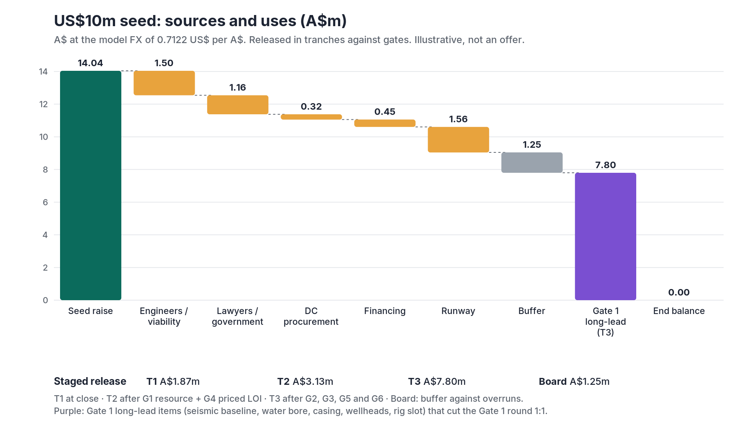
US$10m seed: sources, uses and staged release
ARCHEGON
US$10m = A$14.04m at the model FX (0.7122 US$/A$). Rates are PUBLIC PROXIES or labelled ASSUMPTIONS (Seed tab). Illustrative, not an offer.
Tranche | Released when | A$m | US$m
T1 | At close | 1.87 | 1.33
T2 | G1 resource case and G4 priced LOI both pass | 3.13 | 2.23
T3 | G2 cost, G3 tenure/licence, G5 connectivity pass and G6 Gate 1 lead soft-circled | 7.80 | 5.55
Board | Board release against overruns | 1.25 | 0.89
Total |  | 14.04 | 10.00
G4 kill test (10% hurdle, ASSUMPTION): a priced LOI must clear colo US$509/kW/month (benchmark US$172.5) or compute US$6.66/GPU-h flat (base US$5.52).
Gate 1 round: A$69.23m incl. stimulation, net of T3 long-lead items, grossed up for a 6% success fee (A$4.15m).
Runway is itemised (team, travel, office, insurance, data purchase) on the Seed tab, not a plug. T3 pre-buys Gate 1 long-lead items (seismic baseline, water bore, casing, wellheads, rig slot) and cuts the Gate 1 round 1:1.
Archegon · sourced or labelled figures · illustrative, not an offer · October 2026 · v3 · Model FX A$→US$ 0.7122
22 / 27

Slide 23
EGS short-seller claims: how our gates test each
ARCHEGON
Allegations by a short seller (Morpheus Research, 6 Oct 2026), disputed by Fervo. We treat them as risks to test, not as facts.
Risk raised | What is claimed / known | Gate 1 limit (GO / NO-GO)
Thermal decline | Project Red: stable 500+ days, then -2.5 degF (1.4 °C) in 100 days, ~5 °C/yr if extrapolated. Fervo: expected for tight pilot spacing. | GO: forecast <= 1.0 °C/yr from tracer test + calibrated model; NO-GO >= 5 °C/yr. 12-month circulation record before Gate 2.
Fluid loss | Alleged ~30% vs <1% claimed. History: Fenton Hill 7%, Rosemanowes ~20%, Habanero 2013 ~0%. | GO <= 1%; NO-GO > 5%
Induced seismicity | Alleged 58+ Yellow events at Cape. Fervo cites a positive independent protocol review (Aug 2026). | Traffic light agreed with the SA regulator; receptor-based Red set below Habanero ML 3.7
Flow / output | Cape 24 h flow fell 97 to 93 kg/s; analysts estimate 4.8 MW net vs 8-10 MW claimed. | GO >= 5 MWe net per producer; NO-GO < 3.47; pumping <= 10% of gross
Disclosure | Alleged altered data (incl. a hidden ~90 °F drop at Project Red). Fervo has not yet answered point by point (checked 19 Oct 2026). An independent blog (Tidal Wave Technologies, 16 Oct; not Fervo) says the drop is a monthly average of shut-in readings in March 2024, but concedes a real cooling event that Fervo did not explain. | Test data verified by an independent engineer within 60 days; raw time series, with shut-ins flagged, published to investors
Eavor Geretsried (closed loop, Germany) | First power late 2025, then only 0.5-2.0 MWe gross and almost nothing delivered to the grid. Both rigs withdrawn (16 Oct 2026) and Loop 2 on hold while a firm heat offtake is renegotiated (ThinkGeoEnergy). | Modules are energised one at a time against measured output (Gate 2 sizes the plant to measured flow); no hall build before the offtake price is priced (G4)
Fluid make-up (Water tab): 1% loss = 36 ML/yr; 30% = 1,094 ML/yr and 8 bores (A$300k each, PUBLIC PROXY). Licensed supply, not price, is the constraint. Sources: Morpheus Research (6 Oct); Tidal Wave Technologies blog (16 Oct); ThinkGeoEnergy (16 Oct).
Archegon · sourced or labelled figures · illustrative, not an offer · October 2026 · v3 · Model FX A$→US$ 0.7122
23 / 27

Slide 24
Decline: the well margin absorbs up to ~1 °C/yr
ARCHEGON
Wells deliver 3.06 MW more than the plant can use. Each 1% fall in temperature costs ~2.7% of net power (exergy). Decline tab.
Decline case | °C/yr | First dark yr | Lit yr 25 | Compute flat | Colo net cash
SELECTED (headline) | 0.83 | none in 25 yrs | 4 | 4.1% / A$403m | A$-97m
EGS target 0.65 °C/yr | 0.65 | none in 25 yrs | 4 | 4.1% / A$403m | A$-97m
Conventional wells 0.83 °C/yr | 0.83 | none in 25 yrs | 4 | 4.1% / A$403m | A$-97m
Intermediate 2.0 °C/yr (ASSUMPTION) | 2.00 | 14 | 2 | 2.3% / A$172m | A$-155m
Project Red reading 5.0 °C/yr (disputed) | 5.00 | 7 | 0 | never repays / A$-285m | A$-304m
EGS base case 6.45 °C/yr | 6.45 | 5 | 0 | never repays / A$-328m | A$-344m
Stress 10 °C/yr (ASSUMPTION) | 10.00 | 4 | 0 | never repays / A$-490m | A$-380m
Decline | (a) Extra doublets up front | (b) Make-up doublets on trend | (c) Fewer modules
Intermediate 2.0 °C/yr | +A$123.8m: 2.5% / A$279m | +A$66.9m: 3.5% / A$336m | saves A$226m: 0.6% / A$33m
Project Red reading 5.0 °C/yr | not feasible | +A$267.5m: 1.5% / A$135m | saves A$452m: never repays / A$-337m
EGS base case 6.45 °C/yr | not feasible | +A$468.1m: never repays / A$-65m | saves A$452m: never repays / A$-337m
Stress 10 °C/yr | not feasible | +A$869.4m: never repays / A$-467m | saves A$452m: never repays / A$-337m
Headroom (Headroom tab): AU compute, flat prices, 25-yr IRR / net cash. Make-up doublets drilled on a monitored trend win up to 6.45 °C/yr; at 10 °C/yr building fewer modules loses least. Stimulation (A$8.25m/well) is now in the raise.
Archegon · sourced or labelled figures · illustrative, not an offer · October 2026 · v3 · Model FX A$→US$ 0.7122
24 / 27

Slide 25
Full programme cost and a grid-connected comparator
ARCHEGON
What the 5 MW reference really costs with N-1, firm cover and fees, and what the same hall earns on a metro grid.
Item | A$m
Headline raise | 348.5
N-1 producers | 61.9
N-1 plant | 15.4
Transformer and switchgear N-1 | 0 (RATE_MISSING)
Firm cover | 23.7
Success fee on the Gate 1 round | 4.2
Seed (US$10m) | 14.0
FULL PROGRAMME, A$ | 467.6
Extra capital over the headline raise, A$ | 119.2
Case | Capital | IRR | Net cash
Metro colo | A$134m | never repays | A$-81m
Metro compute, flat prices | A$421m | 6.9% | A$461m
Metro compute, falling prices | A$421m | never repays | A$-843m
AU full programme, Colo |  | never repays
AU full programme, Compute flat |  | 2.5%
AU full programme, Compute falling |  | never repays
Metro grid at A$171.9/MWh delivered (Metro-Grid tab; SAPN HV tariffs + wholesale, PUBLIC PROXY), 15-month connection lead time. On our own numbers a metro hall selling compute beats the geothermal route; the geothermal case rests on power scarcity, not cost.
Archegon · sourced or labelled figures · illustrative, not an offer · October 2026 · v3 · Model FX A$→US$ 0.7122
25 / 27

Slide 26
What we cannot promise
ARCHEGON
Parked CONTESTED class. Estimates stay estimates. Retractions stay retracted.
GPU-hour rates
Parked CONTESTED. BAREMETAL revenue is A$0 because the rates are unpriced, not because the product earns nothing.
NZ generation-share figures
Several NZ generation-share numbers are parked CONTESTED. They are not on this deck and not in the model.
Remote-site loading handbook
Parked CONTESTED. Remote-site loading is a Control toggle, not a verified handbook figure on this slide.
Fervo US$/kW: 7,000 → 5,500 → 3,000
Overnight first-project cost (S-1/A filed 4 May 2026), Phase II all-in expectation (12 Aug 2026), long-term target. GeoBlock 1 runs at 33 MW net; no as-built US$/kW disclosed.
Mercury capacity invitation
Mercury has no 600 MW invitation. Disclosed pipeline is TWh options on a 2030 clock.
Crusoe 4.9 GW
Contracted capacity, not revenue. Pipeline is not contract.
Archegon · sourced or labelled figures · illustrative, not an offer · October 2026 · v3 · Model FX A$→US$ 0.7122
26 / 27

Slide 27
Ask / next 90 days
ARCHEGON
Qualify the investor first. No priced round on this slide.
A US$10m seed buys the viability work; the next round is a reservoir test.
Seed: resource case, well AFE, named principal, tenure and native title, water licence, priced LOI, financing advisers (Seed tab). Gate 1: one doublet + 90–180 day circulation test, A$69.2m incl. stimulation and fee, net of seed long-lead items. No hall until the reservoir passes.
01
02
03
04
Named geothermal principal
Someone who has drilled or operated hot rock, not a slide.
Generator term sheet
Physical offtake or wellhead co-location — not certificates.
ARENA Launchpad application
Non-dilutive parallel path. Named as an application, not as cash.
Iwi / GEL path scoping
NZ partnership and AU tenure are critical-path, unpriced work.
Not a priced round
Seed milestones, not a valuation
archegon.com
Archegon · sourced or labelled figures · illustrative, not an offer · October 2026 · v3 · Model FX A$→US$ 0.7122
27 / 27

