Slide 1
Optimal Machine Learning Model for Credit Card Fraud Detection
Archel Olazabal
Revision 2022.04.30
CDS-492 | Fall 2022 | Dr. Slamani

Slide 2
Agenda
Introduction
Problem Description and Benefits
Review of previous work
Methods
Data description
Error Investigation
Merchant State & Zip
Transaction Types
Correlation
Preprocessing
Computational Tools
Validation methods
Results
Conclusion

Slide 3
Introduction | Problem Description & Benefits
For the past few decades there have been many technological advances. Day to day products and services like food, gas, etc. are bought and sold. The more transactions that occur gives scammers more opportunities to steal credit card information. These fraudulent transactions can cost major loss to businesses or banks since someone must still spend money on the shipment and handling fees and possibly loss the product once shipped. The models used are Logistic Regression, Random Forest, and Bernoulli Naive Baye.
The purpose for this work is so that other businesses can decide on which machine learning model would be best to allocate their resources in developing further.

Slide 4
Introduction | Previous Work
Jain et al. (2022) discusses using the MCC (Matthews Correlation Coefficient) score to get a better understanding of fitment. They use a Random Forest as one of their testing models. The Random Forest model is the better performing model based on MCC score while all other performance metrics were very similar to each other.
Sumanth et al. (2022) uses SVM, Deep Neural Networks and Naïve Bayes models for fraud detection. They use a dataset that gone through PCA transformation but do not describe the data being used. This paper shows the more of the data splitting/model training process of the models.
Saddam et al. (2021) implements the use of SVM, Random Forest and Decision Tree models. It explains the tools used to manipulate the data and the machine learning models used. They also discuss the feasibility of the work not only from a coder's perspective but also from a business perspective.

Slide 5
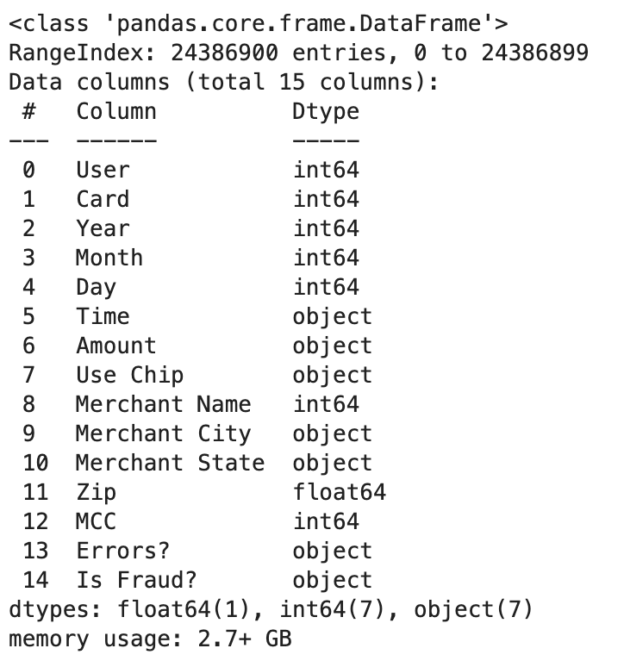
Methods|Data Description
Size: 15 columns by 24,386,900 rows, 2.35GB, Synthetic Data
File Type: CSV
Notable Features:
Merchant Category Code (MCC) - This is the code that defines what type of products/industry the merchant is in i.e. roofing, agriculture, car rentals etc.
Merchant Name - this feature is numerical, and each merchant has a unique identification number. A card transaction can occur at the same merchant multiple times.
Use chip - this feature contains only 3 possible transaction types referring to the card. Online transaction, Swipe Transaction and Chip Transaction. When referring to the online transactions the locations (Merchant City, Merchant State, and Zip) are empty null values.
Data types: Ints, objects, and floats

Slide 6
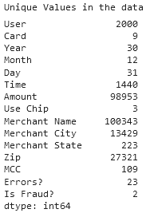
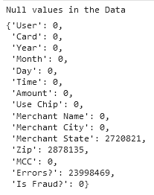
Methods: Data Description
Timeframe
Timeframe of the data is from 1990 to 2020.
Questions that arise
What does the “Errors?” column really mean?
why do “Zip” and “Merchant State” have so many empty values?

Slide 7
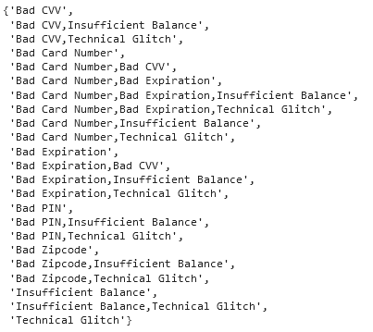
Methods: Data Description | Error Investigation
Error Investigation
A closer look at the possible values of the “Errors?” column, one transaction can have multiple errors.
These rows that contain errors seem to still have their purchase amount which leads to the assumption that the “Amount” column is the intended purchase price and the rows that have empty errors are successful transactions.
The empty values in the columns are transactions that have not ran into issues.
It is assumed that the first error within the line is considered the core error and the rest are ignored.

Slide 8
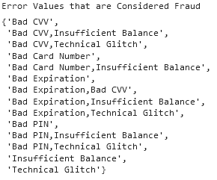
Methods: Data Description | Error Investigation
Error Investigation
Initially errors that only contained the value “Technical Glitch” were none important data but upon further investigation some rows of “Technical Glitches” were also considered as fraud.

Slide 9
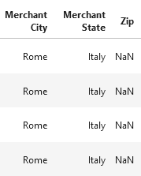
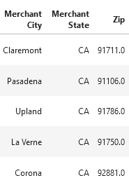
Methods: Data Description | Merchant State & Zip
Merchant State Investigation
Only Investigating rows that are Swipe and Chip transactions. This is because online transactions have Merchant City values as “ONLINE”, Merchant State values as empty and Zip as empty.
Location features are formatted toward the U.S. (Merchant City, Merchant State, Zip) even though there are international locations.
The international locations in the data have their country in the Merchant State and Zip are empty values.

Slide 10
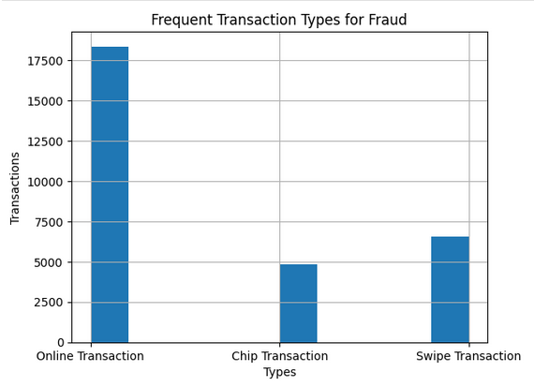
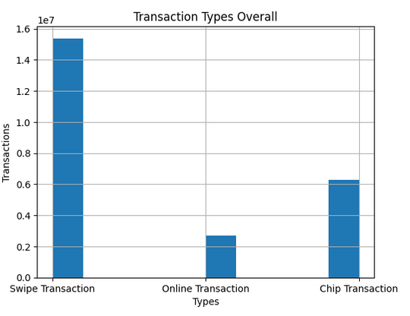
Methods: Data Description | Transaction Types
Use Chip Investigation
Within all the frauds that occurs in this datasets the most frequently used type is online transactions.
In the dataset as a whole, the most used transaction methods are swipe followed by chip then online.

Slide 11
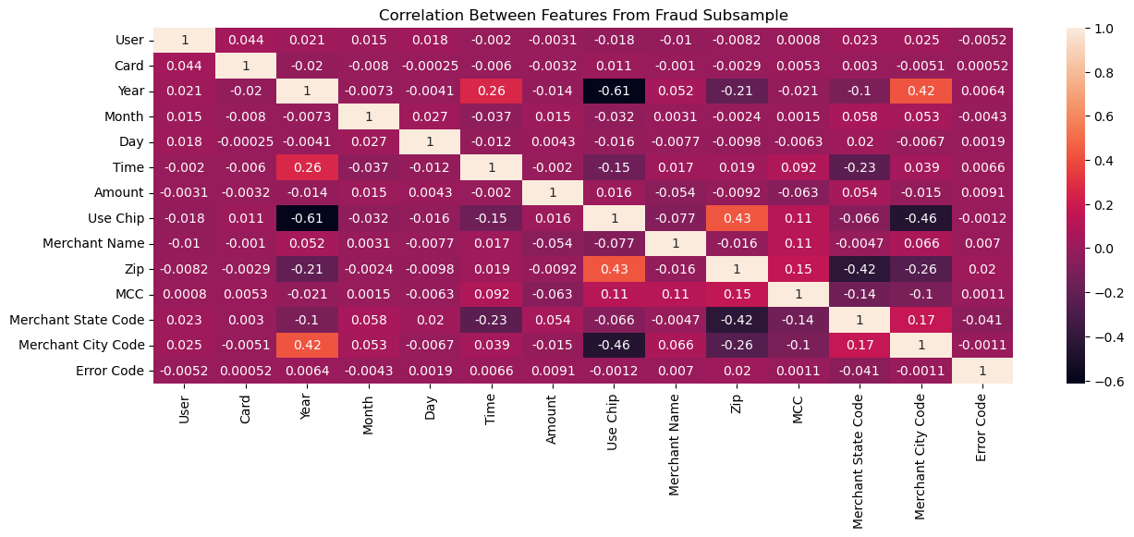
Methods: Data Description | Correlation
A subsample of the dataset was taken which had 40% fraud cases (29,000 rows) and 70% non-fraud (70,000 rows). The image below depicts the correlation between all the fraud transactions. There seems to be some correlations between Year and Merchant City along with along with Use Chip and Zip.

Slide 12
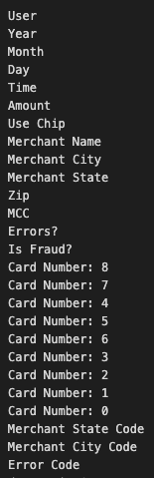
Methods: Preprocessing
When cleaning the data there are 7 object types that must be converted numerically.
The left image shows the data types before processing and the right image shows data types after processing.
The Time and Amount features are converted to numerical values.
Use Chip features were converted into numerical labels
0 = chip transactions
1 = online transactions
2 = swipe transactions
The Merchant State, Merchant City and Errors? features were also encoded using a scikit-learn function called LabelEncoder.
For the Card feature dummy features were created using a scikit-learn function called OneHotEncoding.

Slide 13

Methods: Preprocessing
Before making any feature modification null values were set with place holders. For online purchases, the Merchant City feature had “Online” as a placeholder. I applied the same concept to Merchant State feature. Online purchased zip codes were also null so a zero was placed. In the Errors? feature null values were replaced with “None”.

Slide 14
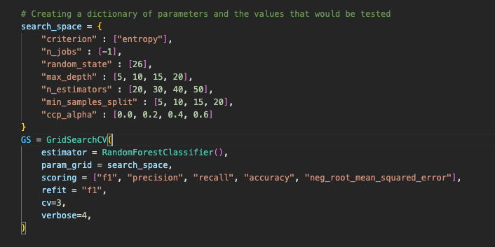
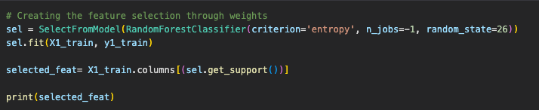
Methods: Computational Tools
The models were all tested and tuned manually. Initially 2 tools from scikit-learn were used for the model testing:
GridSearchCV – is a hyperparameter tester for all models. The number of iteration per given set can be manipulated through the cv parameter.
SelectFromModel – measures the weights of each feature which influences the model results and returns the features that have a higher weight than the average weight.

Slide 15
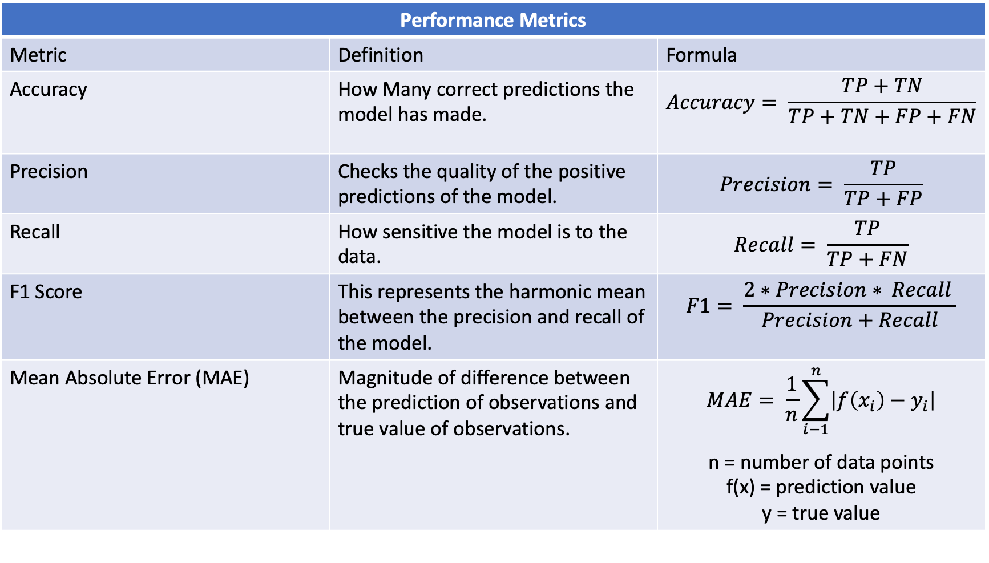
Methods: Validation Methods
Performance Metrics
Metric | Definition | Formula
Accuracy | How Many correct predictions the model has made. | $$Accuracy= \frac{TP+TN}{TP+TN+FP+FN}$$
Precision | Checks the quality of the positive predictions of the model. | $$Precision= \frac{TP}{TP+FP}$$
Recall | How sensitive the model is to the data. | $$Recall= \frac{TP}{TP+FN}$$
F1 Score | This represents the harmonic mean between the precision and recall of the model. | $$F1= \frac{2∗Precision∗ Recall }{Precision+Recall}$$
Mean Absolute Error (MAE) | Magnitude of difference between the prediction of observations and true value of observations. | $$MAE= \frac{1}{n}\sum_{i−1}^{n}{\left|f\left(x_{i}\right)−y_{i}\right|}$$ n = number of data points f(x) = prediction value y = true value

Slide 16
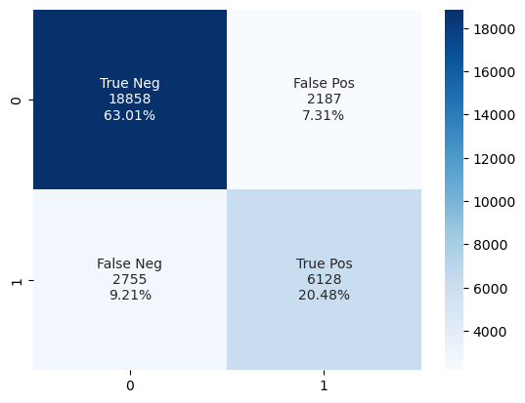
Results: Logistic Regression Model
This model was the least effective at detecting these fraud transactions. The recall is relatively low when compared to the other models. There was more to be desired for the F1 score. Feature selection worked best for this model but only used Merchant Name as the only feature for this model.
Logistic Regression Results
Performance Metrics | Training Data | Testing Data
Accuracy | 0.866 | 0.834
F1 Score | 0.770 | 0.712
MAE | 0.133 | 0.165
Precision | 0.793 | 0.736
Recall | 0.748 | 0.689

Slide 17
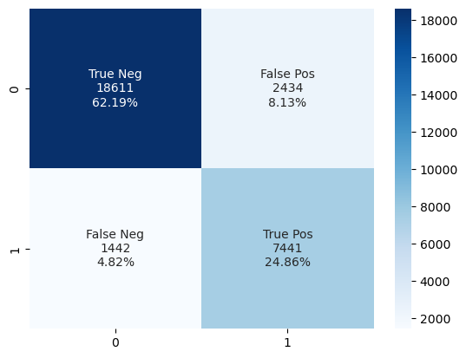
Results: Bernoulli Naïve Baye Model
This model was an improvement over Logistic Regression when comparing F1 scores and Recall. The testing the hyperparameters did not change the results when comparing to the baseline results. Overall the False Negatives have been reduced in the confusion matrix which in this case is not a favorable error since no flags will be raised when a fraud transaction occurs.
Bernoulli Naïve Baye Results
Performance Metrics | Training Data | Testing Data
Accuracy | 0.869 | 0.870
F1 Score | 0.791 | 0.793
MAE | 0.130 | 0.129
Precision | 0.753 | 0.753
Recall | 0.834 | 0.837

Slide 18
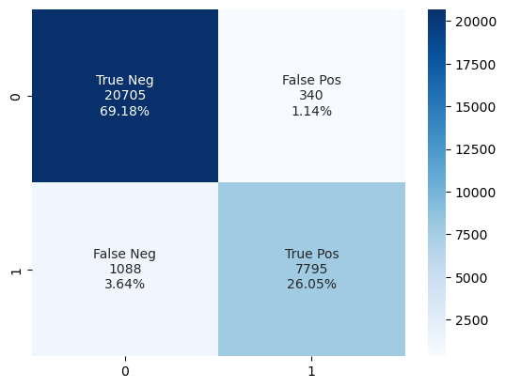
Results: Random Forest Model
The best performing algorithm for credit card fraud detection is Random Forest Model. The model has an overall across all of the metrics. The hyperparameters used for the model are as follows:
Criterion – the solving algorithm used : “gini”
Max_depth – how far the tree should extend in levels = “20”
Min_sample_split – minimum samples needed to split an internal node = “5”
Estimators – The number of trees in the forest = “40”
Random Forest Results
Performance Metrics | Training Data | Testing Data
Accuracy | 0.980 | 0.952
F1 Score | 0.999 | 0.922
MAE | 0.019 | 0.047
Precision | 0.986 | 0.958
Recall | 0.948 | 0.877

Slide 19
Conclusion
Preventing these fraudulent transactions in the absence of these algorithms would be very difficult, expensive and time consuming. Due to these modern innovations, we are able to make these observations instantly with these algorithms. This presentation explored Random Forest, Logistic Regression and Bernoulli Naive Baye models to show which model performs the best at detecting these fraudulent transactions which resulted in Random Forest. Future improvements to this algorithm would reside in the the data applying more cleaning methods along with where to allocate resources for improved detections.

Slide 20
References
Altman, E. (2021). Credit Card Transactions (A. Nitsure & Y. Mroueh, Eds.). Retrieved February 15, 2023, from https://www.kaggle.com/datasets/ealtman2019/credit-card-transactions?select=credit_card_transactions-ibm_v2.csv
Jain, V., Kavitha, H., & Mohana Kumar, S. (2022). Credit Card Fraud Detection Web Application using Streamlit and Machine Learning. 2022 IEEE International Conference on Data Science and Information System (ICDSIS). https://doi.org/10.1109/icdsis55133.2022.9915901
Saddam Hussain, S. K., Sai Charan Reddy, E., Akshay, K. G., & Akanksha, T. (2021). Fraud Detection in Credit Card Transactions Using SVM and Random Forest Algorithms. 2021 Fifth International Conference on I-SMAC (IoT in Social, Mobile, Analytics and Cloud) (I-SMAC). https://doi.org/10.1109/i-smac52330.2021.9640631
Sumanth, C., Kalyan, P. P., Ravi, B., & Balasubramani., S. (2022). Analysis of Credit Card Fraud Detection using Machine Learning Techniques. 2022 7th International Conference on Communication and Electronics Systems (ICCES). https://doi.org/10.1109/icces54183.2022.9835751

