Slide 1
AMERICAN IMPERIALISM

Slide 2
Essential Question- Why did the U.S. break from its isolationist policy?
1.) Define imperialism
2.) Explain why many Americans supported imperialism

Slide 3
IMPERIALISM
Imperialism- the event in which a country attempts to assume control of another country’s territory, government, or economy

Slide 4
REASONS FOR AMERICAN INTEREST IN OVERSEAS EXPANSION
1.) Need new markets
2.) Social Darwinism- civilize “backwards people”
3.) Evangelism

Slide 5
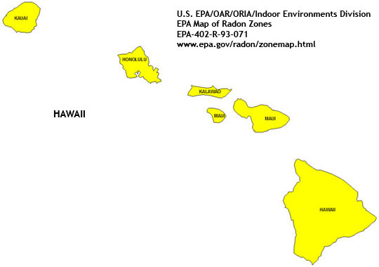
AMERICAN CONTROL OF HAWAII
American ships and missionaries had explored Hawaii since the early 1800s
American sugar planters profited off of their Hawaiian sugar cane plantations
McKinley Tariff posed a problem to their business
Encouraged American government to annex Hawaii

Slide 6
Sanford Dole and other American planters pressured the Hawaiian king into signing a new constitution that basically disenfranchised the natives and left the right to vote and hold office in the hands of the white planters
When he died, his sister, Queen Liliuokalani attempted to institute reform

Slide 7
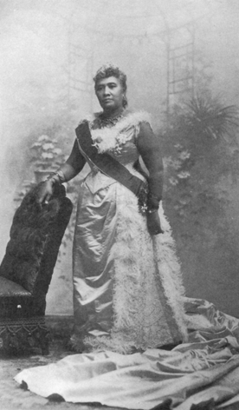

Slide 8
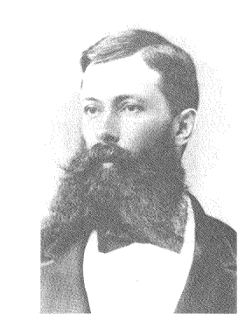
Dole, after receiving help from American troops, led a rebellion that overthrew the Queen
1893, president Grover Cleveland believed that the Americans wronged the Hawaiians and refused to annex the country

Slide 9
He could not dispose of the American planters without help from the army
Hawaii was not annexed until 1898

Slide 10
Spanish American War
Cubans wanted their independence from the Spanish
Many American businesses had sugar plantations in Cuba that were generating large profits
Native Cubans requested aid from the Americans in their fight for independence

Slide 11
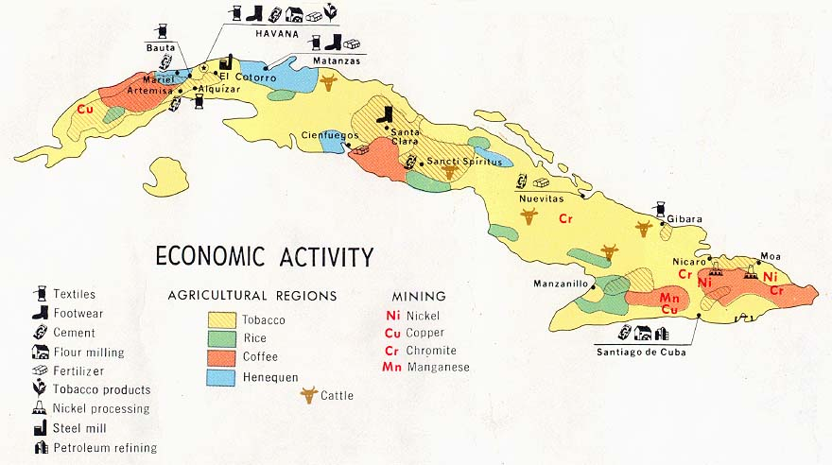

Slide 12
REASONS FOR AMERICAN INTERVENTION
Americans refused
1.) the natives set fire to American sugar plantations in Cuba
2.) American journalists began to publish over-exaggerated pictures and articles of Spanish abuse of the Cuban population (yellow Journalism)

Slide 13
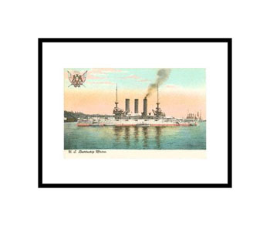
EXPLOSION ABOARD THE BATTLE SHIP MAINE
American government sent a battle ship to evacuate Americans in Cuba
February 15, 1898, Maine exploded
Immediately the Americans blamed the Spanish while others some blamed the Cuban rebels

Slide 14
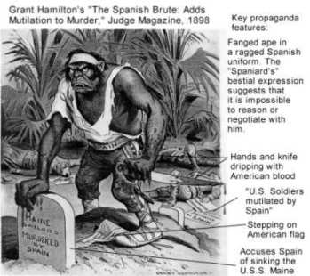

Slide 15
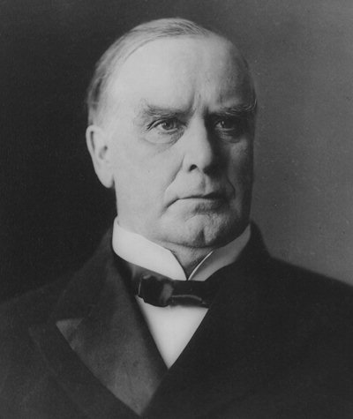
AMERICANS DELCARE WAR ON SPAIN
President McKinley declared war on April 11, 1898
Congress adopted the Teller Amendment- it was proclamation that when the United States had overthrown Spanish rule, the Cubans would gain their independence

Slide 16

STATE OF AMERICAN MILITARY
Led by old Civil War veterans
Small in numbers in comparison to Spain’s army
Theodore Roosevelt-assistant navy secretary
Devised a plan that would center fighting in the Spanish owned Philippines
George Dewey, carried out his orders, and won great victories in Manila

Slide 17
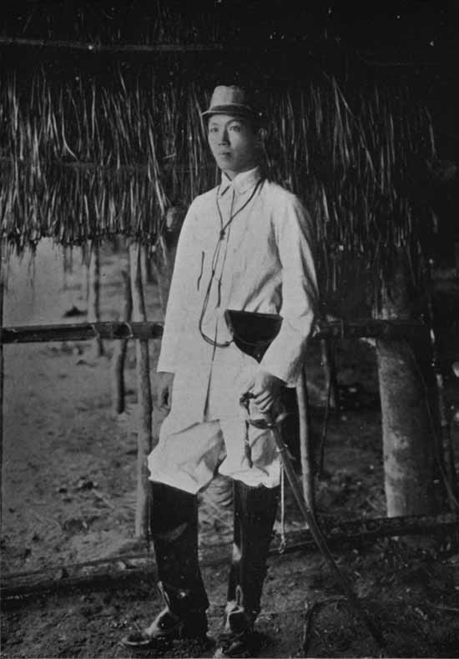
EMILIO AGUINALDO
Assisted Dewey
Philippino insurgent
Showed Americans where Spanish camps were
Helped them maneuver around the island

Slide 18
ATTENTION TURNS TO HAWAII
Americans began to insist that the government should annex Hawaii so that it could be used as a way station to send supplies to Dewey
1898, Hawaii was annexed

Slide 19
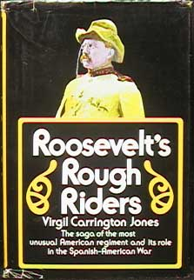
CUBAN ARENA
Americans sent troops into Cuba
“Rough Riders” American volunteers organized by Theodore Roosevelt
Consisted of cowboys, ex-convicts, and ex-polo players
First landed in Tampa, but feared that they would miss the action, rushed into Cuba
Famous for their victory at San Juan Hill

Slide 20
SPANISH DEFEAT
August 12, 1898, the Spaniards signed an armistice
If they would have held out, they might have won, because Americans were suffering from dysentery, typhoid, malnutrition

Slide 21
PEACE AGREEMENT
1.) Cuba would become independent
2.) Puerto Rico would be given to the United States
3.) Philippines would be given to the United States (McKinley thought that it would be a valuable opportunity to Christianize them)
4.) Guam would be given to the United States

Slide 22
PHILIPPINO REACTION
Aguinaldo was infuriated
The military could not leave
They ended up staying for years fighting insurgents
Some of the worst atrocities were committed by the American army within this occupation period

Slide 23
INTELLECTUALS REACT
Leaders of many of the prestigious universities in America protest McKinley’s imperialism and start the Anti-Imperialist League
Violation of the Declaration of Independence

Slide 24
Scaffolding questions
1.) Who is the author?
2.) Who are the Moros and describe the author’s opinion of them? What words or phrases does he use to describe them?
3.)Describe the Moros that were being pursued by the American soldiers?
4.) Compare and contrast the type of weapons used by the Moros and the American soldiers. Was this a fair fight?
5.) According to the author, how does this battle compare with the Civil War, Waterloo, and the Cuban War? Do you agree or disagree?

Slide 25
6.) Describe the irony found in the author’s belief that “this was the greatest victory that was every achieved by the Christian soldiers of the United States.”

Slide 26
IMPERIALIST COUNTER ARGUMENTS
1.) profits
2.) social Darwinism

Slide 27
QUESTIONS
Did the Constitution apply to inhabitants of American owned territories located outside of the North American continent?
Supreme Court ruled that it did not
Puerto Ricans were given citizenship until 1917
Even then they were not given full American rights

Slide 28
CUBA AND THE PLATT AMENDMENT
Honored the Teller Amendment
Forced to include the Platt Amendment in their Constitution:
  1.) Could not go into unreasonable debt
  2.) U.S could intervene to “restore order”
  3.) Had to sell or lease naval stations such as Guantanamo

Slide 29
Insular Cases
Supreme Court had to decide whether inhabitants of territories had the same rights at citizens.
Case was decided in the Supreme Court cases know as the Insular Cases
The Court ruled that they were not given the same rights as citizens

Slide 30
EFFECTS OF THE SPANISH AMERICAN WAR
1.) More territory
2.) overseas respect
3.) nationalism
4.) healed North and South wounds and brought unity

Slide 31
Warm Up
  1.) Define Imperialism
  2.) Provide 3 reasons many Americans supported an imperialistic foreign policy
  3.) Explain how the Teller Amendment differed from the Platt Amendment
  Cause and Effect Chart

Slide 32
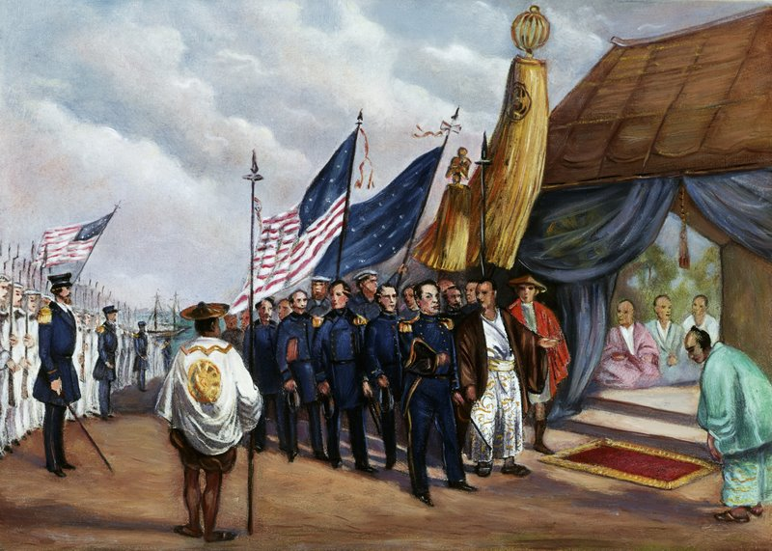
Imperialism in Asia
1853, U.S. president Millard Fillmore sent Matthew Perry to Japan
Forced the Japanese to sign a treaty opening the markets to Western trade
Japan realized they had to westernize their society in order to compete

Slide 33
Open Door Policy
Cause and Effect Chart

Slide 34
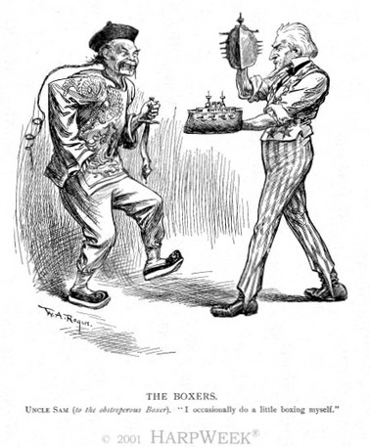
Open Door Policy
1894 war erupted between Japan and Korea over China
Japan easily defeated China
Russia did not want Japan to have Manchuria, in area in China along the Russian border

Slide 35
Russia forced Japan to give that part of Manchuria back to China
They later demanded the Chinese rent that territory to Russia
But Germany, France, and Great Britain wanted access to that area of trade

Slide 36
McKinley did not want the U.S. to be left out of the opportunity to trade in China
He engineered the Open Door Policy- which allowed all countries to trade in China

Slide 37
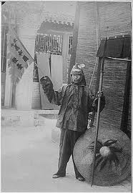
Boxer Rebellion
Chinese are tired of Westerners in their country
They launch a rebellion
The Boxers were a secret society
International force stepped in to defeat the boxers
They were forced to pay millions of dollars in fines to the Europeans as punishment

Slide 38
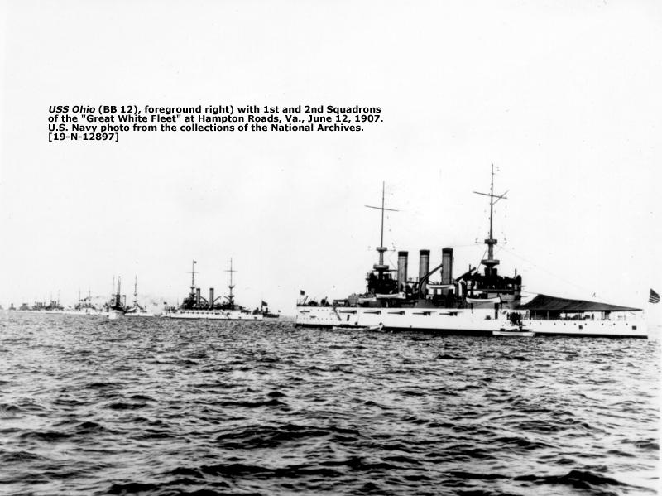
Japan v. Russia
Situation is getting worse
Roosevelt tries to step in to negotiate peace
Also alarmed by Japan’s aggressive policy, Roosevelt sent the Great White Fleet
Navy went on a voyage around the world to show specifically Japan their strength

Slide 39
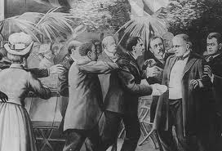
Election of 1900
William McKinley –imperialist vs.
William Jennings Bryan-antimperialist
McKinley wins but is assassinated in 1901 by Leon Czolgosz
Theodore Roosevelt became president

Slide 40
Panama Canal Comprehension Questions
1.) How has the acquisition of the Panama Canal been portrayed in U.S. History?
2.) Identify the Hay Herron Treaty
3.) Explain why Colombia refused the Hay Herron Treaty.
4.) Explain how Roosevelt indirectly intervened in the Panama Revolt.
5.) Explain how the Panamanian Revolt helped the U.S. gain control of the area for the future site of the Panama Canal.

Slide 41
6.) Summarize the criticisms of Roosevelt’s actions during the Panama Revolt.
7.) Explain how the construction of the Panama Cal became a costly project
8.) Explain why many feel the U.S. acquisition of the Panama Canal was a form of imperialism
9.)Should Roosevelt be praised for his actions in Panama? Why or why not?
10.)What has happened to the Canal since its completion?

Slide 42
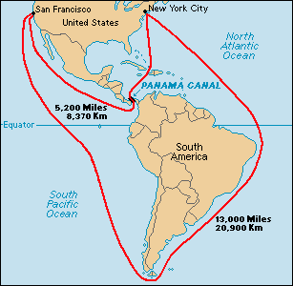
Panama Canal
Need a canal through Central America
Hay-Pauncefote Treaty gave the U.S. the right to build a canal through Panama
Panama was owned by Colombia
Colombia wants more money from the U.S. before they allow the U.S. to build it

Slide 43
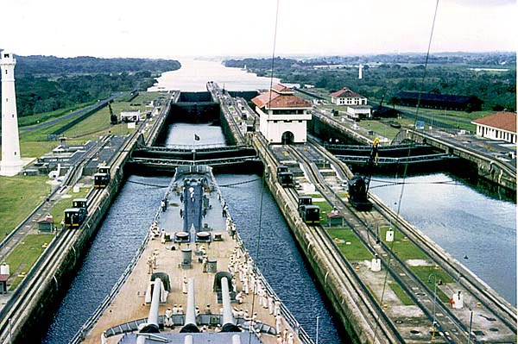
Panama Canal
Roosevelt encourages a rebellion among the Panamanian people
Sends the navy to prevent Colombia from putting down the rebellion
Panama received their freedom and the U.S. was able to build its canal

Slide 44
Roosevelt Corollary
Addition to the Monroe Doctrine
The U.S. would intervene in Latin American affairs any time they saw fit
The U.S. wanted to prevent European nations from sending troops to the area

Slide 45
William Taft’s Dollar Diplomacy
Establish American businesses and loans in Latin America to stabilize it so we don’t have to send troops

Slide 46
Portsmouth Treaty
Russian-Japanese War
Russia was getting beaten by Japan
Roosevelt was called in to help organize a treaty
Roosevelt won the Nobel Prize

Slide 47
Gentlemen’s Agreement
Tensions arise between the U.S. and Japan
Japanese are angry about the discriminatory policies in California
Roosevelt and Japan agree to restrict Japanese emigration to the U.S. and decrease discriminatory policies in California

Slide 48
Exit Ticket
Panama Canal Cause and Effect Chart

