Slide 1
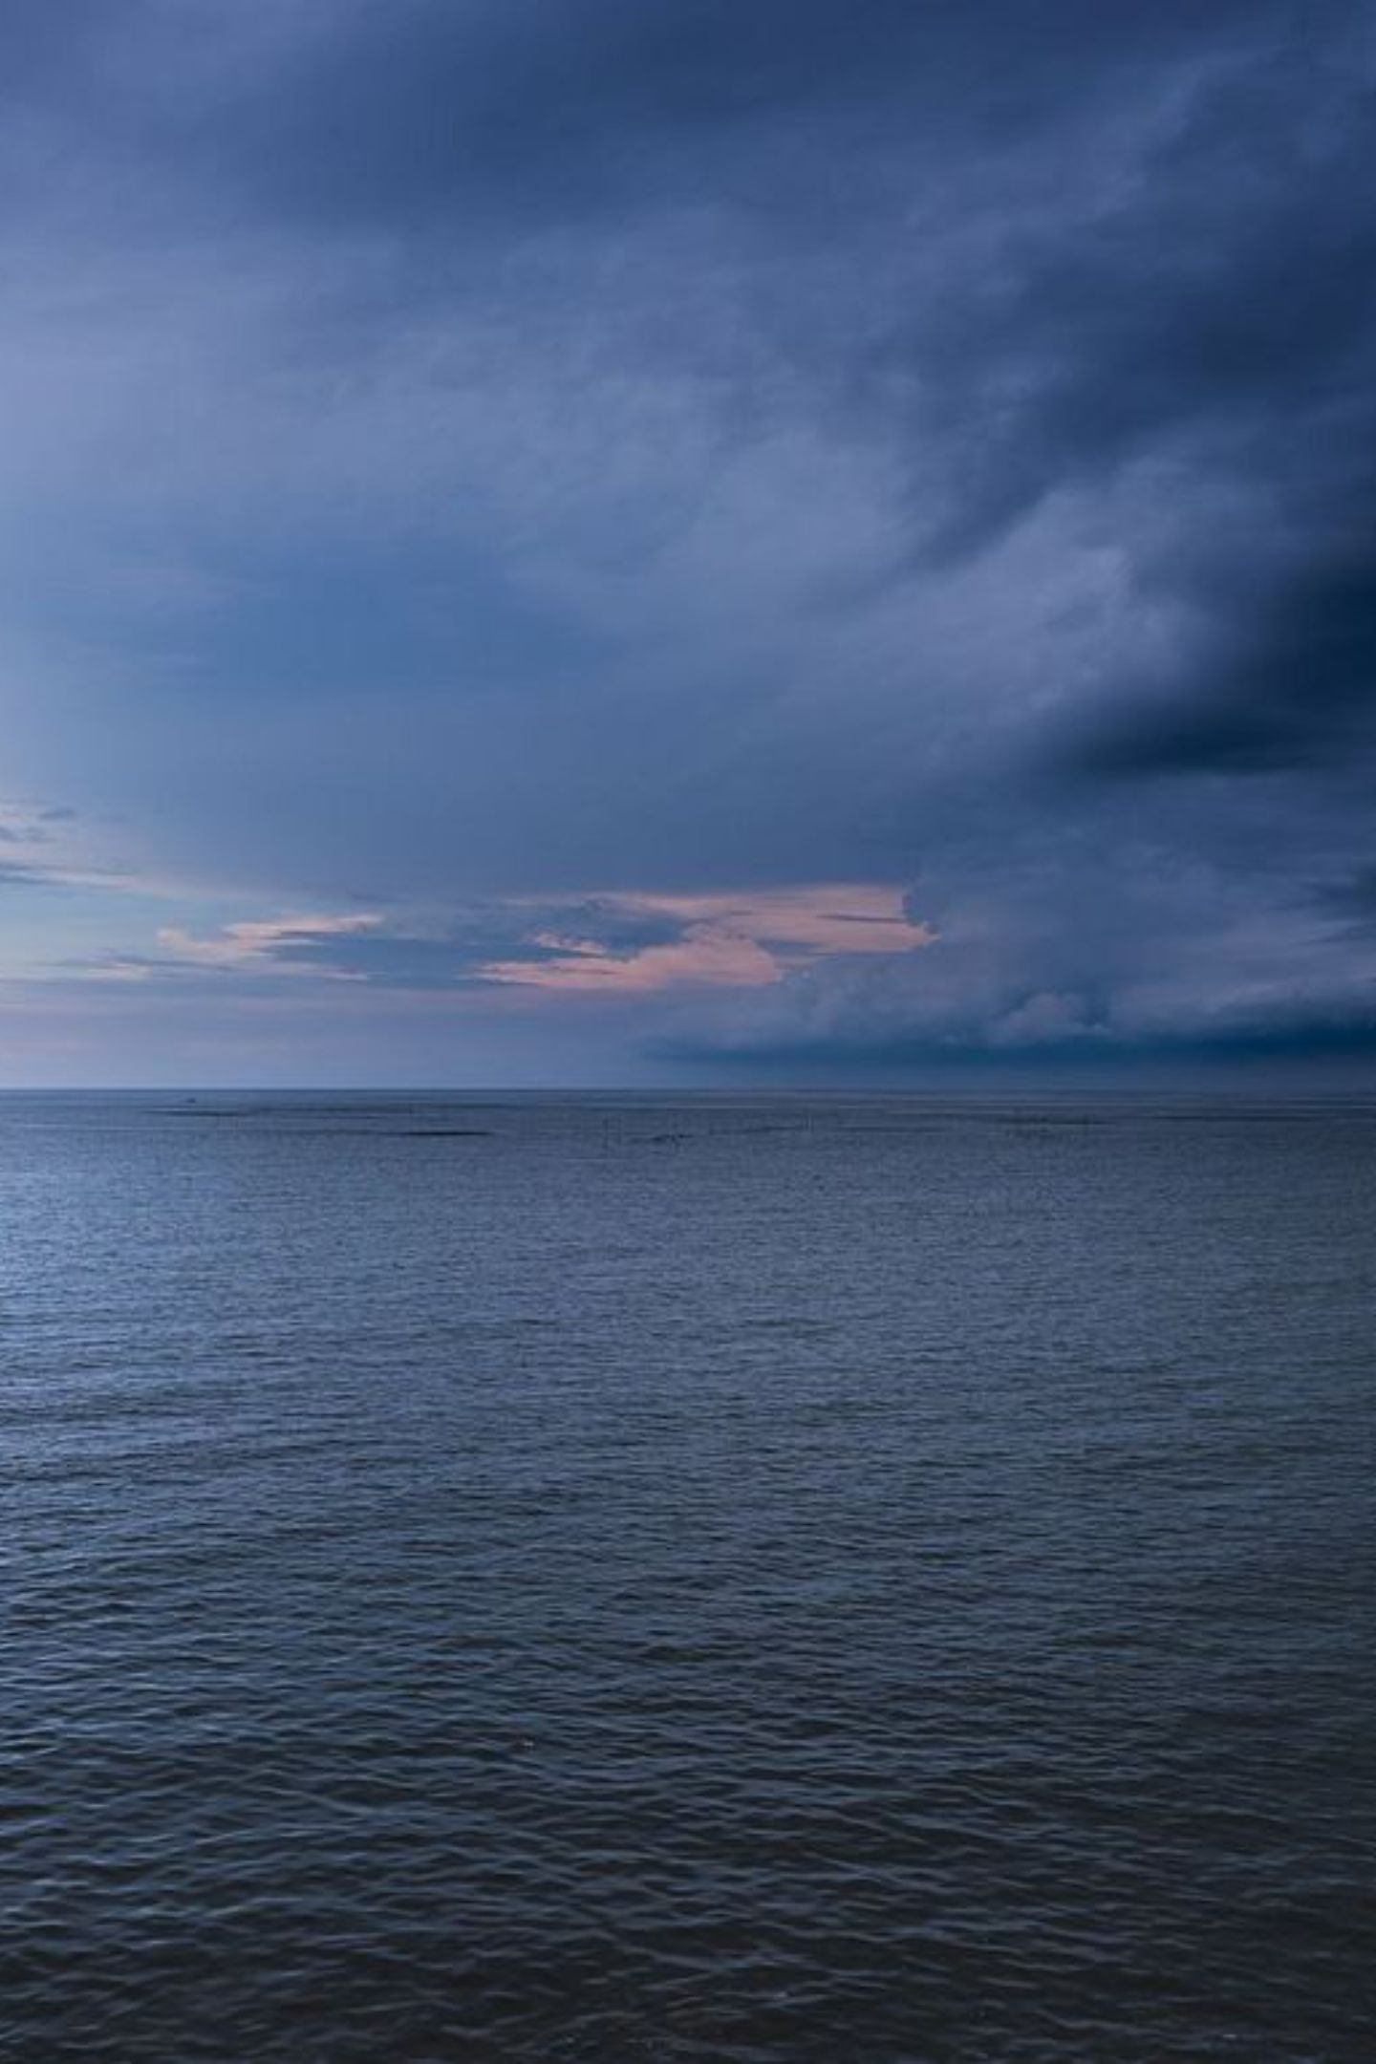
SagaraMesh: Solar & Wave Powered Autonomous Floating Sea Rescue Mesh
A shared renewable-powered floating communication and rescue infrastructure for coastal fishermen

Slide 2
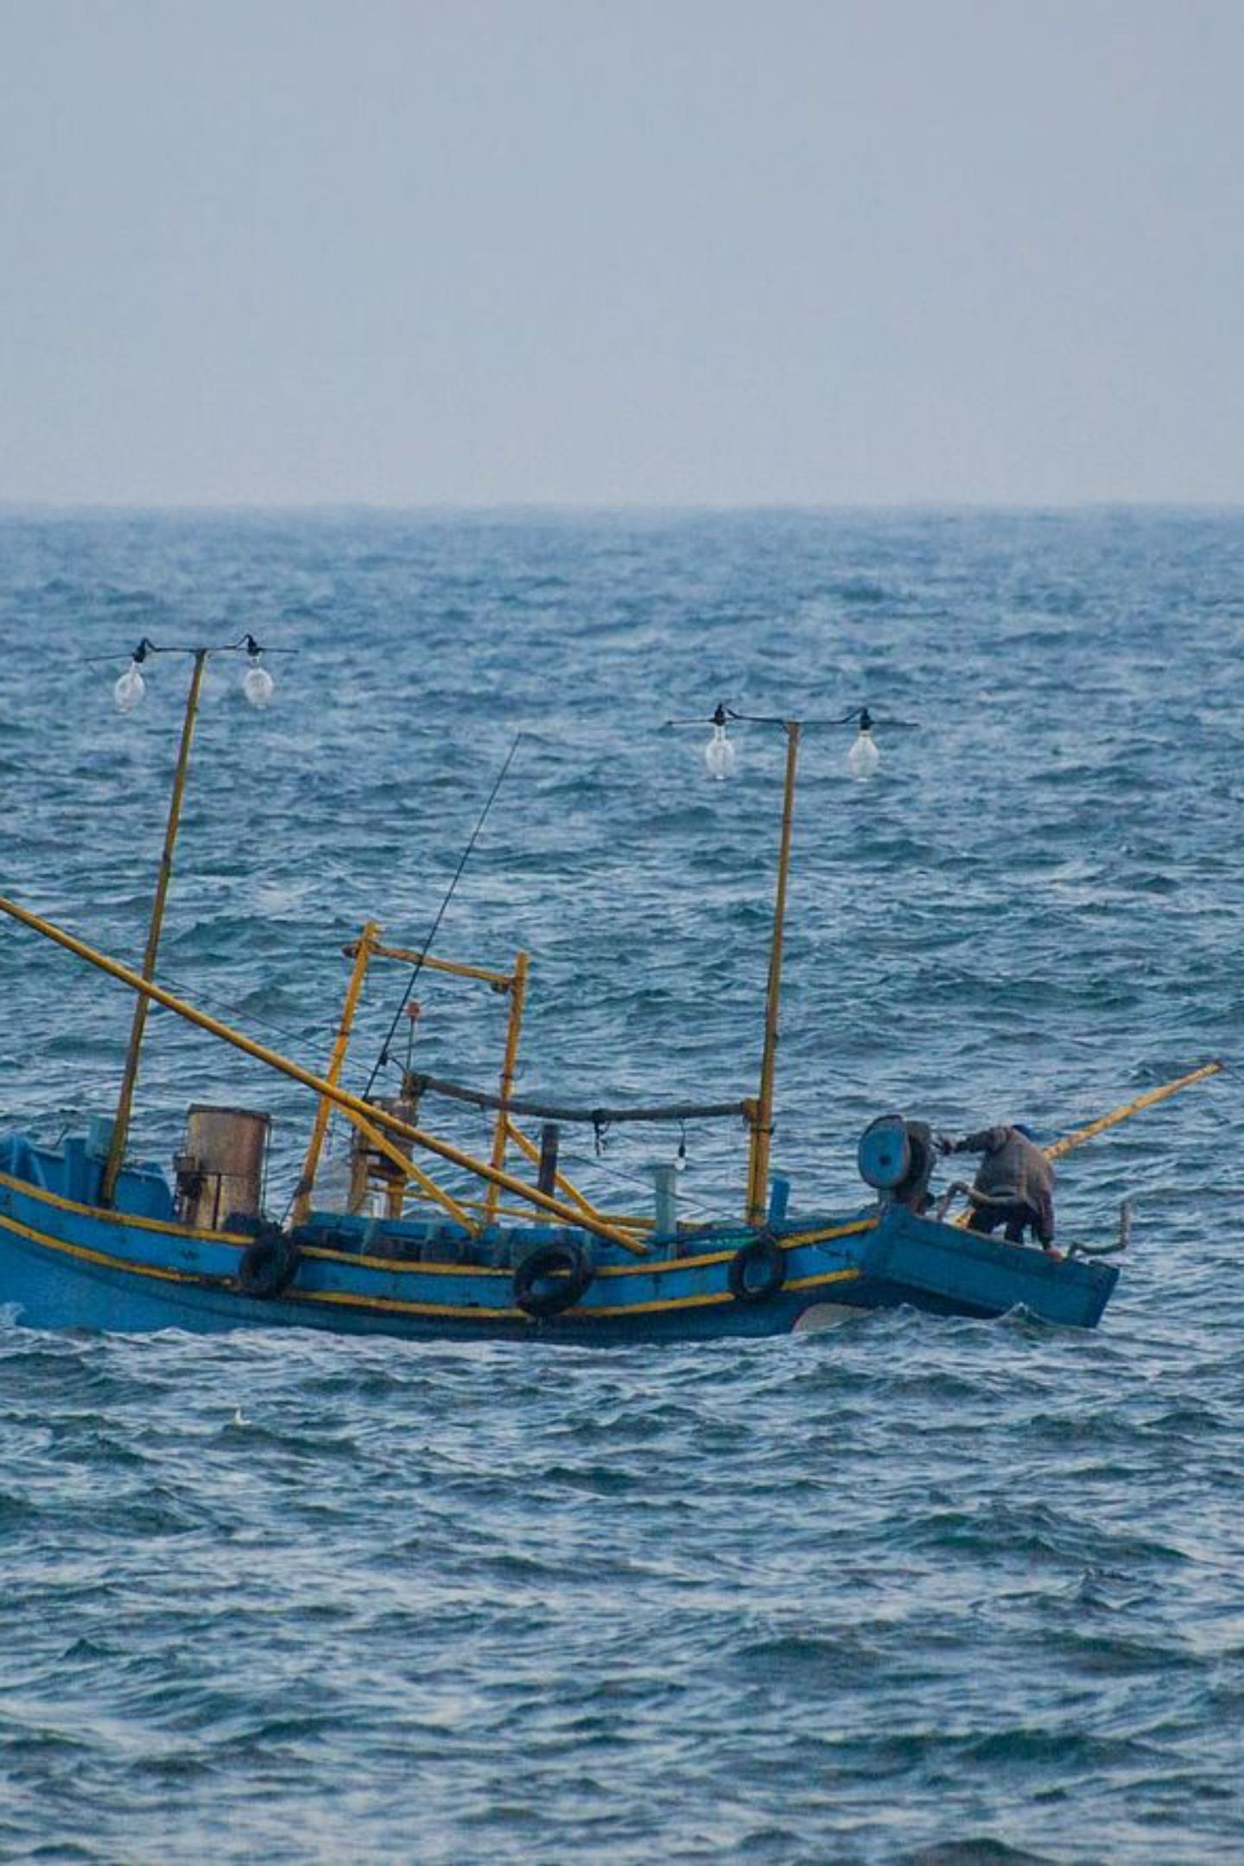



The Problem: Fishermen Beyond the Network
Communication Dead Zones
Distress Assessment Gap
No reliable mobile signal in many fishing routes — fishermen operate completely off-grid and unreachable.
Rescue teams don't know the actual situation before arriving — blind deployment wastes resources.
Drifting Safety Systems
Missed Critical Alerts
Floating buoys can drift away if anchors detach, becoming completely useless in emergencies.
Cyclone, storm, and tsunami warnings don't reach boats at sea — fishermen receive no advance notice.
Affordability Barrier
Delayed Rescue Response
Existing systems are costly for individual fishermen. Tamil Nadu's coastal communities need affordable, autonomous, renewable sea-safety infrastructure.
Without exact GPS location, rescue teams waste precious time searching vast ocean areas.

Slide 3

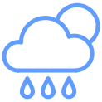


The Solution: SagaraMesh Floating Infrastructure
A network of solar and wave-powered smart buoys placed across fishing routes, creating a shared communication and rescue layer for the sea.
SOS & GPS Relay
Tamil-Language Alerts
Receives SOS alerts and relays exact GPS location to shore via buoy-to-buoy mesh — no mobile towers needed.
Broadcasts weather and cyclone warnings in Tamil and local languages directly to fishermen at sea.
Drone & ROV Deployment
Self-Powered & Self-Repositioning
Deploys drones, payloads, and underwater robots to assess emergencies before rescue teams arrive.
Powered by solar and wave energy. Autonomously returns to preset GPS coordinate if anchor detaches.

Slide 4
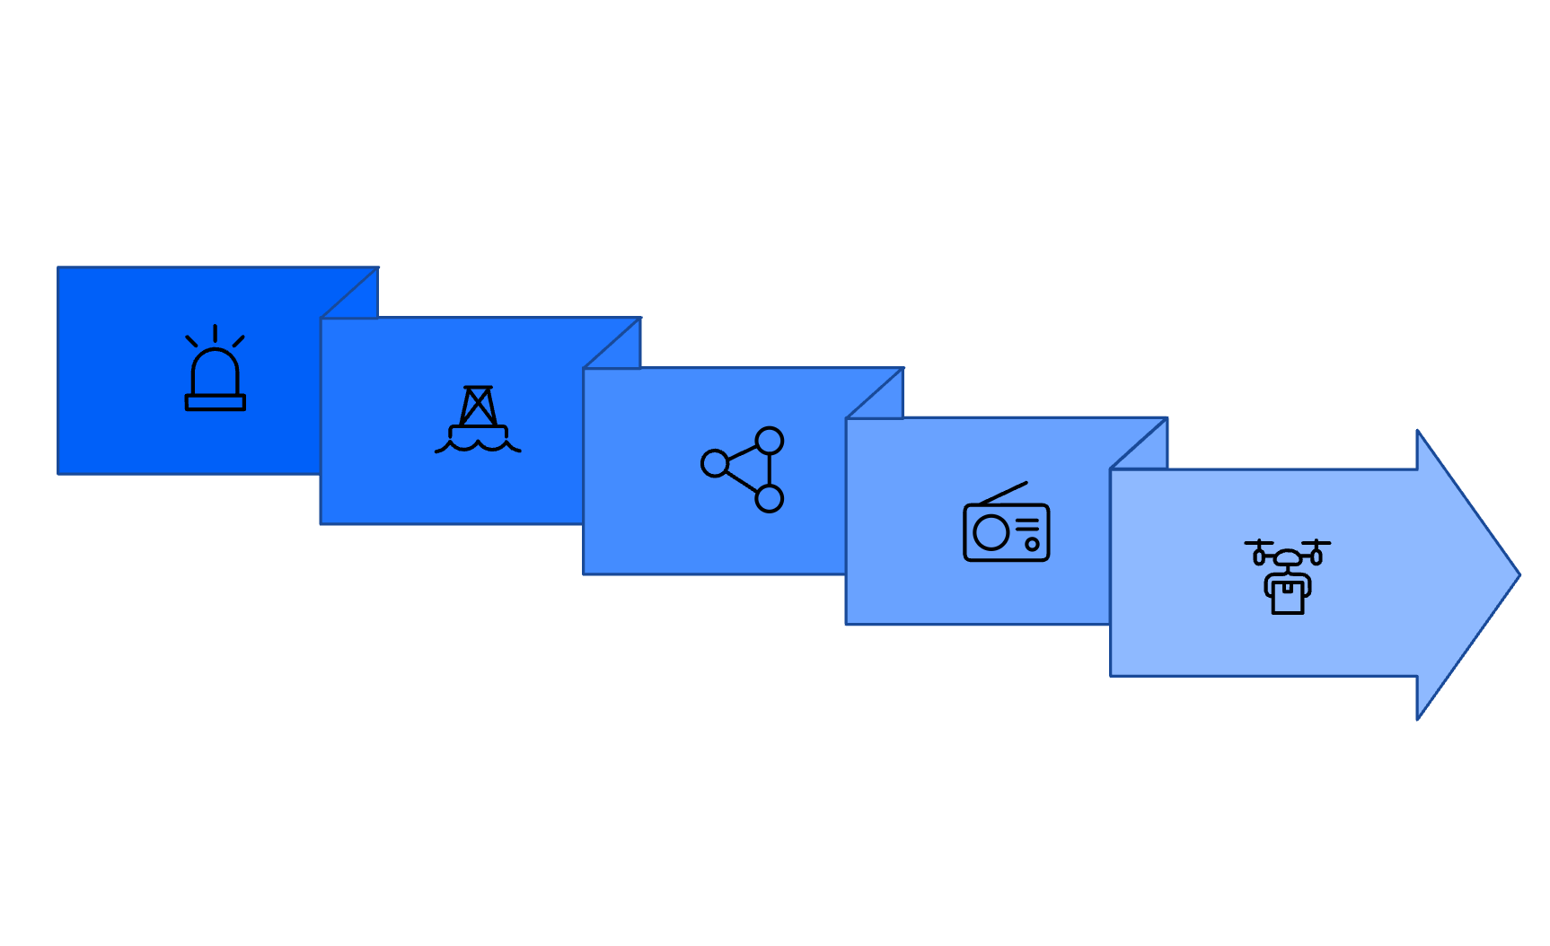
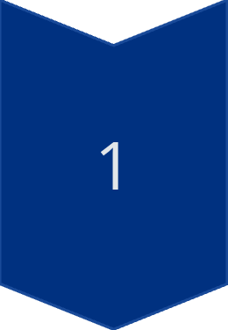
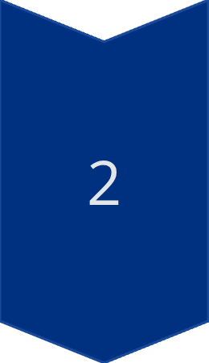
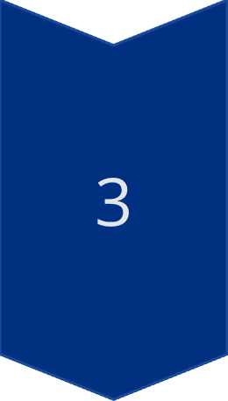
How It Works: From Distress to Rescue
Weather Alert Flow
Weather Department
SOS Sent
Issues cyclone / storm / tsunami alert
Mesh Relay
Drone/ROV Deploys
SagaraMesh Buoys
Receive and amplify the broadcast across the mesh network
Buoy Alert
Command Receives
Fishermen Receive Warning
The full rescue loop — from SOS trigger to informed rescue dispatch — is coordinated autonomously through the mesh.
Tamil and local-language audio/visual alert on boat device

Slide 5
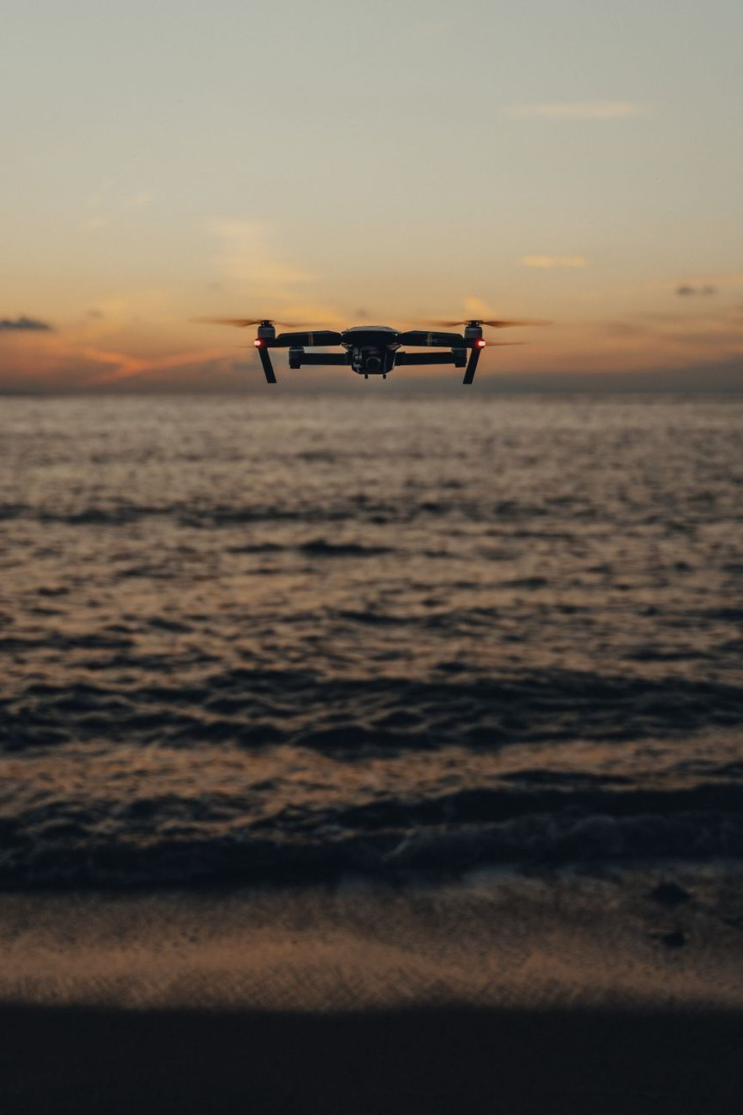
Autonomous Rescue Assessment System
Drone Deployment
Self-Repositioning if Anchor Detaches
Aerial drone launches from buoy dock and flies to distress GPS location
Captures live video and thermal imaging to detect people in water
Drops emergency floating payload — flotation aid, LED beacon, first-aid kit, water
Sends real-time assessment to shore command center
01
Monitor Position
GPS + anchor tension sensors continuously track buoy location
02
Underwater Robot (ROV) Deployment
Detect Detachment
Anchor loss triggers immediate alert to command center
Inspects capsized or sinking boats for underwater damage and hazards
Camera, lights, and sonar for full underwater situation report
03
Auto-Navigate
Electric thrusters activate — buoy returns to preset GPS coordinate autonomously

Slide 6
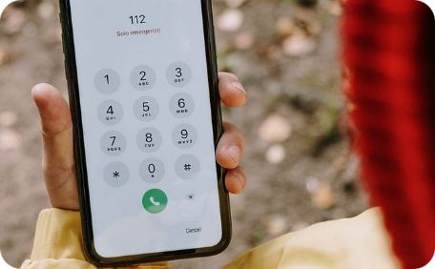
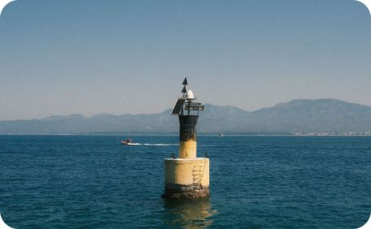
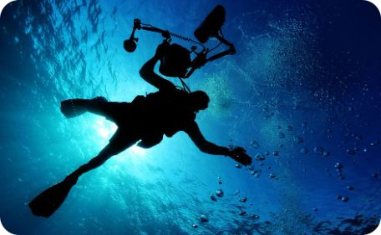
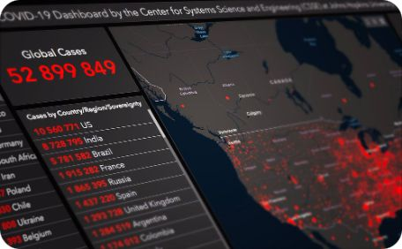
System Components
Boat Device
Floating Buoy
Rescue Assessment
Shore Command Center
Fisherman's unit: SOS button, GPS module, LoRa radio, waterproof casing, LED indicator, battery.
Core infrastructure: solar panels, wave energy harvester, LoRa mesh radio, GPS, IMU, electric thrusters, LED beacon, siren, weather sensors.
Waterproof drone dock, thermal camera, payload drop mechanism, floating emergency kit, underwater ROV with camera and sonar.
Receiver gateway, high-gain antenna, live dashboard with map tracking, SOS alert panel, drone/ROV status, rescue coordination, SMS alerts.

Slide 7

Existing Solutions vs. SagaraMesh
Solution
Type
Key Limitation
SagaraMesh Advantage
ISRO DAT-SG
Satellite distress alert
Alert-only, expensive per unit
Shared mesh + full rescue layer
EPIRB
Marine emergency beacon
One-way signal, no mesh comm
Two-way + buoy-to-buoy relay
PLB
Personal locator beacon
Each person must carry one, no shared infra
Community infrastructure, one buoy = many boats
AIS MOB Devices
Man-overboard AIS alert
Limited range, needs nearby vessels
Independent mesh, no vessel dependency
GMDSS
Global maritime distress
Designed for large ships, not fishing boats
Built for small-boat coastal fishermen
Ocean Monitoring Buoys
Sensor / research buoy
No fisherman communication or rescue coord.
SOS + weather + tracking + drone/ROV
SagaraMesh is not just an SOS device — it is a renewable-powered floating communication and rescue layer for the sea.

Slide 8
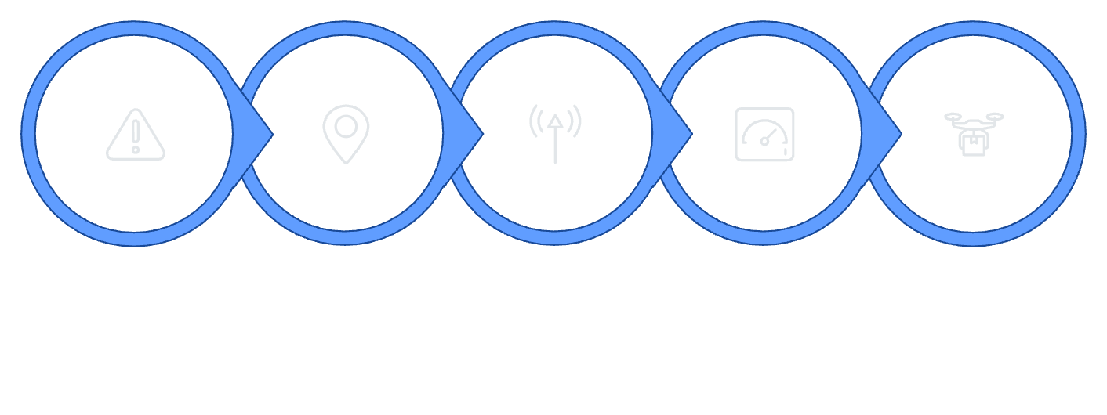

Strengths, Impact & Feasibility
Hackathon MVP Flow
Core Strengths
Social Impact
Faster rescue response times & reduced missing fishermen cases
Better cyclone and storm warnings for safer coastal livelihoods
Support for Coast Guard, families, and disaster management authorities
Future expansion: weather, pollution, and water-quality monitoring
Press SOS
Send GPS
Shore Gateway
Show Alert
Deploy Drone
Uses common components: ESP32 / Arduino / Raspberry Pi Pico, LoRa modules, GPS, SOS button, solar panel, battery, waterproof enclosure, simple dashboard.
Scalability Path
Works Without Mobile Network
Solar + Wave Powered
Two-Way Communication
Drone & ROV Assessment
Tamil-Language Alerts
Self-Repositioning
Village Pilot
Prototype
Indian Coastal Network
District Coastline

Slide 9


Why SagaraMesh is Different
What Existing Solutions Do
What SagaraMesh Does
Individual boat/device-based — each fisherman pays separately
Satellite-only — expensive, one-way, no local fallback
Shared floating infrastructure
Local mesh + satellite backup
One buoy serves many boats — community deployment model
Buoy-to-buoy LoRa relay — works without internet or mobile towers
Distress alert only — no weather, tracking, or rescue assessment
No local-language support — not culturally accessible
SOS + weather + tracking + rescue
Tamil-language alerts
Culturally relevant, locally accessible broadcasts
Buoys drift if anchor fails — no self-correction
Comprehensive safety layer, not just an alert button
Self-repositions autonomously
Returns to preset GPS coordinate if anchor detaches

Slide 10
Why SagaraMesh Can Win
Solves a Real Life-or-Death Problem
Fishermen die because they can't communicate or receive warnings. SagaraMesh fixes this at the infrastructure level.
Multidisciplinary Excellence
Hardware, LoRa communication, renewable energy, robotics, and disaster management — all in one platform.
Clearly Differentiated
Floating mesh infrastructure + autonomous drone/ROV rescue assessment vs. every existing individual-device solution.
Feasible, Scalable, Affordable
Demonstrable MVP in 48 hours. Scales from village pilot to national coastal network. Shared infrastructure slashes per-fisherman cost.
Multi-Stakeholder Value
Fishermen, families, rescue teams, Coast Guard, and disaster management authorities all benefit from one shared platform.
SagaraMesh turns the sea itself into a safety and rescue network.
Connecting fishermen. Assessing danger. Saving lives. Protecting coastal communities.

