Slide 1



GTR Git Tech Review
Hackathon 2018
Adam Dudsic | Derrick Nguyen | Dave Swift

Slide 2
Millions of Microsoft Documentation Topics reside on Git in Markdown format
Impacted groups include Office, Azure, Power BI, and Dynamics, to name a few

Slide 3
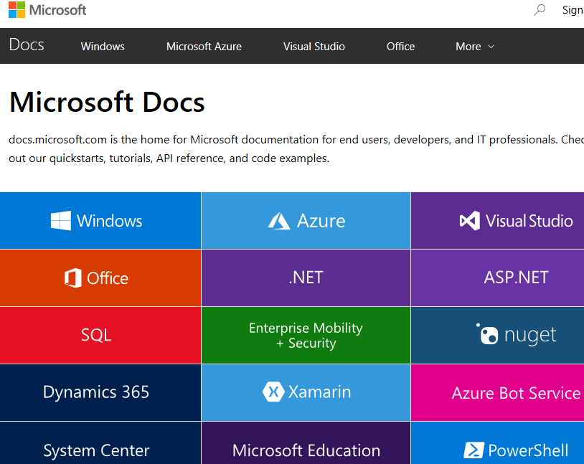
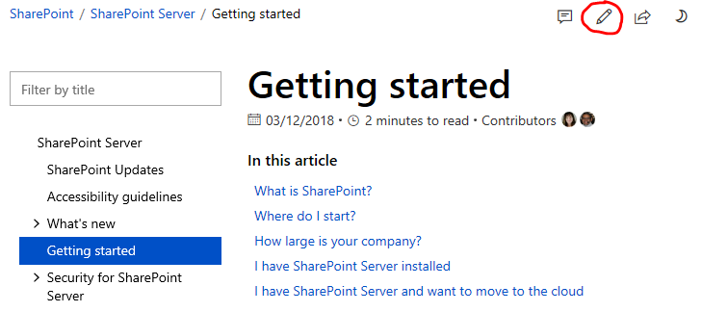
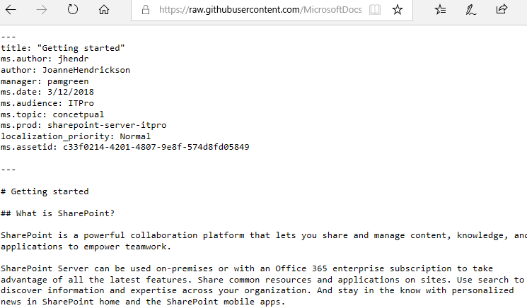
The move to docs (on Git) has greatly enabled contributions

Slide 4
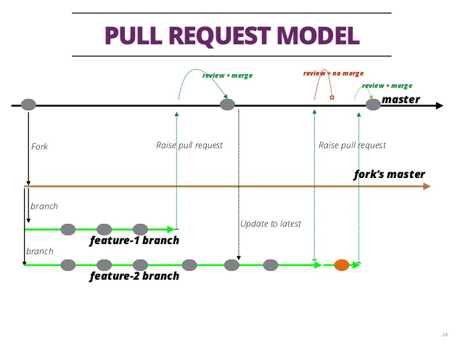
…but it has limitations
Git works well for:
Public collaboration
Simple edits
…but doesn’t support:
Rich commenting
Multi-party, simultaneous change tracking
Real-time collaboration
Notes:
Documentation is best when it is a collaboration and conversation between colleagues.
Existing tools and workflows around the documents for docs.microsoft.com are not great for real-time collaboration nor are they great for content reviews.
Users pull content into their local repo and do not see changes from others until they pull updates. And when they push, the changes might be merged by someone who might not be the subject matter expert.

Slide 5
…and difficulties
Internal collaborators frequently:
Don’t want to learn how to use Git or Markdown
Need to keep their comment Microsoft-confidential

Slide 6
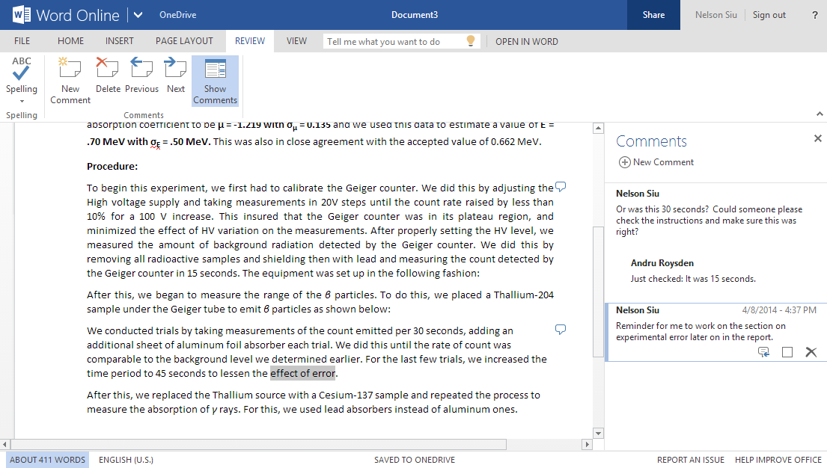
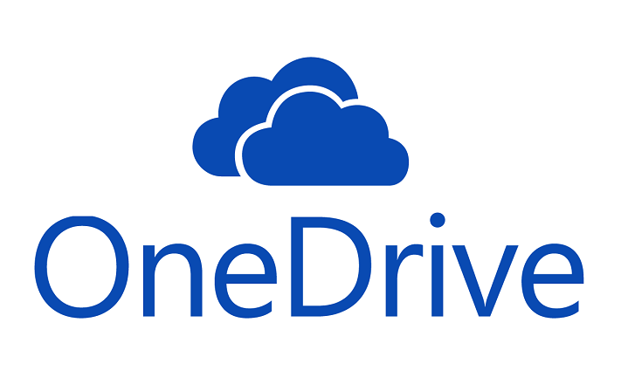
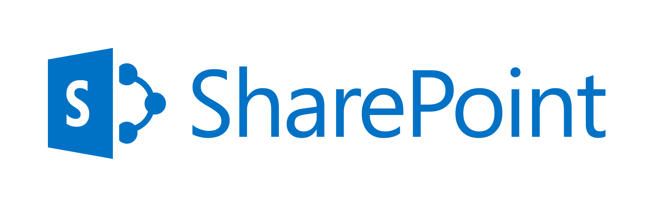
Word Online: Designed For collaboration

Slide 7
Content Developers Typically use Word
To create and develop new topics
To substantially revise existing content
To collaborate with SMEs
To run tech reviews on content

Slide 8
Content Transfer is a Major Pain Point
Manually moving content between a Git Markdown file and a Word docx file:
Requires format conversion
Is time intensive
Can be error prone

Slide 9
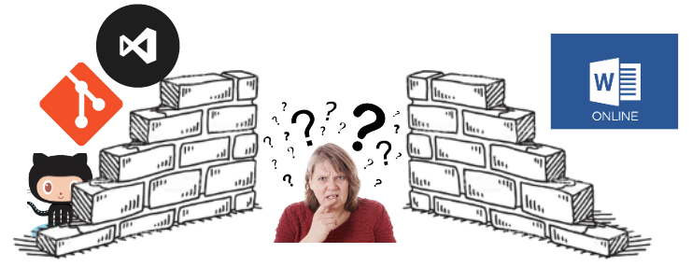
VS Code is the Tool of Choice for Git
Among content developers, VS Code is popular for working in Git because it enables editing and source control in a single tool.
But how do you make the workflow work?

Slide 10
Git-TechReview (GTR) Solves the Transfer Problem
GTR extends VS Code and enables:
Seamless
Automated
On-demand
...exporting of Markdown files to Word docx, and importing of Word docx to Markdown.

Slide 11
Pain Relief!
Content developers can:
Export an existing Markdown topic file to a Word docx file on OneDrive
Collaborate with SMEs using Word Online
Easily import the finished content back into Markdown on Git
—OR—
Start with Word, collaborate, and then import to Markdown on Git.

Slide 12
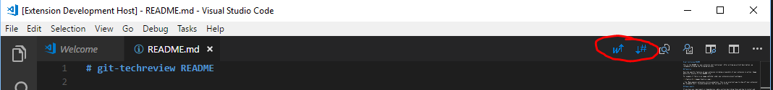
GTR– VS Code demo
When you open a Markdown file, GTR adds 2 new buttons to your toolbar.
- Export to .docx
- Import to .md

Slide 13
GTR – Export to .docx button
Clicking this button launches file explorer. Select the folder where you would like the .docx to be saved.
Click OK and the .md file is converted to .docx and saved in the location that you specified.
Now you may send the file for collaboration.

Slide 14
GTR – Import to .md button
Clicking this button launches file explorer. Select the .docx file that you want to import to markdown.
Click OK and the .docx file is converted to .md and saved over the file that you had open.
Not only can you import .docx files that you previously exported, but you can also import any .docx file using this process.

Slide 15
GTR – Future work (what we would do if we had more time)
Full fidelity roundtrip for docs.microsoft.com content. Custom markdown extensions such as alerts, videos, etc. lose formatting.
Configuration for Import and Export functionality.

