Slide 1

NIKE GLOBAL DIGITAL STRATEGY TEAM
Short-Form Video
Trends Analytics — 2025
YouTube Shorts · TikTok — Campaign Performance, Creator ROI & Viral-Trend Prediction
Presented by,
Archi Katiyar
Cohort-12
PHASE 1 & 2 · SQL + POWER BI

Slide 2

PROJECT OVERVIEW
The Brief
You've joined the Nike Global Digital Strategy Team. Nike invests millions every year in influencer marketing and creator-led short-form content on YouTube Shorts and TikTok. This project analyzes the 2025 short-form video trends dataset to turn that spend into evidence-based strategy.
How Nike's campaigns perform across countries and platforms
What type of content drives completion and engagement
Which creators and hashtags provide the most ROI
How to predict viral trends for upcoming product launches
1
SQL Analytics
2
Power BI Dashboards
Query & analyze the raw dataset
Build interactive visual insights

Slide 3
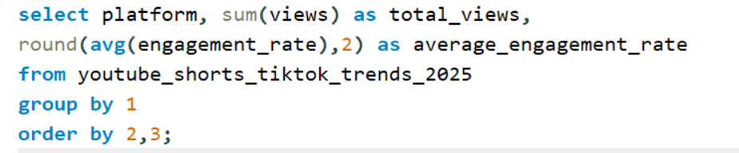
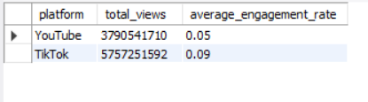
SQL PHASE · QUERY 01 OF 12
01
Platform Comparison
Total views and average engagement rate across YouTube Shorts vs. TikTok.
NIKE SHORT-FORM VIDEO ANALYTICS · SQL PHASE
3 / 23

Slide 4
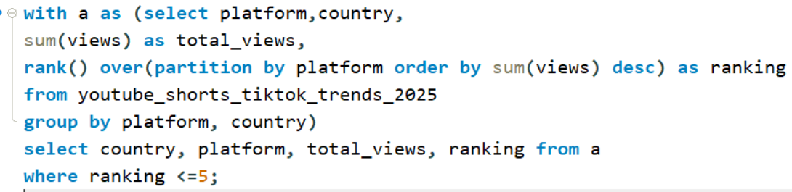
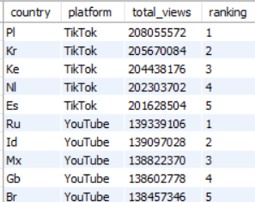
SQL PHASE · QUERY 02 OF 12
02
Regional Hotspots
Top 5 countries with the highest views for Nike campaigns, on each platform.
NIKE SHORT-FORM VIDEO ANALYTICS · SQL PHASE
4 / 23

Slide 5
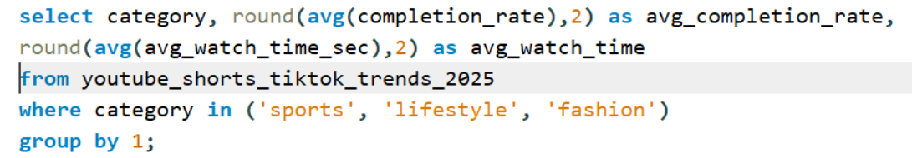
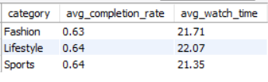
SQL PHASE · QUERY 03 OF 12
03
Category Performance
Average completion rate and avg. watch time for categories like Sports, Lifestyle, Fashion.
NIKE SHORT-FORM VIDEO ANALYTICS · SQL PHASE
5 / 23

Slide 6
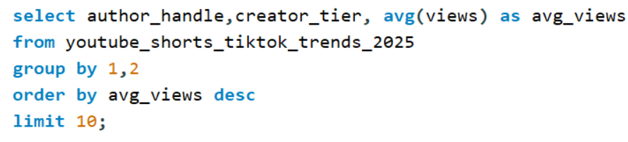
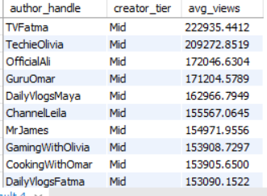
SQL PHASE · QUERY 04 OF 12
04
Creator Impact
Top 10 creators (author_handle) by average views, along with their creator tier.
NIKE SHORT-FORM VIDEO ANALYTICS · SQL PHASE
6 / 23

Slide 7
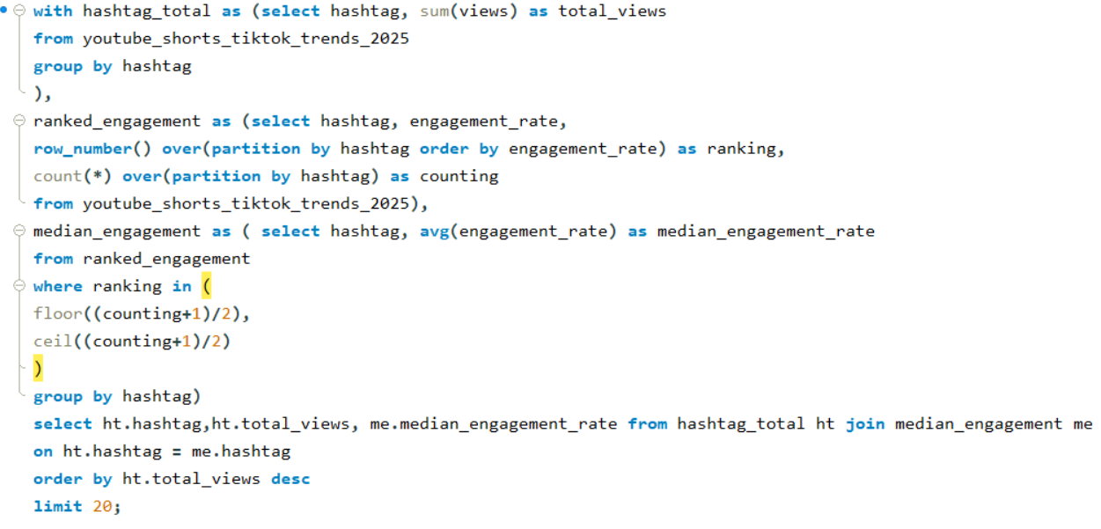
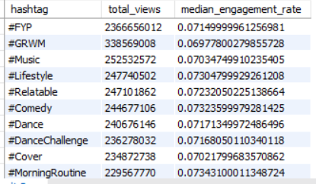
SQL PHASE · QUERY 05 OF 12
05
Hashtag ROI
Top 20 hashtags by total views, with median engagement rate.
NIKE SHORT-FORM VIDEO ANALYTICS · SQL PHASE
7 / 23

Slide 8
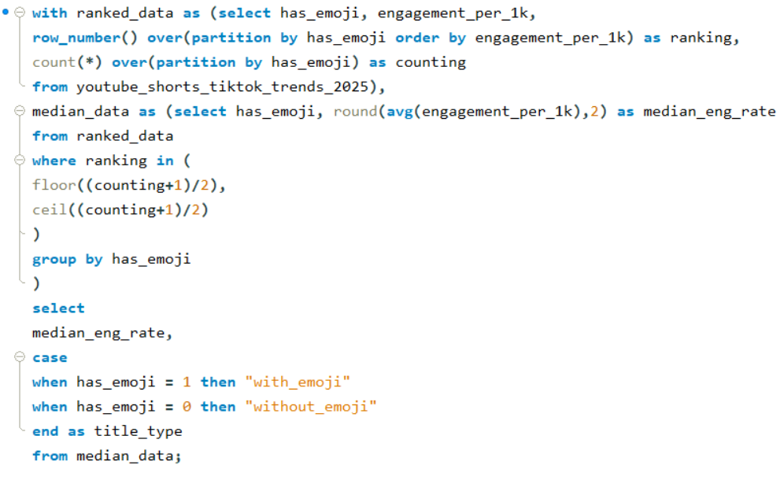

SQL PHASE · QUERY 06 OF 12
06
Emoji Effect
Median engagement per 1K views: videos with an emoji in the title vs. without.
NIKE SHORT-FORM VIDEO ANALYTICS · SQL PHASE
8 / 23

Slide 9
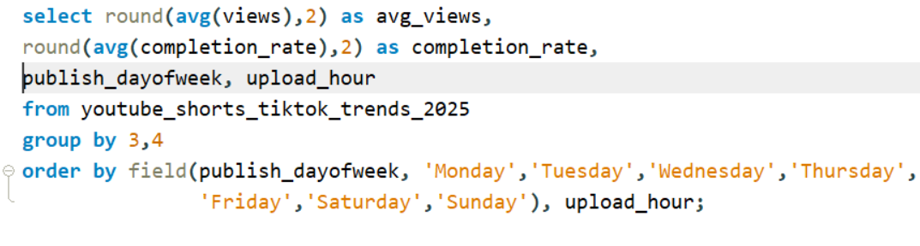
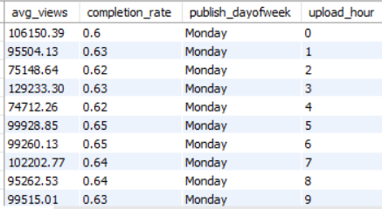
SQL PHASE · QUERY 07 OF 12
07
Upload Timing
Average views and completion rate by publish day-of-week and upload hour.
NIKE SHORT-FORM VIDEO ANALYTICS · SQL PHASE
9 / 23

Slide 10
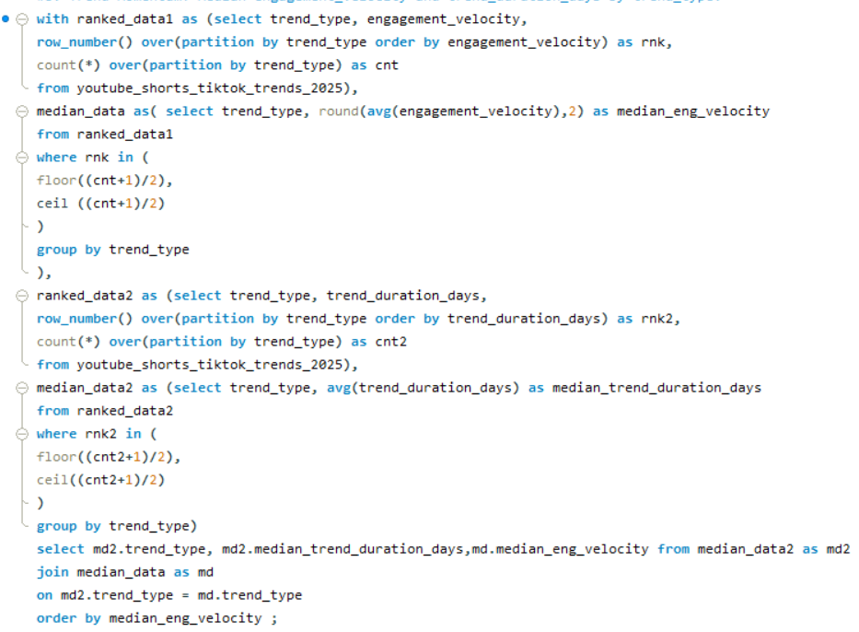
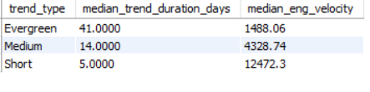
SQL PHASE · QUERY 08 OF 12
08
Trend Momentum
Median engagement velocity and trend duration (days), broken down by trend type.
NIKE SHORT-FORM VIDEO ANALYTICS · SQL PHASE
10 / 23

Slide 11
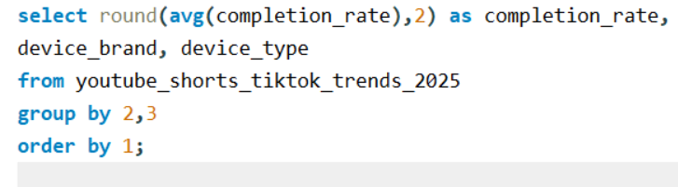
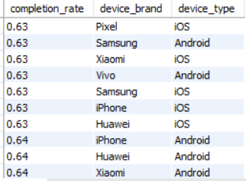
SQL PHASE · QUERY 09 OF 12
09
Device Analysis
Completion rates by device type (Android / iOS / Web) and device brand.
NIKE SHORT-FORM VIDEO ANALYTICS · SQL PHASE
11 / 23

Slide 12
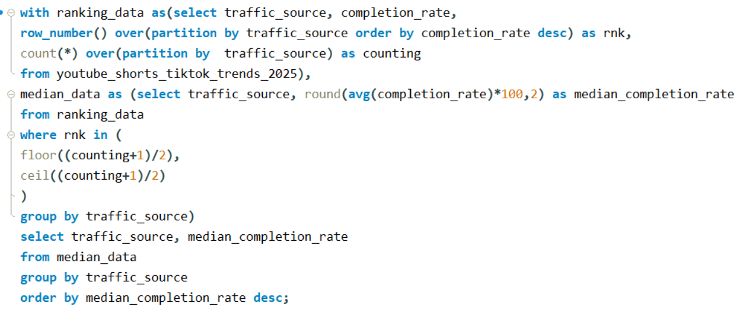
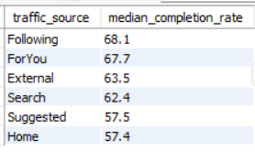
SQL PHASE · QUERY 10 OF 12
10
Traffic Sources
Breakdown of traffic source (For You Page, Search, Direct, etc.) with median completion rate.
NIKE SHORT-FORM VIDEO ANALYTICS · SQL PHASE
12 / 23

Slide 13
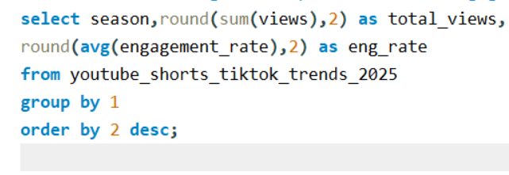
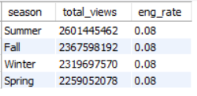
SQL PHASE · QUERY 11 OF 12
11
Seasonal Insights
Views and engagement rate across event seasons — Olympics, Christmas, Summer Sales, etc.
NIKE SHORT-FORM VIDEO ANALYTICS · SQL PHASE
13 / 23

Slide 14
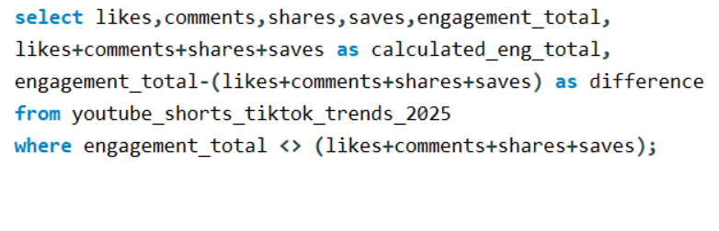
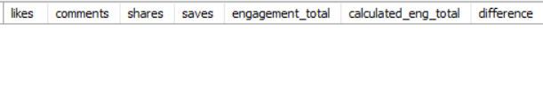
SQL PHASE · QUERY 12 OF 12
12
Data Quality Check
Validate engagement_total = likes + comments + shares + saves. Return mismatched rows.
NIKE SHORT-FORM VIDEO ANALYTICS · SQL PHASE
14 / 23

Slide 15
POWER BI ANALYTICS
Dashboard Overview
Building on the SQL analysis, a 5-page interactive Power BI dashboard was built across the same 48,000+ video dataset — surfacing platform, regional, creator, and seasonal patterns to guide upcoming campaign strategy.
5B
49.70K
64%
8%
Total Views
Videos Analyzed
Avg. Completion Rate
Avg. Engagement Rate
WHAT'S COVERED ACROSS THE 5 PAGES
1
Executive Overview
2
Hashtag & Category Engagement
3
Hashtag ROI & Content Duration
4
Creator Tier & Timing Insights
5
Device, Trend & Seasonal Analysis

Slide 16
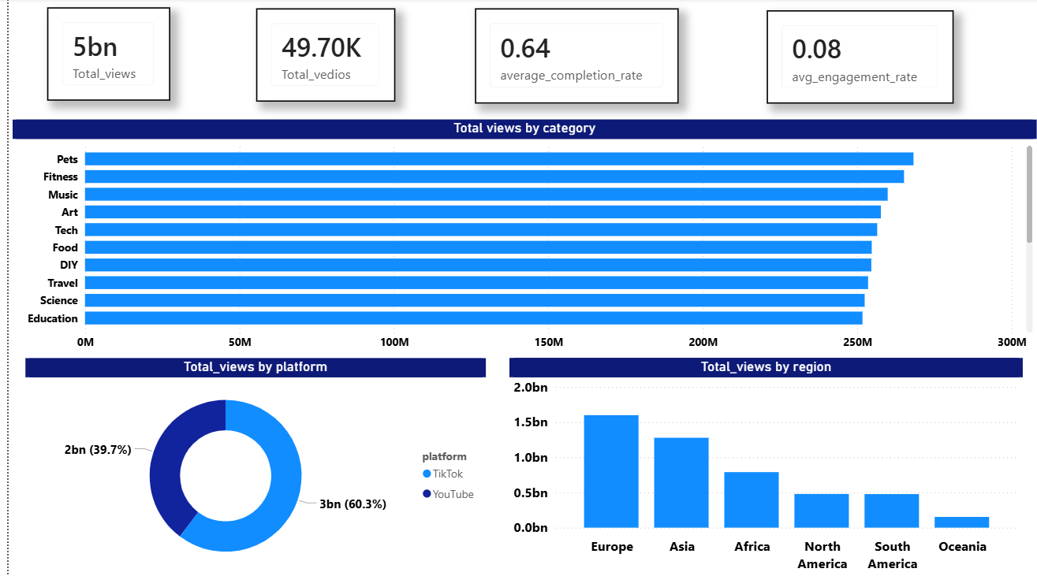
POWER BI PHASE · DASHBOARD 1 OF 5
1
Executive Overview
5B total views across 49.70K short-form videos analyzed
64% average completion rate · 8% average engagement rate
TikTok drives 60.3% of views (3B) vs. YouTube's 39.7% (2B)
Europe leads by region (~1.6B views), ahead of Asia and Africa
Views are fairly evenly spread across categories — Pets, Fitness, and Music lead narrowly
NIKE SHORT-FORM VIDEO ANALYTICS · POWER BI PHASE
16 / 23

Slide 17
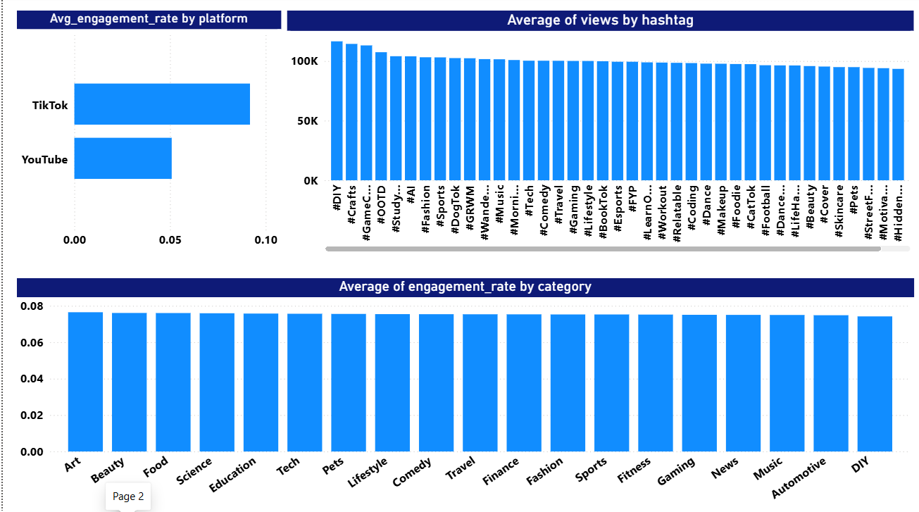
POWER BI PHASE · DASHBOARD 2 OF 5
2
Hashtag &
Category Engagement
TikTok shows a meaningfully higher average engagement rate than YouTube
#DIY, #Crafts, and #GameChanger top the hashtag leaderboard by average views
Engagement rate is fairly consistent across categories (0.06–0.08), with Art and Beauty narrowly leading
No single category dominates — content strategy can diversify safely across formats
NIKE SHORT-FORM VIDEO ANALYTICS · POWER BI PHASE
17 / 23

Slide 18
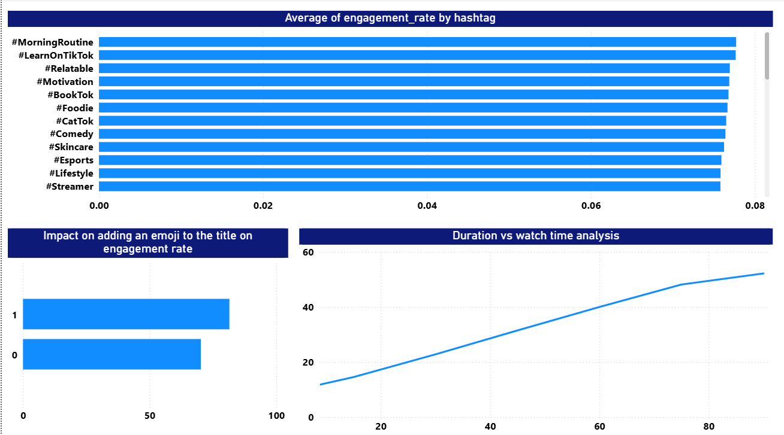
POWER BI PHASE · DASHBOARD 3 OF 5
3
Hashtag ROI & Content Duration
#MorningRoutine, #LearnOnTikTok, and #Relatable post the highest engagement rates
Titles with an emoji show a higher engagement rate than titles without
Watch time scales almost linearly with video duration up to ~90 seconds
No clear drop-off point — longer-format Shorts still hold viewer attention
NIKE SHORT-FORM VIDEO ANALYTICS · POWER BI PHASE
18 / 23

Slide 19
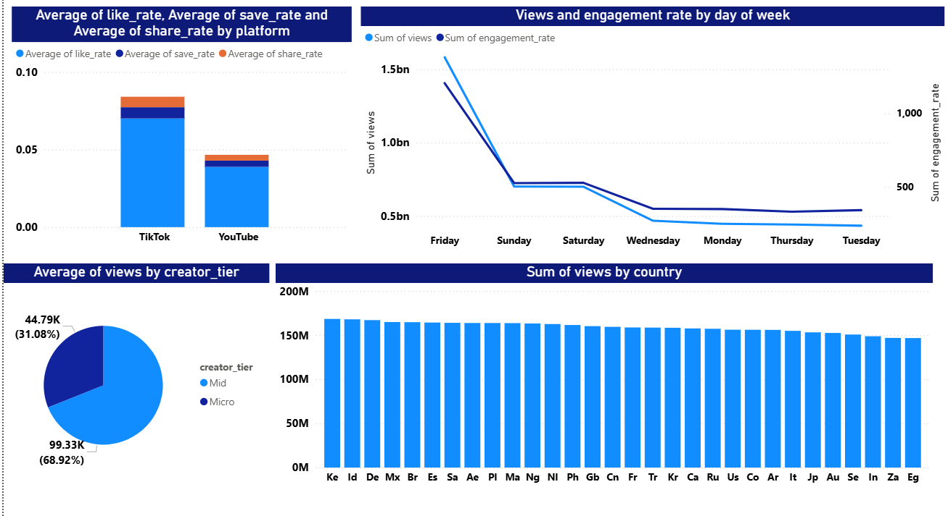
POWER BI PHASE · DASHBOARD 4 OF 5
4
Creator Tier & Timing Insights
TikTok outperforms YouTube on like, save, and share rate alike
Friday is the strongest day for views and engagement; both taper toward mid-week
Mid-tier creators drive 69% of average views vs. 31% from Micro-tier creators
View volume is broadly distributed across 30 countries, led by Kenya, Indonesia, and Germany
NIKE SHORT-FORM VIDEO ANALYTICS · POWER BI PHASE
19 / 23

Slide 20
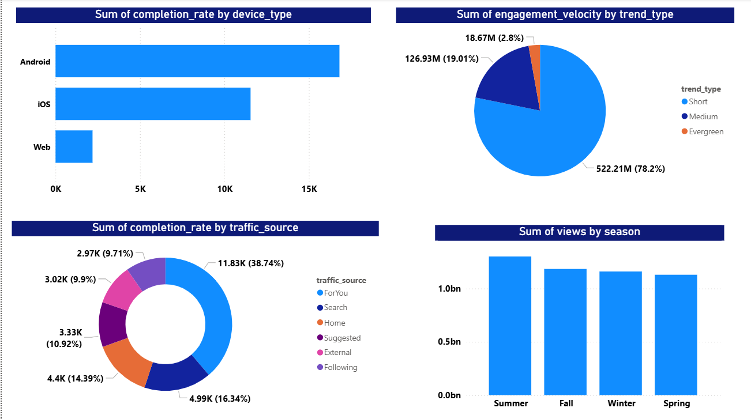
POWER BI PHASE · DASHBOARD 5 OF 5
5
Device, Trend &
Seasonal Analysis
Android drives the highest completion rate, ahead of iOS; Web lags well behind
78% of engagement velocity comes from Short-form trends, vs. 19% Medium and 3% Evergreen
The For You Page drives 39% of completion-rate share — by far the top traffic source
Summer generates the highest view volume, with Fall, Winter, and Spring close behind
NIKE SHORT-FORM VIDEO ANALYTICS · POWER BI PHASE
20 / 23

Slide 21
EXECUTIVE SUMMARY
The Story So Far
Across 48,000+ short-form videos and 5 billion views, Nike's audience is unmistakably TikTok-led, Friday-peaked, and driven more by mid-tier creators than mega-influencers. Engagement is remarkably consistent across content categories, and viewers reward longer, more considered Shorts rather than the shortest possible clips.
60.3%
69%
78%
39%
of views come from TikTok, not YouTube
of average views come from Mid-tier creators
of engagement velocity is driven by Short-form trends
of completion-rate share comes from the For You Page
Nike's short-form audience already has favorites — a platform, a creator tier, a day, and a content length. The opportunity now is to align spend and content strategy to what's already working, rather than spreading budget evenly.
NIKE SHORT-FORM VIDEO ANALYTICS · EXECUTIVE SUMMARY
21 / 23

Slide 22
STRATEGIC RECOMMENDATIONS
Where Nike Should Act Next
Five data-backed moves to sharpen short-form marketing ahead of upcoming product launches.
1
Shift Budget Weight Toward TikTok
2
Scale Mid-Tier Creator Partnerships
TikTok drives 60% of total views and shows meaningfully higher engagement than YouTube. Increase TikTok's share of paid creator spend.
Mid-tier creators generate 69% of average views vs. 31% from Micro-tier. Prioritize mid-tier deals for efficient reach at lower cost than mega-influencers.
3
Anchor Major Drops to Friday
4
Optimize for the For You Page, Not Search
Friday shows the strongest views and engagement of the week. Schedule flagship product-launch content for Friday releases.
39% of completion-rate share comes from FYP distribution. Design content for algorithmic discovery — strong hooks in the first 3 seconds — over search-optimized titles.
5
Keep Shorts in the 60–90s Range
Watch time scales linearly with duration up to ~90 seconds with no drop-off. Favor longer-format storytelling over ultra-short clips for launch content.
NIKE SHORT-FORM VIDEO ANALYTICS · STRATEGIC RECOMMENDATIONS
22 / 23

Slide 23
ANALYSIS COMPLETE
THANKYOU

