Slide 1
FIFA World Cup 2026
USA · CANADA · MEXICO
Dashboard Insights
50
186
300
11 Jun – 20 Jul
Matches
Goals
Players
Tournament window
Submitted by,
Archi katiyar

Slide 2
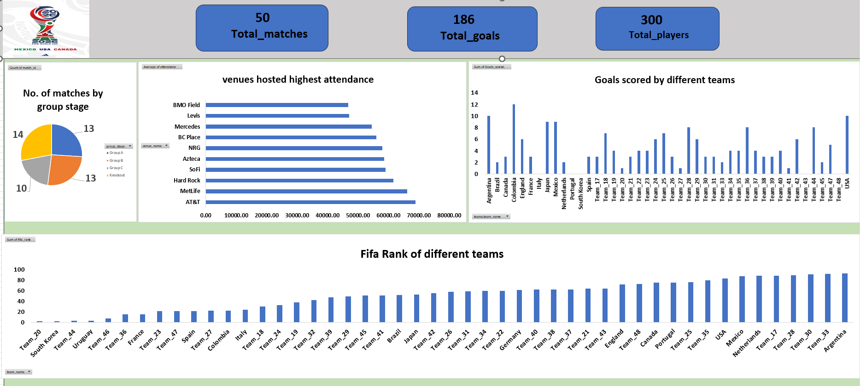
Overview: 50 matches, 186 goals, 3.7 goals per match
Key insights
Balanced schedule. 13 matches each in Group A and Group B, 10 in Group C and 14 in the knockout stage.
Big venues draw the crowds. AT&T (about 69K) and MetLife (about 66K) lead average attendance; BMO Field and Levi’s sit lowest near 47K.
Scoring is spread out. Colombia leads with 12 goals, Argentina and USA follow with 10, while Italy, Portugal and South Korea show none.
Rank does not predict goals. Argentina has the highest rank value (about 93) yet scored 10; Colombia (about 22) scored the most.

Slide 3
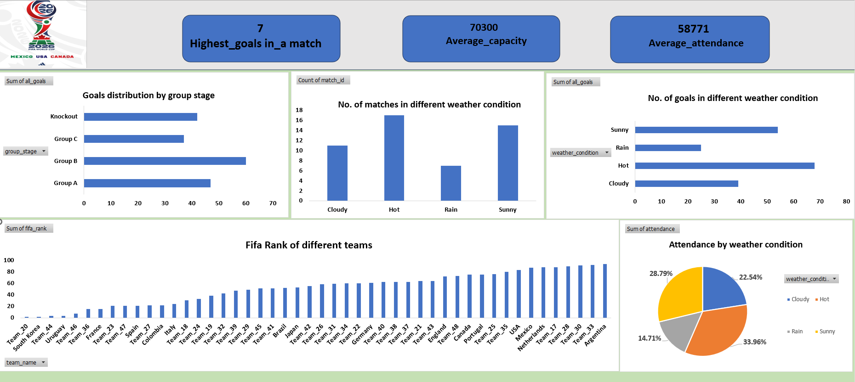
Group B and hot weather bring the most goals
Key insights
Stadiums run at about 84% full. Average attendance is 58,771 against an average capacity of 70,300; the highest-scoring match had 7 goals.
Group B is the scoring group. 60 goals in 13 matches (about 4.6 per match) versus 47 in Group A, 37 in Group C and 42 in the knockouts (about 3.0 per match).
Hot matches score most. 17 matches and 68 goals (about 4.0 per match); rain has 7 matches and 25 goals.
Hot days also pull the biggest share of attendance. 34% of total attendance, ahead of sunny (28.8%), cloudy (22.5%) and rain (14.7%).

Slide 4
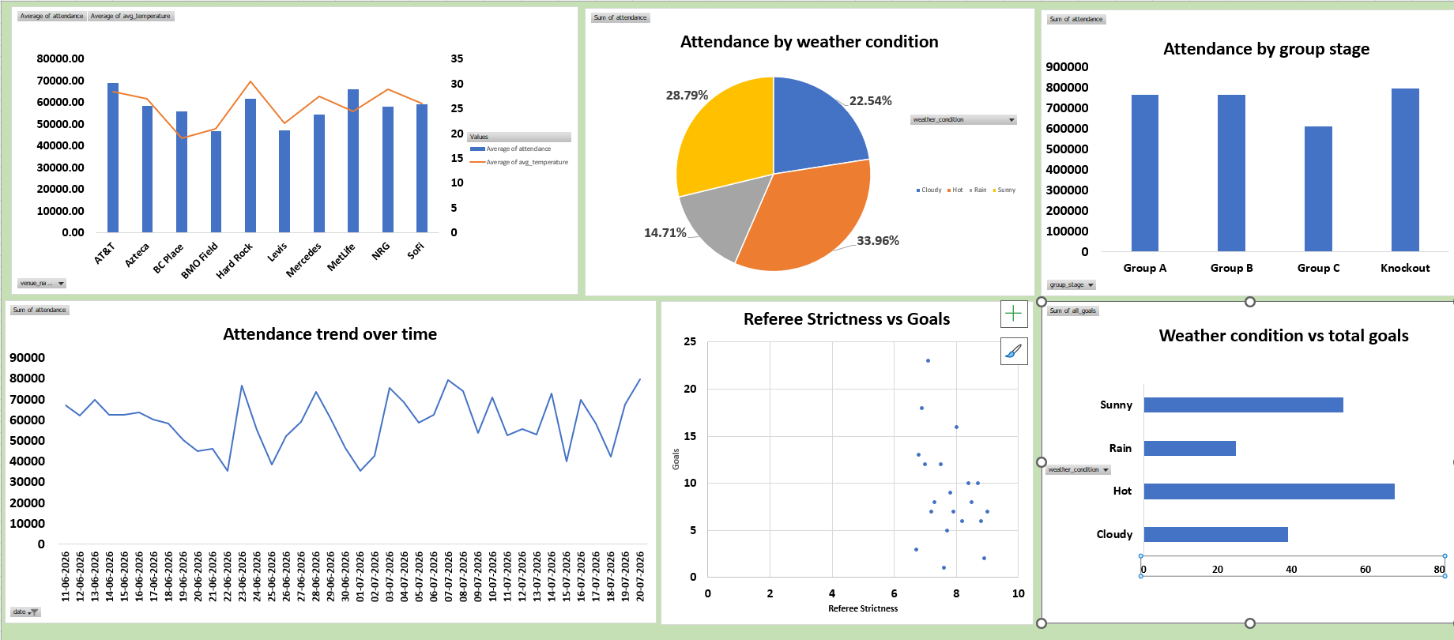
Attendance and referees: schedule and venue matter most
Key insights
Venue beats temperature. Hard Rock is the hottest venue (about 30°C) and BC Place the coolest (about 19°C), yet neither tracks attendance; AT&T leads at about 69K.
Knockouts draw the most in total. About 800K versus about 765K for Groups A and B and about 610K for Group C, which had the fewest matches.
Daily crowds swing widely. Between roughly 35K and 80K, with peaks near 80K on 7 and 20 July and dips near 35K on 22 June and 1 July.
Referee strictness shows no pattern. Ratings of 6.7 to 9.0 are scattered against 1 to 23 goals with no visible trend.
Per match, crowds are steady at about 57K–61K across stages, so totals follow match counts. Calendar and venue are the real levers.

Slide 5
Summary
3.7
84%
4.6
68
goals per match
average stadium fill
Group B goals per match
goals in hot weather
186 goals in 50 matches
58,771 attendance vs 70,300 capacity
from 17 matches, the most of any condition
vs 3.0 in the knockouts
Scoring: Group B and hot-weather matches score the most, but per-match differences by weather are small (about 3.55 to 4.0). FIFA rank does not predict goals.
Attendance: Venue and calendar drive crowds. AT&T and MetLife lead, per-match attendance is steady at about 57K–61K, and stadiums have about 16% spare capacity.

Slide 6
Thank You
USA · CANADA · MEXICO
FIFA World Cup 2026 – Dashboard Insights

