Slide 1
A POWER BI ANALYTICS PROJECT
OLYMPIC INSIGHTS
128 Years of Olympic History, Decoded Through Data
1896–2032
6 Datasets
20,654 Medals
6 Report Pages
Prepared by Archi Katiyar
OLYMPIC INSIGHTS | POWER BI ANALYTICS PROJECT
1

Slide 2




THE OLYMPIC GAMES
A Global Stage Since 1896
1896
The modern Olympic Games began in Athens in 1896, reviving an ancient Greek tradition of athletic competition. Held every four years and alternating between Summer and Winter editions, the Games have grown from a 14-nation gathering into the world's largest multi-sport event.
First modern Games, held in Athens
4-Year
Cycle between each edition, Summer & Winter
200+
“The most important thing is not to win but to take part.”
Nations compete on the Olympic stage today
— Pierre de Coubertin, founder of the modern Olympic movement
32
Sports on the Paris 2024 Summer program
OLYMPIC INSIGHTS | POWER BI ANALYTICS PROJECT
2

Slide 3

PROJECT FOUNDATION
About the Dataset
Six interconnected CSV files spanning every Olympic edition from 1896 to 2032, cleaned and modeled as a star schema.
Athlete Bio
Event Results
Medal Tally
155,861 rows
316,834 rows
1,807 rows
Name, sex, birth date, height, weight, nationality
Every athlete's placement & medal, per event, per edition
Official Gold / Silver / Bronze counts by country & edition
Results Detail
Country Reference
Games Reference
7,394 rows
234 rows
64 rows
Event context: dates, venues, participant counts
NOC code to country name mapping
Edition, year, host city, season, host nation
OLYMPIC INSIGHTS | POWER BI ANALYTICS PROJECT
3

Slide 4




HOW IT WAS BUILT
Tools & Technologies
Power Query
Power BI Desktop
DAX
Power BI Service
Data cleaning, transformation & the ETL pipeline
Star-schema data modeling & DAX measures
Calculated columns, measures & Top-N logic
Interactive 6-page report with cross-filtering
OLYMPIC INSIGHTS | POWER BI ANALYTICS PROJECT
4

Slide 5



FROM RAW TO READY
Data Cleaning & Transformation
01
Trimmed & standardized text
Removed stray whitespace from country names, NOC codes and sport labels.
02
Parsed dates & derived age
Converted birth date text into real dates; computed age at every event.
03
Handled messy values
Averaged weight ranges, nulled impossible ages, flagged cancelled editions.
04
Joined six files together
Merged athlete, event, medal & host data into one enriched fact table.
OLYMPIC INSIGHTS | POWER BI ANALYTICS PROJECT
5

Slide 6
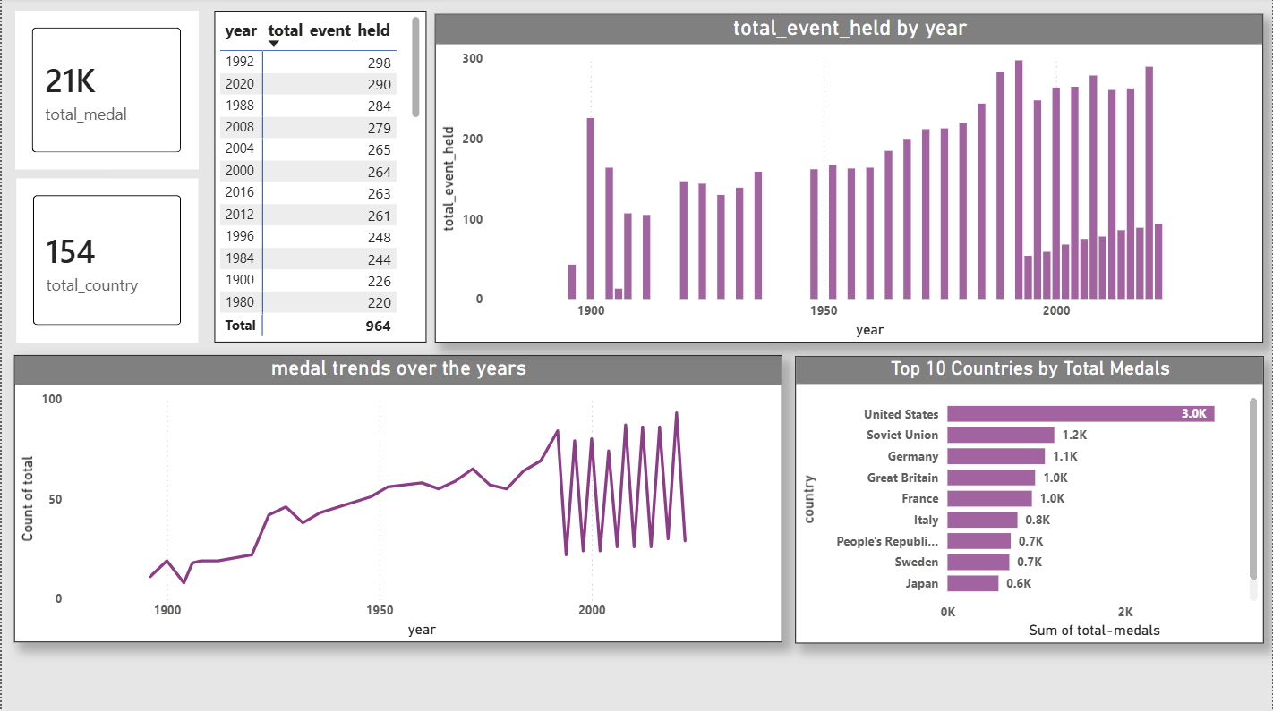


DASHBOARD PAGE 1
Global Medal Overview
3.0K vs 1.2K
United States dominates all-time medals — nearly 2.5x ahead of the Soviet Union in second place.
4x growth
The Olympic program has grown from ~226 events (1900) to 298 by 1992.
154 of 200+
Nations that have won at least one medal — roughly 3 in 4 competing nations have podiumed.
2 World Wars
Visible gaps in 1916, 1940 & 1944 mark real historical cancellations.
20,654
official medals awarded across every Summer & Winter edition since 1896
OLYMPIC INSIGHTS | POWER BI ANALYTICS PROJECT
6

Slide 7
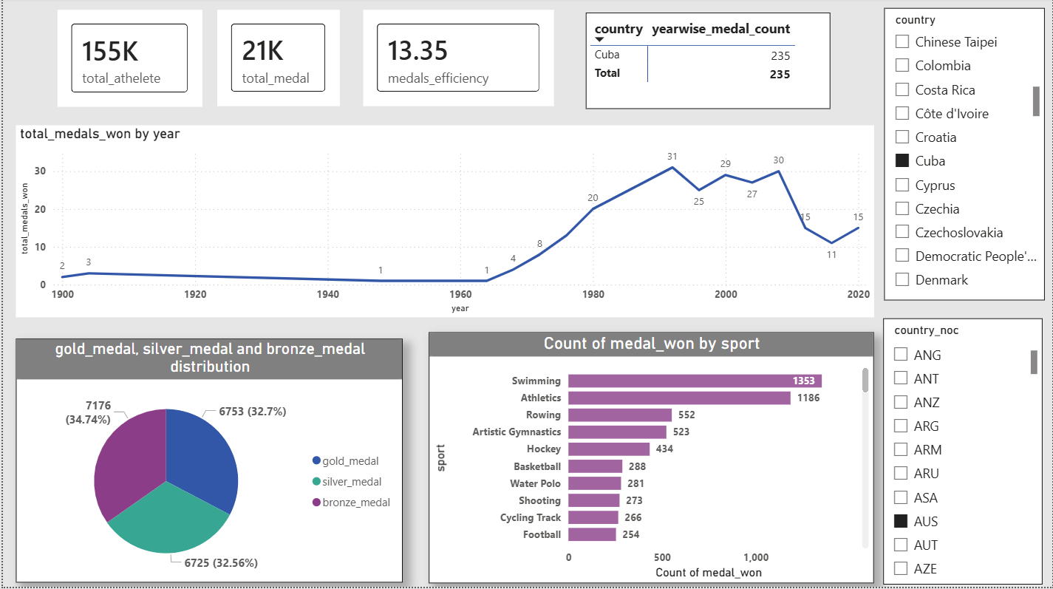

DASHBOARD PAGE 2
Country Insights
Cuba: 235
Medals climbed from single digits pre-1960 to a peak of 31 in 1992, tracking state-sponsored sport investment.
3,151 medals
Athletics is the single largest medal-generating sport — more than double the next closest (Shooting).
32.7/32.6/34.7%
Gold, Silver & Bronze are almost perfectly balanced across all nations — no systemic skew.
Weightlifting #1
Cuba's strongest sports: Weightlifting (19 medals) and Shooting (18).
13.35
medals won per 100 athletes sent — the global medal-efficiency benchmark
OLYMPIC INSIGHTS | POWER BI ANALYTICS PROJECT
7

Slide 8
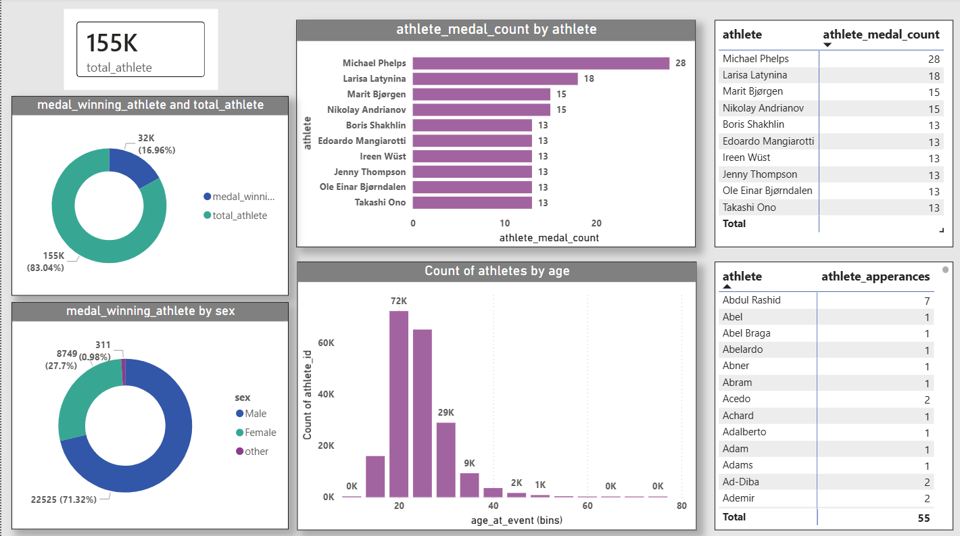


DASHBOARD PAGE 3
Athlete Spotlight
Swimming leads
Top 10 by medals is dominated by swimming & gymnastics — Phelps (28), Latynina (18).
16.96%
Of all 155K athletes, only this share have ever won a medal — most careers end with zero podiums.
71.3% vs 27.7%
Medal winners skew heavily male, though the gap is narrowing in recent decades.
Age 20–24
Peak medal-winning age band, with a sharp drop-off after 30.
28
career medals for Michael Phelps — the most decorated Olympian in history
OLYMPIC INSIGHTS | POWER BI ANALYTICS PROJECT
8

Slide 9
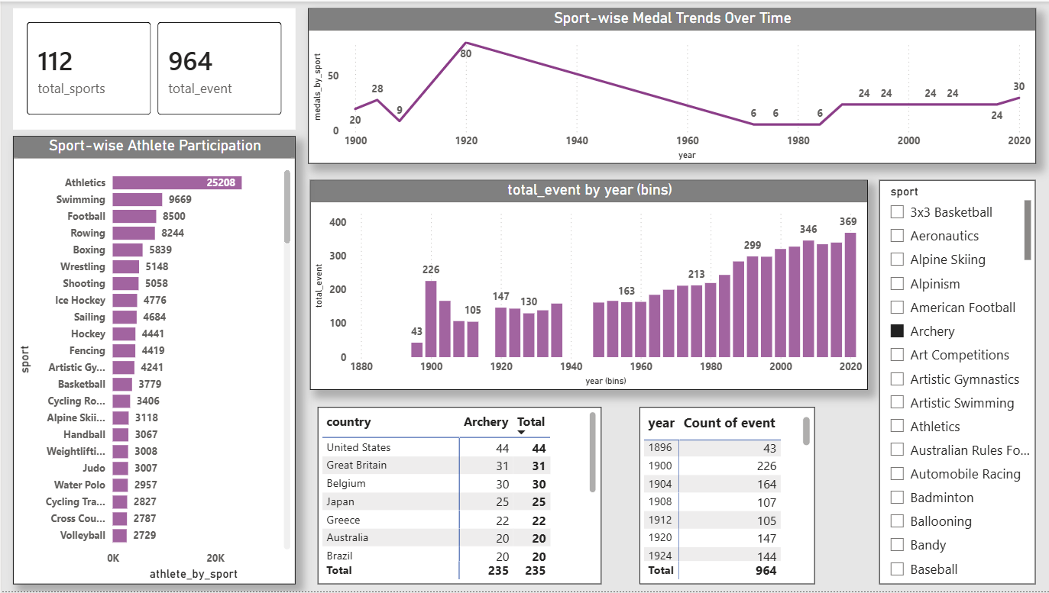

DASHBOARD PAGE 4
Sport & Event Analysis
Archery's gap
Peaked at 80 medals (1920), vanished for decades, returned strong from 1972 — matches its real removal & reinstatement.
USA: 44 medals
The United States leads all-time Archery medals, ahead of Great Britain (31) and Belgium (30).
8x growth
Total events grown from 43 (1900) to 369 by 2020 — steady long-term program expansion.
25,208 appearances
112
Athletics dominates athlete participation — nearly 3x the next-highest sport, Swimming.
distinct sports have appeared on the Olympic program since 1896
OLYMPIC INSIGHTS | POWER BI ANALYTICS PROJECT
9

Slide 10
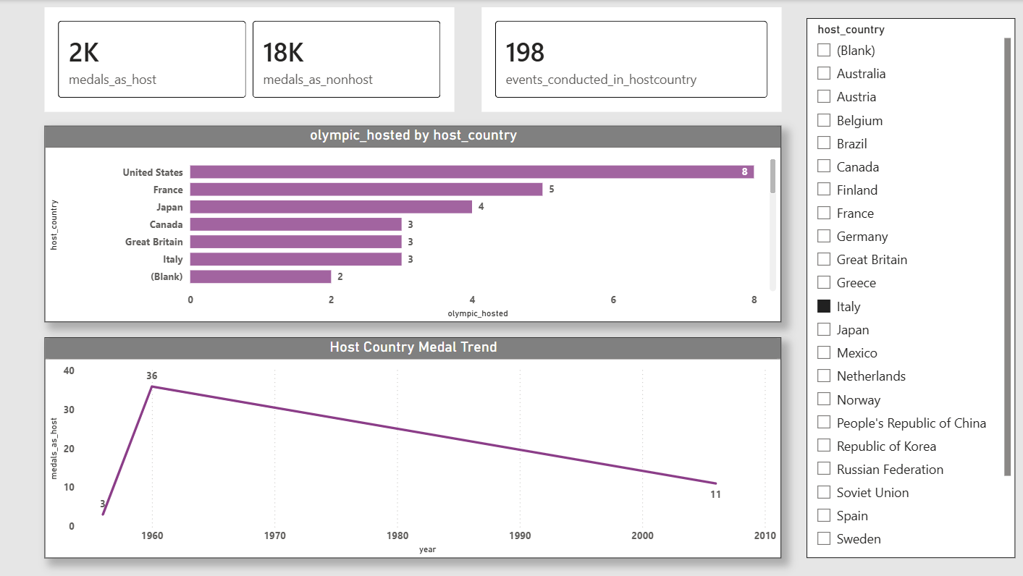
DASHBOARD PAGE 5
Host Country Analysis
Home advantage
Italy's medals peaked exactly in 1960, the year it hosted Rome.
One-time boost
The advantage faded steadily afterward — hosting lifts performance once, not permanently.
USA: 8 hostings
The United States has hosted the most Olympics all-time, ahead of France (5) and Japan (4).
36 vs 11
Italy's medal count the year it hosted (1960) vs. by the mid-2000s
OLYMPIC INSIGHTS | POWER BI ANALYTICS PROJECT
10

Slide 11
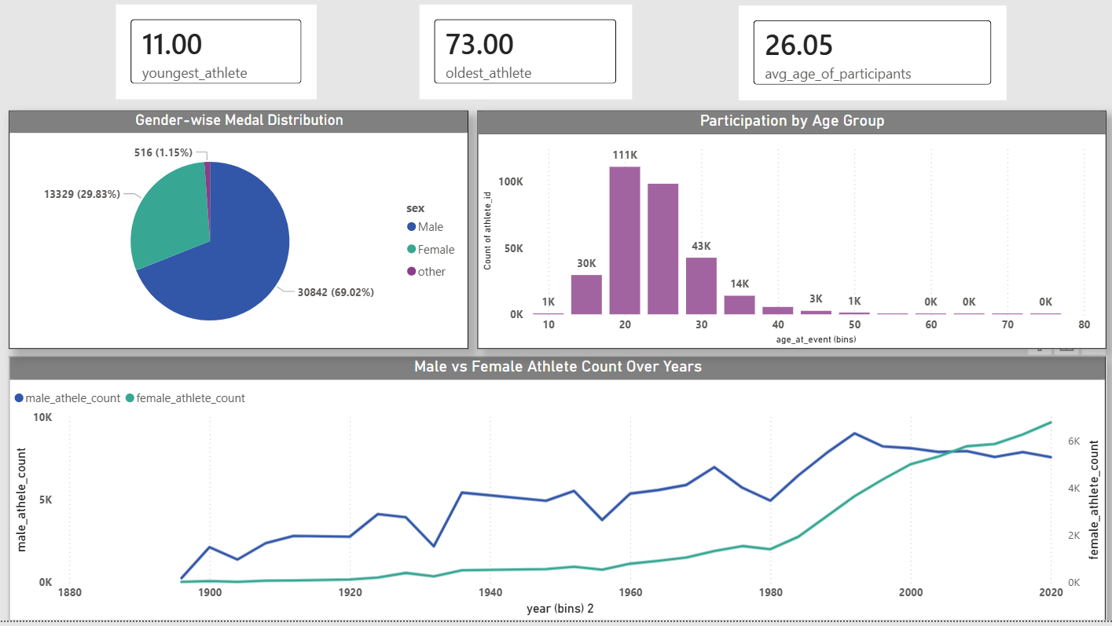
DASHBOARD PAGE 6
Gender & Demographics
Historic crossover
Female participation visibly overtook male participation around 2015–2020.
Age 20–24 peaks
111K athletes concentrate in this age band, dropping sharply after 35.
Avg. age 26.05
Spans a wide range — from an 11-year-old competitor to a 73-year-old.
69/30/1
Male / Female / other split of all 44,687 medals
OLYMPIC INSIGHTS | POWER BI ANALYTICS PROJECT
11

Slide 12
WRAPPING UP
Overall Conclusion
Across 128 years, 155,861 athletes, and 20,654 medals, the data tells a consistent story: sustained national investment and home-field advantage both move the needle, the Games have grown dramatically in scale, and the athlete population has moved steadily toward gender parity.
A few nations dominate the medal table
Home-field advantage is real, but temporary
The United States leads in both total medals and hosting count — a pattern that has held for over a century.
Host nations reliably outperform their average in their hosting year, then revert — confirmed directly in Italy's 1960 data.
Gender parity has genuinely arrived
Female Olympic participation overtook male participation for the first time around 2015–2020.
OLYMPIC INSIGHTS | POWER BI ANALYTICS PROJECT
12

Slide 13
THANK YOU
Questions & discussion welcome.
Global Medal Overview
Country Insights
Athlete Spotlight
Sport & Event Analysis
Host Country Analysis
Gender & Demographics
Archi Katiyar
Olympic Insights — A Power BI Analytics Project

