Slide 1
POWER BI PROJECT
Financial Analysis
Credit Card Customer Data • DAX Measures • Data Modelling
Archi Katiyar
Cohort-12
15 DAX Formulas | Data Cleaning in Power Query | Relationship Modelling

Slide 2
PROJECT OVERVIEW & DATA DICTIONARY
About This Project: This Power BI project performs end-to-end financial analysis on credit card customer data. It covers data cleaning in Power Query, relationship modelling across four source tables, and 15 advanced DAX measures spanning risk scoring, churn detection, time intelligence, and customer segmentation — providing actionable insights into spending, delinquency, and credit utilization.
SOURCE TABLES ( 4 CSVs → 2 Appended Tables )
🗂 CreditCard ( credit_card + cc_add ) — 18 Columns
🗂 Customer ( customer + cust_add ) — 15 Columns
Client_Num
Unique client identifier (PK / FK)
Client_Num
Unique client identifier (PK)
Card_Category
Blue / Silver / Gold / Platinum
Customer_Age
Age of the customer
Annual_Fees
Annual card fee charged
Gender
M / F
Activation_30_Days
Activated within 30 days (0/1)
Dependent_Count
Number of dependents
Customer_Acq_Cost
Cost to acquire the customer
Education_Level
Graduate / Doctorate etc.
Week_Start_Date
Start date of the week (Date)
Marital_Status
Single / Married / Unknown
Week_Num / Qtr / current_year
Time dimensions
state_cd
US state code (CA, NY, TX…)
Credit_Limit
Maximum credit allowed
Zipcode
Postal code
Total_Revolving_Bal
Unpaid balance carried forward
Car_Owner
yes / no
Total_Trans_Amt
Total transaction amount (Sales)
House_Owner
yes / no
Total_Trans_Vol
Count of transactions
Personal_loan
yes / no — loan approval flag
Avg_Utilization_Ratio
Credit used ÷ Credit limit (0–1)
contact
Cellular / Unknown
Use Chip
Chip / Swipe / Online
Customer_Job
Govt / Businessman / Blue-collar…
Exp Type
Expense category (Fuel, Travel…)
Income
Annual income (₹)
Interest_Earned
Interest earned by the bank
Cust_Satisfaction_Score
1–5 satisfaction rating
Delinquent_Acc
1 = missed payment, 0 = on time
🔗 Relationship: Customer[Client_Num] (1) ────── (1) CreditCard[Client_Num] | Join Key: Client_Num | Cardinality: One-to-One | Cross-filter: Both

Slide 3
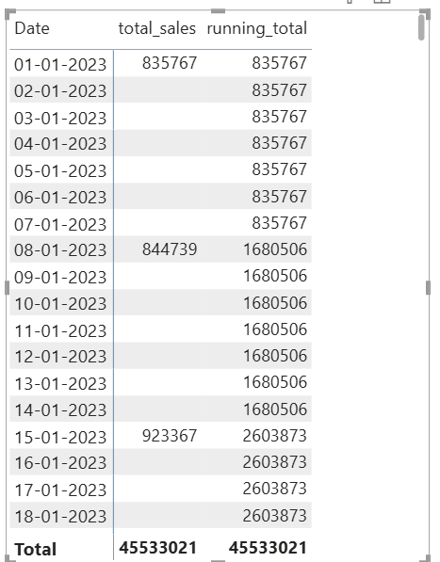
1
Q1 — Running Total of Credit Card Transactions
Calculates the cumulative sum of Total_Trans_Amt (total_sales) up to the current date, using “all” to respect slicer filters while still accumulating over time.
running_total = CALCULATE([total_sales],FILTER(all(calender), calender[Date] <= max(calender[Date])))
POWER BI OUTPUT
DAX FORMULA
📸 Insert Screenshot Here
Power BI Visual / Query Result
Financial Analysis Dashboard • Power BI Project
1 / 15

Slide 4
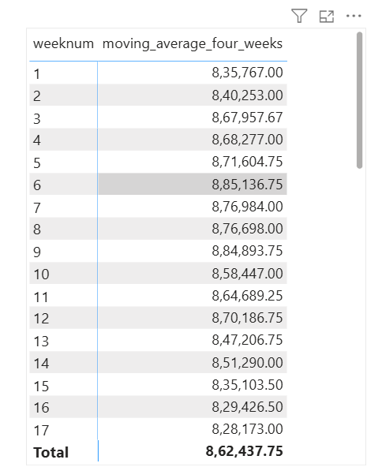
2
Q2 — 4-Week Moving Average of Credit Limit
Calculates the average Credit_Limit over 4 weeks for each client.
Moving_average_four_weeks =
var four_weeks_dates = filter(all(calender), calender[weeknum] >= MAX(calender[weeknum]) -3 && calender[weeknum] <= MAX(calender[weeknum]) && calender[year]= max(calender[year]))
var rev_four_weeks_dates = CALCULATE([total_sales],four_weeks_dates)
var distinct_weeks = CALCULATE(DISTINCTCOUNT(calender[weeknum]),four_weeks_dates)
return divide(rev_four_weeks_dates ,distinct_weeks,0)
POWER BI OUTPUT
DAX FORMULA
📸 Insert Screenshot Here
Power BI Visual / Query Result
Financial Analysis Dashboard • Power BI Project
2 / 15

Slide 5
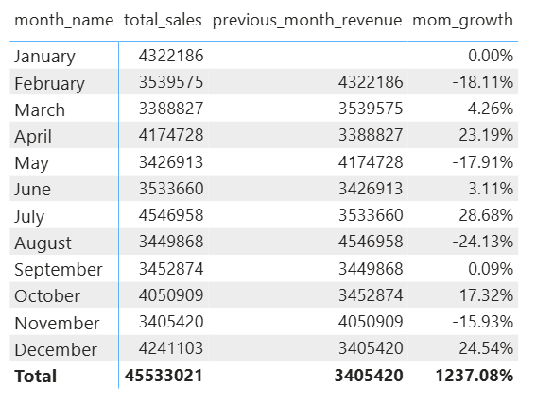
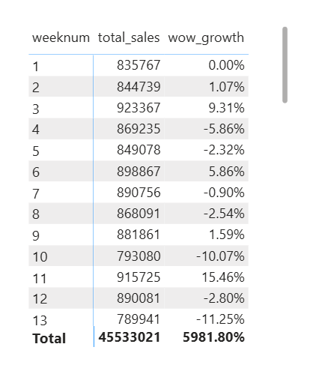
3
Q3 — MoM% and WoW% Growth on Transaction Amount
Uses “filter”, “all” and “max” function to compare current period transaction amounts against the previous month and previous week, returning the percentage change.
1. total_sales = SUMX('Creditcard (New)','Creditcard (New)'[Total_Trans_Amt])
previous_month_revenue = CALCULATE([total_sales],FILTER(all(calender), calender[month] = max(calender[month]) -1), calender[year] = MAX(calender[year]))
mom_growth = DIVIDE([total_sales]-[previous_month_revenue],[previous_month_revenue],0)
2. wow_growth =
var previous_week = CALCULATE([total_sales], FILTER(all(calender), calender[weeknum] = max(calender[weeknum]) -1), calender[year] = MAX(calender[year]))
return DIVIDE([total_sales]-previous_week, previous_week,0)
DAX FORMULA
📸 Insert Screenshot Here
Power BI Visual / Query Result
Financial Analysis Dashboard • Power BI Project
3 / 15

Slide 6
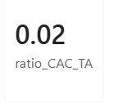
4
Q4 — Customer Acquisition Cost (CAC) as a Ratio of Transaction Amount
Divides the total acquisition cost by total transaction amount to show how much is spent acquiring customers relative to revenue generated.
ratio_CAC_TA = DIVIDE(SUM('Creditcard (New)'[Customer_Acq_Cost]), [total_sales])
POWER BI OUTPUT
DAX FORMULA
Financial Analysis Dashboard • Power BI Project
4 / 15

Slide 7
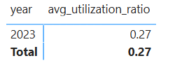
5
Q5 — Yearly Average of Avg_Utilization_Ratio
Calculates the average utilization ratio across all clients for each year, using ALLEXCEPT to preserve the year filter context only.
avg_utilization_ratio =
CALCULATE(AVERAGE('Creditcard (New)'[Avg_Utilization_Ratio]),ALLEXCEPT('Creditcard (New)','Creditcard (New)'[current_year]))
POWER BI OUTPUT
DAX FORMULA
Financial Analysis Dashboard • Power BI Project
5 / 15

Slide 8
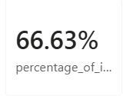
6
Q6 — Interest Earned vs Total Revolving Balance (%)
Shows what percentage of the revolving balance has been earned as interest, helping identify high-yield client segments.
DAX FORMULA
POWER BI OUTPUT
Percentage_of_interest_to_RevolvingBal =
DIVIDE(
SUM(CreditCard[Interest_Earned]),
SUM(CreditCard[Total_Revolving_Bal])
)
Financial Analysis Dashboard • Power BI Project
6 / 15

Slide 9
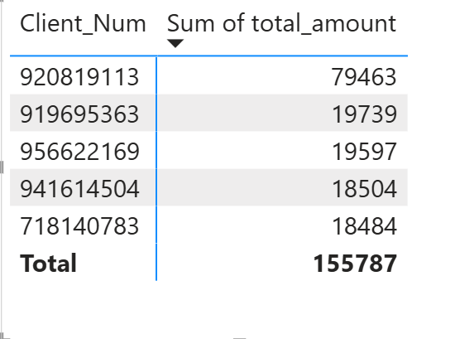
7
Q7 — Top 5 Clients by Total Transaction Amount
Uses TOPN to isolate the 5 highest-spending clients by transaction amount, then filters the measure to show only those clients' totals.
DAX FORMULA
POWER BI OUTPUT
Top5_clients = TOPN(5,SUMMARIZE('Creditcard (New)','Creditcard (New)'[Client_Num],"total_amount",SUM('Creditcard (New)'[Total_Trans_Amt])),[total_amount],DESC)
Financial Analysis Dashboard • Power BI Project
7 / 15

Slide 10
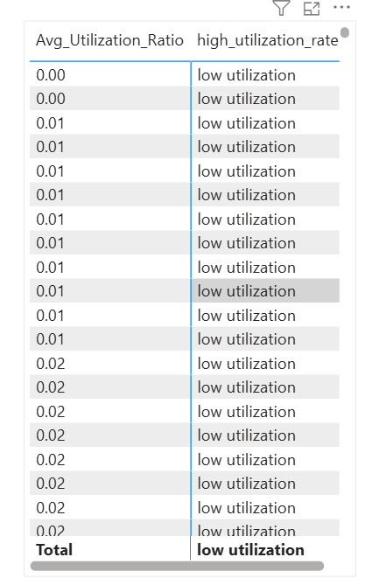
8
Q8 — Identify Clients with Avg_Utilization_Ratio > 80%
Flags clients as 'High Utilization' when their average utilization ratio exceeds 0.8 (80%), helping identify clients at risk of over-leveraging.
high_utilization_rate =
IF([avg_utilization_ratio] > 0.8, "high utilization","low utilization")
POWER BI OUTPUT
DAX FORMULA
Financial Analysis Dashboard • Power BI Project
8 / 15

Slide 11
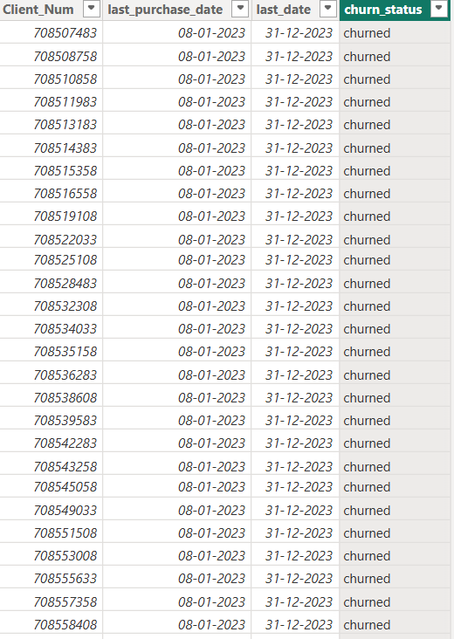
9
Q9 — Customer Churn Indicator (No Transactions in Last 6 Months)
Identifies clients with no recent activity by comparing their last transaction date against 6 months ago, flagging them as 'Churned' or 'Active'.
DAX FORMULA
POWER BI OUTPUT
churn_client = SUMMARIZE('Creditcard (New)','Creditcard (New)'[Client_Num],"last_purchase_date",max('Creditcard (New)'[Week_Start_Date]))
last_date = MAX('Creditcard (New)'[Week_Start_Date])
churn_status = IF(churn_client[last_date]-churn_client[last_purchase_date] >=180, "churned", "not_churned")
Result
Financial Analysis Dashboard • Power BI Project
9 / 15

Slide 12
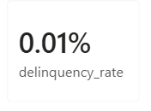
10
Q10 — Delinquency Rate
Calculates the percentage of clients with at least one delinquent account by dividing the count of delinquent clients by total unique clients.
DAX FORMULA
POWER BI OUTPUT
Delinquency Rate =
DIVIDE(
CALCULATE(
DISTINCTCOUNT (CreditCard [Client_Num]),
CreditCard[Delinquent_Acc] > 0
),
DISTINCTCOUNT (CreditCard[Client_Num])
)
Financial Analysis Dashboard • Power BI Project
10 / 15

Slide 13
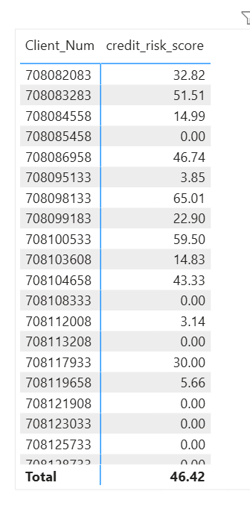
11
Q11 — Credit Risk Score (Composite)
Combines three weighted risk signals into a 0–100 score: utilization ratio (50pts), delinquency penalty (30pts), and revolving balance ratio (20pts).
credit_risk_score =
var util_score = AVERAGE('Creditcard (New)'[Avg_Utilization_Ratio]) * 50
var delinq_score = IF(sum('Creditcard (New)'[Delinquent_Acc]) > 0,30,0)
var Revolvingscore = DIVIDE(AVERAGE('Creditcard (New)'[Total_Revolving_Bal]),AVERAGE('Creditcard (New)'[Credit_Limit]))*20
RETURN util_score + delinq_score + Revolvingscore
POWER BI OUTPUT
DAX FORMULA
Financial Analysis Dashboard • Power BI Project
11 / 15

Slide 14
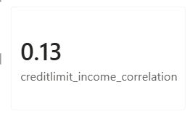
12
Q12 — Income vs Credit Limit Correlation
Manually implements the Pearson correlation coefficient (DAX has no CORREL function) to measure how strongly Income and Credit_Limit move together.
creditlimit_income_correlation =
VAR N = COUNTROWS('Customer (new)’)
var sum_x = SUMX('Customer (new)',RELATED('Creditcard (New)'[Credit_Limit]))
var sumy = SUM('Customer (new)'[Income])
VAR sumxy = SUMX('Customer (new)',RELATED('Creditcard (New)'[Credit_Limit])*'Customer (new)'[Income])
var sumx2 = SUMX('Customer (new)',RELATED('Creditcard (New)'[Credit_Limit])^2)
var sumy2 = SUMX('Customer (new)','Customer (new)'[Income]^2)
var numerator = (N*sumxy)-(sum_x*sumy)
var denominator = SQRT((N*sumx2-sum_x^2)*(N*sumy2-sumy^2))
RETURN DIVIDE(numerator,denominator)
DAX FORMULA
POWER BI OUTPUT
Financial Analysis Dashboard • Power BI Project
12 / 15

Slide 15
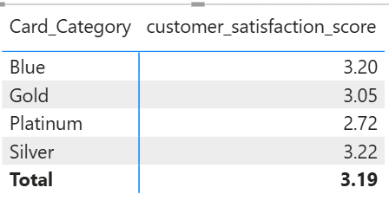
13
Q13 — Avg Customer Satisfaction Score by Card Category
Uses ALLEXCEPT to calculate the average satisfaction score within each Card_Category group, bridging the Customer and CreditCard tables via the 1:1 relationship.
customer_satisfaction_score =
CALCULATE(AVERAGE('Customer (new)'[Cust_Satisfaction_Score]),
ALLEXCEPT('Creditcard (New)','Creditcard (New)'[Card_Category]))
POWER BI OUTPUT
DAX FORMULA
Financial Analysis Dashboard • Power BI Project
13 / 15

Slide 16
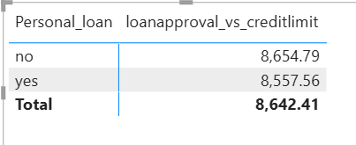
14
Q14 — Loan Approval vs Credit Limit Analysis
Compares the average credit limit for clients who have a personal loan versus those who don't, revealing how credit limit affects loan approval decisions.
loanapproval_vs_creditlimit =
CALCULATE(AVERAGE('Creditcard (New)'[Credit_Limit]), ALLEXCEPT('Customer (new)','Customer (new)'[Personal_loan]))
POWER BI OUTPUT
DAX FORMULA
Financial Analysis Dashboard • Power BI Project
14 / 15

Slide 17
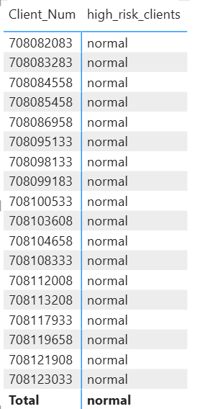
15
Q15 — High Risk Clients Flag
Flags clients as 'High Risk' when their revolving balance exceeds 90% of their credit limit AND their utilization ratio exceeds 80%, combining both debt load signals.
high_risk_clients =
VAR RevolvingPct = DIVIDE(AVERAGE('Creditcard (New)'[Total_Revolving_Bal]),AVERAGE('Creditcard (New)'[Credit_Limit]))
VAR utilRatio = AVERAGE('Creditcard (New)'[Avg_Utilization_Ratio])
RETURN IF(RevolvingPct>0.9 && utilRatio>0.8, "high risk","normal")
POWER BI OUTPUT
DAX FORMULA
Financial Analysis Dashboard • Power BI Project
15 / 15

Slide 18
Thank You
for your attention
4
10,293
15
33
Source Tables
Total Clients
DAX Measures
Columns Analysed
Financial Analysis Dashboard • Power BI Project • DAX • Power Query • Data Modelling

