Slide 1
Food_delivery_analysis
FOOD DELIVERY ANALYTICS
Dashboard Insights
33
71
10K
3M
Customers
Restaurants
Orders
Revenue
Prepared by,
Archi katiyar

Slide 2
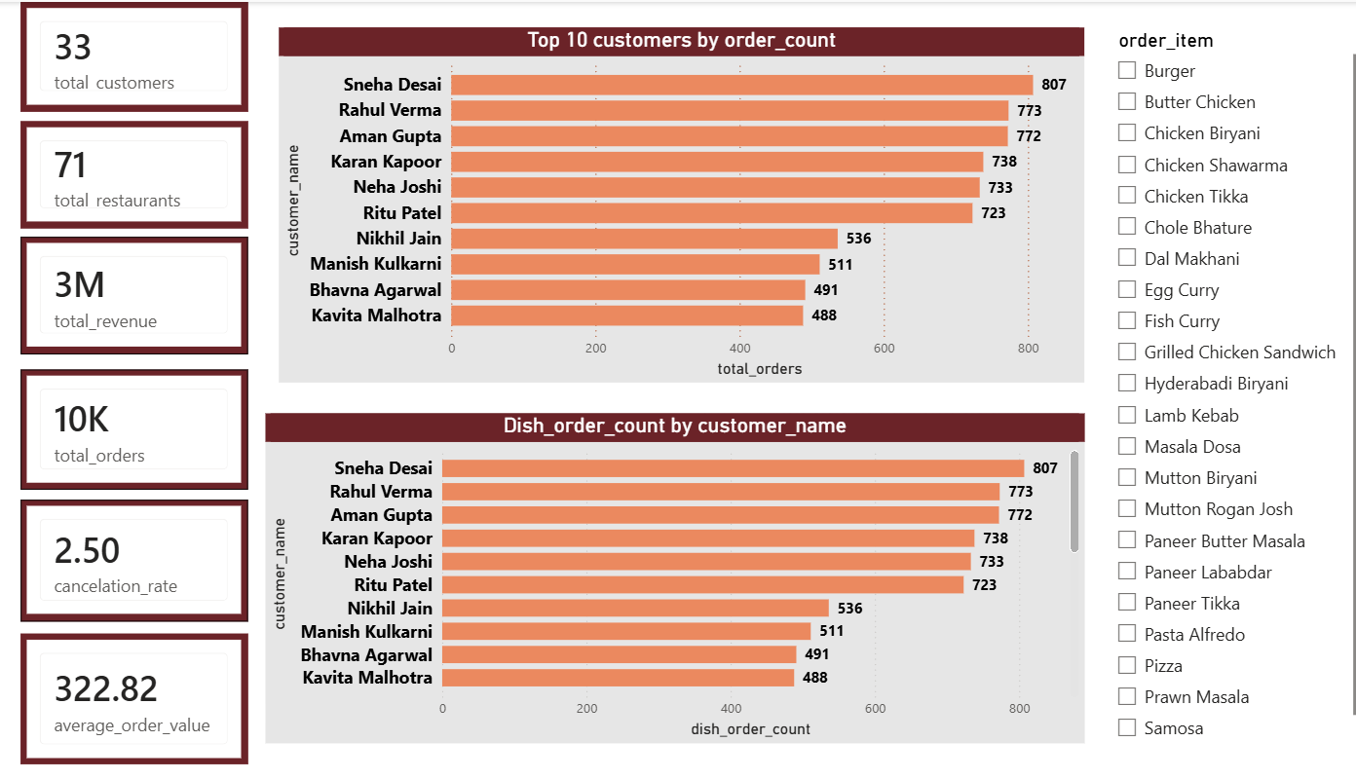
Customers: a few heavy users drive the orders
Key insights
Scale at a glance. 33 customers placed about 10K orders across 71 restaurants, for roughly 3M revenue and an average order value of 322.82.
Six heavy users lead. Sneha Desai (807), Rahul Verma (773), Aman Gupta (772), Karan Kapoor (738), Neha Joshi (733) and Ritu Patel (723).
Steep drop after the top six. The seventh customer, Nikhil Jain, has 536 orders, about 26% fewer than the sixth.
High concentration. The top 10 customers account for about 6,570 orders, roughly two-thirds of all orders.
Healthy completion. The cancellation rate is 2.50%.

Slide 3
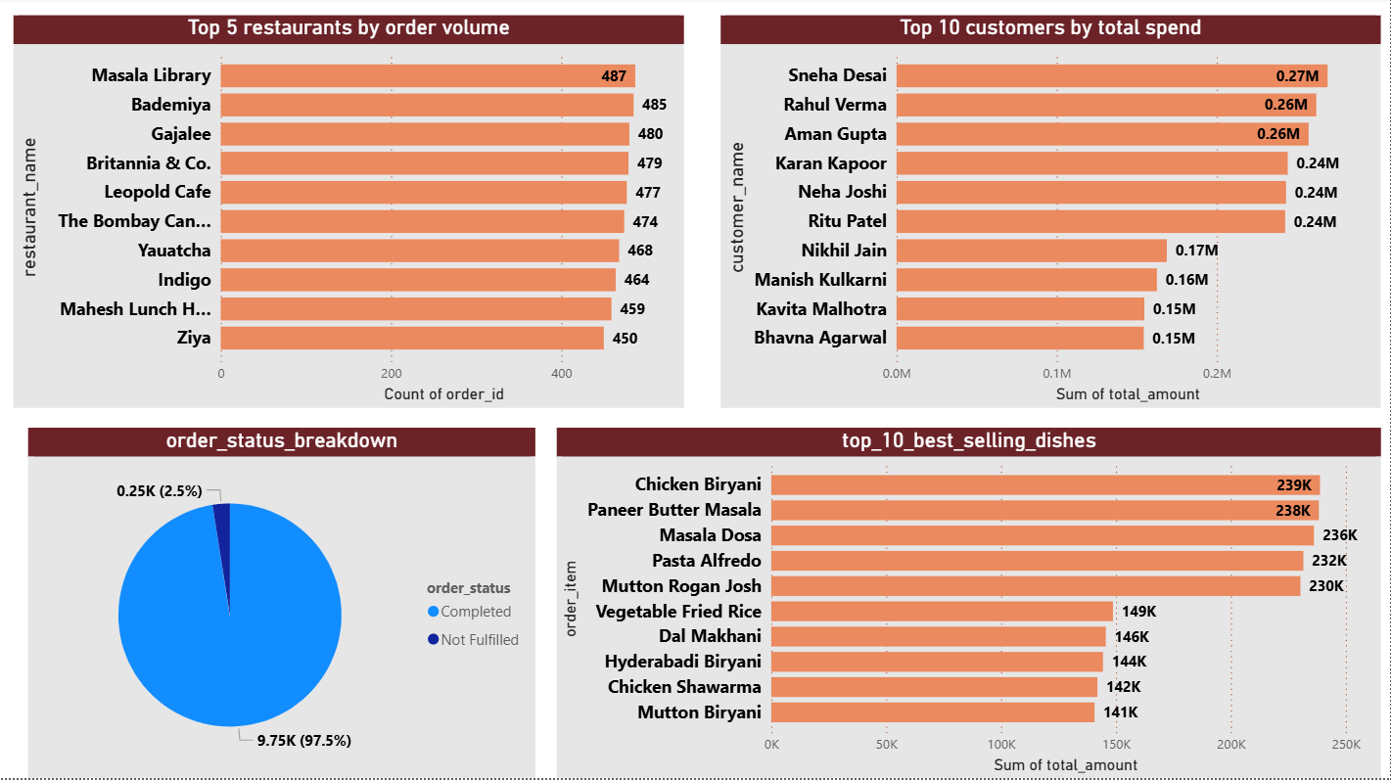
Restaurants and dishes: even demand, a top-5 dish tier
Key insights
No restaurant dominates. Masala Library (487), Bademiya (485) and Gajalee (480) lead, but the top 10 sit in a tight 450 to 487 range.
Top 10 restaurants carry about 47% of orders. Roughly 4,720 of 10K orders come from 10 of the 71 restaurants.
Spend mirrors orders. Sneha Desai (0.27M), Rahul Verma and Aman Gupta (0.26M each) lead; the top 10 customers spend about 2.1M, roughly 70% of revenue.
Top-5 dishes form a tier. Chicken Biryani (239K), Paneer Butter Masala, Masala Dosa, Pasta Alfredo and Mutton Rogan Josh each earn 230K+, about 1.6x the next five (141K to 149K).
Fulfillment is strong. 97.5% of orders are completed and 2.5% (0.25K) are not fulfilled.

Slide 4
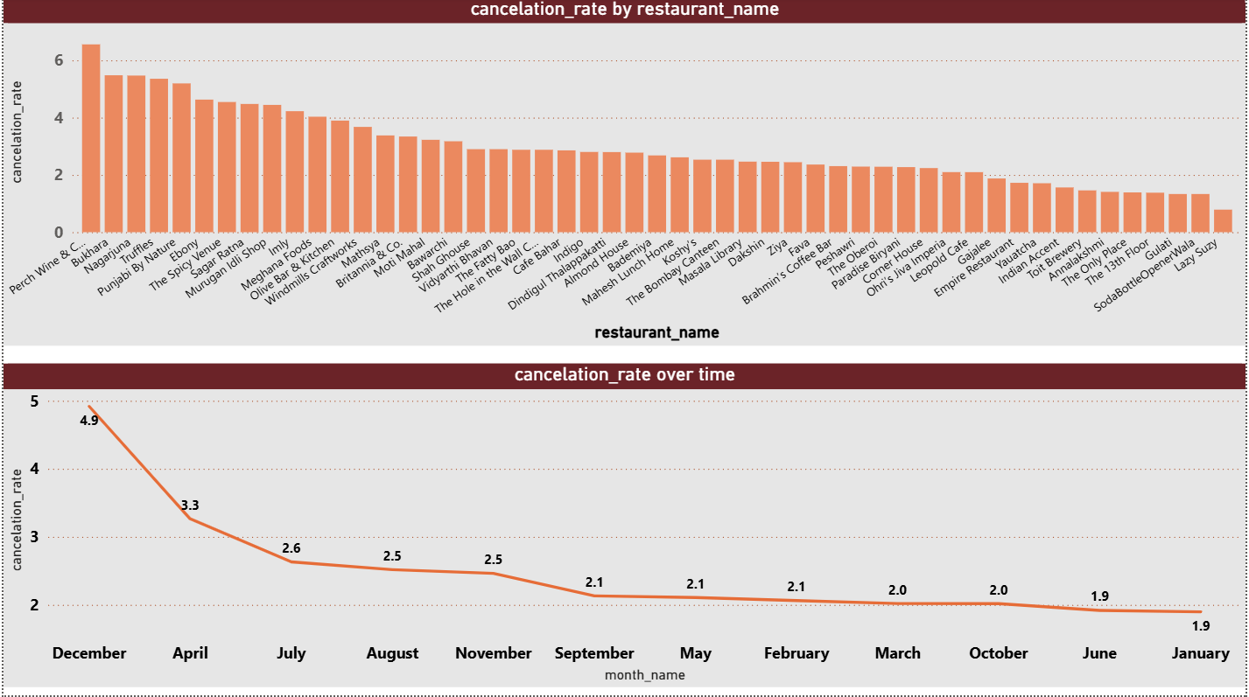
Cancellations: a few restaurants and December stand out
Key insights
Wide gap between restaurants. Cancellation runs from about 0.8% (Lazy Suzy) to about 6.6% (Perch Wine & C…), an 8x spread.
Five restaurants run above 5%. Perch Wine & C…, Bukhara, Nagarjuna, Truffles and Punjabi By Nature are at roughly twice the 2.5% overall rate.
A low-cancellation group exists. About ten restaurants sit below 2%, which is a useful benchmark to copy.
December is the outlier month. Cancellation reaches 4.9%, against 1.9% in January and June; April (3.3%) is next highest.

Slide 5
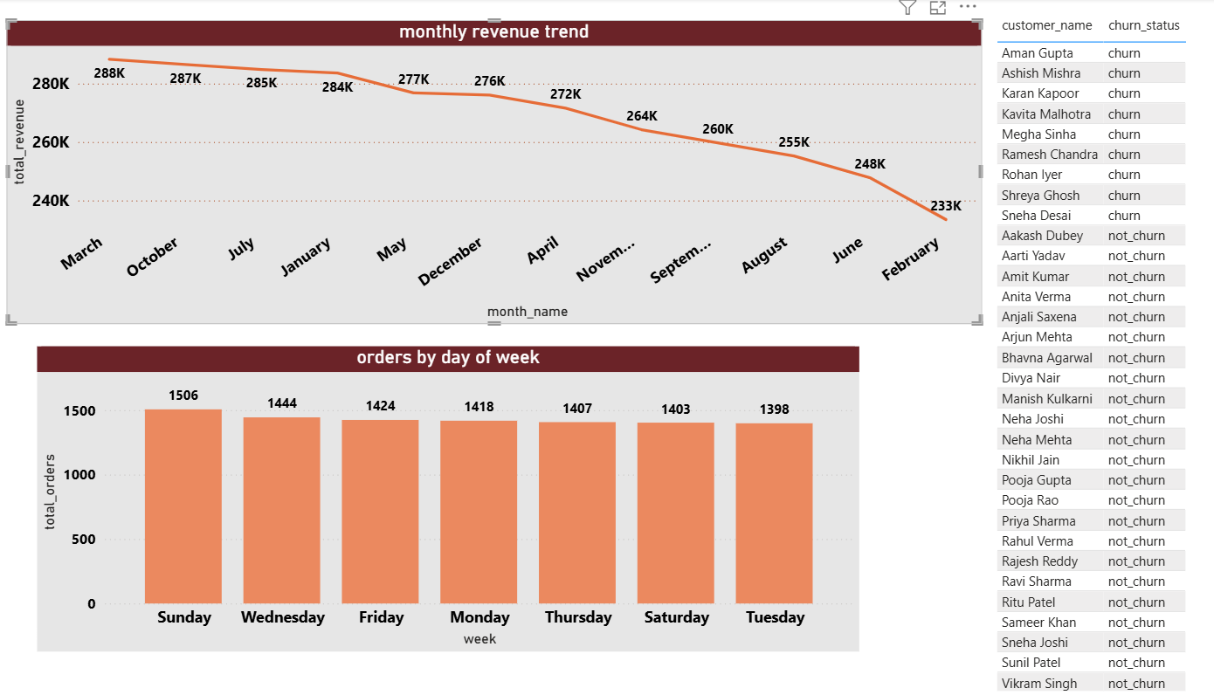
Revenue and churn: steady demand, top customers at risk
Key insights
Revenue is steady. Monthly revenue stays between 233K (February, weakest) and 288K (March, strongest), with an average month near 270K.
Orders are flat across the week. 1,398 (Tuesday) to 1,506 (Sunday), only about 8% apart; Saturday is second lowest.
Nine of 33 customers are marked churn. That includes four top-10 customers: Sneha Desai, Aman Gupta, Karan Kapoor and Kavita Malhotra.
It is a big revenue risk. Those four spent about 0.92M, roughly 30% of the 3M total.

Slide 6
Key takeaways and next steps
Best-selling dishes by revenue (K)
Win back the top customers.
Four of the top 10 customers are marked churn, about 0.92M of spend.
1
2
Fix the cancellation hot spots.
Five restaurants run above 5% and December hits 4.9%, versus 2.5% overall.
3
Build on the top-5 dishes.
They earn about 39% of revenue; bundle them to lift the next five.
4
Clean up the dashboard.
Month charts are sorted by value, not calendar; two customer charts repeat the same numbers.
Data note: shares and totals in this deck (47% of orders, about 70% of revenue, about 39% for top-5 dishes, 0.92M at-risk spend) are computed from the dashboard’s labels, so they are approximate.

Slide 7
Summary
2.5%
322.82
~66%
9 of 33
cancellation rate
average order value
of orders from 10 customers
customers marked churn
97.5% of orders completed
across about 10K orders
the top 10 of 33 customers
including 4 top-10 customers
Customers: A small group drives the business. Six heavy users lead on orders and spend, and four top-10 customers are flagged as churn, about 30% of revenue.
Restaurants and dishes: Demand is spread evenly across restaurants, but five dishes earn 230K+ each, well above the rest. Cancellations spike at five restaurants and in December.
Operations: Orders and revenue are steady across weekdays and months, so retention and cancellation fixes are the clearest levers.

Slide 8
Thank You
FOOD DELIVERY ANALYTICS
Food_delivery_heights – Dashboard Insights

