Slide 1

INTERNSHIP AT
DISRUPTIVE GROUP (AI/ML/DS/App Dev)

Slide 2
INDEX
Essential Skills for a well rounded programmer
Understanding AI, ML, DL, DS
Relationship amongst them
Jupyter Notebook vs Google Colab
Data Processing
Data Visualisation
Types of learning
Neural Networks

Slide 3
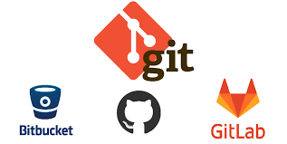
5 ESSENTIAL SKILL FOR WELL ROUNDED PROGRAMMER
1.1. Version Control(GIT):
Version control is a system that records changes to a file or set of files over time so that you can recall specific versions later.

Slide 4
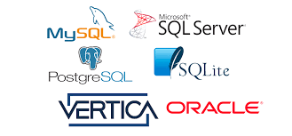
1.2. Database (SQL)
A database is a collection of information that is organized so that it can be easily accessed, managed and updated.
SQL stands for Structured Query Language.

Slide 5
1.3. Command Line (Terminal)
Command line is a text-based interface through which one can navigate, create, execute, and act on a computer's files and directories with precision.
The program which handles the interface is called a command-line interpreter or command-line processor.
1.4. Unit Testing(Continuous Integration/Delivery)
Unit testing is a type of software testing where individual units or components of a software are tested.
It saves time and money, and helps developers write better code, more efficiently.

Slide 6
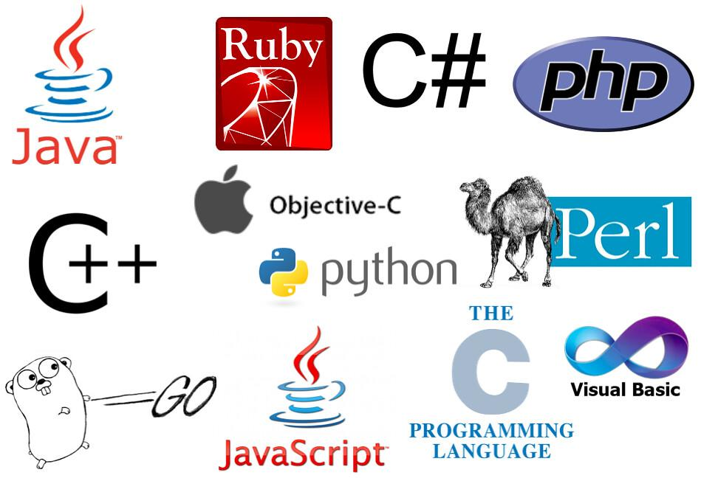
1.5. Learn Multiple Programming Languages
Knowing multiple programming languages makes it easier for the programmer to learn new programming languages.

Slide 7
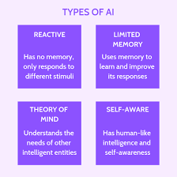
Understanding AI, ML, Deep Learning and Data Science
Artificial intelligence (AI) is a wide-ranging branch of computer science concerned with building smart machines capable of performing tasks that typically require human intelligence.
There are four types of Artificial intelligence:
Reactive Machines
Limited Memory
Theory of Mind
Self-Awareness
Examples of Artificial Intelligence are Siri, Alexa and other smart assistants, Self-driving cars, Robo-advisors.

Slide 8
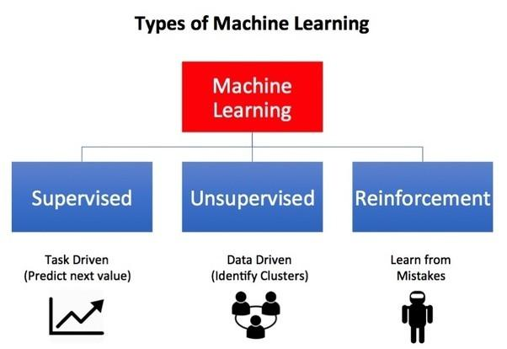
Machine Learning
Machine learning (ML) is the study of computer algorithms that can improve automatically through experience and by the use of data. It is the study of making machines more human-like in their behaviour and decisions by giving them the ability to learn and develop their own programs.
These are three types of machine learning:
supervised learning
unsupervised learning
reinforcement learning.
For Example, when you shop from any website it’s shows related search like:- People who bought also saw this.

Slide 9
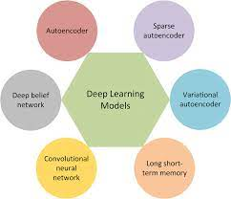
Deep Learning
Deep learning can be considered as a subset of machine learning. It is a field that is based on learning and improving on its own by examining computer algorithms. While machine learning uses simpler concepts, deep learning works with artificial neural networks, which are designed to imitate how humans think and learn.
Practical examples of deep learning are Virtual assistants, vision for driverless cars, money laundering, face recognition and many more.
Supervised Models:
Classic Neural Networks (Multilayer Perceptrons)
Convolutional Neural Networks (CNNs)
Recurrent Neural Networks (RNNs)
Unsupervised Models:
Self-Organizing Maps (SOMs)
Boltzmann Machines
AutoEncoders.

Slide 10
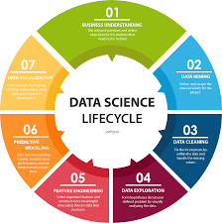
Data Science
Data science combines multiple fields, including statistics, scientific methods, artificial intelligence (AI), and data analysis, to extract value from data.
There are various industries like banking, finance, manufacturing, transport,e-commerce, education, etc. that use data science. As a result, there are several Data Science Applications related to it.

Slide 11
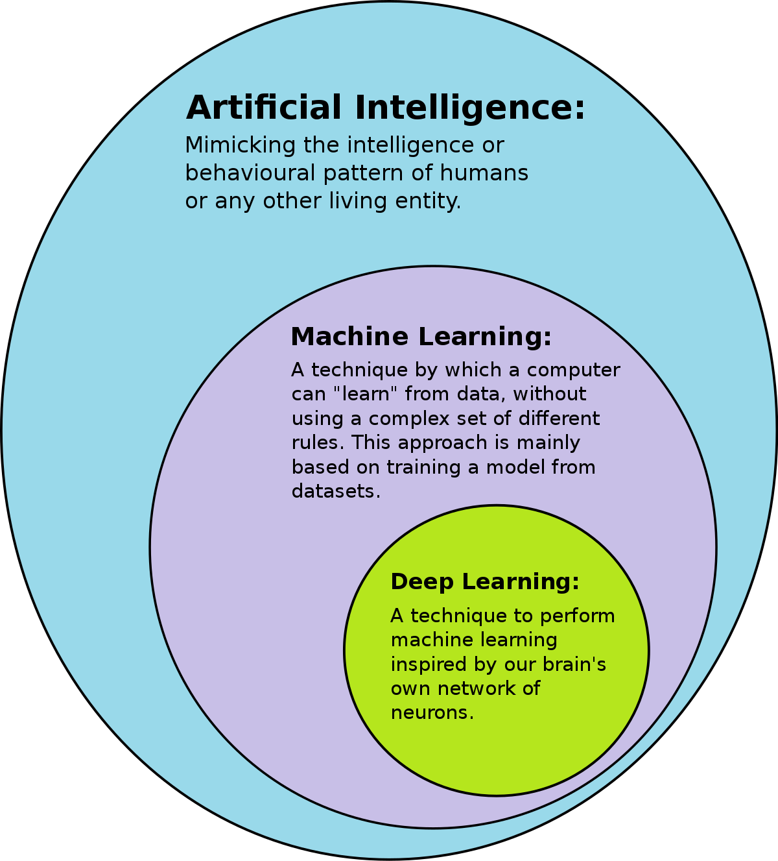
Relationship between AI , ML and DL
AI is an umbrella discipline that covers everything
related to making machines smarter. Machine
Learning (ML) is commonly used along with
AI but it is a subset of AI.
ML refers to an AI system that can self-learn based
on the algorithm.
Deep Learning (DL) is a machine learning (ML)
applied to large data sets.

Slide 12

Jupyter Notebook vs Google colab
Jupyter Notebook:
IDE for writing, executing code.
Needs to be installed in computer.
It is not cloud based. It runs on local machine and files are saved on hard disk.
Jupyter notebook requires high GPU, TPU.
Required libraries need to be installed in local machine.
Here, runtime depends on your system memory limit.
Can’t be shared with others without downloading it.
Jupyter is safer than Colab when it comes to data security.
It is completely free.
Google Colab:
It allows to write, execute code through browser.
Work on any computers. No need of installation.
It is cloud based Jupyter notebook environment and all notebooks are saved in google drives.
Free GPU (and TPU as of 2018-09-29)
Important libraries are pre-installed.
In google colab there is a runtime limit of 12/24 hrs.
Can be shared with other without downloading it.
It is secure but not recommended for highly sensitive work.
It is partially free we can take subscription for upgrading features.

Slide 13
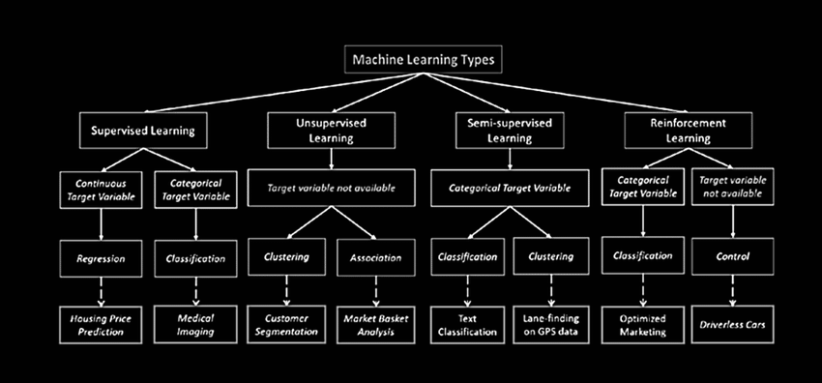
Types of Learning

Slide 14
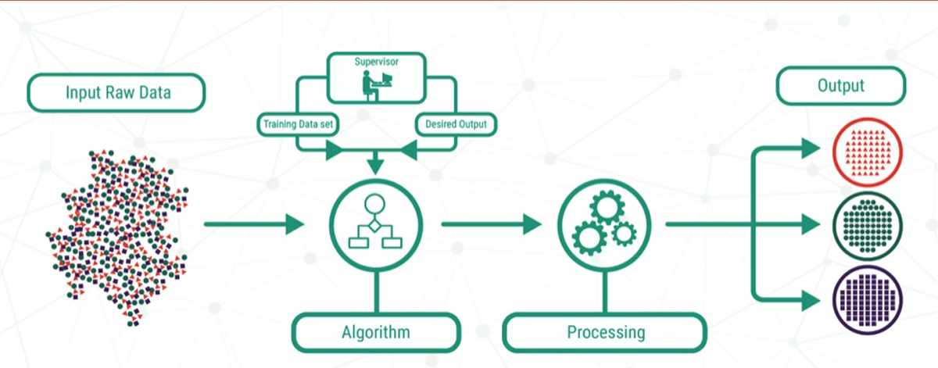
Supervised Learning
Supervised learning is the types of machine learning in which machines are trained using well "labelled" training data, and on basis of that data, machines predict the output.
Supervised learning is a process of providing input data as well as correct output data to the machine learning model.

Slide 15
Types of Supervised Learning
There are two types of Supervised Learning
Regression: Regression algorithms are used if there is a relationship between the input variable and the output variable. It is used for the prediction of continuous variables, such as Weather forecasting, Market Trends, etc.
Below are some popular Regression algorithms which come under supervised learning:
Linear Regression
Regression Trees
Non-Linear Regression
Bayesian Linear Regression
Polynomial Regression
Classification: Classification algorithms are used when the output variable is categorical, which means there are two classes such as Yes-No, Male-Female, True-false, etc.
Random Forest
Decision Trees
Logistic Regression
Support vector Machines

Slide 16
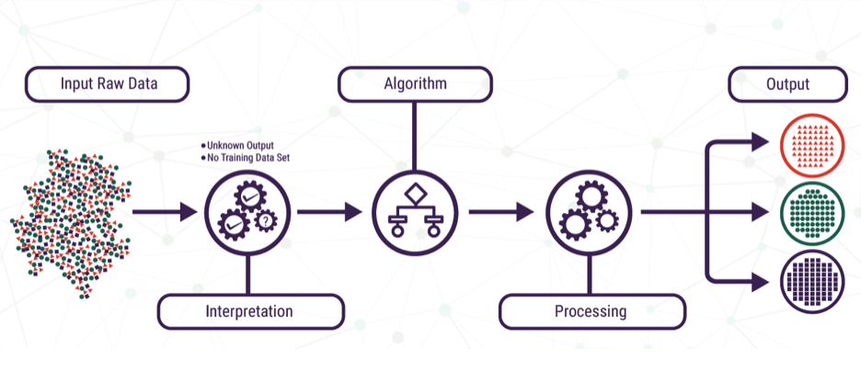
Unsupervised Learning
Unsupervised learning is a machine learning technique in which models are not supervised using training dataset. Instead, models itself find the hidden patterns and insights from the given data. It can be compared to learning which takes place in the human brain while learning new things.
Unsupervised learning cannot be directly applied to a regression or classification problem because unlike supervised learning, we have the input data but no corresponding output data.

Slide 17
Types of Unsupervised Learning
There are two types of Unsupervised Learning
Clustering:Clustering is a method of grouping the objects into clusters such that objects with most similarities remains into a group and has less or no similarities with the objects of another group.
Association: An association rule is an unsupervised learning method which is used for finding the relationships between variables in the large database. It determines the set of items that occurs together in the dataset.
Examples:
K-means clustering
KNN (k-nearest neighbors)
Hierarchical clustering
Anomaly detection
Neural Networks

Slide 18
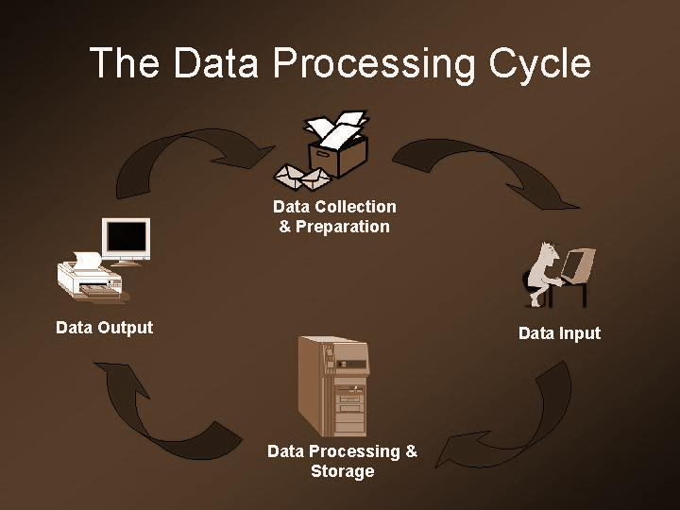
DATA PROCESSING
Data processing is the collection and manipulation of items of data to produce meaningful information.
It includes the conversion of raw data to machine-readable form, flow of data through the CPU and memory to output devices, and formatting or transformation of output.
It translates huge amounts of collected data into a desirable form used by commoners to analyze and interpret the meaning of data processed.
There are five stages of Data Processing:
Data collection
Data preparation
Data input
Data processing
Data output and storage

Slide 19
1.Data Collection:
The collection of raw data is the first step of the data processing cycle. The type of raw data collected has a huge impact on the output produced.
2. Data Preparation:
Data preparation or data cleaning is the process of sorting and filtering the raw data to remove unnecessary and inaccurate data.
3. Data Input:
In this step, the raw data is converted into machine readable form and fed into the processing unit. This can be in the form of data entry through a keyboard, scanner or any other input source.

Slide 20
4. Data Processing:
In this step, the raw data is subjected to various data processing methods using machine learning and artificial intelligence algorithms to generate a desirable output.
5. Data Output and Storage
The data is finally transmitted and displayed to the user in a readable form like graphs, tables, vector files, audio, video, documents, etc. This output can be stored and further processed in the next data processing cycle.
The last step of the data processing cycle is storage, where data and metadata are stored for further use. This allows for quick access and retrieval of information whenever needed, and also allows it to be used as input in the next data processing cycle directly.

Slide 21
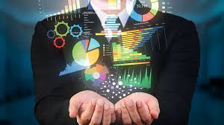
Data Visualization :
Data visualization is the graphical representation of information and data. By using visual elements like charts, graphs, and maps, data visualization tools provide an accessible way to see and understand trends, outliers, and patterns in data.
It is the process of turning your data into graphical representations that communicate logical relationships and lead to more informed decision-making.

Slide 22
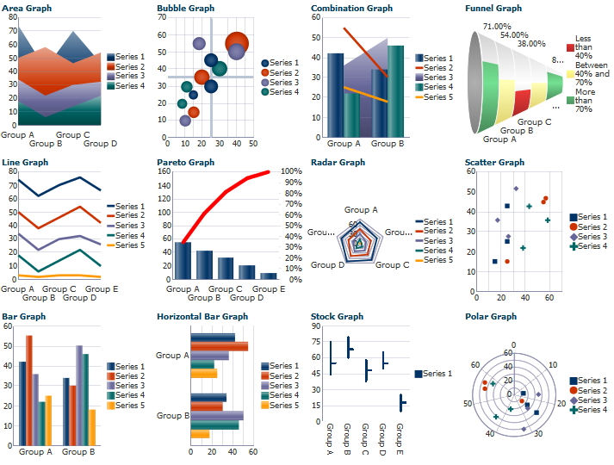
Some of the most common types of data visualization chart and graph formats include:
Column Chart
Bar Graph
Stacked Bar Graph
Stacked Column Chart
Area Chart
Dual Axis Chart
Line Graph
Mekko Chart
Pie Chart
Waterfall Chart
Bubble Chart
Scatter Plot Chart
Bullet Graph
Funnel Chart
Heat Map

Slide 23

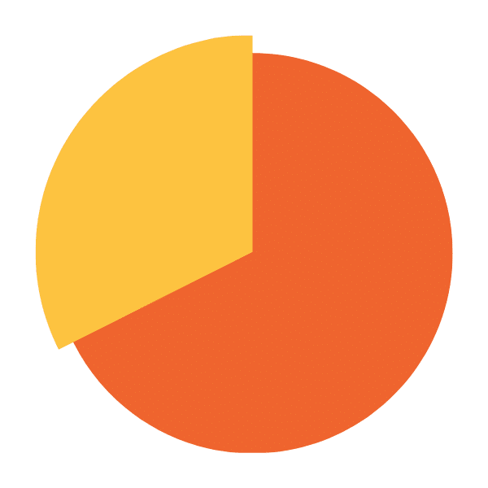
Types of graphs :
Column chart : A column chart will include data labels along the horizontal (X) axis with measured metrics or values presented on the vertical (Y) axis, also known as the left side of the chart.
Pie chart : A pie chart represents one static number, divided into categories that constitute its individual portions.
Column Chart
Pie Chart

Slide 24
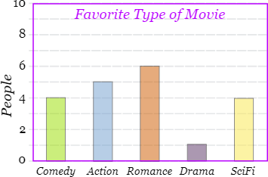
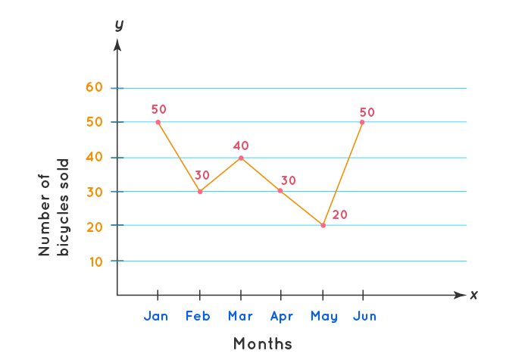
Bar Graph: It is also called Bar Chart and is a graphical display of data using bars of different heights.
We can use bar graphs to show the relative sizes of many things.
Line graph: Line graphs, also called line charts, are used to represent quantitative data collected over a specific subject and a specific time interval.
Bar Graph
Line Graph

Slide 25
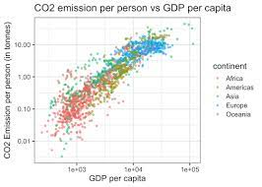
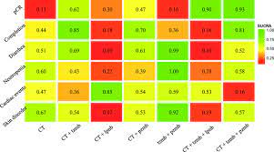
Scatter plot: A scatter plot is a chart type that is normally used to observe and visually display the relationship between variables. The values of the variables are represented by dots.
Heat map: Heat Map Chart, or Heatmap is a two-dimensional visual representation of data, where values are encoded in colors, delivering a convenient, insightful view of information.
Scatter plot
Heat map

Slide 26
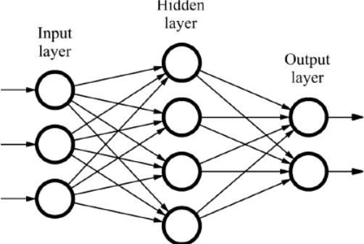
Neural Network:
A neural network is a series of algorithms that endeavors to recognize underlying relationships in a set of data through a process that mimics the way the human brain operates.
It is used to solve computational problems by imitating the way neurons are fired or activated in the brain.

Slide 27
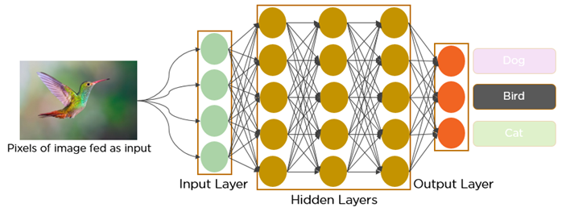
CONVOLUTIONAL NEURAL NETWORK
In the past few decades, Deep Learning has proved to be a very powerful tool because of its ability to handle large amounts of data. The interest to use hidden layers has surpassed traditional techniques, especially in pattern recognition. One of the most popular deep neural networks is Convolutional Neural Networks.
In deep learning, a convolutional neural network (CNN/ConvNet) is a class of deep neural networks, most commonly applied to analyze visual imagery.

Slide 28
ABOUT PROJECT - MALARIA CELL DETECTION
Malaria has been one of the major causes of death in Africa, and being able to classify malaria-infected cell images using convolutional neural networks is pivotal to the quick diagnosis of Malaria. Images were gathered for the development of a deep learning model that can accurately predict the cell that is infected with malaria and the one that is not infected with malaria.
The main aim of project is to predict whether the given image of a cell is uninfected or parasitized.
We do this in the following steps:
Basic Summary of Model to be displayed
Predictions by the Model on the test data
Take a random image from the dataset and display the predictions

Slide 29
Conclusion
We would like to thank Cureya for providing this wonderful opportunity to us for learning and exploring more in the advanced technologies.
The valuable skill about AI,ML,DL has boosted my skills to a higher level and have prepared me well in this field
This has been an excellent and rewarding internship period.It was a great learning experience.
I would like to thank DR. BAJARANG MISHRA and Shivani Mishra. I would also like to thank my mentor Archi Agrawal for her guidance and support.

Slide 30


