Slide 1

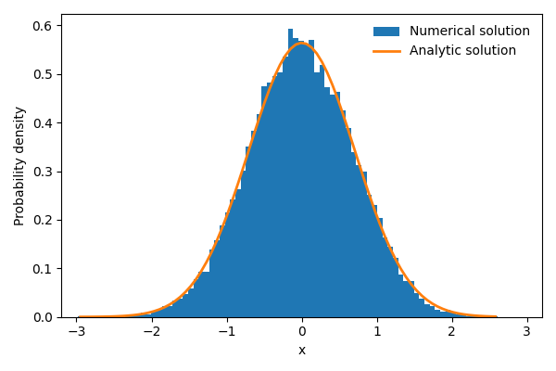
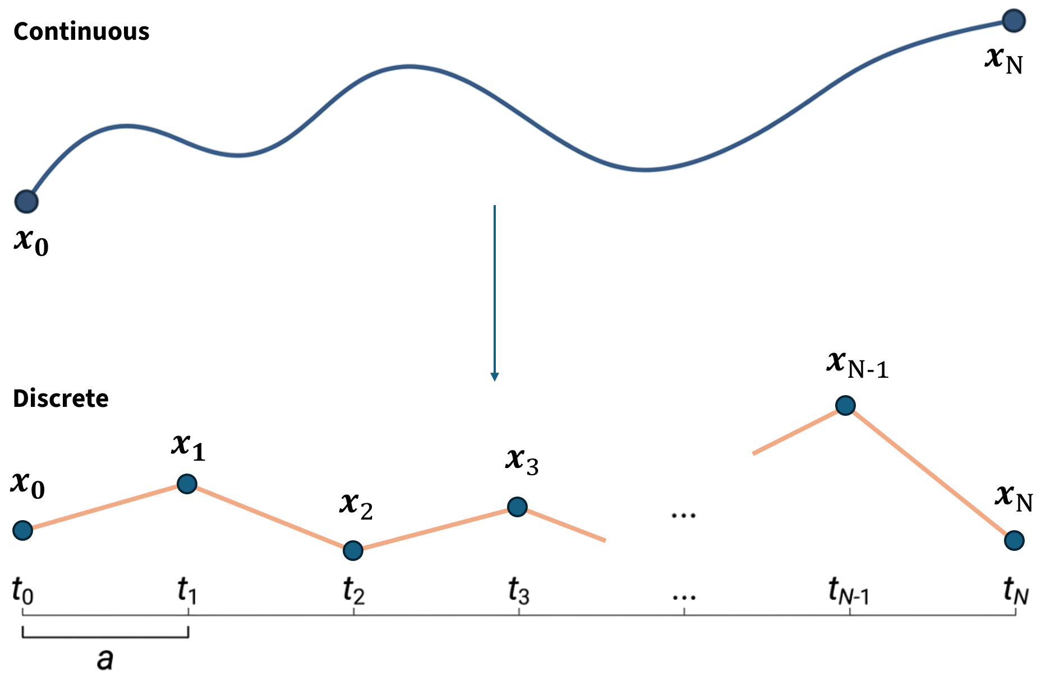
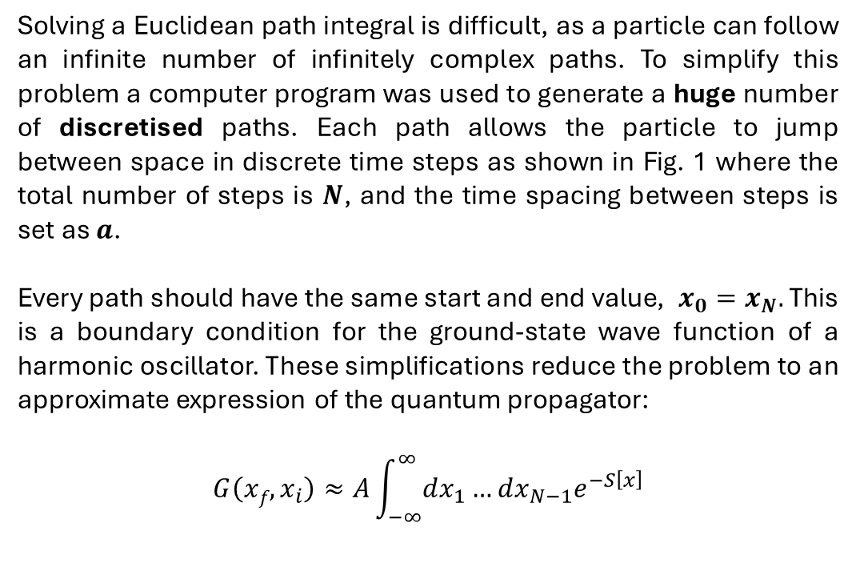
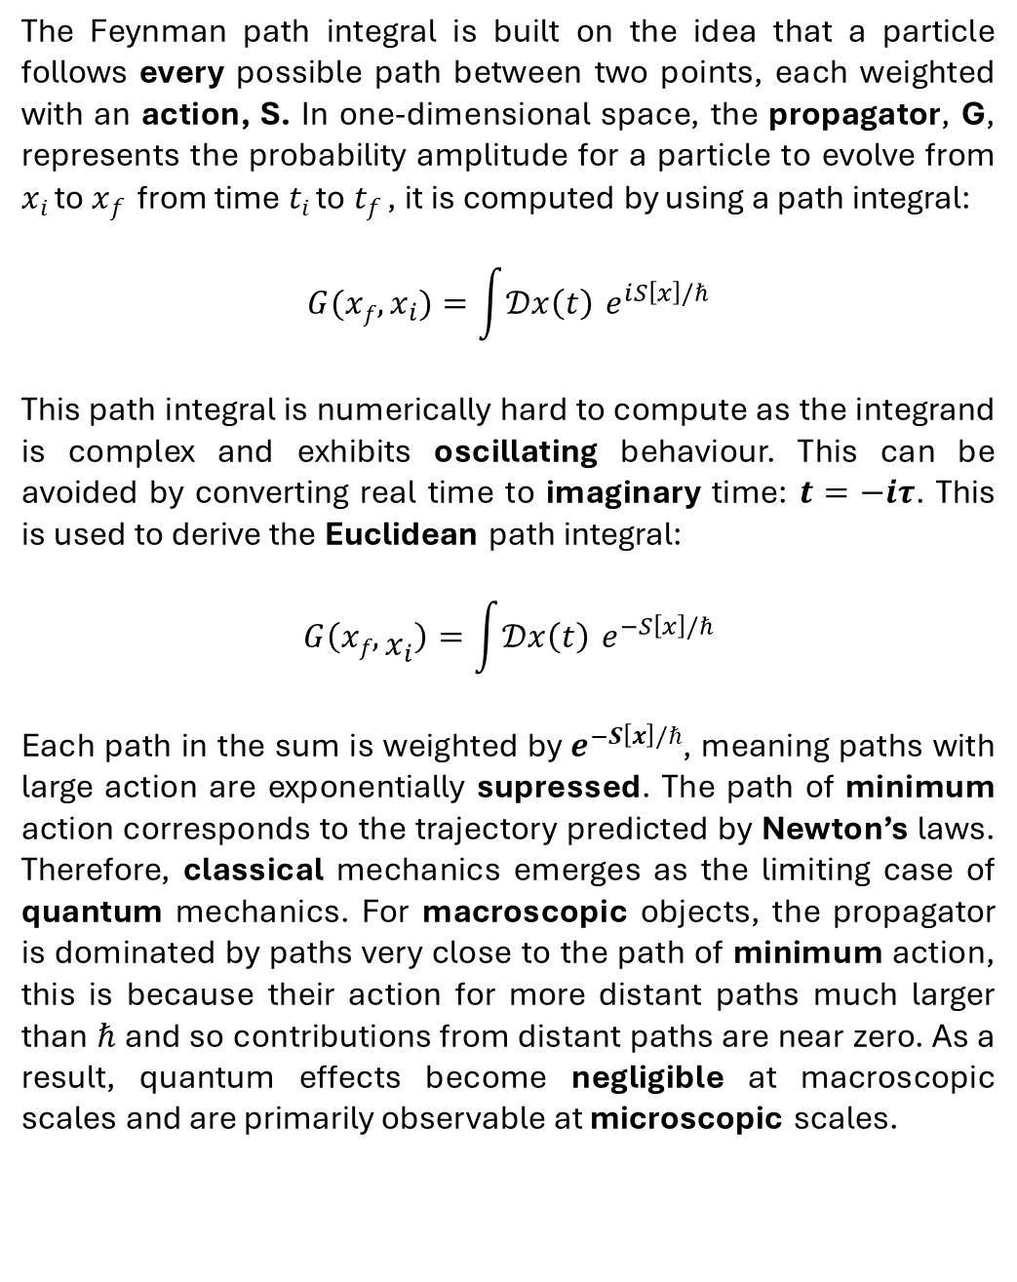
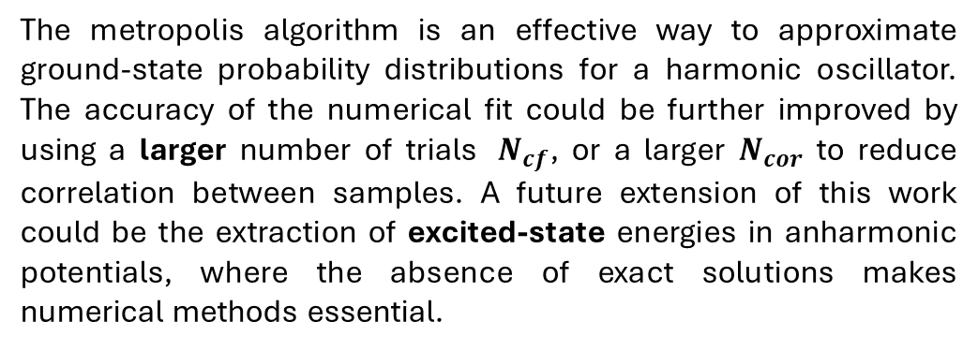
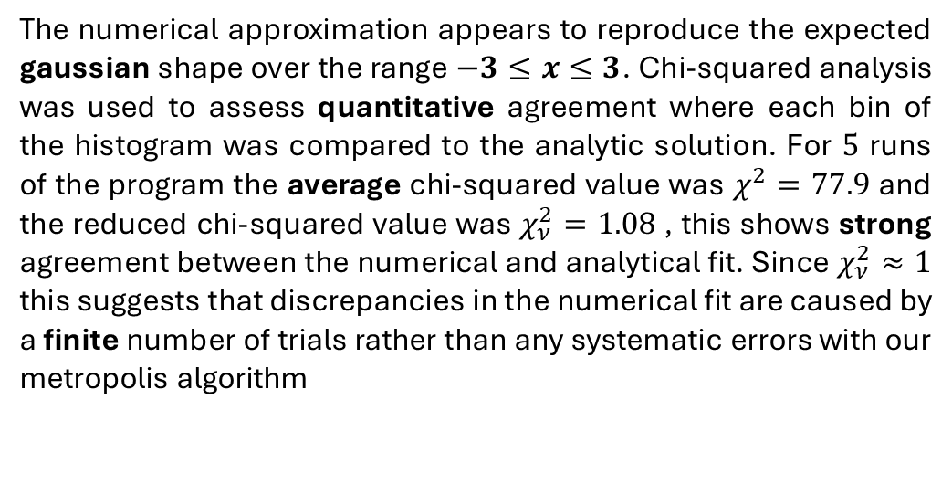
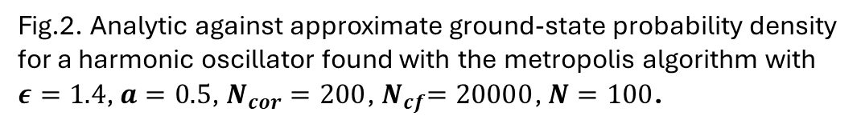
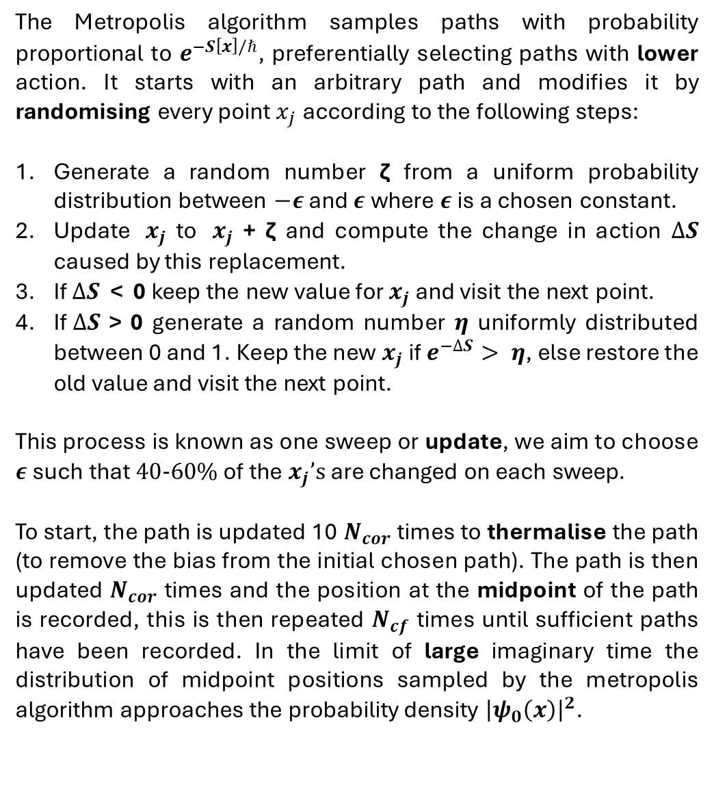
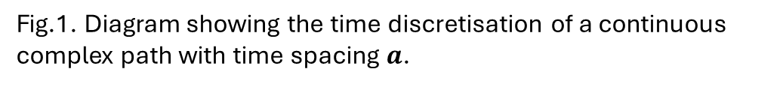
Evaluating Feynman Path Integrals Through Numerical Solution
Archie Headland, Department of Physics, Durham University, 14/12/2025
Theory
Metropolis Algorithm
The Feynman path integral is built on the idea that a particle follows every possible path between two points, each weighted with an action, S. In one-dimensional space, the propagator, G, represents the probability amplitude for a particle to evolve from $x_{i}$ to $x_{f}$ from time $t_{i}$ to $t_{f}$ , it is computed by using a path integral:
$$G(xf,x_{i})=\int{𝒟x\left(t\right)} e^{ⅈS\left[x\right]/ℏ}$$
This path integral is numerically hard to compute as the integrand is complex and exhibits oscillating behaviour. This can be avoided by converting real time to imaginary time: $t=−iτ$. This is used to derive the Euclidean path integral:
$$G\left(xf,x_{i}\right)=\int{𝒟x\left(t\right)} e^{−S\left[x\right]/ℏ}$$
Each path in the sum is weighted by${ e}^{−S\left[x\right]/ℏ}$, meaning paths with large action are exponentially supressed. The path of minimum action corresponds to the trajectory predicted by Newton’s laws. Therefore, classical mechanics emerges as the limiting case of quantum mechanics. For macroscopic objects, the propagator is dominated by paths very close to the path of minimum action, this is because their action for more distant paths much larger than $ℏ$ and so contributions from distant paths are near zero. As a result, quantum effects become negligible at macroscopic scales and are primarily observable at microscopic scales.
The Metropolis algorithm samples paths with probability proportional to $e^{−S\left[x\right]/ℏ}$, preferentially selecting paths with lower action. It starts with an arbitrary path and modifies it by randomising every point${ x}_{j}$ according to the following steps:
Generate a random number ζ from a uniform probability distribution between $−ε$ and $ε$ where $ε$ is a chosen constant.
Update ${ x}_{j}$ to ${ x}_{j}$ + ζ and compute the change in action $∆S$ caused by this replacement.
If $∆S$ < 0 keep the new value for $x_{j}$ and visit the next point.
If$∆S$ > 0 generate a random number $η$ uniformly distributed between 0 and 1. Keep the new $x_{j}$ if $e^{−∆S}> η$, else restore the old value and visit the next point.
This process is known as one sweep or update, we aim to choose $ε$ such that $40-60\%$ of the $x_{j}’s$ are changed on each sweep.
To start, the path is updated 10 $N_{cor}$ times to thermalise the path (to remove the bias from the initial chosen path). The path is then updated $N_{cor}$ times and the position at the midpoint of the path is recorded, this is then repeated $N_{cf}$ times until sufficient paths have been recorded. In the limit of large imaginary time the distribution of midpoint positions sampled by the metropolis algorithm approaches the probability density ${\left|ψ_{0}\left(x\right)\right|}^{2}$.
(1)
(2)
Fig.2. Analytic against approximate ground-state probability density for a harmonic oscillator found with the metropolis algorithm with $ε=1.4$, $a=0.5$, $N_{cor}=200$,${ N}_{cf}=20000$, $N=100$.
Results
The numerical approximation appears to reproduce the expected gaussian shape over the range $−3≤x≤3$. Chi-squared analysis was used to assess quantitative agreement where each bin of the histogram was compared to the analytic solution. For $5$ runs of the program the average chi-squared value was $χ^{2}=77.9$ and the reduced chi-squared value was $χ_{ν}^{2}=1.08$, this shows strong agreement between the numerical and analytical fit. Since $χ_{ν}^{2}≈1$ this suggests that discrepancies in the numerical fit are caused by a finite number of trials rather than any systematic errors with our metropolis algorithm
Path Generation
Solving a Euclidean path integral is difficult, as a particle can follow an infinite number of infinitely complex paths. To simplify this problem a computer program was used to generate a huge number of discretised paths. Each path allows the particle to jump between space in discrete time steps as shown in Fig. 1 where the total number of steps is $N$, and the time spacing between steps is set as $a$.
Every path should have the same start and end value, $x_{0}=x_{N}.$ This is a boundary condition for the ground-state wave function of a harmonic oscillator. These simplifications reduce the problem to an approximate expression of the quantum propagator:
$$G\left(xf,x_{i}\right)≈A\int_{−∞}^{∞}{dx_{1}}…dx_{N−1}e^{−S\left[x\right]}$$
Conclusion
The metropolis algorithm is an effective way to approximate ground-state probability distributions for a harmonic oscillator. The accuracy of the numerical fit could be further improved by using a larger number of trials ${ N}_{cf}$, or a larger $N_{cor}$ to reduce correlation between samples. A future extension of this work could be the extraction of excited-state energies in anharmonic potentials, where the absence of exact solutions makes numerical methods essential.
Fig.1. Diagram showing the time discretisation of a continuous complex path with time spacing $a$.
References
(3)
[1] R. P. Feynman, “Space-Time Approach to Non-Relativistic Quantum Mechanics.” Rev. Mod. Phys. 20, 367–387 (1948).
doi: 10.1103/RevModPhys.20.367
[2] G. P. Lepage, “Lattice QCD for Novices.” (2005).
doi: 10.48550/arXiv.hep-lat/0506036
GenAI Statement: Tool: Copilot. Use: Improving written language for select statements. Evaluation: Returned output was carefully considered to ensure original meaning.

