Slide 1
Mini-Project 2 Checkpoint 2 ECE 471 Fall 2022
Name1 (NetID1), Name2 (NetID2), Name3 (NetID3)

Slide 2
Task 1 – Question 1
a. Draw the Bayesian Network:
b. . Factorization of joint probability distribution:

Slide 3
Task 1 – Question 2 & 3
Q2. Histogram of Wait Time, characteristics of the distribution; Histogram of log-scale Wait Time, what distribution does it look like:
Q3. Repeat Task 1.2, conditioning on Collection Method; Mean and standard deviation of log of Wait Time for samples collected by nurses:

Slide 4
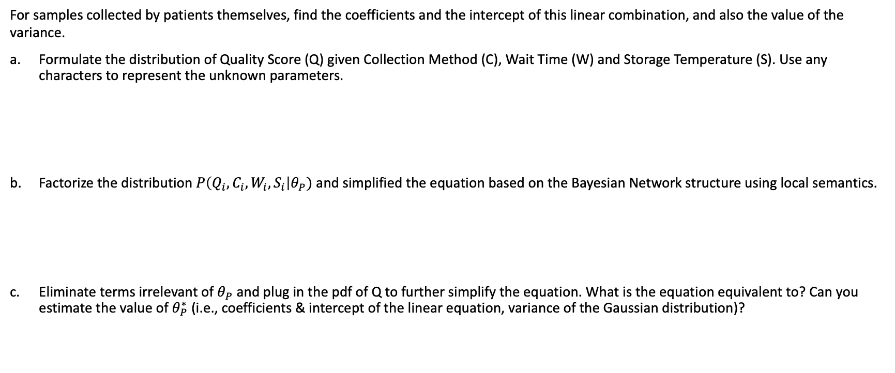
Task 1 – Question 4
For samples collected by patients themselves, find the coefficients and the intercept of this linear combination, and also the value of the variance.
Formulate the distribution of Quality Score (Q) given Collection Method (C), Wait Time (W) and Storage Temperature (S). Use any characters to represent the unknown parameters.
Factorize the distribution $P\left(Q_{i}, C_{i}, W_{i},S_{i}\right|θ_{P})$ and simplified the equation based on the Bayesian Network structure using local semantics.
Eliminate terms irrelevant of $θ_{P}$ and plug in the pdf of Q to further simplify the equation. What is the equation equivalent to? Can you estimate the value of $θ_{P}^{∗}$ (i.e., coefficients & intercept of the linear equation, variance of the Gaussian distribution)?

Slide 5
Task 1 – Question 4 (continued)
For samples collected by the patients:
Compute the mean of log Wait Time and the mean of Storage Time.
What is the variance of Quality Score of the samples that fall into the small region?
How does the variance compare with the estimated variance in (c)?

Slide 6
Task 1 – Question 5
Detailed procedure for inferring the most likely Collection Method for the first sample in the training data; Show the entries (rows) where your inferred Collection Method differs from the actual data:

Slide 7
Task 1 – Question 6
Detailed procedure for deciding whether the first sample in the data has poor quality; IDs of the poor-quality samples:

Slide 8
Task 1 – Part 2
Heatmaps (controls on left cases on right):
Summarize your observations

Slide 9
Task 1 – Part 2 (continued)
Which aspects of the data are the heatmaps good at highlighting? What types of things are heatmaps less suitable for?

Slide 10
Task 2 – Question 1
1. Is the KS test a parametric test or a non-parametric test? When does one want to use non-parametric tests?
3. What is the null hypothesis of the KS test in our context? Use one microbe as an example to explain your answer.
4. Count the number of microbes with significantly altered expression at alpha=0.1, 0.05, 0.01, 0.005 and 0.001 level? Summarize your answers in a table below:

Slide 11
Task 2 – Question 2
1. What does a p-value of 0.05 represent in our context?
2. If the null hypothesis is true, what distribution will the p-values follow?
3. If no microbe’s abundance was altered, how many significant p-values does one expect to see at alpha=0.1, 0.05, 0.01, 0.005 and 0.001 level? Compare your answers with your results in Task 2.1.c. Show the comparison in a table below:

Slide 12
Task 2 – Question 2 (continued)
4. Q-Q plot:

Slide 13
Task 2 – Question 2 (continued)
5.1. How does taking the -log10() of the p-values help you visualize the p-value distribution?
5.2. What can you conclude from the Q-Q plot?

Slide 14
Task 3 – Question 1
2. Scree plots:
Number of principal components needed to explain 80% of the total variance (controls and cases):

Slide 15
Task 3 – Question 1 (continued)
3. Plots:
Observations:

Slide 16
Task 3 – Question 2
1. K-means:

Slide 17
Task 3 – Question 2 (continued)
2. Gaussian mixture model:

Slide 18
Task 3 – Question 2 (continued)
3. Interpretation and comparison of the different methods:

Slide 19
Task 3 – Question 2 (continued)
4. In context, what do the clusters you have found represent?
5. Based on your process for deciding the number of clusters to partition the data into, what situations or factors might result in your decision being inaccurate?

Slide 20
Task 3 – Question 3
1. Determining which case subpopulations had a significantly different microbiome than the control samples. Explain your decision process and provide evidence supporting your conclusions.

Slide 21
Task 3 – Question 3 (continued)
2. Determining the control subpopulation most similar to each case subpopulation with a significantly different microbiome. Explain the decision process and provide evidence to support your conclusions.

Slide 22
Task 3 – Question 3 (continued)
3. Microbes with significantly altered abundance based on KS test:

Slide 23
Task 4
How do you integrate the insights you got from the doctors and biologists? Do you perform dimensionality reduction? How do you perform feature selection (if it’s necessary)? What algorithms have you tried and how well each of the performed and why? What methods or procedure do you use to arrive at your most confident model? You can use multiple pages with tables, graphs and English explanation.

