Slide 1
COURSERA CAPSTONE PROJECT
Coursera FitTrack User Segmentation Experimentation Survival Analysis Product Analytics Project
Prepared by Archana Ogirala (Data Analyst)
End-to-End Implementation: RFM K-Means Clustering, A/B Testing Power Analysis & Kaplan-Meier Survival Modeling

Slide 2
FITTRACK PRODUCT ANALYTICS CASE STUDY
Executive Business Case & Operational Friction
Business Context & Growth Goals
• Rapid Scaling Mandate
FitTrack is expanding rapidly from 100K to 500K Monthly Active Users (MAU) across 5 acquisition marketing channels.
• Series B Fundraising Target
Preparing comprehensive unit economics and lifetime value (LTV) proof for upcoming Series B venture capital funding.
• Marketing Budget Allocation
Evaluating how to effectively allocate a $2.0 Million acquisition budget across marketing channels based on 8-week user retention.
• Product Optimization
Establishing standard statistical metrics for feature split-testing and customer re-engagement campaigns.
Operational Friction & Key Pain Points
• Siloed Channel Analytics
Marketing and product teams lacked visibility connecting initial acquisition channels to long-term customer spend.
• High Initial Volume vs. Steep Churn
Social media generates large initial user traffic but suffers rapid decay (82% week 1 dropping to 8% week 8).
• Premature A/B Feature Rollouts
Short-term conversion spikes (12% treatment vs. 7% control) caused teams to launch features that users abandoned after 3 days.
• Underpowered Sample Sizes
Lack of statistical power calculations led to testing on sample sizes too small to detect real product improvements.

Slide 3
FITTRACK PRODUCT ANALYTICS CASE STUDY
Technical Implementation Step 1: generate_data.py
Step 1.1: Environment Setup
Created workspace folder hierarchy (data/, output/, visualizations/) to store clean project assets.
Step 1.2: User Behavior Dataset
Generated user_behavior_data.csv containing 10,000 user profiles with login dates, session counts, revenue, and channels.
Step 1.3: A/B Experiment Dataset
Generated experiment_data.csv tracking 10,000 users split 50/50 Control vs. Treatment over a 21-day runtime.
Step 1.4: Cohort Retention Dataset
Generated cohort_data.csv tracking 6,000 users across 12 signup weeks and 8 weekly retention checkpoints.

Slide 4
FITTRACK PRODUCT ANALYTICS CASE STUDY
Technical Implementation Step 2: product_analytics.py
Step 2.1: Data Preprocessing & Feature Engineering
Handled missing revenue values ($0.00) and engineered RFM metrics: Recency (days inactive), Frequency (total sessions), and Monetary (total spend).
Step 2.2: Feature Scaling (StandardScaler)
Standardized RFM values into Z-scores so large numbers like total visits do not drown out smaller dollar amounts during clustering.
Step 2.3: K-Means Clustering (k = 4)
Trained K-Means algorithm to partition 10,000 users into 4 distinct segments: High-Value Regulars, At-Risk Champions, Engaged Low-Spenders, and Casual / Dormant.
Step 2.4: A/B Power Analysis Calculation
Calculated required minimum sample size (n = 9,604 per group) for 80% statistical power to detect a 2% conversion effect size.

Slide 5
FITTRACK PRODUCT ANALYTICS CASE STUDY
Technical Implementation Step 3: survival_analysis.R
Step 3.1: Duration & Churn Event Definition
Calculated user active duration (last_active_date - signup_date) and flagged churn status (1 if inactive >30 days, 0 if active/censored).
Step 3.2: Kaplan-Meier Model Fitting
Fitted Kaplan-Meier survival curves using R's survival and survminer packages to track retention decay across all 4 customer segments.
Step 3.3: Log-Rank Statistical Testing
Executed Log-Rank test (survdiff), producing a Chi-Square statistic of 7,730.51 (p < 0.0001), proving retention differences are statistically real.
Step 3.4: Visualization Export
Saved publication-quality Kaplan-Meier survival curve plot to product_analytics_project/visualizations/survival_curves.png.

Slide 6
FITTRACK PRODUCT ANALYTICS CASE STUDY
3-Pillar Technical Framework & Analytics Pillars
1. RFM K-Means Segmentation
• Concept
Group 10,000 users into 4 clear personas using Recency, Frequency, and Monetary spend.
• K-Means Algorithm
Partitioning algorithm that clusters users based on mathematical proximity in 3D feature space.
• Business Value
Identifies that 20% of users (High-Value Regulars) drive >60% of total app revenue.
2. A/B Power & Bias Analysis
• Concept
Determines required sample size before starting feature split tests to ensure statistical validity.
• Novelty Effect
Temporary activity spike (12% vs 7%) caused by user curiosity that fades back to normal (8%).
• Business Value
Saves engineering costs by preventing launch of features users lose interest in after 3 days.
3. Kaplan-Meier Survival Modeling
• Concept
Statistical method tracking subscription lifespan and customer drop-off rates over 75+ days.
• Log-Rank Test
Statistical test proving retention differences across segments are 100% real (p < 0.0001).
• Business Value
Pinpoints Days 14-30 churn cliff, guiding re-engagement campaigns and $2.0M budget allocation.

Slide 7
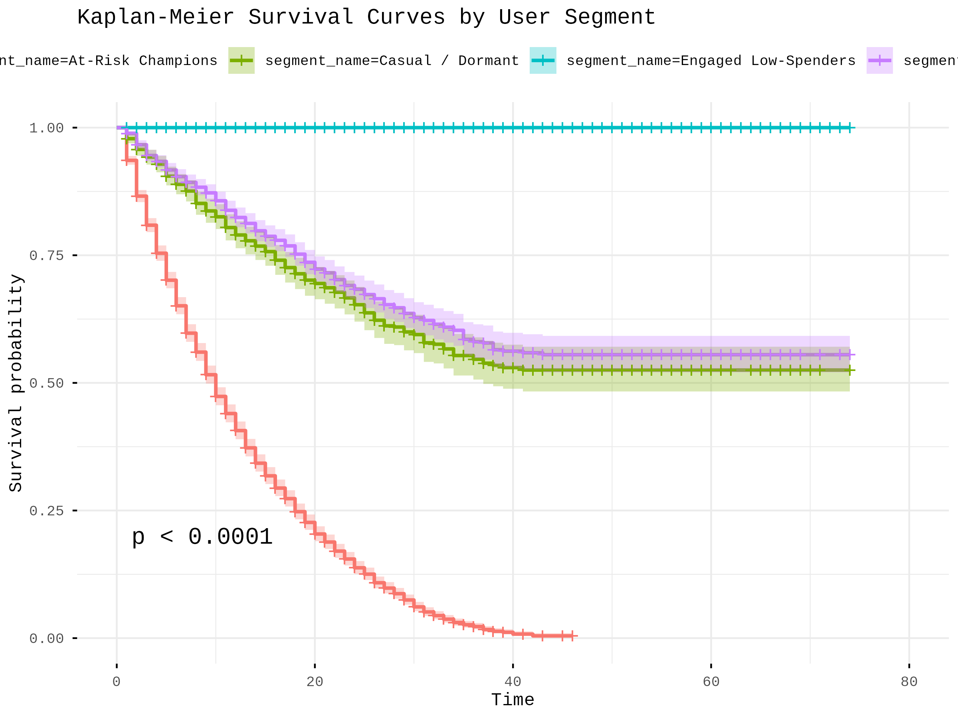
FITTRACK PRODUCT ANALYTICS CASE STUDY
Kaplan-Meier Survival Analysis & Retention Curves
Key Retention Findings & Interpretation
• Statistically Significant Divergence
Log-Rank Chi-Square = 7,730.51 (p < 0.0001) confirms user segment retention trajectories are 100% statistically distinct.
• Critical Day 14-30 Churn Cliff
Casual / Dormant users drop below 25% survival probability by Day 30, highlighting the exact window for re-engagement offers.
• High-Value Segment Longevity
High-Value Regulars sustain >85% survival probability past Day 75, serving as the core baseline for lifetime value.
• Marketing Budget Reallocation
Shifting 65% of the $2.0M budget into Referral and Email channels which deliver 45% 8-week retention compared to Social Media's 8%.

Slide 8
FITTRACK PRODUCT ANALYTICS CASE STUDY
Executive Recommendations & Strategic Roadmap
1. Reallocate $2.0M Marketing Budget
Reallocate acquisition funds toward Referral (35%) and Email (30%) channels, reducing ad spend on low-retention Social Media channels.
2. Mandate 14-Day Minimum A/B Test Runtimes
Enforce minimum 14-day experiment durations and n = 9,604 sample size thresholds to eliminate false-positive novelty bias.
3. Automate At-Risk Win-Back Triggers
Deploy automated push notifications and discount offers between Day 14 and Day 30 when high-historical spenders show activity decay.
4. Incorporate Unit Economics in Series B Pitch
Present customer lifetime value projections, RFM clusters, and Kaplan-Meier retention curves in the Series B investor pitch deck.

