Slide 1
GLOBALTECH FINANCIAL SERVICES
Workforce Gap Analysis & Financial Optimization
End-to-End People Analytics Capstone Project | Power BI & Star Schema Solution
$50.0M
Board Budget Ceiling
Strict Financial Allocation
+401 FTE
Net Headcount Gap
Year 3 Demand Shortfall
41.6%
Internal Mobility
Exceeds 40% Mandate
Star Schema
Power BI Model
Dynamic DAX Engine

Slide 2
GLOBALTECH CAPSTONE CASE STUDY
1. Executive Business Case Scenario & Transformation Mandate
Digital Transformation Context
Background: GlobalTech Financial Services is 18 months into a 36-month Digital Transformation Program (DTP) to modernize core banking and AI capabilities.
The Challenge: While technology infrastructure delivery is on schedule, severe workforce capability shortages threaten operational execution.
Baseline Supply: 364 FTEs across 6 critical technical domains prior to reskilling and expansion.
Target Demand: 765 FTEs required by Year 3 (FY2027), creating a net shortfall of +401 FTEs.
Board Mandates & Governance Constraints
$50.0M Budget Ceiling: Total talent strategy expenditure (hiring, upskilling, retention, vendor) cannot exceed $50.0M.
40.0% Internal Mobility Quota: CHRO mandate requiring at least 40% of net headcount gaps to be filled via internal reskilling.
Q4 2024 Audit Deadline: Cybersecurity compliance mandates immediate Year 1 expansion (+29 net FTEs) to meet regulatory requirements.
3-Year Phased Rollout: Year 1 Stabilization (+159 FTEs) -> Year 2 Platform Scaling (+282 FTEs) -> Year 3 Digital Maturity (+401 FTEs).

Slide 3
GLOBALTECH CAPSTONE CASE STUDY
2. Current Business Pain Points & Operational Friction
Pain Point 1: Siloed HR Analytics
Historical workforce data resided in static Excel files, preventing leadership from viewing real-time headcount gaps and cross-department skill deficits.
Pain Point 2: Critical Skill Deficits
Severe proficiency gaps in AI/ML (2.83/5.0 avg) and Cybersecurity (2.52/5.0 avg) directly threatened regulatory compliance and digital product releases.
Pain Point 3: High Attrition & Cost Drain
Voluntary turnover reached 20.0% in AI/ML and 18.0% in Data Engineering, creating a $22.19M cumulative turnover cost exposure over 3 years.
Pain Point 4: Unstructured Capital Spend
Without risk-weighted prioritization, budget was at risk of over-allocating to low-impact roles while starving high-criticality bottlenecks.

Slide 4
GLOBALTECH CAPSTONE CASE STUDY
3. Project Goals & Power BI Solution Architecture
Strategic Goal 1: Automated Data Engine
Unify headcount, skill evaluations, attrition risks, and financial datasets into an enterprise-grade relational Star Schema model.
Strategic Goal 2: Dynamic Executive Decision Support
Build an interactive Power BI dashboard featuring horizon slicers (Year 1, 2, 3), bright heatmap matrices, and risk rankings.
Strategic Goal 3: Strategic Financial ROI
Optimize $46.10M in talent spend, preserve a $5.0M contingency reserve, and maintain a $3.90M unallocated safety buffer under the board ceiling.

Slide 5
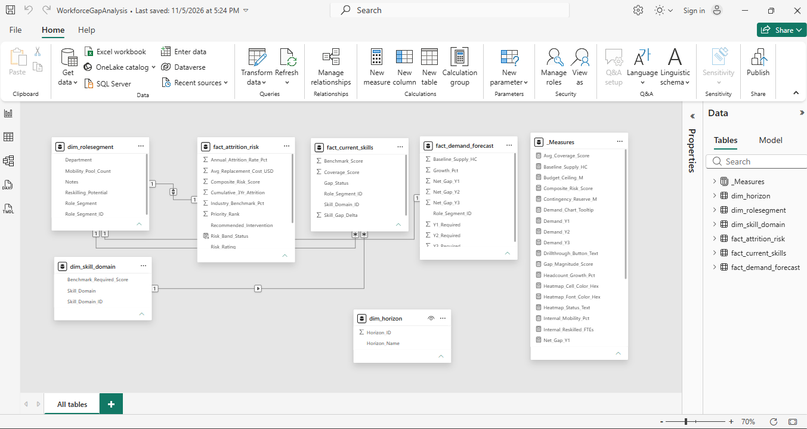
GLOBALTECH CAPSTONE CASE STUDY
4. Star Schema Data Architecture & Relationship Model
Data Model Design & Relationship Rules
dim_rolesegment: Central dimension storing 6 role categories, department groupings, and internal reskilling pools.
dim_skill_domain: Skill domain dimension defining required benchmark proficiency scores (1.0 - 5.0).
dim_horizon: Time dimension controlling Year 1, Year 2, and Year 3 multi-horizon slicer context.
fact_demand_forecast: Headcount supply (364) and target demand (523, 649, 765).
fact_current_skills: Employee competency evaluations across skill domains.
fact_attrition_risk: Turnover rates, replacement costs ($22.19M total), and spend allocations.
Bidirectional Filtering: dim_rolesegment <-> fact_attrition_risk set to 'Both' so Risk Rating slicers filter all 4 visuals.

Slide 6
GLOBALTECH CAPSTONE CASE STUDY
5. Enterprise DAX Calculations & Logic Engine
Dynamic Horizon Demand (Visual 1)
Selected_Demand_FTEs =
VAR SelectedHorizon = SELECTEDVALUE('dim_horizon'[Horizon_ID], 3)
RETURN
SWITCH(
SelectedHorizon,
1, [Demand_Y1], 2, [Demand_Y2], 3, [Demand_Y3],
[Demand_Y3]
)
Calculates FTE demand target based on active horizon slicer button (defaults to Y3 765 FTEs).
Composite Risk Score (Visual 3)
Composite_Risk_Score =
VAR WeightedGap = 0.40 * [Gap_Magnitude_Score]
VAR WeightedAttrition = 0.35 * [Attrition_Risk_Score]
VAR WeightedScarcity = 0.25 * [Skill_Scarcity_Score]
RETURN
ROUND(WeightedGap + WeightedAttrition + WeightedScarcity, 1)
Prioritizes strategic roles (P1-P6) combining headcount gap, turnover %, and market scarcity.
Bright Heatmap Formatting (Visual 2)
Heatmap_Cell_Color_Hex =
VAR Score = [Avg_Coverage_Score]
RETURN
SWITCH(
TRUE(),
Score >= 4.0, "#2E7D32", -- Vivid Green
Score >= 3.0, "#FBC02D", -- Bright Amber
Score >= 2.0, "#FB8C00", -- Vivid Orange
"#D32F2F" -- Vivid Crimson Red
)
Applies vibrant, high-contrast visual status formatting across skill domain tiles.

Slide 7
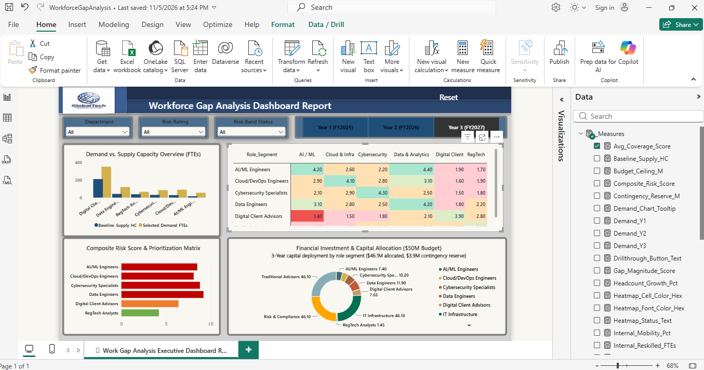
GLOBALTECH CAPSTONE CASE STUDY
6. Final Executive Dashboard & Interactive Canvas
Dashboard Visual Layout
Visual 1 (Top-Left): Clustered Column Chart comparing Baseline Supply vs. Target Demand FTEs.
Visual 2 (Top-Right): Skill Gap Heatmap matrix evaluating scores against 6 skill domain benchmarks.
Visual 3 (Bottom-Left): Composite Risk Score bar chart ranking strategic priorities P1 through P6.
Visual 4 (Bottom-Right): Donut Chart showing $46.10M budget deployment with dynamic center totals.
Interactive Slicers: Department, Risk Band, and Horizon (Y1, Y2, Y3) slicers filter visuals in real time.

Slide 8
GLOBALTECH CAPSTONE CASE STUDY
7. Quantitative Findings Across 6 Critical Role Segments
Role Segment | Priority | Net Gap | Turnover % | Critical Deficit | Closure Pathway
Data Engineers | P1 (9.2) | +78 FTE | 18.0% | Data Pipelines (2.80) | 60% External Hire / 40% IT Reskill
Cybersecurity Specialists | P2 (8.8) | +54 FTE | 15.0% | Info Security (2.52) | Fast-Track Hire (Q4 2024 Audit)
AI / ML Engineers | P3 (8.5) | +40 FTE | 20.0% | AI/ML Modeling (2.83) | External Hire + $4.1M Retention Pool
Cloud / DevOps Engineers | P4 (8.1) | +62 FTE | 14.0% | Cloud Infra (2.73) | Reskill Infrastructure Staff
Digital Client Advisors | P5 (6.4) | +140 FTE | 8.0% | Client Domain (2.10) | Reskill 90 Retail Advisors (Academy)
RegTech Analysts | P6 (4.2) | +27 FTE | 6.0% | Compliance (1.80) | Redeploy 22 Risk & Compliance Staff

Slide 9
GLOBALTECH CAPSTONE CASE STUDY
8. Strategic Recommendations & 3-Year Implementation Roadmap
1. Fast-Track Year 1 Compliance Hiring
Deploy $4.2M immediately to recruit 29 Cybersecurity Specialists and 28 Data Engineers, securing Q4 2024 audit readiness.
2. Launch Advisory Reskilling Academy
Upskill 90 Retail Advisors to Digital Advisors, achieving 41.6% internal mobility and saving ~$7.8M in external recruitment fees.
3. Deploy Targeted Retention Pools
Allocate $4.1M in stay-bonuses for AI/ML and Data Engineering staff, reducing turnover from 20.0% to under 12.0%.
4. Implement Stage-Gated Releases
Release Year 2 ($16.3M) and Year 3 ($8.5M) capital contingent upon passing annual audit gates and reskilling milestones.
5. Operationalize Power BI PMO Tracking
Establish monthly C-suite dashboard reviews to monitor hiring velocity, skill proficiency progression, and budget burn rate.

