Slide 1

Analyzing Opioid Drug Evolution from 2013 to 2017 Team Name: Husky Coders Team Number: 09 Team Members: Anirudh Sundaresan Archisha Dama Akshay Rao

Slide 2





BACKGROUND
Prescribing Opioids is controversial with evidence of both significant underutilization and over utilization.
There is some evidence to support the efficacy for chronic non- malignant pain, but community and individual harms are increasing and are respectively reported.

Slide 3
OBJECTIVE
Examination of Opioid Drugs in United States of America from 2013 to 2017
Detailed analysis on the prescription of Opioid Drugs by medical facilities during the year 2016 -2017.

Slide 4
DATA DESCRIPTION
We have 5 major Data sets:
Provider Enrollment
Enrollment level data for providers actively enrolled in Medicare.
Provider Utilization data
Information on prescription drugs, beneficiaries and claim counts
Opioid drug list 2013-2017
Contains list of opioid and their generic names
Specialty codes data
Medicare specialty and provider taxonomy codes
Part D prescriber National summary report
Details on Part D prescription drug, cost and number of beneficiaries

Slide 5
METHODOLOGY
Select the business process
Determining the granularity and keys
ETL Mapping document
Data conversion, Data Profiling and Cleaning
Slowly changing Dimensions
Designing the Datawarehouse
Populate the Datawarehouse
Analyze the data – Relationship and Hierarchies
Visualization

Slide 6
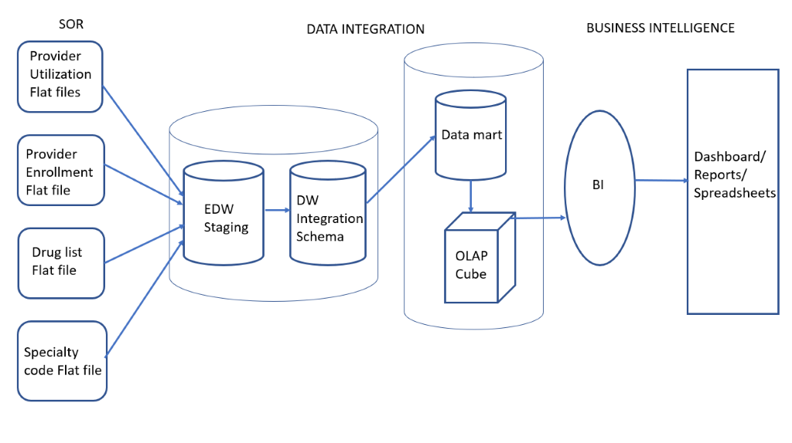
LOGICAL MODEL

Slide 7
TECHNICAL REQUIREMENTS
S.NO | Tool | Purpose
1 | SQL Server Management Studio | Tables and Data storage
2 | SQL Server Integration Services | Periodic loading, error handling, Staging Logic, SCD
3 | Talend Data Quality | Profiling Data
4 | SQL Analysis Services | Multi-dimensional cubes
5 | SQL Reporting Services | Periodic data refresh for Visualization
6 | Tableau | Visualization

Slide 8
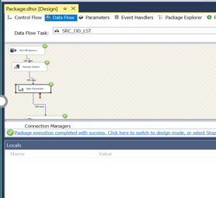
Data conversion
SSIS
Derived column Transformation
Data conversion Transformation

Slide 9
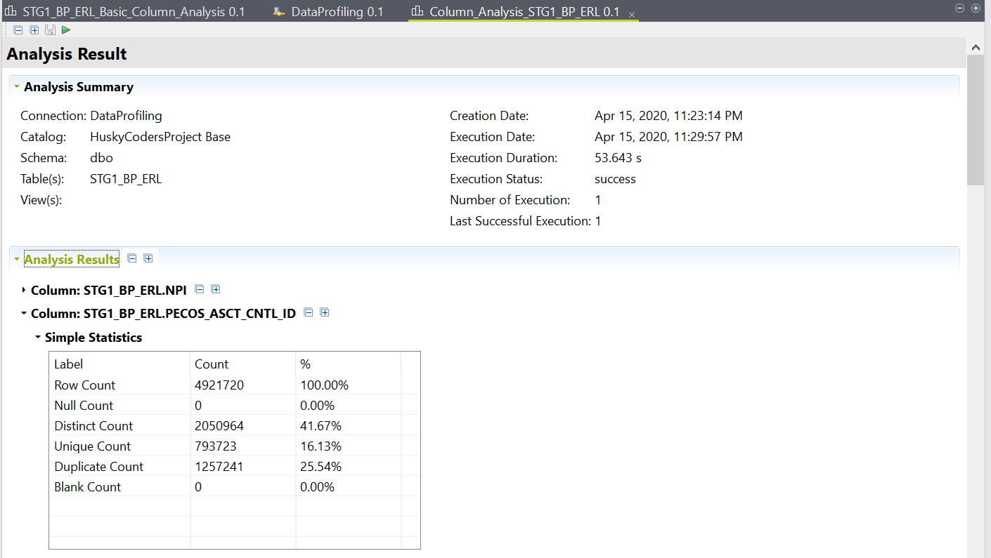
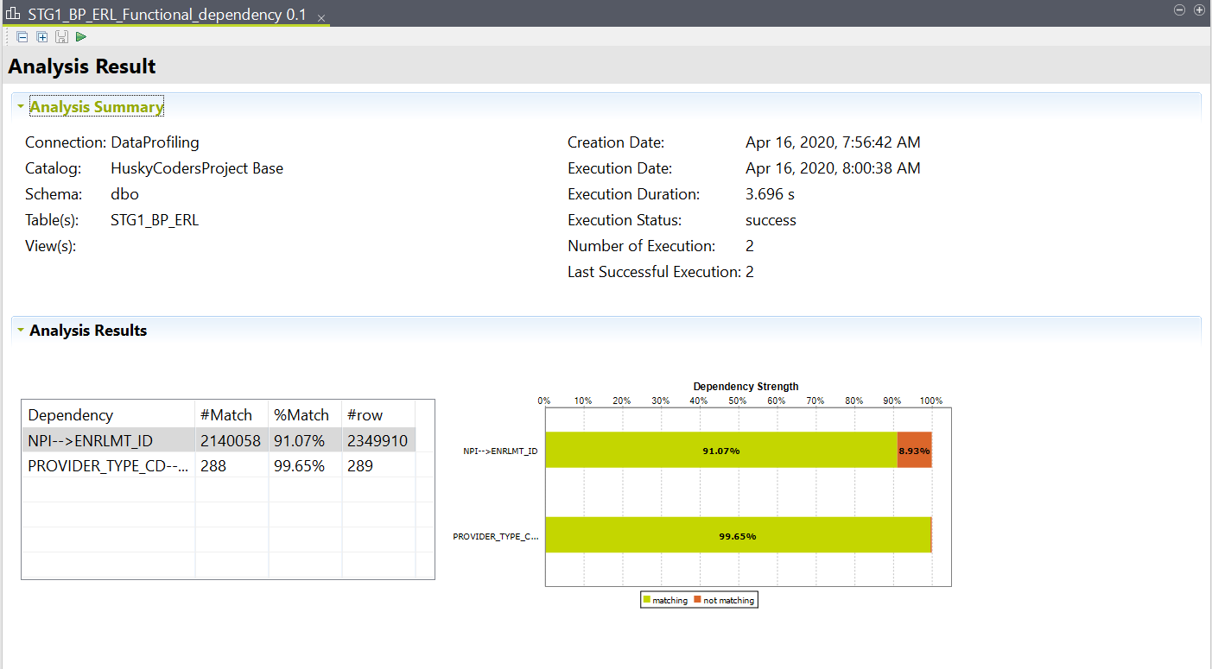
DATA PROFILING
TALEND
Column analysis
Functional Dependencies
Nominal Analysis

Slide 10
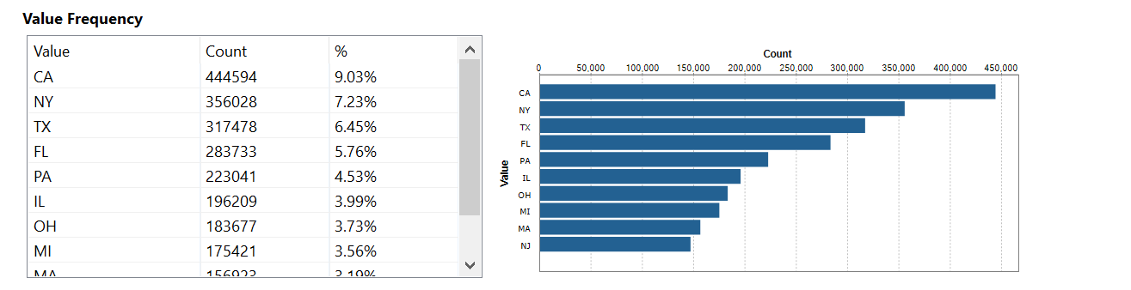
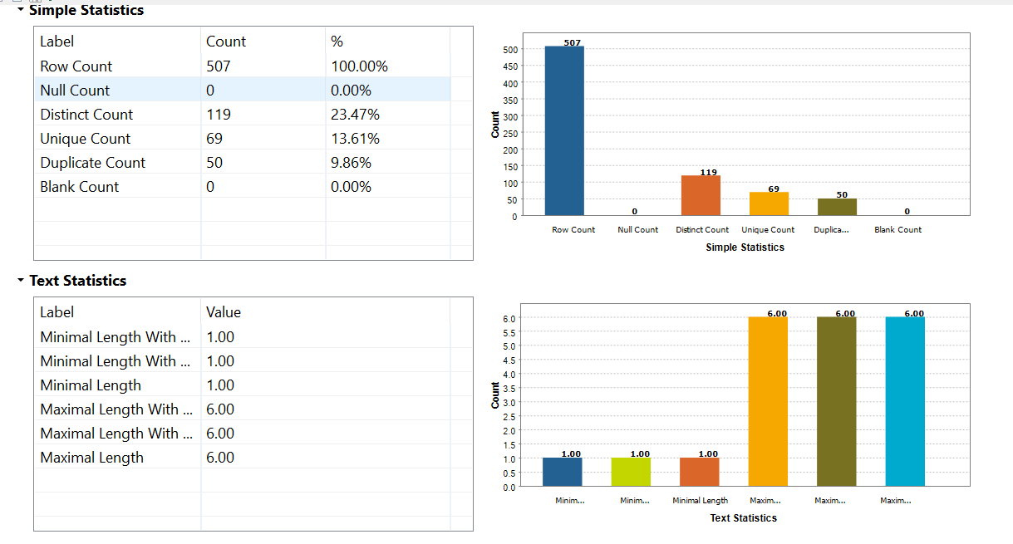
DATA PROFILING

Slide 11
DATA CLEANING
Deleted Duplicate data, Error data
Inserted and replaced Correct data
Union operations to combine tables
Split data into multiple columns
Removed text wrapped with special characters "", %, &
Added comment columns to explain flags

Slide 12
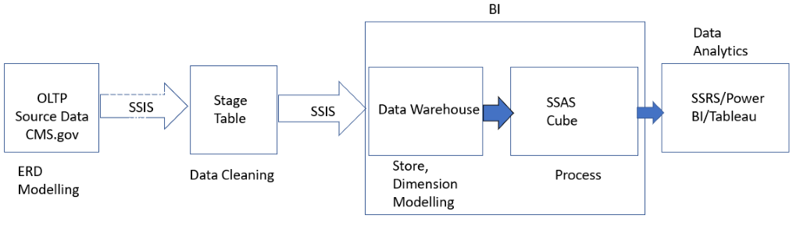
LOAD PROCESS

Slide 13
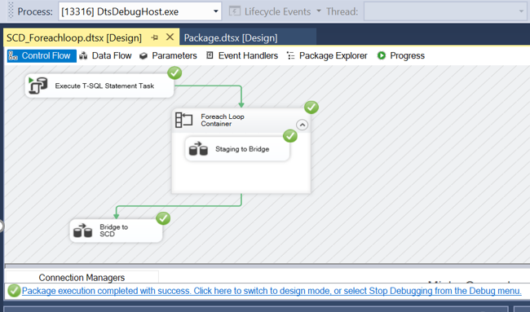
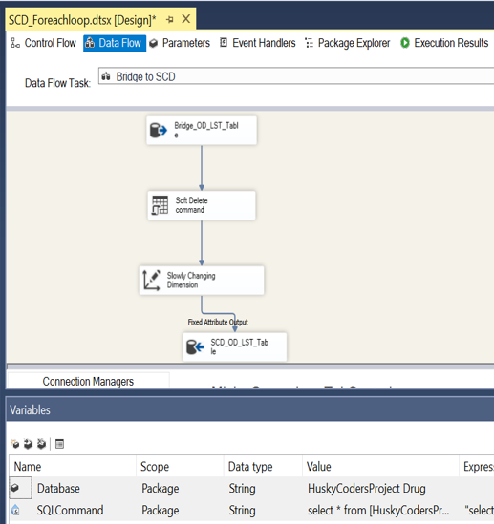
Slowly changing Dimensions

Slide 14
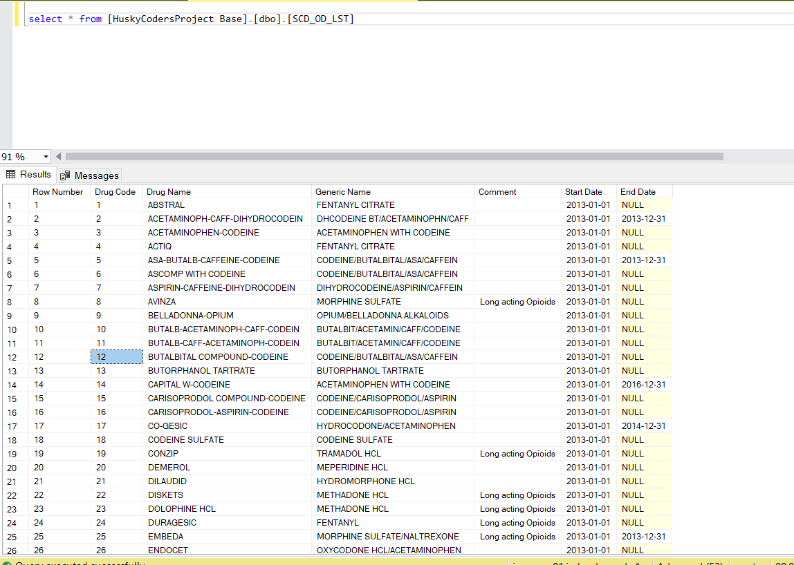
Slowly changing Dimensions

Slide 15
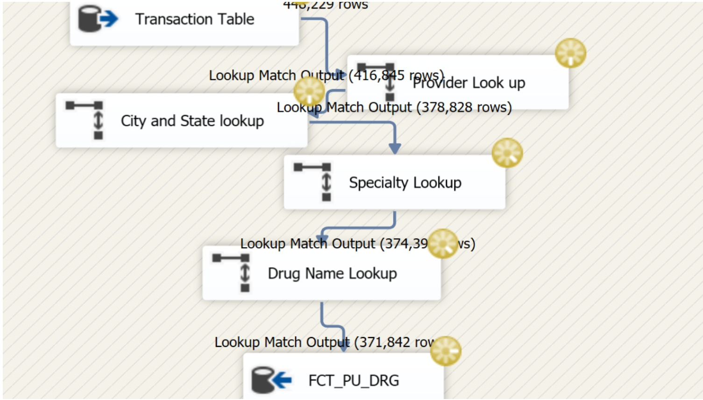
Populate the Datawarehouse

Slide 16
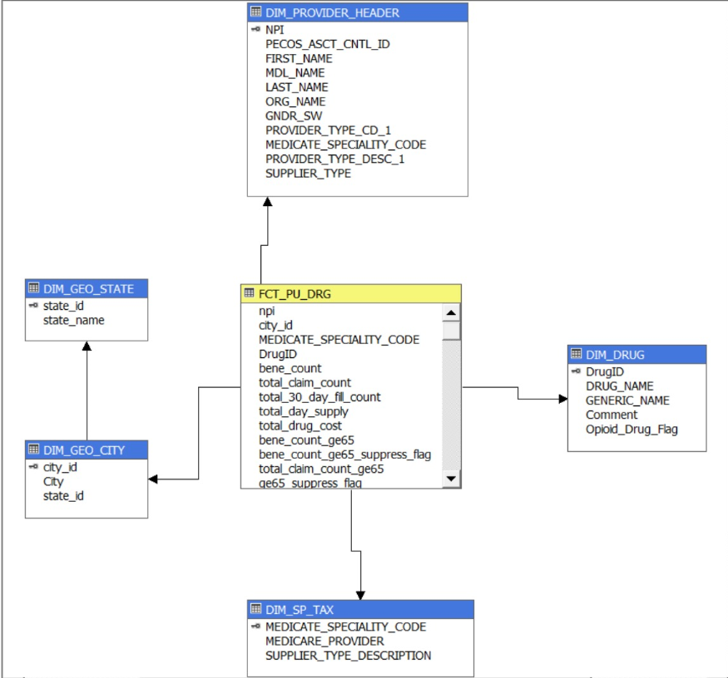
DIMENSIONAL MODELLING

Slide 17
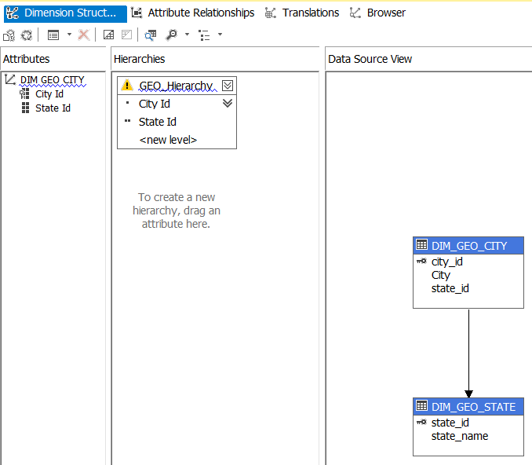
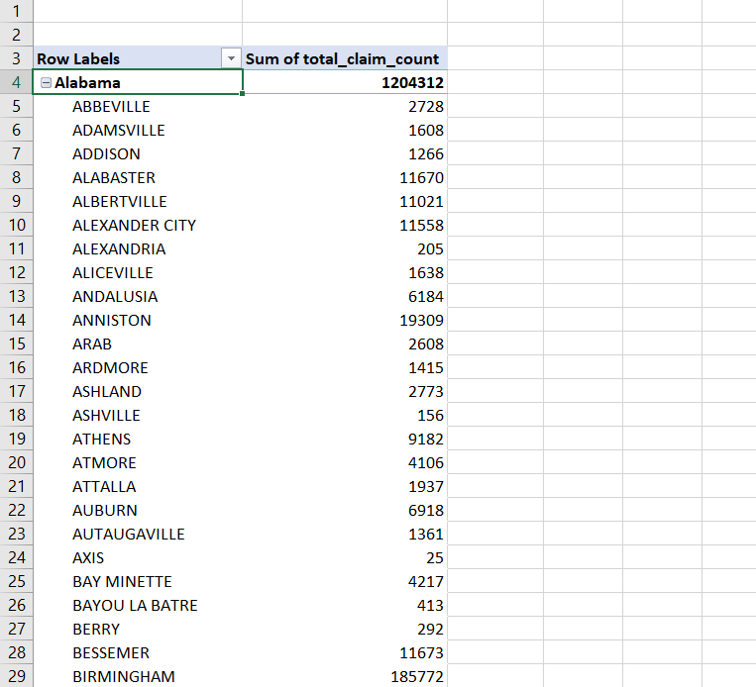
Hierarchy

Slide 18
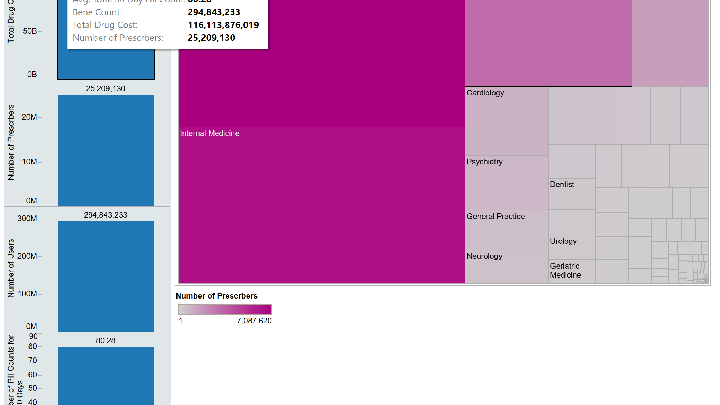
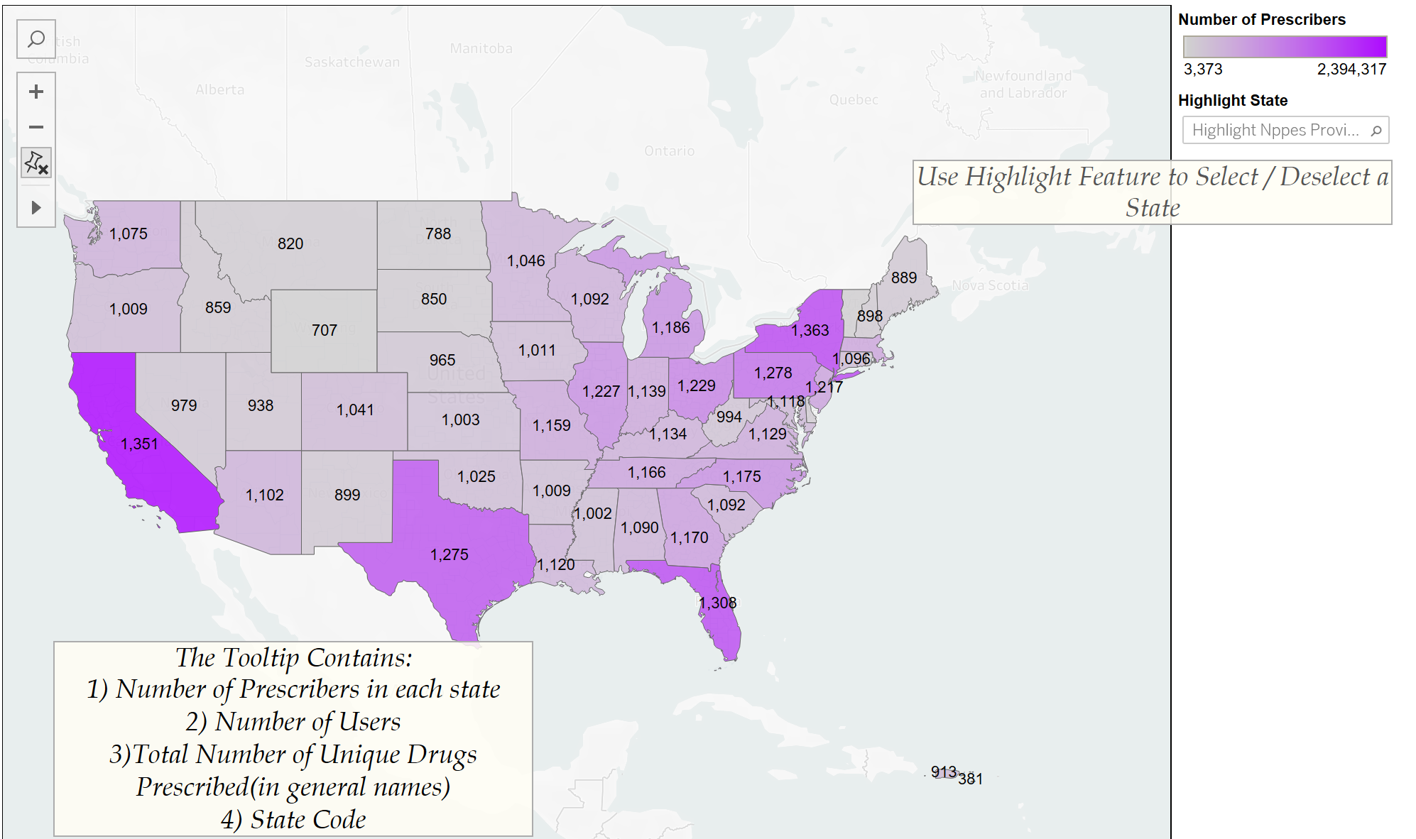
Visualization
Shown in Tableau

Slide 19
Future scope
Cost Analysis
As the data increases, we plan to store data on cloud

Slide 20
REFERENCES
https://www.cms.gov/Medicare/Medicare
https://www.fda.gov/drugs/drug-approvals-and-databases/national-drug-code-directory
http://bi-architects.blogspot.com/2011/12/ssis-datatypes-vs-sql-server-datatypes.html

Slide 21

Thank You

Slide 22
Q & A

