Slide 1


VIDYA UNIVERSITY
Department of Computer Science & Engineering
FIRST PROJECT PRESENTATION · 3RD SEMESTER · CSE (AI & ML)
PrepPilot
An Offline-First, AI-Assisted Study and
Examination Preparation Platform
PRESENTED BY
PROJECT GUIDE
Archit Jain
Vanshika Rajput
Ms. Kareena
Roll No. ______________
Roll No. ______________
Dept. of Computer Science & Engineering
Lavi Chaudhary
Jasmine Chaudhary
Roll No. ______________
Roll No. ______________
SUBMISSION DATE
12 September 2026
Notes:
Good morning. We are presenting PrepPilot, an offline-first, AI-assisted study and exam preparation platform built for Android. I am Archit Jain, with Vanshika, Lavi and Jasmine, guided by Ms. Kareena. Over the next twenty minutes we will cover the problem we set out to solve, our proposed solution, the architecture behind it, and — importantly — an honest account of what the system does and does not do.

Slide 2
WHAT WE WILL COVER
Agenda
01
02
03
04
The Problem
Our Solution
Engineering
Evidence
Problem statement
Why it matters
Existing approaches
Objectives
Proposed system
Core features
Architecture
Offline-first & sync
AI integration
Technology stack
Testing
Limitations & scope
Every technical claim in this presentation is traceable to the repository audit recorded in docs/AUDIT.md.
PrepPilot · Vidya University · Dept. of Computer Science & Engineering
2
Notes:
Our presentation moves in four parts: first the problem, then our solution, then the engineering that makes it work, and finally the evidence — testing, and an honest statement of limitations. Everything we claim is backed by the audit document in our repository.

Slide 3
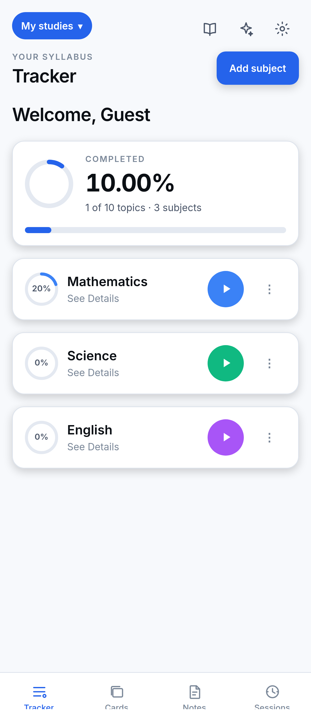
PROJECT INTRODUCTION
What is PrepPilot?
A mobile application that helps a student organise a syllabus, record what they have genuinely completed, time their study, and revise — with or without an internet connection.
Syllabus at the centre
Offline-first, strictly
Tracker first, AI second
Subject → Chapter → Topic → Sub-topic. Every feature attaches to this structure.
On-device SQLite is the source of truth. The cloud syncs; it is never required.
The assistant supports the workflow. It can propose, never apply.
THE ORGANISING IDEA
A student's syllabus is a structure, and progress is a measurement over that structure. Timers, flashcards, notes and reminders all point back to it.
Tracker screen — captured from the running app
PrepPilot · Vidya University · Dept. of Computer Science & Engineering
3
Notes:
PrepPilot is built around one idea: a syllabus is a structure, and progress is a measurement over it. Everything hangs off that. Two commitments shape the engineering. First, offline-first in the strict sense — the local database is authoritative, not a cache. Second, the AI assists but never drives; it can propose changes, but it cannot apply them.

Slide 4
THE PROBLEM WE SET OUT TO SOLVE
Problem Statement
Students lack a single, reliable, offline-capable tool that answers “how much of my syllabus have I actually finished?” honestly — and that supports the study workflow against that same structure.
No accurate measurement
Connectivity dependence
Paper, spreadsheets and memory cannot compute meaningful completion across a hierarchical syllabus of unequal parts.
Most study apps need a network round-trip for basic operation — unusable in libraries, hostels and trains.
Fragmentation
Misleading metrics
Tracking, timers, flashcards and notes live in three or four unconnected apps that share no context.
Naive progress calculations systematically misrepresent how much work actually remains.
PrepPilot · Vidya University · Dept. of Computer Science & Engineering
4
Notes:
The problem is organisational rather than academic. Four specific failures: students cannot measure progress accurately; most tools require connectivity they do not have while studying; their tooling is fragmented across several apps; and where progress is computed, it is usually computed wrongly. The next slide shows exactly how wrongly.

Slide 5
A WRONG NUMBER IS WORSE THAN NO NUMBER
Why This Problem Matters
Consider a subject with two chapters: one topic complete out of one, and zero complete out of ninety-nine.
THE OBVIOUS WAY
WHAT PREPPILOT DOES
Average the chapter percentages
Weight by topics, not chapters
( 100% + 0% ) ÷ 2
1 topic ÷ 100 topics
= 50% complete
= 1% complete
WHY THIS IS THE CORE PROMISE
A student who believes they are halfway through when they are 1% through will plan their remaining weeks wrongly. The averaging mistake is the obvious implementation — so our progress engine guards against it with an explicit regression test.
PrepPilot · Vidya University · Dept. of Computer Science & Engineering
5
Notes:
This is the heart of our motivation. Take a subject with two chapters: one has a single topic, complete. The other has ninety-nine topics, none complete. Averaging the chapter percentages gives fifty percent. The truth is one percent. That difference decides how a student spends their final weeks. Because averaging is the obvious implementation, we wrote a regression test specifically to prevent anyone reintroducing it.

Slide 6
WHAT WE SET OUT TO BUILD
Objectives
01
02
03
Model the syllabus
Measure honestly
Work offline
Four-level hierarchy with per-item completion
Topic-weighted progress that never misrepresents
Local database authoritative; network optional
04
05
06
Sync deterministically
Record study accurately
Integrate AI safely
Multi-device with predictable conflict rules
Survive backgrounding and process death
No client-side keys; no unconfirmed changes
All twelve project objectives are met. Six further objectives — templates, multi-course support, revision tooling, data isolation and automated validation — are listed in the synopsis.
PrepPilot · Vidya University · Dept. of Computer Science & Engineering
6
Notes:
We set twelve objectives; these are the six principal ones. Each is measurable and each is met. Note objective six in particular — integrating AI safely was treated as an engineering constraint from the start, not something added afterwards.

Slide 7
WHY CURRENT TOOLS FALL SHORT
Existing Approaches and the Gap
APPROACH
LIMITATION
THE GAP
Paper checklists
No computed progress · no backup · no time tracking
No existing tool combines a structured syllabus model, an honest progress calculation, offline-first operation and integrated study tooling in one application.
Spreadsheets
Laborious on a phone · manual formulas · no revision tooling
To-do apps
Flat lists · no syllabus concept · no weighted progress
Flashcard apps
Strong revision, but hold no syllabus and no progress model
So students run three or four apps that share no context — and the syllabus exists in none of them.
Pomodoro timers
Time only — no connection to what was actually studied
Coaching portals
Require connectivity · content-locked · track their syllabus
PrepPilot · Vidya University · Dept. of Computer Science & Engineering
7
Notes:
We looked at six categories of existing approach. Each fails differently, but the pattern is consistent: tools that revise well hold no syllabus; tools that track time do not know what was studied; tools that hold content require connectivity. The gap is an application where the syllabus is the spine and everything else attaches to it.

Slide 8
ONE APPLICATION, ONE STRUCTURE
Proposed Solution
Progress
Notes
topic-weighted
per topic
Sessions
Reminders
3 timer modes
SYLLABUS
Subject → Chapter → Topic
student-set only
Flashcards
AI Assistant
scheduled review
explain · quiz
Local database is the source of truth
Progress computed in exactly one place
AI may propose, never apply
Secrets never reach the device
PrepPilot · Vidya University · Dept. of Computer Science & Engineering
8
Notes:
Our solution is one application in which the syllabus is the central data structure and every other feature references it. Progress, study sessions, flashcards, notes, reminders and the AI assistant all read from and write to that one structure. The four commitments along the bottom are design rules we held to throughout — each is implemented, not aspirational.

Slide 9
HOW THE HIERARCHY IS COUNTED
Syllabus Structure and Progress
SUBJECT
Topic-weighted
Mathematics
Subject progress is all completed units ÷ all units — never the mean of chapter percentages.
CHAPTER
Trigonometry
Empty is not zero
TOPIC
A chapter with no topics reports “—”, not 0%. It is unmeasured, not unstarted.
Identities
Sub-topics become the unit
SUB-TOPIC
A topic split into four parts weighs four times one that is not — it is four times the work.
optional fourth level
Rounding is honest
9,999 of 10,000 topics displays as 99%, never a falsely triumphant 100%.
All five figures — topic, chapter, subject, overall and dashboard — are derived from a single traversal, so they cannot disagree.
PrepPilot · Vidya University · Dept. of Computer Science & Engineering
9
Notes:
The syllabus is four levels deep, the fourth optional. Four rules govern how it is counted. The most important is topic weighting, which we saw on the earlier slide. The second matters more than it looks: an empty chapter reports an em dash, not zero percent, because a chapter you have not filled in yet is unmeasured, not unstarted. Showing zero would be a lie about work that does not exist. Finally, all five progress figures come from one traversal, so they are consistent by construction rather than by careful maintenance.

Slide 10
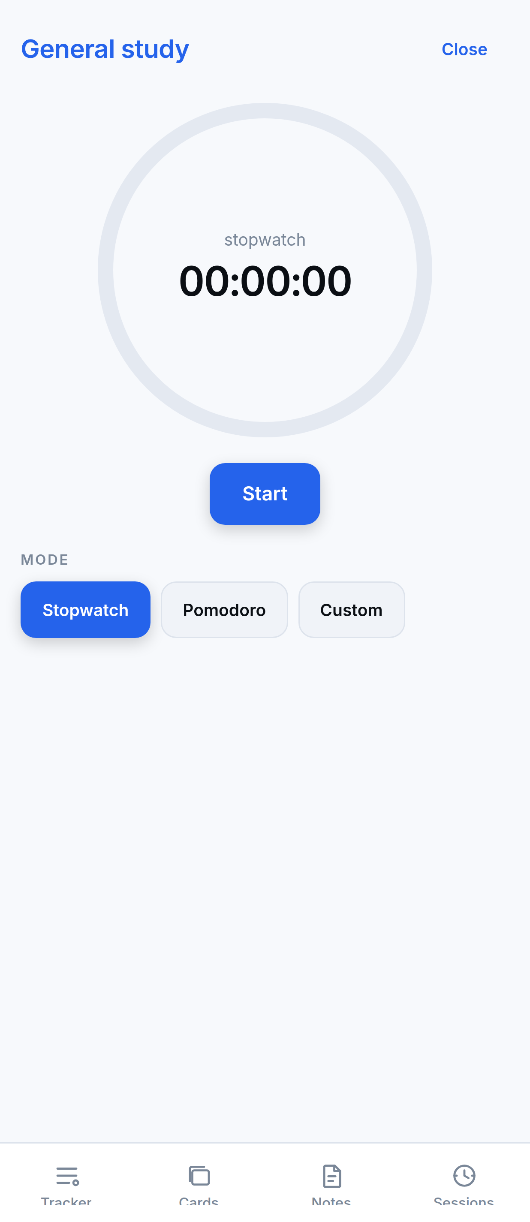
RECORDING TIME THAT ACTUALLY HAPPENED
Study Timers and Sessions
Stopwatch
Pomodoro
Custom
Counts up, no limit
25 / 5 / 15, configurable
Any countdown, 1–480 min
Elapsed time is derived, never accumulated
Time is computed from timestamps — now − startedAt + banked — not by a counter ticking each second.
Android suspends background processes. A ticking counter stops when the screen locks and would silently under-report the session. Deriving from a start timestamp survives backgrounding and process death.
Breaks are not study time
Interrupted sessions survive
Pomodoro break phases are excluded from recorded duration. Counting them would inflate “total time studied” and make the figure meaningless.
A session killed by the OS is recorded as “abandoned” with the last heartbeat's duration — a crash costs one interval, not the whole sitting.
PrepPilot · Vidya University · Dept. of Computer Science & Engineering
10
Notes:
Three timer modes. The engineering detail worth explaining is how we measure elapsed time. The naive approach is a counter incremented every second — but Android suspends background processes, so that counter stops the moment a student locks their screen, and the session is under-reported. We instead derive elapsed time from the start timestamp, which survives both backgrounding and process death without needing a foreground service. We also exclude Pomodoro breaks, because counting rest as study makes the total meaningless.

Slide 11
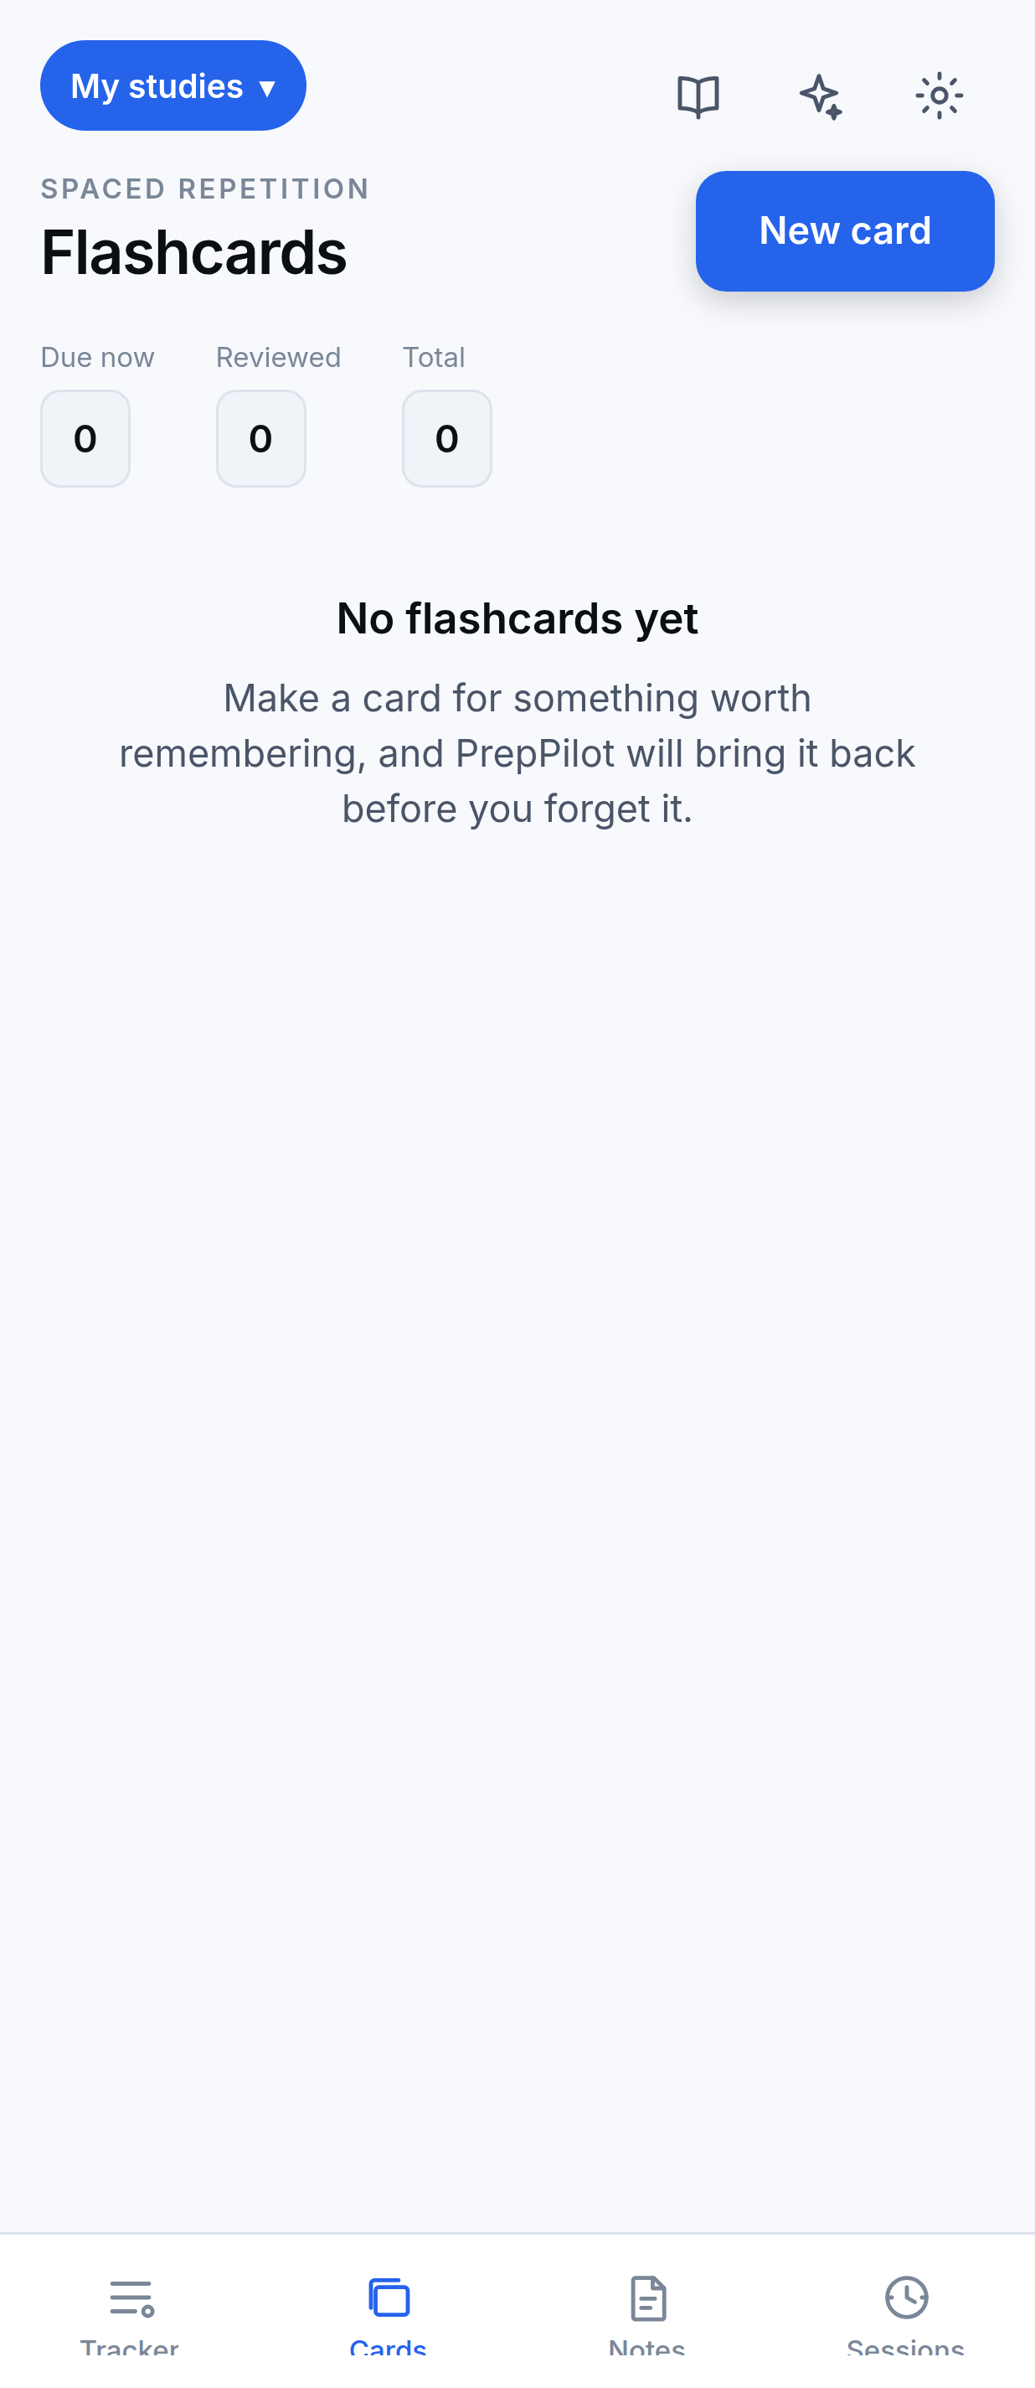
REVISION BOUND TO THE SYLLABUS
Flashcards and Review Scheduling
How review works today
After seeing the answer, the student picks one of four fixed intervals. The card returns after that interval.
5 min
1 day
2 days
4 days
STATED ACCURATELY
PrepPilot implements fixed-interval spaced repetition — not SM-2. A full, tested SM-2 implementation exists in our shared package, and its bookkeeping (ease factor, repetitions, lapses) is maintained under every review — but the review screen does not currently call it.
Why fixed intervals: an adaptive schedule changes its button labels every review, so “1 day” is not a day on a mature card. Fixed labels say exactly what they do.
PrepPilot · Vidya University · Dept. of Computer Science & Engineering
11
Notes:
This slide is deliberately precise, and it is the one we most expect to be questioned on. Many apps say 'spaced repetition' and mean SM-2, the Anki algorithm. We implemented SM-2 fully and tested it — but our review screen currently uses four fixed intervals instead, because fixed labels tell the student exactly what will happen, whereas an adaptive schedule's '1 day' button is not one day on a mature card. We maintain the SM-2 statistics underneath, so switching is a one-line change. We would rather state this accurately than claim an algorithm we do not currently run.

Slide 12
SUPPORT FEATURES — AND THEIR REAL LIMITS
Notes, Reminders and Focus Mode
Notes
Reminders
Focus Mode
Free-text notes on any topic or sub-topic, managed from one screen — so fixing a typo does not mean hunting through a collapsed syllabus.
Student-created only — PrepPilot never invents schedules. Repeat rules: none, daily, weekdays, weekly.
A single distraction-free screen that keeps the display awake, silences PrepPilot's own reminders, and counts departures.
LIMITATIONS WE STATE IN THE APP
Focus Mode cannot block other apps.
Do Not Disturb is not toggled.
Android forbids it without an AccessibilityService or device-admin rights, both restricted by Play Store policy.
It needs a system permission no Expo module exposes. We ask students to use their device's own DND alongside a session.
Web reminders stop when the tab closes.
Weekday reminders are re-armed by the app.
A browser tab has no OS scheduler. On Android the operating system holds the schedule and they fire reliably.
Neither platform offers a weekday-only trigger, so if the app is never opened they stop firing.
PrepPilot · Vidya University · Dept. of Computer Science & Engineering
12
Notes:
Three supporting features — and the slide below them is the one we are proudest of, because it states what these features cannot do. Focus Mode does not block other apps; Android simply does not permit that without privileges the Play Store restricts. We do not toggle Do Not Disturb. Web reminders die with the tab. Rather than let a student discover these by being let down, the app itself displays a capability list saying so. If asked why we did not implement app blocking — the answer is that it is not a matter of effort, it is a platform restriction.

Slide 13
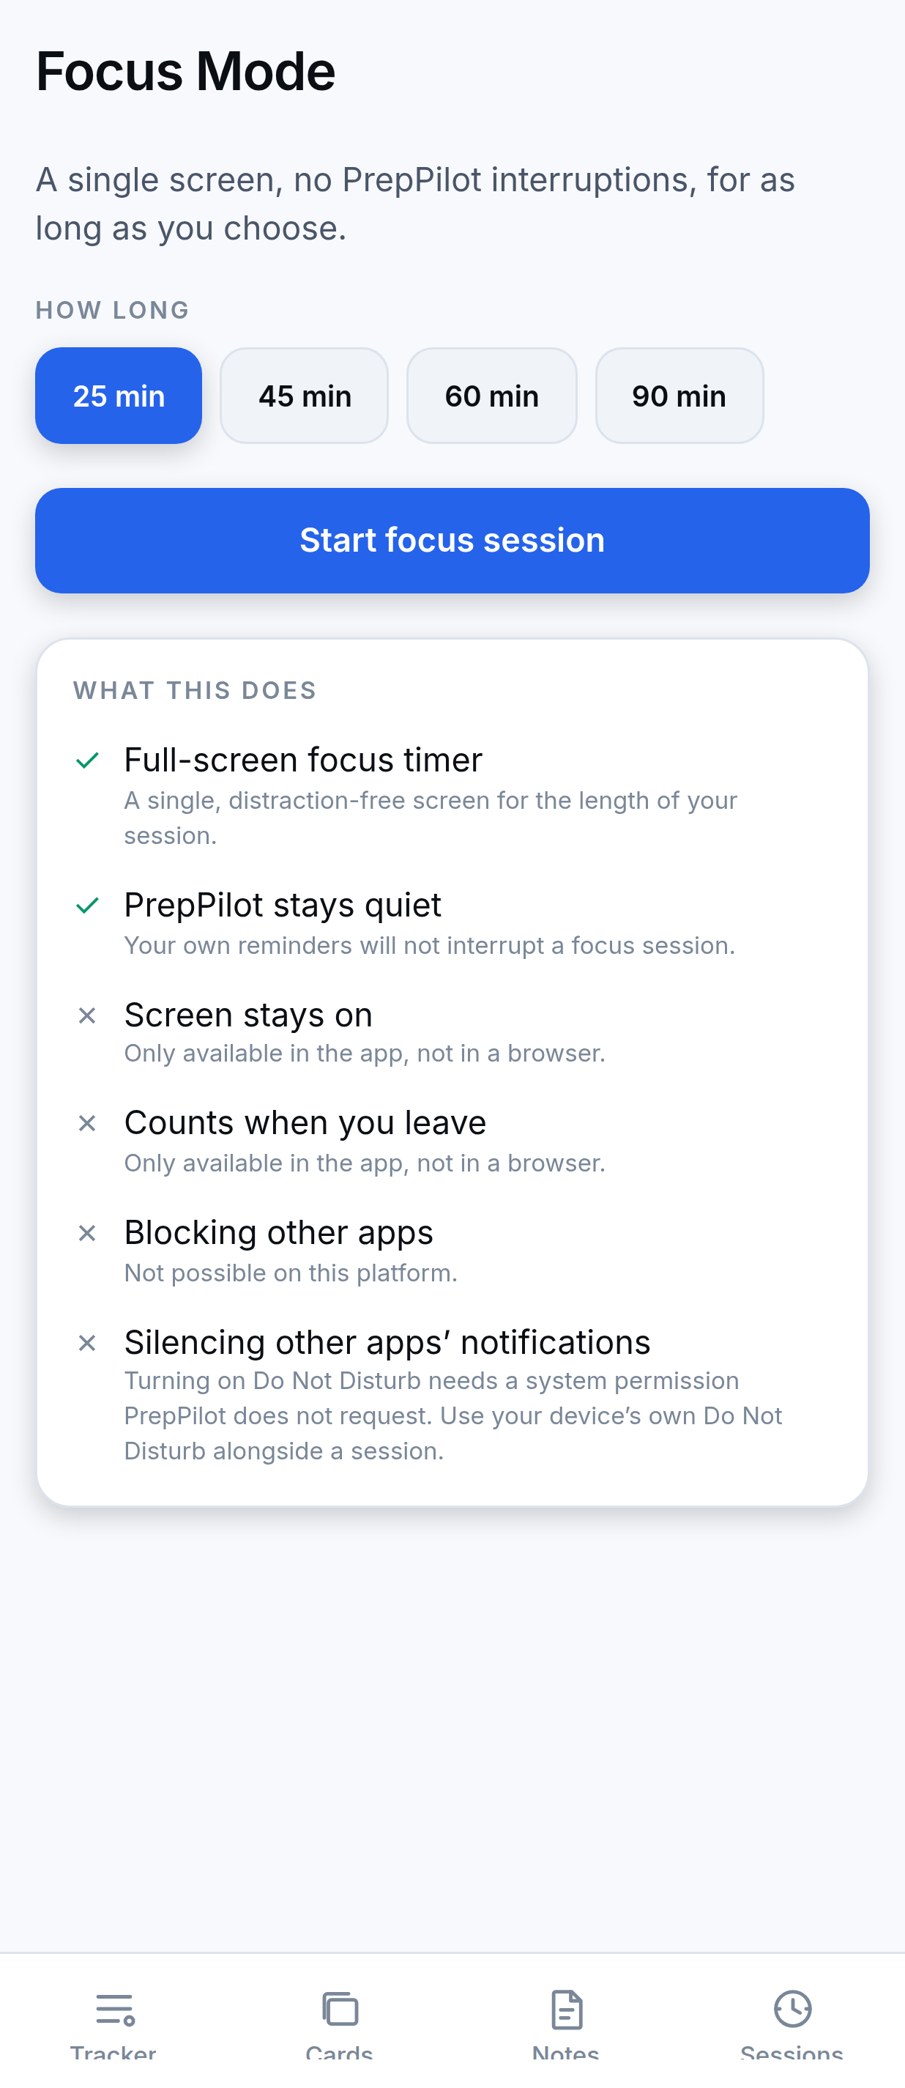
THE APP STATES ITS OWN LIMITS, IN THE INTERFACE
Honesty by Design
Focus Mode ships with a capability list. Every item is marked supported or not supported, with the reason.
✓
Full-screen focus timer
✓
PrepPilot stays quiet
✗
Blocking other apps — not possible on this platform
✗
Silencing other apps' notifications — needs a permission we do not request
WHY THIS MATTERS
A student planning months of preparation around a tool needs that tool to be accurate about itself.
PrepPilot · Vidya University · Dept. of Computer Science & Engineering
13
Notes:
This screenshot is from the running application. Note the two ticks and the two crosses, each with a reason. In the browser build two further items show as unsupported because they are app-only capabilities. We consider this the right default: state the limit in the interface, at the moment the student would otherwise form a false expectation.

Slide 14
THE LOCAL DATABASE IS AUTHORITATIVE
Offline-First Architecture
“Offline-first” here does not mean “caches data for offline viewing”. It means the local database is the source of truth and the network is optional.
OFFLINE
CONNECTIVITY RETURNS
Student ticks a topic
PULL rows changed since watermark
Write to local SQLite · syncStatus = 'pending'
MERGE conflicts deterministically
Progress updates immediately
PUSH rows marked pending
Client-generated UUIDv7 ids
Tombstones, never hard deletes
Server-side watermark
A row created offline has its final identity at once — so it arrives as a conflict, not a duplicate.
A deleted row is marked, not removed. Otherwise the next pull cannot tell “deleted here” from “not yet seen” and resurrects it.
The next pull resumes from the server's clock. A fast device clock would otherwise bookmark the future and skip rows forever.
PrepPilot · Vidya University · Dept. of Computer Science & Engineering
14
Notes:
Offline-first is a precise claim, so let us be precise. The local SQLite database is authoritative — writes complete there regardless of network state, and progress updates immediately. Synchronisation is a separate concern that happens later. Three design properties make this work, and each addresses a specific failure mode. Client-generated ids mean an offline row is recognised as the same row, not a duplicate. Tombstones mean deletions survive a sync. And taking the watermark from the server's clock rather than the device's prevents a device with a fast clock silently skipping rows forever.

Slide 15
DETERMINISTIC, AND THE SAME ON EVERY DEVICE
Synchronisation and Conflict Resolution
PULL
remote rows since watermark
MERGE
resolve conflicts
PUSH
send agreed version
Pulling before pushing is deliberate: pushing first would overwrite the server with a local row that has not been reconciled, destroying changes made elsewhere.
1
A tombstone wins
2
Completion resolves on its own timestamp
Deletion is sticky. Resurrecting something a student deleted is worse than losing an edit to it.
So renaming a topic on one device cannot revert a tick made on another.
3
A tie on completion resolves to completed
4
Everything else is last-write-wins
Silently un-ticking finished work is the failure a student would never forgive.
On updatedAt, with the local copy winning an exact tie so a device never churns its own rows.
Eight tables synchronise. Preferences deliberately do not — a theme choice belongs to a device, not to an account.
PrepPilot · Vidya University · Dept. of Computer Science & Engineering
15
Notes:
Synchronisation runs pull, merge, then push — in that order, and the order matters. Four conflict rules, applied identically on every device. Rule two is the subtle one: topics carry a separate completedChangedAt column so that completion resolves independently of the rest of the row. Without it, renaming a topic on your tablet would silently revert a tick you made on your phone, because the two changes would be indistinguishable. Rule three settles genuine ties in favour of completed, because un-ticking finished work is the error a student would never forgive us for.

Slide 16
THE CLIENT NEVER HOLDS THE GEMINI KEY
AI Integration
PrepPilot Client
React Native
Supabase Edge Function
ask-gemini · Deno
Google Gemini API
gemini-3.6-flash
JWT
API key
The Gemini API key is read from a Supabase secret inside the Edge Function and never returned to a client. No key appears anywhere in the app bundle.
Identity from the JWT
Rate limited
Thinking capped
Errors not forwarded
The caller is read from the token's sub claim, not a header — a header is whatever the caller types.
20 requests per hour per account. In-memory and per-instance: it bounds runaway use, it is not a durable quota.
The model's reasoning budget is capped at 512 tokens, so a simple question is not deliberated over.
Upstream error bodies can carry key or quota detail, so they are never passed back to the client.
THREE MODES
ask
summarize
quiz
Answers a question, given the student's subject names
Summarises one topic in at most six sentences
Generates exactly three multiple-choice questions
PrepPilot · Vidya University · Dept. of Computer Science & Engineering
16
Notes:
This is the AI architecture, and the important point is what is NOT in the picture: the client never talks to Gemini directly, and the API key never reaches a device. If we had put the key in the app, anyone who downloaded the APK could extract it and spend our quota. Instead the client calls a Supabase Edge Function which holds the key as a server secret. That function also identifies the caller from their signed token rather than a header — because a header is just text the caller writes, so a rate limit keyed on one is bypassed by editing it.

Slide 17
THE ASSISTANT MAY PROPOSE. IT CANNOT APPLY.
AI Safety
AI Proposal
parsed into an inert object
User Review
student sees what would change
Confirmation
explicit, never implied
Apply
only now does storage change
THE PROPOSAL GRAMMAR
Structural, not a prompt instruction
Exactly two verbs exist:
Safety comes from the program's shape, not from asking the model nicely.
• addChapters
Model output is untrusted input
• addTopics
Names returned by the model are validated exactly as typed user input is.
There is no verb for deleting, completing, renaming or reordering. Such a request cannot be represented — so it cannot be applied.
Large proposals are flagged
Anything over 200 topics is marked too large to review meaningfully.
The AI is also the one feature that requires connectivity — and the interface says so rather than failing silently.
PrepPilot · Vidya University · Dept. of Computer Science & Engineering
17
Notes:
This is our answer to the question 'what stops the AI wrecking a student's syllabus?' The answer is not that we asked it nicely. A model reply is parsed into an inert proposal object, and the proposal grammar admits exactly two verbs — add chapters, and add topics. There is no verb for deleting, completing or reordering. A reply asking for those operations cannot even be represented in our data structure, so it cannot be applied. Safety is structural. We also treat model output as untrusted input and validate names exactly as we validate typed input.

Slide 18
LAYERED CLIENT, MANAGED CLOUD BACKEND
System Architecture
MOBILE CLIENT — REACT NATIVE / EXPO
SUPABASE — BACKEND PLATFORM
Presentation
Expo Router screens · design-system components
Supabase Auth
email · Google · phone OTP
State
Zustand stores, one per feature
PostgreSQL
Row Level Security on every table
Domain — packages/shared
progress · timer · scheduling · merge · AI parsing
Edge Functions
ask-gemini · delete-account (Deno)
Repository
typed data access
sync engine
Google Gemini API
gemini-3.6-flash
SQLite via Drizzle ORM
expo-sqlite on device · sql.js WASM in browser
The domain layer holds no React Native imports, so the app, the browser build and the test suite compute progress with the same code — they cannot disagree about a percentage.
PrepPilot · Vidya University · Dept. of Computer Science & Engineering
18
Notes:
Five client layers, each with one job. The layer worth pointing out is the domain layer in packages/shared — it is deliberately free of React Native imports, which means the identical code runs in the Android app, in the browser build, and in our test suite. The mobile app and the web demo therefore cannot disagree about a percentage. On the right, Supabase is our backend — Auth, Postgres with row-level security, and two Deno Edge Functions. Note there is no Node.js server anywhere: Node is our build tooling, not our backend.

Slide 19
NINE LOCAL TABLES, EIGHT SYNCHRONISED
Database and Data Model
trackers
subjects
chapters
UUIDv7 primary keys
one exam or course
top level
second level
client-generated
topics
subtopics
flashcards
userId on every row
primary completion unit
optional fourth level
revision + schedule
one predicate scopes a query; RLS mirrors it
study_sessions
reminders
preferences
deletedAt tombstone
recorded study
student-created
device-local settings
deletions survive sync
● synchronised ● device-local
completedChangedAt
completion resolves independently of a rename
SOFT REFERENCES — A DELIBERATE DECISION
Study sessions and flashcards carry no foreign key to the syllabus — only plain ids plus a snapshot of the names. Deleting a subject must not shrink “total time studied”: the student really did spend that time. Nor should deleting a topic destroy the cards written for it.
PrepPilot · Vidya University · Dept. of Computer Science & Engineering
19
Notes:
Nine tables locally, eight of which synchronise. Preferences stays on the device because a theme choice belongs to a device, not an account. The bottom panel describes a decision we think is worth defending: study sessions and flashcards deliberately have no foreign key to the syllabus. If they did, deleting a subject would cascade and shrink your total study time — but you really did spend those hours. So we keep the ids as plain references plus a snapshot of the names, which also keeps history readable after a rename.

Slide 20
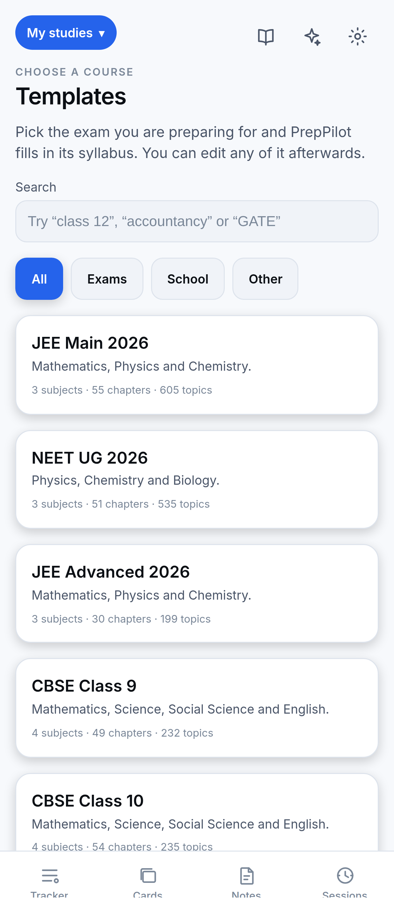
22 BUNDLED SYLLABI, IMPORTABLE OFFLINE
Syllabus Templates and Multi-Course Support
3
Generated from source syllabi
JEE Main 2026 · JEE Advanced 2026 · NEET UG 2026
10
CBSE, hand-written
Classes 9 & 10 · Classes 11 & 12 in PCM, PCMB, Commerce, Humanities
9
Competitive & professional
UPSC CSE · SSC CGL · GATE CS/IT · NEET PG · CA Foundation / Inter / Final · MBBS · DevOps
Bundled, not fetched
Importing copies
Templates ship inside the app, so importing one works with no connectivity. Each shows its source and a verified flag.
The template id is a label, not a live link. The student's copy is theirs and free to diverge.
PrepPilot · Vidya University · Dept. of Computer Science & Engineering
20
Notes:
Twenty-two syllabi ship inside the app. Three are generated from official source syllabi; ten CBSE streams and nine competitive or professional syllabi are hand-written from each body's published syllabus, because none of these bodies publishes a machine-readable version. Because they are bundled rather than fetched, importing works with no connectivity — which matters, since setting up your syllabus is the first thing you do. A tracker represents one exam, so a student sitting both GATE and UPSC keeps two, and switching switches everything.

Slide 21
ISOLATION ENFORCED AT THE DATABASE
Authentication and Security
Email + password
Google OAuth
Phone OTP
Guest mode
Implemented
PKCE via system browser
Behind a feature flag
Local only; no AI
ROW LEVEL SECURITY
Supabase anon key
Enabled AND forced on every table — forcing applies policies to the owner too
In the bundle — correct. It is publishable and bounded entirely by RLS.
Policies for select, insert and update, each scoped to auth.uid()
Service-role key
Server-side only, inside the delete-account Edge Function.
No delete policy anywhere — deletion is by tombstone, enforced at the database
Gemini API key
Server-side only, read from a Supabase secret.
Known limitation: the local SQLite database is not encrypted, and the AI rate limit is in-memory per instance rather than a durable quota.
PrepPilot · Vidya University · Dept. of Computer Science & Engineering
21
Notes:
Four sign-in methods. The security model rests on row-level security: every table has it enabled and forced — forcing matters, because without it the policies do not apply to the table owner. Note the third bullet: there is deliberately no delete policy anywhere. Deletion happens by tombstone, and the absence of that policy is what enforces it at the database rather than trusting client code. On secrets — the anon key being in the bundle is correct and intentional; it is publishable and its power is bounded by RLS. The keys that matter never leave the server.

Slide 22
AS BUILT, WITH VERSIONS
Technology Stack
Language & Frontend
Data Layer
Backend & AI
Build & Tooling
TypeScript
SQLite
Supabase
EAS Build
strict, everywhere
expo-sqlite on device
the backend platform
Android APK
React Native 0.86
sql.js (WASM)
Supabase Auth
GitHub Actions
Android primary
in the browser
authentication
CI on every PR
Expo SDK 57
Drizzle ORM 0.45
Edge Functions
Jest · Vitest · Deno
runtime & build
typed schema & queries
Deno runtime
test runners
Expo Router
PostgreSQL
Google Gemini
Node.js 22 · pnpm
file-based routing
cloud, with RLS
gemini-3.6-flash
toolchain only
Zustand 5
state management
NativeWind
styling
Terminology: Node.js is our development toolchain — it runs the bundler, the test runners and the formatter. It is not this project's backend; there is no Node server in the repository. Supabase is the backend.
PrepPilot · Vidya University · Dept. of Computer Science & Engineering
22
Notes:
The stack as actually built, with versions taken from our package manifests. The note at the bottom is one we would like to pre-empt a question on. It is common to list Node.js as a backend. In our case that would be wrong: Node runs our bundler, our test runners and our formatter, but there is no Node server anywhere in the repository. Our backend is Supabase — managed Postgres, Auth, and Deno Edge Functions.

Slide 23
EVIDENCE THAT IT WORKS
Testing and Validation
1,799
80
6
2
tests passing
test suites
CI stages per change
bundle builds verified
CI RUNS ON EVERY CHANGE
TEST BREAKDOWN
1
Formatting check
packages/shared
15 suites
512 tests
2
Type-check every package
apps/mobile
65 suites
1,287 tests
3
Full suite with coverage thresholds
Total
80 suites
1,799 tests
4
Deno tests for the Edge Functions
5
Android bundle build
Measured by running the suite from a clean install.
6
Web bundle build
The Android APK has been built via EAS and tested on a physical device. Supabase and the deployed AI function are live.
PrepPilot · Vidya University · Dept. of Computer Science & Engineering
23
Notes:
Our evidence base. Seventeen hundred and ninety-nine tests across eighty suites, all passing — and this number was measured, not estimated: we ran the suite from a clean install while preparing this presentation. Continuous integration runs six stages on every change. Two of those are worth explaining: we build the Android bundle and the web bundle in CI, because a green test suite does not prove the app still bundles through a pnpm workspace — that is a failure mode we hit and now guard against.

Slide 24
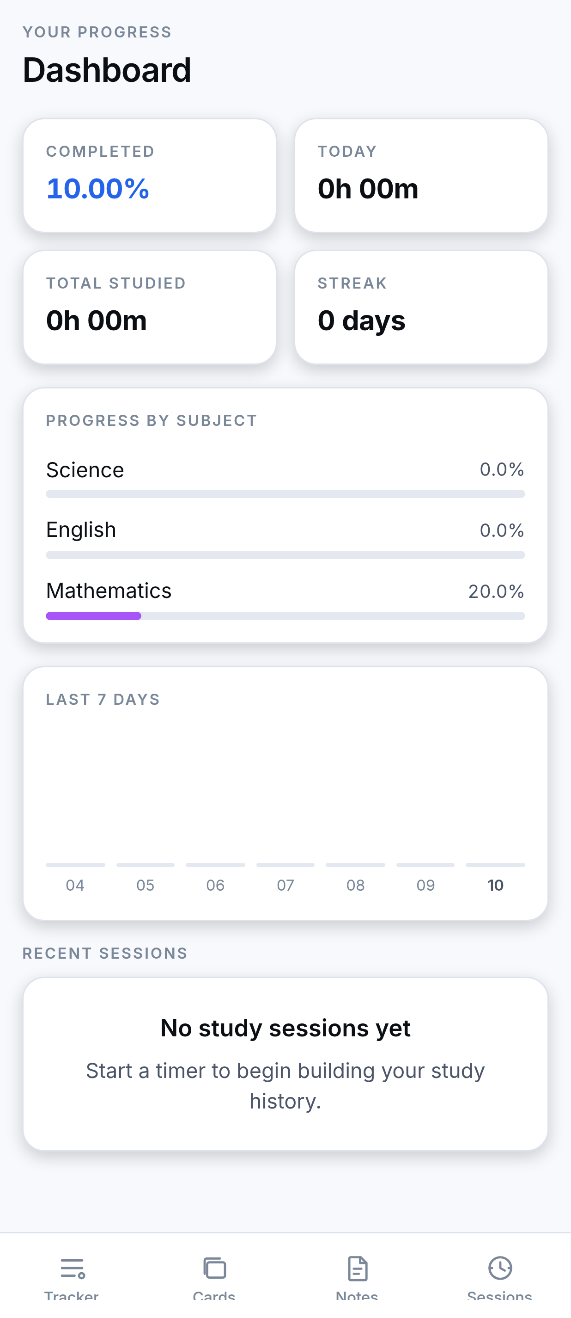
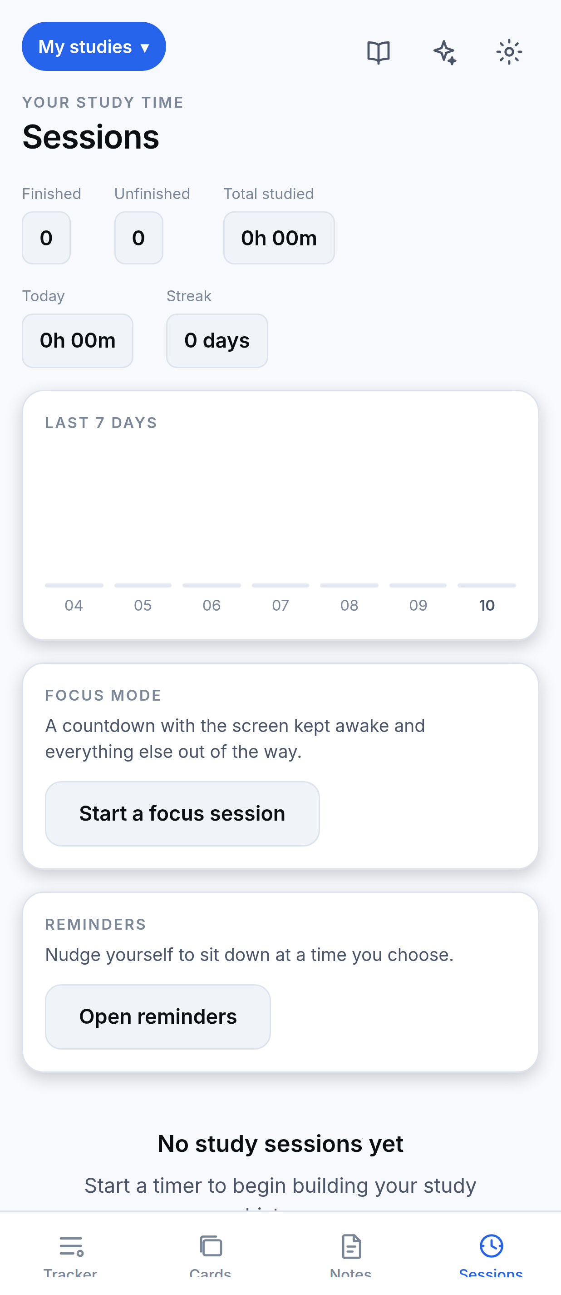
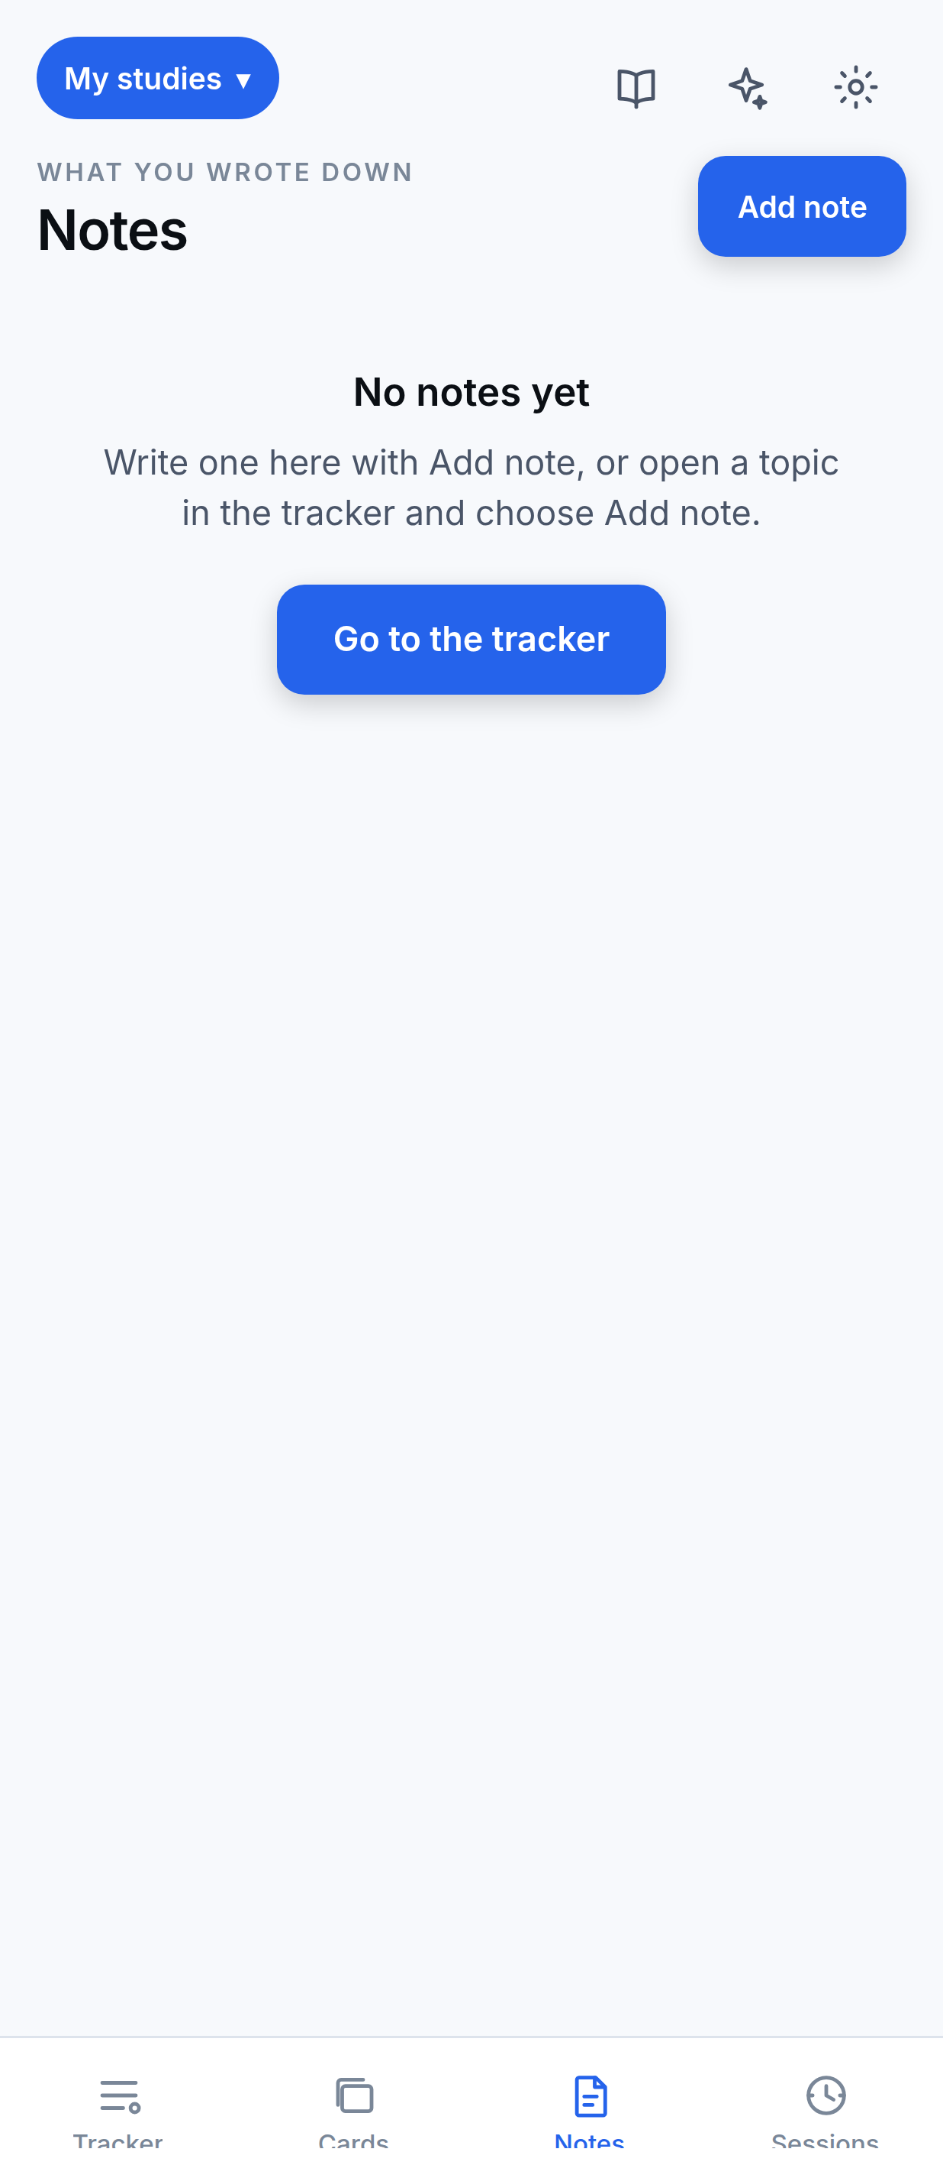
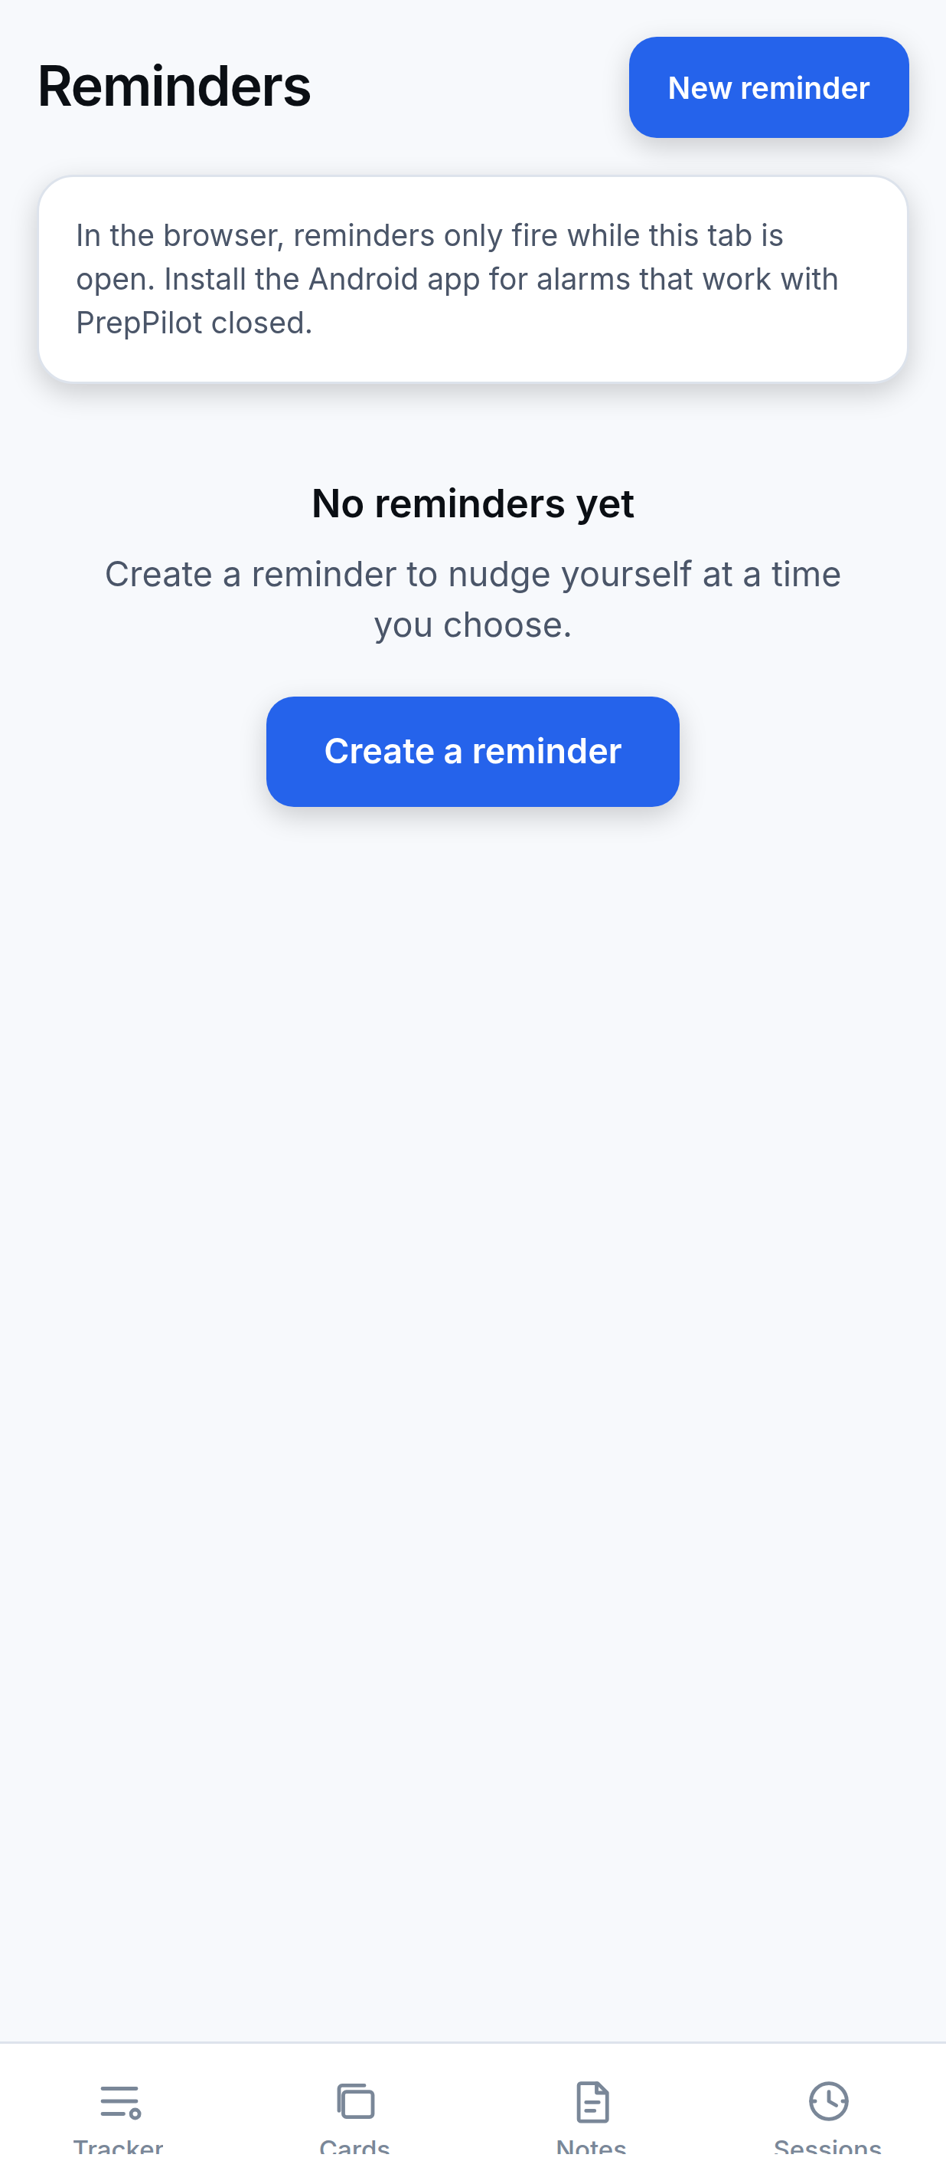
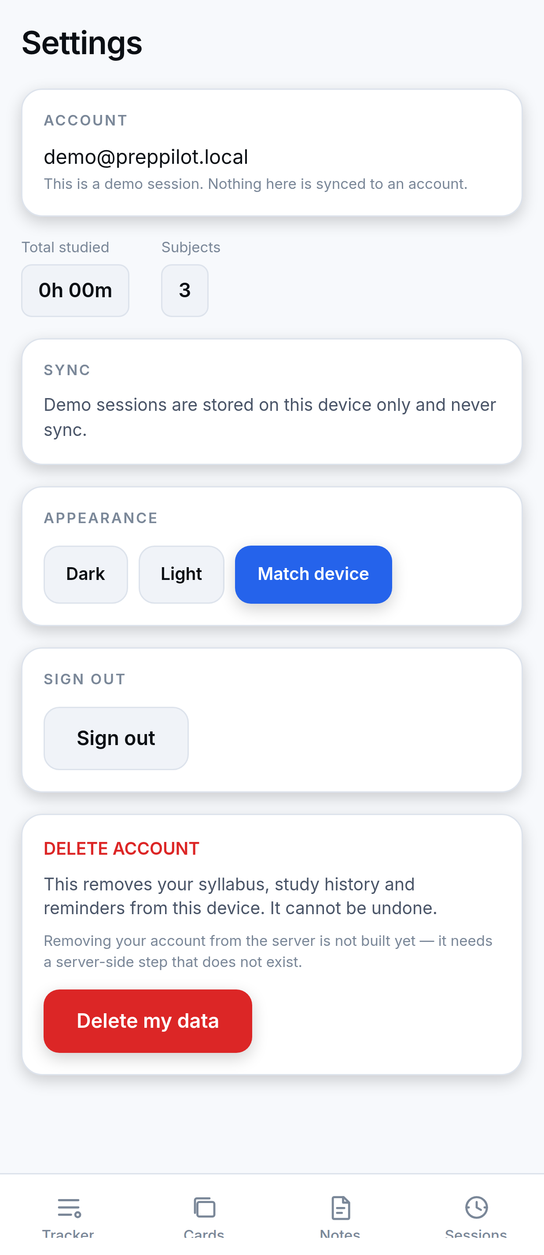
CAPTURED FROM THE RUNNING APPLICATION
Application Screens
Tracker
Dashboard
Sessions
Notes
Reminders
Settings
These are genuine screenshots of PrepPilot running in its browser build, which uses the same code and the same SQLite schema as the Android app. The demo-session banner has been hidden for legibility.
PrepPilot · Vidya University · Dept. of Computer Science & Engineering
24
Notes:
These are real screenshots, not mock-ups. They were captured from the application running in its browser build — which is the same codebase and the same SQLite schema as the Android app, compiled to WebAssembly. We hid the demo-session banner for legibility, and we are noting that openly rather than presenting a cropped image as something it is not.

Slide 25
HOW A STUDENT ACTUALLY USES IT
Methodology and Working Flow
Sign in
email · Google · guest
Set up syllabus
import a template or add manually
Study
tick topics · run a timer · review cards
Write locally
SQLite, syncStatus = pending
Sync when online
pull → merge → push
THE CRITICAL PROPERTY
DEVELOPMENT METHODOLOGY
The local write completes regardless of network state. Synchronisation is a separate, later concern — so no student action ever waits on connectivity.
Incremental and decision-logged: every architectural choice is recorded in DECISIONS.md with its reasoning and alternatives. CI gates every change.
WHAT HAPPENS WHEN THE AI IS ASKED TO CHANGE SOMETHING
Reply parsed
Proposal shown
Student confirms
Applied to syllabus
Progress recomputed
PrepPilot · Vidya University · Dept. of Computer Science & Engineering
25
Notes:
The top row is the everyday flow. The property we want to highlight is in the amber box: the local write completes regardless of network state, so no student action ever waits on connectivity. The bottom row shows the AI path specifically — note that 'student confirms' sits between the proposal and anything being applied, and that progress is recomputed only after the change lands.

Slide 26
STATED PLAINLY, BECAUSE A KNOWN LIMITATION IS A SMALLER PROBLEM
Limitations
Platform restrictions
Implementation gaps
Scope and verification
Focus Mode cannot block other apps — Android forbids it
Flashcards use fixed intervals, not adaptive SM-2
Sign-in is required before first offline use
Do Not Disturb is not toggled — no Expo module exposes it
Reordering is menu-based, not drag-and-drop
The AI is the one feature needing connectivity
Web reminders stop when the browser tab closes
The local database is not encrypted
Device testing is not systematic across Android versions
Weekday reminders need the app opened to re-arm
The AI rate limit is in-memory, not durable
iOS is untested — nothing prevents it, nothing verifies it
Every one of these is documented in docs/developer/LIMITATIONS.md, and the platform restrictions are stated inside the application itself.
PrepPilot · Vidya University · Dept. of Computer Science & Engineering
26
Notes:
We would rather present this slide ourselves than have it discovered in questioning. Three categories. The first are platform restrictions — not things we ran out of time for, but things Android does not permit. The second are genuine implementation gaps we would close with more time; the flashcard scheduler is the most significant. The third is scope: our project targets Android, iOS is untested, and while we have run the app on a real device, we have not tested systematically across Android versions and manufacturer battery policies — which is where notification delivery is most likely to vary.

Slide 27
WHAT WE WOULD BUILD NEXT
Future Scope
NEAR TERM — GROUNDWORK ALREADY IN PLACE
LONGER TERM
Adaptive review scheduling
Local database encryption
Wire the existing, tested SM-2 implementation to the review screen — the required history is already being recorded.
SQLCipher or equivalent, for data at rest.
Drag-and-drop reordering
iOS release
The repositories already support arbitrary reordering; only the gesture layer is missing.
The codebase is cross-platform; verification is the missing work.
Durable AI rate limiting
Systematic device testing
Move the limit into PostgreSQL so it survives instance recycling.
Especially notification delivery under OEM battery optimisation.
Further ahead: collaborative study groups, richer productivity analytics, home-screen widgets, and an expanded template library covering more state boards.
PrepPilot · Vidya University · Dept. of Computer Science & Engineering
27
Notes:
Our near-term work is deliberately unglamorous, because the groundwork is already in place. Adaptive scheduling is the clearest example: the SM-2 implementation exists and is tested, and we already record the ease factors and lapse counts it needs — so switching is a small, safe change rather than a rewrite. Same with drag-and-drop: the data layer supports arbitrary reordering; only the gesture handling is missing.

Slide 28
WHAT PREPPILOT DEMONSTRATES
Conclusion
PrepPilot demonstrates that a student-facing application can be both technically rigorous and honest about its own limits.
Offline-first, genuinely
Measurement that does not flatter
AI safety that is structural
The local database is authoritative — made workable by client-generated ids, tombstone deletion and a server-side watermark, each addressing a specific failure mode.
Topic-weighted rather than averaged, unmeasured rather than zero, and rounded honestly.
The proposal grammar has no verb for destruction, so unsafe operations are not discouraged — they are inexpressible.
AND WHAT IT DECLINES TO CLAIM
Focus Mode does not pretend to block apps it cannot block. Web reminders say they will stop when the tab closes. The flashcard scheduler is described as what it is. A student planning months of preparation around a tool needs that tool to be accurate about itself.
1,799
22
9
2
tests passing
syllabus templates
database tables
platforms from one codebase
PrepPilot · Vidya University · Dept. of Computer Science & Engineering
28
Notes:
To conclude. Three technical contributions: a genuinely offline-first architecture, a progress model that refuses to flatter the user, and an AI integration whose safety is structural rather than advisory. But equally deliberate is what we decline to claim. We think that posture is not modesty for its own sake — a student planning months of preparation around a tool needs that tool to be accurate about itself. Thank you. We are happy to take questions.

Slide 29
Thank You
Questions are welcome
Archit Jain · Vanshika Rajput · Lavi Chaudhary · Jasmine Chaudhary
Guided by Ms. Kareena
Department of Computer Science & Engineering · Vidya University · 12 September 2026
PrepPilot
29
Notes:
Thank you for your time. We are happy to answer questions on any part of the architecture, the progress model, the synchronisation rules, or the limitations we have described.

