Slide 1

Sales Performance & Operational Dashboard Analysis
Strategic Dashboard Insights & Business Recommendations

Slide 2
Company Background
E-commerce business operating in B2B and B2C segments.
Offers multiple product categories across various locations.
Uses different fulfillment and courier partners.
Objective: Improve revenue growth, operational efficiency, and customer satisfaction.

Slide 3
Problem Statement
Understand revenue growth trends over time.
Identify high-performing locations and categories.
Analyze cancellation impact on revenue.
Evaluate fulfillment efficiency (B2B vs B2C).
Improve customer satisfaction and reduce cancellations.

Slide 4
Project Challenges
Data cleaning & date transformation
Building drill-down time hierarchy
No Customer ID for retention insights
KPI modeling & relationship setup

Slide 5
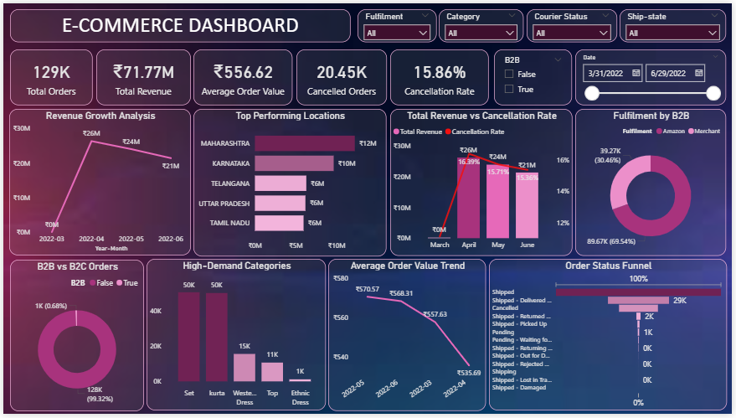
Sales Performance Dashboard Overview

Slide 6
KPI Overview
Total Orders – Measures demand volume.
Total Revenue – Measures financial performance.
AOV – Indicates average transaction size.
Cancelled Orders – Tracks order loss.
Cancellation Rate – Measures service efficiency.

Slide 7
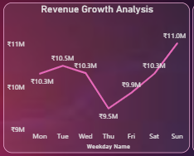
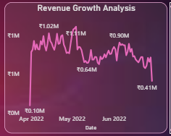
Revenue Growth Analysis
Purpose: Identify seasonal & growth patterns
Insight: Revenue shows periodic fluctuations
Impact: Enables forecasting & inventory planning

Slide 8
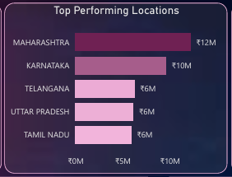
Top Performing Locations
Purpose: Compare regional revenue contribution
Insight: Revenue concentrated in specific states
Impact: Guides regional expansion & targeting

Slide 9
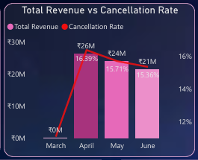
Revenue vs Cancellation Impact
Purpose: Measure revenue leakage
Insight: High cancellation months reduce net revenue
Impact: Operational improvement opportunity

Slide 10
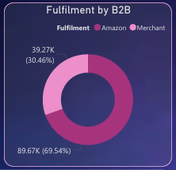
Fulfillment by B2B
Purpose: Understand fulfillment distribution within B2B
Insight: Shows dependency on specific fulfillment methods
Impact: Identifies logistics optimization opportunities

Slide 11
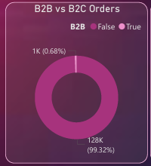
B2B vs B2C Orders
Purpose: Compare order share by business segment
Insight: Identifies dominant revenue driver
Impact: Supports strategic resource allocation

Slide 12
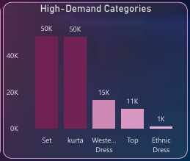
High Demand Categories
Purpose: Identify top-performing categories
Insight: Few categories dominate revenue
Impact: Inventory & procurement optimization

Slide 13
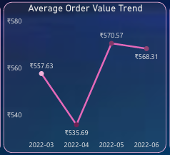
Average Order Value Trend
Purpose: Measure transaction size growth
Insight: AOV trend indicates pricing & bundling effect
Impact: Determines quality of revenue growth

Slide 14
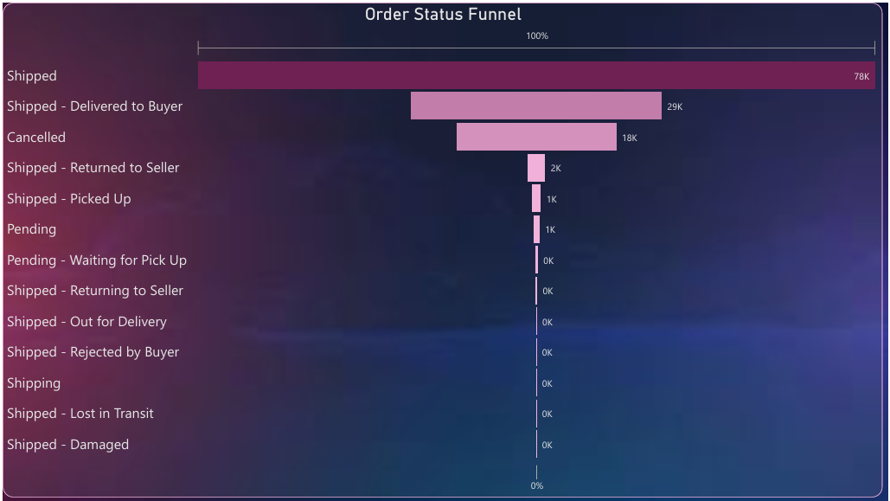
Order Status Funnel
Purpose: Track order lifecycle efficiency
Insight: Drop-offs observed before delivery stage
Impact: Process & logistics improvement area

Slide 15
Interactive Filters Used in Dashboard
Fulfillment
Category
Courier Status
Ship State
B2B Segment
Date

Slide 16
Conclusion
From the revenue growth analysis with month-wise, weekday-wise, and date-wise drill-down, we identified clear seasonal trends and daily buying patterns. Revenue is influenced by specific months and peak weekdays, which can be leveraged for better forecasting and campaign planning.
The top-performing location analysis showed that revenue is concentrated in certain regions, highlighting strong markets as well as opportunities for improvement in underperforming areas.
The Total Revenue vs Cancellation Rate analysis revealed that revenue growth must be evaluated alongside cancellation percentage, as higher cancellations directly impact revenue quality and profitability.
The B2B vs B2C orders segmentation highlighted the company’s dependency on specific customer segments, while the Fulfillment by B2B analysis provided operational insight into distribution and logistics structure.
The high-demand category analysis identified key product drivers contributing most to revenue, supporting better inventory and marketing decisions.
The AOV trend analysis showed changes in customer spending behavior, indicating whether revenue growth is driven by higher order volume or increased basket size.
The order status funnel revealed process-stage drop-offs, helping identify operational inefficiencies that affect order completion.
Finally, KPI indicators and interactive filters allow real-time monitoring and dynamic analysis across fulfillment type, category, courier status, location, segment, and time.
This dashboard transforms raw transactional data into structured, actionable insights that support strategic growth, operational optimization, and data-driven decision-making.
Data becomes powerful when it drives decisions and that’s the purpose of this dashboard.

Slide 17
Recommendations
Reduce cancellations via fulfillment tracking
Invest in high-demand categories
Expand focus in top-performing regions
Improve AOV through bundling & upselling
Enhance logistics monitoring

Slide 18
Thank You
Thank you for your time and attention.
For further discussion, please connect with me:
📧 Email: archissave5112@gmail.com
💻 GitHub: https://github.com/Archis-Save
🔗 LinkedIn: linkedin.com/in/archis-save

