Slide 1
SQL & Python Business Analytics Project
SQL & Python Data Analytics Project
Insights & Visual Analysis

Slide 2
Project Objective
Solve 15 business problems
Execute queries in SQL
Solve same problems in Python
Validate that outputs are identical
Demonstrate technical accuracy & analytical consistency

Slide 3
BASIC PROBLEMS

Slide 4

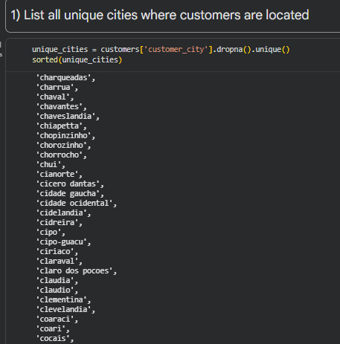
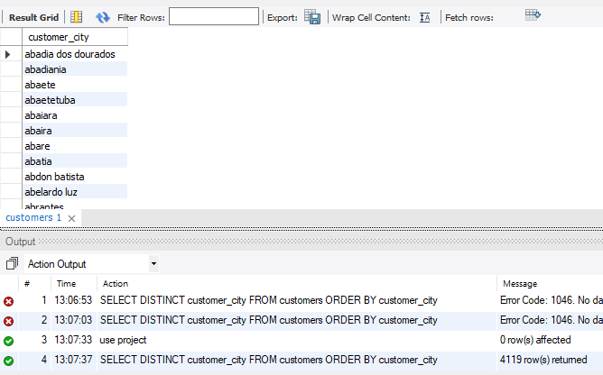

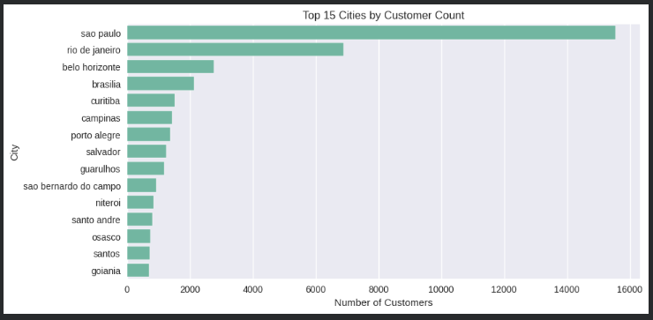
1) List all unique cities where customers are located
SQL Code:
Python Code:

Slide 5
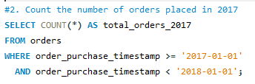
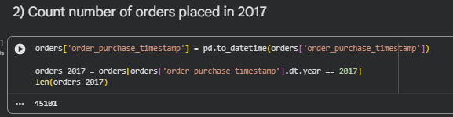
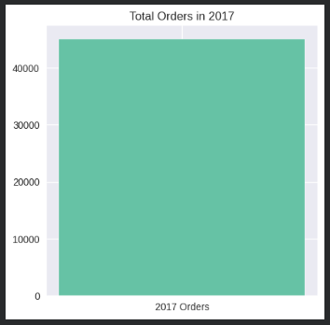

2) Count the number of orders placed in 2017
SQL Code:
Python Code:

Slide 6
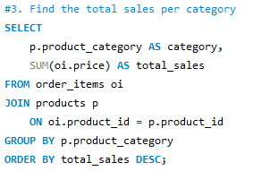
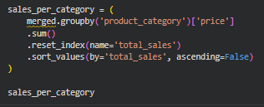
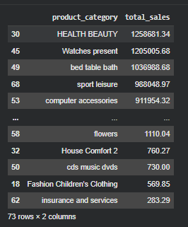
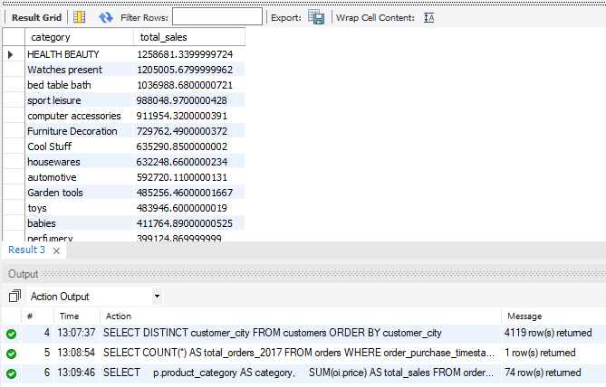
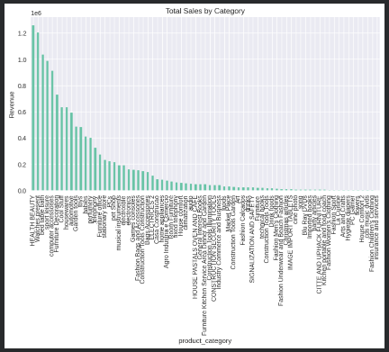
3) Find the total sales per category
SQL Code:
Python Code:

Slide 7
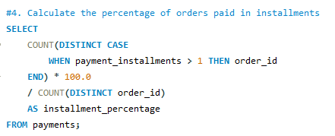
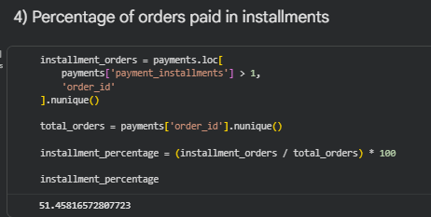
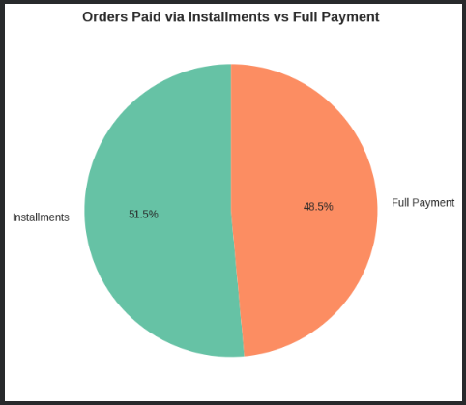

4) Calculate the percentage of orders paid in installments
SQL Code:
Python Code:

Slide 8
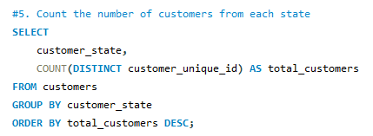
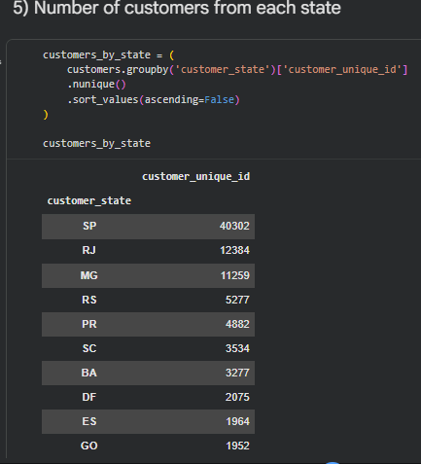
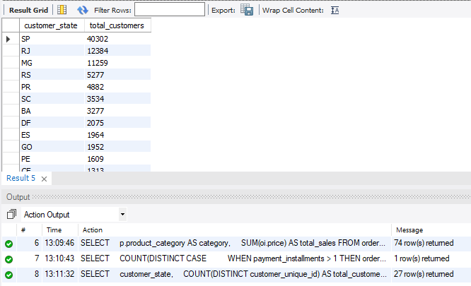

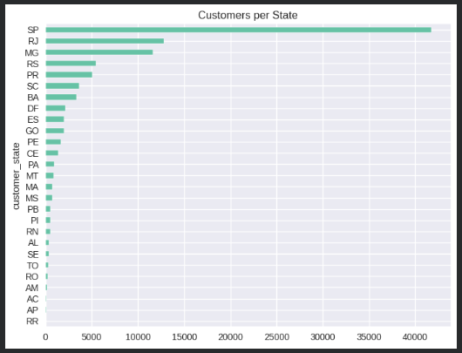
5) Count the number of customers from each state
SQL Code:
Python Code:

Slide 9
INTERMEDIATE PROBLEMS

Slide 10
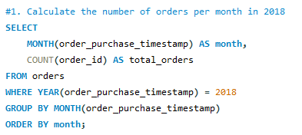
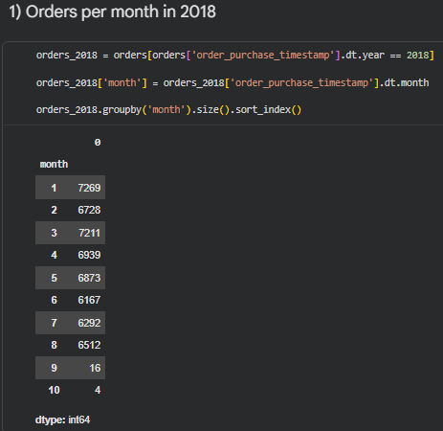
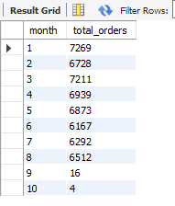
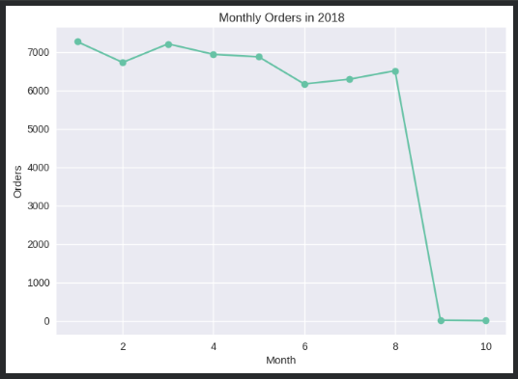
1) Calculate the number of orders per month in 2018
SQL Code:
Python Code:

Slide 11
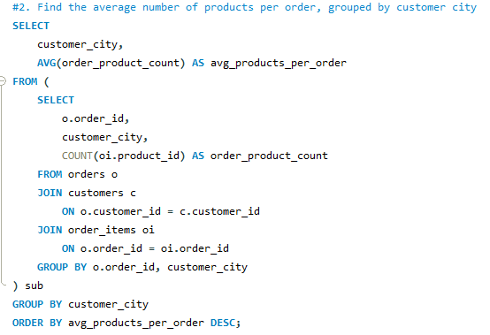
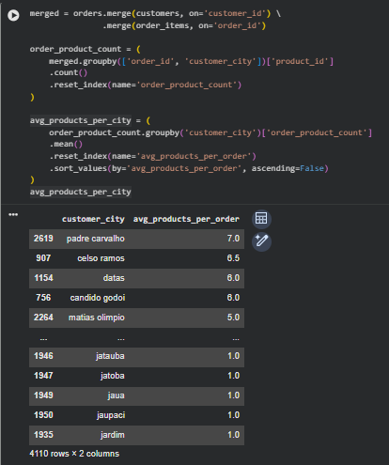
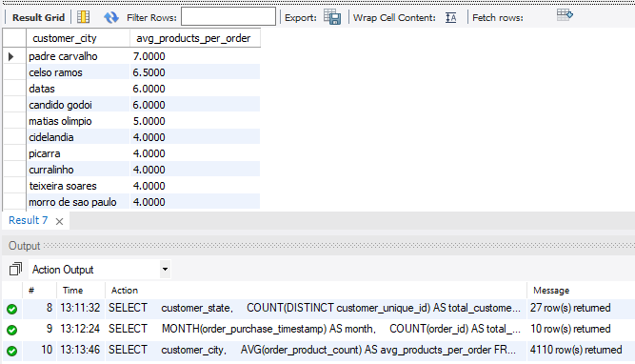
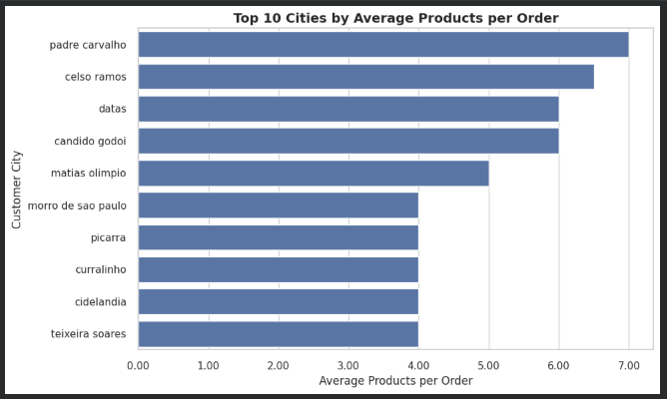
2) Find the average number of products per order, grouped by customer city
SQL Code:
Python Code:

Slide 12
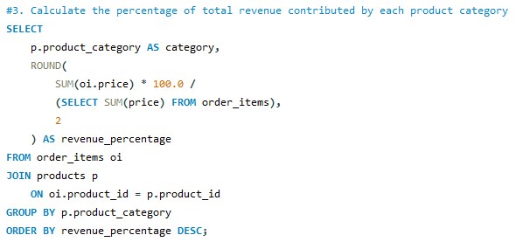
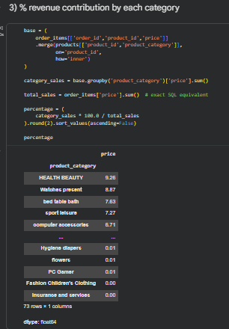
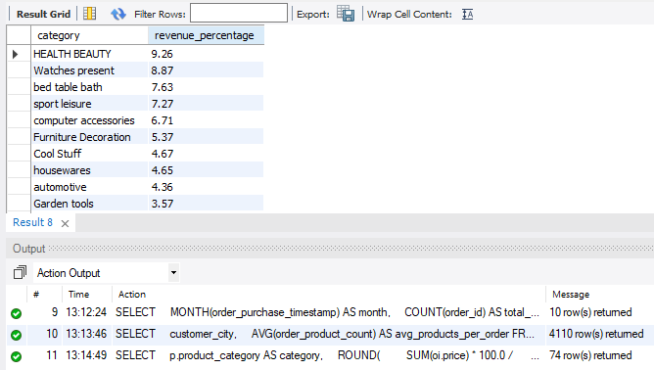
3) Calculate the percentage of total revenue contributed by each product category
SQL Code:
Python Code:

Slide 13
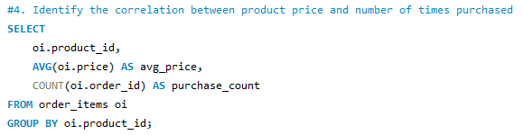
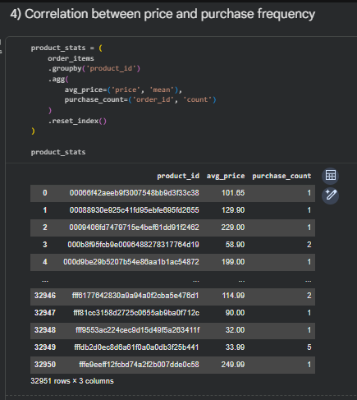
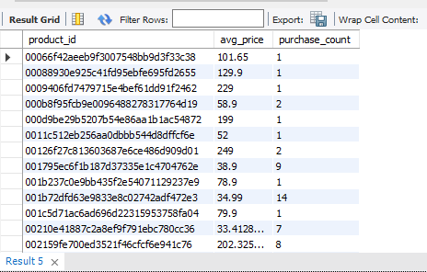
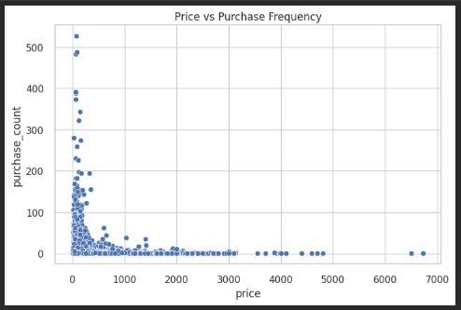
4) Identify the correlation between product price and number of times purchased
SQL Code:
Python Code:

Slide 14
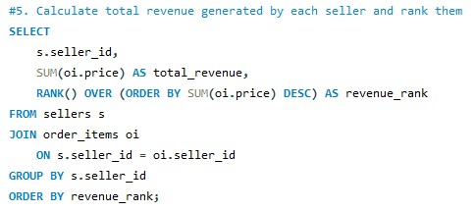
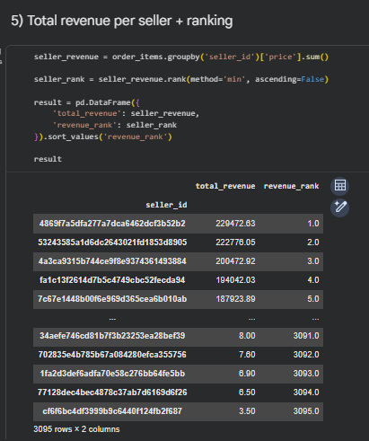
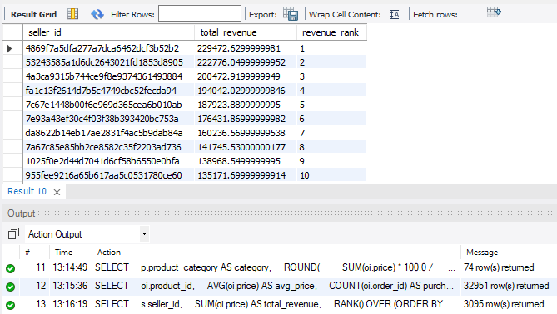
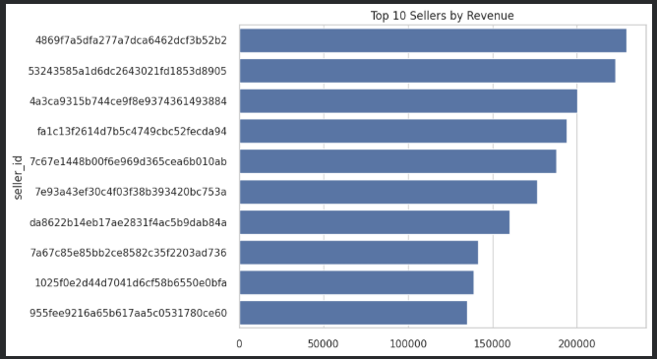
5) Calculate total revenue generated by each seller and rank them
SQL Code:
Python Code:

Slide 15
ADVANCE PROBLEMS

Slide 16
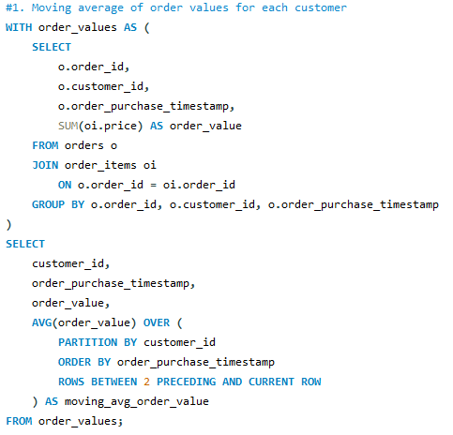
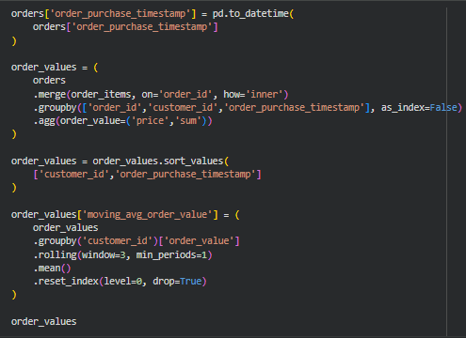
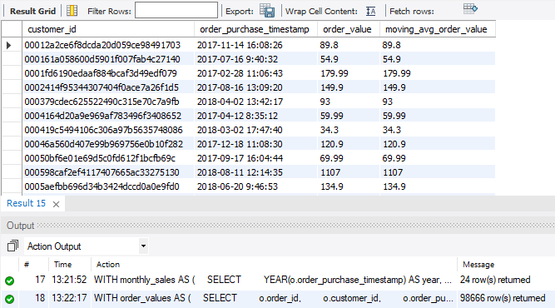
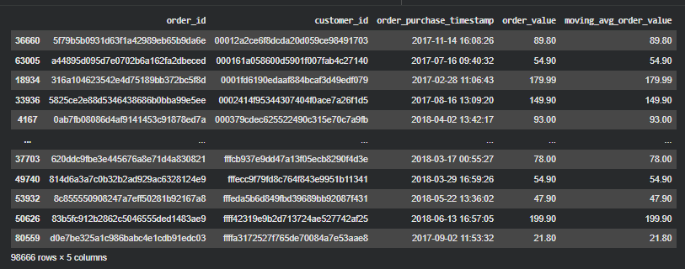
1) Moving average of order values for each customer
SQL Code:
Python Code:

Slide 17
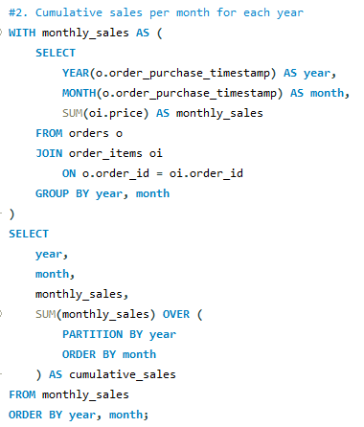
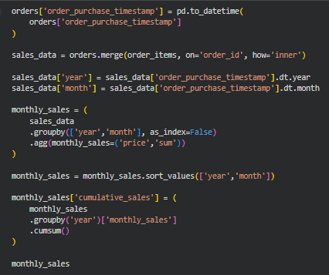
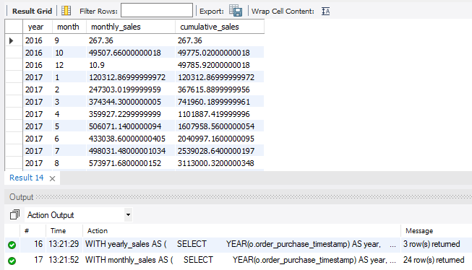
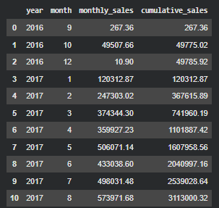
2) Cumulative sales per month for each year
SQL Code:
Python Code:

Slide 18
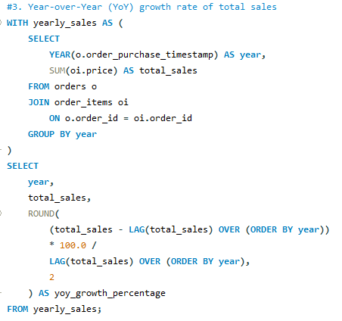
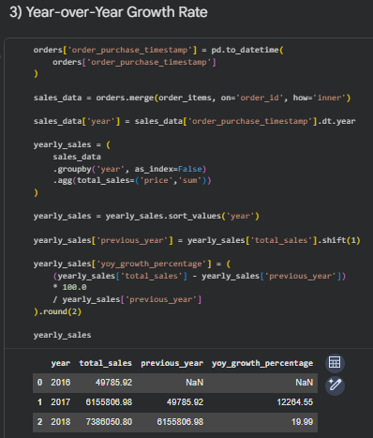
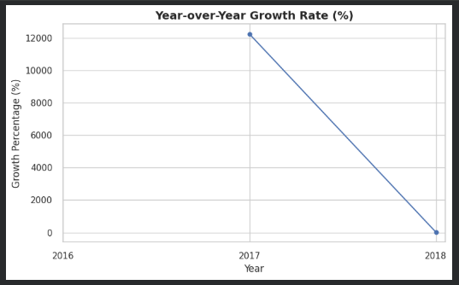
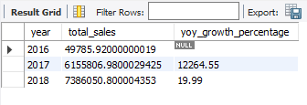
3) Year-over-Year (YoY) growth rate of total sales
SQL Code:
Python Code:

Slide 19
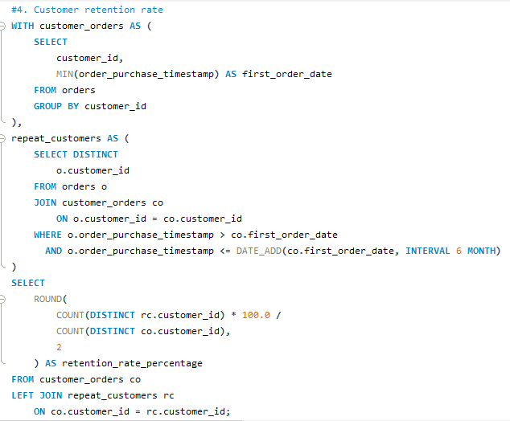



4) Customer retention rate
SQL Code:
Python Code:

Slide 20




5) Top 3 customers by spending in each year
SQL Code:
Python Code:

Slide 21
Conclusion
This project demonstrates full-stack analytical capability by combining SQL, Python, window functions, and validation methodology to transform raw transactional data into strategic business insights.
Consistent cross-validation between SQL and Python ensures analytical accuracy and production-level reliability.

