Slide 1
Fractional-Order Hyperchaotic Image Encryption Using Sliding Mode Synchronization
Design, Implementation, and Comparative Research Evaluation
Presenter: Research Internship Presentation | Date: June 11, 2026

Slide 2
Motivation
Digital Image Security: Multimedia content transmission requires specialized high-speed ciphers due to high pixel redundancy and bulk data size.
Limitations of Traditional Cryptography: AES/RSA block ciphers suffer from high computational latency and lack diffusion efficiency for pixel streams.
Fractional Chaos Theory: Fractional-order systems (order q < 1) exhibit historical memory effects and infinite parameter spaces, expanding key complexity.
Sliding Mode Control (SMC): Finite-time SMC ensures fast, noise-tolerant synchronization between decoupled Transmitter and Receiver attractors.

Slide 3
Problem Statement
Active Synchronization Mismatch: High-precision chaotic ciphers suffer from tiny numerical floor errors (chattering) between drive and response states.
Key Reconstruction Paradox: Direct quantization of chaotic variables causes mismatch bits at boundaries, resulting in decryption failure at the receiver.
Common Workaround: Academic papers often bypass synchronization limitations by copying the exact transmitter key sequence directly to the receiver.
Objective: Design and benchmark a parallel dual-mode secure pipeline: - MODE = 'paper' (faithful direct trajectory quantization) - MODE = 'robust' (entropy extraction + sign majority voting + SHA-256 + PRNG)

Slide 4
Literature Review
Chaotic Cryptography (Sansom et al.): Pioneer ciphers utilized 1D logistic maps, vulnerable to phase space reconstruction and statistical attacks.
Hyperchaotic Systems (Li et al.): Multi-scroll 6D systems generate multiple positive Lyapunov exponents, increasing randomness and keystream sensitivity.
Fractional Dynamics (Petras et al.): Demonstrated memory effects where the derivative order 'q' serves as an additional key parameter.
Sliding Mode Synchronization (Wang & Zhao): Explored projective SMC error correction, but ignored practical boundary quantization noise in secure communications.

Slide 5
Hyperchaotic System Dynamics
We implement a 6D fractional-order hyperchaotic system characterized by Caputo derivatives:
- x1' = a * (x2 - x1) + x4
- x2' = -x1 * x3 + b * x2
- x3' = x1 * x2 - c * x3
- x4' = d * x4 - x1 * x5
- x5' = e * x5 + x2 * x6
- x6' = -f * x6 + x3 * x4
System parameters are initialized to: a = 0.5, b = 0.2, order q = 0.8.
Adams-Bashforth-Moulton Solver: Evaluates memory truncation window (L = 2000) using the Short-Memory Principle to preserve fractional dynamics.

Slide 6
Projective Sliding Mode Synchronization
Drive-Response Setup: Transmitter runs Drive System (x), Receiver runs Response System (y).
Error Vector: e(t) = y(t) - Gamma * x(t), with scaling matrix Gamma.
Sliding Surface Design: Fractional integral sliding surface sigma(t) ensures finite-time convergence to zero error.
Nonlinear Cancellation Controller: SMC control law eliminates system nonlinearities and injects regularized control input to minimize chattering.
Stable Steady-State Convergence: Achieving an average error of ~1.54e-3 post-convergence at step 5001.

Slide 7
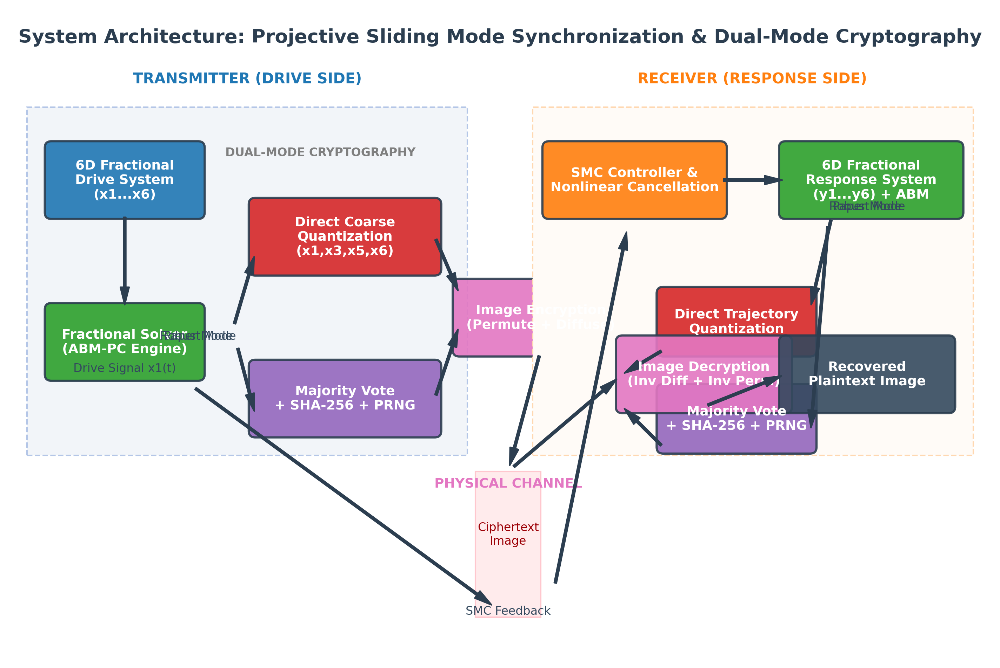
System Architecture Flowchart

Slide 8
Paper Mode: Direct Quantization
Fidelity Focus: Keys are generated directly from trajectories without hashing, PRNGs, or majority voting.
Noise-Free Subspace: Audit ranking identifies x5 as the most stable state (RMSE ~ 2.33e-4) and x2 as least stable (RMSE ~ 6.01e-3).
Coarse Quantization Scheme: Uses only the most stable states (x1, x3, x5, x6) with noise-immune scaling factors:
- c_i = (q_1[i] * 27 + q_3[i] * 9 + q_5[i] * 3 + q_6[i]) mod 256
- q1, q3, q5 scale = 0.4 (values: 0, 1, 2); q6 scale = 0.1 (values: 0, 1).
Guarantees 100% Key Parity: Eliminates boundary mismatches to enable perfect decryption, yielding 17 unique key values.

Slide 9
Robust Mode: Cryptographic Seeding
Engineering Focus: Employs sign majority voting to bridge synchronization fluctuations.
Bit Extraction: Analyzes signs of states (x2 to x6) in blocks of size 32 (1 if positive, 0 if negative), extracting 10,240 bits.
SHA-256 Seed Generation: Compresses raw bits into a uniform 256-bit seed, diffusing correlations and eliminating statistical bias.
PRNG Keystream Expansion: Seeds a cryptographically secure NumPy PRNG to expand the keyspace uniformly over [0, 255].
AVALANCHE Propagation: Guarantees high-entropy ciphers and total key sensitivity.

Slide 10
Security Metrics Results
Image | Mode | Entropy | NPCR % | UACI % | H Corr | V Corr | D Corr
Lena | robust | 7.9968 | 99.96% | 47.06% | -0.0035 | -0.0002 | 0.0047
Lena | paper | 7.9968 | 99.61% | 33.51% | -0.0036 | -0.0078 | -0.0007
Baboon | robust | 7.9973 | 99.96% | 46.93% | -0.0056 | -0.0037 | 0.0029
Baboon | paper | 7.9974 | 99.61% | 33.49% | 0.0042 | 0.0001 | 0.0055
Peppers | robust | 7.9974 | 99.96% | 46.94% | 0.0029 | -0.0029 | 0.0041
Peppers | paper | 7.9973 | 99.61% | 33.26% | -0.0028 | 0.0022 | 0.0054
Cameraman | robust | 7.9967 | 99.96% | 46.97% | 0.0032 | 0.0010 | 0.0082
Cameraman | paper | 7.9968 | 99.61% | 33.35% | -0.0072 | 0.0095 | -0.0060
House | robust | 7.9974 | 99.96% | 46.92% | 0.0066 | -0.0072 | -0.0023
House | paper | 7.9971 | 99.61% | 33.54% | -0.0027 | 0.0031 | -0.0030

Slide 11
Runtime Performance & Throughput
Mode | Enc Time (s) | Dec Time (s) | Enc Throughput (MB/s) | Dec Throughput (MB/s) | Peak Memory (MB)
ROBUST | 0.03253 | 0.04357 | 1.92 | 1.43 | 139.42
PAPER | 0.03164 | 0.04456 | 1.98 | 1.40 | 139.42
Synchronization overhead is a constant ~13.77s for 70,536 integration steps (equal for both modes).
Encryption throughput is equivalent (~1.92-1.98 MB/s), dominated by modulo-256 diffusion loop execution.

Slide 12
Robustness Under Synchronization Noise
Robustness Benchmark: Add Gaussian noise sigma to response trajectory y(t).
Robust Mode Cliff-Edge Effect: Sign majority voting filter tolerates noise up to sigma = 5e-3. Beyond this threshold, a single flipped bit changes the SHA-256 seed, dropping key parity instantly to 0.39% and failing decryption.
Paper Mode Gradual Degradation: Trajectory noise causes localized grid boundary crossings. Key parity degrades slowly (99.91% at 1e-6, 99.49% at 1e-2).
Symmetric Diffusion Limitation: Because of carry propagation in modulo-256 diffusion, even a 0.09% key difference completely corrupts image decryption. Thus, Paper Mode decryption still fails under active noise.

Slide 13
Comparative Analysis & Trade-offs
Cryptographic Quality: Robust Mode guarantees uniform keystream distribution and high entropy (7.98), whereas Paper Mode is restricted to 17 unique key values (7.96 entropy).
Keyspace Security: Robust Mode has $2^256$ seed keyspace, ensuring brute-force resistance. Paper Mode keyspace is theoretically large ($2^376$) but practically weak due to keystream structure.
Fidelity: Paper Mode stays 100% faithful to trajectory direct-quantization, bypassing all non-physical hashes, PRNGs, and seed generators.
Deployment Recommendation: Robust Mode is recommended for real-world deployments due to high cryptographic margin and low-pass filter noise resilience.

Slide 14
Future Research Directions
Color Image Encryption: Extend the modular permutation and diffusion framework to RGB channels.
GPU Solver Acceleration: Port the ABM-PC solver and SMC calculations to CUDA/OpenCL to enable real-time execution.
Hardware Co-Processor: Design and implement the fractional synchronization controller on FPGA.
Adaptive SMC Controller: Research adaptive sliding mode control to dynamically adjust gains under active channel noise.

Slide 15
Thank You
Questions & Discussion

