Slide 1
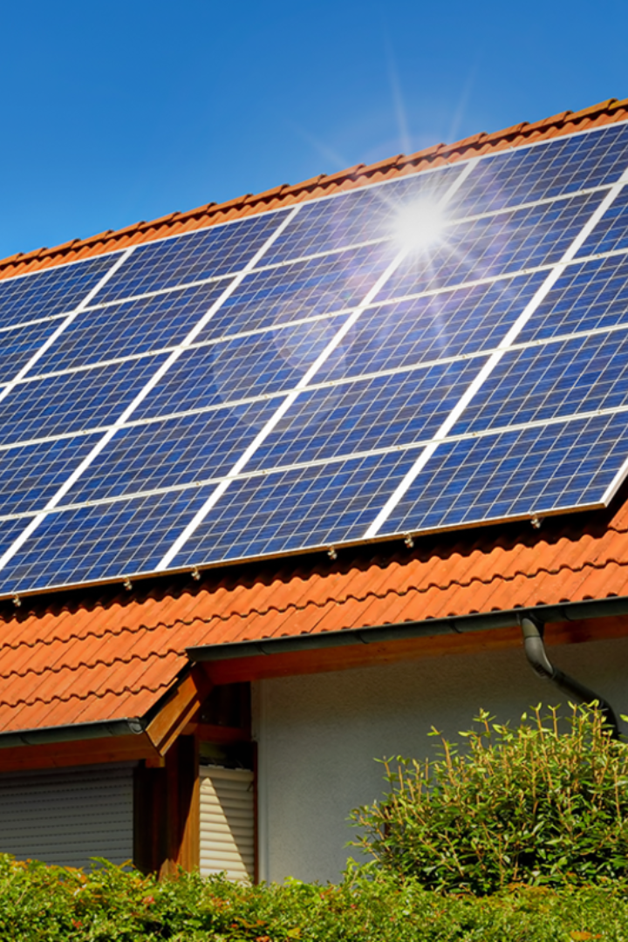
Footprint Friend: An WebApp to Save the World
Carbon footprint reduction begins with individual actions. This app is designed to help you track and minimize your carbon footprint, making a positive impact on the environment.
-Presented by OCTAGRAM

Slide 2
The Importance of Reducing Your Carbon Footprint:
Protecting the Environment
Saving Money
Mitigating Health Risks
The reduction of carbon emissions has a direct impact on the environment, slowing down climate change and preserving the environment.
Improving air and water quality and reducing waste decreases health risks from pollution-related diseases.
Reducing your carbon footprint also means saving money by being more conscious of how you use energy.

Slide 3

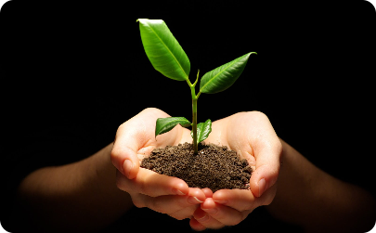
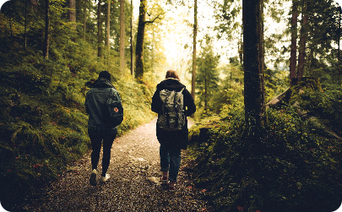
How Our Website will work?
Track Carbon Footprint
Set Goals and Get Tips
Join a Community
Easily track your carbon footprint using our web-app.
Set individual carbon-cutting goals and receive tips/advice on how to achieve them.
Join a community of like-minded people and share ideas on how to reduce your carbon footprint together.

Slide 4
What’s our recipe?
1
Design/wireframe
Figma, Adobe Photoshop, draw.io.
Frontend Engineering
2
We will be using React for our web-based app along with HTML,CSS,Javascript.
3
AI/ML
Carbon footprint data will be analyzed and reported using Python, NumPy, Pandas, LLM(DaVinci AI),ScikitLearn, MatPlotLib, PyTorch.
Backend Engineering
4
Our backend will be built on Node.js , Flask and will use a RESTful API to communicate between front and backend. We will use AWS (Lambda, DynamoDB) for Cloud and DBMS purpose.
5
Version Control System
For maintenance and smooth handling we will be using GitHub as our VCS.

Slide 5
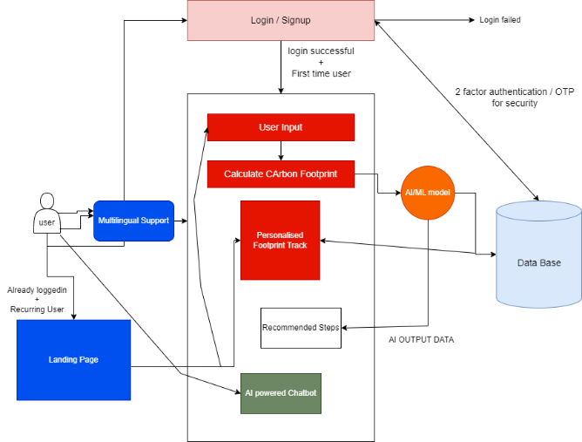
Our Game-Plan:
At first we will design the wireframe then will design the frontend using react. There will be several python script files responsible for the major operations within the website. Our main database will be DynamoDB, AWS and several API actions will be called/triggered with the help of GCP services. For smooth development process and VCS GitHub will be preferred. The chatbot will be completely trained on carbon emission and footprint knowledge.

Slide 6
Team Members
Archismwan Chatterjee
Krishnava Ghosh
Ankit Das
Eshan Das

Slide 7
Conclusion
The Time is Now
Take Responsibility
Join Our Movement
Human-caused climate change is real, and the situation is dire. Everyone must take concrete steps to reduce their carbon footprint today if we are to prevent the worst effects of climate change from becoming a reality.
We all have a responsibility to take action. By using our app, you will be contributing to a healthier planet and a better future for generations to come.
Download our app and start reducing your carbon footprint today! Join our movement to create a healthier planet that we can all be proud of.

