Slide 1

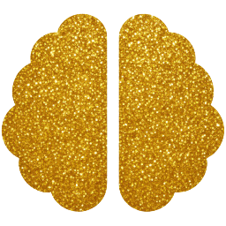
Brain Emotion Perception Inspired EEG Emotion Recognition With Deep Reinforcement Learning
via Papez-Circuit-Inspired FLD3QN + HARL
with Multi-Level Domain Adaptation — DEAP & SEED-IV
· Shashank Maurya · Divya Jaisansaria · Archit Savaliya ·
Department of Artificial Intelligence, SVNIT Surat — 395007, Gujarat, India
DEAP Dataset
SEED-IV Dataset
LOSO Eval
Deep RL + HARL
Notes:
1

Slide 2

Why Current EEG Models Fail in the Real World
Mental Health
Monitoring
Adaptive
Learning
Autonomous
Vehicle Safety
Continuous affective BCI
needs zero calibration
Real-time emotion feedback
across all students
Driver drowsiness detection
for every individual
THE PROBLEM: Subject-Dependent Models Require 20–30 min Per-User Calibration — Impractical for Real BCI Deployment
>30%
20-30
2
Accuracy drop
without calibration
Minutes of
labeling per user
Datasets tested:
DEAP + SEED-IV
Notes:
2

Slide 3
The Core Challenge: Inter-Subject Covariance Shift
SUBJECT A
SUBJECT B
3 Root Causes
Neuroanatomical
Diversity
P(X) ≠ P(X')
BUT
Affective Style
Heterogeneity
P(Y|X) ≈ P(Y|X')
EEG Non-
Stationarity
EEG Space: Region A
EEG Space: Region B
Notes:
3

Slide 4
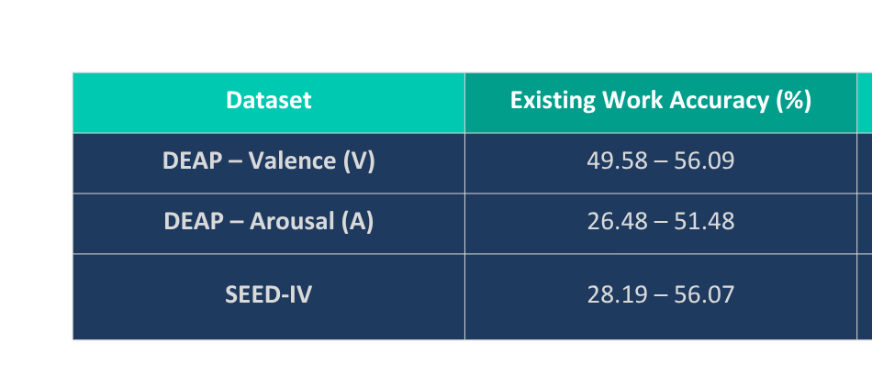
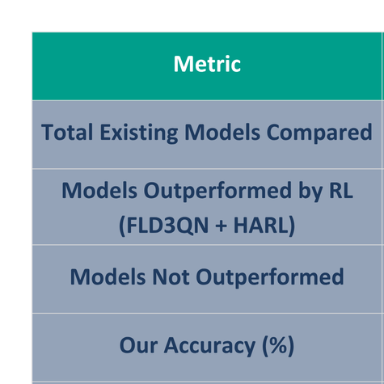
Where Existing Work Falls Short
Subject-Dep. Ceiling: ~86%
~30 pp GAP
Our LOSO Floors: ~56% (DEAP) / ~36% (SEED-IV 4-class)
Our work establishes the first open-source dual-dataset LOSO baseline — practical zero-calibration deployment floors.
Notes:
4

Slide 5
Our Key Innovation: Three-Level Domain Alignment
LEVEL 1
LEVEL 2
LEVEL 3
Euclidean
Alignment
CORAL
Loss
DANN
+ GRL
RAW
EEG
Signal Level
Feature Level
Representation Level
HARL
+
PPO
X̃ = R⁻¹/² X
‖Cs−Ct‖²F / 4d²
min θ max φ
32 ch / 62 ch
128–200 Hz
Whitens covariance
to identity matrix
Aligns 2nd-order
feature covariance
Adversarial training
makes features
subject-invariant
SEED-IV
only
Reduces 1st-order shift
Reduces 2nd-order shift
Eliminates identity signals
Notes:
5

Slide 6
Architecture: Papez-Circuit Inspired BiFRCNN + D3QN
ELECTRODE PARTITIONING
BiFRCNN BACKBONE
TASK HEADS
Left Hemisphere
Flf = [Fl ; Ffl]
DEAP: Dual D3QN
13 ch (DEAP) / left topographic (SEED-IV)
Left fusion
Valence head
Arousal head
Right Hemisphere
Frf = [Fr ; Ffr]
13 ch (DEAP) / right topographic (SEED-IV)
Right fusion
Left Frontal
Flr = [Flf ; Frf]
SEED-IV: HARL-EEG
6 ch (AF3, F3, F7…)
Full merge
PPO actor π_ψ
Per-sample weights w
4-class D3QN head
Right Frontal
FC (256) + Dropout
6 ch (AF4, F4, F8…)
Shared head
+ SE Attention: Squeeze → Excite → Recalibrate (r = 4)
DE Features: 5 bands × 32/62 ch
Reward: +1 / −1 − λt
(Dopamine analog)
Notes:
6

Slide 7
NEW: HARL-EEG — Hierarchical Adaptive Reinforcement Learning
WHY HARL?
PPO POLICY FLOW
KEY PARAMS
SEED-IV has 3 sessions
1
Domain Gap Estimator
Calib. fraction:
Cosine dist between
source batch & target centroid g
10% unlabelled
target data
→ additional within-subject non-stationarity beyond DEAP
PPO clip:
2
PPO Actor π_ψ(w | g)
ε = 0.2
Static λ is insufficient
λ_RL:
Outputs per-sample weights
w ∈ [0,1]^B
0.05
→ fixed DANN/CORAL weights underalign hard batches
λ_CORAL:
3
Dynamic λ Scaling
0.05 (dynamic)
Domain gap varies per batch
λ*_dann = λ_dann(1 + w̄)
λ*_coral = λ_coral(1 + w̄)
λ_DANN:
0.1 (dynamic)
→ need dynamic modulation of alignment strength
4
Reward Signal
Training:
Result: comparable std across subjects
(5.18% SEED-IV ≈ 5.11% DEAP valence) [Sec. 5.6.3]
r = −CE_loss + 0.2(1−g)
entropy bonus prevents collapse
60 epochs
(RL from epoch 5)
Notes:
7

Slide 8
Experimental Setup: DEAP + SEED-IV Dual-Dataset Evaluation
DEAP DATASET [2]
SEED-IV DATASET [13] — NEW
32
subjects (16M/16F)
15
subjects × 3 sessions each
128 Hz
EEG · 32 channels
200 Hz
EEG · 62 channels
2,400
samples/subject (1 s windows)
2,505
windows/subject (pre-computed DE)
Binary
Valence / Arousal (threshold = 5)
4-Class
Neutral / Sad / Fear / Happy
LOSO
30 subjects (S03, S21 excluded)
25%
Chance level (4-class uniform)
😐 Neutral
😢 Sad
😨 Fear
😊 Happy
Notes:
8

Slide 9
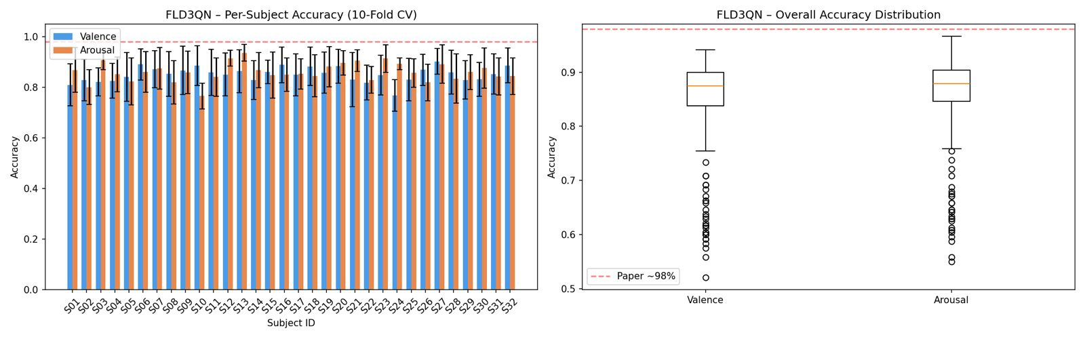
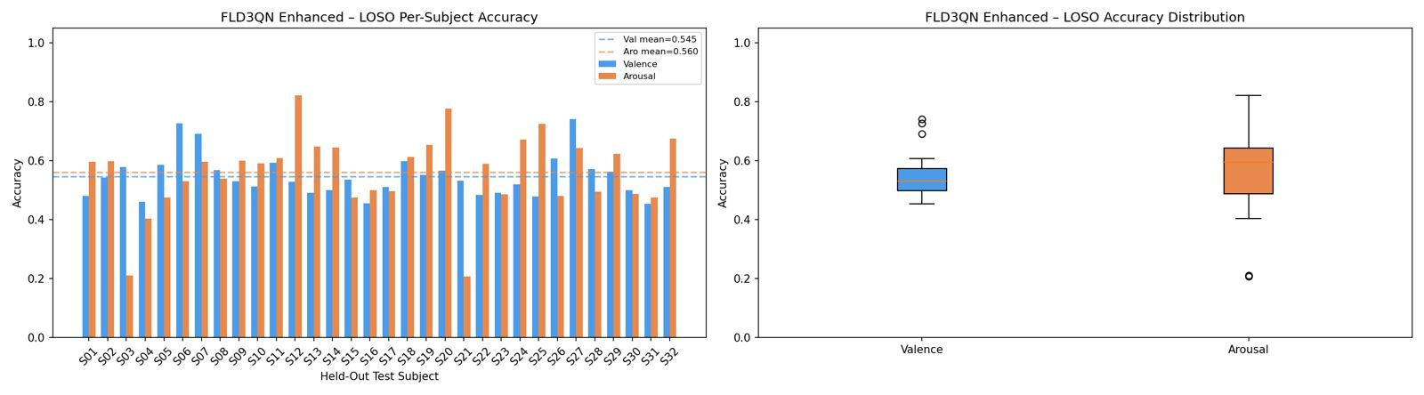
DEAP Results: Phase 1 (Subject-Dependent) & Phase 2 Baseline
PHASE 1 — Subject-Dependent (10-Fold CV)
PHASE 2 — Basic LOSO (32 subjects, no alignment)
~88%/88%
~98%
54.5%
56.0%
Phase 1 mean
(Val / Aro)
Paper benchmark
[1]
Naive LOSO
valence
Naive LOSO
arousal
Notes:
9

Slide 10
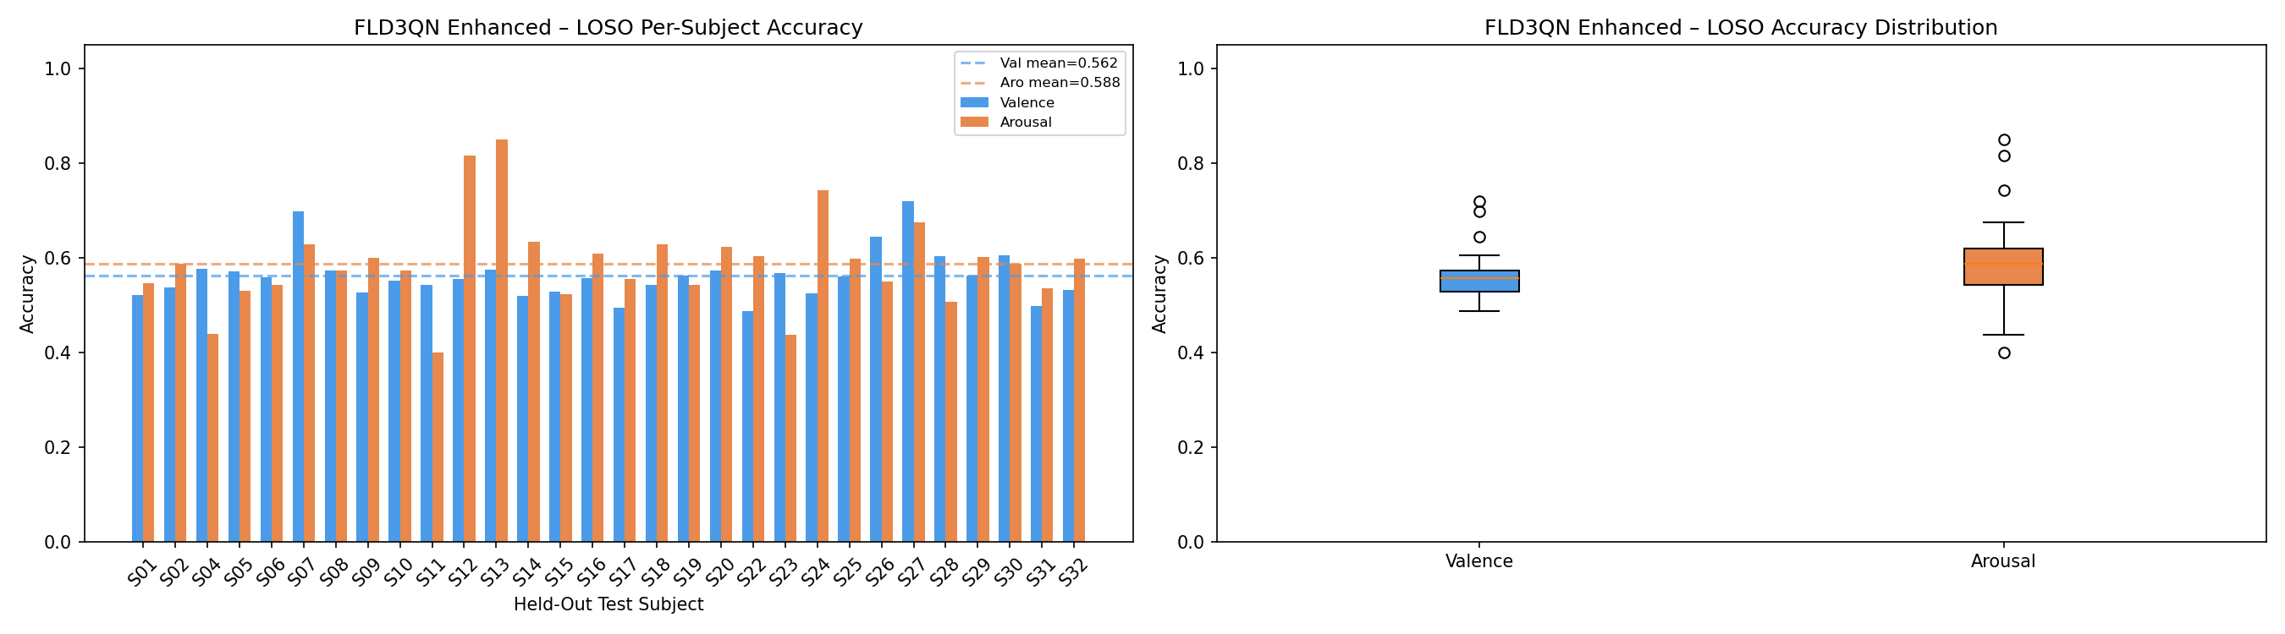
DEAP Enhanced Results: Full Domain Adaptation Pipeline
PHASE 2 IMPROVED — Enhanced LOSO (30 subjects)
56.22%
Mean Valence
(σ = 5.11%)
+1.70 pp
58.78%
Mean Arousal
(σ = 9.42%)
+2.75 pp
5.1% / 9.4%
Reduced Std Dev
(was 7.0% / 13.0%)
↓ variance
Notable performers: S27 (71.96%/67.54%), S13 (57.46%/85.00%) · Near-chance: S17, S31 [Table 2]
Notes:
10

Slide 11
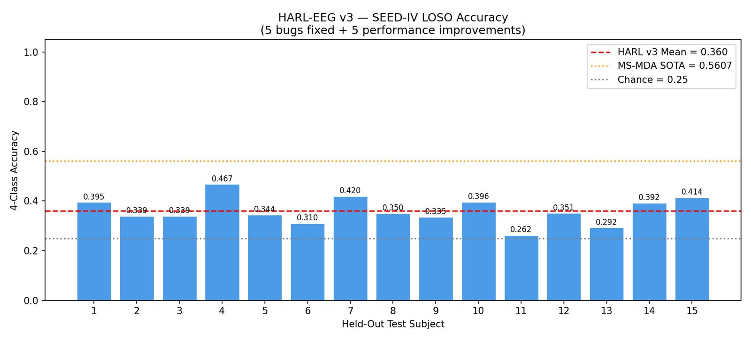
SEED-IV Results: HARL-EEG v3 — 4-Class Emotion Recognition
PHASE 3 — HARL-EEG v3 SEED-IV LOSO (15 subjects, 4-class)
36.03%
Mean Accuracy
(σ = 5.18%)
+11.03 pp
Above 4-class
chance (25%)
15/15
Subjects above
chance level
46.74%
Near-chance: S11 (26.16%), S13 (29.22%) · High performers: S04 (46.74%), S07 (41.95%) [Table 3]
Best subject S04
(max accuracy)
Notes:
11

Slide 12
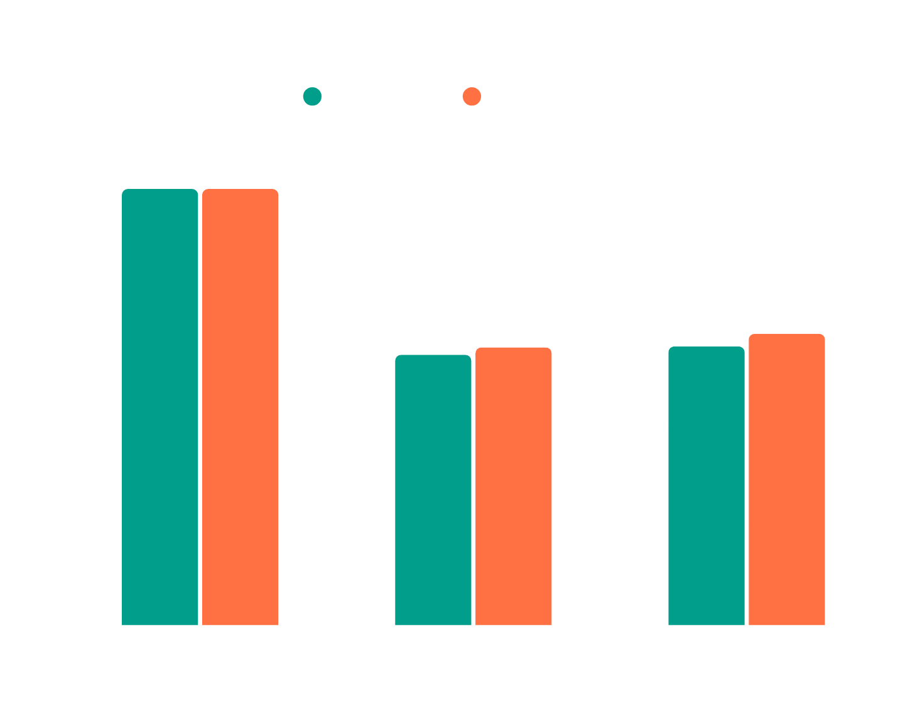
DEAP Accuracy: Across Three Phases
+1.70 pp
Valence improvement
(Baseline → Enhanced)
+2.75 pp
Arousal improvement
(Baseline → Enhanced)
5.1%/9.4%
New inter-subject
std dev (down from 7%/13%)
Notes:
12

Slide 13



Cross-Dataset Robustness: Papez-Circuit Prior Generalises
DEAP (Binary, 2-class)
SEED-IV (Discrete, 4-class) — NEW
32-ch layout → L/R hemisphere + frontal split
62-ch layout → same topographic partition principle [Sec. 2.3.1]
Binary valence & arousal labels
4-class: Neutral / Sad / Fear / Happy
Static λ_DANN = λ_CORAL = 0.1
→
Dynamic HARL λ* via PPO actor [Eq. 11]
Multi-task dual D3QN heads
3-session non-stationarity handled by HARL
Result: 56.22% / 58.78% (+1.70 / +2.75 pp) [Table 2]
Result: 36.03% (+11.03 pp above chance) [Table 3]
KEY INSIGHT: The frontal alpha-asymmetry electrode partition transfers across datasets without architectural modification [Sec. 5.6.2]
Notes:
14

Slide 14



Why Does It Work? Mechanism Breakdown
Papez-Circuit Prior
Synergistic 3-Level Alignment
Electrode split into L/R + frontal streams focuses gradients on AF3/F3/F7/AF4/F4/F8 — the most cross-subject-stable emotion channels [Sec. 5.6.2]
EA → CORAL → DANN targets 1st-, 2nd-, and higher-order shift. No single level alone achieves the variance reduction [Sec. 5.6.4]
SE as Implicit Denoiser
HARL Dynamic Weighting
SE blocks suppress subject-identity-heavy peripheral channels, cleaning features before CORAL & DANN apply [Sec. 2.3.2]
PPO policy increases λ* when domain gap g is large, decreasing it when g is small — producing uniform generalisation on 4-class SEED-IV [Sec. 5.6.3]
Notes:
15

Slide 15


Honest Assessment: What We Haven't Solved Yet
Compute Budget Constraint
DEAP: 5,000 steps/fold · SEED-IV: 60 epochs. Extended training expected to yield further accuracy gains.
DANN Requires Target Calibration Samples
10% unlabelled target data needed for HARL domain-gap estimator. Fully zero-shot generalisation remains open.
SEED-IV Gap Below SOTA: −20 pp vs MS-MDA
MS-MDA uses dedicated 3-session alignment. BiDANN (65.6%) uses per-subject discriminators. Our single-discriminator DANN is architecture-agnostic but less specialised [Sec. 5.6.5].
~42 pp gap to subject-dependent ceiling remains — the open frontier of generalizable affective BCI research.
Notes:
16

Slide 16

Conclusion
First open-source dual-dataset LOSO baseline (DEAP binary + SEED-IV 4-class)
EA + CORAL + DANN reduce inter-subject σ from 7%/13% → 5.1%/9.4% [Sec. 5.3]
Open-Source
HARL-EEG: 36.03% on SEED-IV — all 15 subjects above 25% chance [Sec. 5.4]
Full PyTorch code
Phase 1 · 2 · 2+ · HARL-EEG v3
GitHub (on acceptance)
Papez-circuit frontal partition transfers across channel layouts without retuning
Future Directions
DEAP:
eecs.qmul.ac.uk/mmv/
datasets/deap/
Riemannian Geometry
Meta-Learning (MAML)
SPD manifold geodesic alignment
Rapid few-shot subject adaptation
SEED-IV:
bcmi.sjtu.edu.cn/
home/seed/seed-iv.html
Federated Learning
DREAMER / SEED / MAHNOB
Privacy-preserving cross-institution
Cross-dataset evaluation suite
Notes:
17

Slide 17
Thank You!

