Slide 1
Basic Details of the Team and Problem Statement
Hack With India 2024
Problem Statement Title: ADHD students experiencing challenges in academic settings due to difficulties in attention, organization, and impulse control.
Team Name: PROPHECY
Team Leader Name: Swayam Khanduri
Institute Name: SRM Institute of Science and Technology
Institute Code (AISHE): U-0473
Theme Name: Smart Education

Slide 2

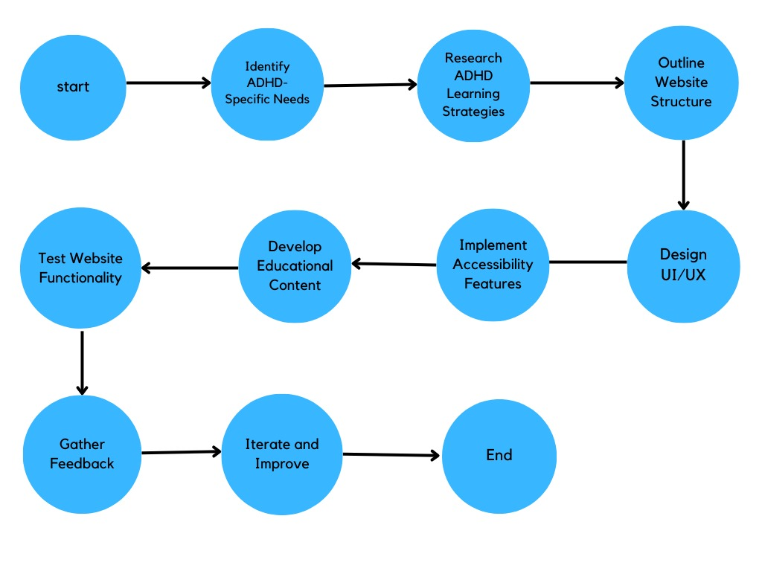
Idea/Approach Details
Description of idea/Solution/Prototype:
We seek a solution for ADHD, a condition worsened by decreasing attention spans influenced by social media, which can lead to severe future Mental Health Challenges.
Revolutionizing education through SNIPPETIZE : Offering children bit-sized, digestible snippets of knowledge, fostering engagement and overcoming short attention span through gamification.
Implementing mindfulness and relaxation techniques within the Snippetize platform to help ADHD students to manage stress and improve focus, promoting holistic wellbeing alongside academic success.
Technology stack:
Frontend: HTML, CSS, JavaScript
Backend: Firebase
Hosting: Cloudflare
Version Control: Git, GitHub
Tools and Frameworks: .net framework, utility game engine( C# language), Auth0

Slide 3
Idea/Approach Details
Description of use cases:
Description of Dependencies / Show stopper:
Utilizing time-based games and quizzes within our platform aims to enhance attention levels, as time-based activities have shown to be highly effective in improving focus among individuals with ADHD.
Snippetize can be used by parents and teachers of ADHD students, offering an easy-to-use platform for enhanced collaboration and tailored educational support.
Snippetize offers immersive 3D visualization and virtual tours, bringing real-world experiences to life for enhanced learning and engagement.
Understanding ADHD’s educational challenges with the help of doctors and teachers and analyzing the study pattern of these children.
Gather data from students playing games to observe patterns in ADHD students’ behavior, aiding future medical studies.
Automatic generation of rewards of game currency through Machine Learning and artificial intelligence.
A multilingual web based platform based on 32 different languages, which serves the ADHD students with inattention, hyperactivity or both with an efficient structure.
Sensory stimulation that leverages visual, auditory and kinesthetic feedback to keep track of children with hyperactivity.

Slide 4
Team Member Details
Team Leader Name: Swayam Khanduri
Branch ( Btech ): Stream ( CSE ): Year ( I I ):
Team Member 1 Name: Srishti Sharma
Branch ( Btech ): Stream ( CSE ): Year ( I I ):
Team Member 2 Name: Vanshika Sankholia
Branch ( Btech ): Stream ( CSE ): Year ( I I ):
Team Member 3 Name: Abhishek Chaudhary
Branch ( Btech ): Stream ( CSE ): Year ( I I ):
Team Member 4 Name: Archit Jain
Branch ( Btech ): Stream ( CSE ): Year ( I I )

