Slide 1
Predicting the appropriate location for ‘Medical Supply Store’ in Bronx, NY
Archit Banwari Aug, 2021

Slide 2
Introduction
Healing-Touch is a famous pharmaceutical company that wishes to establish a 'Medical Supply Store' somewhere in Bronx Area.
To find an optimal location for a 'Medical Supply'. Specifically, this report will be targeted to Healing-Touch Pharmaceuticals.
We will use data science to generate a few most neighborhoods based on these criteria and suggestions can be made to client based on our analysis.

Slide 3
Data Sources
Coordinate of Bronx, NY neighborhood can be extracted from the available newyork json data
Coordinate of Bronx, NY city centre can be generated by using Google Maps API geocoding
All kind of Venues in every neighborhood will be obtained using Foursquare API

Slide 4
Data exploration and Analysis – Segmentation and clustering

Slide 5
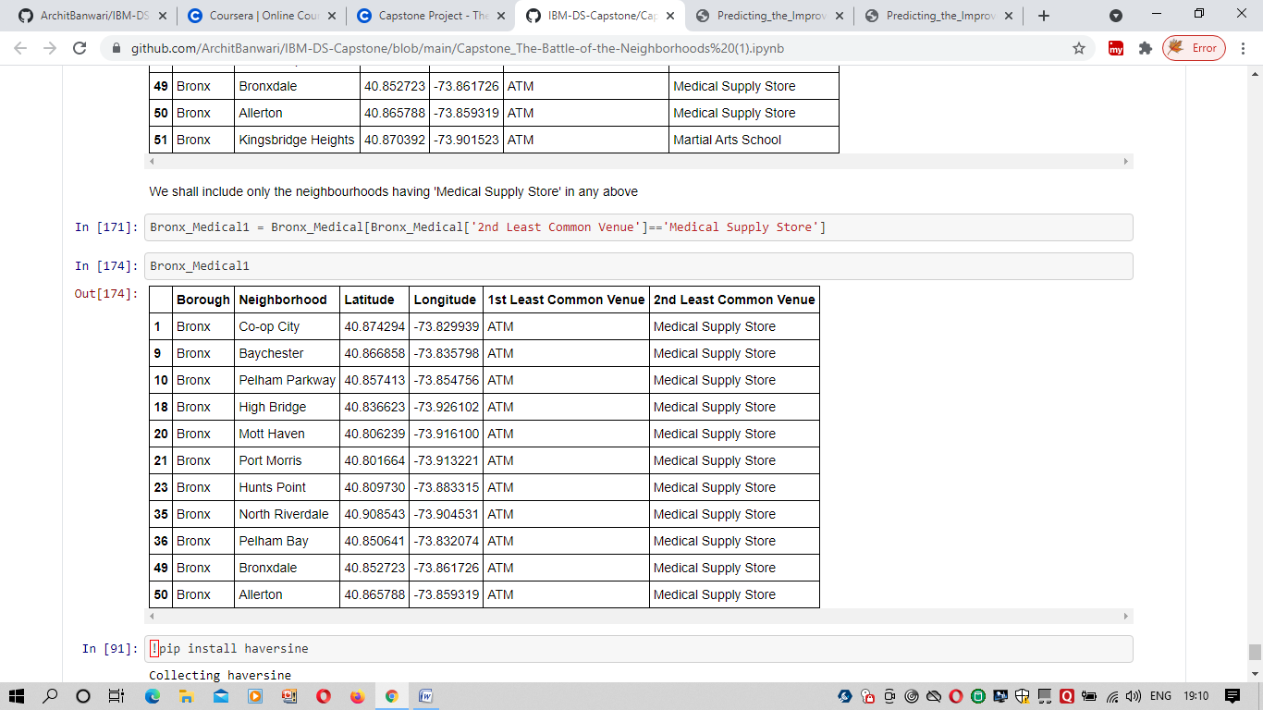
Below neighborhoods were found as the ones having ‘Medical Supply Store’ as least occurring venue.

Slide 6
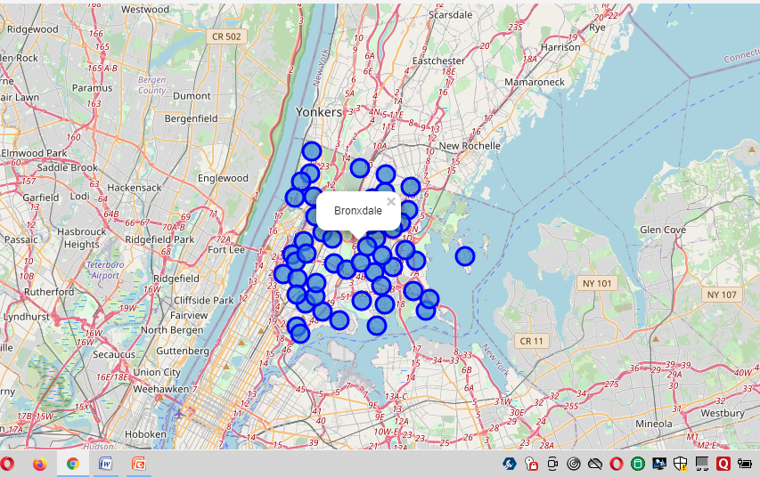
Neighborhoods on Map

Slide 7
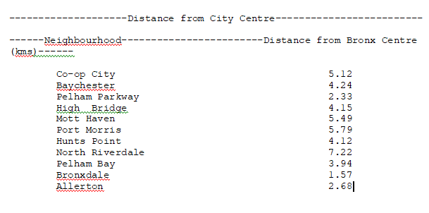
Distance from Bronx City Centre

Slide 8
Results and Discussion
Our analysis shows that although there are quite many neighborhoods in Bronx where lack of Medical Supply can be found, we have shortlisted the list where 'Medical Supply' is the least found venue.
After directing our attention to this more narrow area of interest, we found out the distance between the shortlisted neighborhoods and the Bronx city centre.
Result of all this is 11 neighborhoods with the distance from city centre ranging between 1.5 to 6 kms. Client can now be provided with these options for creating a 'Medical Supply Centre'

