Slide 1

Deep Learning Based Urban Analytics Platform:- Applications to Traffic Flow Modeling and Prediction
Archit Parnami, Prajval Bavi, Dimitris Papanikolaou,
Srinivas Akella, Minwoo Lee, Siddharth Krishnan
The University of North Carolina at Charlotte U.S

Slide 2
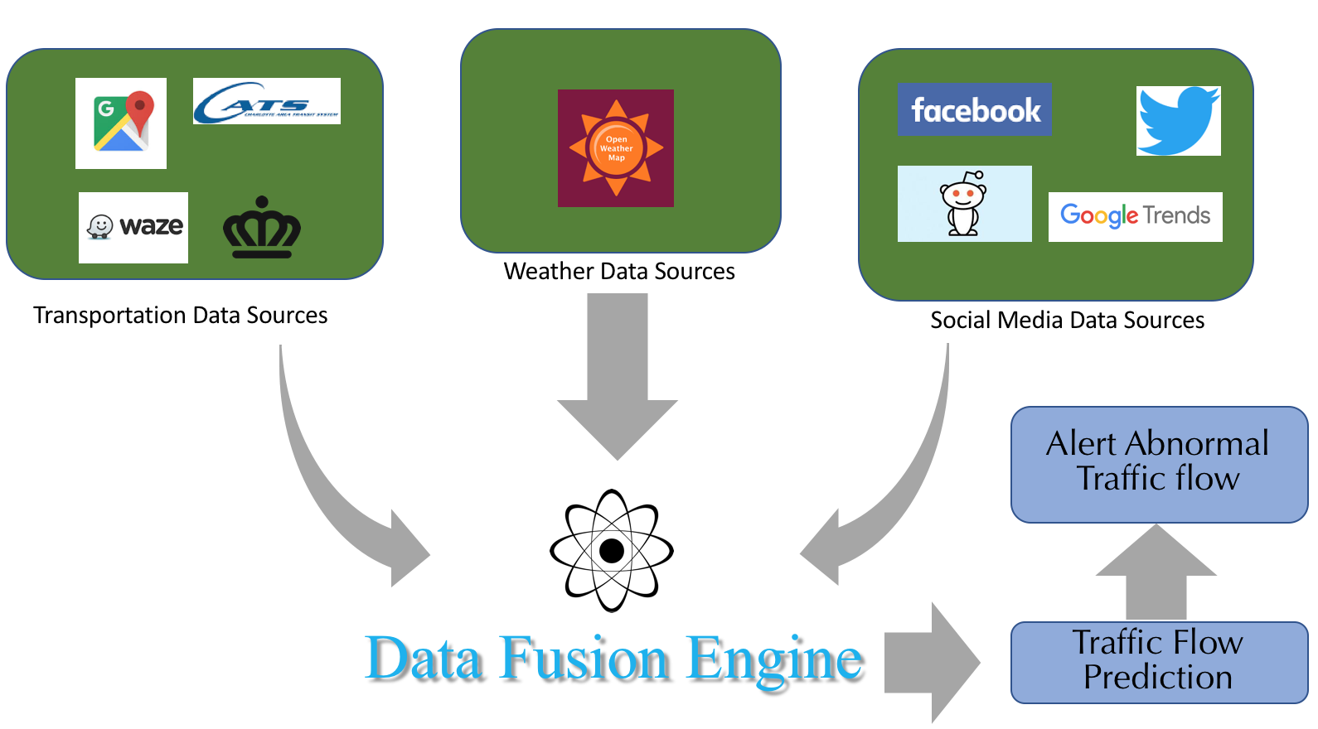
Concept and Motivation
Notes:
Transportation is an ever-growing industry It is something we all are part of. Having correctly understand the way we use them is not only important for policy planning but also for services which rely upon them such as logistics and emergency services. Which motivated us to focus on the concept of traffic prediction.
The idea is to use urban analytics to solve the problem of traffic prediction. Because traffic though has a trend is also influenced by various factors such as weather conditions, sports events, accidents etc. So could we use data from these sources to make accurate traffic predictions?

Slide 3
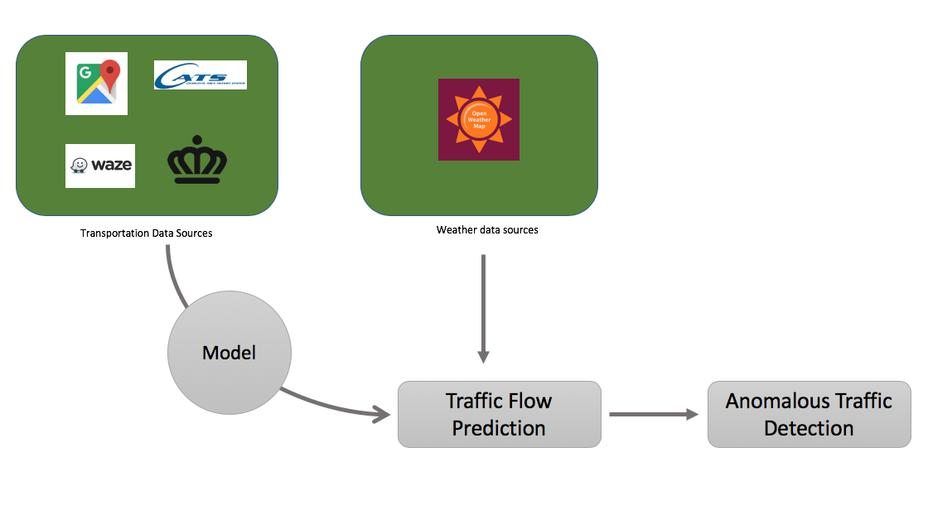
Phase 1 – Traffic Prediction
Notes:
As a starting point, this paper focuses on building a model to first have accurate traffic predictions and then once we have some significant results we correlate where we performed poorly using weather information.

Slide 4
Traffic Data Collection
Getting high quality traffic data is expensive and challenging!
Need loop detectors/ physical sensors on roads to measure traffic
Not every city has the capability or resources to install such devices.
Alternatives?
Google Maps API
Offers limited free service to get traffic information (2500 requests / day)
But quickly becomes expensive if you want to capture the traffic for more than few routes.
Waze (Crowdsourced Navigation App)
Though they publicly do not offer an API service yet, but through web scrapping traffic information for any number of routes can be collected from Waze.

Slide 5
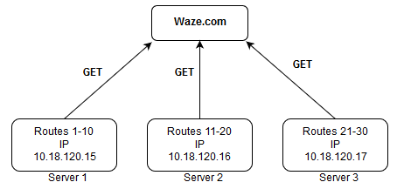
Traffic Data From Waze
Traffic data is the estimated time of travel from point A to point B using car as the medium of transportation.
We define parameters which tells us the number of servers needed for collecting traffic data from Waze using web scraping.
This paper:
5 Servers for 1092 routes collecting data every 5 minutes.

Slide 6
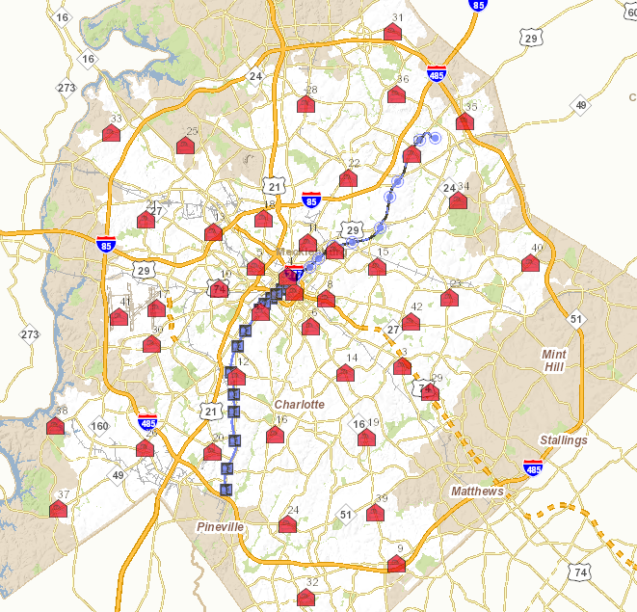
Interest Points for Data Collection
42 Fire Stations (Red Huts)
26 Light Rail Stations (Blue Circles)
Routes = 42 * 26 = 1092
To estimate the traffic conditions throughout the city, we selected Fire Station as the source points (since they are evenly spread throughout the city) and light rail stations as destination points.
The data is collected every 5 minutes between each fire station and rail station.
Charlotte, North Carolina, U.S

Slide 7
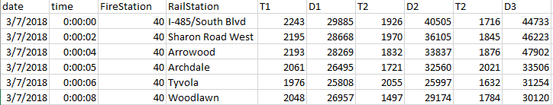
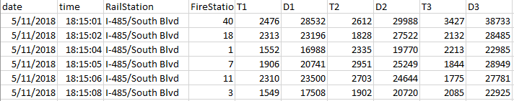
Sample Traffic Data
Inbound Traffic Data
Outbound Traffic Data
Where T_{i} is the estimated time of travel in seconds and D_{i} is the distance in meters
Notes:
Now there can be multiple ways to travel from a source to destination. With Waze we get up to three routes for every source destination, pair.

Slide 8
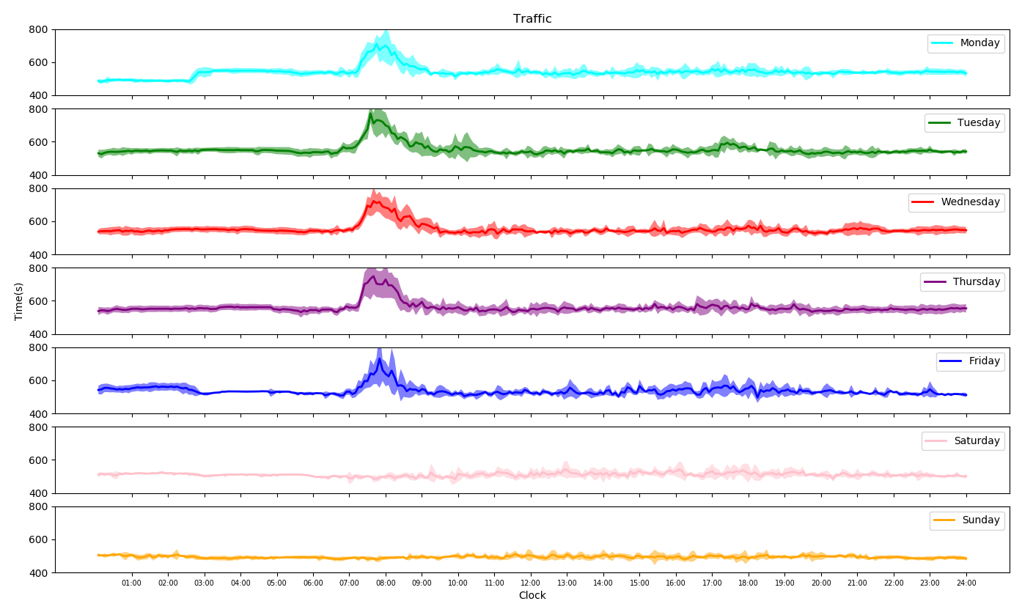
Data Analysis
Estimated Travel Time
Time of the day
Notes:
For a single short route we analyze the one way traffic flow pattern.
As observed the traffic flow pattern on weekdays are similar. There is a spike in traffic from 7:00 AM to 9:00 AM which can be attributed to people driving to work.
The same spike is missing on Saturdays and Sundays reason it being a holiday.

Slide 9
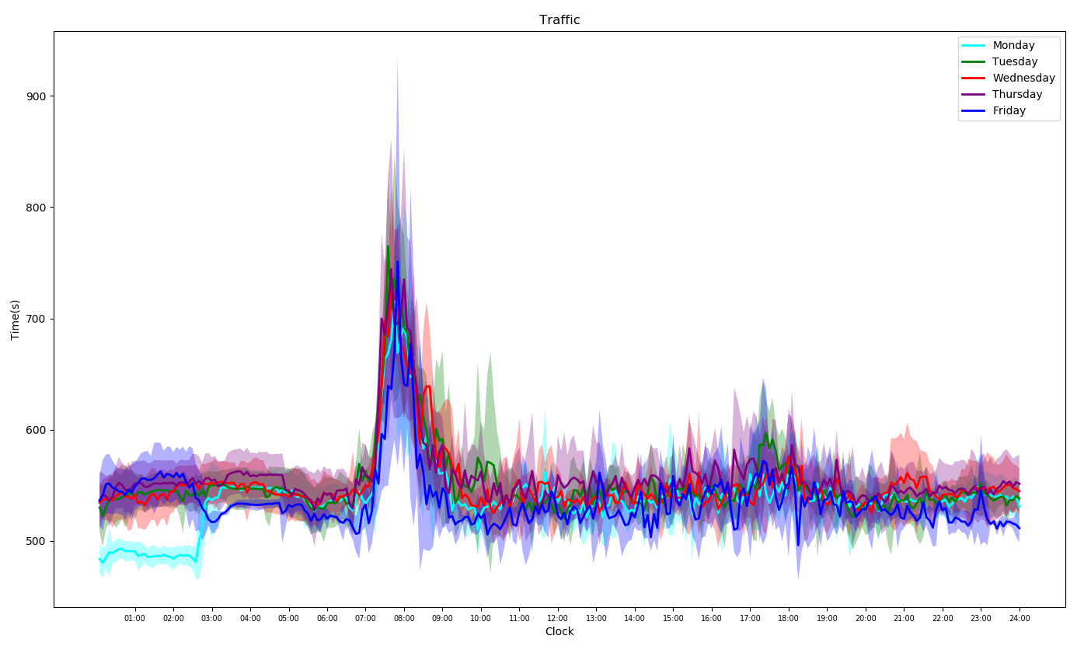
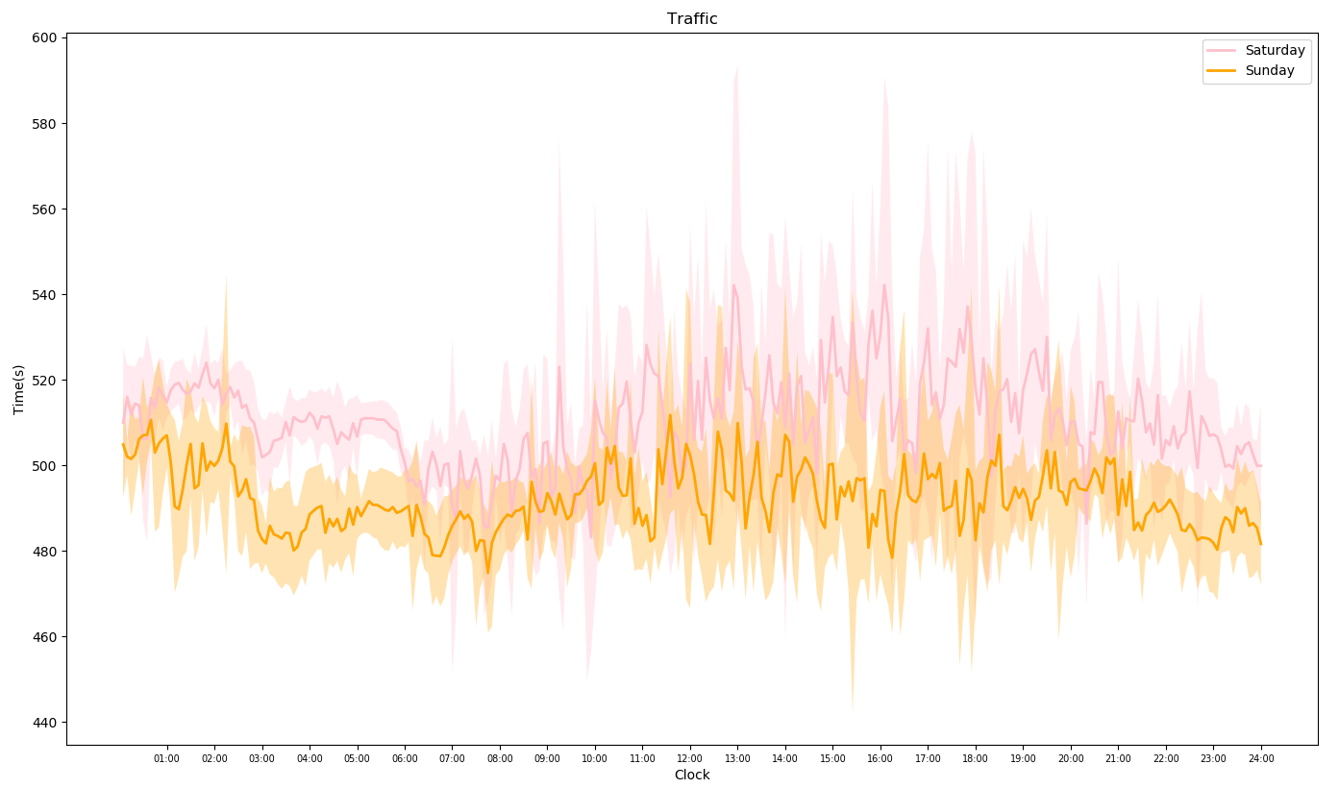
Traffic Patterns
Weekdays
Weekends
Notes:
Overlaying data from the previous slide into groups of weekdays and weekends tells us traffic patterns on weekdays are same where as on weekends they may or may not be same.

Slide 10
Traffic Prediction
Notes:
Using the captured traffic information and analysis of traffic patterns, we now move towards traffic prediction.

Slide 11
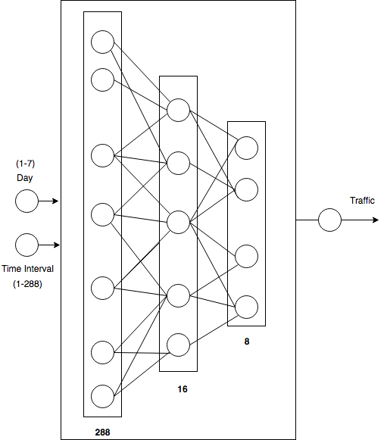
Neural Network Model
Hidden Layers = 3
288,16,8
Input
Day and Time
Output
Traffic
Notes:
A Neural Network with 3 hidden layers (288,16,8) was trained to predict traffic at any given day and time.
The input to the model was day of the week (1-7) and time interval (1-255) and the output was the estimated traffic.

Slide 12
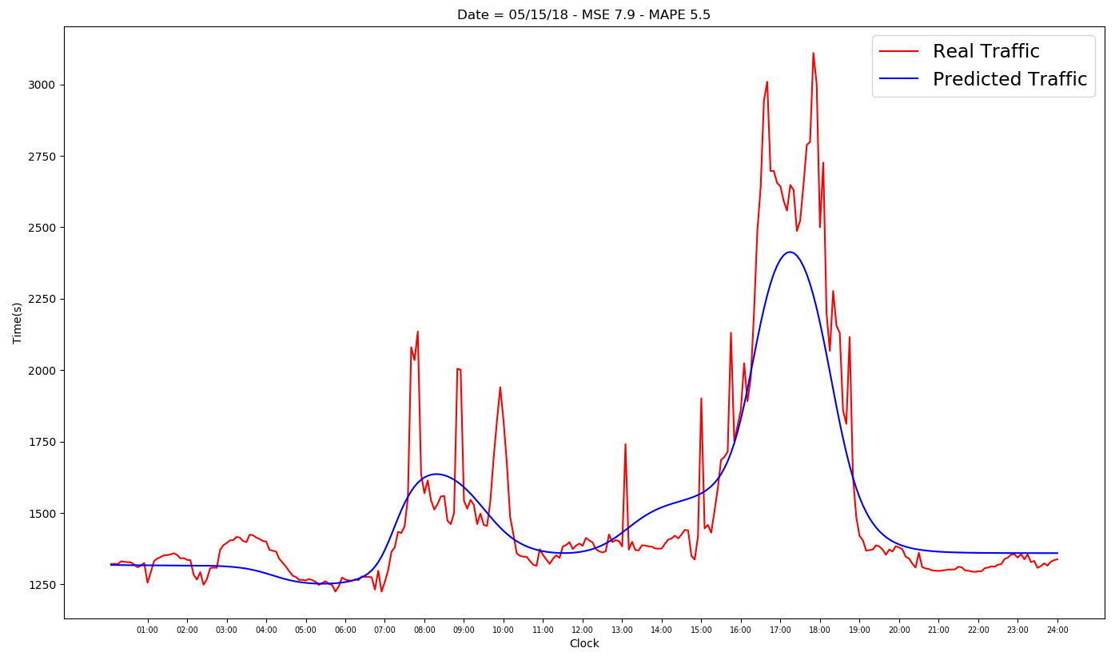
Neural Network Model: Results
Estimated Travel Time
Time of the day
Notes:
The Neural Network model was easily able to learn the general trend of traffic on any given day and time.
However it could not capture the troughs and the peaks.

Slide 13
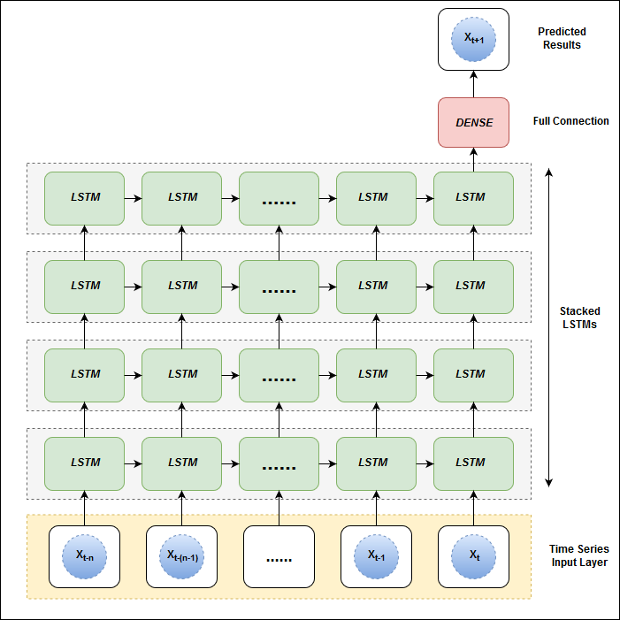
Deep Stacked LSTM Model
Layers = 4
Input:
Past 1 Hour of Traffic (12 Time steps)
Output:
Next 5 Minutes of Traffic (1 Time Step)
Notes:
While the original LSTM model is comprised of a single hidden LSTM layer followed by a standard feed forward output layer, the stacked LSTM has multiple hidden LSTM layers where each layer contains multiple memory cells.
Studies have shown that deep LSTM architectures with several hidden layers can build up progressively higher levels of representations of sequence data, and thus, work more effectively
We experimented with different number of LSTM layers stacked onto each other and empirically determined that a stacked LSTM with 4 layers works best for our data
Since we collect data every 5 minutes for a route, we have 288 time intervals in a 24 hour day.
The model is trained on past one hour of traffic data (12 timesteps) continuously to predict the next 5 minute of traffic (single timestep).

Slide 14
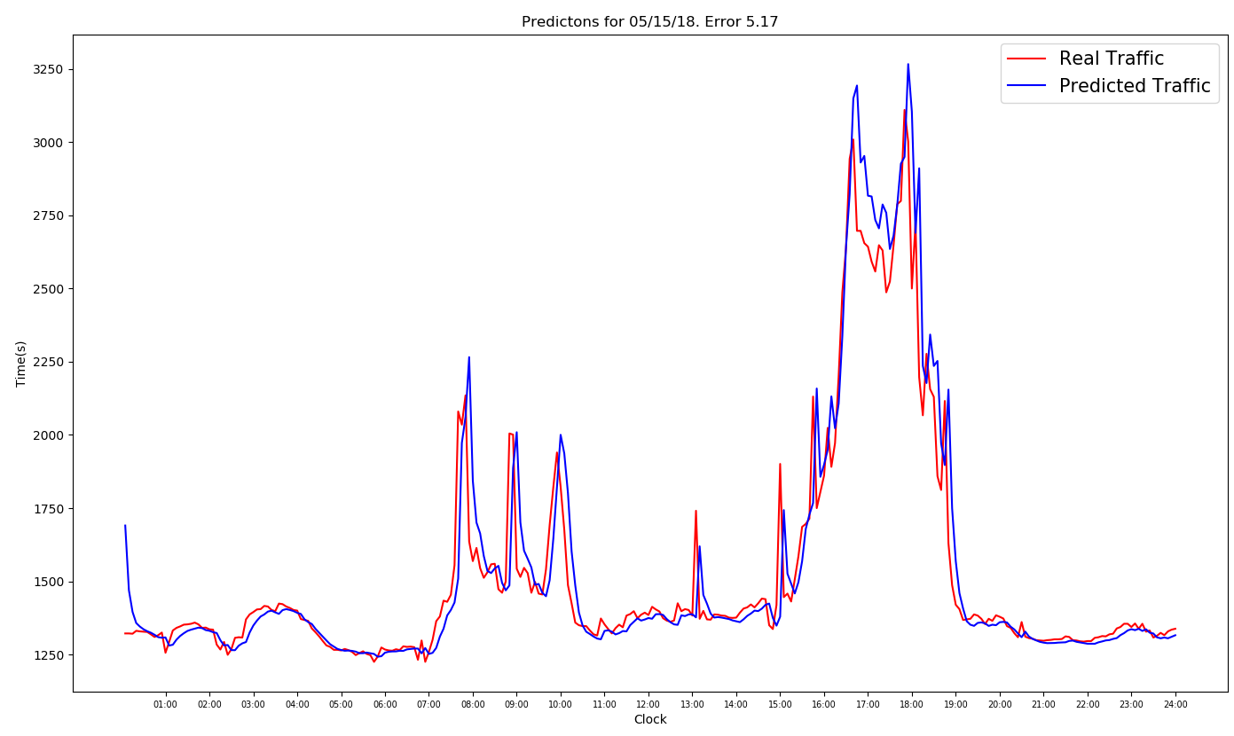
Stacked LSTM MODEL: Results
Estimated Travel Time
Time of the day

Slide 15
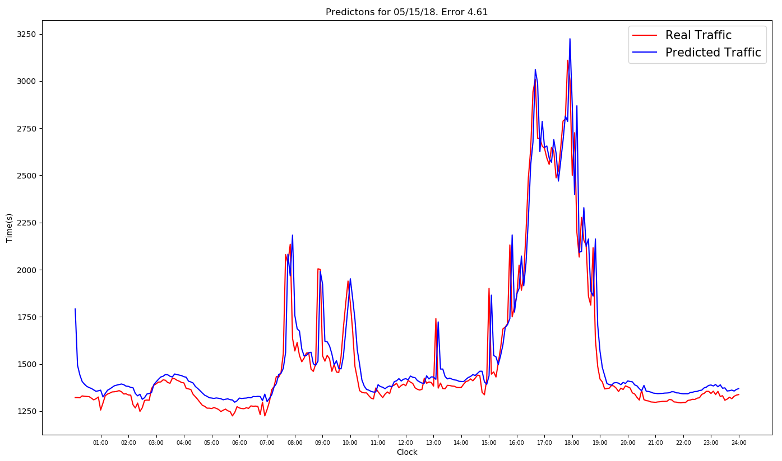
Improving results with Training LSTM model ONLY for weekdays
Estimated Travel Time
Time of the day
Notes:
While the stacked LSTM architecture fits very well for making traffic predictions, we observed that having a separate stacked LSTM model just for weekdays could improve the prediction result.
This is based on our previous observations that the weekday traffic pattern differs from the weekend traffic pattern, so having a separate model would benefit.

Slide 16
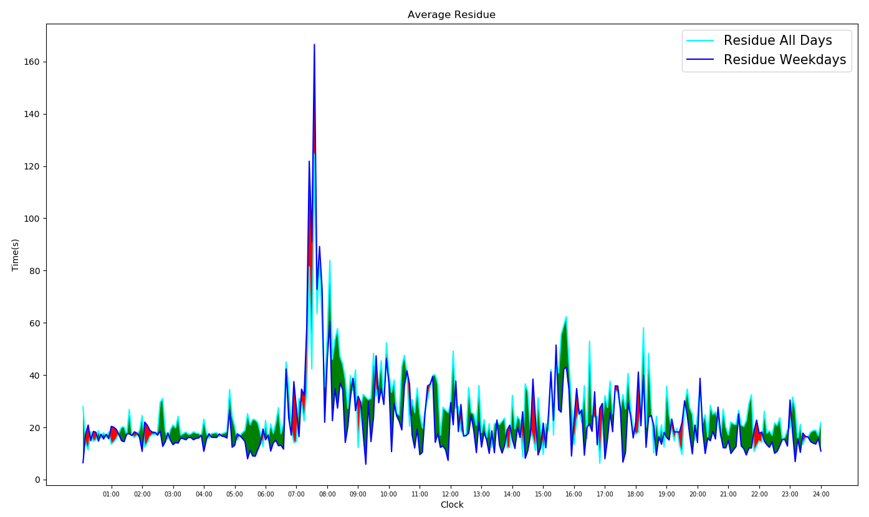
Weekdays vs ALL Days Training
Absolute Residual Error
Time of the day
Notes:
In the figure, the green area represents the intervals where the average error for prediction was less when using the Weekday model whereas the red area captures the interval when average error for prediction was high when using the Weekday model.

Slide 17
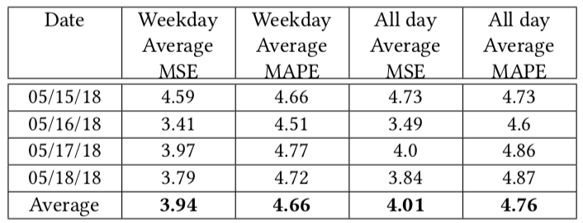
Results:- Weekdays vs ALL Days MODEL
3.94
4.66
4.01
4.76
Notes:
From the Table , we can conclude that the Weekday training model performed better than all days training model.

Slide 18
CORRELATING DEVIATIONS IN TRAFFIC PREDICTION WITH WEATHER CONDITIONS
Notes:
The next step in Urban Analytics Platform is to improve upon the predictions or at minimal find the cause of deviations using secondary sources of data.

Slide 19
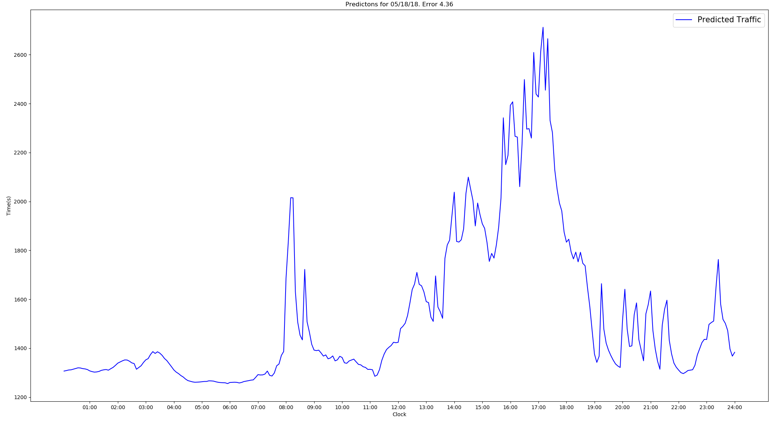
Predicted Traffic WITH LSTM
Estimated Travel Time
Time of the day

Slide 20
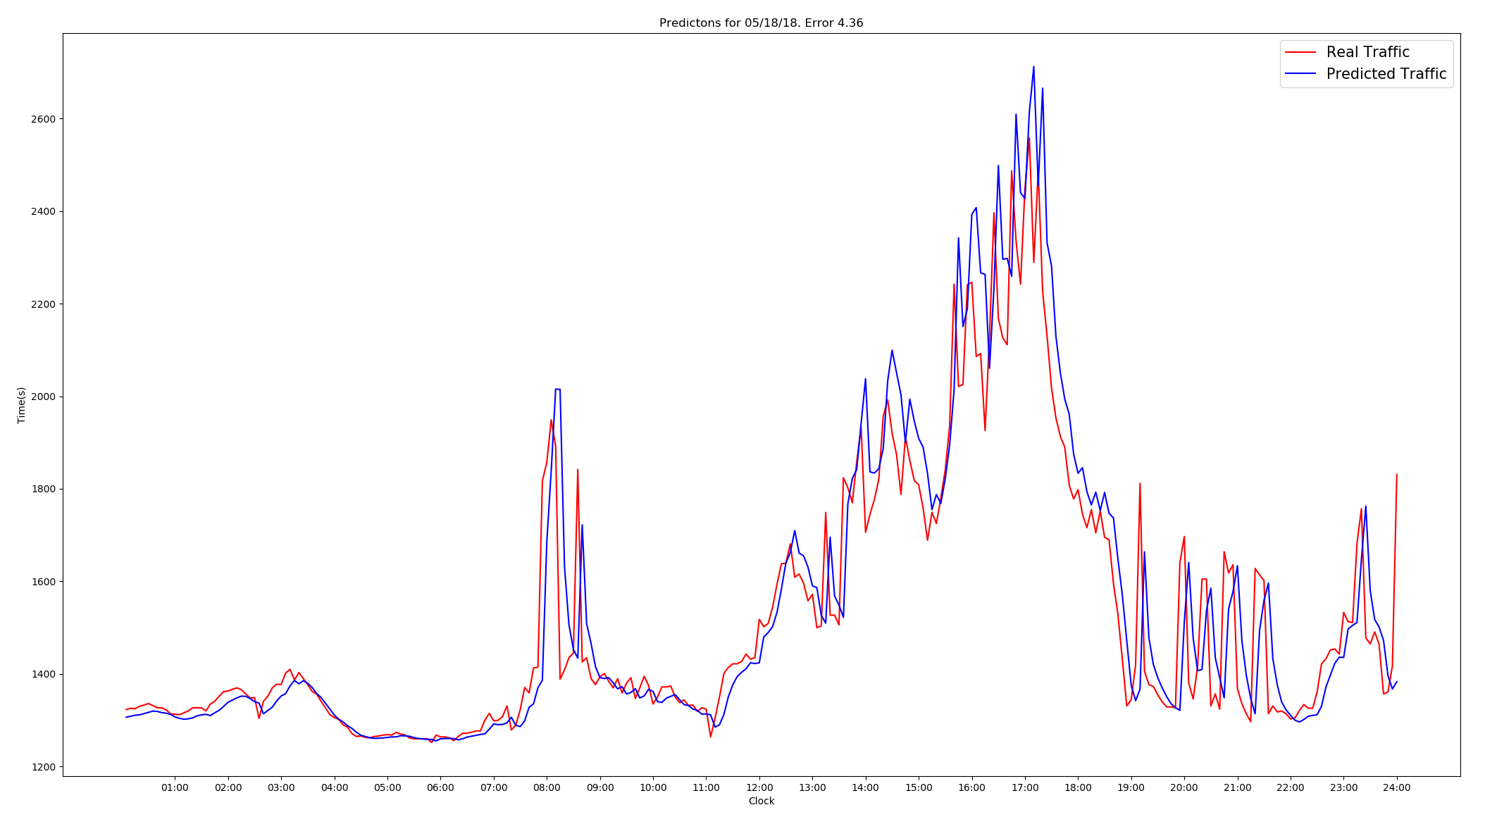
Predictions VS Real Traffic
Estimated Travel Time
Time of the day

Slide 21
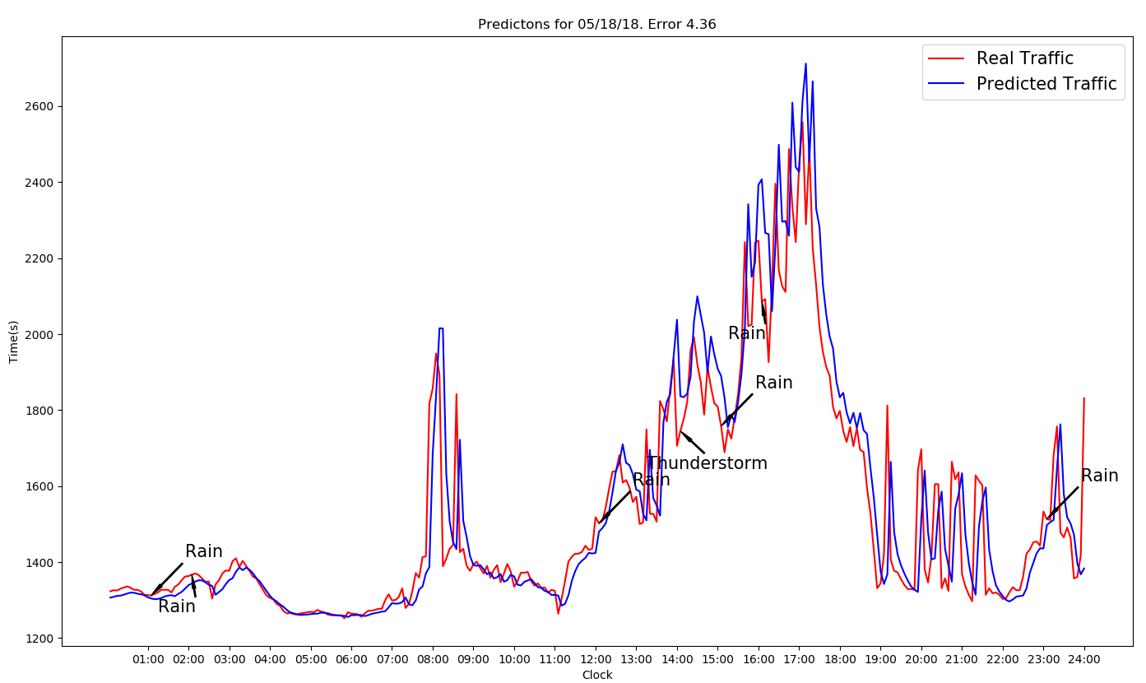
Weather and Traffic
Notes:
Overlaying weather conditions with traffic information could help us understand the cause of deviation in predictions.
At some points it is observed that an abnormal weather condition have an affect on traffic while other times it didn’t.
However upon closer inspection on the type of weather condition (mild vs strong), an adverse weather does seem to impact the traffic conditions (as otherwise understood intuitively)

Slide 22
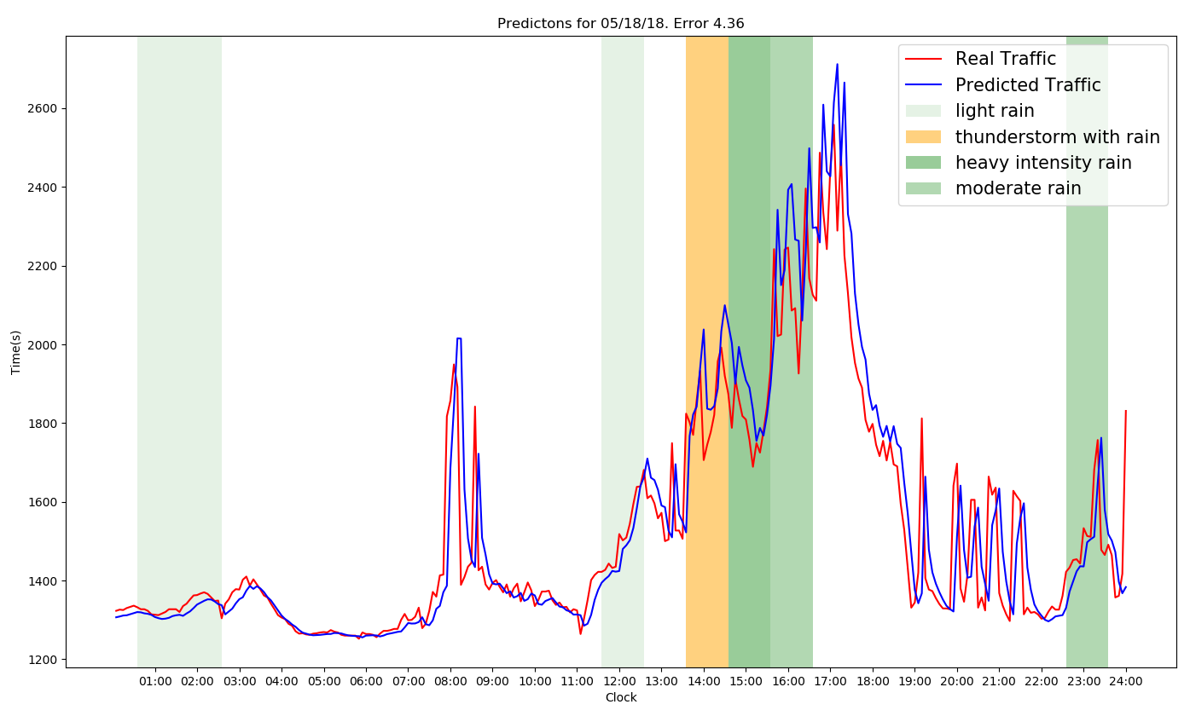
Weather and Traffic
Notes:
A Thunderstorm and a heavy rain correlates strongly with deviations in traffic predictions while a light rain and does not seem to have an affect on traffic.

Slide 23
Conclusion & Future Works

Slide 24
Thank You!
Please contact for more information
aparnami@uncc.edu

