Slide 1
Traffic Data Collection Using Waze

Slide 2
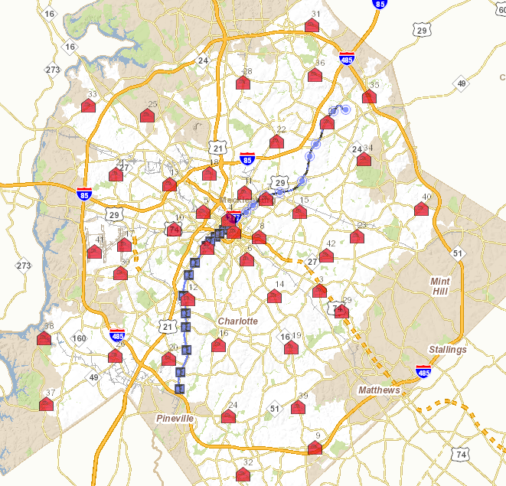
Interest Point Selection
To estimate the traffic conditions throughout the city, we selected Fire Station locations (Represented in Red) as the source points since they are evenly spread throughout the city.
Rail Stations act as destination points.
There are 42 Fire Stations
There are 26 Light Rail Stations
Routes: 42 * 26 = 1092

Slide 3
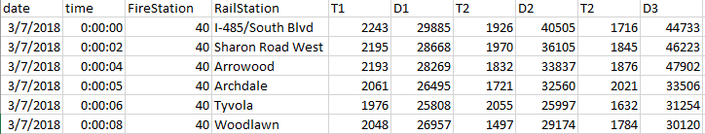
Inflow Traffic Data
Inflow : Traffic from Fire Stations to Light Rail Stations.
Estimated Time of Travel is fetched from Waze every 5 minutes between each pair of source and destination.
Waze returns three possible routes. i.e., for each (source, destination) pair we have three (time, distance) pairs.
T_{i} is time in seconds and D_{i} is distance in meters.

Slide 4
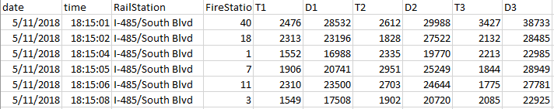
Outflow Traffic Data
Outflow : Traffic from Light Rail Stations to Fire Stations
Estimated Time of Travel is fetched from Waze every 5 minutes between each pair of source and destination.
Waze returns three possible routes. i.e., for each (source, destination) pair we have three (time, distance) pairs.
T_{i} is time in seconds and D_{i} is distance in meters.

Slide 5
Data Stats
Inflow : Traffic from Fire Stations to Light Rail Stations
Dates:
Stable Data: 77 Days
Start Date: 03/07/18
End Date: 05/22/18
Data collection in progress at present
Outflow : Traffic from Light Rail Stations to Fire Stations
Dates:
Stable Data: 11 Days
Start Date: 05/12/18
End Data: 05/22/18
Data collection in progress at present

Slide 6
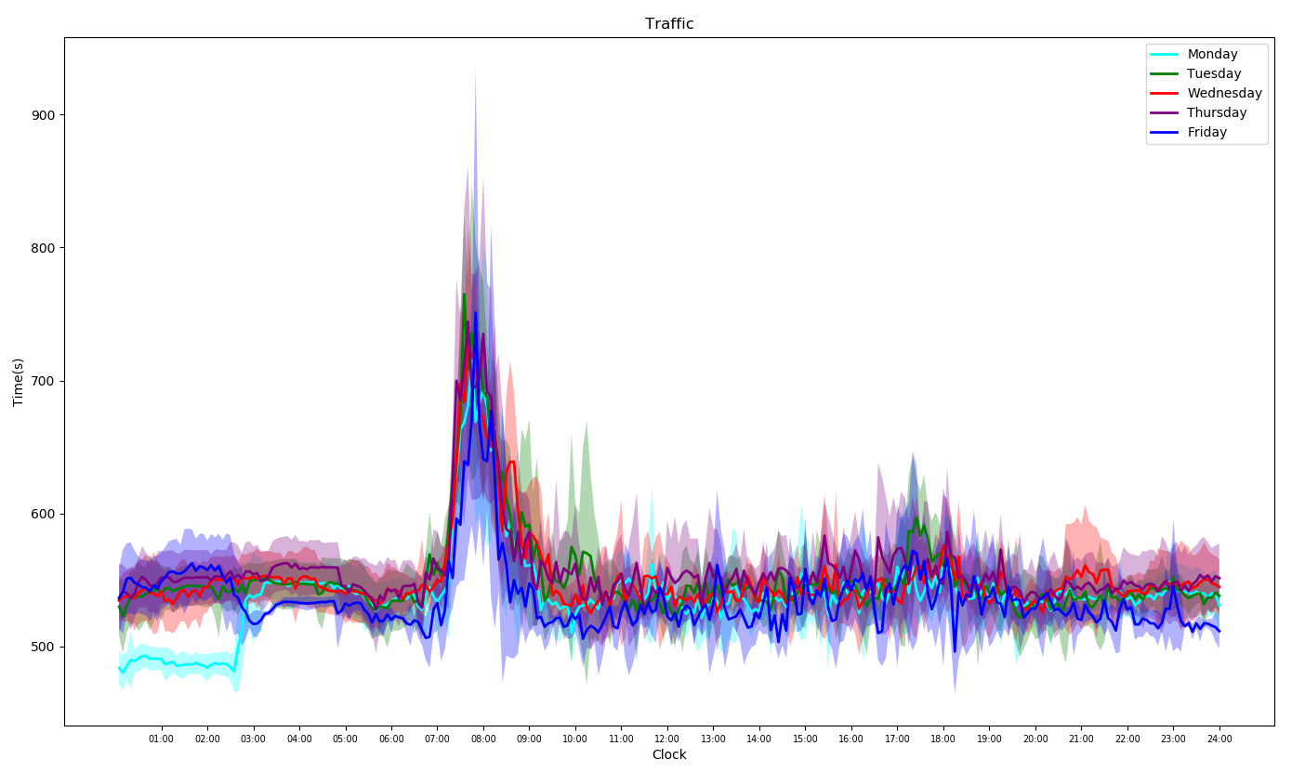
Inflow Traffic pattern for a single route

Slide 7
Thank You!

