Slide 1
Project Presentation of Co-Op Project at Industry (Module-1)
On
Verification Debt: Trust and Reliability of AI-Generated Code
Archita Garg | Anshika Mahajan |
2210991336 | 2210991304 |
Supervised By
Rajat Takkar, Chitkara University
Department of Computer Science and Engineering,
Chitkara University, Punjab

Slide 2
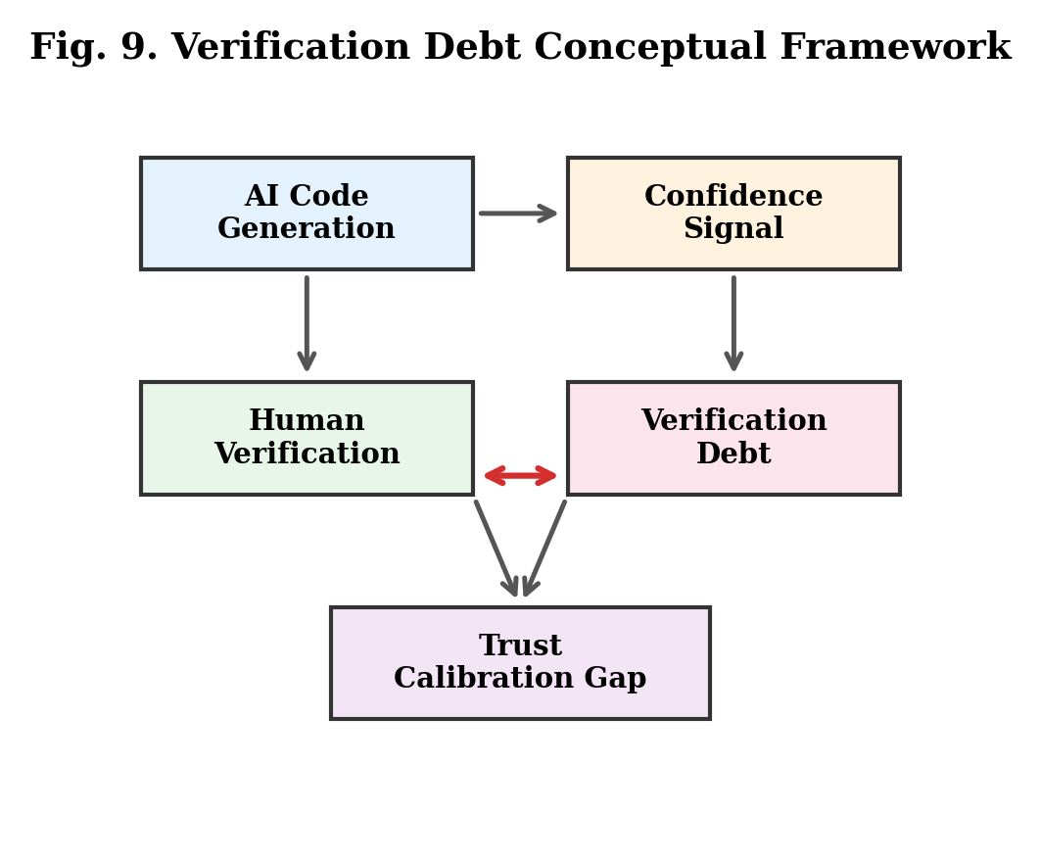
Introduction & Objective
• AI code tools (Copilot, ChatGPT, Claude) now used by 92% of developers; Copilot generates ~46% of code in enabled files.
• ~40% of AI-generated code has security flaws; 42% silent failure rate (Stanford CodeHallucinate benchmark).
• We define "Verification Debt" — the accumulated risk from accepting AI-generated code without proper verification.
• Empirical study of 1,000 human-AI interactions across 6 AI models (ChatGPT-3.5, GPT-4, Claude, Gemini, Llama, Mistral) and 12 query categories.
• Goal: Quantify the calibration gap, identify debt drivers, and propose mitigation strategies.
2

Slide 3
Methodology
Dataset & Models
Dataset: AI Skepticism Dataset — 1,000 transcripts, 23 variables.
6 AI Models: ChatGPT, GPT-4, Claude, Gemini, Llama, Mistral.
12 Query Categories: math, coding, medical, legal, etc.
Verification Debt Formula:
Vd = Σ P(di) × C(di) × (1 − V(i))
• P(di): defect probability; C(di): defect cost
• V(i): verification thoroughness [0,1]
Analysis Methods
Descriptive statistics + Pearson correlations
Group difference analysis (models, demographics)
Trust calibration assessment
Calibration Gap:
Gcal = (1/N) Σ |Conf(i) − Acc(i)|
4 Types of Verification Debt
Functional: edge case failures
Security: code vulnerabilities
Specification: intent mismatch
Maintenance: poor code structure
3

Slide 4
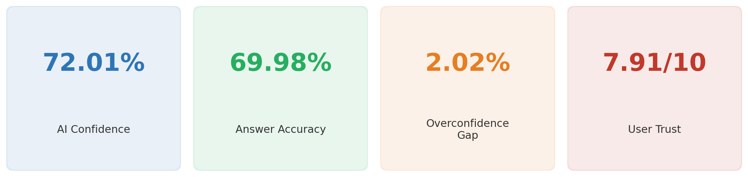
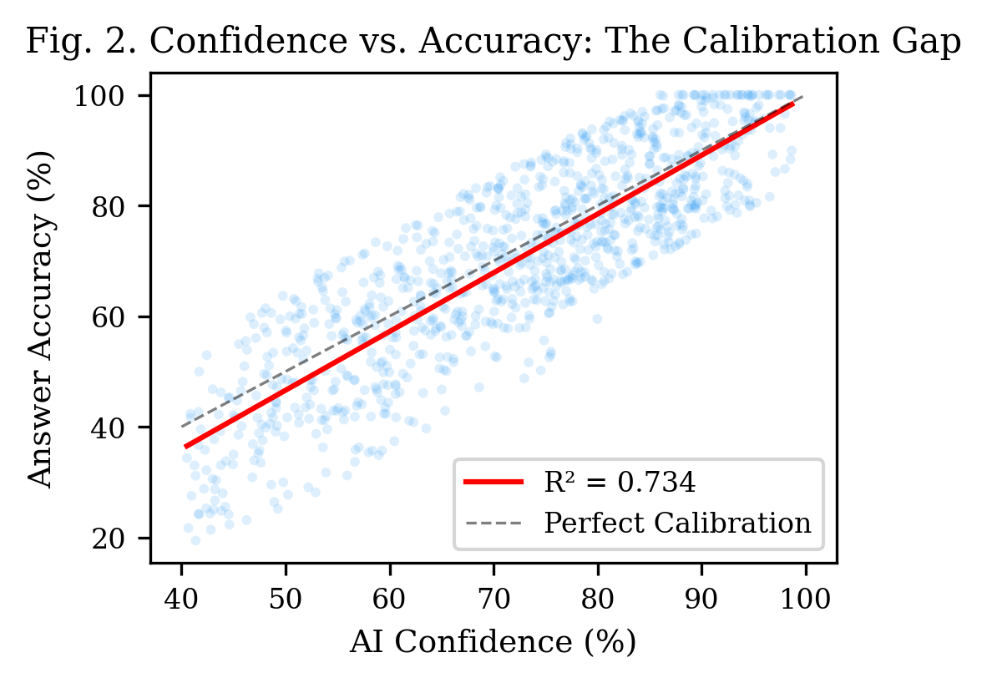
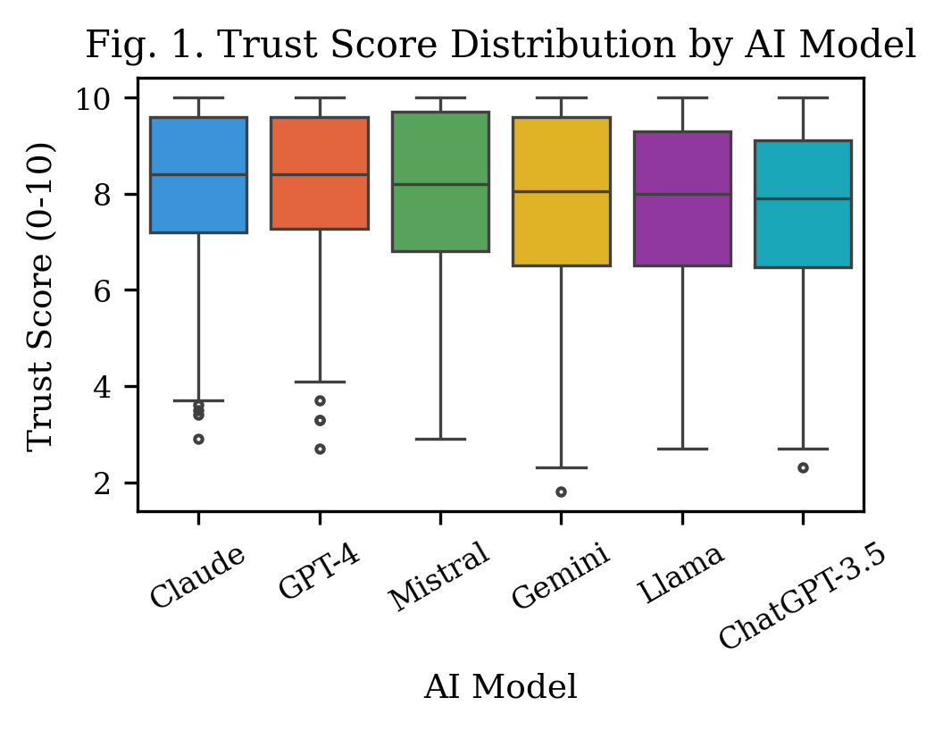
Key Findings
4

Slide 5
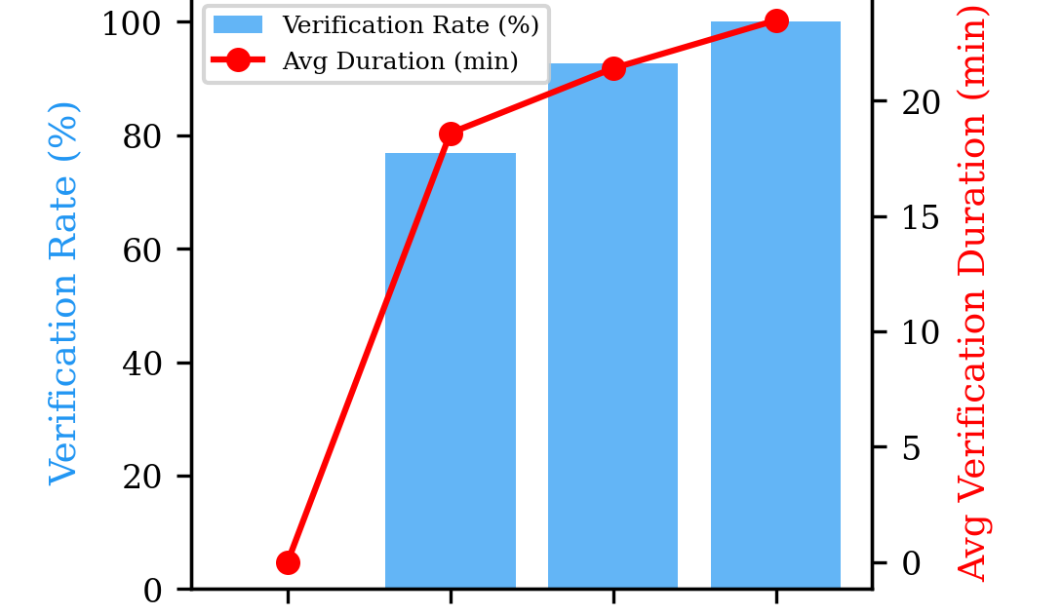
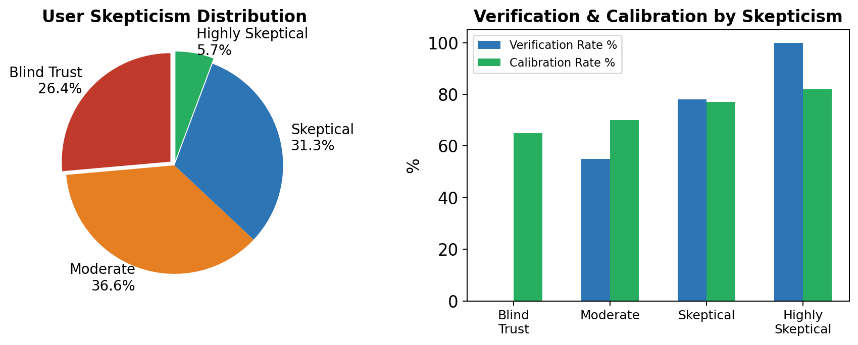
Verification Behavior
37.2% of users never verify AI output.
Average verification time: 14.8 minutes.
26.4% “Blind Trust” users (65% calibrated).
Only 5.7% are “Highly Skeptical” (82% calibrated).
5

Slide 6

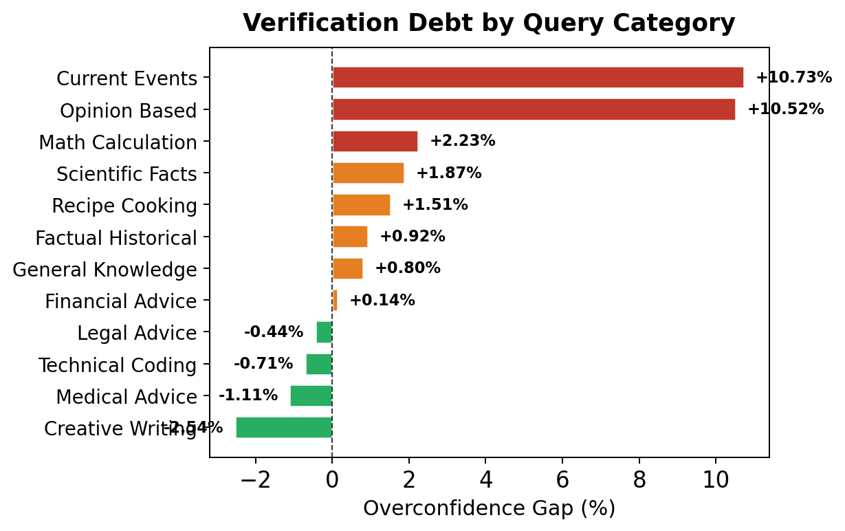
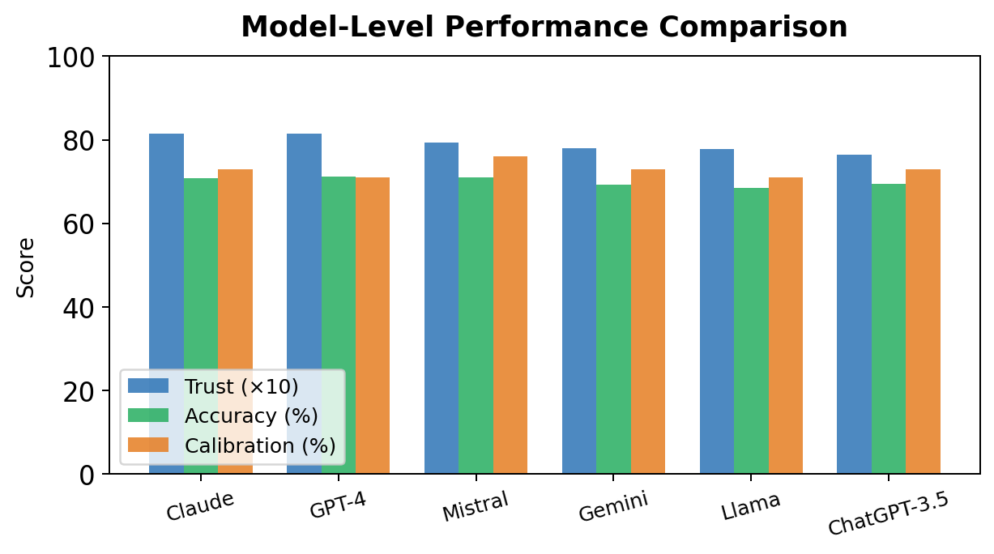
Domain & Model Analysis
• Highest debt: Current Events (+10.73%) and Opinion-Based (+10.52%) — AI most overconfident here.
• Technical Coding (−0.71%) and Math (89.66% accuracy) — AI is well-calibrated in these domains.
• Claude & GPT-4: lowest debt (1.60%, 1.65%); Llama: highest (2.92%); Mistral: best calibration (76%).
6

Slide 7
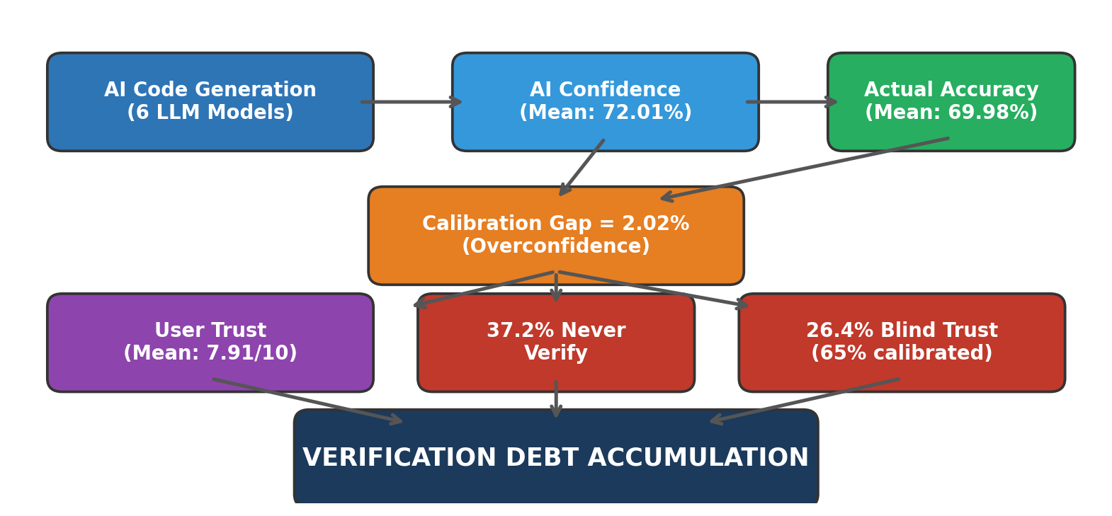
Discussion
• 2.02% overconfidence gap compounds across hundreds of daily AI suggestions — like financial debt.
• The "Fluency Trap": syntactically correct AI code creates an illusion of correctness, discouraging verification.
• 26.4% Blind Trust users are miscalibrated 35% of the time — bugs silently enter production.
• Verification debt should be tracked as a first-class metric alongside code coverage.
7

Slide 8
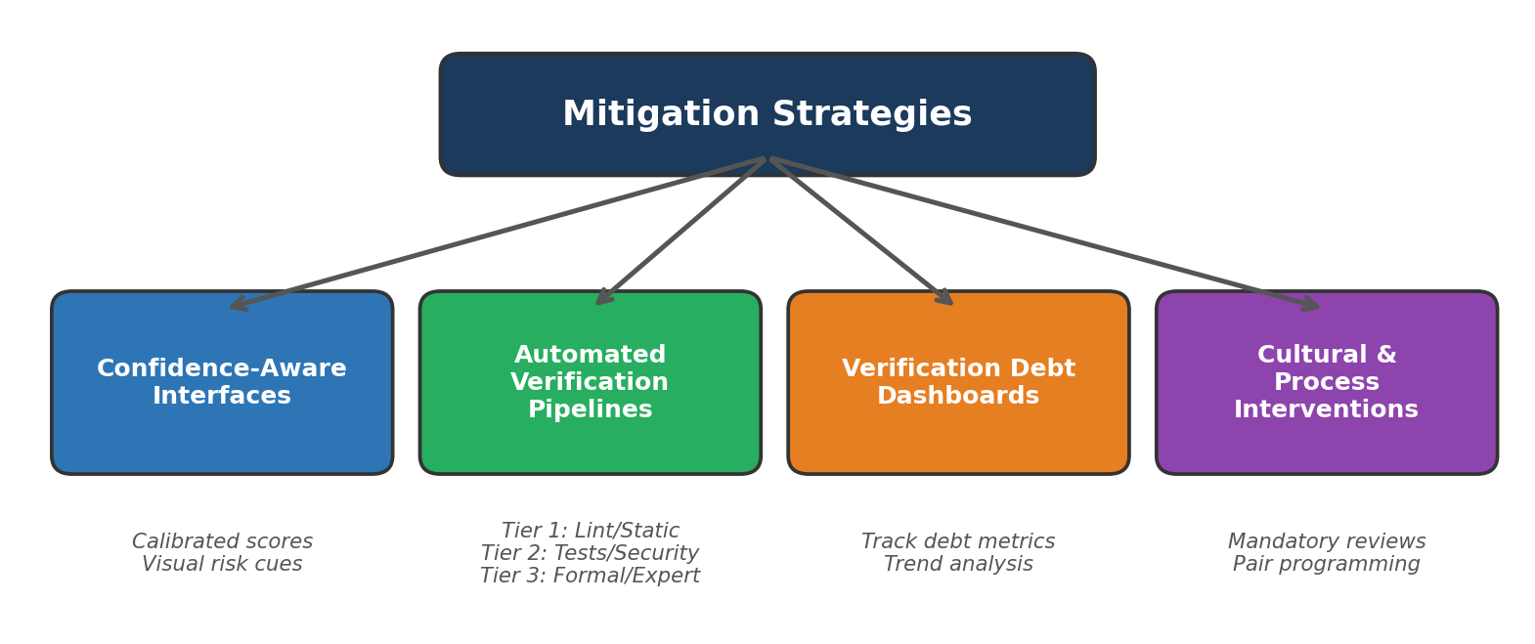
Mitigation Strategies
• Confidence-Aware Interfaces: show calibrated confidence with visual risk cues, not raw model scores.
• Automated Verification Pipelines: Tier 1 (lint/static), Tier 2 (tests/security), Tier 3 (formal/expert review).
• Verification Debt Dashboards: track % AI code by verification status, trends, and defect correlation.
• Cultural Interventions: mandatory review for AI code in critical paths, pair programming, retrospectives.
8

Slide 9
Conclusion & Future Scope
Conclusion
• "Verification Debt" is a formal, measurable construct for AI-generated code risk.
• AI models are systematically overconfident (2.02% gap); users trust highly (7.91/10) but 37.2% never verify.
• Current events (+10.73%) and opinion-based (+10.52%) queries carry the highest debt.
• Proposed multi-layered framework: confidence-aware interfaces, automated pipelines, dashboards, cultural change.
Future Scope
• Longitudinal studies tracking verification debt accumulation over time.
• Automated tools for estimating verification debt in real codebases.
• Controlled experiments to evaluate mitigation strategy effectiveness.
• Integration of verification debt metrics into CI/CD pipelines and IDE tooling.
9

