Slide 1


Flo 2026
Next-Gen Root Cause Analysis
Automating infra diagnostics with KAG and OpenTelemetry
Format: 45 min — 20 min discussion + 25 min live demo
Flat log retrieval finds the loudest error. A knowledge graph finds the cause.
Flo beyond the waves
Notes:
TIMING: 20 min discussion (slides 1-8) | 25 min demo (slide 9) | wrap (10-12).
Open with the thesis, not the agenda.
"Every one of us has spent hours in the wrong service during an incident. Today I want to show you why that keeps happening — and a technique that fixes the specific reason it happens."
Do not read the subtitle aloud. Let it sit.

Slide 2

THE CODE
Everything in this talk is on GitHub
Four instrumented services
QR code
goes here
Spring Boot + the OpenTelemetry Java agent. Zero instrumentation code.
The KAG engine
Graph builder, traversal, ranking and the prompt — about 900 lines of Python.
The live console
Run every scenario and both analyses from one screen.
Runbook, Q&A and code walkthrough
Everything needed to re-run this session yourself.
Scan to clone the demo
Notes:
~1 minute. Put the QR up early so people can scan while you talk — do not save it for the end, half the room will have left.
TO FINISH THIS SLIDE: generate a QR for your repo URL, paste the image over the dashed box, then delete the dashed box and the 'QR code goes here' text.
Say: "Everything you are about to see is in here — the services, the engine, and the runbook. You can re-run this whole session on your own laptop."

Slide 3

AGENDA
Where we're going
01
The problem
~4 min
05
Live demo
25 min
Why root cause analysis still takes hours
Same data, same model — one has a graph
02
Why log search cannot win
~4 min
06
Under the hood
~5 min
The cause that never wrote a log line
Four stages, four signals
03
The shift
~4 min
07
Limits and what's next
~4 min
From retrieving text to traversing structure
Where this genuinely stands
04
The foundations
~8 min
OpenTelemetry, and the WHAT/WHY gap
The demo is the middle of the talk, not the end of it. Everything before it is setup; everything after it is honesty.
Notes:
~1 minute. Do not read all seven lines aloud — point at the shape of it.
Two things worth saying: the demo sits in the MIDDLE, not at the end, so there is time to explain how it works afterwards; and the last section is limitations, which is deliberate.
Flag the interaction model now: "stop me during the demo — that part is meant to be interrupted."

Slide 4
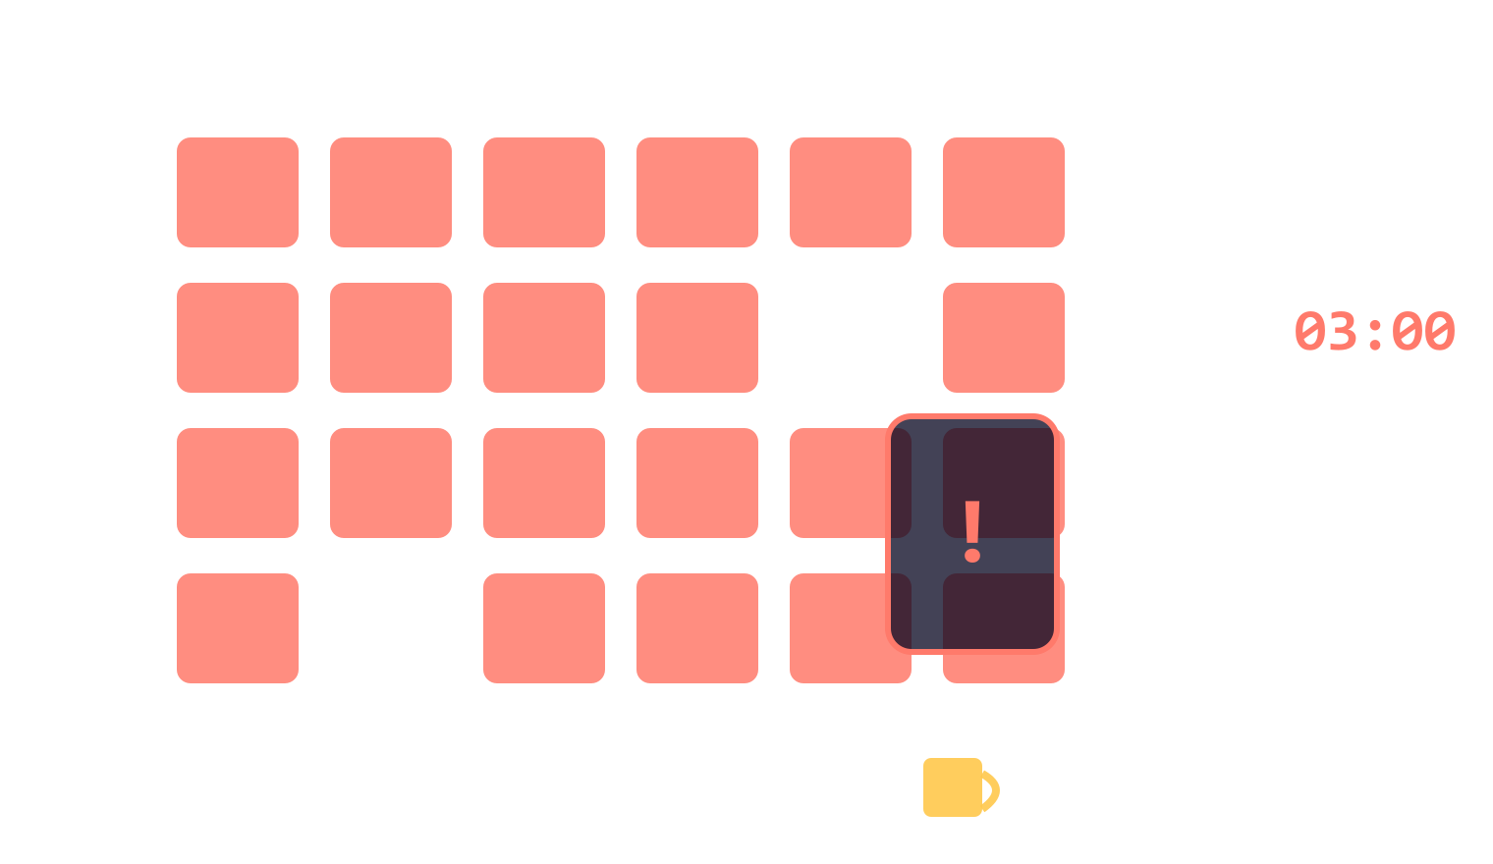
THE PROBLEM
It's 3 AM. Everything is red.
1
The page fires
Checkout is failing. Most orders are erroring.
2
The dashboard is useless
Six services are red — all downstream of each other.
3
You start guessing
order-api has the most errors. You start there. It is healthy.
4
The real cause is silent
The expensive part of an incident is not the fix. It is the search.
A config value changed 20 minutes ago. It logged nothing.
Notes:
~4 minutes. Tell it in the second person — the room has lived this.
Land beat 4 and PAUSE: "the thing that broke never wrote a log line." That is the hinge of the entire talk.
Optional show of hands: 'who has spent more than an hour in the wrong service during an incident?' Every hand goes up. Use it.

Slide 5
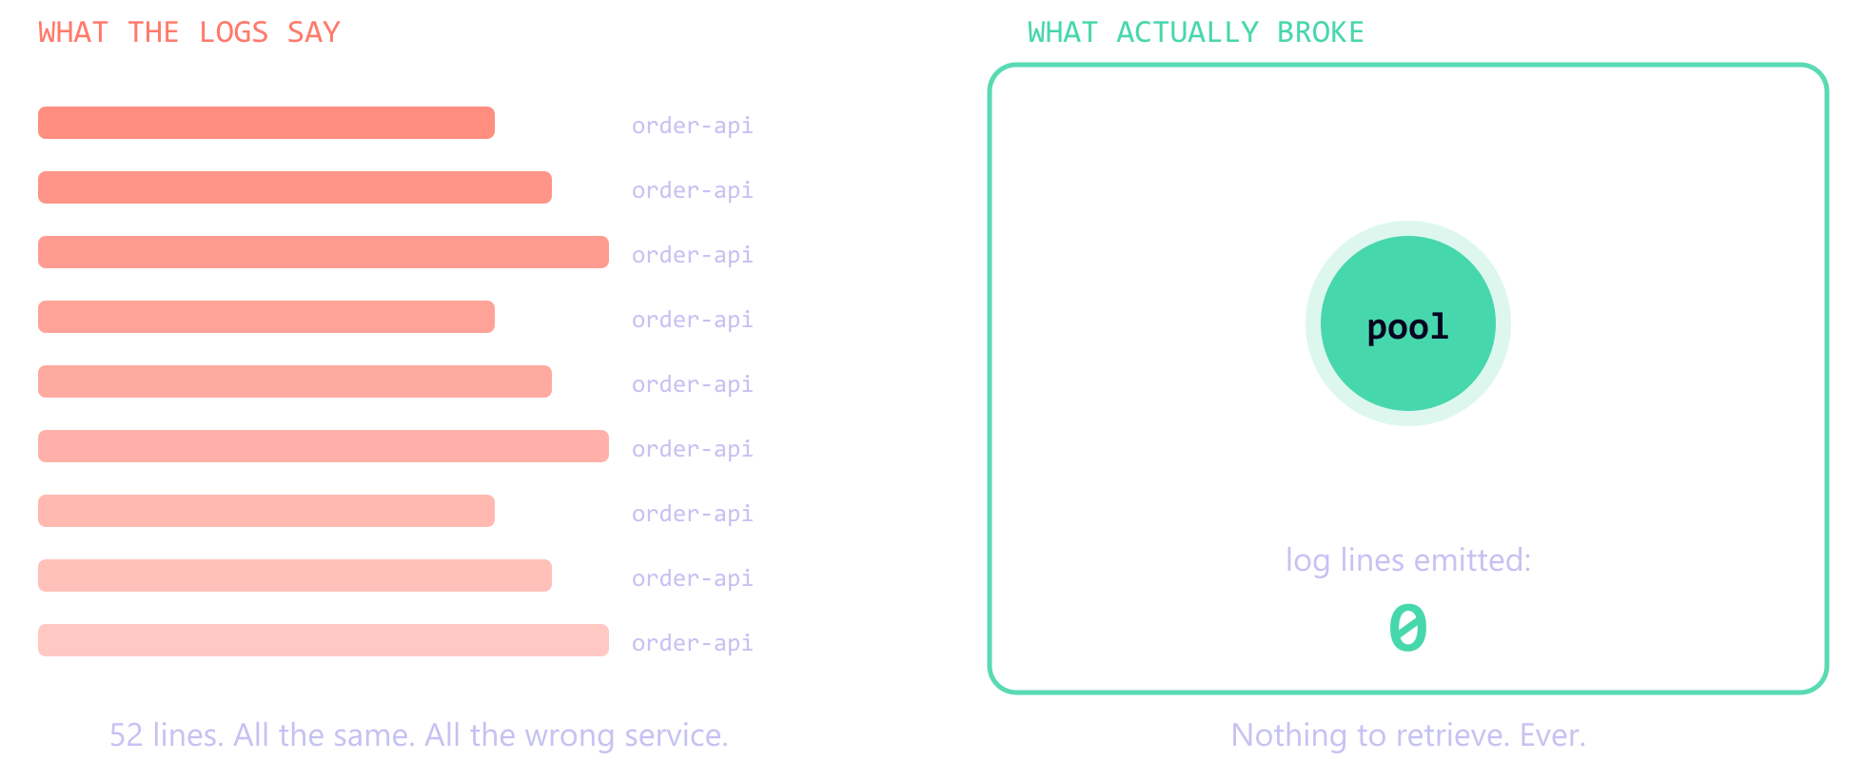
WHY LOG SEARCH CANNOT WIN
The cause never wrote a log line
Config, capacity and topology do not emit errors. There is no text to retrieve — so no amount of log search, and no better model, reaches the answer.
Notes:
~4 minutes. Three distinct reasons log-based RCA fails — say all three:
1. SILENCE — config and capacity do not log. Nothing to retrieve.
2. MISATTRIBUTION — the service that TIMES OUT logs the error; the service that is SLOW returns 200 and logs nothing.
3. NO STRUCTURE — 'A is slow' and 'queue B is backed up' are two strings. Only a graph knows they share a dependency two hops away.
Point at the 0. That number is the whole argument.

Slide 6
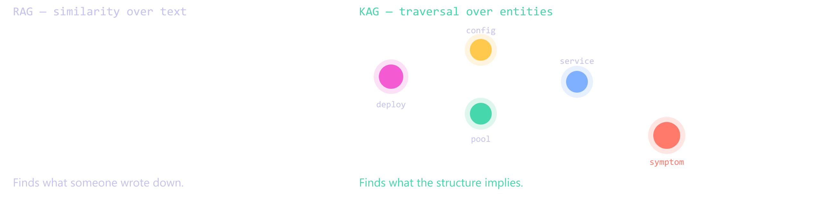
THE SHIFT
From retrieving text to traversing structure
RAG asks: “What text resembles my question?”
KAG asks: “What could have produced exactly these symptoms?”
Notes:
~4 minutes. The conceptual pivot.
KAG = Knowledge Augmented Generation. Be straight that this implements the IDEA — explicit graph, structured retrieval, LLM reasoning over the retrieved subgraph — rather than the OpenSPG SDK. If asked why: the SDK needs a config server, an embeddings provider and a vector store, and it hides the exact mechanism I am here to show.
Distinguish the three if asked: RAG retrieves text chunks by similarity. GraphRAG builds a graph FROM text and is still bounded by that text. KAG traverses typed entities that were never text in the first place.
If you are running long, this is the slide to compress. Never the demo.

Slide 7
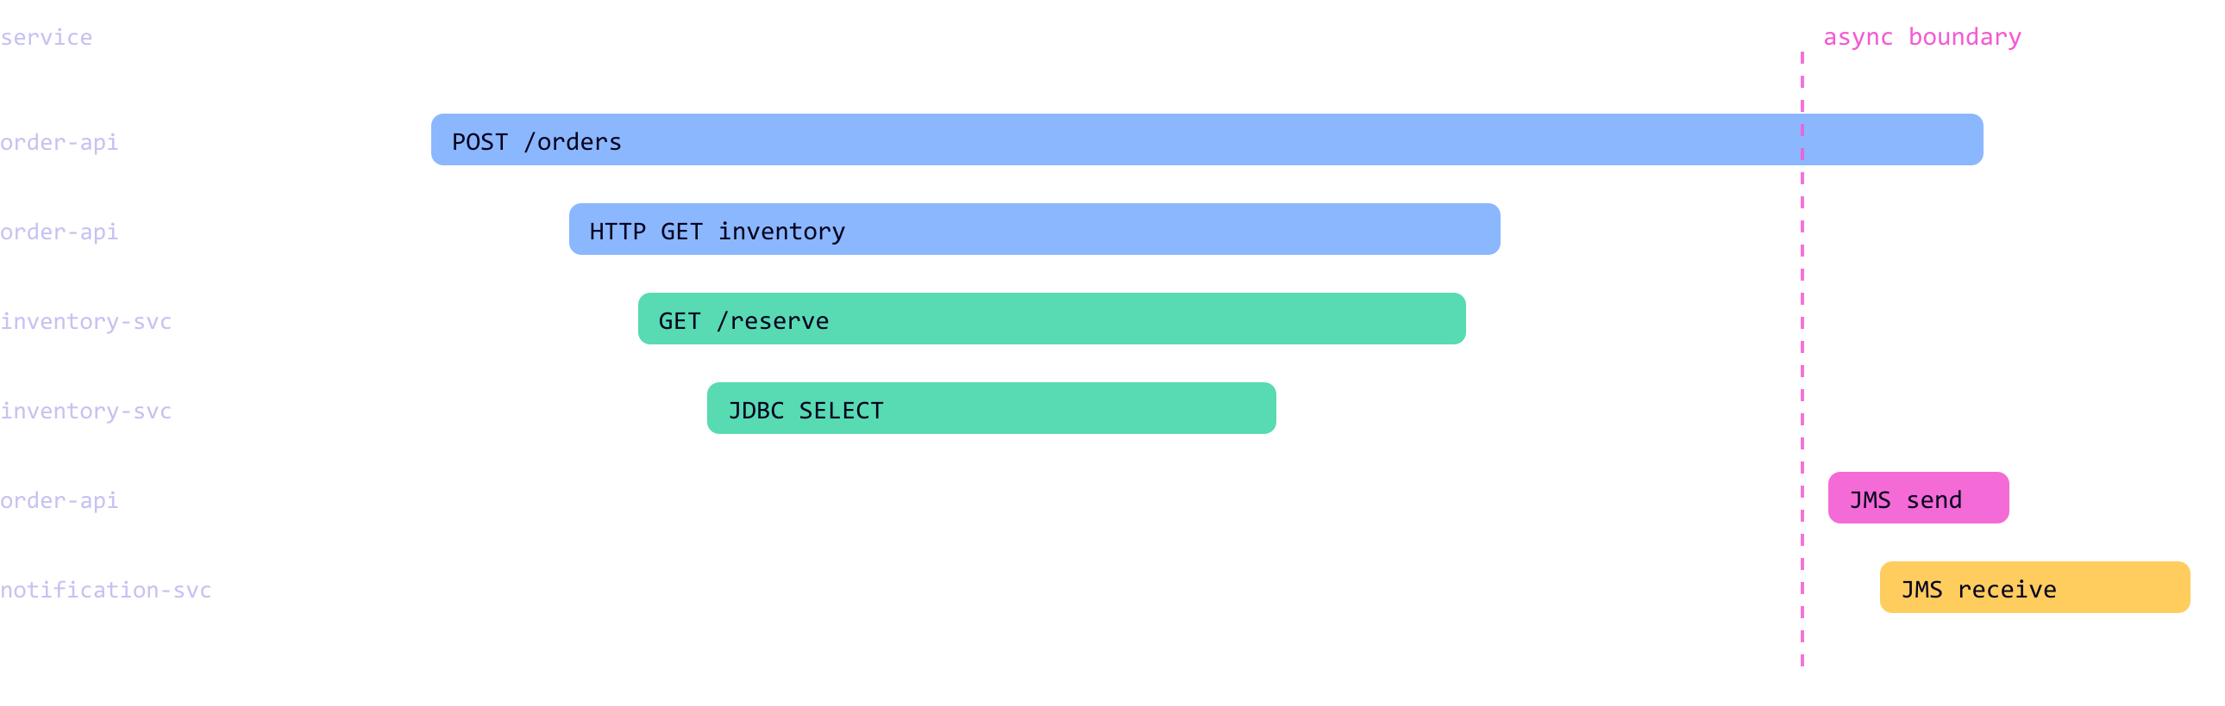
FOUNDATIONS · 1 OF 2
What OpenTelemetry actually gives you
A span is one unit of work. A trace is a tree of spans sharing one id. Context propagation carries that id across process boundaries — including the message broker. None of this required a line of instrumentation code.
Notes:
~4 minutes. You have just told them WHAT to build; this is what it is built ON. It also sets up the demo — they need to read a trace to follow it.
Three things to land:
1. SPAN = one unit of work; TRACE = a tree of them sharing a trace id.
2. CONTEXT PROPAGATION is the magic — W3C traceparent over HTTP, message properties over JMS. That is why the async hop stays in one trace.
3. ZERO instrumentation code. The Java agent is attached with -javaagent and instruments Spring MVC, JDBC, the HTTP client and JMS automatically. People assume otherwise — say it explicitly.
Detail worth having ready: the agent emits SEVERAL spans per request. That matters later — error rate per span is not error rate per request.

Slide 8

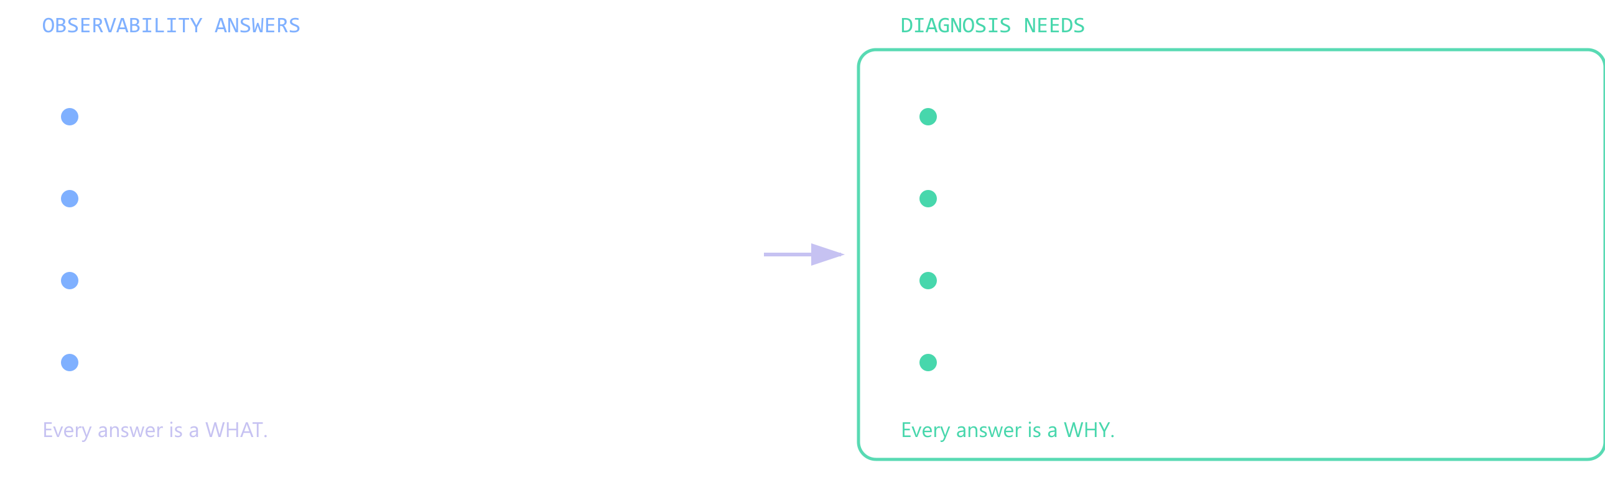
FOUNDATIONS · 2 OF 2
Observability tells you WHAT. Not WHY.
Telemetry is a record of what happened. Diagnosis needs what changed, what depends on what, and which single change explains every symptom — and none of that lives in a log line.
Notes:
~4 minutes. This is the last slide before the demo — it states precisely what the graph has to supply and the demo then supplies it.
The move: everything on the left is a measurement. Everything on the right is a RELATIONSHIP. Dashboards are very good at the left column and have no representation at all of the right one.
Good line: "We have spent a decade getting very good at collecting WHAT. We have not built the thing that answers WHY."
If someone raises Dynatrace/Datadog here — acknowledge they have service maps and change correlation; the difference is config and deployments as first-class nodes plus an inspectable ranking. Do not trash them.

Slide 9
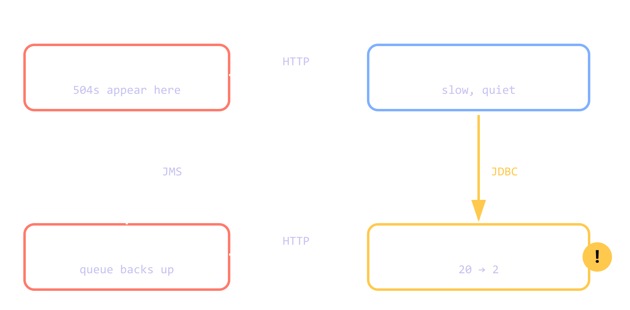
25 MINUTES
Live demo — the system we're about to break
Run the baseline first
Every line it can see says order-api. Let the room read it.
Watch the stages tick
SEED → TRAVERSE → RANK → REASON, with live counts.
Watch the decoy lose
Two recent deploys. Only one has a corroborated chain.
One fault. Two symptoms, in places that look unrelated.
Console: http://localhost:8090
Notes:
HARD STOP — switch to the console at http://localhost:8090. Budget 25 min.
Derive the fault live, it beats stating it:
Capacity = pool size / hold time
Before: 20 / 0.15s = ~133 req/sec. Fine.
After: 2 / 0.15s = ~13 req/sec. Everything queues.
The timeout asymmetry is the key detail and it is NOT contrived: order-api gives up at 2s, the pool at 3s. The caller fails before the callee admits it is struggling. Callers with shorter timeouts than the callee is the most common timeout misconfiguration in real systems.
Order matters: BASELINE first, then KAG. Say: "Same Jaeger. Same window. Same model. The only difference is the graph."
If asked whether it is hardcoded: click Reset to healthy and run it — it says 'no symptoms detected'. That one click ends the question.
FALLBACK: if the model call fails, the console still shows the retrieval trace and the exact prompt. The retrieval IS the argument — you can deliver the whole demo without a successful LLM call.

Slide 10
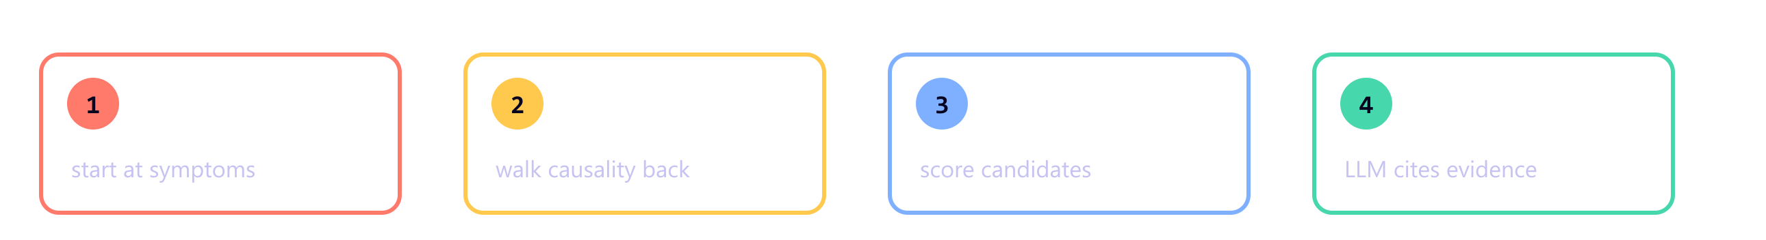
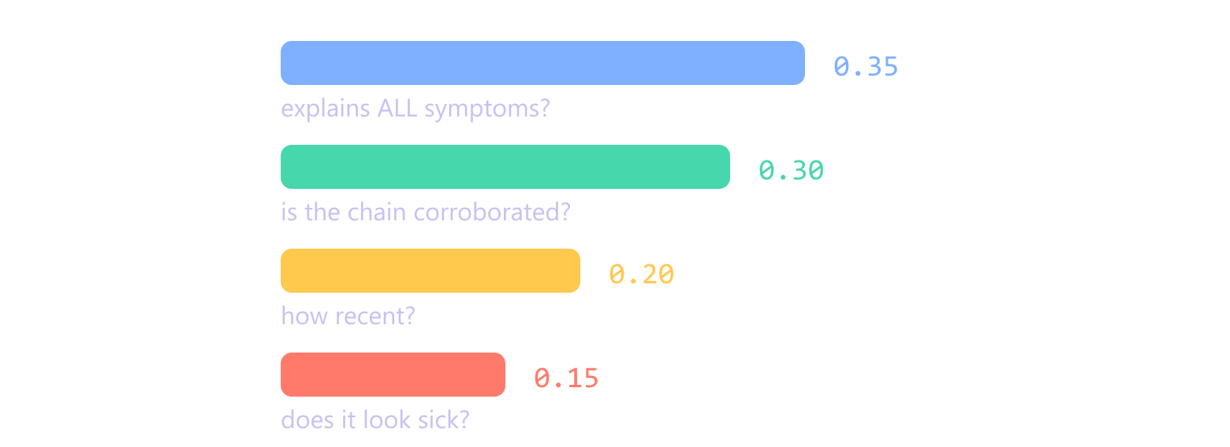
UNDER THE HOOD
Four stages, four signals
How a candidate is scored
Why two signals, not one
blast is topology: could this explain every symptom?
mechanism is evidence: does every link in the chain actually look broken?
A coincidental recent change scores 1.00 on the first and badly on the second. That is how the decoy deploy loses.
Notes:
~5 minutes, after the demo. Two things to land:
1. Retrieval starts at the SYMPTOM and walks causality BACKWARDS. It never asks 'what looks broken?', only 'what could have produced exactly this?'
2. blast vs mechanism. Topology says what COULD cause the symptoms; evidence says what DID.
Best 'we actually engineered this' detail if you have time: the Deployment → Service edge is deliberately NOT causal. A deploy does not break a service by magic; it breaks it through what it changed. Leaving it causal gave every deploy a one-hop shortcut past the evidence and they all scored identically.

Slide 11
WHERE THIS STANDS
Honest limits, and what's next
What it does
What it does not
Next
Finds causes that are in the graph
Replace an engineer's judgement
1. Noisy-neighbour scenario
where the logs contain literally nothing
Cites evidence for every claim
Find causes nobody modelled
2. Real graph sources
Ranks alternatives visibly
Work without accurate topology
Helm, Terraform, the K8s API — not a checked-in file
3. Measure it
Costs ~$0.05 per incident analysed
Survive a wrong graph
top-1 accuracy over real incident history
You already pay to collect this telemetry. Connect it to what you changed.
Notes:
~4 minutes. Lead with the limitations — in a room of engineers that is what buys you the rest.
Say 'no' plainly to the big two: it is NOT production ready, and it does NOT replace engineers. It shortens the search; a human decides and acts.
Cost framing that lands with managers: cost scales with INCIDENTS, not telemetry volume — the opposite of most observability pricing.
If asked for MTTR numbers, do not invent one: "I'd want to measure it against your own incident history first."

Slide 12
Thank you
Questions?
Flat log retrieval finds the loudest error. A knowledge graph finds the cause.
Flo beyond the waves
Notes:
PLACEHOLDER — to be customised. Add your name, contact and the repo QR here.
Do not end on 'any questions?' in silence. Seed the first one yourself: "The question I get most is whether this replaces engineers — it does not, it shortens the search." That gives the room permission to start.
Keep the console open behind this slide in case someone wants to see something re-run during Q&A.

