Slide 1
BUILDING SERVERLESS ROBUST, SECURED ANGULAR 6 WEB APPLICATIONS
By Jeff ST. GERMAIN

Slide 2

About me
Senior Software Engineer
Wrote my 1st program at 10.
Beer
CrossFit
Volleyball

Slide 3

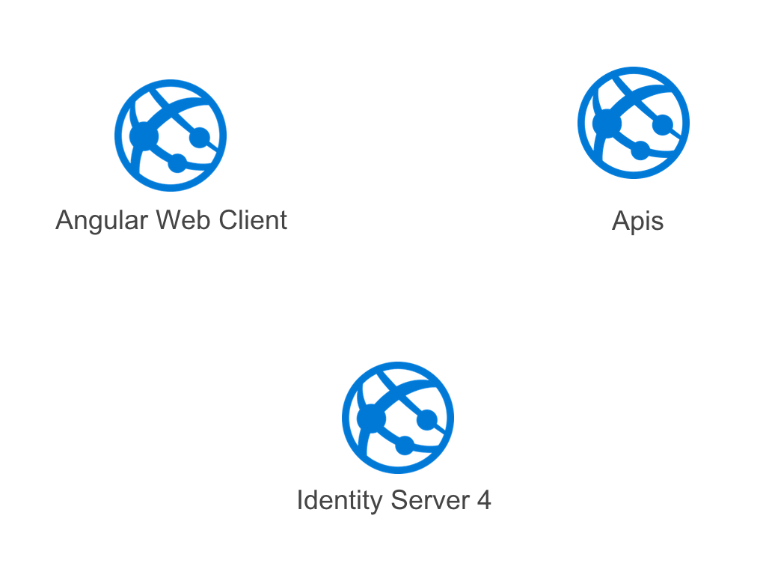
What we COULD BUILD

Slide 4
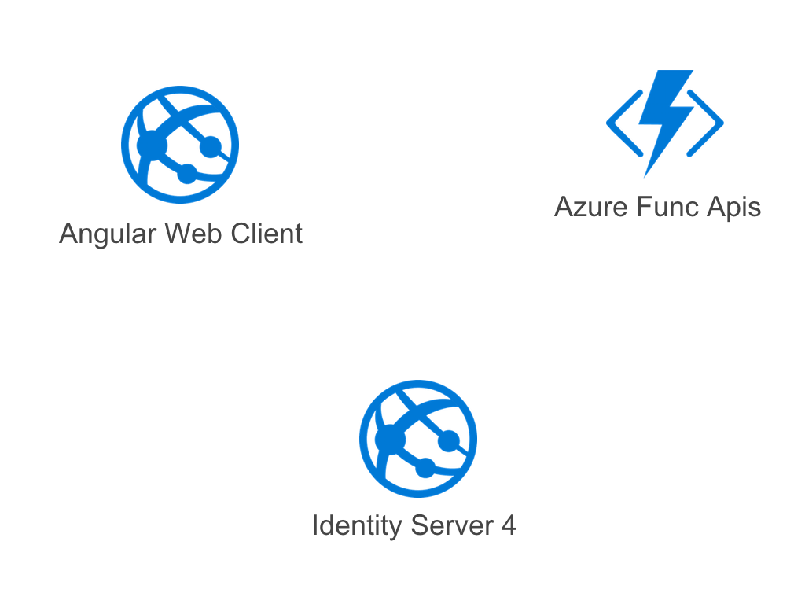
What we are talking about building

Slide 5
Using AZURE Function Pros Cons
PROS
Cost savings!!!
Help you to create succinct unit of code that are scalable
Chain functions together for functionality
CONS
Tooling for swagger lacking to ingest into angular.
Maintaining local to environment is different.
Tooling around functions is still a little lacking.

Slide 6


User Login
User Login
Request
Angular Client
Azure Function
APIs
Token
Response
Token
Request
Identity Server

Slide 7
API Request
Data Request (Bearer)
Angular Client
Azure Function
APIs
Identity Server

Slide 8
Validate Token
Validate Role Claims
Angular Client
Azure Function
APIs
Validate Token
Yay or Nay
Identity Server

Slide 9
API Request
Data Response
Angular Client
Azure Function
APIs
Identity Server

Slide 10
DEMO TIME

Slide 11
Evaluate Sessions
Help the conference out and evaluate the sessions you attended.
https://www.readydev.one/evaluate

Slide 12
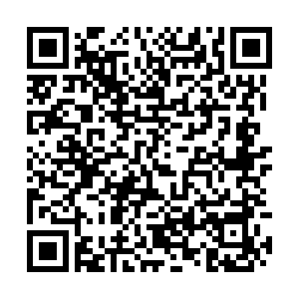
Contact Information
Jeff St. Germain
ArchitectNow
E: jstgermain@architectnow.net

Slide 13

















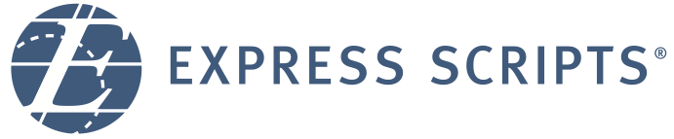








Swag Bags
Platinum Sponsors
Lanyards
Party
Gold Sponsors
Notebooks
Media

