Slide 1

Lending CluB Case Study
Authors: Vineet Kumar
Raghavender B

Slide 2

Problem Statement
Lending Club lends various types of loan to urban customers. On receiving loan application , company has to make a decision to either approve the loan or reject the loan application. If a loan application is rejected and if that applicant would have repaid the loan then it is loss of business. If a loan application is approved and applicant default then it is a financial lost to company.
Lending club wants to analyse and find out the variables/data patterns which impact loan repay capability and want to use those insights to take actions on the loan application like rejecting a high probable default loan application, reducing amount for loan, changing tenure of lloan, charging higher interest rate etc.
As an analyst in the company , we have to do Exploratory data analysis and determine those variables which has clear impact on loan status.
Note: Loan rejected has not been considered in Loan Dataset.

Slide 3
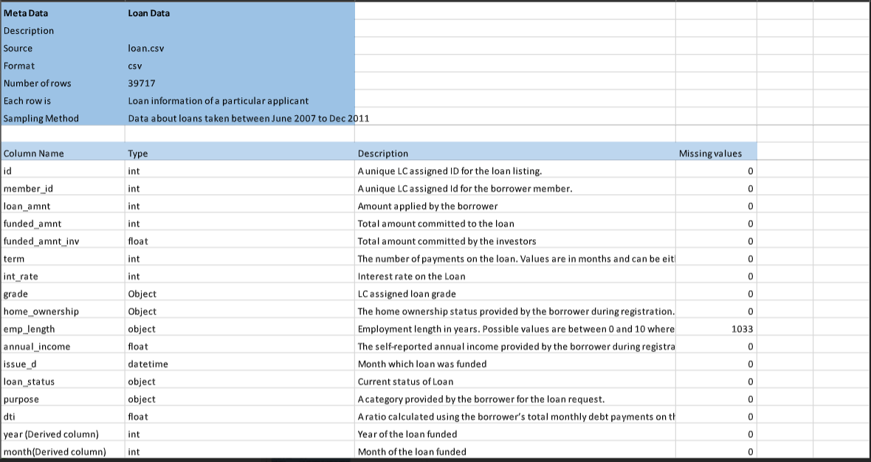
Metadata Description

Slide 4
Data Cleaning- Fixing Rows and Columns
Fix Columns | Action output
Add Column names if missing | No such scenario in Loan dataset
Rename column consistently | Columns naming does not require any change
Delete unnecessary columns | We deleted 57 columns having only null data
Split columns for more data | We derived Year from date columns for our analysis
Merge columns for identifiers | Not required for this analysis
Align misaligned columns | Not required for this analysis
Delete summary rows: Total, Subtotal rows | Scenario not observed in dataset
Delete incorrect rows: Header rows, Footer rows | Scenario not observed in dataset
Delete extra rows: Column number, indicators, Blank rows, Page No. | Scenario not observed in dataset

Slide 5
Data Cleaning- Fixing missing values
Missing Values columns | Action Output
57 columns with all values null | Removed from dataset for analysis
emp_title – 2459 Null Values , emp_length 1075 Null Values , chargeoff_within_12_mths 56 Nulls, pub_rec_bankruptcies 697 Nulls tax_liens 39 Null values | Small number of Null values compared to total row count 39717. No external data or domain info available to replace it with meaningful values so we are keeping as is into dataset.
desc – 12940 Null Values | While it has significant number of Null rows , We do not plan to consider this column for our analysis to find variables impacting Loan default so we plan to keep this column as is for info purpose.
mths_since_last_delinq – 25682 Null values | Significant Null values greater than 70% so column has been dropped from analysis
mths_since_last_record - 36931 Null Values , next_pymnt_d – 38577 Null Values | Very Significant Null values greater than 90% so columns has been dropped from analysis
Zip_code | It has 0 null values but has been dropped as not much significance to current analysis

Slide 6
Data Standardization
Standardization | Action Output
Column name updates for better readability | Changing the term column name to term_months and int_rate column name to int_rate_percent
Data Format change | Formatting the data of column term to remove months and removing the % from the column int_rate_percent and revol_util
Data Format change | Changing data types of columns to float and int as per the data
Data Format change | converting data type to date for columns issue_d, earliest_cr_line, last_pymnt_d, last_credit_pull_d

Slide 7
Data Sanity Checks and Removing Invalid values if Any
Data Sanity Checks
loan_amnt should be always greater than funded_amnt
loan_amnt should be always greater than funded_amnt_inv
int_rate_percent should be greater than 0 and less than 100

Slide 8
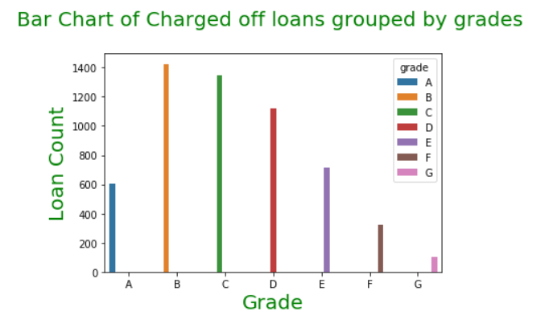
Univariate Analysis (ordered categorical variable)- Loan count distribution over grade for charged off loans
Loans with grade B and C has higher chances of default compared to loans with status A ,F and G

Slide 9
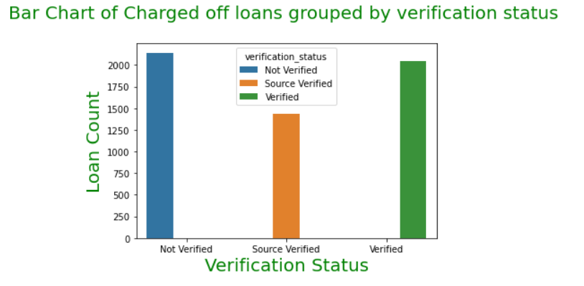
Univariate Analysis (unordered categorical variable)- Loan applications distribution over Verification status for charged off loans
Lending club should give more loans to people whose are source verified

Slide 10
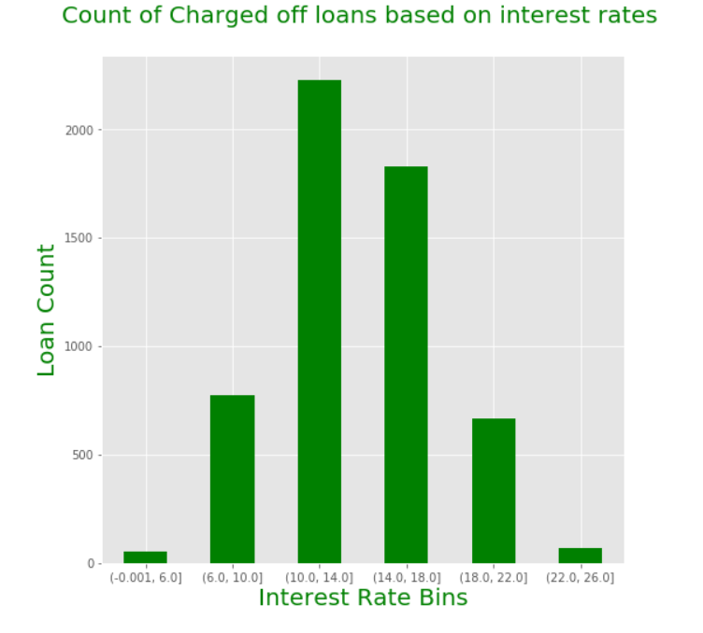
Univariate Analysis (Quantitative variable)- Loan count distribution for Interest rate for defaulters
Loans with interest rates between 10% to 18% has highest chance of getting default

Slide 11
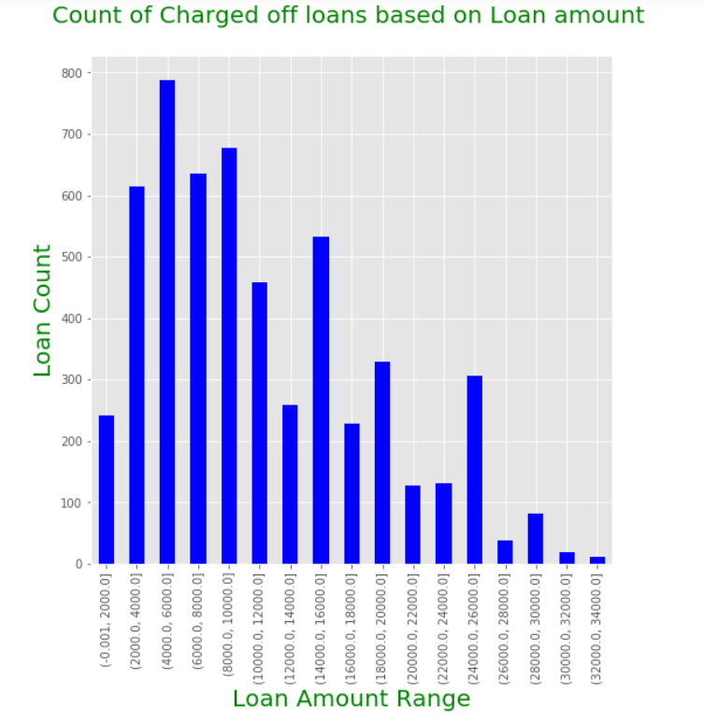
Univariate Analysis (Quantitative variable)- Loan count distribution for Loan Amount for defaulters
Loans grant with loan amount in range of 2000 -10000 has highest chance of getting charged off

Slide 12
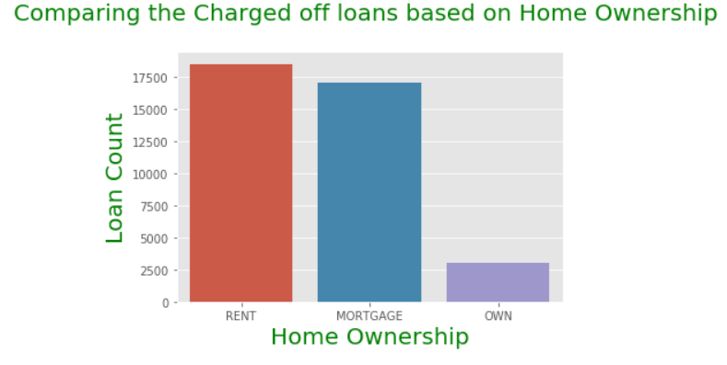
Segmented Analysis - Loan applications distribution over loan status on home_ownership
Lending club should give more loans to people who own a house as that is lowest in defaulting loan.

Slide 13
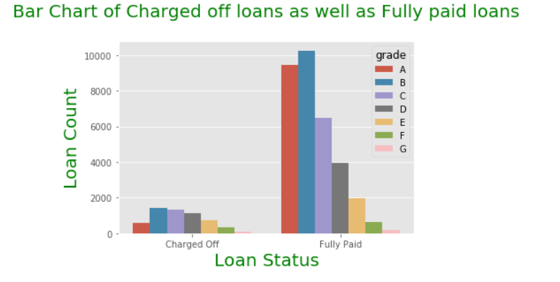
Segmented Analysis - Loan count distribution over loan status on grade
Loans with grade B and C has higher chances of default compared to loans with status A ,F and G

Slide 14
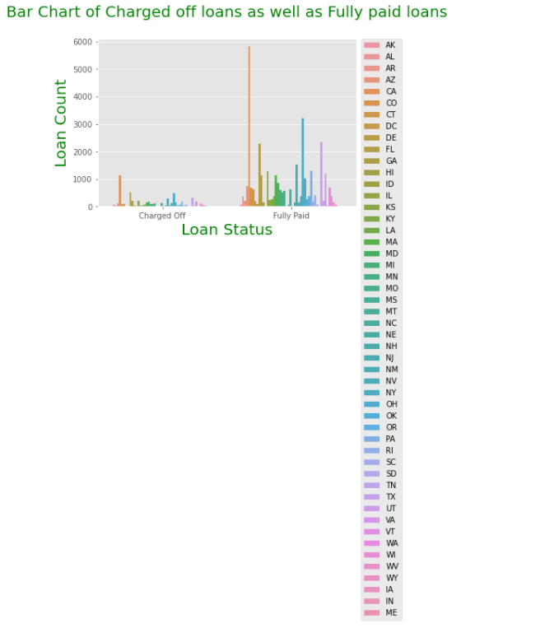
Segmented Analysis - Loan count distribution over loan status on state
Loan applicants from CA ,CO and CT has higher chance of default may be due to state economy or some other state specific reason to be investigated

Slide 15
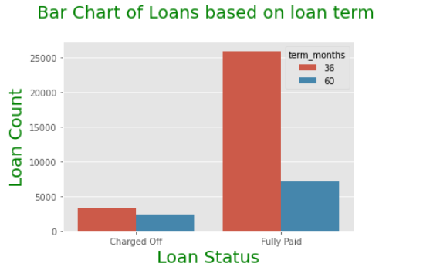
Segmented Analysis - Loan count distribution over loan status on loan term
For customer with other variables indicating a possibility of charge off in future, Loan can be granted to applicant for longer duration of 60 month to reduce chances of defaulting on loan

Slide 16
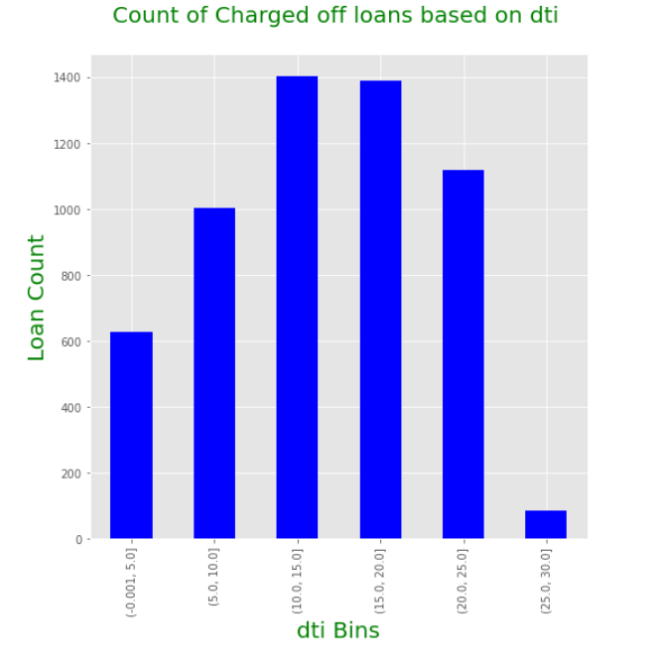
Segmented Analysis - Loan count distribution for charged off loan on dti
Customers having dti in range of 10 to 20 has higher chance of defaulting their loan. Lending club can use this variable to reject loans or tighten loan conditions.

Slide 17
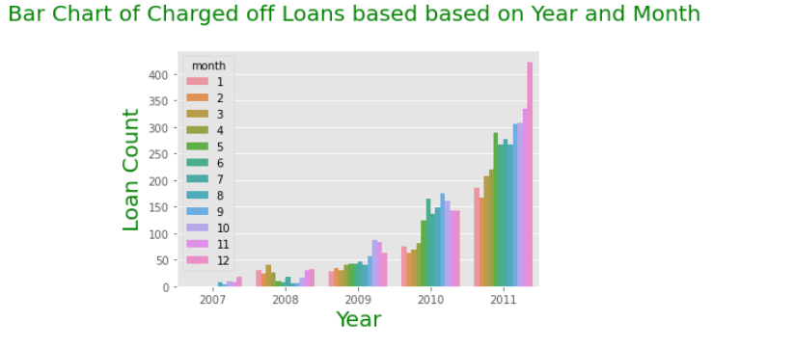
Derived metrics univariate Analysis - Loan count distribution for charged off loan on Year and Month
Higher number of loans which get defaulted are being given in last 4 months of an year. This could be due to pressure on bankers to meet yearly targets and lesser scrutiny of loan applications. Lending club must plan for more audits and checks in last 4 month of approved loan applications

Slide 18
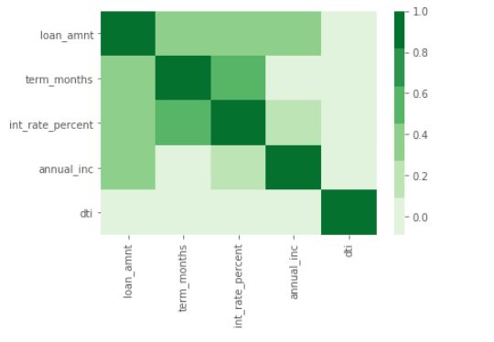
Bivariate Analysis – Correlation among multiple variables
No Significant info after seeing correlation of multiple variables

Slide 19
Conclusion
Loans with grade B and C has higher chances of default compared to loans with status A ,F and G
Lending club should give more loans to people whose are source verified as they have lesser chance of defaulting on their loan.
Loans with interest rates between 10% to 18% has highest chance of getting charged off. Interest rate should be managed to be out of this range.
Loans grant with loan amount in range of 2000 -10000 has highest chance of getting charged off
Lending club should give more loans to people who own a house as they have lowest number of charged off loan.
Loan applicants from CA ,CO and CT has higher chance of default may be due to state economy or some other state specific reason to be investigated. Lending club should come up with different loan policy for residents of these states.
For customer with other variables indicating a possibility of charge off in future, Loan can be granted to applicant for longer duration of 60 month to reduce chances of defaulting on loan.
Customers having dti in range of 10 to 20 has higher chance of defaulting their loan. Lending club can use this variable to reject loans or tighten loan conditions.
Higher number of loans which get defaulted are being given in last 4 months of an year. This could be due to pressure on bankers to meet yearly targets and lesser scrutiny of loan applications. Lending club must plan for more audits and checks in last 4 month of approved loan applications

Slide 20
Thank You

